Slide 1
CM at NASA, it really is Rocket Science!
Rajiv Doreswamy, Ph.D
Deputy Implementation Manager, National Institute for Rocket Propulsion Systems,
June 5, 2013
Notes:
[Presenter: use this chart to introduce yourself and tell what you do at Marshall.]

Slide 2
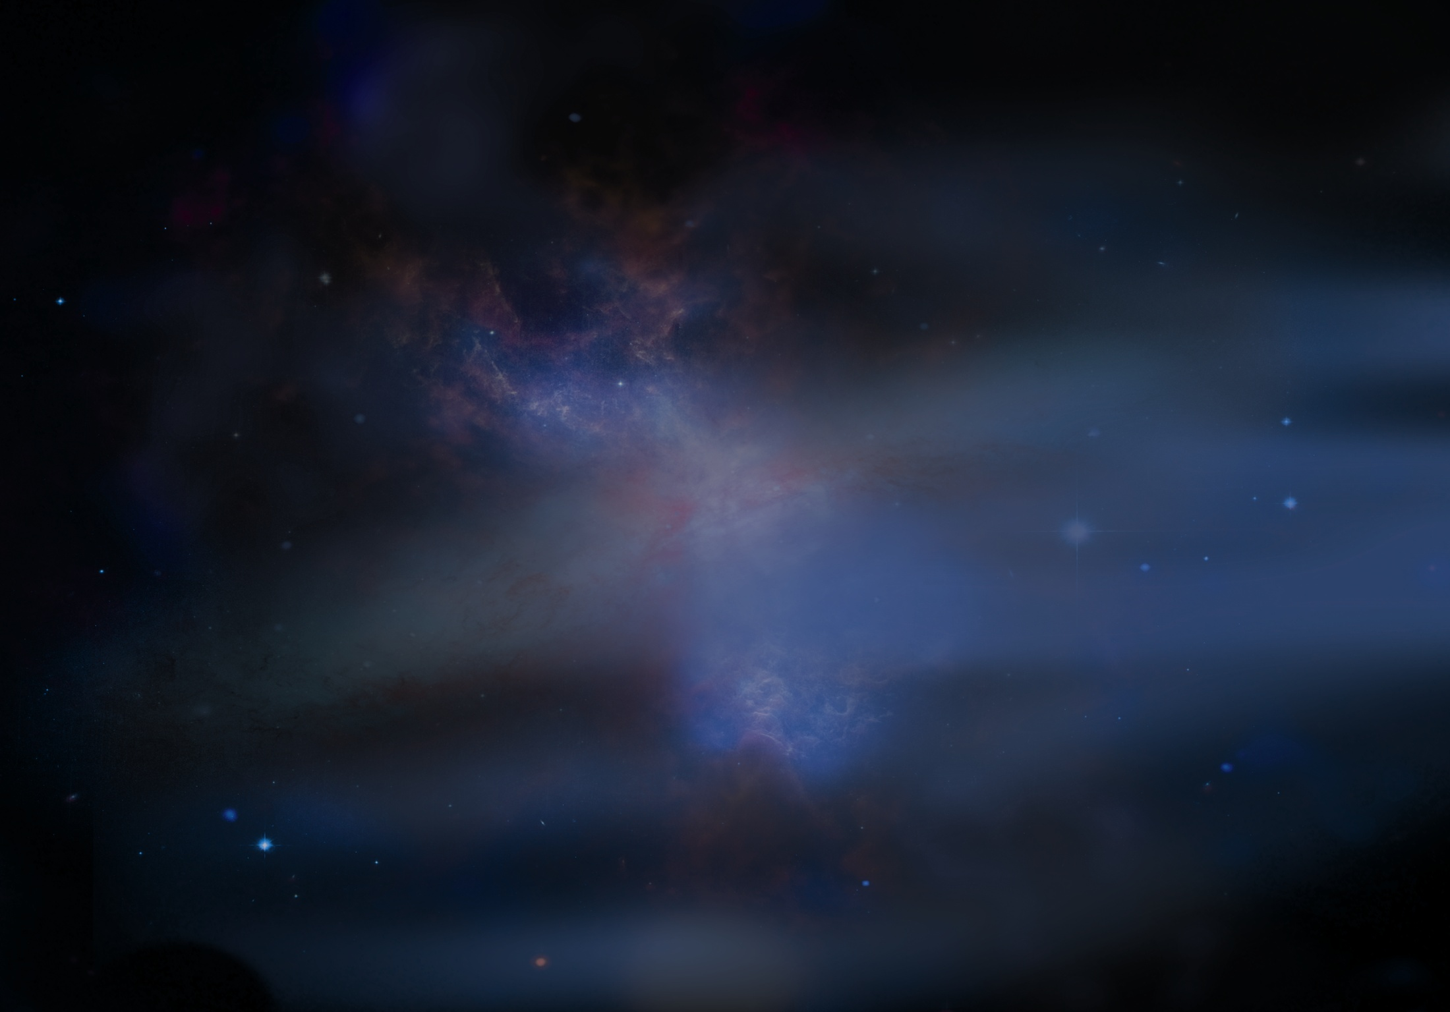
CM at NASA
NASA programs are characterized by complexity, harsh environments and the fact that we usually have one chance to get it right
Programs last decades and need to accept new hardware and technology as it is developed
We have multiple suppliers and international partners
Our challenges are many, our costs are high and our failures are highly visible
CM systems need to be scalable, adaptable to new technology and span the life cycle of the program (30+ years)

Slide 3
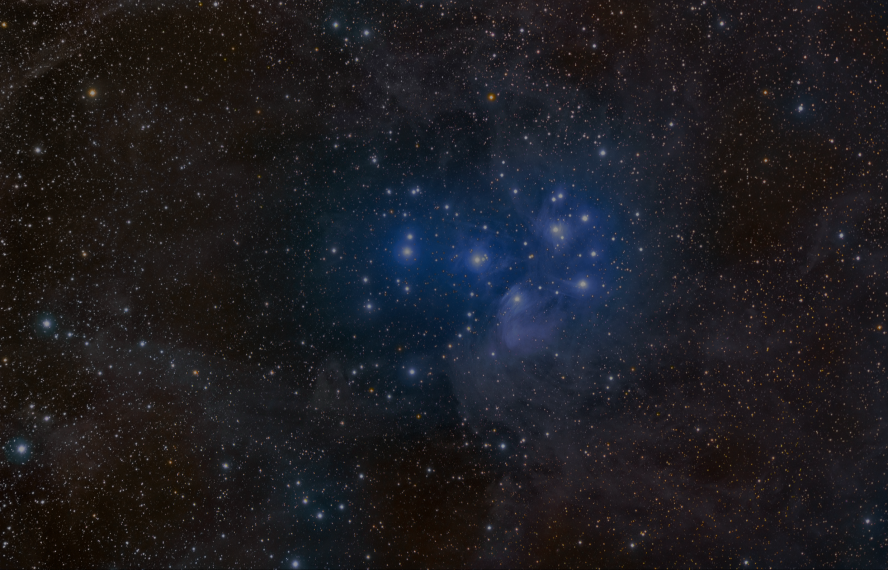
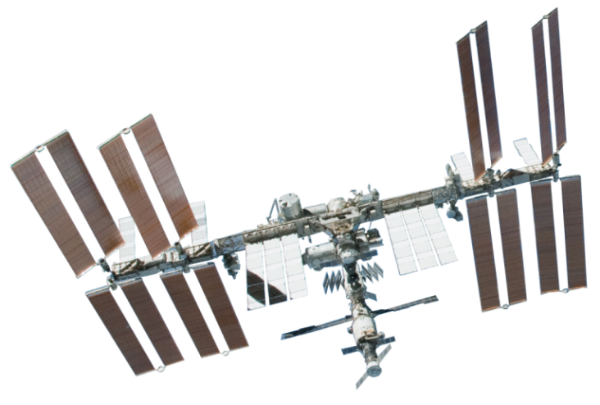
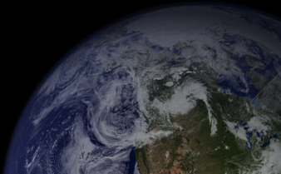
International Space Station (ISS)
First Element launch: Nov 1998
Assembly Complete: May 2011
Number of launches (May 2013):127
  81 Russian
  37 Space Shuttle
  2 Commercial
  3 Japanese
  3 European
Orbital Mass: 420,000kg
Overall length: 109m
Software: 2 million lines (flight vehicle) + 3 million lines (ground systems)
International Partners: NASA+ 14
Multiple visiting vehicles: Shuttle, Soyuz, Progress ,ATV, HTV, Dragon, etc
Notes:
Marshall plays a huge role in America’s space exploration, and serves the agency through three primary areas.
Lifting from Earth - getting to and through space - Propulsion/Transportation Systems.
For example, Saturn, shuttle, and the new Space Launch System
Also includes research and development of new propulsion technologies
Living and Working in Space – sustaining life and enabling discovery
For example, International Space Station systems for air and water; around-the-clock ISS science command post from Marshall's Payload Operations Center.
Understanding Our World and Beyond – making discoveries and learning about our planet, solar system and the entire universe
For example, great space telescopes, weather observations and forecasting, and solar studies

Slide 4

ISS Assembly Sequence 24 years in two minutes

Slide 5
International Space Station (ISS)
CM Lessons Learned
Multiple Systems, Contractors and Countries added major levels of complexity to the ISS program and CM/DM and requirements management systems
CM Systems need to be designed for long design life
  Space Station Design started in 1984
  Assembly Complete in 2011
Systems were developed on a task basis without an overall system perspective
Technology moves faster than a large project office, try to make sure you have a system that can adapt
Notes:
Marshall plays a huge role in America’s space exploration, and serves the agency through three primary areas.
Lifting from Earth - getting to and through space - Propulsion/Transportation Systems.
For example, Saturn, shuttle, and the new Space Launch System
Also includes research and development of new propulsion technologies
Living and Working in Space – sustaining life and enabling discovery
For example, International Space Station systems for air and water; around-the-clock ISS science command post from Marshall's Payload Operations Center.
Understanding Our World and Beyond – making discoveries and learning about our planet, solar system and the entire universe
For example, great space telescopes, weather observations and forecasting, and solar studies

Slide 6
Rajiv’s Rules for CM
Try to remember that your kids will be working on this system and will need to understand what you did
CM is a key system for mission success, invest in it up front
Focus on the functions, not on the tool
CM manager must be a key part of the tem and report to senior program management; either the chief engineer or planning and control manager
Build a CM system that covers the life cycle of the project
  Requirements Management
  Conceptual Design
  Final design
  Test and verification
Don’t forget software CM!
Notes:
Marshall plays a huge role in America’s space exploration, and serves the agency through three primary areas.
Lifting from Earth - getting to and through space - Propulsion/Transportation Systems.
For example, Saturn, shuttle, and the new Space Launch System
Also includes research and development of new propulsion technologies
Living and Working in Space – sustaining life and enabling discovery
For example, International Space Station systems for air and water; around-the-clock ISS science command post from Marshall's Payload Operations Center.
Understanding Our World and Beyond – making discoveries and learning about our planet, solar system and the entire universe
For example, great space telescopes, weather observations and forecasting, and solar studies

Slide 7
Now that you have this great CM system, what are you going to use it for?

Slide 8
NASA Priorities
Develop a capability to lift humans and high value payloads from Earth
Continue to live and work in Space, while extending human presence outside of Low Earth Orbit (LEO)
Build the ability and expertise to understand our planet and the universe beyond it
NASA has the engineering expertise to ensure our nation can send humans beyond Earth and into deep space.

Slide 9
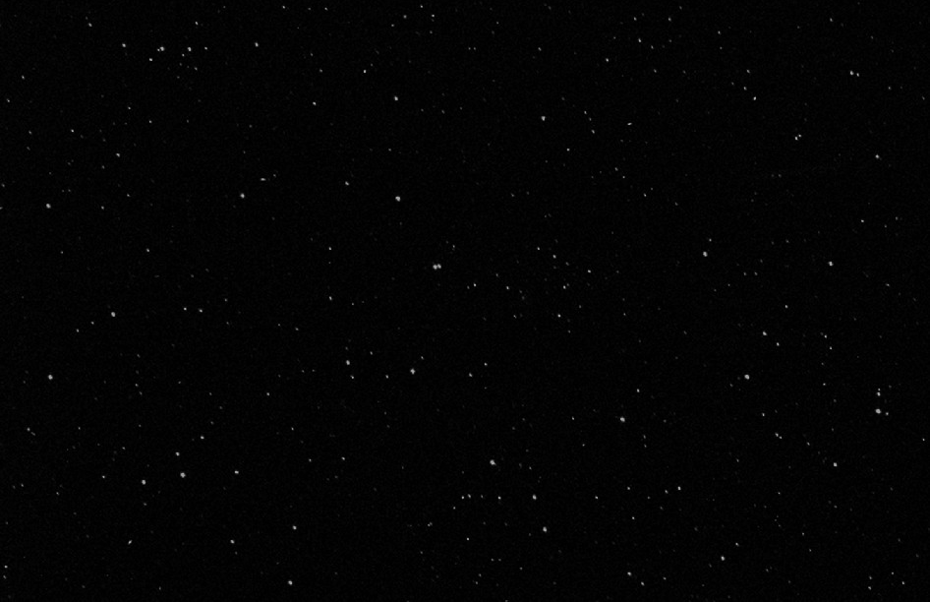
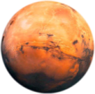
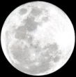

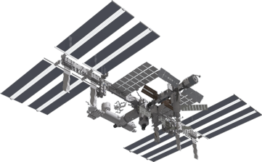
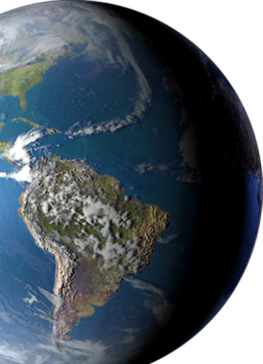
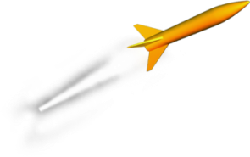
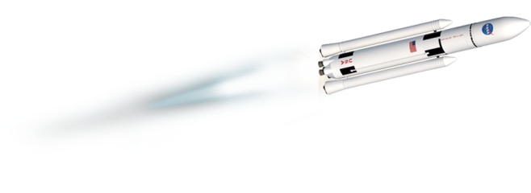
America’s Human Spaceflight Architecture
Commercial support for ISS in low Earth orbit
SLS for reaching new destinations beyond low Earth orbit
Ensuring our nation can send humans beyond Earth and into deep space.
Notes:
What is NASA’s future for human spaceflight?
Destinations for space exploration include continued exploration from LEO (like ISS, Hubble, most scientific satellites and many weather satellites) but also include Earth’s moon, Mars and its Moons, and Near Earth Asteroids where scientists can answer some of the most compelling questions of our time.
Commercial Space Transportation Companies will provide access to the International Space Station for both crew and cargo. NASA’s Commercial Orbital Transportation Services (COTS) program involves two companies, SpaceX and Orbital. Each company is flying demonstration flights, with the first cargo exchange at the station currently slated for 2012. The goal for crewed commercial flights is the middle of the decade.
Marshall is supporting commercial space companies by partnering to facilitate advancement of their technologies. There is an unprecedented number of agreements and requests that are currently being worked to enable these partnerships.
So, what about the destinations beyond LEO?
What can we gain from visiting these destinations?
HEO/GEO/Lagrange points:
– Microgravity destinations beyond LEO
– Opportunities for construction, fueling, and repair of complex in-space systems
– Excellent locations for advanced space telescopes and Earth observatories
Earth’s Moon:
– Witness to the birth of the Earth and
inner planets
– Has critical resources to sustain humans
– Significant opportunities for commercial and international collaboration
Mars and its moons:
– A premier destination for discovery: Is there life beyond Earth?
How did Mars evolve?
– True possibility for extended, even permanent, stays
– Significant opportunities for international collaboration
– Technological driver for
space systems
Near-Earth Asteroids:
– Compelling science questions:
How did the Solar System form? Where did Earth’s water and organics come from?
– Planetary defense: Understanding and mitigating the threat of impact
– Potential for valuable space resources
– Excellent stepping stone for Mars
How will we make it to these destinations?
NASA’s new Space Launch System (SLS) and the Multi-purpose Crew Vehicle will provide the capability for astronauts to leave Earth’s orbit for the first time in four decades.

Slide 10
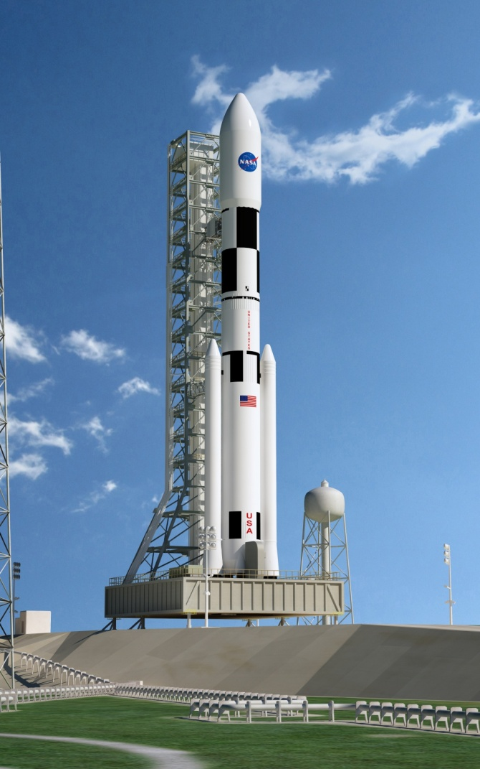
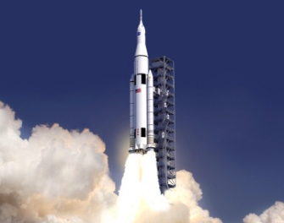
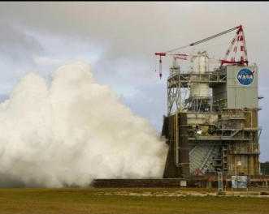
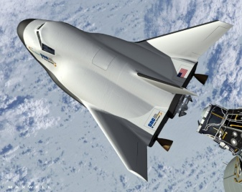
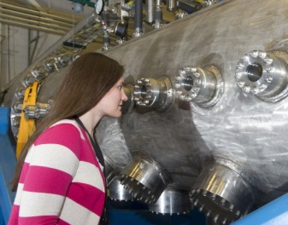
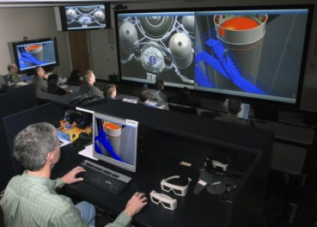
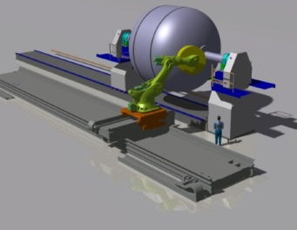
Lifting from Earth
Space Launch System (SLS)
America’s next heavy-lift rocket –
sustainable and affordable
Commercial Spaceflight
Partnering for success –
sharing facilities and expertise
Research for the Future
New fuels, new manufacturing and test methods, and advanced concepts
SLS – Block I
(70-ton)
J2-X Engine Pack Testing
Supporting Commercial Spaceflight
Affordable Testing for Nuclear Fuel Prototypes
Collaborative Engineering Design
In-space Cryogenic Fuel Storage Concept
Marshall is leading our nation’s propulsion capabilities.

Slide 11

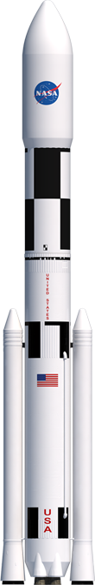

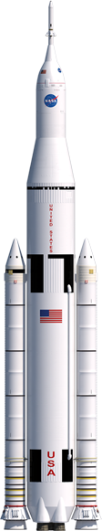

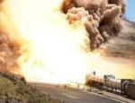
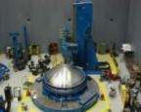
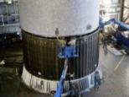
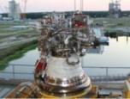
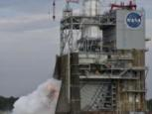
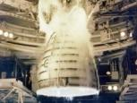
Lifting from Earth
SLS – America’s Heavy-lift Rocket
  Safe, affordable, and sustainable
  Carries the Orion Multi-Purpose Crew Vehicle
  Supports national missions beyond Earth orbit
  Initial lift capacity of 70 metric tons (t) evolving to 130 t
  Builds on Saturn, Shuttle, and Ares experience
70t
130t
Solid Rocket Motor Test
Friction Stir
Welding
Shell Buckling
Test
Upper Stage
J-2X Engine
J-2X Engine
Tests
Core Stage
RS-25 Engines
SLS is essential to the nation’s space exploration goals.

Slide 12
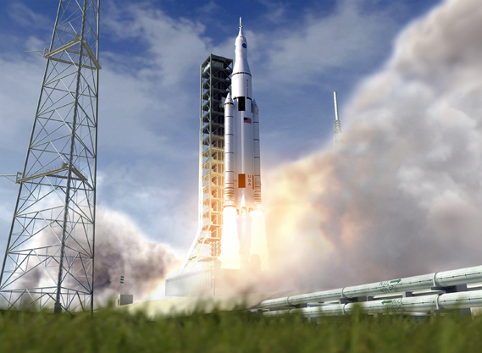
Lifting from Earth
SLS – On track for a 2017 first flight
Key tenets: safety, affordability, and sustainability
Progress being made on all elements of the vehicle
Prime contractors on board, work being done across the country
Completed System Requirements Review / System Definition Review, now working toward Preliminary Design Review in 2013
Flight hardware being tested on EFT-1 in 2014
Design Analysis Cycle (DAC) 2 configuration released
www.nasa.gov/sls
Notes:
NOTES:
SLS is an infrastructure asset that complements the payload delivery capabilities of our commercial space partners. We need both to be successful.
The SLS value proposition is missions of national and international importance, delivering more capacity and thrust than any past, present, or otherwise planned vehicle, for entirely new missions beyond Earth’s orbit.
The SLS Program is building a real rocket made right here in the U.S.A. by high-tech workers for human and scientific exploration that opens doors to limitless possibilities.
Please visit our website for news and multimedia.

Slide 13

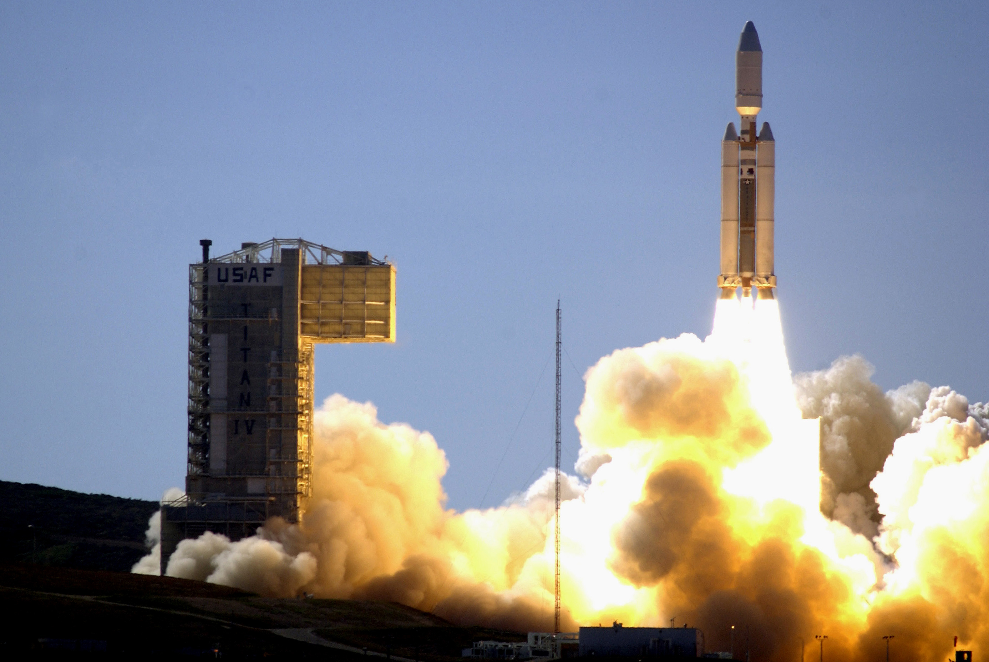
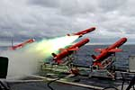
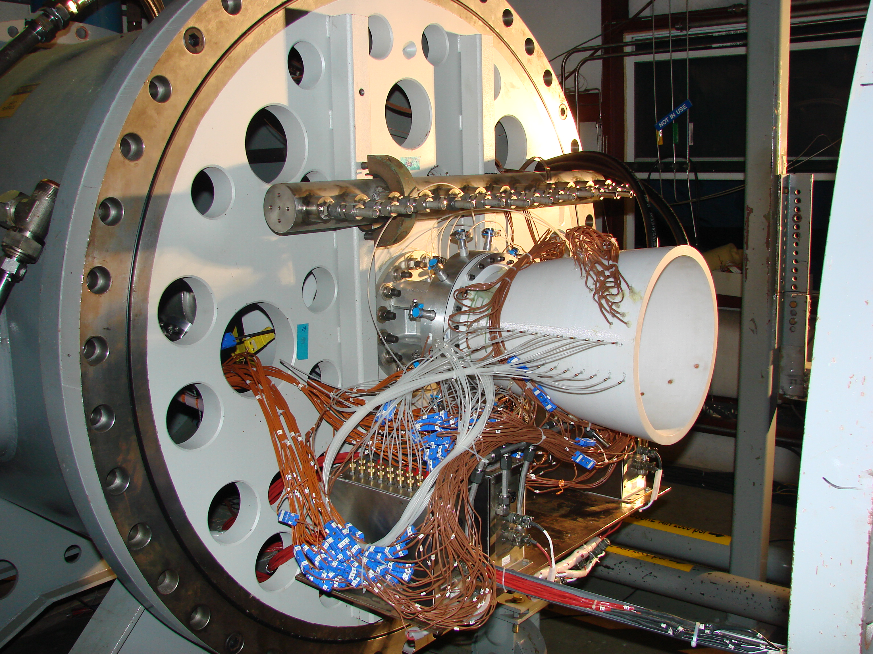
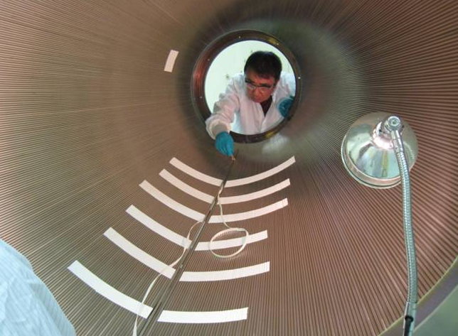
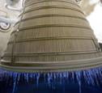
Supporting U.S. Leadership in Propulsion Systems
Stewardship
Formulate and recommend National Policy options and strategies that promote a healthy industrial base.
Technology
Identify technology needs and recommend technology insertions.
Solutions facilitator
Maintain relationships and awareness across the Government and industry to align available capacity with emerging demand.
Notes:
One of the issues facing our nation in the current economic climate is retaining the capabilities required to maintain America’s leadership in space. While the Shuttle launched into LEO several times a year, the new SLS will be launched much less frequently, as little as one launch per year. So, with the reductions in consistent rocket propulsion operations and reduced development, there is a need to retain these capabilities and streamline rocket propulsion systems across all Federal government organizations.
Purpose:
NIRPS will help preserve and align government and private rocket propulsion capabilities to meet present and future US commercial, civil, and defense needs, while providing authoritative insight and recommendations to National decisional authorities
Stewardship
Formulate and recommend National Policy options and strategies that promote a healthy industrial base.
Technology
Identify technology needs and recommend technology insertions.
Solutions facilitator
Maintain relationships and awareness across the Government and industry to align available capacity with emerging demand.

Slide 14
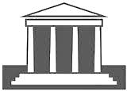


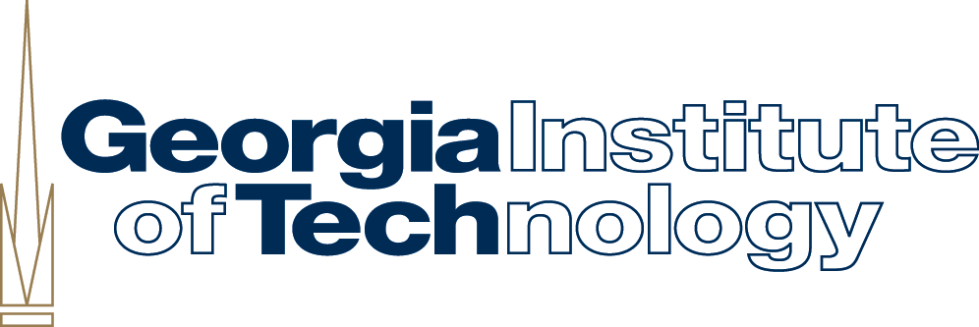

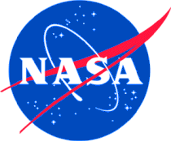

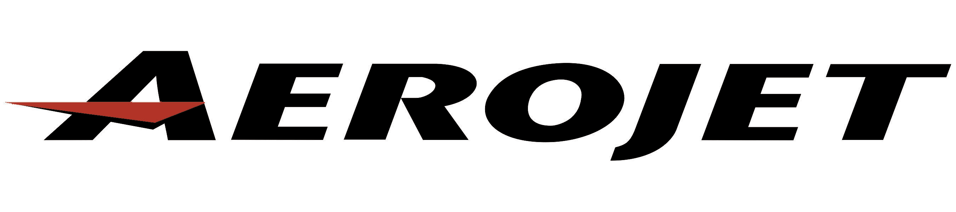
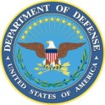




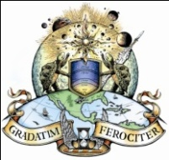

NIRPS: An Enabler for America’s Space Endeavors
Academia
Industry
U.S. Government
NASA
FAA
DOD
Fostering
a vibrant rocket propulsion community
that provides reliable and affordable propulsion systems
in support of the nation’s defense, civil, and commercial needs.
Notes:
Also on the propulsion side . . . Marshall is playing a leading role in creation of the National Institute for Rocket Propulsion Systems, which is intended to help preserve and align government and private rocket propulsion capabilities to meet present and future US commercial, civil, and defense needs, while providing authoritative insight and recommendations to National decisional authorities.
One of the issues facing our nation in the current economic climate is retaining the capabilities required to maintain America’s leadership in space. While the Shuttle launched into LEO several times a year, the new SLS will be launched much less frequently, as little as one launch per year. So, with the reductions in consistent rocket propulsion operations and reduced development, there is a need to retain these capabilities and streamline rocket propulsion systems across all Federal government organizations. Various agencies and think tanks have written about this problem for years with the reductions and consolidations in the defense and aerospace communities, but the problem is becoming acute.
NIRPS will monitor the national propulsion base, formulate national policy options for decision makers, identify technology needs and recommend technology insertions, and seek to provide technical solutions. NIRPS already has a big vote of confidence for what it’s trying to do and what it’s done already. The Defense Authorization passed back around Christmas included a congressional requirement for a National Rocket Propulsion Strategy. In March, the White House Office of Science and Technology Policy asked the NIRPS to take the lead in developing this strategy. The required study has to include the effects of the end of the Space Shuttle and Constellation programs on the solid and liquid rocket engine industrial base, plans to mitigate those impacts, planning for future tactical and strategic missiles, interceptors, targets, and launch vehicles, and options for synchronizing plans, programs and budgets for development, procurement, operations, and workforce among the affected agencies to strengthen the industrial base.
NIRPS is conceived from the outset as an enabling, collaborative effort, not as a command and control manifold for the rocket propulsion programs of its members. It’s important to note that NIRPS is a virtual organization, governed and operated by its members. It’s products are policy inputs and solutions for the propulsion community, not guidance. This model has received great support from DoD, as well as industry, in terms of people and time.
Update 7/26/2012
We got a positive reaction from across the base when we initially briefed them in the exploratory phase of NIRPS. Since then, we’ve had good engagement from across the sectors. Our weekly NIRPS planning discussions currently include 167 participants representing 54 organizations, with more joining weekly. By sector, there are 9 government organizations, 42 industry organizations, and 3 academic organizations.

Slide 15
Our unique capability is in large scale, complex space systems development.
Living and Working in Space

Slide 16
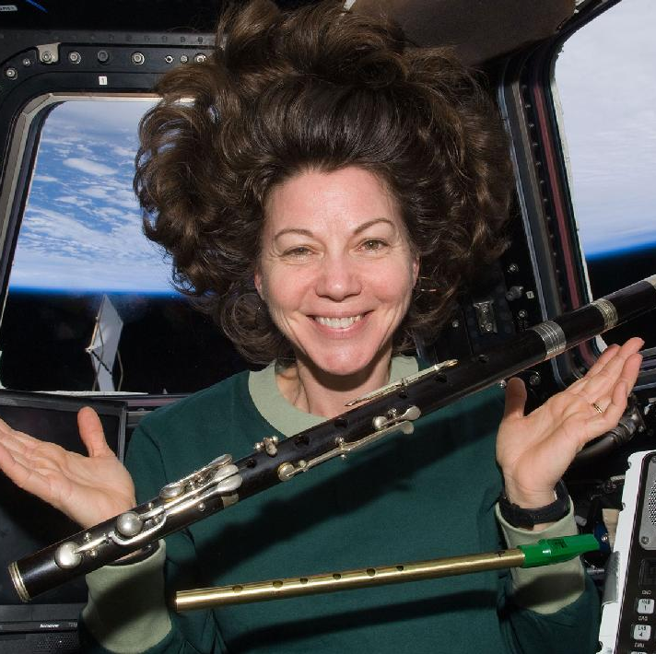
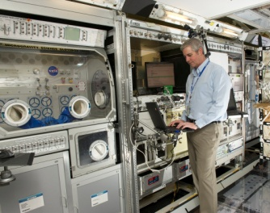
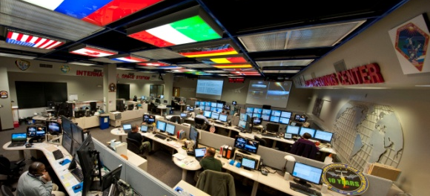
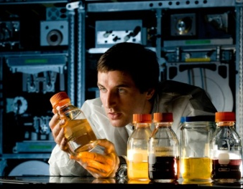
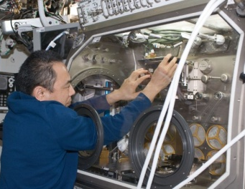
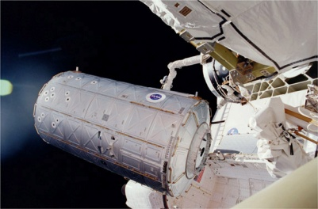
Living and Working in Space
Supporting Life in Space
Supporting Scientific Research on the International Space Station
Lab Training Complex
Payload Operations Center
ECLSS testing
at Marshall
Microgravity
Science Glovebox
ISS U.S. Destiny Lab
From large space structures to life support systems
and operations, Marshall supports crews in space.

Slide 17
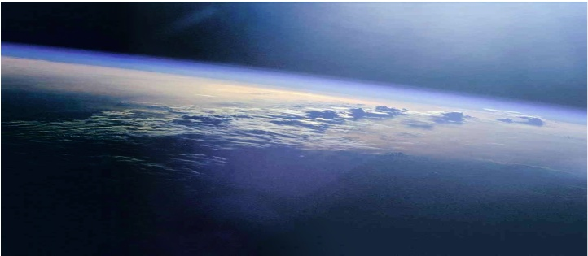

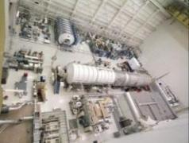
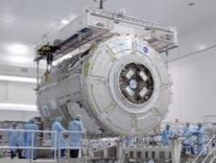
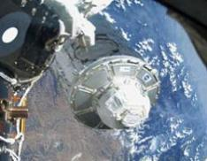
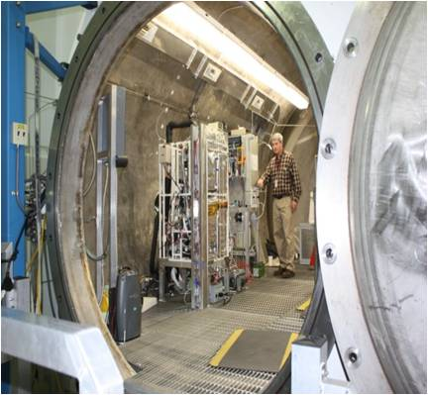
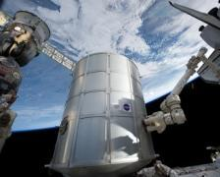

Living and Working in Space
Supporting Life in Space
  International Space Station
    Continual human presence since 2000
    Assembly Complete in 2011
  Major U.S. nodes and modules
  Cleaning air and recycling water
  Environmental affects on people and materials
ISS Test Facility
at Marshall
Node 3
Tranquility
Delivery of the ISS Cupola
Atmosphere Resource Recovery and Environmental Monitoring
Multi-purpose Logistics Module, Leonardo
Environmental
Control & Life Support System (ECLSS)
Marshall develops systems for living and working on the ISS.
Notes:
The International Space Station is the largest and most complex international scientific project in history. While floating some 240 miles (390 kilometers) above Earth's surface, the station has hosted a rotating international crew since November 2000. Construction of US components was completed in 2010 with the installation of the Tranquility node and Cupola observation window.
Marshall has designed and developed numerous systems used on the International Space Station. Marshall led the design, development, and testing of the Regenerative Environmental Control and Life Support System (ECLSS) and continues to refine this important capability. This system provides water and oxygen for the crew, recycling wastewater into usable water and reducing resupply costs.
Unity, the first U.S.-built component of the station, was assembled in the same unique Marshall building where the Saturn V rocket was assembled decades before. In late 1998, the space shuttle Endeavour carried Unity into orbit to begin space station assembly.
The P-6 Truss was delivered and installed in late 2000 to support the first U.S. solar arrays, which were tested at Marshall. This same facility hosted development and construction of the Destiny module which was attached to the space station in 2001. The final major US truss segment, Starboard 6, was installed in 2009,
Marshall also managed development of the Harmony and Tranquility nodes.
There are several capabilities at the center that are concentrated on studying the effects of the space environment on people and equipment in space. This includes debris impact, radiation affects and extreme temperatures as well as other areas of research.
ABOUT THE PHOTOS
ISS Test Facility
Marshall maintains facilities for testing and evaluating life support technologies. These facilities also allow engineers on the ground to troubleshoot on the ground any problems encountered in space. Testing includes life cycle tests to determine maintenance and change-out requirements, operational tests, such as those using volunteers to generate waste-water for the Water Recovery System, and integration tests of flight hardware for the Space Station.
Node 3 Tranquility was delivered to the ISS in February 2010 on STS-130. This node was built by ESA. It provides six berthing locations, one of which is used by the Cupola. It houses the ECLSS racks and the crew’s waste and hygiene compartment.
The Cupola, the largest window ever used in space, has six side windows and a top window. It provides an observation and work area for the ISS crew to support ISS maintenance and viewing Earth and celestial objects.
ECLSS performs several functions on the space station:
• Provides oxygen for metabolic consumption;
• Provides potable water for consumption, food preparation and hygiene uses;
• Removes carbon dioxide from the cabin air;
• Filters particulates and microorganisms from the cabin air;
• Removes volatile organic trace gases from the cabin air;
• Monitors and controls cabin air partial pres­sures of nitrogen, oxygen, carbon dioxide, methane, hydrogen and water vapor;
• Maintains total cabin pressure;
• Maintains cabin temperature and humidity levels;
• Distributes cabin air between connected modules.
Inside the Cupola
ISS026-E-028133 (5 Feb. 2011) --- NASA astronaut Scott Kelly, Expedition 26 commander, is pictured in the Cupola of the International Space Station.
Leonardo
Space shuttle Discovery launched on its final planned mission to deliver the Permanent Multipurpose Module Leonardo and the EXPRESS Logistics Carrier 4 external stowage platform to the International Space Station as well as equipment and supplies.
FUN FACTS:
Facts and Figures
Wingspan End-to-End Width 356.4 feet (108.6 meters)
Length 262 feet (79.9 meters)
Mass (weight) 1,005,021 pounds
(456,620 kilograms)
Operating Altitude 220 nautical miles average
(407 kilometers)
Inclination 51.6 degrees to the Equator
Atmosphere 14.7 pounds per square inch
(101.36 kilopascals per square meter)
same as Earth
Crew Size Up to seven people at assembly
complete

Slide 18







Living and Working in Space
Supporting Scientific Research in Space
  Manage science operations around the clock
  Window Observational Research Facility
  Microgravity Science Glovebox
  Materials Science Research Rack
Payload Operations Center at Marshall
WORF – Window Observational
Research Facility
EXPRESS Racks for
Destiny Module
Materials Science
Research Racks
Microgravity
Science Glovebox
Destiny Laboratory
Marshall is the command post for science on the ISS.
Notes:
Around-the-Clock, 24/7 Science Operations Support (Payload Operations Center) The POC manages all U.S. science and research experiments onboard the station.
Making Science Experimentation Possible in Space
Marshall manages several projects that make science work possible on the ISS. These projects include special racks to hold experiments and hardware, connector modules between facilities, and cargo modules to transport supplies back and forth.
The Window Observational Research Facility (WORF) provides a facility for Earth science remote sensing instruments using the Destiny science window with the highest quality optics ever flown on a human-occupied spacecraft.
Responsible for on-orbit and operating of Microgravity Science Glovebox and the Materials Science Research Rack
The Microgravity Science Glovebox (MSG), located in the European Space Agency’s Columbus laboratory module, enables scientists from multiple disciplines to participate actively in the assembly and operation of experiments in space. It is managed by NASA's Marshall Space Flight Center. Because the work area is sealed and held at a negative pressure, the crew can manipulate experiment hardware and samples without the danger of small parts, particulates, fluids, or gasses escaping into the open laboratory module.
Destiny Laboratory is the primary research laboratory for U.S. payloads, supporting a wide range of experiments and studies contributing to health, safety and quality of life for people all over the world. Science conducted on the Station offers researchers an unparalleled opportunity to test physical processes in the absence of gravity. The results of these experiments will allow scientists to better understand our world and ourselves and prepare us for future missions, perhaps to the Moon and Mars.

Slide 19
We advance space technologies and expand our knowledge of the universe.
Understanding Our World and Beyond

Slide 20









Understanding Our World and Beyond
Observing
Earth
Studying Our Solar System
Exploring Our Universe
Weather & Climate Monitoring
SERVIR
SUMI Solar Capture
Discovery &
New Frontiers
Chandra
James Webb Space Telescope
Marshall is expanding knowledge
of our world and beyond.
20

Slide 21







Observing Earth
Understanding global climate system patterns
Improving weather forecasts and storm warning times
Predicting the intensity and dynamics of storms
Providing and analyzing data for urban planning and natural resource and environmental management
AMPR
Weather & Climate Monitoring
PEOPLE - ACE
Hurricane Imaging Radiometer
SERVIR
SPoRT

Slide 22






Studying Our Solar System
  Managing missions through our solar system to learn more about asteroids, planets, and their moons
  Developing robotic landers that can safely land on precise locations without human control
  Learning how the sun and space weather affect life
  on Earth
  Mapping the moon and measuring its gravitational field
SUMI image of solar flares
*GRAIL, twin spacecraft mapping the moon
*Asteroid Vesta from Dawn spacecraft
Robotic Lander
autonomous landing test
Preparing SUMI
for flight
Solar Wind, Electrons, Alphas, and Protons (SWEAP)
*Featured missions from the Discover and New Frontiers program, managed at Marshall.
Notes:
Speaker’s note:
GRAIL and Dawn are part of the Discovery and New Frontiers programs managed at Marshall.

Slide 23






Exploring the Universe Beyond
  Analyzing complex data from various space observation instruments
  Analyzing complex data from various space observation instruments
  Developing and testing optical systems for advanced deep-space telescopes applications
  Capturing visible and infrared light, gamma rays, and X-rays
JWST mirror testing
JWST instrument testing
Cats Eye Nebula from Chandra X-ray Observatory
Fermi Gamma Ray Space Telescope map of the Gamma Ray sky
Omega Nebula from Hubble

Slide 24
Marshall supports NASA’s mission.
Technology – Goals – Benefits – Education

Slide 25







Proving Technology Readiness
  Advancing Space Technology Development
  Nuclear Cryogenic Propulsion Stage
  Atmosphere Resource Recovery and Environmental Monitoring (ARREM)
  Deep Space Habitat
  Radiation Protection
  In-Space Manufacturing
  Cryogenic Propellant Storage and Transfer
  Materials on ISS Experiments (MISSE)
  Robotic Lunar Lander Development (Mighty Eagle)
  Advanced Mirror Technology Development
  Edison Small Satellite
  Innovative Manufacturing
  In-Space Propulsion
  SWORDS
  Nuclear Systems
  Human-Robotic Systems
  Avionics Hardware
  Composite Cryogenic Propellant Tank
  Synthetic Biology
  Demonstrating Feasibility of New Technologies
  Technology Demonstration Missions – Level II Program Office
  Centennial Challenges Program –Level II Program Office
  Cryo Propellant Storage
MISSE
Robotic Lander
Green Flight
Space Tether
Composite Cryotank
Notes:
NASA has put a lot of emphasis on technology development, particularly those technologies that will enable exploration beyond Earth orbit in the future. Some of those are near-term technologies ready to test fly. Others are laboratory experiments. Our funding and direction comes from various NASA organizations like the Science Mission Directorate, Human Exploration and Operations and the Office of Chief Technologist. We manage some technology efforts for NASA. We support projects managed by other centers. These are the projects with Marshall involvement.
These are some tongue twisting names but the common threads that are important are: propulsion, life support, and other technologies that get us into deep space faster, safer, more affordably, more reliably.
The projects here are grouped left, top to bottom and right, top to bottom. The first top left grouping is AES. Below that are the OCT/Space Technology Program’s Crosscutting Tech Demo projects. Below that are two SMD technology projects. The righthand column is all the OCT/ Space Technology Program’s Game Changing Division.
Below those are the Level II technology program management offices located at Marshall:
TDM is under Crosscutting under OCT
Centennial Challenges is under Early Stage Innovation under OCT

Slide 26




The National Aeronautics and Space Administration
Science
Space
Technology
Human Exploration
and Operations
Aeronautics
Research
Marshall supports three of the NASA Mission Areas.
Notes:
NASA’s work falls into four main areas:
Science: Explores the Earth, moon, Mars, and beyond; includes our work with heliophysics, astrophysics, planetary science, and earth science.
Space Technology: Investing to find innovative technologies to help us explore better, faster, cheaper. Areas of space technology include early-stage innovation, game changing technology, technology demonstrations, and innovative partnerships.
Human Exploration and Operations: includes creating new capabilities and spacecraft for affordable, sustainable human and robotic exploration, such as our current work developing a Space Launch System and multi-purpose crew vehicle; and our Space Operations work we do with the International Space Station.
Aeronautics: Pioneers and proves new flight technologies that improve our ability to explore and which have practical applications on Earth. Includes flight research, ground and flight testing and green aviation initiatives.

Slide 27

NASA Around the Country
Glenn Research Center
Aeronautics and Spacecraft Technology
Cleveland, Ohio
Ames Research Center
Aerospace and
Small Spacecraft
Moffett Field, Calif.
Goddard Space
Flight Center
Science Missions
and Telescopes
Greenbelt, Md.
Dryden Flight
Research Center
Atmospheric Research
and Testing
Edwards, Calif.
NASA Headquarters
Washington, D.C.
Langley Research Center
Aviation and Space Research
Hampton, Va.
Jet Propulsion Laboratory
Deep Space Robotic
Rovers and Networks
Pasadena, Calif.
Kennedy Space Center
Space Vehicle Launch and Landing
Cape Canaveral, Fla.
Johnson Space Center
Human Space Flight Operations
Houston, Texas
Marshall Space
Flight Center
Space Transportation, Propulsion Systems, Space Systems, and Science
Huntsville, Ala.
Michoud
Assembly Facility
Large Vehicle Manufacturing
New Orleans, La.
Stennis Space Center
Vehicle Engine Testing
Bay St. Louis, Miss.
Supporting NASA’s mission with unique engineering expertise.
27
Notes:
Marshall is one of NASA’s 10 field centers and works under the direction of headquarters in Washington, D.C.
The map shows the location and specialty of each center -- each with its own unique role in meeting the agency’s goals.
Marshall Space Flight Center, right here in Huntsville, Alabama, is providing critical support in space transportation, space operations, and scientific research.
One of Marshall’s unique roles in the agency is the management of the Michoud Assembly Facility in New Orleans, Louisiana.
It’s a major space vehicle manufacturing and assembly facility and among the world’s largest manufacturing sites.
Michoud manufactured Saturn components, space shuttle external tanks and is ready to play a role in NASA’s new launch vehicles.
Now, let’s take a closer look at Marshall.

Slide 28







Benefitting Life on Earth - Technology Spinoffs
Technologies developed at Marshall touch our lives in many ways.
High-pressure fire hose nozzles
Weather & Climate Monitoring
Nextel™ Flame Stopping Dot Paper
Kevlar™ Body Armor
Improving Vision Screening
Healing Treatments
Water Filtration Systems
Science and exploration improves our lives and our planet.
28

Slide 29







Science, Technology, Engineering and Math (STEM)
Marshall reaches out
to all ages to encourage
STEM educations and careers.
Outreach Activities
Observe the
Moon Night
Student Launch Projects
Moonbuggy Race
Co-op and Intern Programs
Marshall is inspiring a new generation of explorers.
29
Notes:
So, how do we accomplish these new directions? It will take the bright minds of today’s youth.
Marshall Space Flight Center conducts education programs to inspire the next generation of scientists, engineers and explorers. The Great Moonbuggy Race brings together dozens of teams from both high school and college to compete on a simulated moonscape track. Each team brings a slightly different perspective to their design.
NASA’s Student Launch Initiative allows college and high school student teams to design, build and launch a rocket with a developed science payload. They also develop Web sites, learned how to budget — including how to present financial proposals to NASA engineers and community leaders — and gain problem-solving and leadership skills.
These educational outreach initiatives enable students from elementary school through college to apply their learning to science and engineering projects.
By sharing our past accomplishments and exciting plans for the future, Marshall can help to motivate and encourage students to will build a brighter future for America in space. This future will bring new technologies for generations to come.

Slide 30













NASA Centers’ Regions for Public Outreach
NASA Headquarters
Glenn Research Center
Cleveland, Ohio
Ames Research Center
Plum Brook Station
Sandusky, Ohio
Goddard Space Flight Center
Greenbelt, Maryland
Ames Research Center
Moffett Field, California
NASA Headquarters
Washington, D.C.
Dryden Flight Research Center
Dryden Flight Research Center
Edwards, California
Wallops Flight Facility
Wallops Island, Virginia
Langley Research Center
Hampton, Virginia
Jet Propulsion Laboratory
Pasadena, California
Marshall Space Flight Center
Huntsville, Alabama
Glenn Research Center
White Sands Test Facility
White Sands, New Mexico
Stennis Space Center
Bay St. Louis, Mississippi
Johnson Space Center
Houston, Texas
Michoud Assembly Facility
New Orleans, Louisiana
Kennedy Space Center
Cape Canaveral, Florida
Goddard Space Flight Center
Jet Propulsion Laboratory
Johnson Space Center
Kennedy Space Center
Langley Research Center
Stennis Space Center
Marshall Space Flight Center
Michoud Assembly Facility
Notes:
Each NASA center is responsible for public outreach in a designated region.
Marshall’s six-state region (indicated in blue on the map) includes:
Alabama
Tennessee
Louisiana
Arkansas
Missouri
Iowa

Slide 31
Marshall in the Community
Marshall Profile

Slide 32






Marshall Profile
$2.3B expenditures
nationally (FY2011)
$1.2B in Alabama
Nearly 6,000 employees
(FY12 2,490 civil service)
2nd largest employer
in the Huntsville – Madison County area
26 core capabilities and more than 125
unique and specialized facilities and labs
Part of a technological community
Redstone Arsenal – home to 22 primary federal/international organizations
Cummings Research Park –
2nd largest in U.S. and 4th largest in the world
Huntsville’s concentration of high-tech workers is 2nd in the nation
Marshall impacts the community.
Notes:
Marshall has a distinct impact to our community.
$2.3B expenditures in nation (FY2011); $1.2 in Alabama (per FY2011 Economic Impact Study by Dr. Addy)
$2.3B FY2011 Actual budget (FY2012)
$6.8B nationwide Impact (FY2011)
Nearly 6,000 contractor and civil servant employees at Marshall and MAF
FY 2012 civil service control number is 2490 including Michoud
FY 2012 end of year projection is 2463
Current heads on board 2419 (including students)
3rd largest employer in the Huntsville – Madison county area – including civil service and contractors
26 core capabilities and more than 125 unique and specialized facilities/labs
Part of a vibrant, supportive, high-technology community:
Redstone Arsenal is home to 22 primary federal/international organizations ranging from the NATO Medium Engagement Air Defense Support Management Activity (NAMEADSMA) international organization to federal organizations like the FBI and ATF to DOD organizations like DIA and MDA to Army organizations.
Research Park – 2nd largest in US and 4th largest in the world
Huntsville’s Concentration of High-Tech Workers is 2nd in the Nation

Slide 33
Questions?
www.nasa.gov/marshall
rajiv.doreswamy@nasa.gov
(256) 698 0358

