Slide 1
CMBG History
Presented By:
John Parler
CMBG Steering Committee

Slide 2

Why does the CMBG exist?
Open forum to share CM information with our peers
Nuclear industry CM Community of Practice
Notes:
Brief review on the history and operations of CMBG
CM Fundamentals Breakout this afternoon. Discuss CM concepts and processes in more detail.

Slide 3
How CMBG was started
First Nuclear Configuration Management Benchmarking conference hosted by PPL in Fall 1994 in the Pocono Mountains of Pennsylvania.
17 US utilities
represented
Notes:
Mike Stout was asked by the senior management of the Pennsylvania Power and Light Company (PP&L) to bring together a cross-functional team of design, operations and maintenance personnel and develop a consensus configuration management (CM) program description for the Susquehanna Steam Electric Station

Slide 4
How CMBG was started
Each utility made presentation about their Configuration Management program
No motivational speeches
No sales promotions by service providers

Slide 5
The CMBG Idea Grows
Second conference hosted by
Ontario Hydro in 1995
Drafted plans for continuing organization - approved in 1996
Name: Configuration Management Benchmarking Group
Formed Steering Committee
Wrote Mission Statement
Defined ground rules for holding future conferences

Slide 6
CMBG Mission
To provide a forum for the exchange of information that is useful to practitioners of nuclear facility configuration management and to act as the CM Community of Practice for the nuclear industry.

Slide 7
CMBG is not affiliated with any other single organization
No funding from any agency
No membership fees
Conference costs are paid by registration fees and supplemented by host utility
Host utility pays for web site annual fee
CMBG makes no position statements or endorsements
Written Principles and Practices guide our endeavors.
Notes:
CMBG is not affiliated with any other single organization
P & P’s on CMBG.org website

Slide 8
CMBG Steering Committee Mission
To support the Benchmarking Group mission by providing continuity and direction for the group’s activities and to represent CMBG in communications with INPO, NEI and other industry groups.

Slide 9
Role of Steering Committee:
Promote CM principles and practices
Work to increase active participation
in annual conferences
Establish and apply criteria for selecting a host for the annual conference
Define ground rules for planning and conducting conferences
Provide input to the agenda for annual conferences
Assign and direct the functions of working groups

Slide 10
Steering Committee Members
Paul Davis, PSEG Nuclear - Chairman
Mike Dickson, Duke Energy
Kent Freeland, PowerKnowledge Energy
Mike Hayes, Exelon
Eric Helm, Areva
Andrew Neal, Southern Co.
John Parler, SCE&G
Laurent Perkins, Bently
Josh Olson, Southern Co.
Dave Weber, Energy Northwest – 2014 host

Slide 11
CMBG
Conferences
1994 PP&L Poconos, PA
1995 Ontario Hydro Ontario, Canada
1996 Houston Lighting & Power Galveston, TX
1997 Commonwealth Edison Chicago, IL
1998 NAESCO Boston, MA
1999 Duke Power Charlotte, NC
2000 Consolidated Edison Tarrytown, NY
2001 Progress Energy Raleigh, NC
2002 PSEG Nuclear Atlantic City, NJ
2003 PP&L Hershey, PA
2004 Wolf Creek Nuclear Kansas City, KS
2005 First Energy Cleveland, OH
2006 Dominion Richmond, VA
2007 SCE&G Charleston, SC
2008 Pacific Gas and Electric Shell Beach, CA
Entergy Boston, MA
Duke Energy Charlotte, NC
PSEG Nuclear Philadelphia, PA
Exelon Chicago, IL
Southern Co. Atlanta, GA
Energy Northwest Seattle, WA
Notes:
Make a pitch of prospective future sites for CMBG. Talk to steering committee members if potentially interested. Provides great industry and regulator visibility of your fleet/ station’s commitment to CM.

Slide 12
2013 Conference Attendees
91 people involved in CM
23 US Utilities
4 Utilities outside US
3 Nuclear Industry Organizations
16 Service Providers

Slide 13
CMBG Accomplishments / Involvements
Annual Conferences
Communications Network
Web Site (www.cmbg.org)
Named CM Community of Practice by NEI in 2002
Task Forces developed consistent CM Process Model and KPI’s
Support for an industry standards and Documents (ANSI/NIRMA CM 1.0; INPO AP-929; INPO AP-932;)
Knowledge exchange with IAEA
CM Survival Guide
Notes:
ANSI/NIRMA CM 1.0 (rev 0 in 2000; rev 1 in 2007; rev 2 in process)
CMBG members had a leadership role and were active participants in the development of ANSI/NIRMA Standard CM 1.0 2000. Developed briefings and training material about “Three Ball Model”, as depicted in ANSI NIRMA Standard CM 1.0 - 2000.
Provided staffing and leadership for completion of the NEI Configuration Control Benchmarking Project.
Following lengthy discussion of a proposal by the Nuclear Energy Institute (NEI), in 2002 the Steering Committee agreed that CMBG would take on the role of “Community of Practice” for the Configuration Management process, in the context of NEI’s Standard Nuclear Performance Model. This new role required some revision to the CMBG mission and charter which was completed in 2003.
Engage with INPO providing draft wording changes needed in AP-929, Both Rev 0 & 1
2009 Worked with INPO Configuration Management group to develop AP-932 New Plant Configuration Management Development and Implementation Process (Preliminary). Draft document was presented at CMBG conference by INPO and industry input and feedback was obtained. CMBG members were involved in review and comment to this document.
Although KPIs in various forms are accepted by most CM groups, CMBG notes that most utilities do not collect and report a standard set of KPIs. Most utilities use CM-type trending codes as part of their corrective action process to monitor overall CM performance.
International Atomic Energy Agency
Worked with International Atomic Energy Agency to share design basis and safety methods knowledge to European nuclear facilities, CMBG has continually supported CM knowledge exchange with IAEA since 2001.
Has participated in eight cooperative workshops and two multi-year projects to develop IAEA CM technical documents (largely back in the 2003- 07 time frame.

Slide 14

Communications Network
Name/company/phone/email
500+/- people
32 US Nuclear Utilities
10 Utilities outside US
7 Other Nuclear Facilities
10 Nuclear Industry Organizations
25+ Service Providers
Established CMBG Google Group

Slide 15
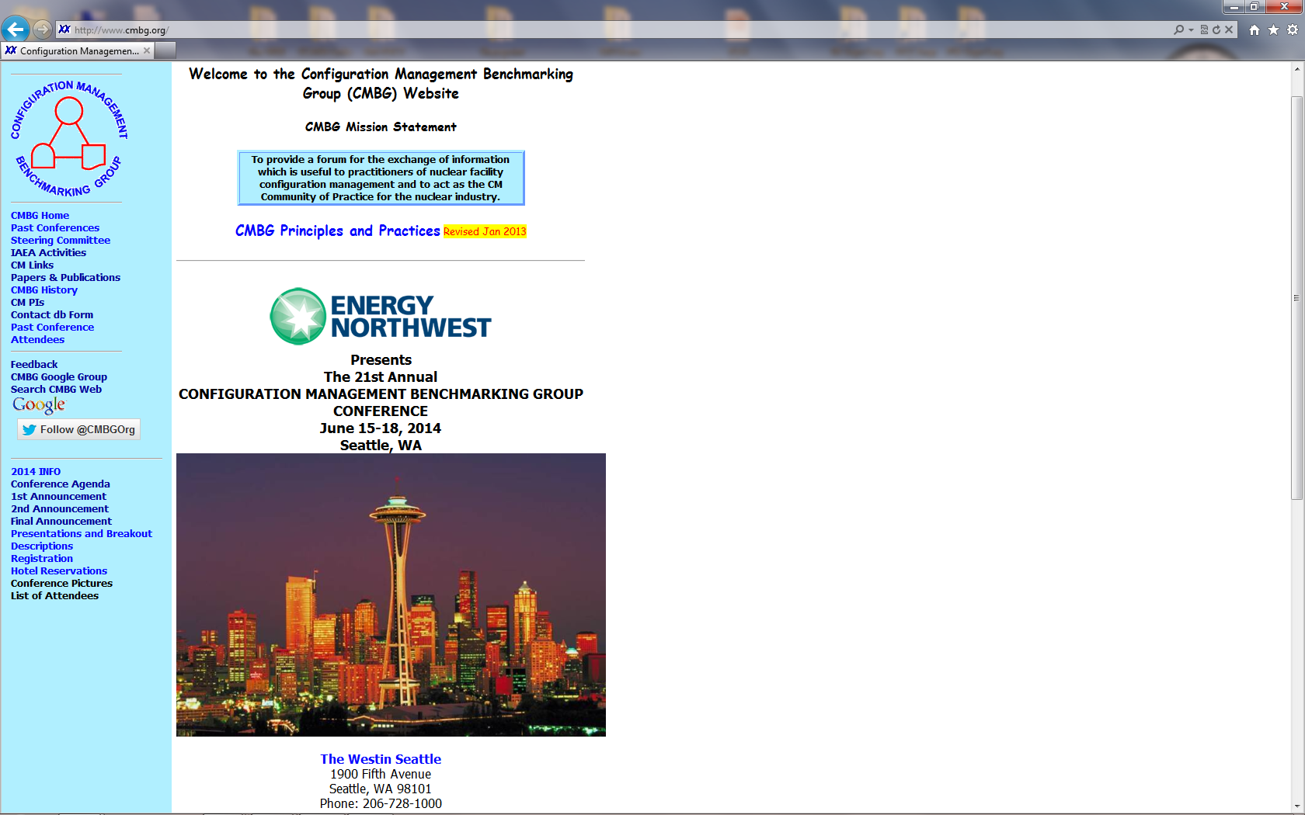

Slide 16
Korea
Lithuania
Mexico
Romania
Past conference attendees outside the US have included representatives from:
Armenia
Belgium
Canada
Czech Republic
France
Great Britain
Hungary
IAEA – Vienna HQ
Japan
Russian Federation
Slovenia
Spain
Ukraine
Notes:
International Atomic Energy Agency

Slide 17
Recent Developments
INPO 09-003 Excellence in the Management of Design and Operating Margins (input provided from some CMBG members)
CM for new plants
  CMBG is a forum for sharing lessons learned from the current generation of operating plants in developing CM controls/ processes for the next generation of the nuclear fleet
Current effort to revise ANSI/NIRMA Standard-CM-1.0-2007 Breakout Session E-2 (Monday)
Notes:
“Recent” being defined as in the past few years.
Several CMBG practioners provided input to INPO on development of 09-003
As with many of the INPO documents CMBG has had presentations and breakout sessions on this topic at past conferences.

Slide 18
What’s Next in Nuclear CM
We need your help in identifying the CM issues important to our Nuclear Station Health
YOUR CMBG will continue to provide a forum for industry benchmarking on CM issues
Notes:
Your participation and feedback are critical to keeping CMBG a meaningful forum for the industry.
New plants have a significant opportunity to learn from the mistakes/ successes of the existing fleet in the area of effective CM.
In addition to this conference, we encourage you to use the network available to you on our CMBG Google Group to benchmark the industry and share your plant’s approach to current issues in CM.
Another Plug for Hosting
And
Participation with presentations – breakouts.
Feedback on future suggestions

Slide 19

What’s next?
Notes:
CM Aspects of
Beyond Design Basis
Fukuschemia

