Slide 1
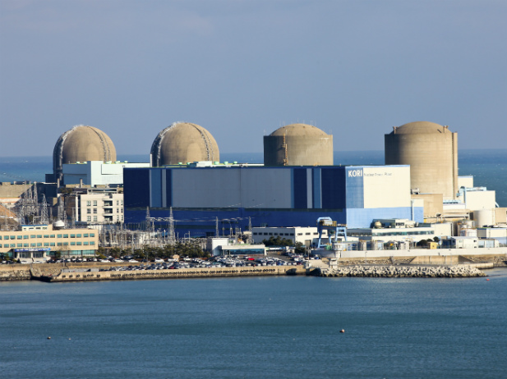
Korean Nuclear Power Program
Configuration Management Benchmarking Group (CMBG)
2014
Kent R. Freeland, P. E.
PowerKnowledge Energy Systems
ENERGY SYSTEMS

Slide 2
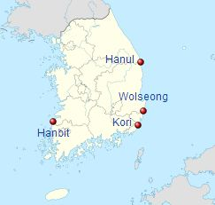
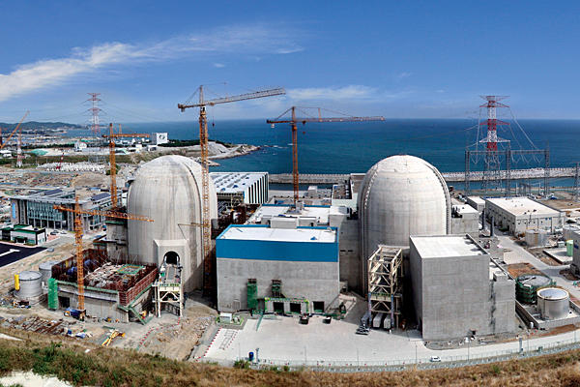
The South Korean Commercial Nuclear Power Program is comprised of 23 reactors of a variety of technologies, producing over 20 Gwe of Power, or around 47% of total national power demand.
NPP’s are located at four sites in South Korea
ENERGY SYSTEMS

Slide 3
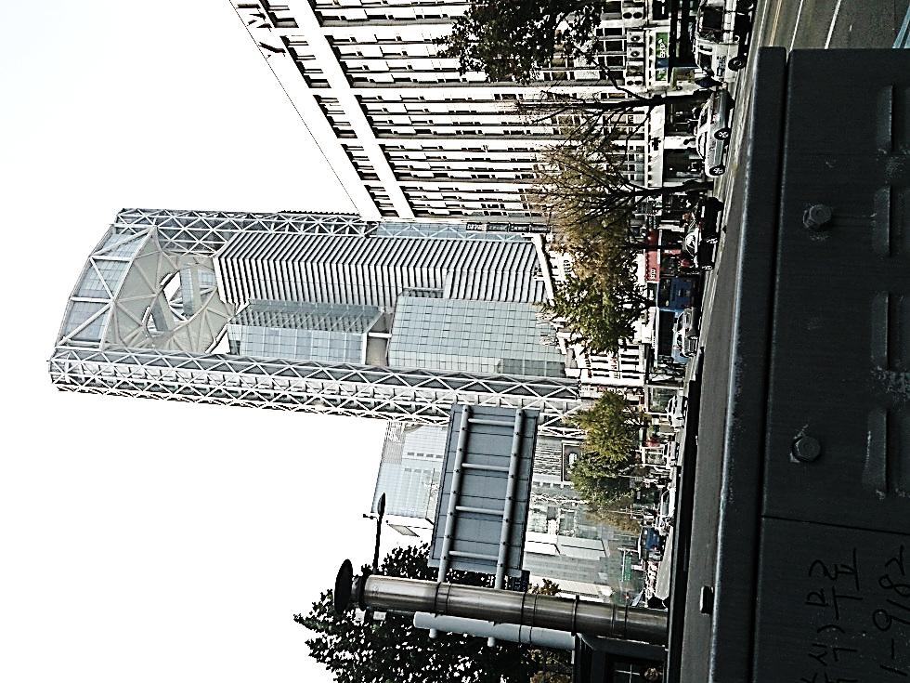
South Korea has:
49 Million People
Technology leadership in most every product market, including electronics and computers, automobiles, heavy equipment, steel, chemicals, construction, shipping – and nuclear power generation
Member of the “Trillion Dollar Club”, with a $1.67T economy
Per-capita Income of over $33,000 per year
World’s 12th-Largest Economy
Typical 3.5%-5% economic growth per year
ENERGY SYSTEMS

Slide 4
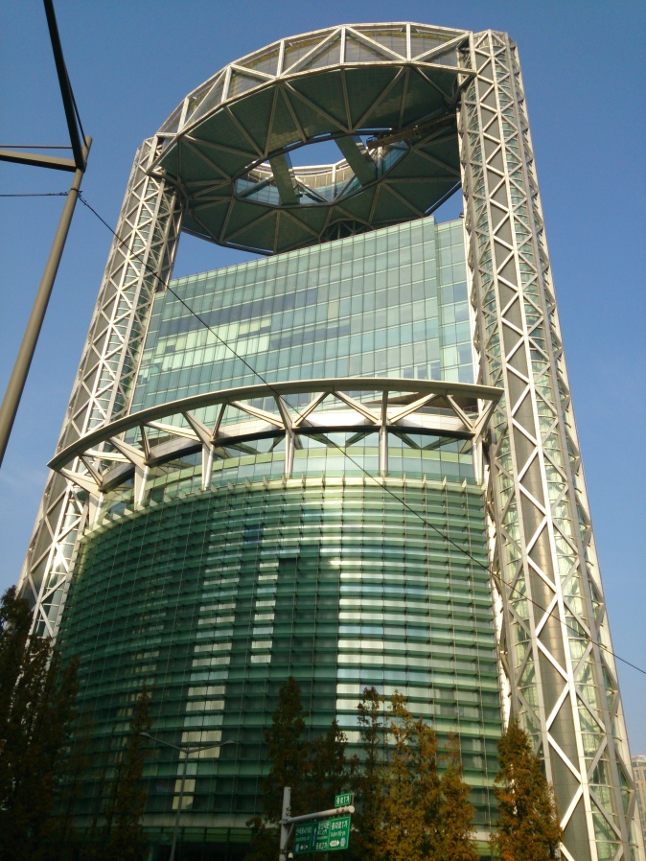
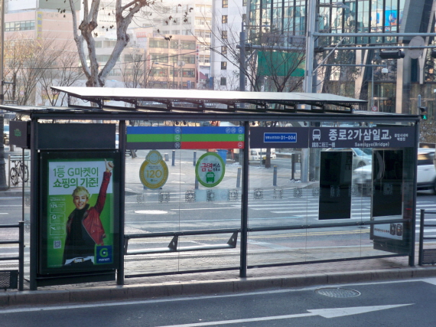
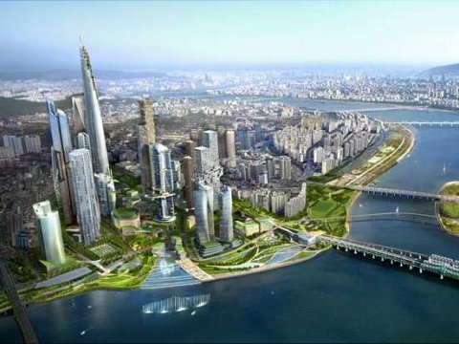
Flat screen displays at bus stop show realtime bus number, position, arrival time and available seat capacity
Samsung building, Seoul
ENERGY SYSTEMS
Seoul

Slide 5
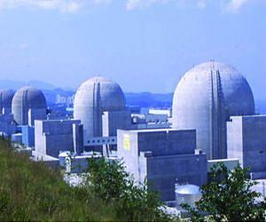
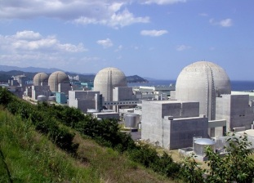
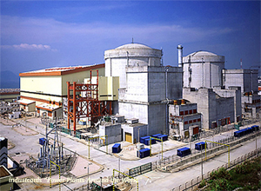
The South Korean Commercial Nuclear Power Program Reactors
are varied and represent virtually every PWR technology available
Westinghouse Model 60 3-Loop PWR 630 MWe
(similar to Kewanee and VC Summer)
CANDU Model 6 4-Loop PHWR 700 MWe
(similar to Bruce NPP Canada)
Westinghouse Model 61F 3/4-Loop PWR 900-1050 MWe
(similar to DC Cook)
Combustion Engineering Model 80+ 2-Loop PWR 1000 MWe
Sometimes classed as OPR-1000 due to heavy domestic content
(similar to San Onofre and Palo Verde)
KEPCO Model KSNP/OPR-1000 2-Loop PWR 1000 MWe
KEPCO Model APR-1400 2-Loop PWR 1400 MWe
(Korea and UAE)
23 Units Operating
5 Under Construction
4 Planned
Framatome CPI 3-Loop PWR 945 MWe
ENERGY SYSTEMS

Slide 6
The South Korean Commercial Nuclear Power Program is virtually 100% domestic
KEPCO
Korea Electric Power Corporation. Parent Utility of KHNP and KEPCO.
KINS
Korea Institute of Nuclear Safety. Serves as Nuclear Regulator and TSO
KETEP
Korea Institute of Energy Technology Evaluation and Planning
KHNP
Korea Hydro & Nuclear Power, serves as Owner/Operator for construction and operation of nuclear power plants, with some embedded Owner’s Engineer/AE functions.
KEPCO E&C
KEPCO Engineering & Construction, acts as the NSSS and Nuclear Steam Supply Systems designer for nuclear power plants. Performs most Owner’s Engineer functions as well.
KAERI
Korea Atomic Energy Research Institute provides R&D on nuclear projects.
ENERGY SYSTEMS

Slide 7
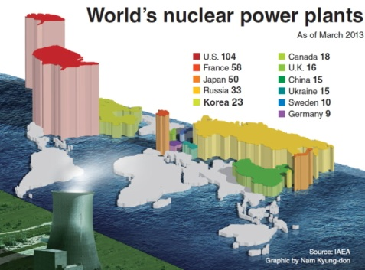
Major Milestones in the South Korean Commercial Nuclear Power Program include:
1957 Republic of Korea becomes a member of the IAEA
1959 Predecessor of KAERI established
1962 Korea operates its first research reactor
1971 Construction starts on first commercial nuclear station
1980's Construction on nuclear plants continues and includes increasing involvement of Korean based firms
1987 ROK signs a ten-year agreement with Combustion Engineering (CE)
to transfer technology to Korea
1990's Additional reactors are built at several plant sites mostly
with local design and technology
2008 Korea unveils its National Energy Basic Plan increasing the percentage of electricity generated by nuclear power to a target of 59% by 2030
2009 KHNP consortium wins $20 billion contract for 4-unit nuclear generating station in the United Arab Emirates (UAE)
ENERGY SYSTEMS

Slide 8
Challenges to Configuration Management in the South Korean Nuclear Power Program
Diverse fleet by vendor, age, and design
Strong Safety Culture and Concern for Design Integrity
Reliance on/conformance to International (IAEA, WANO) and USA Nuclear Safety Standards
Long design age range from newly commissioned and under construction, to over 30 years+ old
Combination of vendor-based designs and domestic KEPCO designs
Enormous materials, spare parts and qualification challenge
Large amount of legacy design basis and design requirements to be researched and reconciled
Complex handover/turnover relationships with subcontractors, similar to aerospace manufacturers
Development of Plant Information Models (PIM)
Developing graded approaches by plant and component lifecycle and safety function
Development of enterprise CMIS and IT solutions
Many of these challenges are faced in the USA today as utilities merge and buy/sell nuclear asset fleets
ENERGY SYSTEMS

Slide 9
Path Forward for CM in the South Korean Nuclear Power Program
Integration of Configuration Management programs with Asset Management and Maintenance Programs
Preparing for introduction of Knowledge Management programs to support long-term design basis knowledge and turnover
Streamlining Design Basis and Design Requirements Capture processes
Integration of CM with the KHNP Integrated Management System (IMS)
Establishing programs that will support a full NPP lifecycle, including legacy plants, newer operating plants, on-going construction and design, and new-build planning
Creating custom CM programs for international clients
ENERGY SYSTEMS

Slide 10
Conclusions for CM in the South Korean Nuclear Power Program
The Republic of Korea will have 33 operating nuclear units domestically, and many more international plants world-wide, within the next 10 years. Nearly 2/3 of these will be of modern Korean design and construction.
With one of the world’s largest nuclear fleets, the opportunity to integrate the Design and Configuration Management programs, along with a standard Plant Information Taxonomy and Turnover Process is enormous, would deliver great return on investment, and can set the standard for the industry.
The bulk of the fleet (the OPR-1000 and APR-1400 models) are virtually identical in design and offer great opportunities to standardize CM and DBD methods and taxonomies even more.
Packaging of CM Information System, Design Turnover methods and IT solution services would also give a decisive edge in competitive placement of new units in international builds.
ENERGY SYSTEMS

Slide 11
감사합니다!
Merci!
Thank you!
ENERGY SYSTEMS

