Slide 1
CM Platform for Operating NPP
2014. 6. 17

Slide 2
Contents
Project Information
New built vs Operating NPP
Platform Modules for CM
Platform Architecture
DBD Taxonomy
Requirement Management Platform
Traceability Management Platform
Change Management Platform
Facility Configuration Information Platform
Physical Configuration
Demo

Slide 3
Project Information
Title
Development of Configuration Management Platform for Operating NPP
Period
2013.10 ~ 2016.9 (3 years)
Organizations
NSE & KHNP
Funding
KETEP (Korea Institute of Energy Technology Evaluation and Planning)
Project Plan
2013
2014
2015
2016
Req. Analysis
Prototype
Req. Spec.
Platform Dev.
Test
Trial

Slide 4
New-Built and Operating NPP
Item | New-Built | Operating
CM Model
Main Differences | Virtual Plant: Modeling 2-D and 3-D (dimensional), up to 4-D (time), 5-D (cost), and 6-D (material) The CM principles and practices are established and functional with Virtual Plant. Data-Centric CM Standards and Cooperation should be established among participated EPCs. Data-Centric should be used at operation time. | CM starts with confirming CM Equilibrium after information turnover. Main purpose is the change management to maintain CM Equilibrium of changing equipment. Document-Centric CM (including Electric files) Considering ready-made processes for equipment/material/quality management. Make old drawings intelligent in order to trace requirements and component in the drawings.
Design
Requirement
What needs to be there
Physical
Configuration
What is actually there
Design
Requirement
What needs to be there
Facility
Configuration
Information
What we say
is there
Physical
Configuration
What is actually there
Facility
Configuration
Information
What we say
is there
Virtual Plant
Data Model
Notes:
The relationship of the information generated for new builds is sometimes called
Virtual Plant, which is defined as “a computer-based information model
environment formed by computer technology consisting of 2-D and 3-D
(dimensional), 4-D (time), 5-D (cost), and 6-D (material) modeling along with
data, databases, and electronic document sources.” Unlike the existing facilities,
Virtual Plant acknowledges that the physical configuration might not be in place,
but the CM principles and practices must be established and functional.

Slide 5
Platform Modules for CM
Design Requirement
Requirement Management
Traceability Management
Change
Management
Design Bases Taxonomy
Dynamic Traceability
Workflow(BPM) Engine
Requirement Control
GUI Engine
Change History
Information Management
Design Requirement Repository
Data-centric Management
Information
Traceability
Repository
Control Log
Repository
Physical Configuration
Facility Configuration Information
3D
Process/2D Schematics
Pictures
3D Drawings
P&ID
Instrument Control
Schematics
Data Warehouse
Document Repository
Workflow Management
Change Management

Slide 6
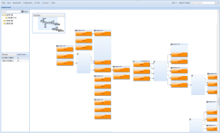
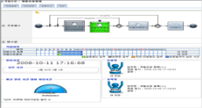
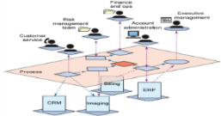
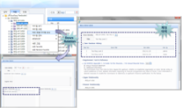
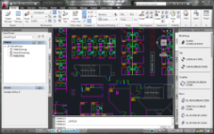
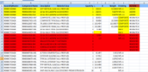
Platform Architecture
Platform Architecture
Integrated Configuration Management Platform
Requirement, Information, Change, Traceability Management Platform
Requirement Management
Traceability Management
Change
Management
Design Bases Taxonomy
Dynamic Traceability
Workflow(BPM) Engine
Traceability View
Requirement Control
GUI Engine
Change History
Service Management
Web Service
Policy Service
Security Service
Authorization Service
Information Management
Workflow/Change View
Requirement View
Design Requirement Repository
Data-centric Management
Information
Traceability
Repository
Control Log
Repository
SAP Sync. Channel
Old Data
Engineering Data Sync. Channel
Legacy System
Facility Configuration Management System
Facility
Mapper
2D Drawing
SAP
Data Warehouse
Workflow Management
Document Repository
Workflow Management
Change Management
3D
Process/2D Schematics
Material Data
Documents Management
3D Drawings
P&ID
Instrument Control
Schematics

Slide 7
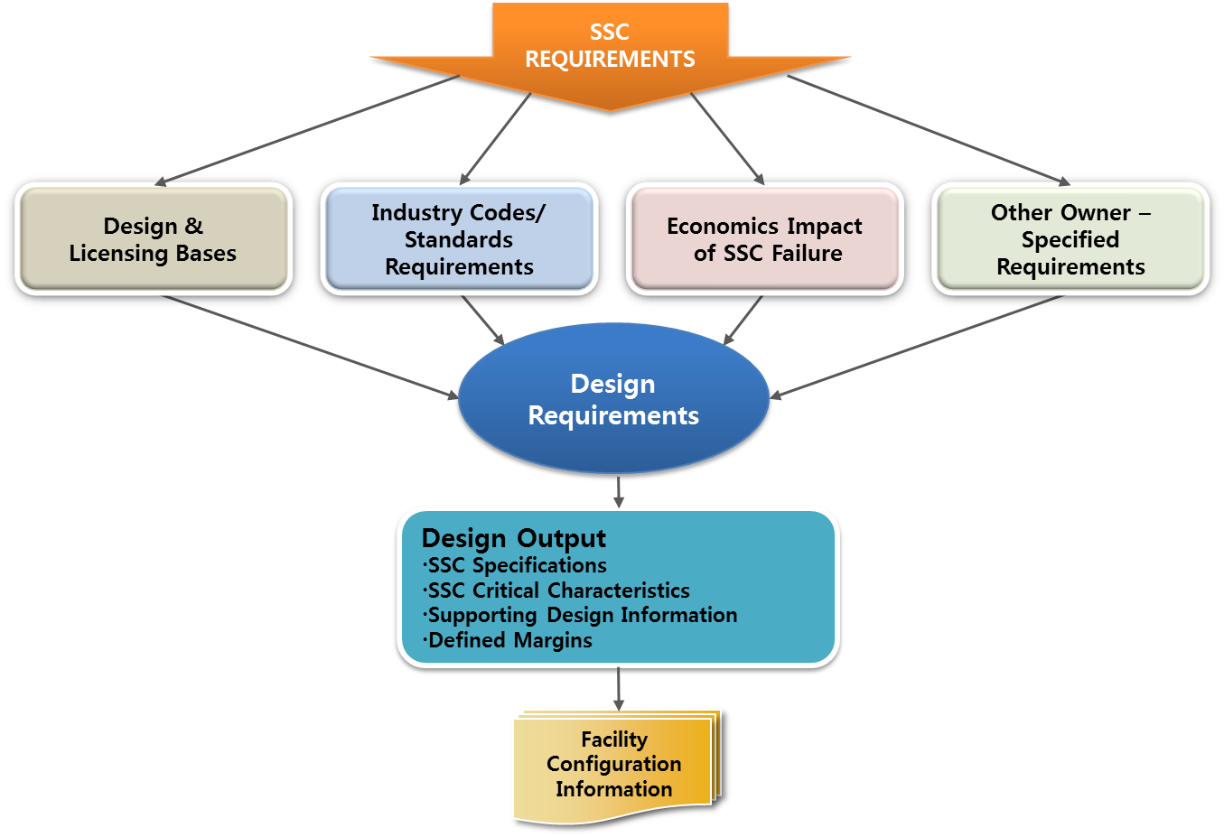
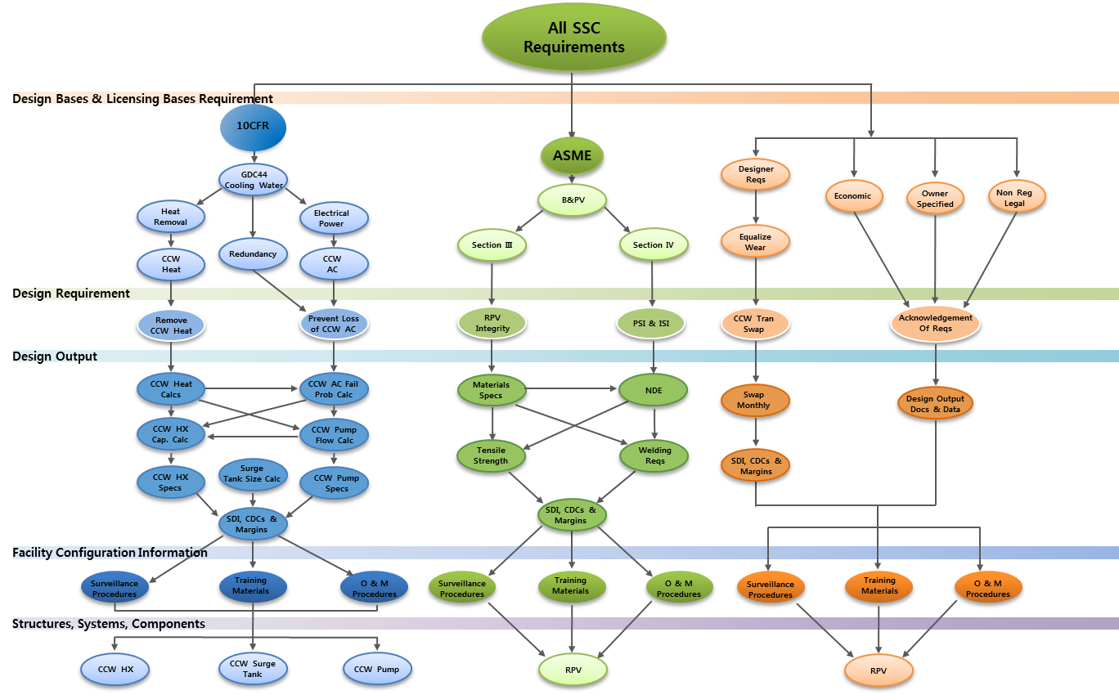
DBD TAXONOMY
Reference: EPRI TR; 1022684; April 2011

Slide 8
Requirement Management Platform
Requirement Management
System
Taxonomy
DBD
Margin Configuration Management
Ultimate Capability
Unanalyzed margin
Analyzed Design Limit
Design Margin
Operating Limit
Operation Margin
Range of Normal Operation

Slide 9
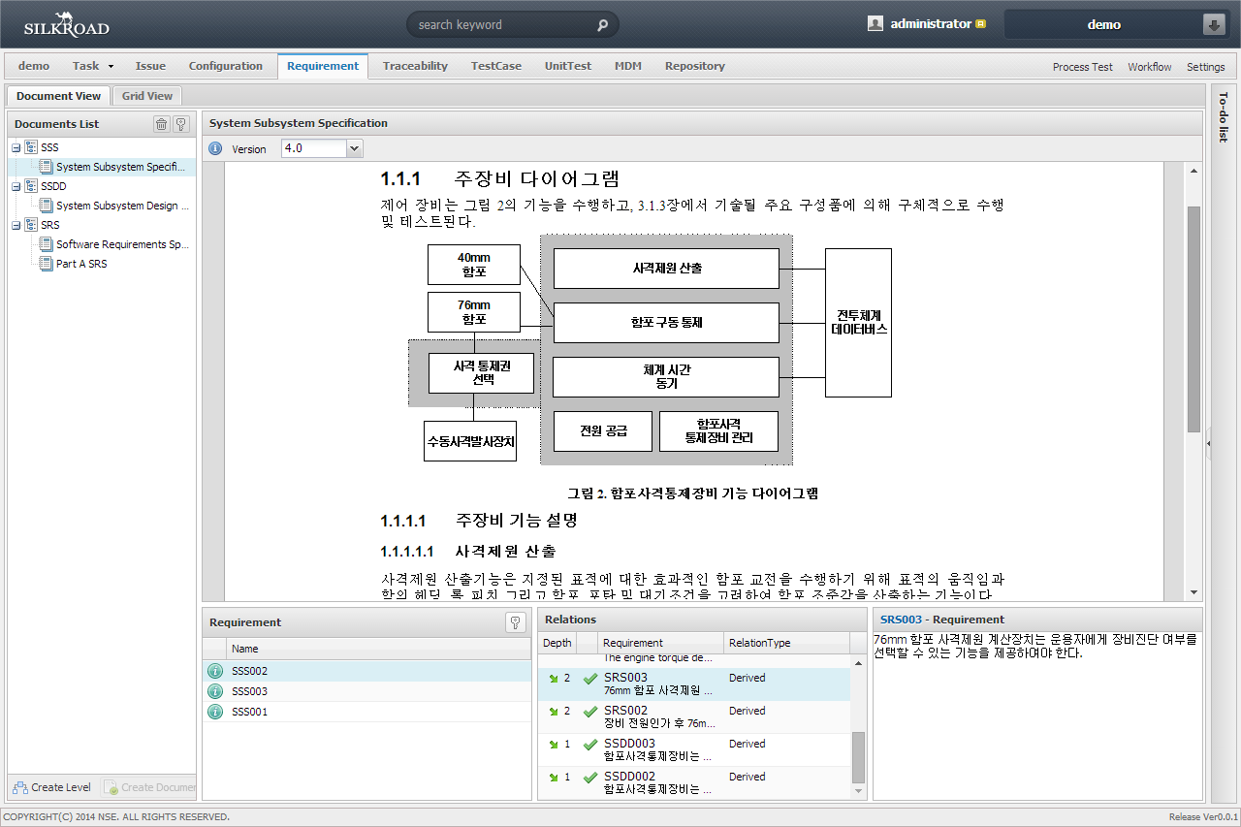
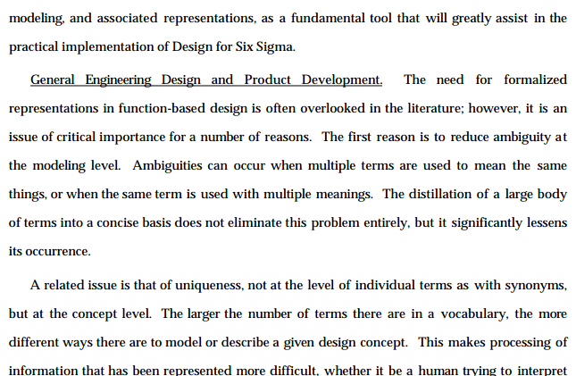
Requirement Management Platform
DBD Management
Requirement Management
Traceability Management
Change Management
System
Search
Fluid System
유체계통
보조급수계통
1차측기기냉각수계통
주급수계통원자로냉각재계통
안전주입계통 및 정지냉각계통
비상디젤발전기계통
사용후연료저장조 냉각/정화계통
Auxiliary Feedwater System
Feedwater System
Reactor Coolant System
Safety Injection System
Shutdown Cooling System
Emergency Diesel Generator System
Spent Fuel Pool Cooling and Cleanup System
Instrumentation System
계측계통
Plant protection system
Engineered Safety Feature Actuation System
발전소보호계통
공학적안전설비작동계통
Structure system
구조물계통
Primary Auxiliary Building
일차보조건물계통
Taxonomy

Slide 10
Requirement Traceability Platform
Taxonomy-based Traceability (EPRI PIM View)
Design
Requirement
Design Base Specification
System, Structure, Component Specification
Design
Parameter
Supporting
Design
Information
Supporting Operating Information

Slide 11
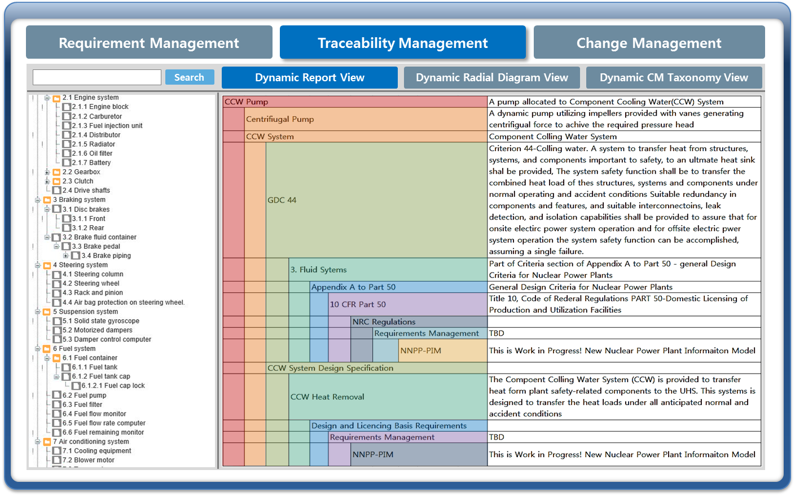
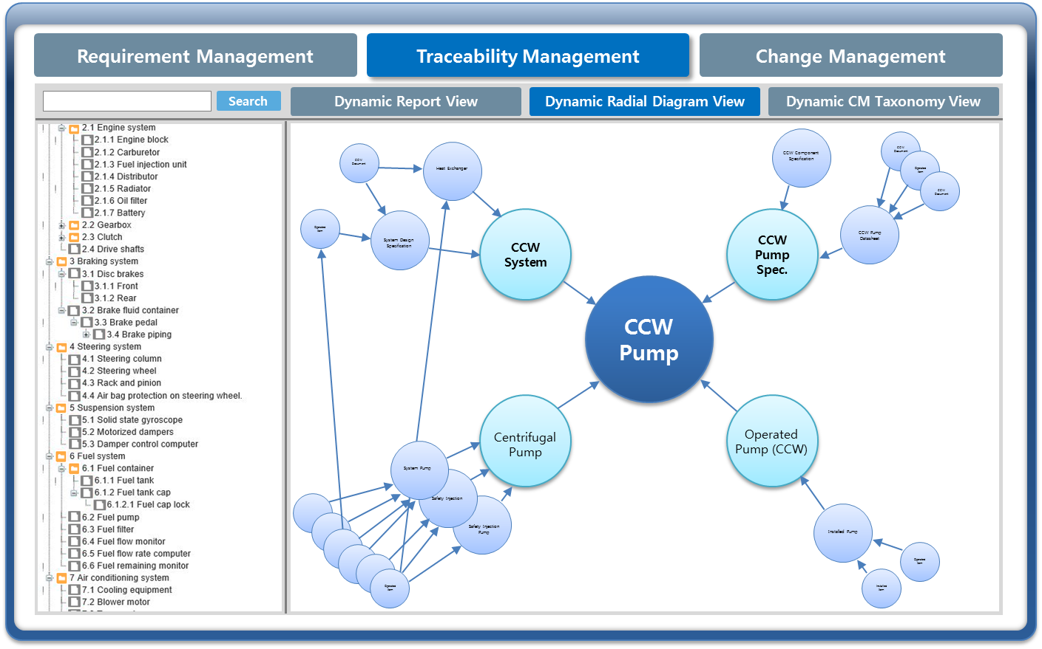
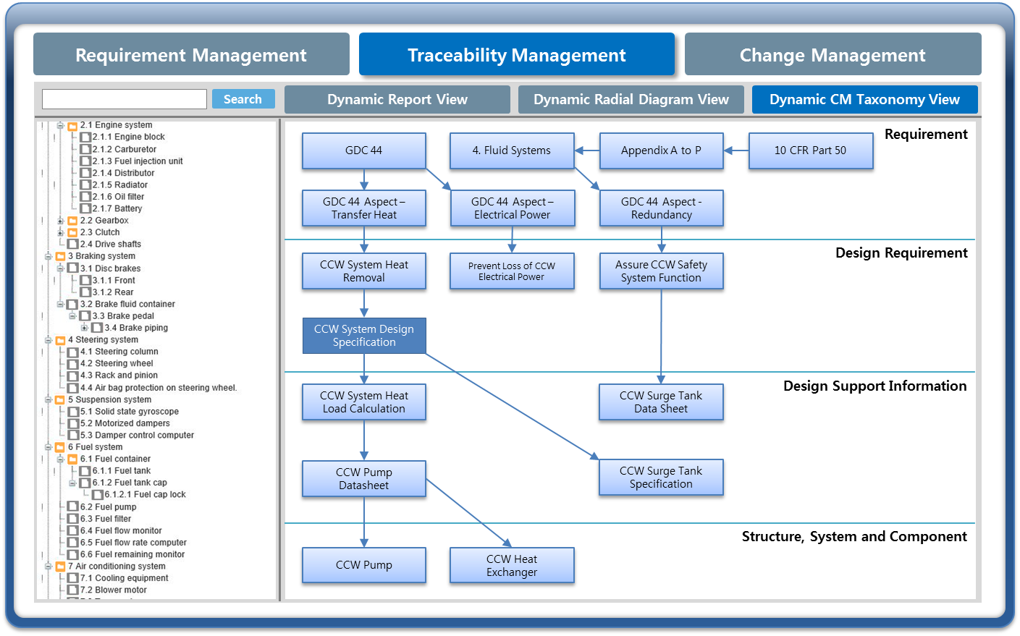
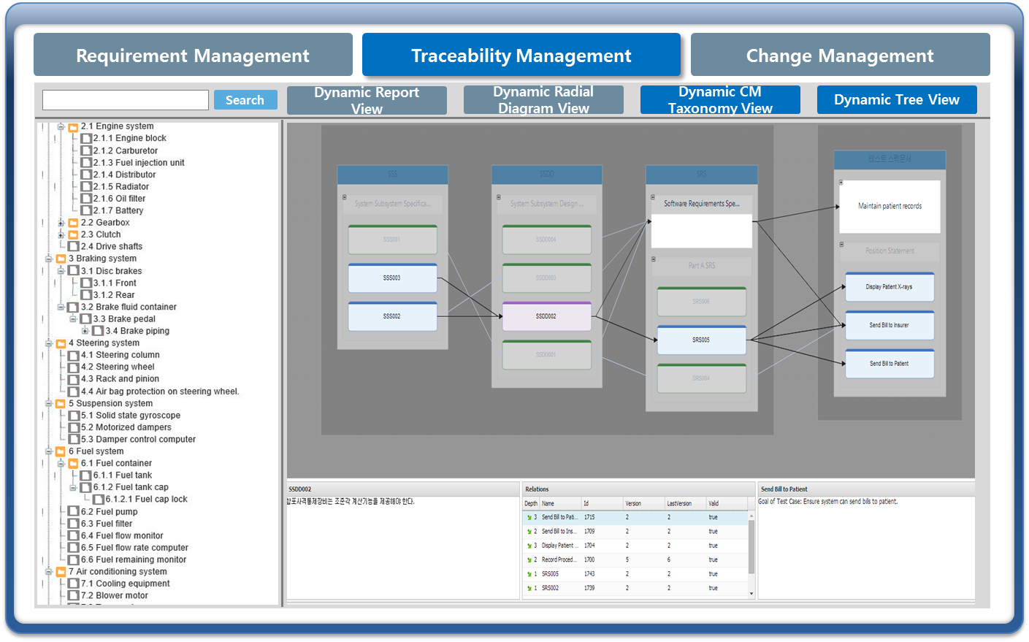
Traceability Management Platform
Report View
Radial Diagram View
Taxonomy View
Tree View

Slide 12
Change Management Platform
AP-929
CM001
Evaluate Identified
Problem or Desired
Change
Change design
requirements
No
Change physical
requirements
No
Change facility
configuration
information
No
Do nothing more
Yes
Yes
Yes
CM002
CM003
CM004
Design Requirements
Change Processes
Physical Configuration
Change Authorization
Processes
Facility Configuration
Information Change Processes
CM Equilibrium

Slide 13
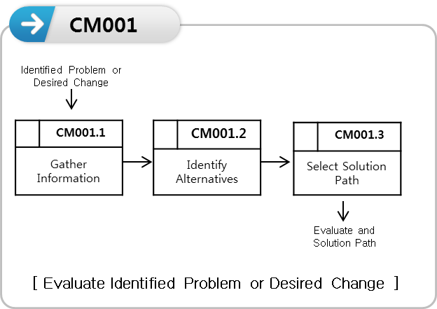
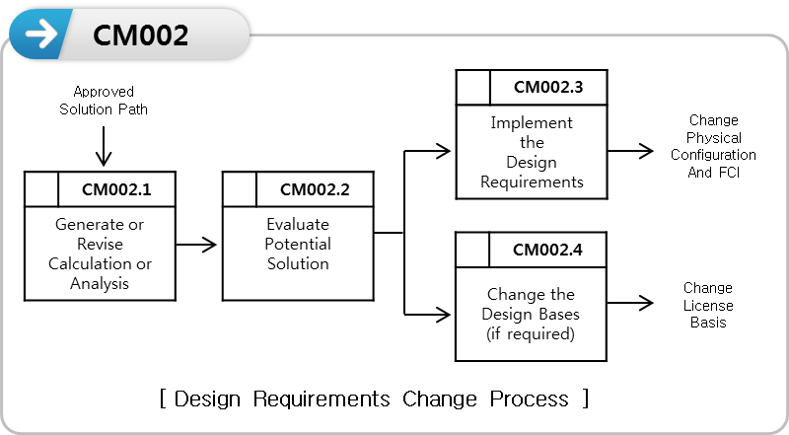
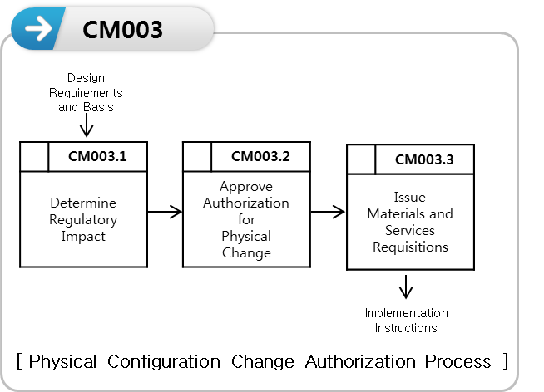
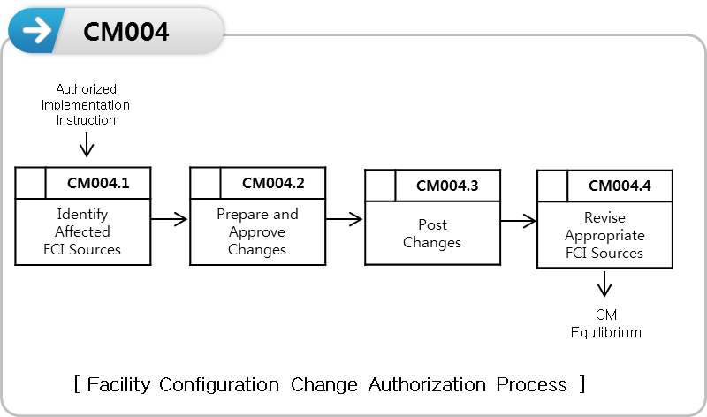
Change Management Platform
· · ·
Work Place
Monitoring
Reports
Dashboard
Portal
Change Process
(Company Specific)
+
X
+
X
BPM Engine

Slide 14
Facility Configuration Information Platform
Expected
Actual
Intelligent Documents
Intelligent Data
Intelligence
Legacy System
Tag Mapping
Procedure, etc.
Procedure
P&ID(dgn)
P&ID(dgn)
Specification
Equipment
Equipment
Calculation
Material
FSAR
Material BOM
FCI Platform

Slide 15
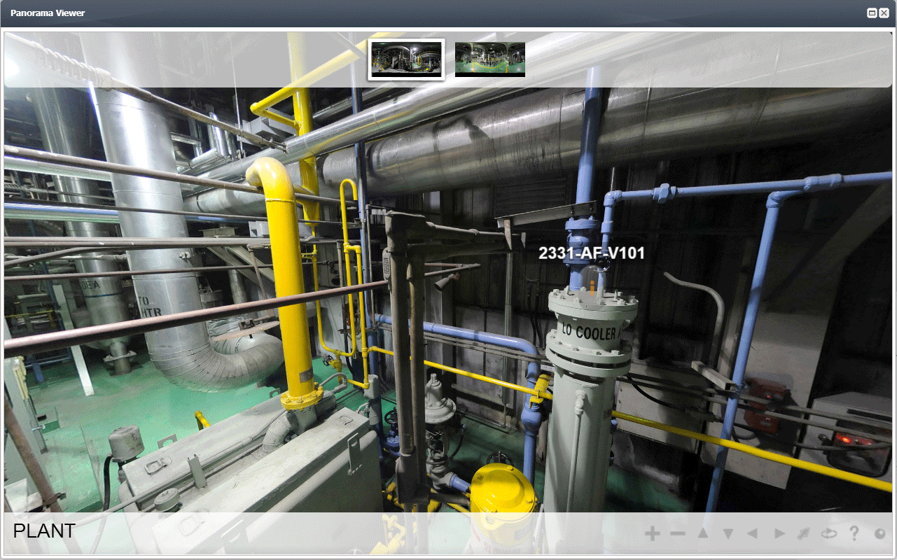
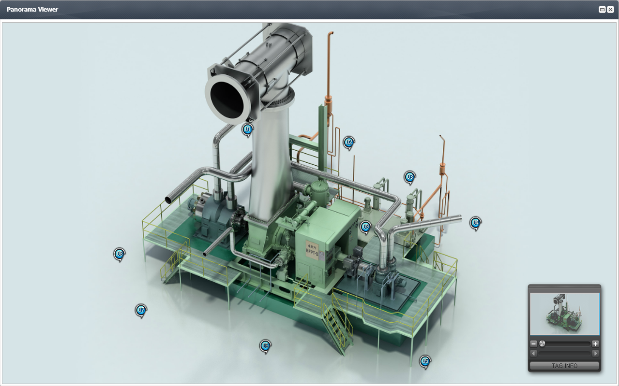
Physical Configuration
Panorama View
Ex) Fossil Plant provided by POMIT Inc.

Slide 16
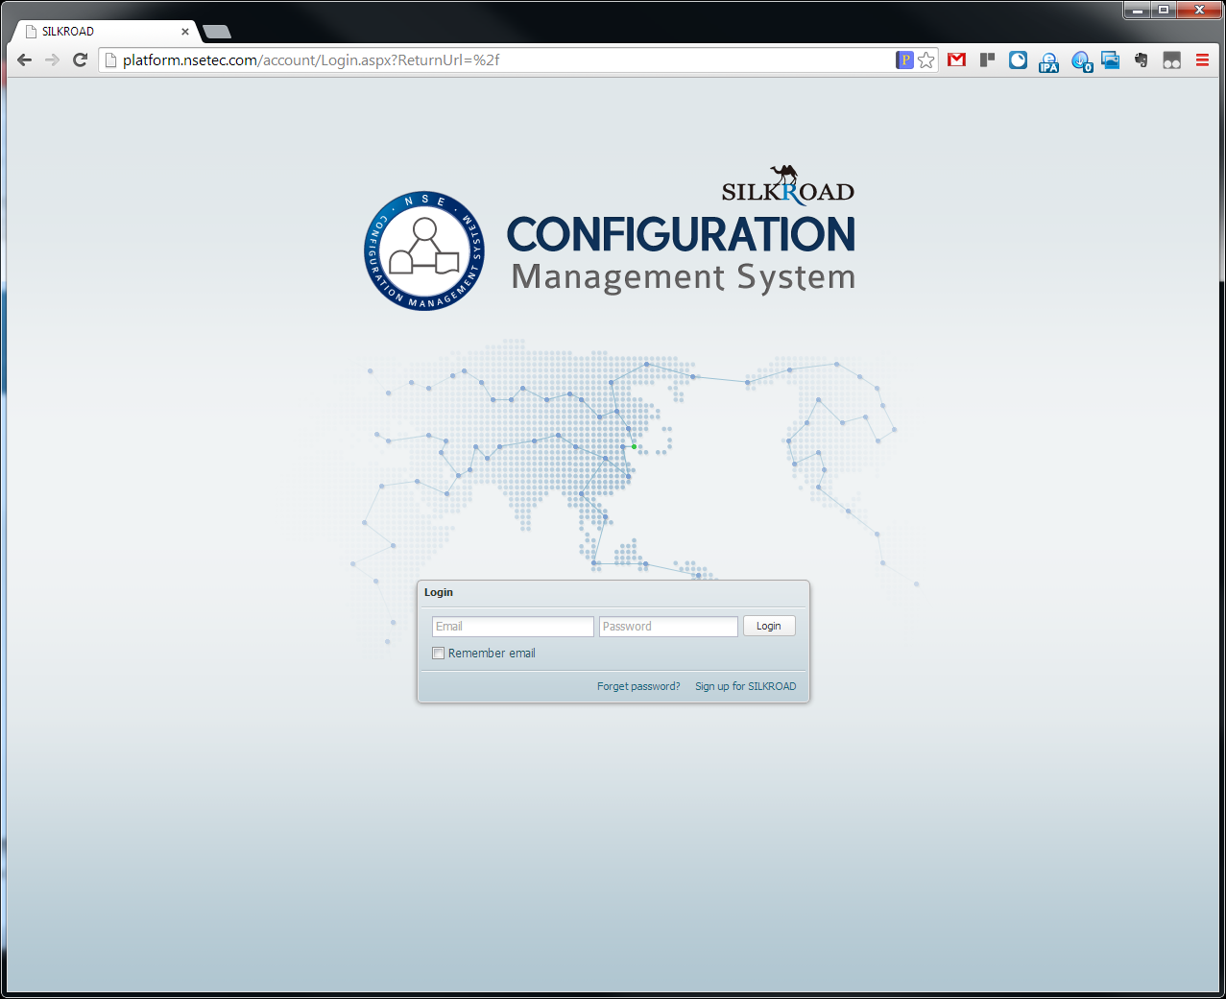
Demo

