Slide 1

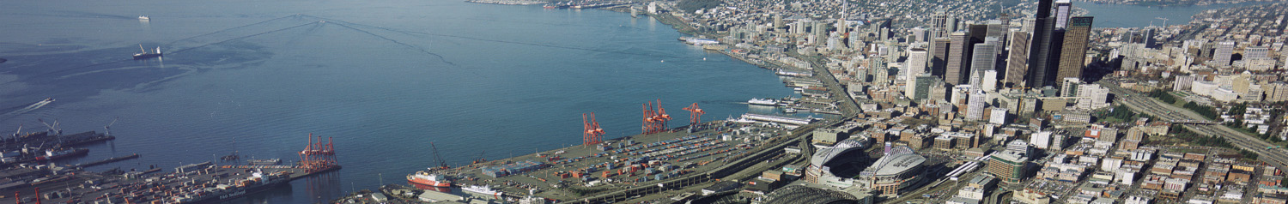
Organization
Date
Configuration Management Benchmark Group
21st Annual Conference
June 18, 2014

Slide 2
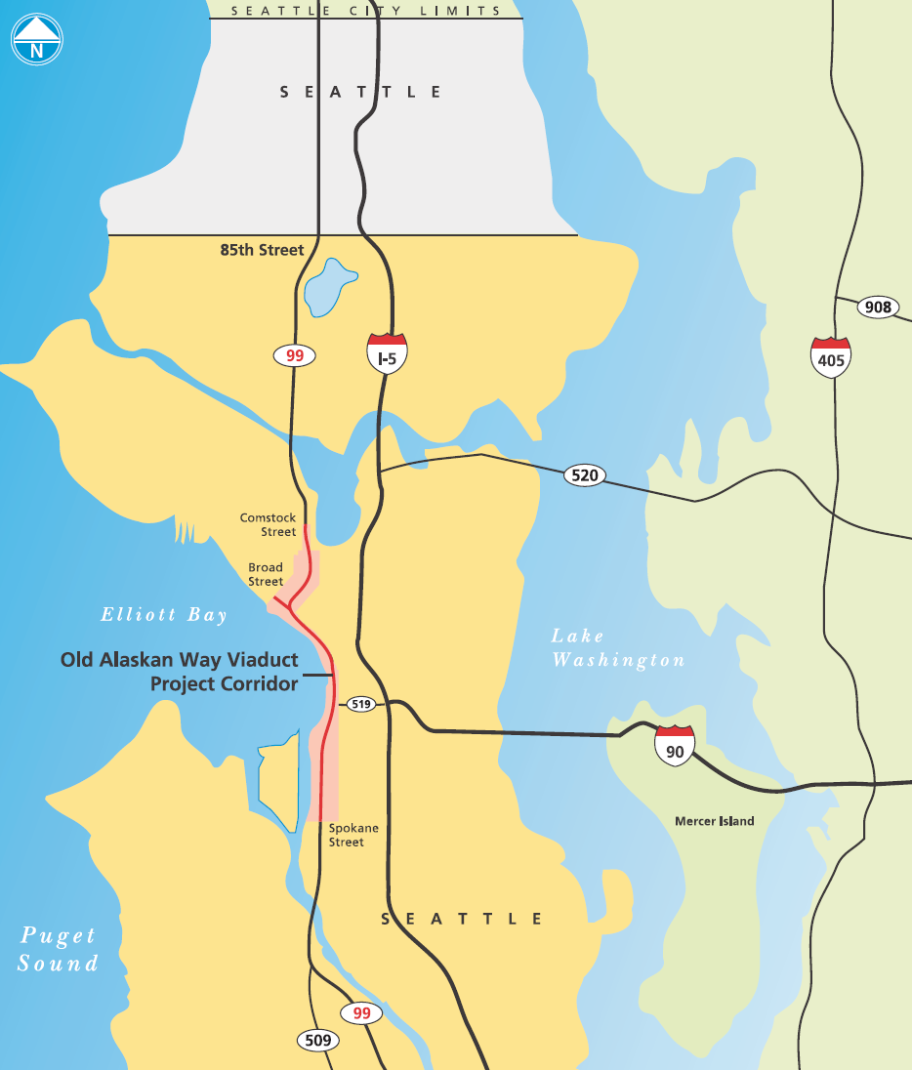
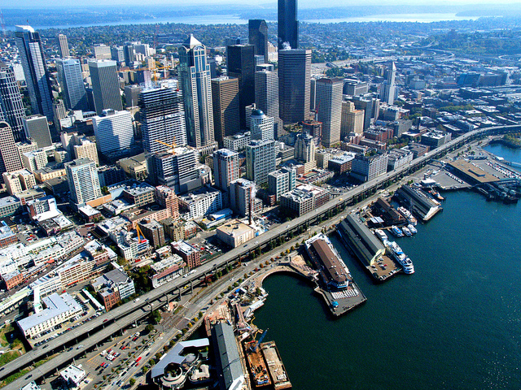

Project Location

Slide 3
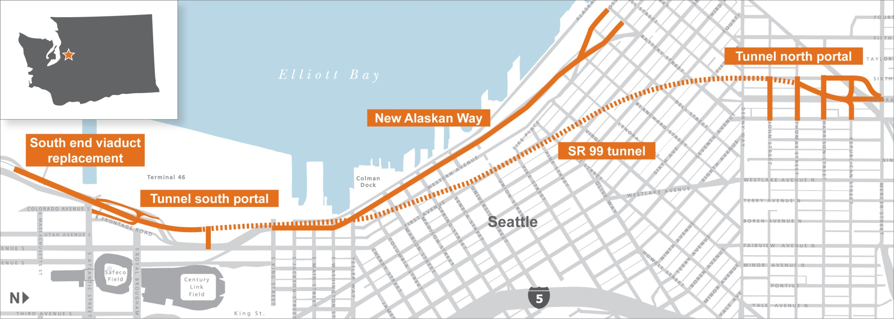
Building the New SR 99 Corridor

Slide 4
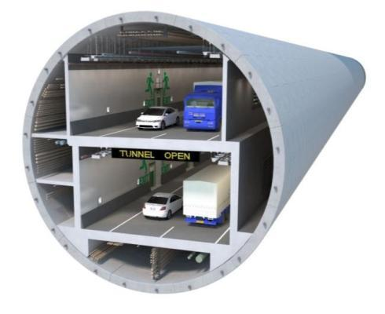
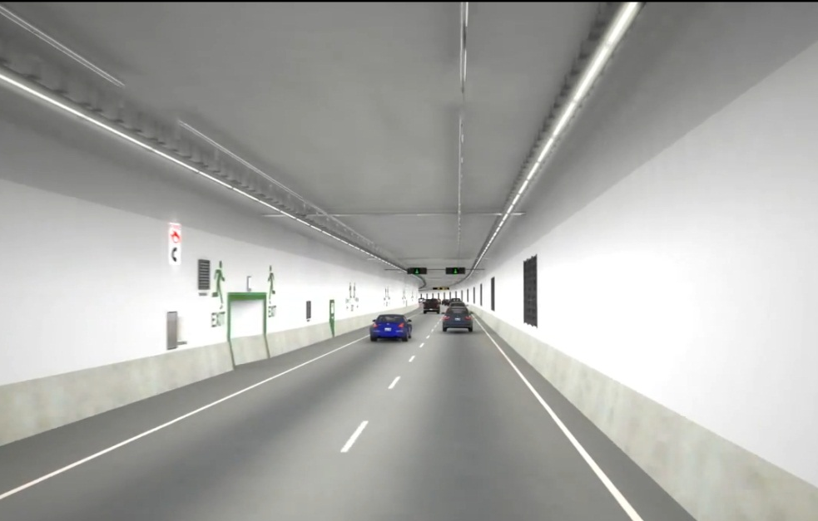
SR 99 Tunnel
Approximately two miles long.
Two lanes with eight-foot safety shoulder in each direction.
State-of-the-art safety systems.
Southbound
Northbound
Design concept.
Design concept of tunnel interior.

Slide 5
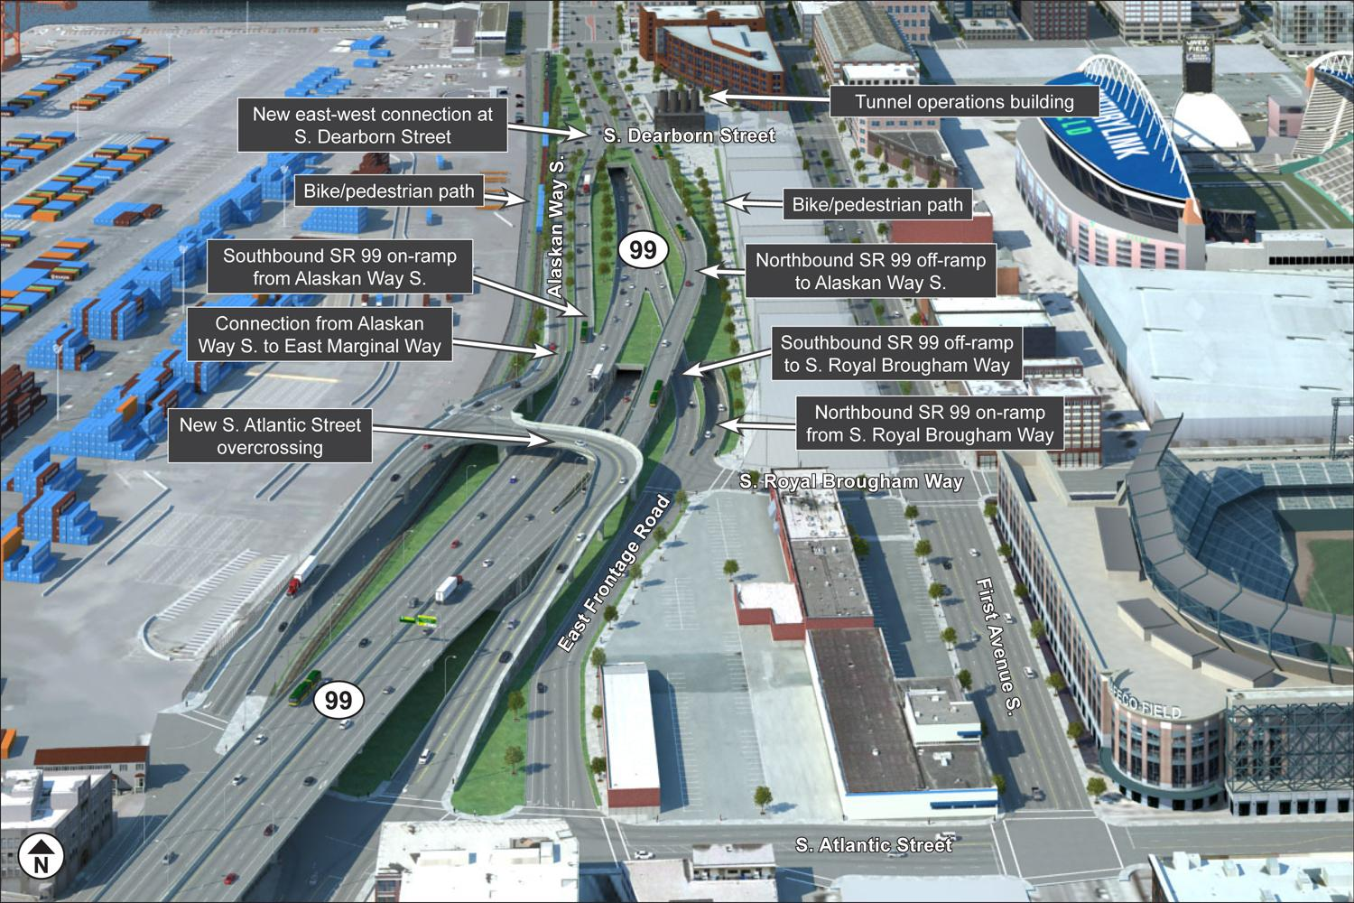
South Portal Design

Slide 6
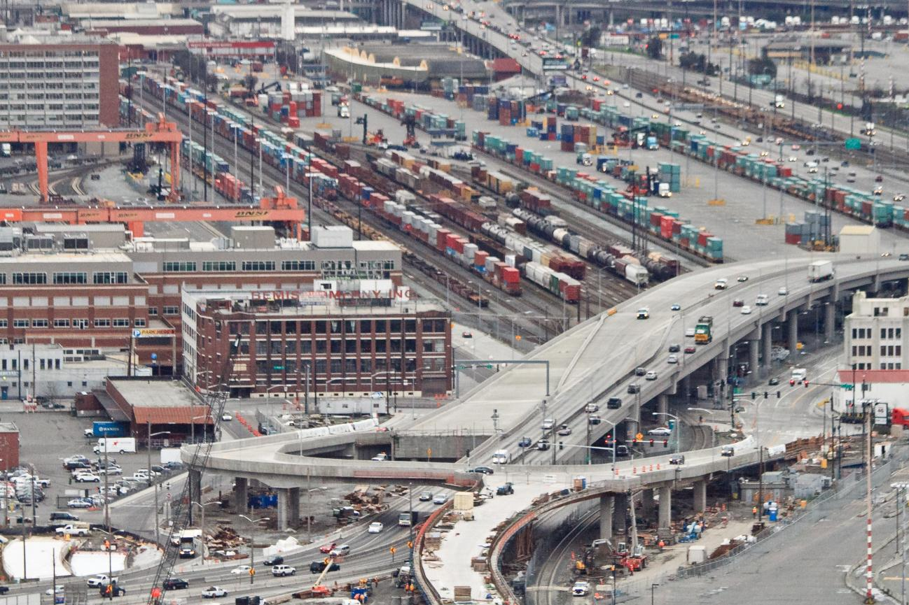
South Atlantic Street Overpass
Photo from Jan. 30, 2014.

Slide 7
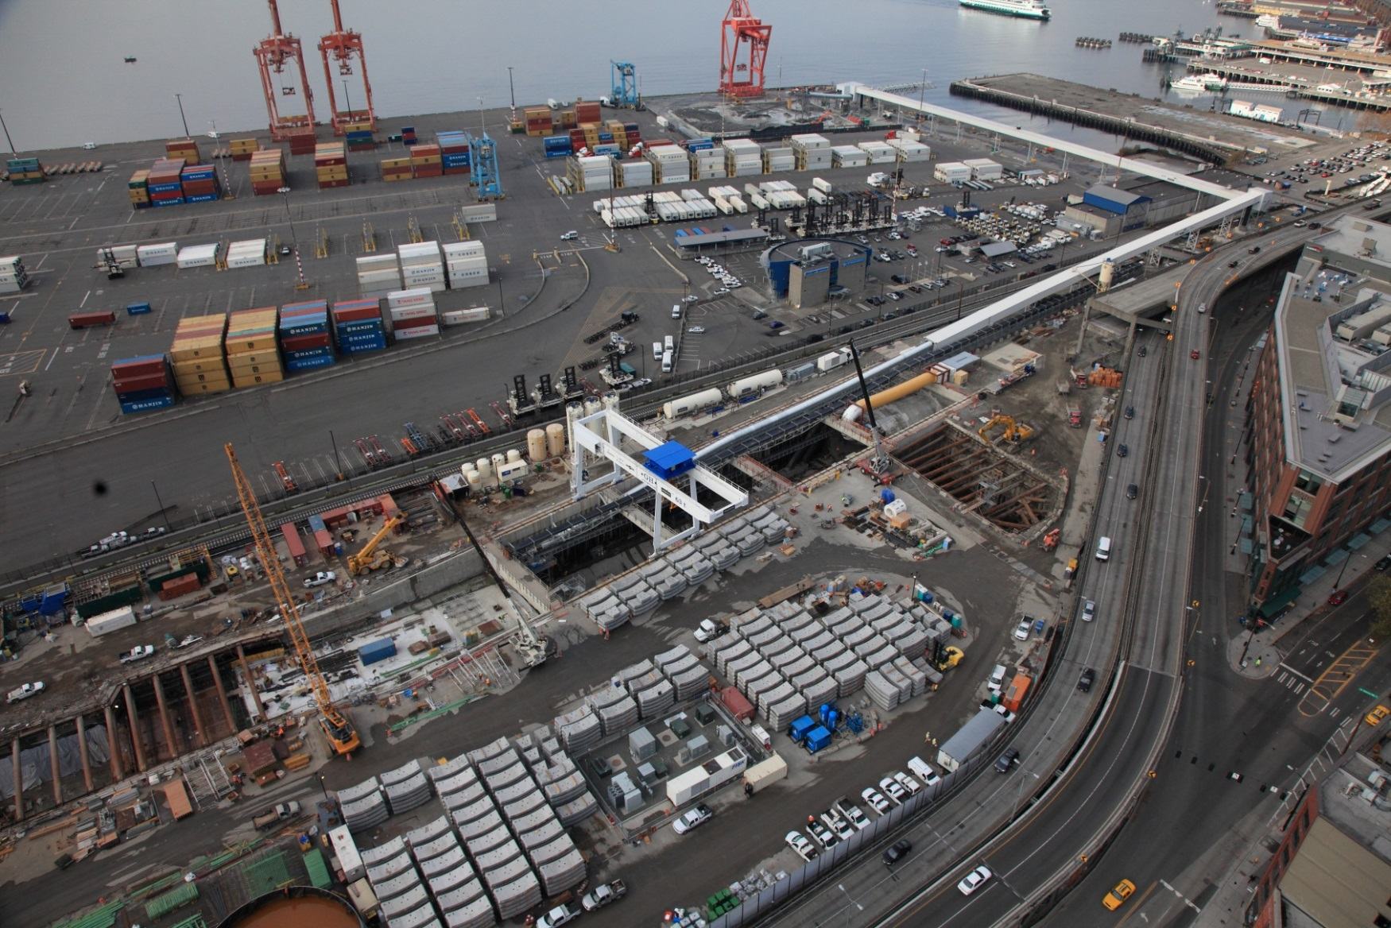
Aerial of SR 99 Tunnel Work Site
Photo from winter 2014.

Slide 8
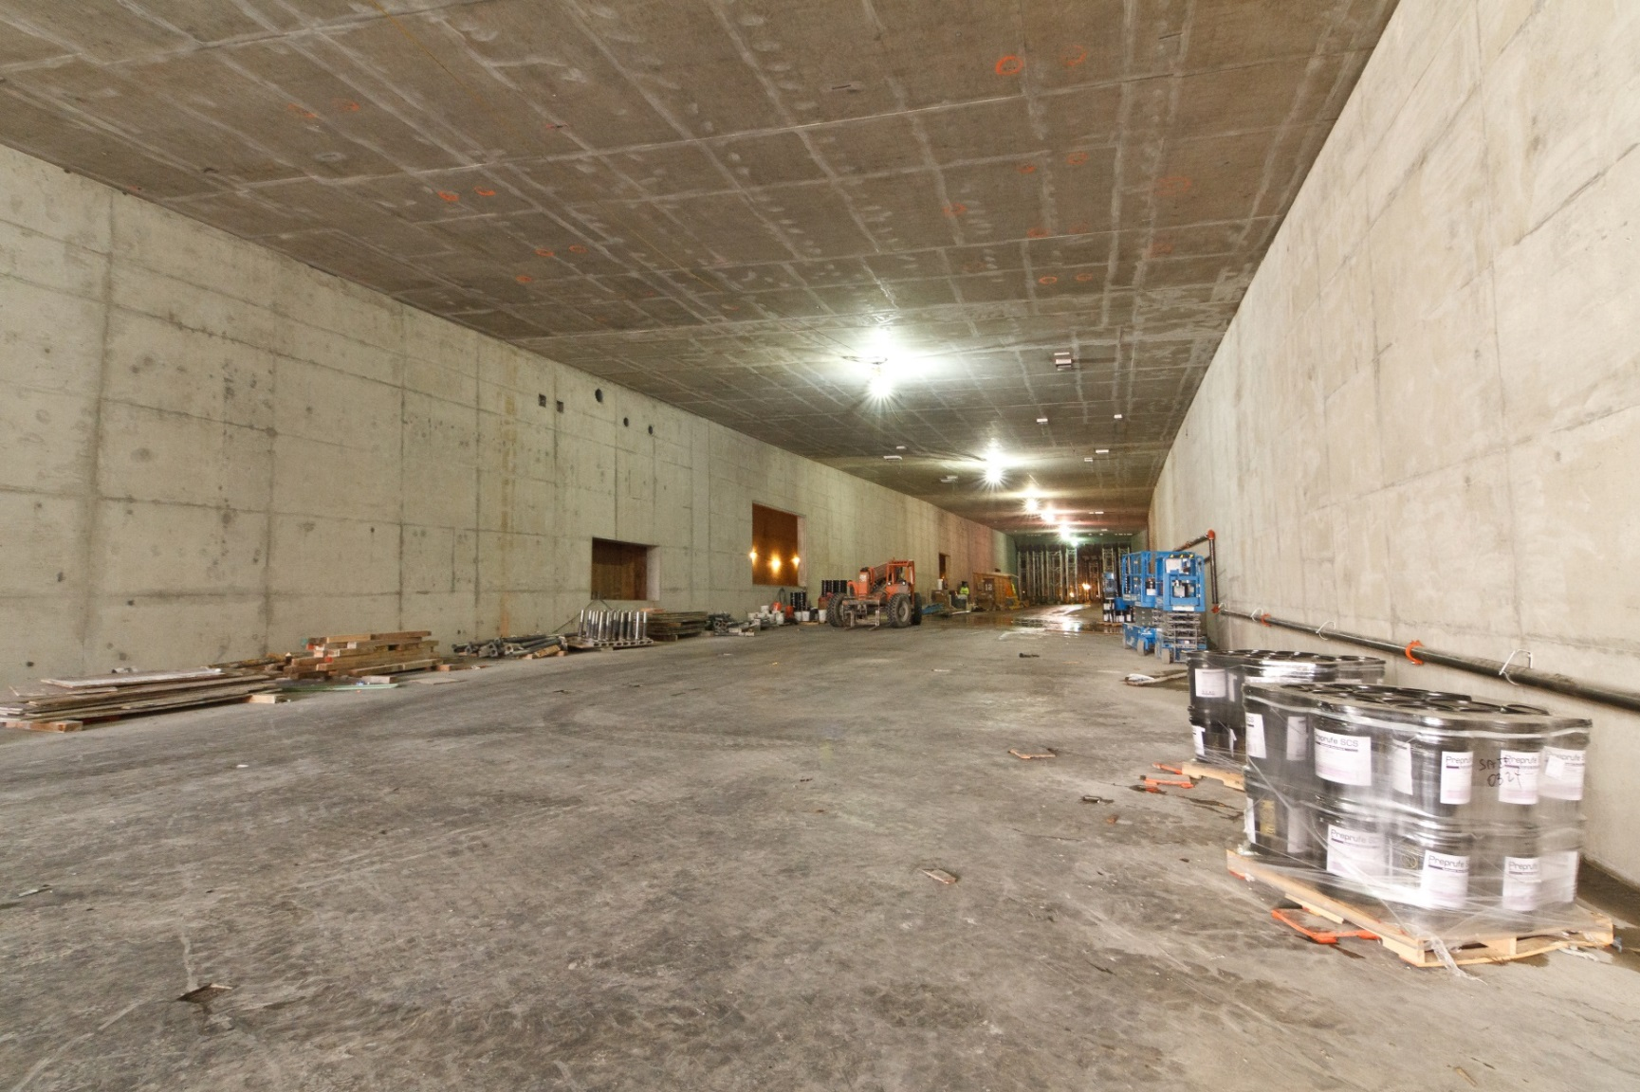
South Portal Construction
Photo from May 1, 2014.

Slide 9
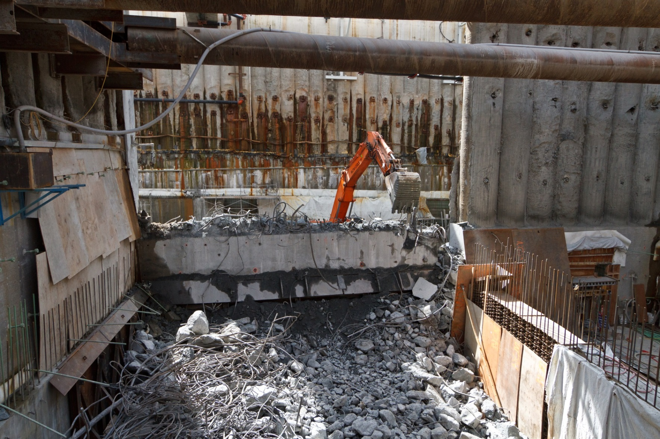
South Portal Operations Building Construction
Photo from May 21, 2014.

Slide 10
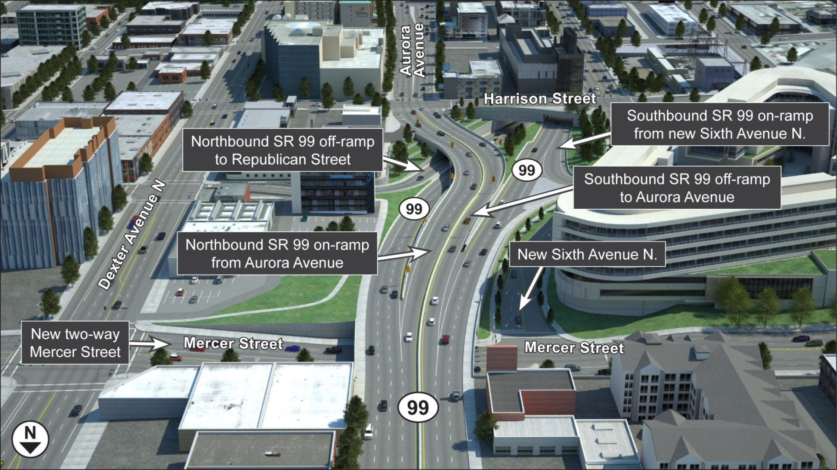
North Portal Design

Slide 11
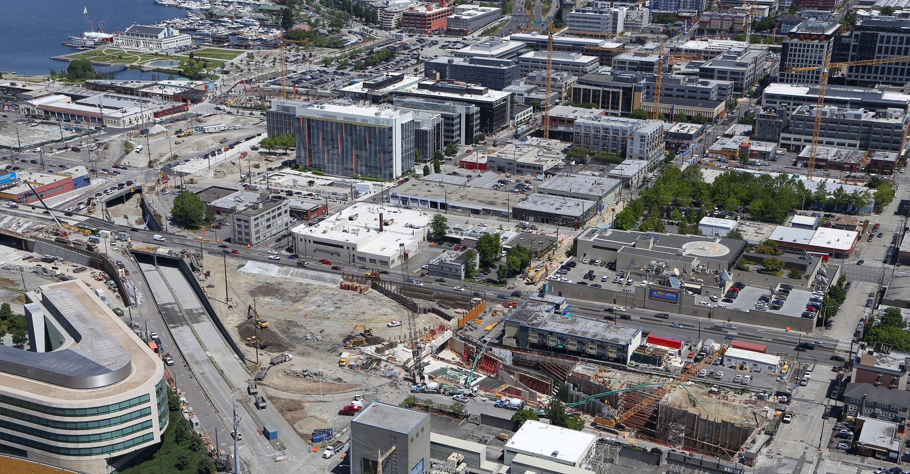
North Portal Construction
Photo from June 11, 2014.
Notes:
11

Slide 12
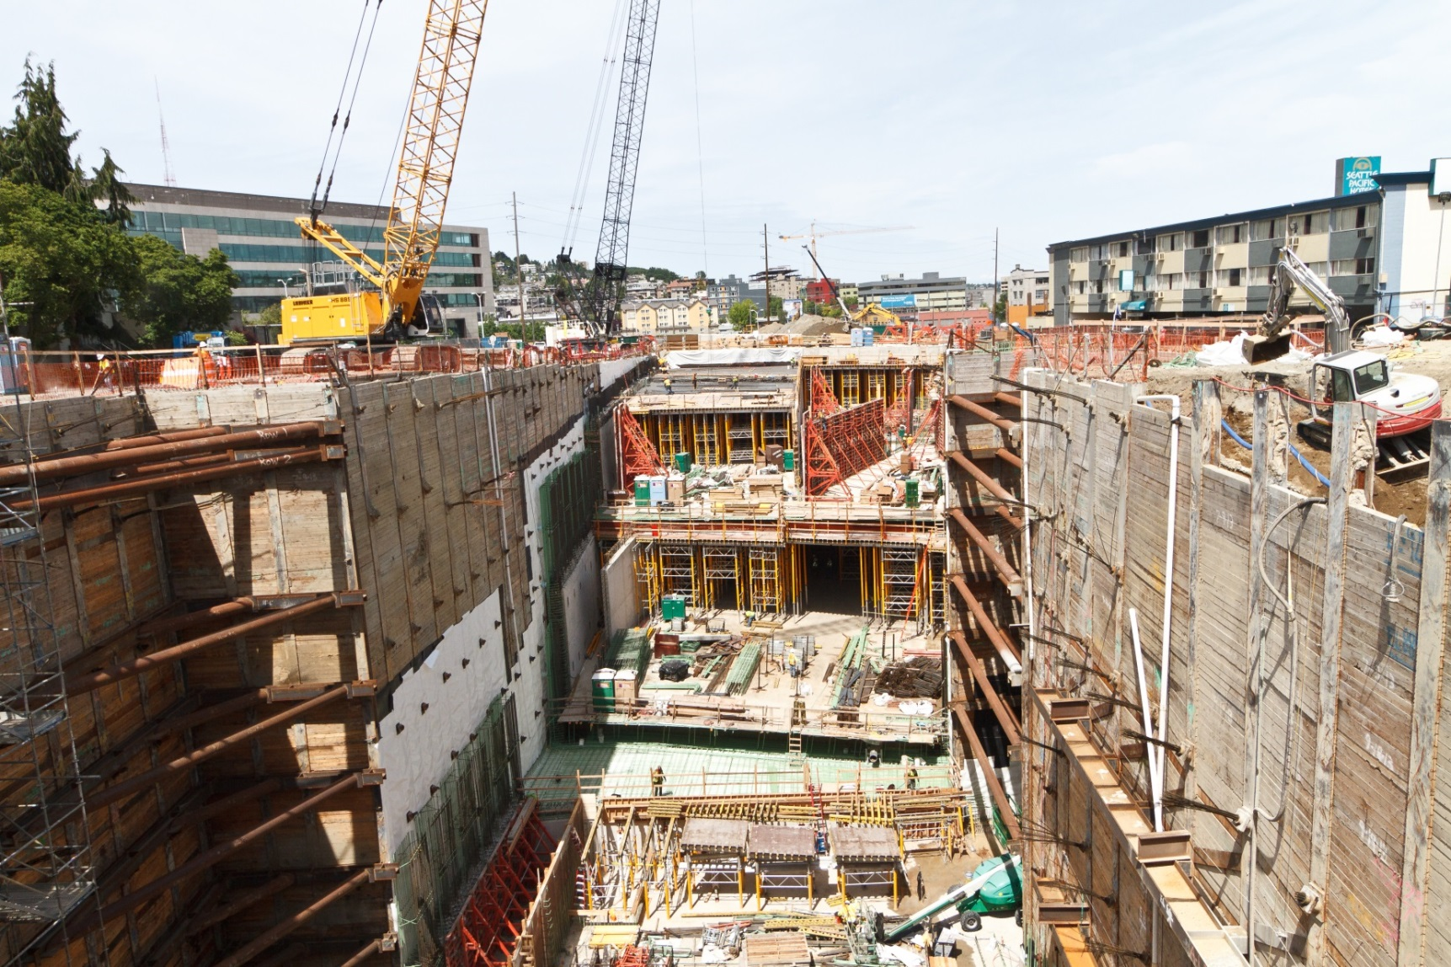
North Portal Receiving Pit
Photo from May 22, 2014.

Slide 13
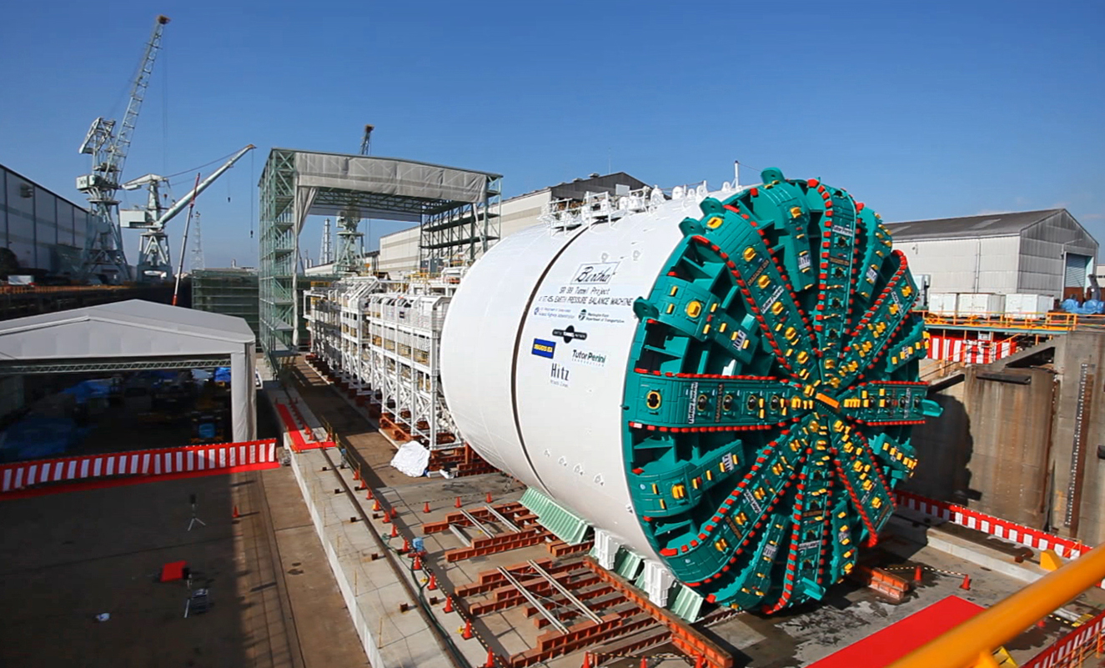
Meet Bertha, the SR 99 Tunneling Machine
Photo from spring 2013.

Slide 14
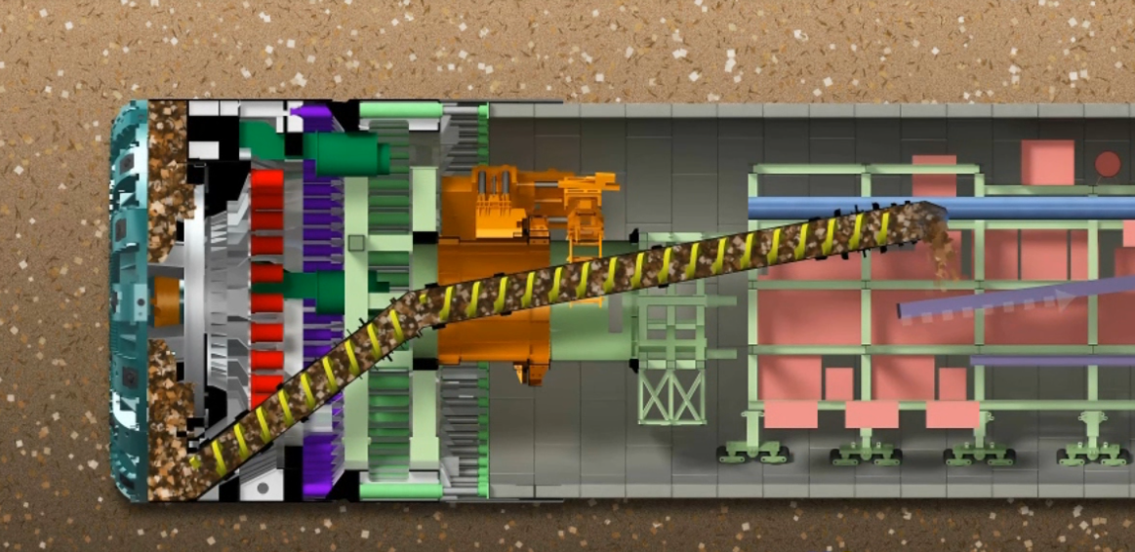
Meet Bertha, the SR 99 Tunneling Machine
Cutterhead
Thrust jacks
Tunnel liner
Conveyor belt
Segment erector
Screw conveyor

Slide 15
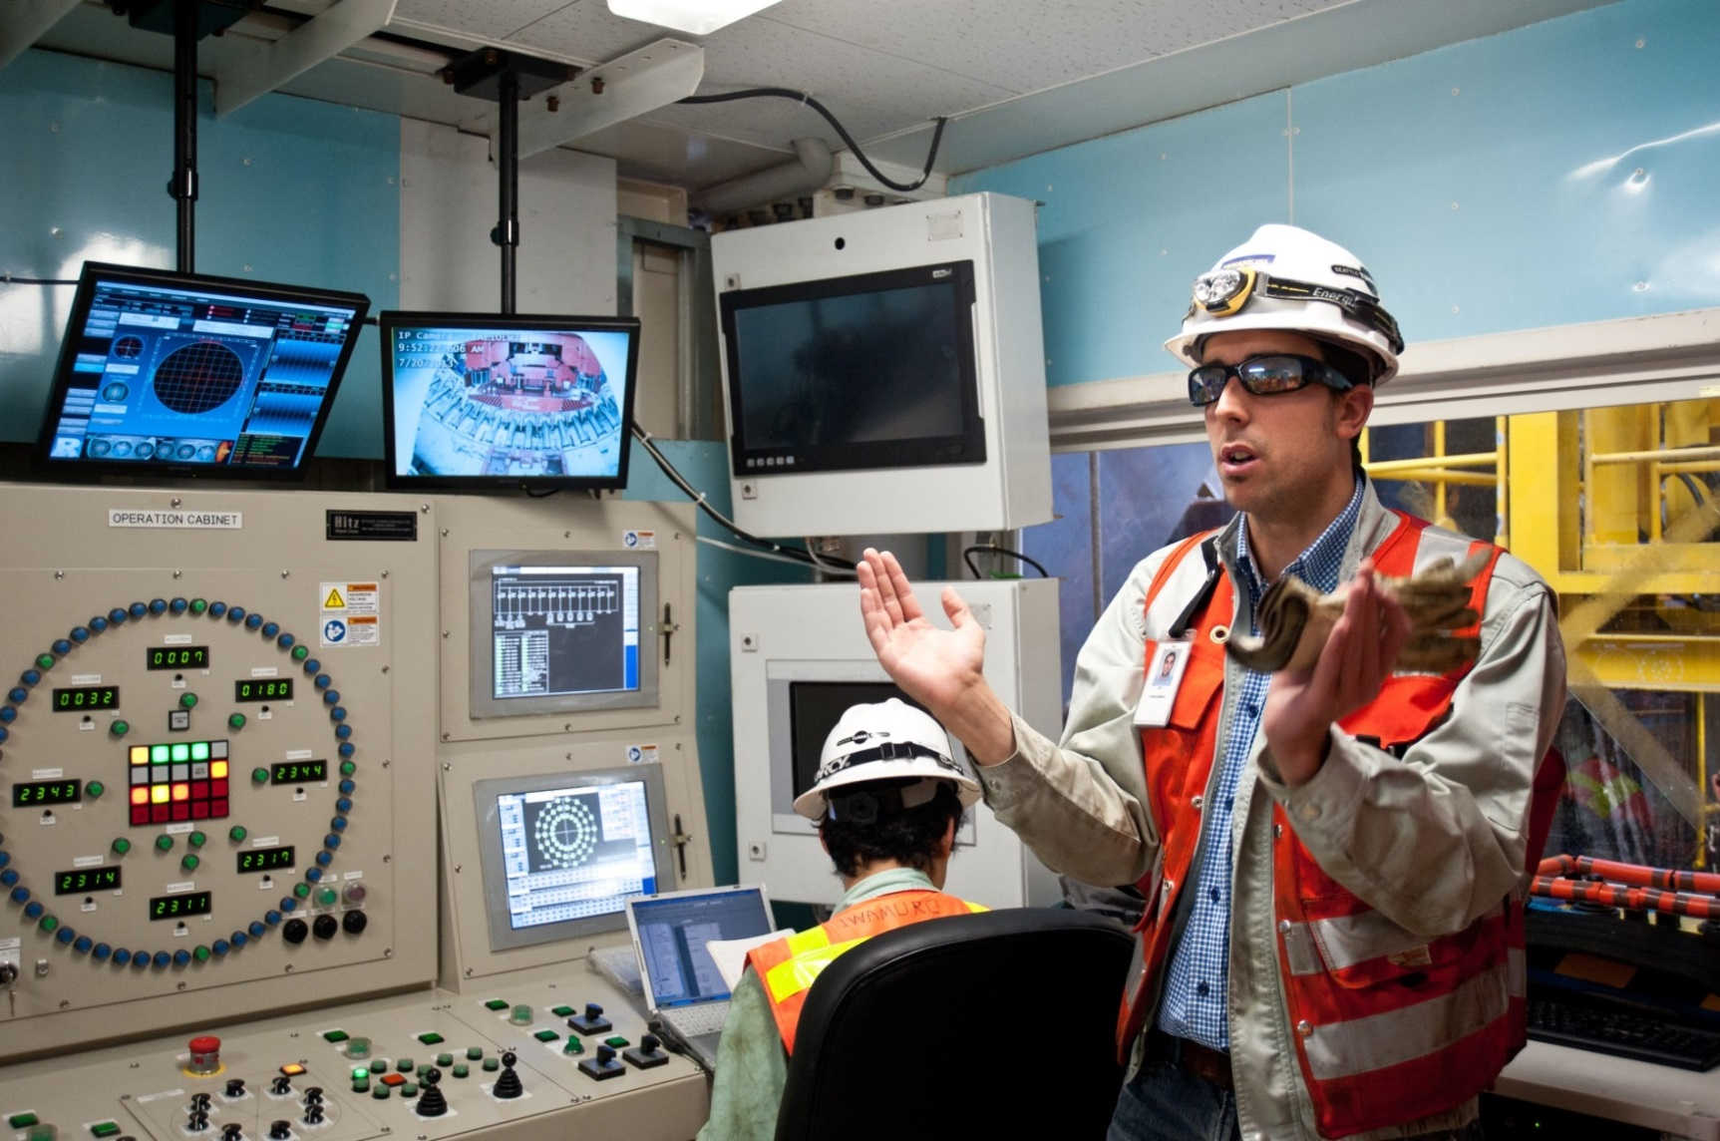
Inside the Machine’s Control Room

Slide 16
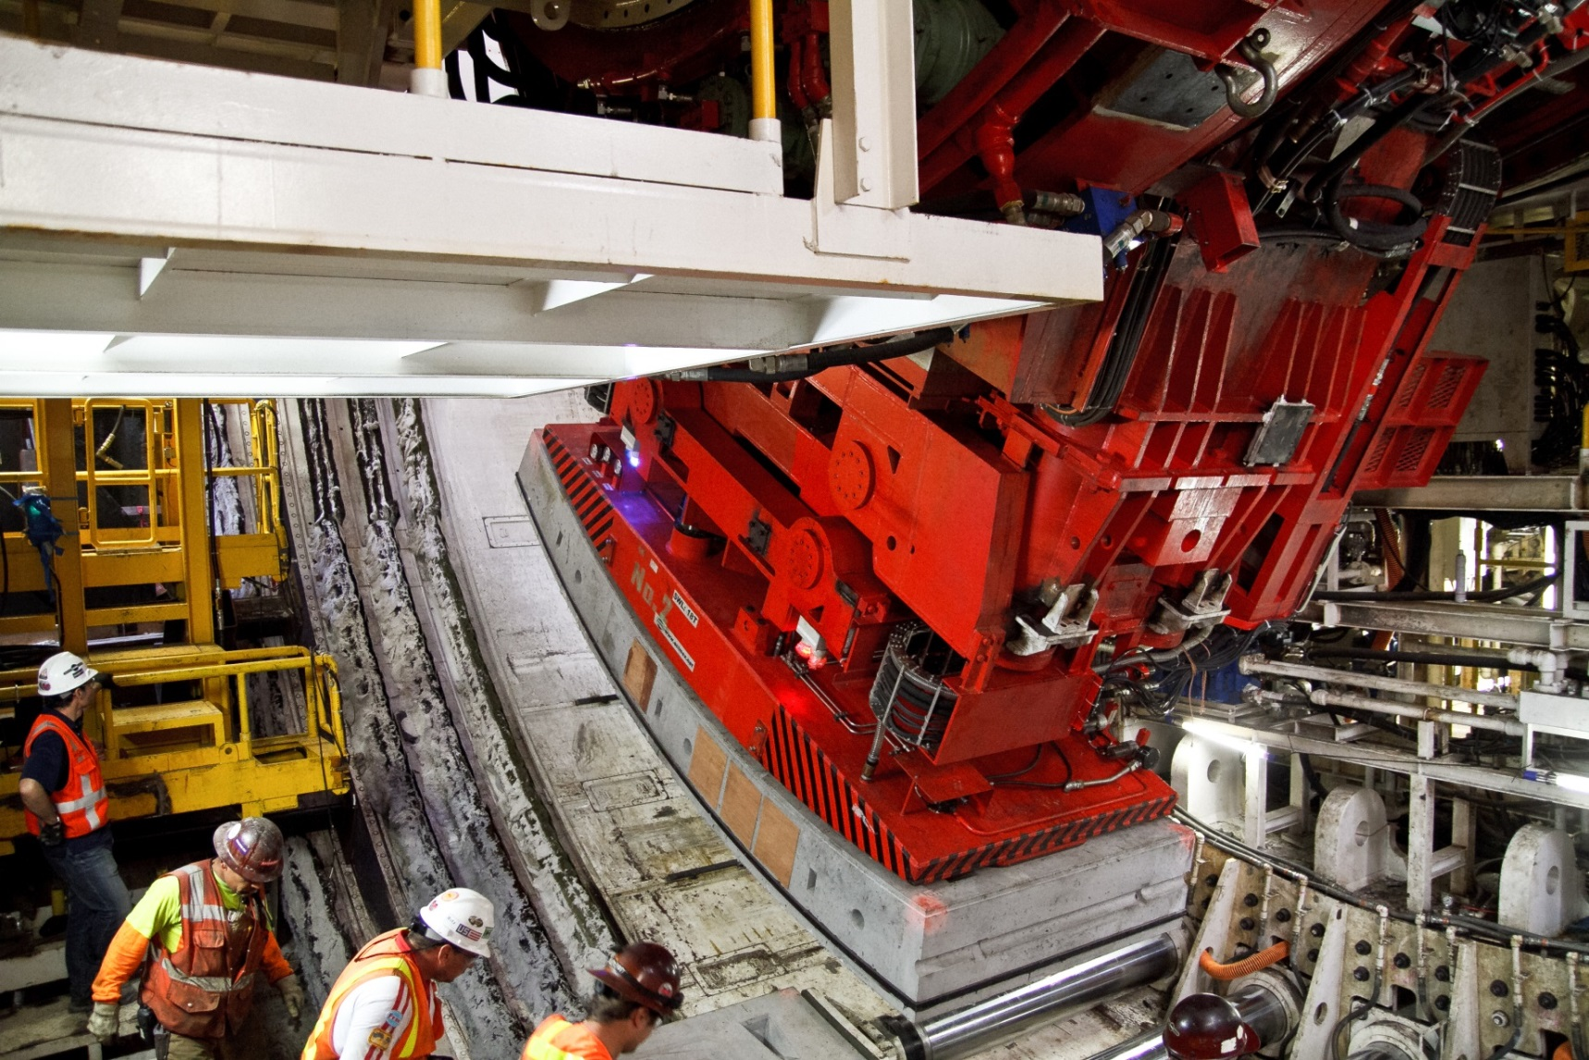
Bertha’s Segment Erector

Slide 17
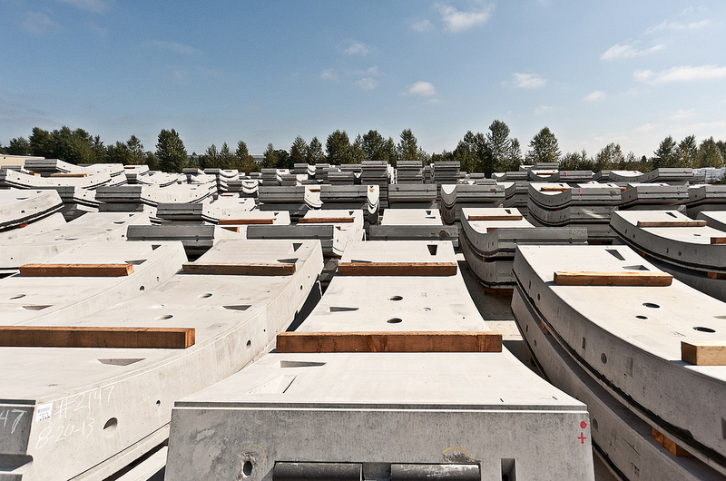
Tunnel Liner Segments
Photo from Sept. 12, 2013.

Slide 18
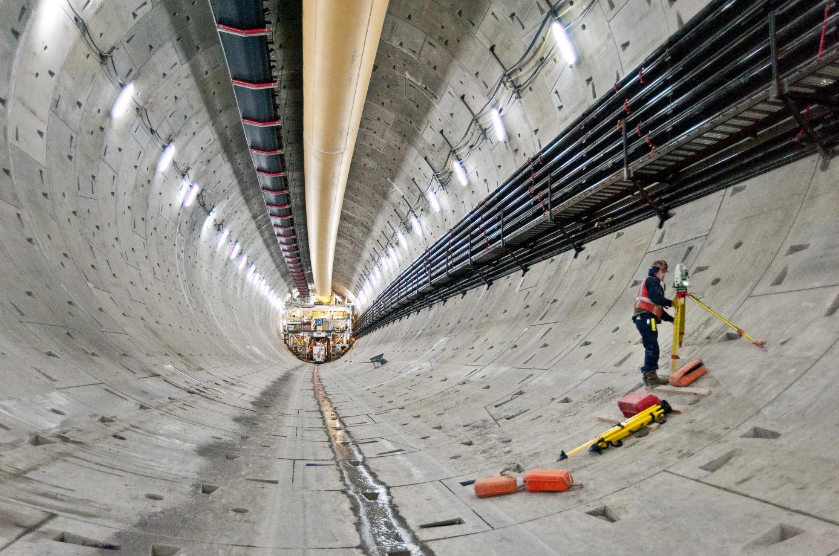
Inside the Tunnel
Photo from Dec. 6, 2013.

Slide 19
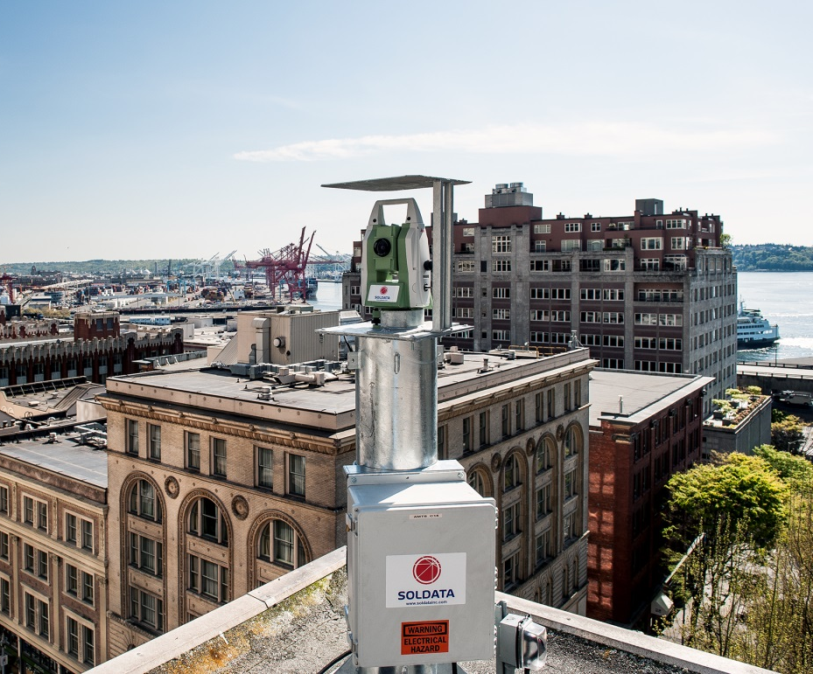
Protecting Structures Along the Tunnel Route
Install monitoring equipment on nearly 200 buildings.
Install 700 instruments under streets and sidewalks to measure any ground changes.
Track measurements of excavated material as tunnel boring machine progresses.
Use satellite images to assess any changes in ground condition.
Monitoring equipment installed on a rooftop. Photo by Soldata.

Slide 20
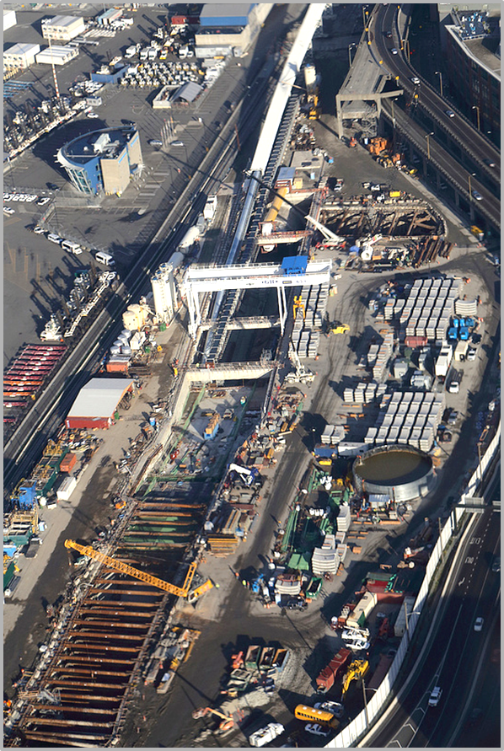
Benefits of Design-Build Contracting for the
SR 99 Tunnel
Accelerated schedule/faster project delivery.
Innovation on a challenging project.
Flexibility in means and methods for contractor.
Ability for owner to target prequalification.
Ability for owner to make a best value selection.
Better predictability of final cost at the onset.
Reduces owner staffing requirements.
Strategic risk distribution and control.
Aerial of the SR 99 tunnel work site, fall 2013.

Slide 21
Design Development, Quality Assurance and Review
Contractor Design Team | Contractor Construction Team | WSDOT Design and Construction
STP Design Manager | STP Construction Manager | WSDOT Design Manager WSDOT Construction Manager
Design Discipline Leads | Construction Superintendents | WSDOT Lead Reviewer
Design Team | Construction Team (not on site during design) | WSDOT Reviewers and Technical Reviewers
Design Quality Control |  | WSDOT Audits
Document Control |  | Document Control

Slide 22
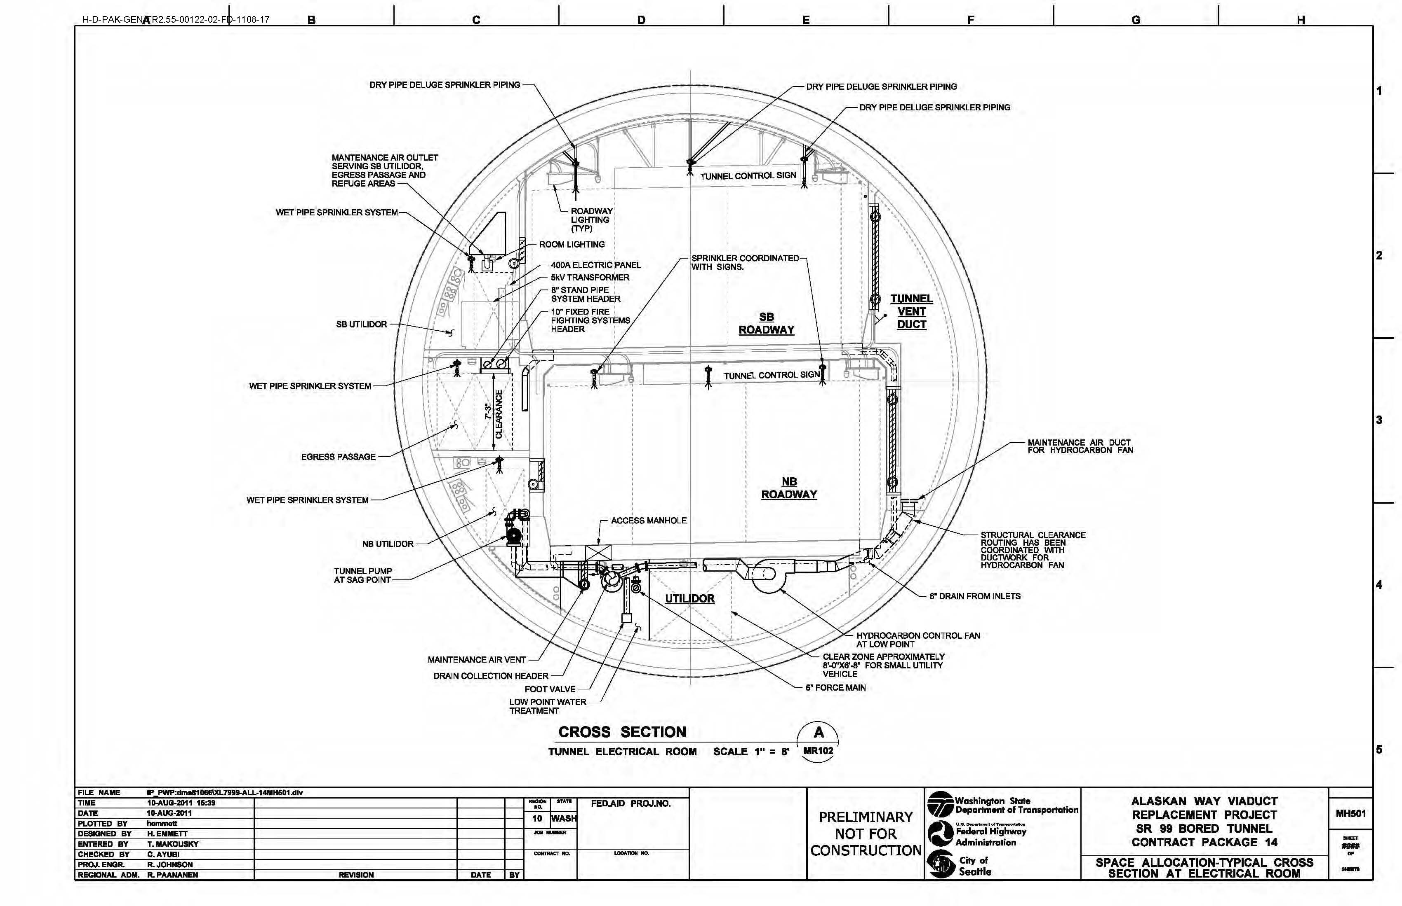
Our Configuration Management
Design Definition Submittals
Space Allocation Plan

Slide 23
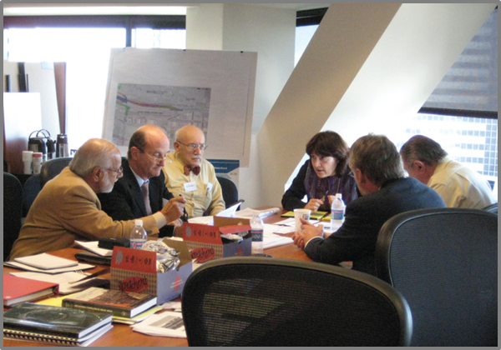
Our Configuration Management
CONCEPTUAL
Task forces.
Over the shoulder reviews.
Integration team.
Preliminary design.
Final design.
Shop drawing reviews
RFIs.

Slide 24
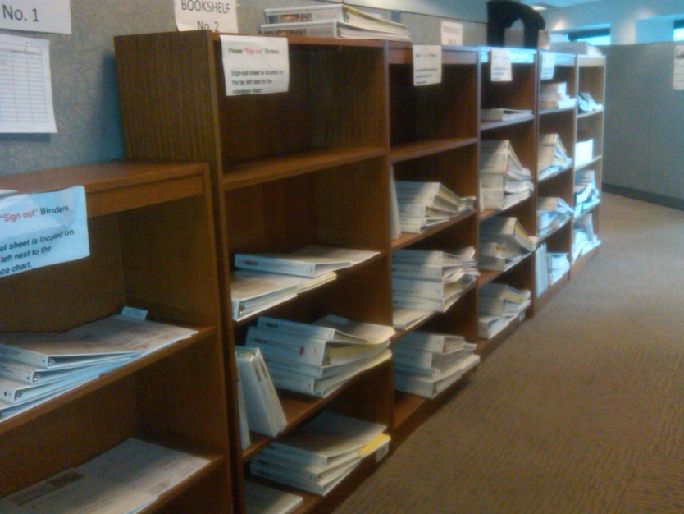
Be Accurate in Coordinating Design Management Personnel
CONCEPTUAL
BEFORE the first submittal arrives:
Assign reviews by discipline.
Assign lead reviewers.
Develop review process.
Test review software.
Train and empower reviewers.
Plan for employee absences and job changes.
Develop process for getting updated information to all reviewers.
110 Release for Construction plan set copies.

Slide 25
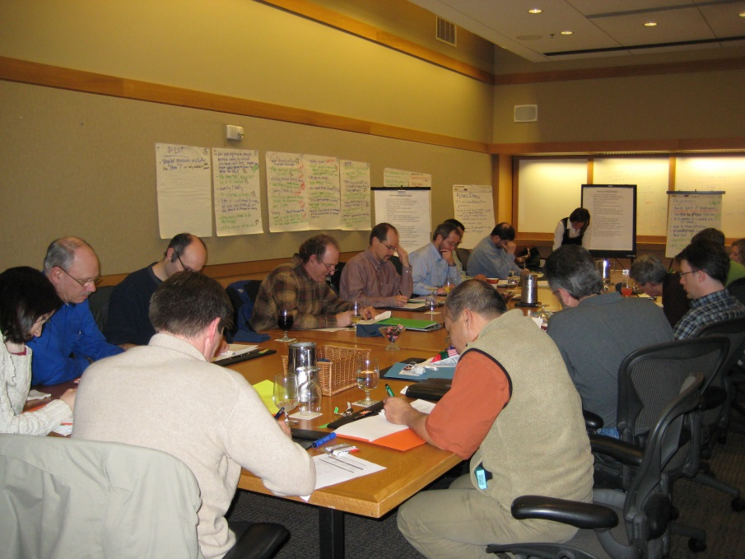
Be Accurate in Coordinating Design Management Personnel
CONCEPTUAL
Assign task force attendees for each discipline.
Use design-builder’s schedule to plan upcoming reviews.
When design overlaps more than one discipline, assign a lead reviewer for the design area.

Slide 26
SCADA Configuration Management
CONCEPTUAL
Normal operations.
Response plans.
Agreement by all parties.
Flow charts.
Operation plan.
Training plan.
Documentation.
Change management.

Slide 27
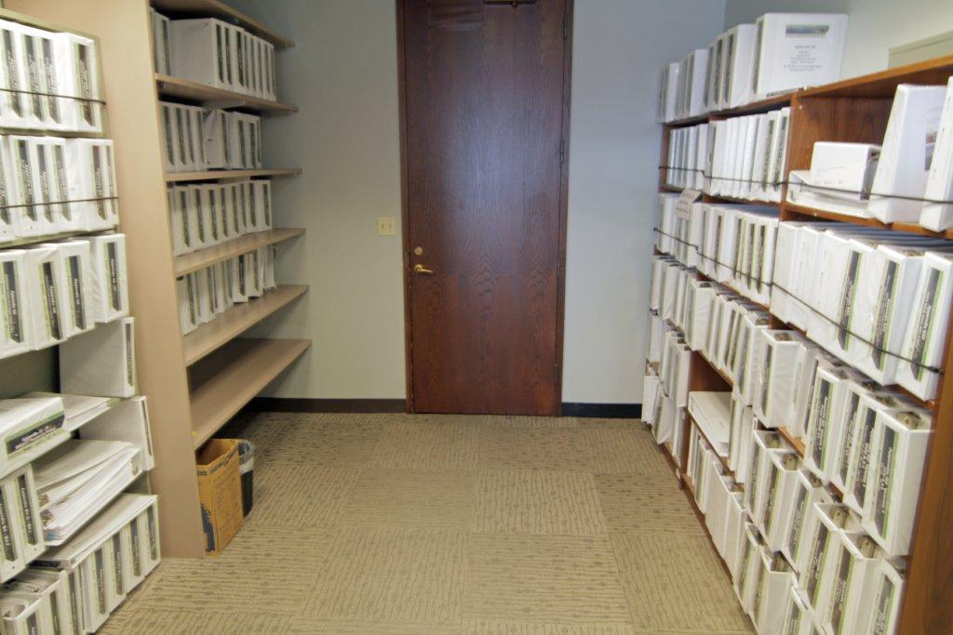
Document Control
Document control can make or break a project.
CONCEPTUAL
Copy of most of the RFP and appendices.

Slide 28
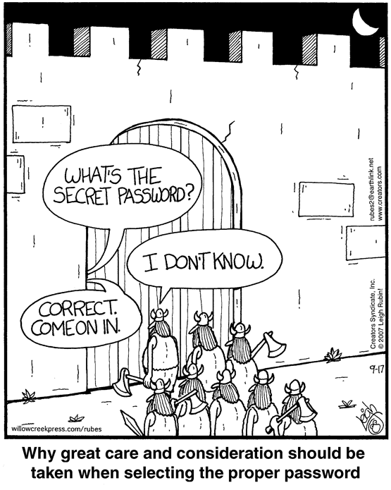
Security Software and Intrusion
CONCEPTUAL
Separate physical security system.
SCADA communicates with several systems.
Some systems have “air gaps” with WSDOT network.
Need to control who can get into the system.

Slide 29
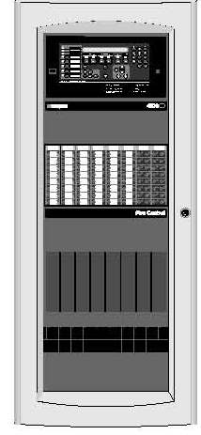
SCADAs Interface With Other Systems
SCADA Interfaces with:
Maintenance management.
Fire control.
Security.
Emergency phones.
Fire control system

Slide 30
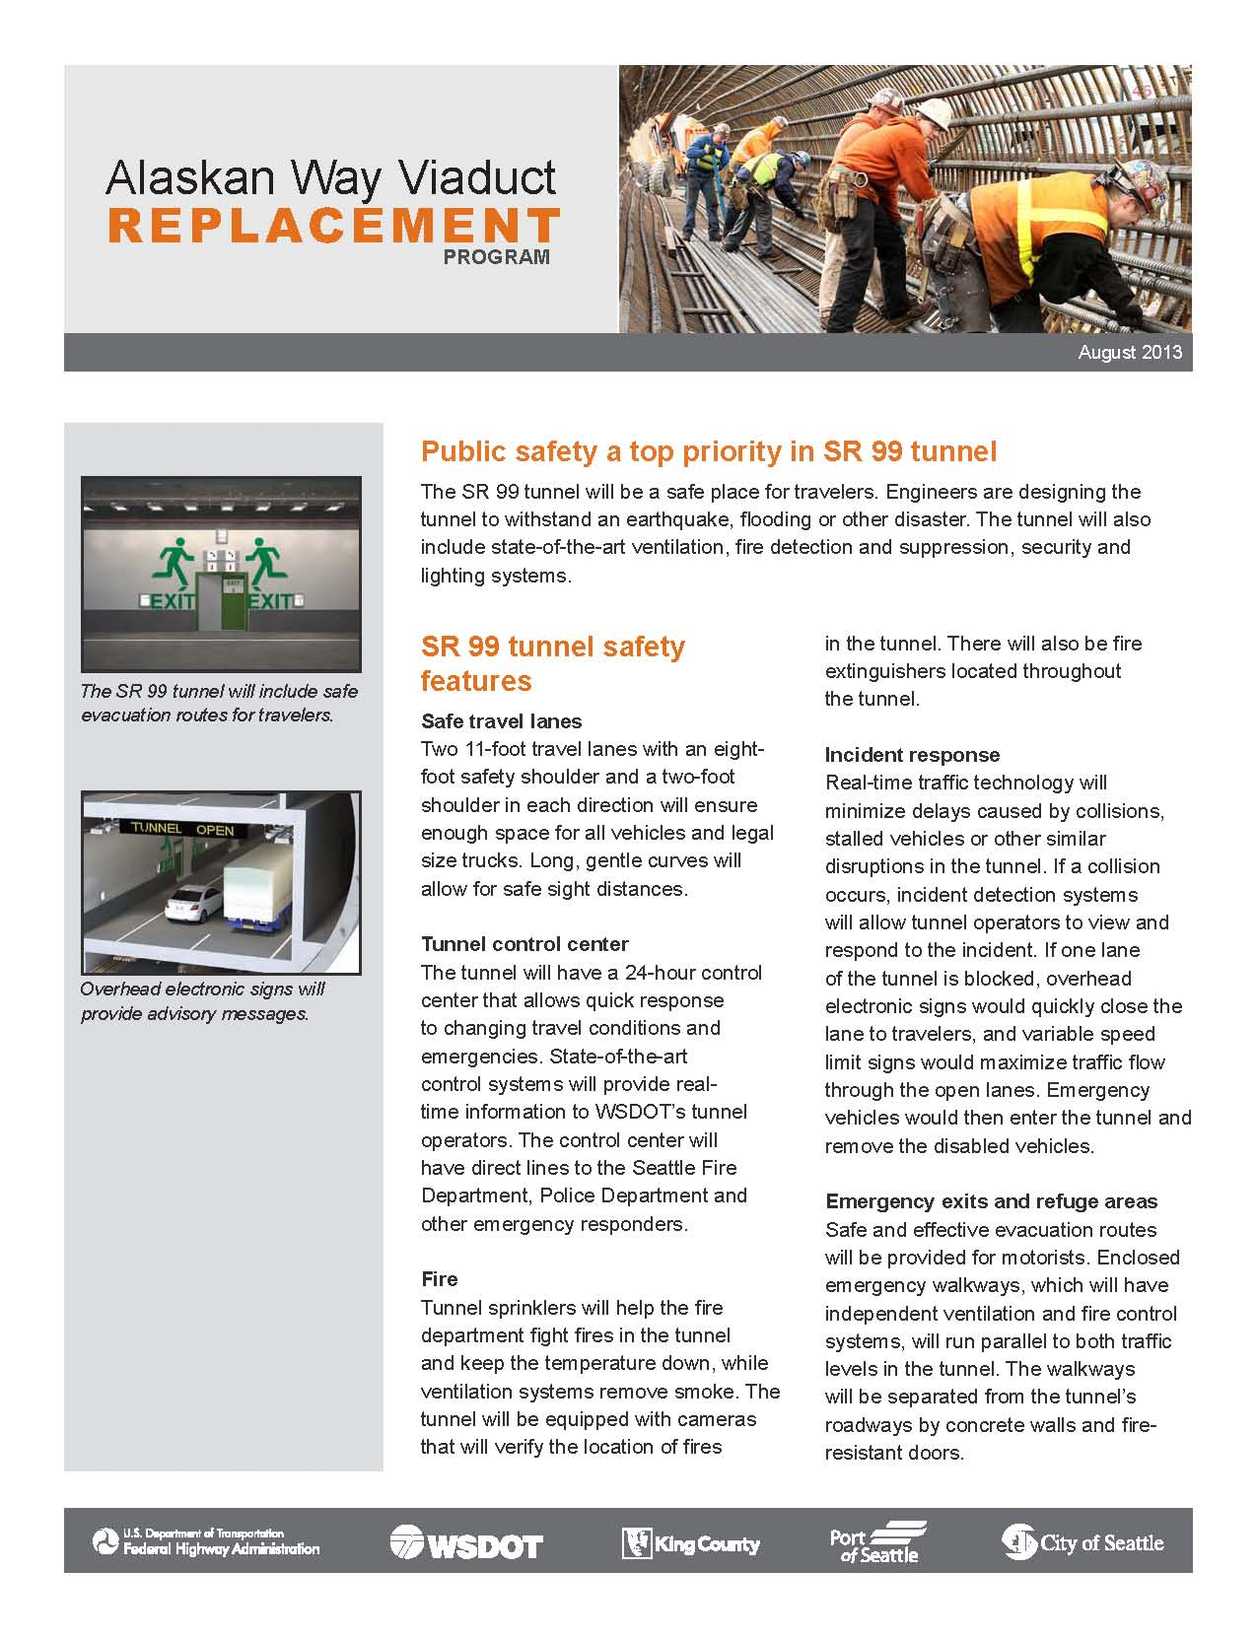
Public Information
FULL TIME STAFF PROVIDING INFORMATION TO A WORLDWIDE AUDIENCE
CONCEPTUAL
Project status.
Traffic impacts.
Tunnel design and construction.
Papers and presentations.
Tunnel safety features.
Tolling.
Emergency operations.

Slide 31
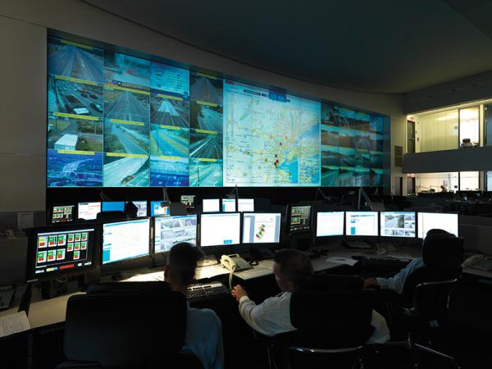
Commissioning Training and Emergency Responder
CONCEPTUAL
Commissioning matrix based on contract requirements.
Training plan outline is based on the response plans.
Emergency responders review all operation materials
Table tops and emergency responder walk-thrus.

Slide 32
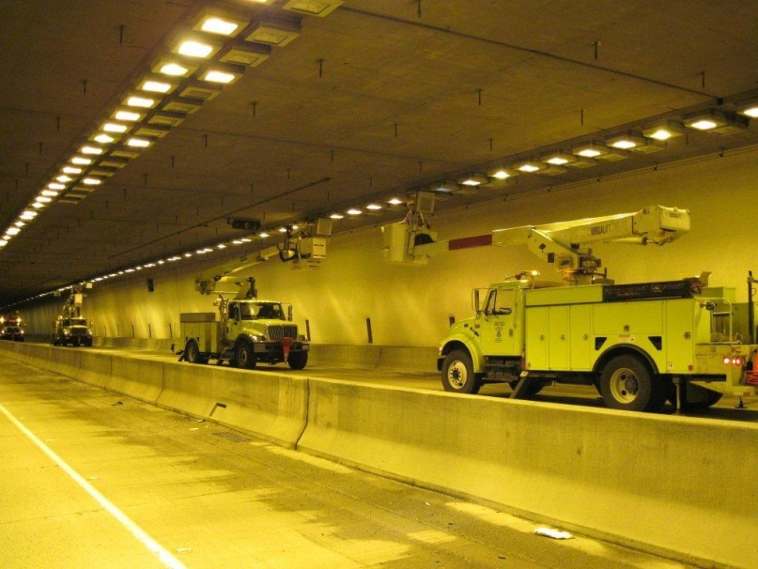
Life Cycle - Removal and Replacement - Operation Cost
CONCEPTUAL
Based on other tunnels WSDOT operates.
Permit requirements.
Few code requirements.
Storage of equipment.

Slide 33
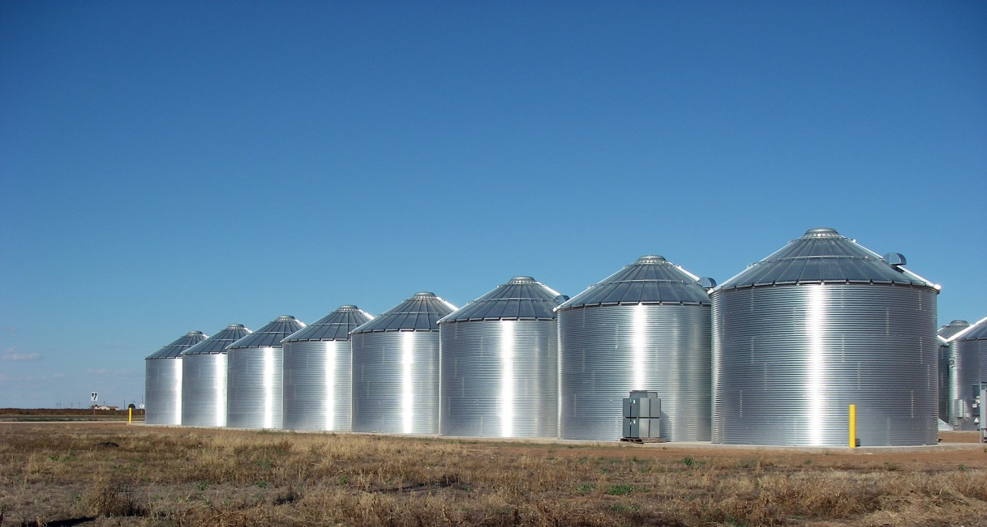
Decision Making Within Limited Budget
Program management.
Preventing silos.
Opportunity cost.
Safety first.
Operation cost.

Slide 34
CONCEPTUAL
Current Issues and Problems

Slide 35
Seattle Tunnel Partners’ Repair Schedule
April 21: STP announces new schedule
October: STP begins repairs to seal system and replacement of main bearing
March 2015: Tunneling resumes
Late May: Underground wall construction begins
February: Testing of machine begins
Late July: Access pit excavation begins
November: STP provides WSDOT with a full list of repairs
June 16: STP/Hitachi announce repair plan
April | May | June | July | Aug. | Sept. | Oct. | Nov. | Dec. | Jan. | Feb. | March
2014 | 2015
Seattle Tunnel Partners’ repair plan – May 2014

Slide 36
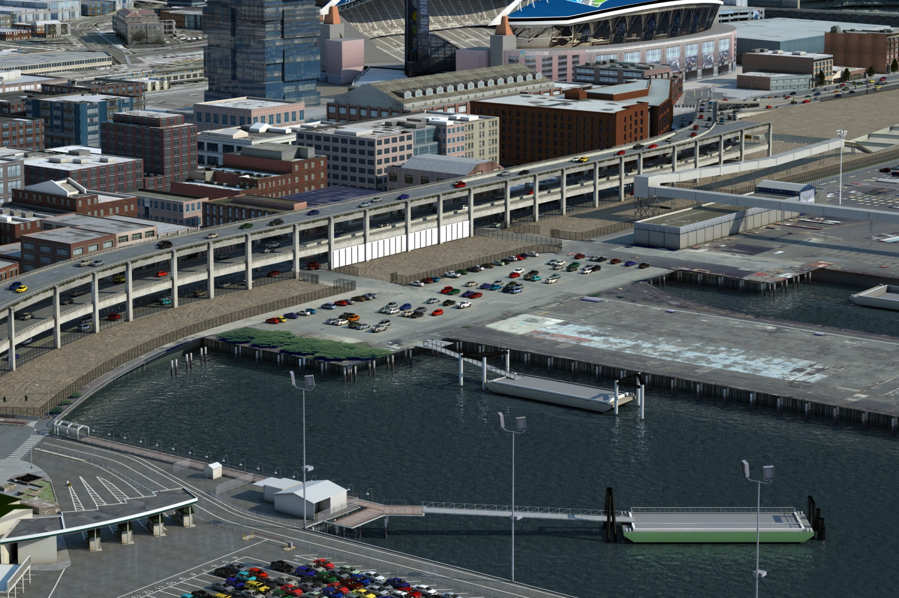
Access Pit Site Today, Above Ground
CONCEPTUAL
Seattle Tunnel Partners’ repair plan – June 2014

Slide 37
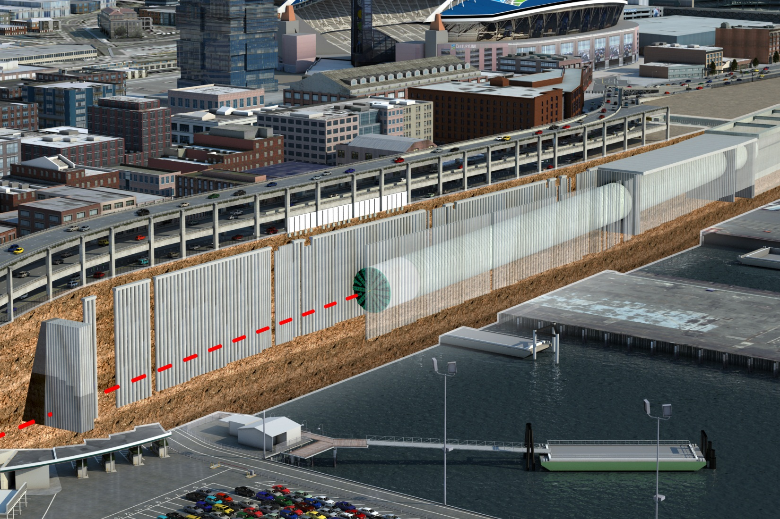
Access Pit Site Today, Below Ground
CONCEPTUAL
Seattle Tunnel Partners’ repair plan – June 2014

Slide 38
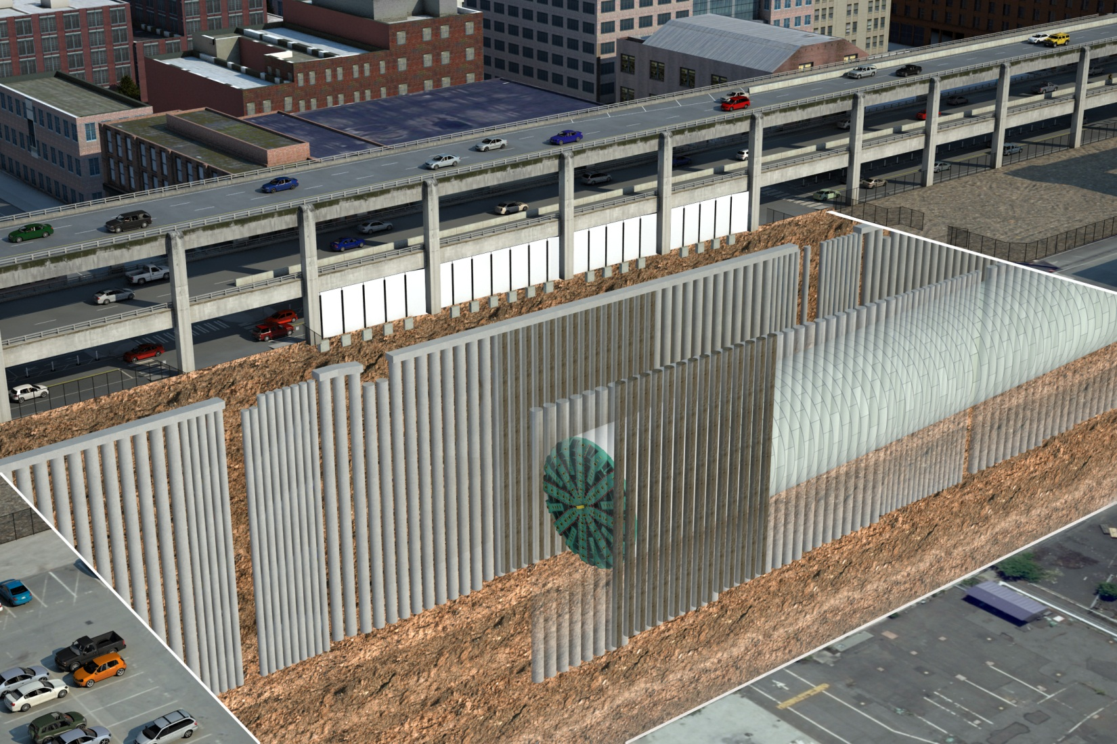
Inject Grout Between Existing Piles
CONCEPTUAL
Seattle Tunnel Partners’ repair plan – June 2014

Slide 39
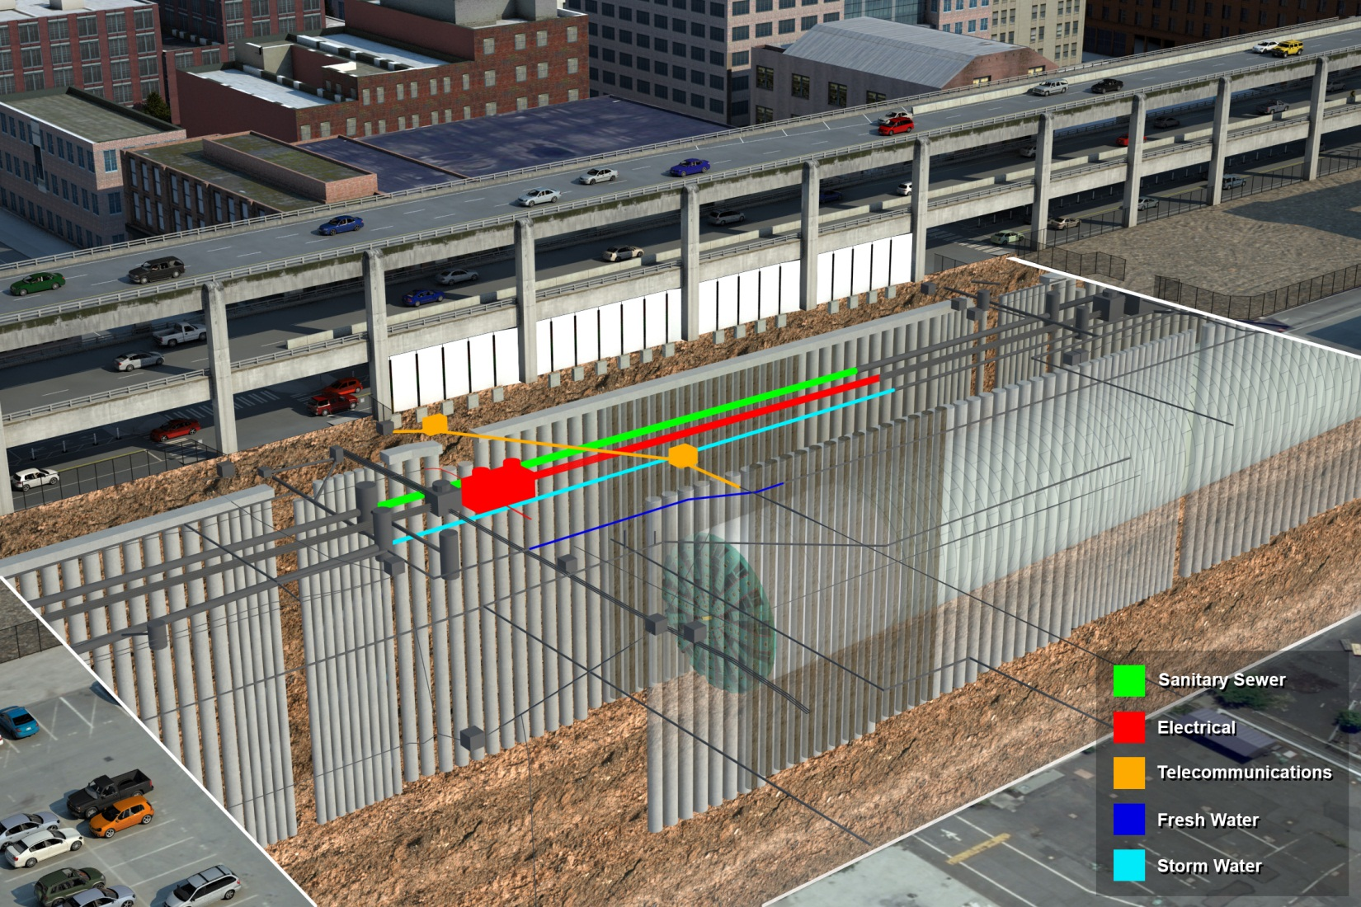
Relocate Utilities (Before)
CONCEPTUAL
Seattle Tunnel Partners’ repair plan – June 2014

Slide 40
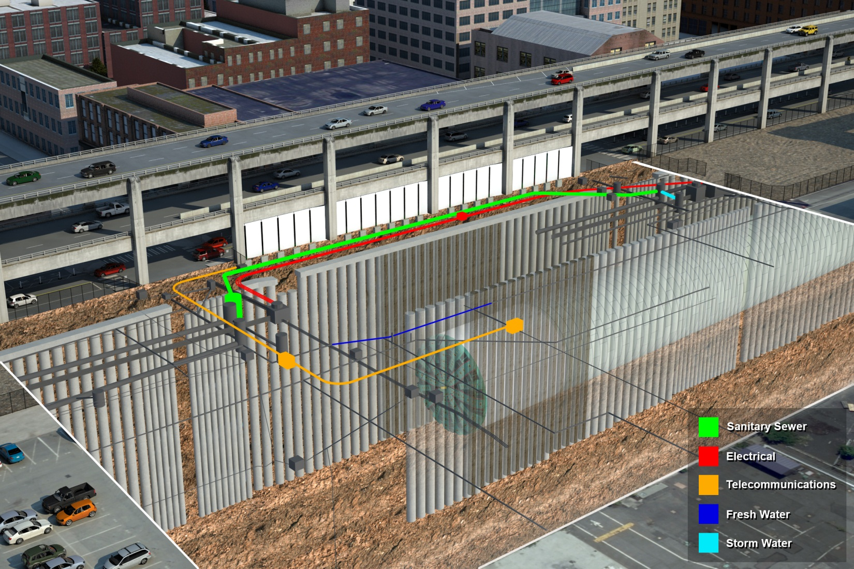
Relocate Utilities (After)
CONCEPTUAL
Seattle Tunnel Partners’ repair plan – June 2014

Slide 41
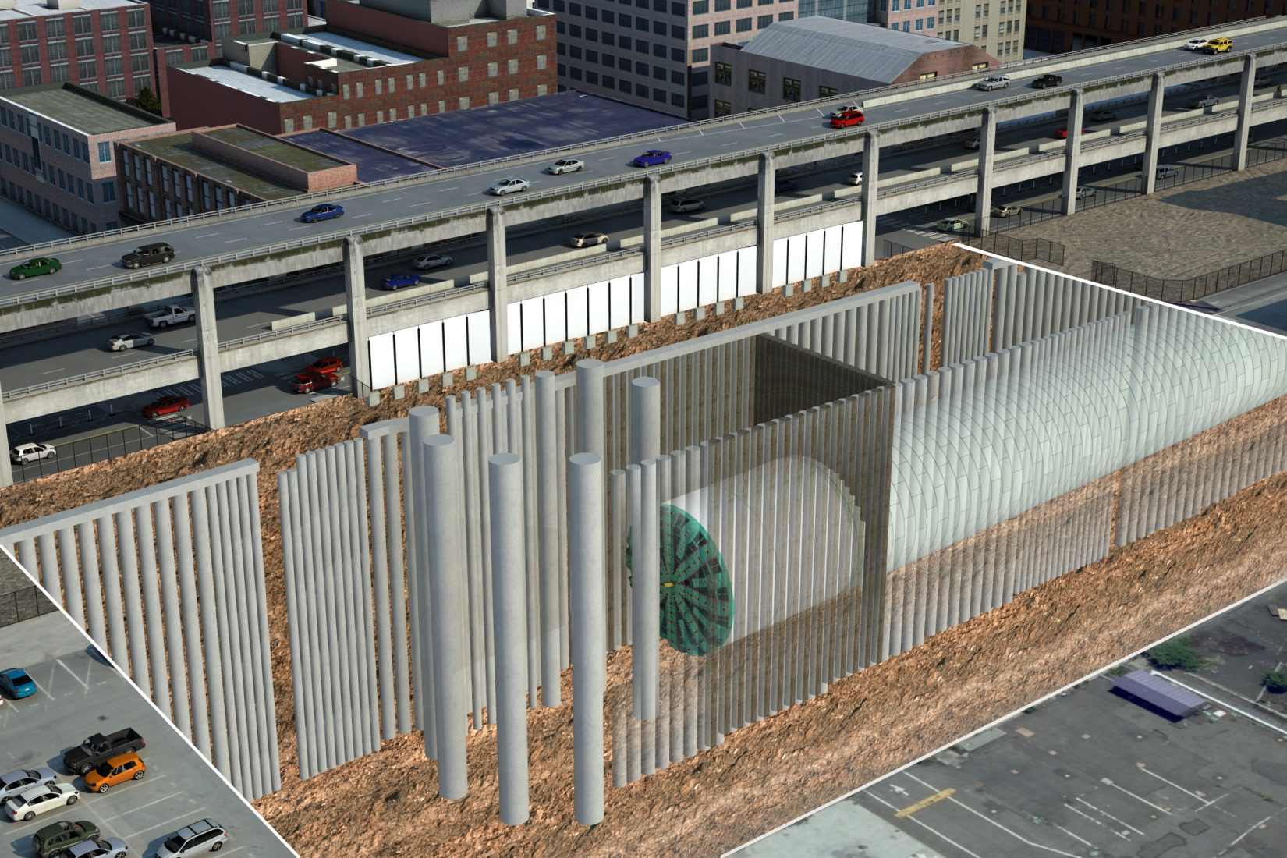
Build the Access Pit’s Walls
CONCEPTUAL
Seattle Tunnel Partners’ repair plan – June 2014

Slide 42
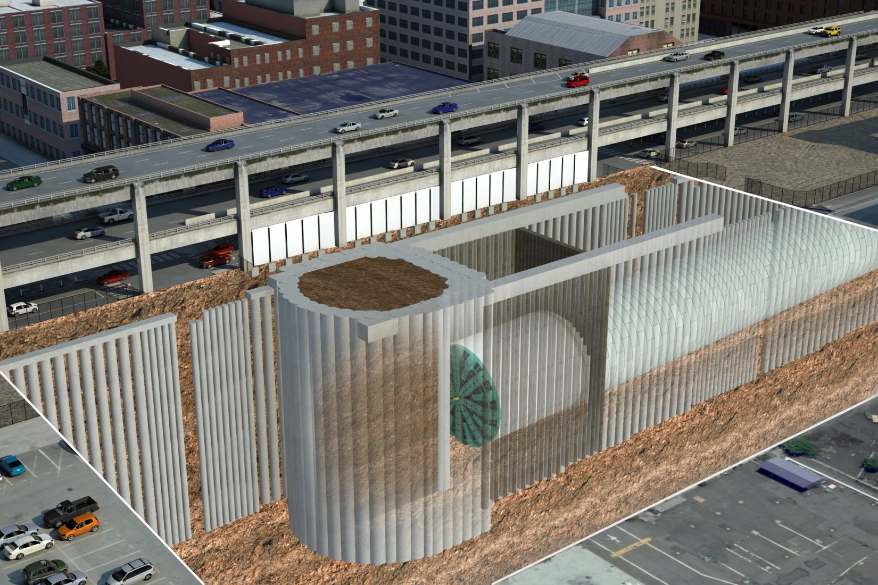
Build the Access Pit’s Walls
CONCEPTUAL
Seattle Tunnel Partners’ repair plan – June 2014

Slide 43
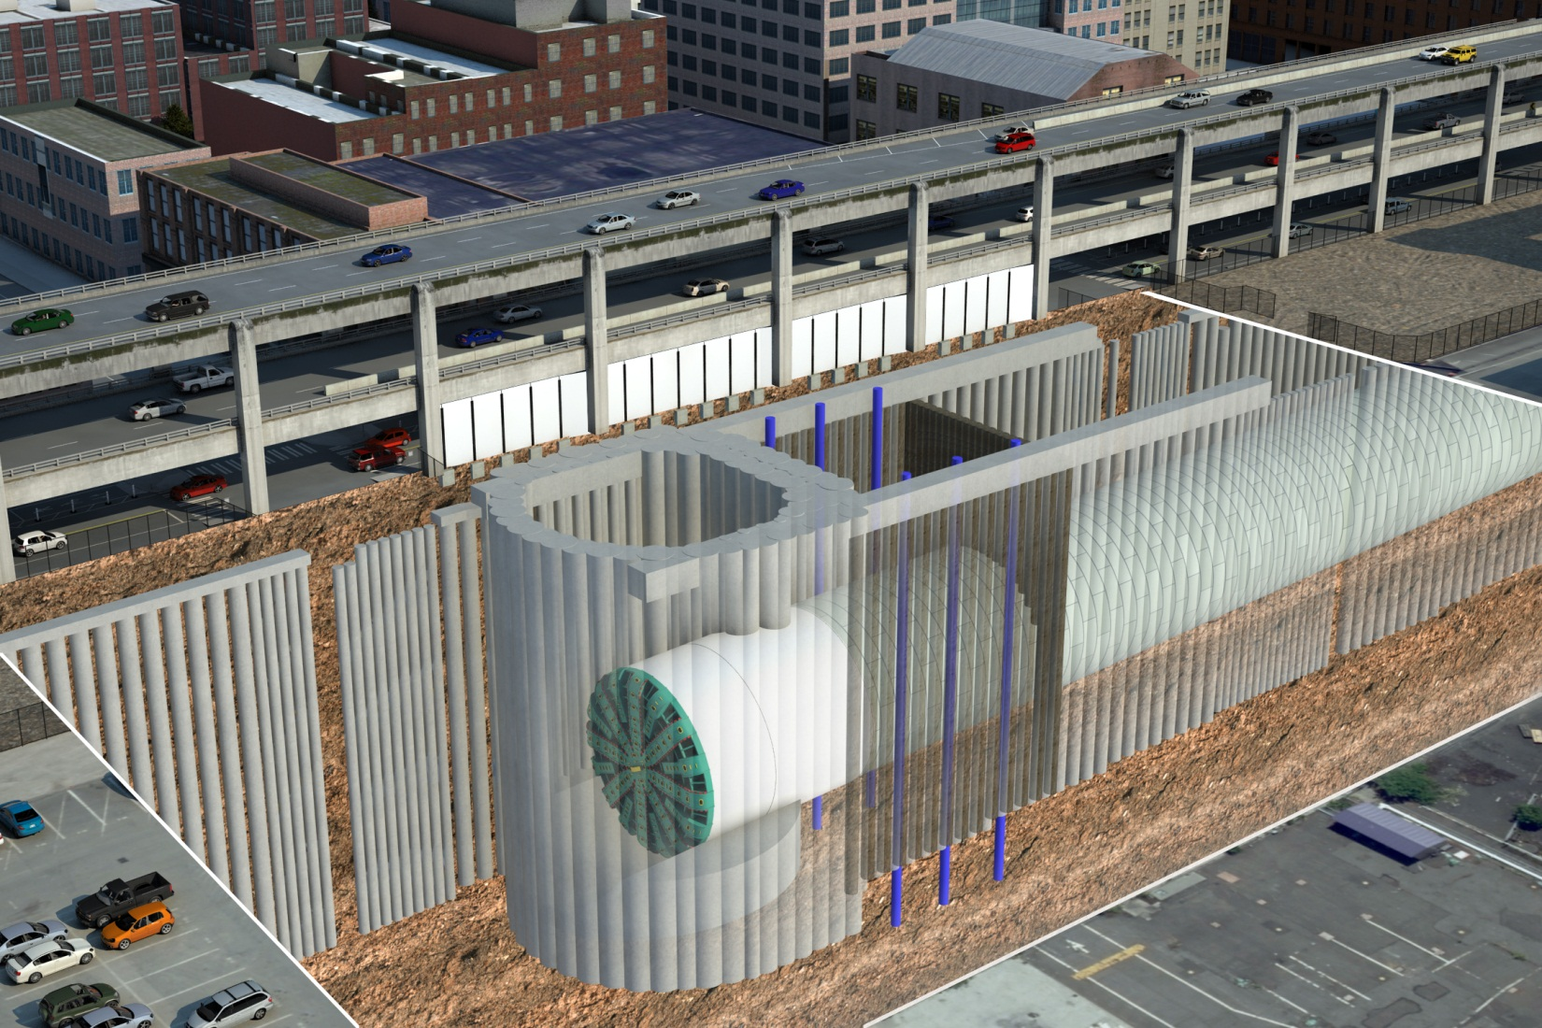
Excavate, then Tunnel into the Access Pit
CONCEPTUAL
Seattle Tunnel Partners’ repair plan – June 2014

Slide 44
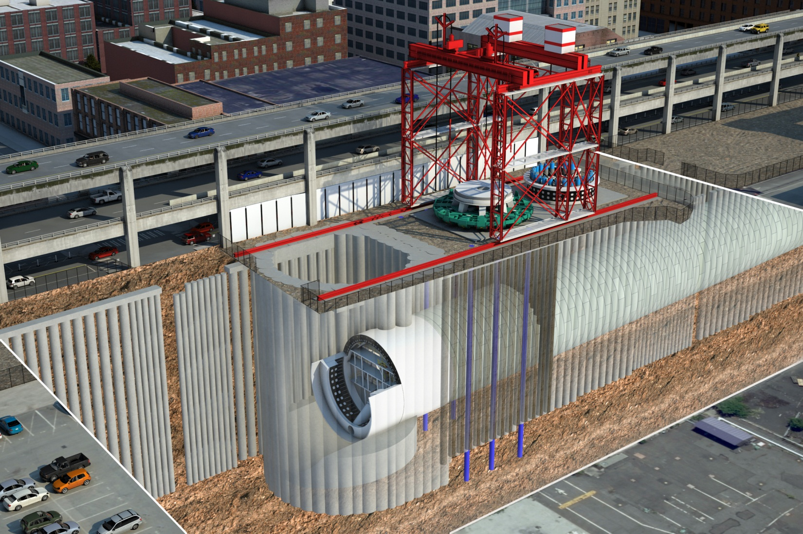
Remove Pieces, Make Repairs
CONCEPTUAL
Seattle Tunnel Partners’ repair plan – June 2014

Slide 45
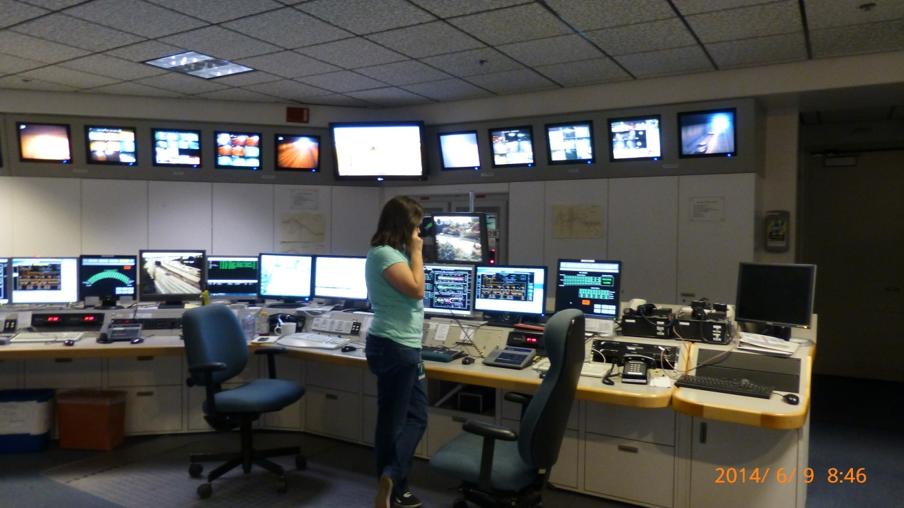
Integration Success Stories
CONCEPTUAL
Response plans.
Road alignment of Atlantic Street by-pass.
SCADA/Fire control interface.

Slide 46

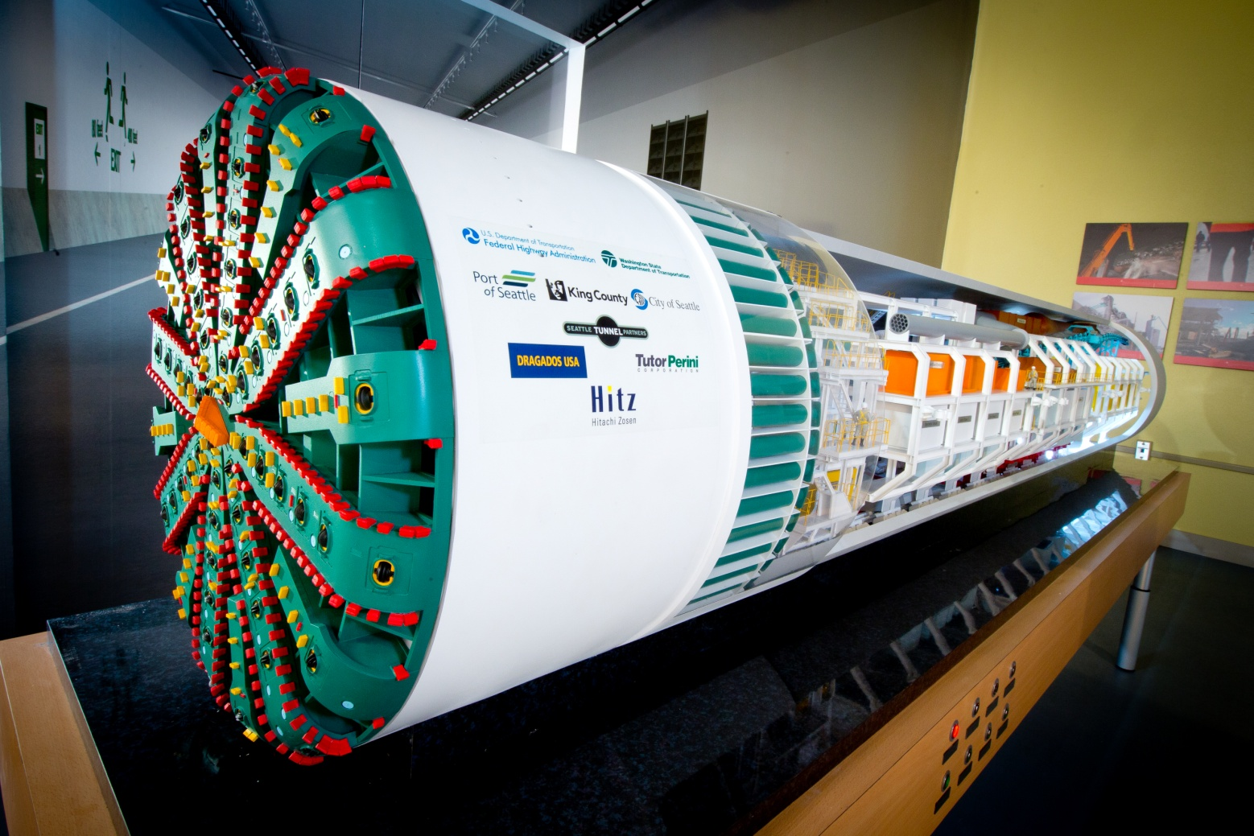
Website:
www.AlaskanWayViaduct.org
Twitter: @BerthaDigsSR99
Email:
viaduct@wsdot.wa.gov
Hotline:
1-888-AWV-LINE
Milepost 31 is located at 211 First Ave. S.

