Slide 1
Driving Configuration Management on the Road to Excellence
Welcome

Slide 2
Welcome to Seattle and the 21st Configuration Management Benchmarking Group annual conference
June 15-18, 2014

Slide 3
Alarm
Safety Tips
Announcement
Nearest Exit
Breaks
Restrooms
Network Opportunity

Slide 4
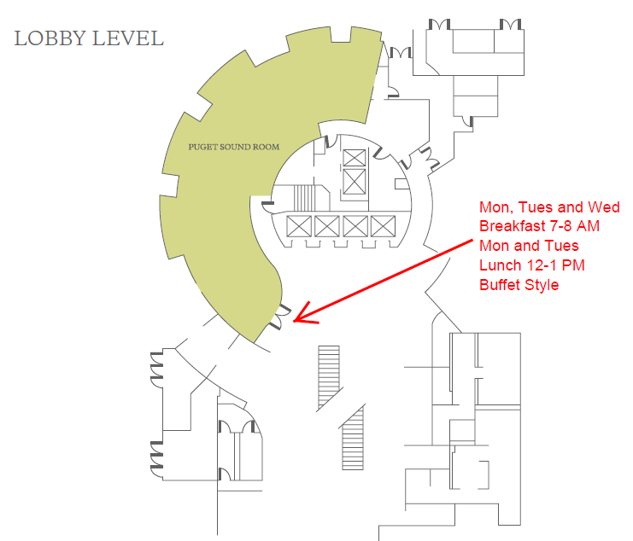

Slide 5
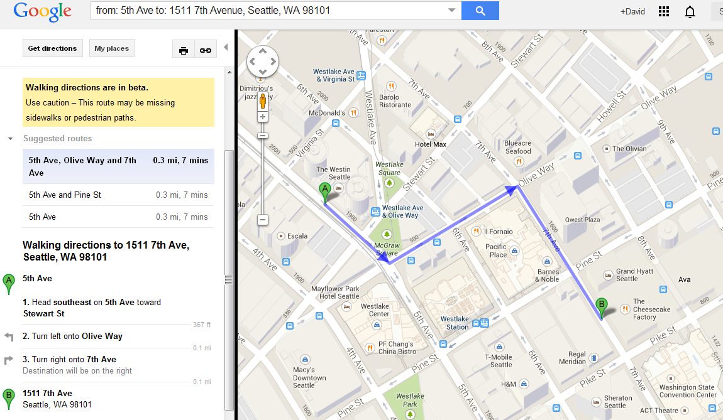
Mix and Mingle Buffet. TWO HOUR TIME PLAY CARD: Hourly cards are good on all games except games that give out tickets or prizes

Slide 6
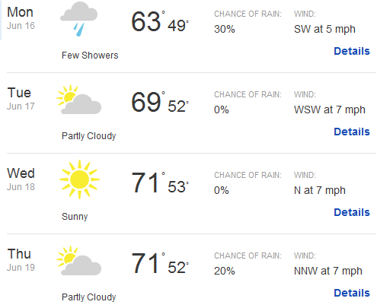
The Weather Outlook

Slide 7
84 Participants
2014 Conference Statistics
43 First time Attendees
5 Countries Represented
64 – United States
13 - Korea
3 - Canada
2 - Japan
2 – United Arab Emirates
Industry Oversight – INPO and NRC Representatives
CMBG Steering Committee

Slide 8
What’s in the Folder?
Hotel and Downtown Seattle Maps
Smart Phone Users – Bar Code App
www.knotis.com
Agenda
Conference Attendance
Presentation and Breakout Summaries for note taking
Nuclear Industry CMBG Principles and Practices
Nuclear Facility CM Survival Guide
2014 CMBG Conference Feedback Form

Slide 9
Dave Kettering
Energy Northwest
Design Engineering Manager

