Slide 1
INPO Update Configuration Management CMBG Meeting
June 16, 2014

Slide 2
Objectives
Overview of IER L1 14-20 – Integrated Risk and Healthy Technical Conscience
Overview of CM Department Activities , Focus Areas, and Initiatives
Recent trend in Intake Structure Blockages

Slide 3
Integrated Risk
High consequence, low probability, station operational and project risks that could affect the viability of the unit
Use of the term “risk” is complementary and broadens the usage of this same term with regards to Probabilistic Risk Assessment or Integrated Risk Management processes
Determination of acceptable risk is utility, station, and region-specific, and may change over time based on factors within and outside the control of the organization

Slide 4
Technical Conscience and Leadership
The personal obligation leaders and individuals internalize and exercise to ensure plant operation, maintenance, and engineering activities are conducted in a manner that upholds plant design requirements and preserves operating, design, and safety margins
Described fully in INPO 10-005, Principles for Maintaining an Effective Technical Conscience

Slide 5
Inputs Considered - Industry
Topic in November 2013 CEO Conference
Several stations met at INPO in January 2014 to find common lessons learned
Engineering VPs commented extensively
Several engineering vendors provided comments
CNO Advisory Committee reviews
EAG Briefed and provided comments

Slide 6
Inputs Considered - Events
Crystal River Containment Delamination
Cook LP Turbine Failure
Ft. Calhoun Breaker Fire and Design Bases Extended Shutdown
St. Lucie MSIV Failure
Wolf Creek Unexpected Power Increase
*Multiple events with engineering errors were also reviewed but not documented

Slide 7
Common Lessons Learned

Slide 8
Common Lessons Learned
Integrated Risk: Identification, Assessment & Mitigation
First-of-a-Kind / First-in-a-While Projects
Technical Expertise Not Available or Kept Proficient
Critical Design Requirements & Margins Not Understood
Testing Not Used to Address Uncertainties
Engineering Vendor Insights

Slide 9
Recommendations

Slide 10
Rec. 1 – Integrated Risk Strategies
Formal risk reviews of projects to look at project, operational, and enterprise risk including
Application of new methods, models, or techniques
Use of First-of-a-Kind or First-in-a-While equipment/techniques
Proficiency of corporate, station, and vendor experts
Affect on design basis and design margins
Project management team proficiency and rigor
Adequacy of bridging / mitigating strategies
Senior oversight and key decision challenges

Slide 11
Rec. 1 – Integrated Risk Strategies
Governance so that risk/adverse consequences communicated to senior corporate executives
Determine level of the organization approval needed for project reaching a risk threshold.

Slide 12
Rec. 2 – Healthy Technical Conscience
Self-assessment to determine degree of organization’s technical conscience
Assessment will include processes and behaviors
Periodic training on the principles
Use of INPO 10-005, Principles for Maintaining an Effective Technical Conscience

Slide 13
Rec. 3 – Engineering Vendor Oversight
Adhere to sound project management fundamentals and clearly define vendor expectations
Transmit achievable objectives, hold supplier accountable for meeting them
Access technical and project management expertise
Oversight supports event reporting and transparency

Slide 14
Integrated Risk Discussion
IER 14-20 Rec 1 (Projects)
IER 14-20 Rec 2 (Healthy Tech Conscience)
IER 14-20 Rec 3 (Vendors)
IER 13-10
SOER 10-2 Rec 1B
Margin Management Program
System Health Reporting
Plant Health Committee
Corrective Action Process

Slide 15
Assessment Plan & Activities
Rec. 1 – INPO Corporate Evaluations
Rec. 2-3 – INPO Plant Evaluations
Webcasts April 15, May 13, and ~June 19
Working Group to develop response template
Inform INPO of corrective action plans within 150 days if issue date*
Hold collaborative review
Information sharing on website
Working closely with NEIL and a parallel effort they have underway
* per INPO 10-006

Slide 16
CM Department Update
June 16, 2014

Slide 17
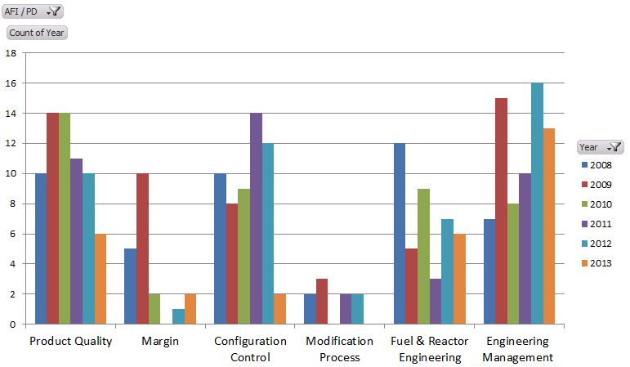
EN & CM Evaluation Trends
Number of AFIs

Slide 18
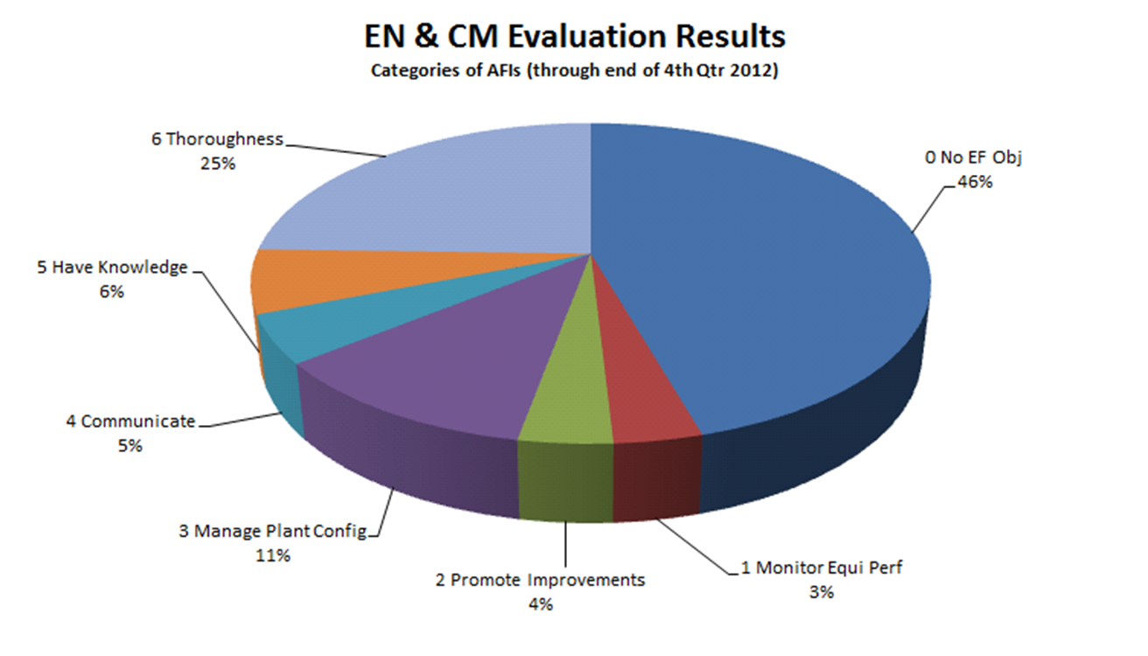
Engineering Fundamentals in AFIs

Slide 19
Department Initiatives
Focus Areas
Vendor Engagement / Oversight
Digital / Cyber Security
External Events / Seismic
PSA and Nuclear Risk Management (new)
Advanced Engineering Training Activities
Accident dose consequence
HELB
Flooding
Tornadoes
Protective relay
* per INPO 10-006

Slide 20
Department Initiatives (Cont)
WANO Interactions
New Evaluation Approach for Design
Principles of Managing Design Basis
Startup Review Visits
ALNOTTS
Renewed Focus on Outliers
Cumulative Effects Efforts
System / Program Health Reports
Engineering Work Management
Human Performance

Slide 21
Department Changes
Technical Conscience Principles
Human Performance
Staffing / Organizational Changes
TSG Responsibilities
Fuel / Rx Engineering
Department Manager

Slide 22
2014 Department Meetings
New Engineering Directors – July 8
Engineering Directors – July 9-10
Design Engineering Managers – July 29-30
PRA Engineers Forum – August 12-13
Engineering VP Meeting – October 28-29
* per INPO 10-006

Slide 23
Industry Trend Update: SOER 07-2 Intake Structure Blockage
June 16, 2014

Slide 24
Adverse Data Trend
Only if applicable – if so, provide data

Slide 25
Adverse Data Trend
Only if applicable – if so, provide data

Slide 26
Adverse Data Trend
Only if applicable – if so, provide data

Slide 27
Continuing Issue
Recommendations from SOER 07-2, Intake Structure Blockage, have not been effective in preventing intake structure blockage and subsequent forced generation losses in some cases.

Slide 28
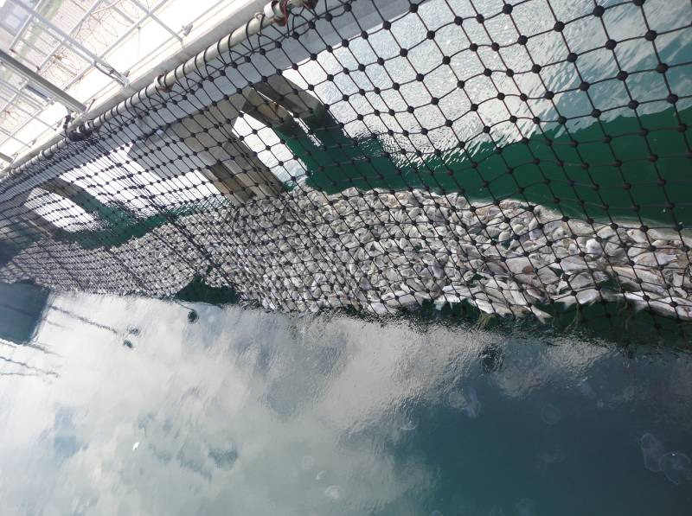

Slide 29
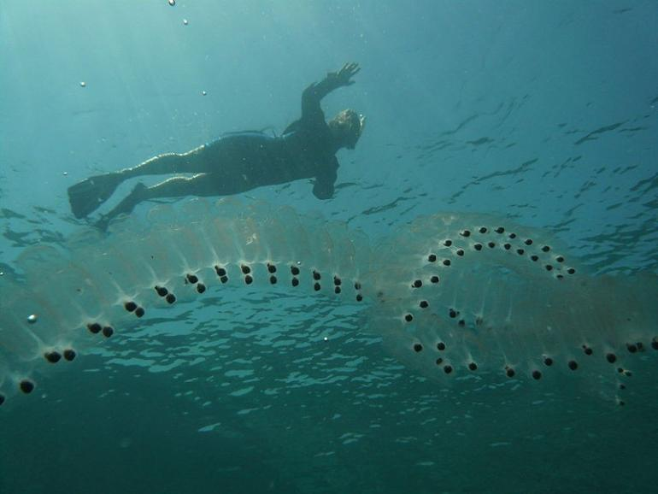

Slide 30
Safety Impact
Intake structure blockage events challenge operators with transients and degrade the normal heat removal path.
The safety related heat sink can be impacted (Maanshan 2, loss of ultimate heat sink for 93 minutes)

Slide 31
Questions?

