Slide 1
Industry Shaping Event 1996 Millstone Loss of Configuration Management
Robert Gambrill
Manager Engineering & Configuration Management

Slide 2
Objectives
Identify how latent Configuration Management weaknesses from original plant construction were identified at Millstone.
Understand the causes for loss of Configuration Management.
State industry actions required to assure Configuration Management.

Slide 3
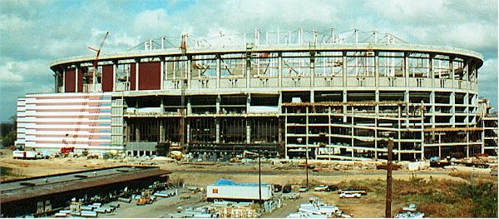
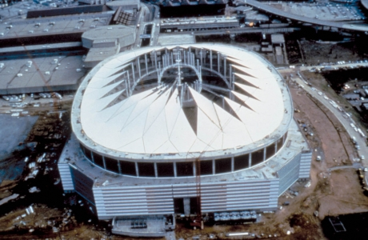
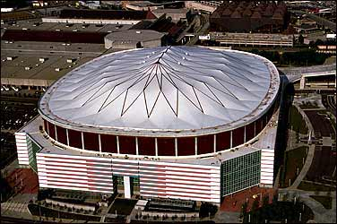
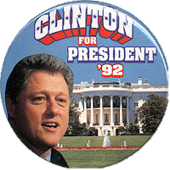
1992

Slide 4
Tidbits of 1992
Interest Rates: 6.00%
Gallon of Gas: $1.05
Famous Movie Quote: "You can't handle the truth!"- Jack Nicholson, in 'A Few Good Men‘
Cost of a Superbowl ad in 1992: $850,000

Slide 5
Who Is This Person?
Notes:
Next slide

Slide 6
Loss of Configuration Management

Slide 7
Who Is This Person?
1992 – He Identified a Nuclear Safety Concern On Spent Fuel Capability to Handle a Full Core Offload?

Slide 8
TIME© Magazine, March 4, 1996
Millstone Unit 1 Safety Concerns:
Full Core off loads performed contrary to licensing requirements
Fuel moves did not wait required 150 hours
Spent Fuel Pool not analyzed for Full Core heat load

Slide 9
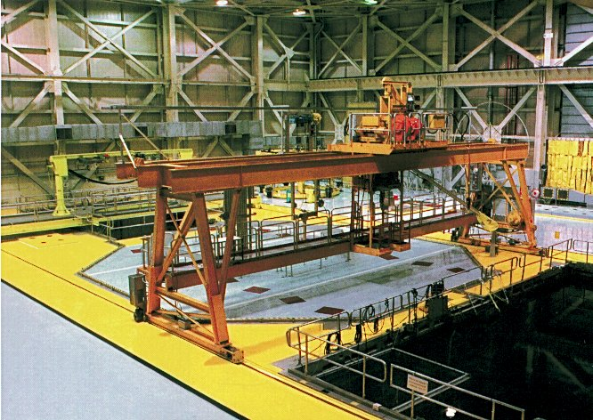
Millstone Unit 1
BWR Mark I
Containment
660 MW electric
Commercial Operation - December 28, 1970
Last Operated November 5, 1995
Permanently Shutdown July 17, 1998
Not Financially Viable to Recover CM

Slide 10
All Three Millstone Units Were Shutdown Due to Loss of CM
Unit 1 – November 1995 (never restarted)
Unit 2 – February 1996 to March 1999
Unit 3 – March 1996 to July 1998
NRC Watch List in January 1996
NRC approval to restart was required

Slide 11
Tidbits of 1996
Interest Rates Year End Federal Reserve 8.25%
eBay was started
Minimum wage: $5.15/hour
Famous Movie Quote: "Show me the Money!" - Cuba Gooding, Jr., in 'Jerry Maguire‘
‘ER’ was the #1 TV show

Slide 12
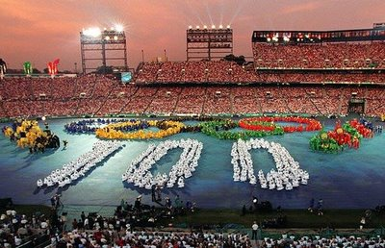
1996

Slide 13
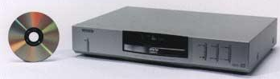
1996

Slide 14
CM Equilibrium Diagram for Millstone Pre-1997
Design Requirements
What is required to be there
Inaccurate or Missing
Facility Configuration Information
What is said to be there
Physical Configuration
What is there

Slide 15
Primary Factors Contributing to Loss of CM
Leadership identified as the primary reason for declining performance:
High standards not set and maintained
Clear accountabilities not established
Inefficient processes
Failure to identify true root cases

Slide 16
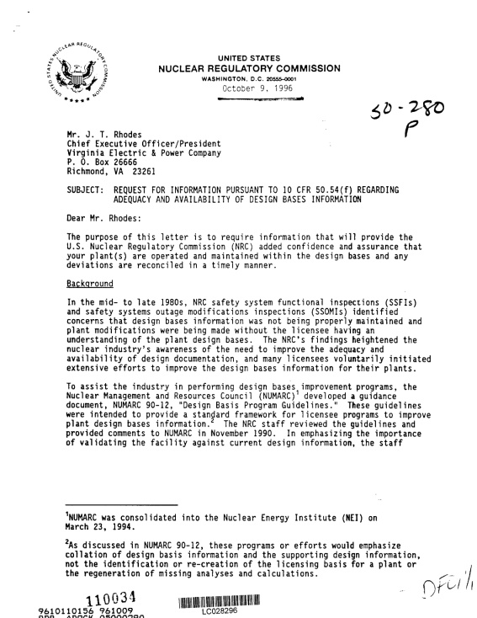
NRC 10CFR50.54(f) Letter
On October 9, 1996 the Nuclear Regulatory Commission issued a letter to every Nuclear Utility in the US entitled, "Request For Information Pursuant To 10 CFR 50.54 (f) Regarding Adequacy And Availability Of Design Bases Information"

Slide 17
Each utility was required to provide:
Description of engineering design and configuration control processes
How you know that design basis requirements are correctly translated into operating, maintenance, and testing procedures
How you know that system, structure, and component configuration and performance are consistent with design bases
Corrective Action process effectiveness for problem identification and resolution
Effectiveness of current processes to ensure the plant configuration is consistent with the design bases

Slide 18
1999 – Millstone configuration management recovery completed with the restart of Unit 2.

Slide 19
Tidbits of 1999
The human population of the world surpassed six billion
The initial release of Napster
Famous Movie Quote: 'Is that your final answer?'- Regis Philbin, on Who Wants To Be A Millionaire?
Cost of a Superbowl ad in 1999: $1,600,000

Slide 20
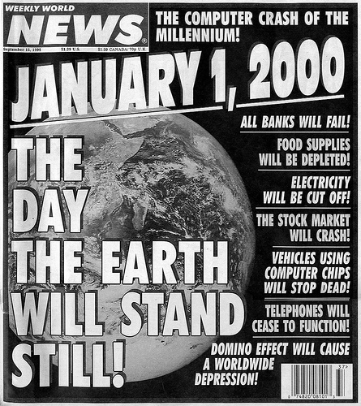
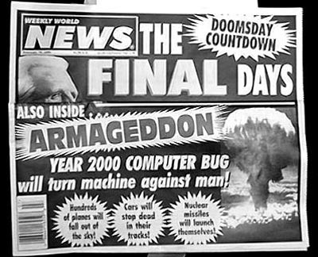
1999

Slide 21
Millstone CM Recovery Activities Required Prior to Restart
Costs: Over $100 Million spent for CM recovery
$10 Million in regulatory fines

Slide 22
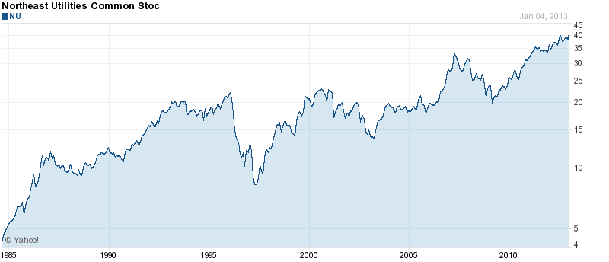
Loss of Configuration Management
Millstone Affect on NU Stock Price
TIME Magazine Article
Millstone Sale Agreement
NRC Watch List
All 3 Units Shutdown
NU stock price dropped from around $25 to $7

Slide 23
Extended Plant Shutdowns for CM Recovery
Examples:
Millstone Unit 2 over 3 years
Millstone Unit 3 over 2 years
DC Cook over 2 years

Slide 24
Questions or
Comments?

