Slide 1
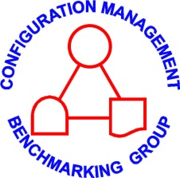
Configuration Management
Fundamentals
Kent R. Bjornn
Palo Verde - APS

Slide 2
Configuration Management Fundamentals
CM Equilibrium – What is it?
CM History
Equilibrium Upsets
CM Process Model & Equilibrium Restoration
Using CM to protect Design and Operating Margins
An Individual’s CM Responsibilities
Examples - Letting CM get out of Control is Costly
  Borrowed extensively from previous presenters

Slide 3
1 – CM Equilibrium

Slide 4
CM - What
The objective of CM is the conformance of the three elements represented by the CM Equilibrium Model
Design
Require-ments
Physical
Config
Facility
Config
Info
In its simplest terms –
Configuration Management (CM) is what we do to assure ourselves and our regulators that we are doing everything we said we would do for Design, Operation, & Maintenance of the plant.

Slide 5
CM - What
Keep the 3 elements consistent - in equilibrium
Processes connect & work within the elements
Design
Requirements
What needs to be there.
Physical
Configuration
What is actually there.
Facility Configuration
Info
What we say is there.

Slide 6

What is CM Equilibrium?
“Трехэлементная диаграмма”
speaking the same language... in any language
Требования к проекту
Что должно туда входить
Рабочие процессы должны обеспечивать:
Постоянное соответствие элементов
Авторизацию всех изменений
Проверку соответствия
Физическая станция
Что там имеется на самом деле
Данные по конфигурации объекта
Что там имеется
Каждый из этих пунктов представляет важную концепцию!
Рабочие процессы должны обеспечивать:
Постоянное соответствие элементов
Авторизацию всех изменений
Проверку соответствия
Notes:
Slide from presentation in Russian in March 2001
Same slide used in US to train on the Objective of Configuration Management

Slide 7

What is CM Equilibrium?
speaking the same language... in any language

Slide 8
CM – What – Req 1/6
Design
Require-ments
Requirements - technical requirements derived from external sources or self imposed that dictate the final design.
Physical
Config
Facility
Config
Info
What Needs to be there
  Design characteristics and bounding parameters needed for the design to work
  Includes Owner requirements via contract
  Must be verified or monitored to confirm that design is valid & continues to be valid

Slide 9
CM – What – Req 2/6
Regulatory Requirements
  Requirements imposed by federal, state, and local jurisdictions, including NRC (e.g. GDCs), EPA, OSHA.
  Commonly for the reactor system (Unit) as a whole
    Requirements also apply to components, but are usually derived from higher level design information
Notes:
Regulatory comparison – NRC is more performance based. They provide a set of requirements based on performance – what the system will do, not how it will be built. Whereas OSHA and others are much more compliance based – the hand rail will be x” high, with a diameter of y”, there will be a middle rail. Some part of DHS fined a company $10,000 because they used the wrong word in the title of a required report – rather than reject and say try again.
These are generally requirements for the site as a whole. The same 3-ball model can apply to a particular component, but the requirements are not usually based on GDCs, but rather on the higher level design information → given that we have a CE plant with a SI system to accomplish a certain function then the requirement for the LPSI pump is ___.
What is difference between Regulatory Design & License requirements?
Design requirements based on regulation are not really changeable.
License is specific to particular site and can be changed
Example: To drive I need to know how and be able to control a car. I also need a license that has specific conditions (commercial, corrective lenses). License can be changed – I have Lasik surgery and don’t need spectacles – change the license. Still need to meet basic design regulatory requirements.

Slide 10
CM – What – Req 3/6
License & Permit Requirements
  What is difference between Regulatory design requirements and License requirements?
    Both are legal requirements
    Regulatory – applies broadly (nation), very difficult to change
    License – specific to site, can be changed
    Difference is meaningful when solving CM upsets
  Specific for a site to be allowed for Operation
    NRC License
    Environmental Permit (air & water releases)
    OSHA & ADOSH → VPP
Notes:
Regulatory comparison – NRC is more performance based. They provide a set of requirements based on performance – what the system will do, not how it will be built. Whereas OSHA and others are much more compliance based – the hand rail will be x” high, with a diameter of y”, there will be a middle rail. Some part of DHS fined a company $10,000 because they used the wrong word in the title of a required report – rather than reject and say try again.
These are generally requirements for the site as a whole. The same 3-ball model can apply to a particular component, but the requirements are not usually based on GDCs, but rather on the higher level design information → given that we have a CE plant with a SI system to accomplish a certain function then the requirement for the LPSI pump is ___.
What is difference between Regulatory Design & License requirements?
Design requirements based on regulation are not really changeable.
License is specific to particular site and can be changed
Example: To drive I need to know how and be able to control a car. I also need a license that has specific conditions (commercial, corrective lenses). License can be changed – I have Lasik surgery and don’t need spectacles – change the license. Still need to meet basic design regulatory requirements.

Slide 11
CM – What – Req 4/6
Effective Methods for Engr, Ops & Maintenance
National Codes, Standards, & Regulatory Guides
Lessons learned by society over years
  Are Codes & Standards regulatory requirements?
    Usually not, but see 10 CFR 50.55a
  Are Regulatory Guides requirements?
    Only as we make them so by committing to them →
    License requirement
  Why do we make these legal or practical requirements?
    Learn from others - Economic choice to conform instead of “reinvent the wheel”
    Easier for regulatory compliance

Slide 12
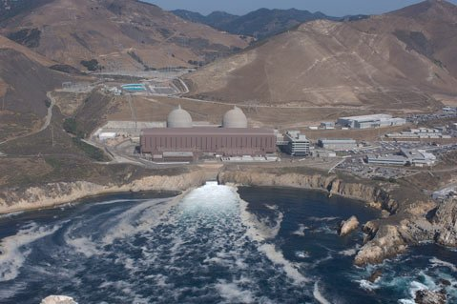
CM – What – Req 5/6
Business Needs
  Size of reactor in electrical power, cooling method
  Economies of scale
  Corporate policies and standards
Notes:
Business Needs An example of design is that some sites have two reactor. They are mirror image plants and maybe even share the same control room. Diablo Canyon & Calvert Cliffs

Slide 13
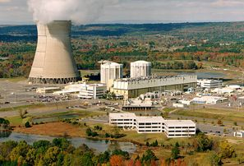
CM – What – Req 6/6
Management Wishes
  Management style
  Plant aesthetics
Notes:
ANO – VP wanted the containment dome of the CE plant to match the already built containment for the B&W plant – nice aesthetics to have symmetric domes.
Result – CE containment is smaller than really desired → smaller PZR to fit into smaller containment → harder to be able to handle transients

Slide 14
CM – What – FCI 1/1
Design
Require-ments
Facility Configuration Information (FCI) is documentation & data that defines/describes how the plant is designed, operated, & maintained.
3 major pages – Engr, Ops, Maint
Physical
Config
Facility
Config
Info
What we say is there
  Design Output Docs – drawings, specifications, calcs
  Operations Docs – Ops procedures
  Maintenance – maint procedures, WO instructions
  Training and Procurement Information
Notes:
FCI for the plant as a whole includes DBMs.
Any of these may be in a database or other electronic format or hard copy

Slide 15
CM – What – Physical 1/1
Physical Configuration - actual physical location, arrangement and material condition of SSCs
Design
Require-ments
Physical
Config
Facility
Config
Info
What is actually there
  SSCs installed (design)
  SSC position (operating configuration) (valve is open/shut, motor is/is not running)
  SSC condition – equipment reliability
  SSCs include electrical, chemical, mechanical properties, liquids & coatings, and computer hardware & software.

Slide 16
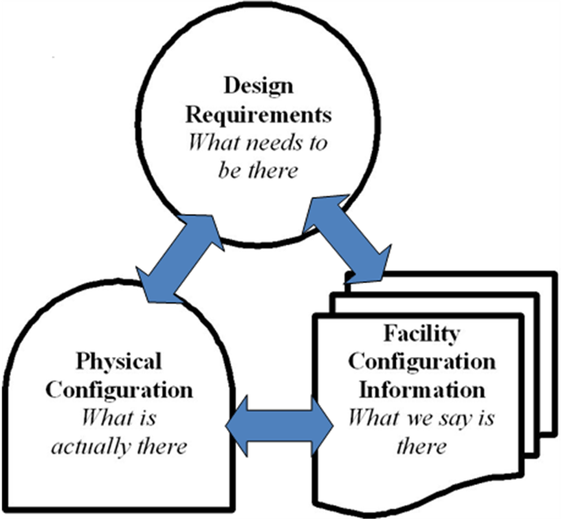
Industry standards: ASME, ANSI, IEEE
Corporate policies & standards
Configuration Management process of maintaining physical plant and documents to support plant operation consistent with design
EPA – OSHA Requirements
FMEA
TCAs
Time Critical Actions
Work processes must ensure that elements conform all the time, all changes are authorized, conformance can be verified
Margin Management
Temporary Changes - Compensatory Actions
Design Bases
Commitment Control
Some requirements shown are at the Plant level (e.g. NRC regulations), some are at the system level (e.g. Design Bases, TCAs) etc.
Licensing Bases
NRC Regulations
Design Output Documents, including drawings, vendor information, specifications, calculations, databases, test plans, etc.
SSCs - physical arrangement meets design configuration
A component’s electrical, chemical, and mechanical properties, coatings, and computer hardware & software, cyber security
Operational Configuration Documents, including surveillances, system alignment checks, procedures used to manipulate components, etc.
Other Operating, Maintenance, Training, and Procurement Information, including corrective & preventive maintenance process, maintenance procedures, training lesson plans, safeguards information, approved parts substitutes, procurement contracts, etc.
Component position meets operating configuration
SSC material condition

Slide 17
CM - What - Processes 1/2
Work Processes must assure that:
Elements conform all the time
CM Equilibrium is restored in a timely manner if the elements do not conform
All Changes are Evaluated and Approved
People are trained and qualified
Equilibrium conformance can be verified
Design
Require-ments
Physical
Config
Facility
Config
Info

Slide 18
CM - What - Processes 2/2
Work Processes are the administrative and management measures used to ensure the configuration is maintained. These processes include;
Design control
Document control – update docs with plant
Corrective Action Program (CAP)
Work management
Surveillance & test programs
Work protection isolation
Formal training
Assessments
Design
Require-ments
Physical
Config
Facility
Config
Info

Slide 19

CM Equilibrium for New NPPs 1/1
Virtual Plant
A computer-based information model environment formed by computer technology consisting of 2D (dimensional), 3D, 4D (time), 5D (cost), 6D (material) modeling other intelligent technologies along with data, databases, and electronic document sources.
Reduce FCI by transferring it to Virtual Plant
Design
Require-ments
Physical
Config
Facility
Config
Info

Slide 20
Configuration Management:
“It’s what you do now
When you don’t have to do anything
That let’s you be
What you want to be
When it’s too late to do anything about it.”
Warren Owen, Exec. VP Duke Power (Retired)
Notes:
This is a quote from a retired Duke Power executive that underscores the necessity of a questioning attitude and forward thinking required to make CM a success.

Slide 21
2 – CM History

Slide 22
Brief History of CM in Nuclear 1/9
Configuration Management in military and aerospace industry geared towards product conformance to facilitate interchangeability of parts while still satisfying the overall design requirements
MIL-STD-973 (1992), ”Configuration Management” (later replaced by ANSI/EIA-649-1998)
Notes:
First couple of slides are focused on U.S. government CM initiatives. Military CM started in the post WWII era of jet aircraft development.
Many contractors and parts manufactures involved. Rapidly evolving designs.

Slide 23
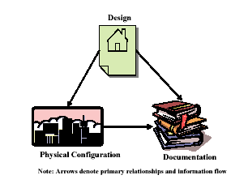
Brief History of CM in Nuclear 2/9
DOE STD 1073-93 “Configuration Management”
Applicable to DOE nuclear facilities in the operational phase.
DOE-STD-1073 was updated in 2003
Notes:
DOE had numerous facilities for handling nuclear materials and needed to define controls of the processes to change these facilities.
This became the early model for nuclear CM

Slide 24
Brief History of CM in Nuclear 3/9
Nuclear plants in mid 60’s to early 80’s typically designed by AEs under contract
Final design documents typically turned over to the utility at the end of construction
Little knowledge transfer of design info to utility engineering organization
Utilities struggled with long term design maintenance and related document upkeep
Documents dumped into Records
Notes:
Commercial nuclear power
Not much structure – Get the documents and dump them into Records
Anyone in the audience under the age of 35. Probably never seen a “Velum Drawing”

Slide 25
Brief History of CM in Nuclear 4/9
Early indicators that the nuclear plant design basis knowledge was becoming disconnected from the physical plant
IE Bulletin 79-14 uncovered
  calculation discrepancies
  undocumented modifications
  document discrepancies
  as-built problems
Notes:
A series of commercial nuclear industry events led to regulatory actions.
IE- NRC Inspection and Enforcement bulletins are predecessors to Generic Letters
IE Bulletin 79-14 was focused on hangers/pipe supports
Bulletin 79-14: Seismic Analyses For As-Built Safety-Related Piping Systems

Slide 26
Brief History of CM in Nuclear 5/9
TMI Accident (1979) – Event Shaped Industry #2
Three Mile Island accident was a partial core melt down that occurred on March 28, 1979 in one of the two TMI nuclear reactors.
Stuck open relief valve
Human Factors items and operator training
Design indicator deficiencies
INPO formed 9 months later.
Notes:
The accident began with failures in the non-nuclear secondary system, followed by a stuck-open relief valve in the primary system, which allowed large amounts of coolant to escape. The mechanical failures were compounded by the initial failure of plant operators to recognize the situation as a Loss of coolant accident (LOCA) due to inadequate training and human factors such as human computer interface, design oversights relating to ambiguous control room indicators in the power plant
Industry Changes Increase Safety
Within nine months of the accident, the industry had formed INPO, whose mission is to promote the highest levels of safety and reliability in the operation of nuclear power plants.

Slide 27
Brief History of CM in Nuclear 6/9
Salem ATWS (1983) – Event Shaped Industry #6
Generic implications identified in NUREG-1000 and NRC Generic Letter 83-28
  compliance with vendor recommendations
  part and procurement issues
  vendor manual controls
Industry initiatives by INPO, NUMARC and EPRI to provide guidance and consistency
→ Vendor Engr Technical Interface Program
Notes:
Salem event – Feb 1983 SG low-low level event and there was no trip.
Happened twice in a couple of weeks.
Challenged the Reactor Protection System.

Slide 28
Brief History of CM in Nuclear 7/9
Davis Besse Loss of Feedwater event (1985) –
Event Shaped Industry #10
Led to NRC Safety System Functional Inspections (SSFIs) (NUREG-1154 - report of event)
  difficulties maintaining operational readiness of safety systems
  lack of understanding design bases
Voluntary design basis reconstitution, DBDs and self-evaluation
NUMARC 90-012, “Design Bases Program Guidelines”
NUREG-1397, “An Assessment of Design Control Practices and Design Reconstitution Programs in the Nuclear Power Industry.”
INPO 87-006 and NUREG/CR-5147
Notes:
Bottom Line it lead to:
A range of industry regulation and guidance issued as a result of these inspections.
NUREG 1397 and NUMARC 90-012- Design control and design reconstitution\
INPO 87-006 and NUREG/CR-5147 Fundamentals for CM program for Design control
INPO 87-006, “Report on Configuration Management in the Nuclear Utility Industry”

Slide 29
Brief History of CM in Nuclear 8/9
Browns Ferry (1985)
Browns Ferry fire in Unit 1 (1975, #1) led to changes in NRC standards for Fire Protection
All three Browns Ferry units shut down voluntarily in March 1985 due to CM related problems - containment isolation testing (Unit 1), reactor water level instrumentation (Unit 2)
Unit 1 restarted in May 2007 after 22 year shutdown
Led to creation of Appendix R to 10CFR50
Notes:
Led to creation of Appendix R to 10CFR50
“Train Separation”

Slide 30
Brief History of CM in Nuclear 9/9
Nuclear Information and Records Management Association (NIRMA) CM Committee developed solution
  control of technical information by engineering and operations personnel
  mature records management and document control process
PP02-1994 “Position Paper on Configuration Management Program”
NIRMA TG19-1996 “ Configuration Management of Nuclear Facilities”
Basis for ANSI/NIRMA CM-1.0-2000
Notes:
In the early ’90s
Mostly focused on control of the Paper.

Slide 31
3 - Upsets to CM Triangle

Slide 32
CM Equilibrium Upsets 1/10
Upsets are discrepancies within any one of the three elements or between any of the elements.
Or, they may be intentional desired changes.
Done right, these are short-term upsets – won’t be discussed further
Design
Require-ments
Physical
Config
Facility
Config
Info

Slide 33
CM Equilibrium Upsets 2/10
Upsets within any of the three Elements
Design
Require-ments
Physical
Config
Facility
Config
Info
The design basis of an SSC is often described in multiple places in the FSAR and could be in conflict.
A data discrepancy is found between the electronic equipment database and a paper image drawing
A drawing and an operating procedure may differ
A label on a component may not be updated after the component was changed with a different component type.

Slide 34
CM Equilibrium Upsets 3/10
Design
Require-ments
Upsets Between Design Requirements & Facility Configuration Information
Facility
Config
Info
Errors in analysis, design inputs
Errors in licensing documents
Operating procedure invalidates design calculation (response time)
Mgt commits to later Code edition and the requirements don’t transfer to all required documents
Notes:
Example of response time problem –
If design assumes that operators take action within 10 minutes; but the Operations allows that it can be done “sometime in the next hour”, then they have invalidated the design.

Slide 35
CM Equilibrium Upsets 4/10
Design
Require-ments
Upsets Between Design Requirements & Facility Configuration Information
Facility
Config
Info
Performance test doesn’t measure all relevant parameters
A test requirement (committed in UFSAR) is not included in Test Program
UFSAR assumes system is operable with shiftly operator checks. Operations cost-cutting changes checks to daily.
Modification installs a new design of pump, but affected preventive maintenance plans were not updated

Slide 36
CM Equilibrium Upsets 5/10
Design
Require-ments
Upsets Between Design Requirements & Facility Configuration Information
Facility
Config
Info
Equipment Specifications are less conservative than UFSAR Design Basis values
Operating procedure conflicts with Tech Spec setpoint
Procedure conflicts with OSHA personnel safety requirements.

Slide 37
CM Equilibrium Upsets 6/10
Upsets Between Physical Config & Facility Config Info
The most common CM Equilibrium Upset
Physical
Config
Facility
Config
Info
Drawing to plant discrepancies
Components found in wrong position
“Midnight Mods” - The drawing may not be wrong!
Maintenance errors that affect plant configuration
Vendor Manual out of date - Vendor Notice specifying a new lubrication requirement is not implemented in plant
Notes:
Most common occurrence of an upset in CM Equilibrium.
When the plant and the documents don’t match, people in the design organization are likely to say “The plant doesn’t look like the drawing” and people in operations are likely to say “The drawing doesn’t look like the plant” The first thing to do is to find out which one meets the Design Requirements.
For example, valve “A” is installed but equipment database says that valve “B” is installed. You must first perform an evaluation to determine if valve “A” or valve “B” or both meet the Design Requirements.
If “A” doesn't meet Design Requirements, it must be replaced.
If “A” is okay it may be more cost effective to revise database.
Similar process is used to evaluate a component that is found out of its expected position.
For new plants, many errors are uncovered during start-up when the Architect Engineer turns over documents to the Owner.
An example of where design is different from configuration. October 2010, a valve was installed backwards. The valve was designed and built by manufacturer to be used either direction for different needs. Our design was to have it in a certain way. Configuration didn’t match (having trouble getting the control settings to work right). We perhaps could have changed the design (and reanalyzed all the settings). Instead we reinstalled the valve.

Slide 38
CM Equilibrium Upsets 7/10
Upsets Between Physical Config & Facility Config Info
Evaluate which condition meets Requirements
Physical
Config
Facility
Config
Info
Overgrown tree with bald eagles nest in a protected area is removed. Tree is shown on site plan with note to not remove.
Maintenance test equipment out of “cal” → invalidates test
Operations goes to open a valve and finds it already open
Maintenance repairs pump, tries to install part from Stores that will not fit.

Slide 39
CM Equilibrium Upsets 8/10
Design
Require-ments
Upsets Between Design Requirements & Physical Config
Physical
Config
Construction error – e.g. incorrect wiring termination from construction that did not affect pre-operational or startup test results
Failure of SSC to meet design performance criteria – e.g. pump during an Inservice Test
Equipment exceeds allowable tolerances – e.g. instrument calibration
Notes:
As plant components age or break they may not meet the performance requirements that were assumed in the original design.
This is why we constantly monitor their condition and performance using established programs, such as:
field walk downs, including operator rounds
component testing & performance monitoring
erosion & corrosion monitoring

Slide 40
CM Equilibrium Upsets 9/10
Design
Require-ments
Upsets Between Design Requirements & Physical Config
Physical
Config
Equipment exceeds allowable limits in a Tech Spec
During a system flush, effluent discharge exceeds EPA Permit Limits
Erosion or corrosion of piping systems exceeds ASME Code limits committed to in the UFSAR.
Unexpected degradation in SSC performance

Slide 41
CM Equilibrium Upsets 10/10
Design
Require-ments
Upsets Between Design Requirements & Physical Config
Physical
Config
Inadequate equivalency evaluation
Design calculation assumes that an operator can reach a valve to manually close it in 10 minutes. A seismic upgrade included a new load-bearing wall that creates a significant barrier (i.e., increased time to close the valve).
ITAAC Package for a New Build was not updated with new test data that affected multiple ITAAC Packages.

Slide 42
4 - CM Equilibrium Restoration

Slide 43
CM Equilibrium Restoration 1/16
Upsets Between Design Requirements & Facility Configuration Information
Design
Require-ments
Physical
Config
Facility
Config
Info
Update requirements
Correct license (may need NRC approval)
Correct analyses, calculations, specifications
Retrain operators
Correct Operations or Maintenance procedures

Slide 44
CM Equilibrium Restoration 2/16
Upsets Between Physical Config & Facility Config Info
Evaluate which condition meets Requirements → Cost
Design
Require-ments
Physical
Config
Facility
Config
Info
Change plant - Rework
Change drawings, docs – Use As-is
Change both - Repair
Operations change component position
May involve reanalysis
Notes:
Most common occurrence of an upset in CM Equilibrium.
When the plant and the documents don’t match, people in the design organization are likely to say “The plant doesn’t look like the drawing” and people in operations are likely to say “The drawing doesn’t look like the plant” The first thing to do is to find out which one meets the Design Requirements.
For example, valve “A” is installed but equipment database says that valve “B” is installed. You must first perform an evaluation to determine if valve “A” or valve “B” or both meet the Design Requirements.
If “A” doesn't meet Design Requirements, it must be replaced.
If “A” is okay it may be more cost effective to revise database.
Similar process is used to evaluate a component that is found out of its expected position.
For new plants, many errors are uncovered during start-up when the Architect Engineer turns over documents to the Owner.

Slide 45
CM Equilibrium Restoration 3/16
Upsets Between Design Requirements & Physical Config
Design
Require-ments
Physical
Config
Facility
Config
Info
Retest (test quirk), maintenance & retest
Adjust (calibrate)
Maintenance
Equipment replacement
Reanalyze support equipment capabilities
Modification

Slide 46
CM Equilibrium Restoration 4/16
The following slides present a high level model using integrated processes to return CM Upsets to the Equilibrium
The Process starts with a discrepancy found and recorded in the Corrective Action Program OR a desire to change the plant to improve performance.
The question protocol addresses the 3 CM elements
The model was developed by CMBG and has influenced the content of numerous industry guidance documents
It provides a useful tool for developing CM Performance Indicators

Slide 47
CM Equilibrium Restoration 5/16
CM Equilibrium-The Desired Start & End State
SSCs performing as expected
People are being trained
Procedures are in place and being followed
CM Program is being monitored/trended
Change
Requirements
?
Change
Physical
Configuration
?
Change
Facility
Configuration
Information
?
Evaluate
Identified
Problem or
Desired
Change
No
No
No
Do
Nothing
More
CM Equilibrium
Yes
Yes
Yes
Requirements
Change Process
Physical
Configuration
Change
Authorization
Process
Facility
Configuration
Information
Change Process
Notes:
This is the point in the CM cycle where the CM Equilibrium has been established.
The Equilibrium may be at the plant level or system level or individual component level.
This condition remains until a problem is identified or an intentional change is considered.

Slide 48

CM Equilibrium Restoration 6/16
CM Equilibrium
It is recommended that facilities using this CM Fundamentals module tailor it to their specific situation. For example, after each of the upcoming slides, it would be helpful to list the site specific documents or procedures in place to implement the required actions to restore the CM Equilibrium.
For this section, there may be a CM Program Description, Policy Statement or high level procedure
Procedures governing design control, document control, work control, etc. would be appropriate

Slide 49
CM Equilibrium Restoration 7/16
Evaluate Identified Problem or Desired Change
Apparent discrepancy (discovered error)
Unsatisfactory test results
Desired change (modification, Equivalency Evaluation, manipulating SSCs)
Change
Requirements
?
Change
Physical
Configuration
?
Change
Facility
Configuration
Information
?
Evaluate
Identified
Problem or
Desired
Change
No
No
No
Do
Nothing
More
CM Equilibrium
Yes
Yes
Yes
Requirements
Change Process
Physical
Configuration
Change
Authorization
Process
Facility
Configuration
Information
Change Process
Notes:
This step is identified in the NEI Standard Nuclear Performance Model as CM001.
Identify and evaluate the upset in the equilibrium.
discovered error (plant/drawing mismatch or mispositioned component)
desired change (modification or operational configuration change) .
At a high level the process is the same whether it’s a discovered error or a desired change.
First evaluate the problem or desired change. Usually this is done through the Corrective Action Program and/or the modification process.

Slide 50
CM Equilibrium Restoration 8/16
Evaluate Identified Problem or Desired Change
For this section, it would be appropriate to identify the facility’s Corrective Action Program, Self Assessment Program, System Health Monitoring Program, Periodic Test and Surveillance programs.
Evaluate
Identified
Problem or
Desired
Change
Problem Identified through Self Assessment Program, System Health Monitoring Program, Periodic Test and Surveillance programs, etc.
Problem Evaluated in Corrective Action Program, Engineering Change Request, Work Request, etc.

Slide 51
CM Equilibrium Restoration 9/16
Change Requirements?
What are Design & License Requirements?
Does identified or desired change affect Requirements? License Req?
Do I want to accept the condition and change the Requirement?
Does a change affect an Owner (contract) Requirement? Do I want to negotiate a change to the Contract?
Change
Requirements
?
Change
Physical
Configuration
?
Change
Facility
Configuration
Information
?
Evaluate
Identified
Problem or
Desired
Change
No
No
No
Do
Nothing
More
CM Equilibrium
Yes
Yes
Yes
Requirements
Change Process
Physical
Configuration
Change
Authorization
Process
Facility
Configuration
Information
Change Process
Notes:
This step is identified in the NEI Standard Nuclear Performance Model as CM002.
Next step: Evaluate problem or desired change.
What are the Design Requirements?
Does this error or change affect the Design Requirements?
Are the Design Requirements correct or do they need to be changed?
If Design Requirement must be changed, use plant processes for changing Design Requirements.
This part of the process is what is described in INPO-929 for modifications “Configuration Control Process Description”

Slide 52
CM Equilibrium Restoration 10/16
Requirements Change Process
For this section, it would be appropriate to identify the 10CFR50.59 Process (or equivalent), Design Control Procedure, SAR Revision or License Amendment Procedure, etc.
Requirements
Change Process
Processes to evaluate impact of a Requirement include:
Operability (enter an LCO Action statement until discrepancy resolved),
10CFR50.59 Process.
UFSAR Revision or License Amendment Procedure.
For Contracts, enter contract change process
Facility Configuration Information changes may also be needed.

Slide 53
CM Equilibrium Restoration 11/16
Change Physical Configuration?
Modify SSCs or change position of components?
Use Operating procedures to change component position
Use Maintenance Process to repair a degraded SSC.
Use Engineering Change Process to change Design/Configuration
Change
Requirements
?
Change
Physical
Configuration
?
Change
Facility
Configuration
Information
?
Evaluate
Identified
Problem or
Desired
Change
No
No
No
Do
Nothing
More
CM Equilibrium
Yes
Yes
Yes
Requirements
Change Process
Physical
Configuration
Change
Authorization
Process
Facility
Configuration
Information
Change Process
Notes:
This step is identified in the NEI Standard Nuclear Performance Model as CM003.
Do I need to make a physical change?
If so, use normal change authorization process to implement physical change
Use work orders to replace a component within the modification process.
Use work orders to replace equivalent parts.
Use operating procedures to change the position of a component.

Slide 54
CM Equilibrium Restoration 12/16
Physical Configuration Change Process
For this section, it would be appropriate to identify the Modification Procedure, Work Control Procedure, Conduct of Operations Procedure, etc.
Physical
Configuration
Change
Authorization
Process
Design Change Procedure, Equivalency Change Procedure, Temp Mods Procedure, Work Control Procedure, Conduct of Operations Procedure, etc.
Facility Configuration Information changes may also be needed.

Slide 55
CM Equilibrium Restoration 13/16
Change Facility Configuration Information?
Design Output documents (drawings, calcs & specs, etc.)
Operational Configuration Documents
Other operating, maintenance, training, etc. documents
A decision may be made to “Use As-Is”
Change
Requirements
?
Change
Physical
Configuration
?
Change
Facility
Configuration
Information
?
Evaluate
Identified
Problem or
Desired
Change
No
No
No
Do
Nothing
More
CM Equilibrium
Yes
Yes
Yes
Requirements
Change Process
Physical
Configuration
Change
Authorization
Process
Facility
Configuration
Information
Change Process
Notes:
This step is identified in the NEI Standard Nuclear Performance Model as CM004.
“The job is not complete until the paperwork is done”
Update documents (including databases) that need to be updated to match the physical configuration and file them as records.
For changes in operational configuration changes, file the documentation of completed procedure.
Any of these may be in electronic format.

Slide 56
CM Equilibrium Restoration 14/16
Facility Configuration Information Change Process
For this section, it would be appropriate to identify the following procedures: drawing update, procedure update, database update, SAR update, maintenance on work package completion, etc.
Facility
Configuration
Information
Change
Process
A decision to “Use As-Is” still likely needs an update to FCI.
Drawing update procedure, procedure update procedure, database update procedure, SAR update procedure, maintenance procedure on documenting work package completion, etc.
Changing only a document may still require an Engineering Change if the design requirements of an SSC are changed.
This is probably the lengthiest list to identify.

Slide 57
CM Equilibrium Restoration 15/16
Do Nothing More
If cost effective, do nothing more…except
Document your conclusion
  Misunderstood requirement
  Faulty test equipment
“The job is not complete until the paperwork is done”
Change
Requirements
?
Change
Physical
Configuration
?
Change
Facility
Configuration
Information
?
Evaluate
Identified
Problem or
Desired
Change
No
No
No
Do
Nothing
More
CM Equilibrium
Yes
Yes
Yes
Requirements
Change Process
Physical
Configuration
Change
Authorization
Process
Facility
Configuration
Information
Change Process
Notes:
In some cases no changes are needed and the most cost effective solution is to do nothing more.
Examples:
a misunderstood Design Requirement
faulty test equipment
a set point that can operate within it’s documented range.
Document your decision to no nothing more.

Slide 58
CM Equilibrium Restoration 16/16
Do Nothing More
For this section, it would be appropriate to identify the Corrective Action Program, operability and engineering evaluation procedure, etc.
Do
Nothing
More
Examples
  Condition Report due to misunderstood requirement
  Test fails due to faulty test equipment
“The job is not complete until the paperwork is done”

Slide 59
5 - Using CM to Protect Margins

Slide 60
Using CM to Protect Margins 1/18
Margin Definition
Margin is simply additional capability of an SSC above what is needed for minimum performance requirements to prevent failure due to
  wear and tear,
  degradation,
  additional load, or
  unanticipated conditions.
Margins in plant design and operational configuration ensure that design and license requirements are met despite factors above.

Slide 61
Using CM to Protect Margins 2/18
Margin Definition
Margin is quantified capability or qualitative “conservatism”
(some treat margin as quantitative and conservatism as qualitative)
In quantitative terms, margin is the difference between the actual (or predicted) and required performance of a SSC.
Margin is a safety factor included in design and analyses.
(Code or analysis margin)
Margin can be used for uncertainties in analysis methods
Some think that margin accounts for uncertainties related to instrumentation – that is process only perspective, NOT a system or operations perspective.

Slide 62
Using CM to Protect Margins 3/18
Margin Concepts - Notes
Describes one parameter only; different parameters may be interrelated
Direction may be positive or negative
Doesn’t represent all possible limits and setpoints
Gaps not intended to represent relative size of margins –
margin may be zero

Slide 63
Using CM to Protect Margins 4/18
Margin Concepts - Operations
Operating Limit
Design documents (Ops box)
Operating Margin
Operations controlled
Operator Alarm (HI-HI)
Range of Normal Operation
Operator Alarm (HI)

Slide 64
Using CM to Protect Margins 5/18
Margin Concepts - Operations
Range of normal operations should allow for all normal conditions and scenarios
Operating Limit should allow for additional operating events of moderate frequency

Slide 65
Using CM to Protect Margins 6/18
Margin Concepts - Engineering
Analyzed Design Limit
Design analyses & calculations
Design Margin
Engineering controlled
Design ___ Margin
Operating Limit
Operating Margin
Operations controlled
Range of Normal Operation

Slide 66
Using CM to Protect Margins 7/18
Margin Concepts - Engineering
Range of normal operations should allow for all normal conditions and scenarios
Operating Limit should allow for additional operating events of moderate frequency
Design Limit is extent to which various and numerous analyses have shown plant to have safe operation. Some analysis summary & results are copied into UFSAR.
Operations must be safe, therefore
Operations Limit <= Design Limit

Slide 67
Using CM to Protect Margins 8/18
Margin Concepts - Engineering
Failure point unknown - many variables
Ultimate Capability
SSC safety challenged
Unanalyzed Region
Unknown, Code margin, analysis consrvtsm
Analyzed Design Limit
Design Margin
Engineering controlled
Design ___ Margin
Operating Limit
Operating Margin
Operations controlled
Range of Normal Operation

Slide 68
Using CM to Protect Margins 9/18
Margin Concepts - Engineering
Range of normal operations should allow for all normal conditions and scenarios
Operating Limit should allow for additional operating events of moderate frequency
Design Limit is extent to which various and numerous analyses have shown plant to have safe operation.
Operations must be safe, therefore
Operations Limit <= Design Limit
Unanalyzed includes “Code” margin (analysis margin)
Unanalyzed region is generally not usable - except in qualitative “conservatisms”

Slide 69
Using CM to Protect Margins 10/18
Margin Concepts - Licensing
Ultimate Capability
Unanalyzed Region
Unknown, Code margin, analysis consrvtsm
Analyzed Design Limit
Design Margin
SSC Operability (legal) challenged
Useful for ODs
License Limit
Engineering controlled
Design & License Margin
Licensing controlled
Operating Limit
Operating Margin
Operations controlled
Range of Normal Operation

Slide 70
Using CM to Protect Margins 11/18
Margin Concepts - Licensing
Not all parameters have a License Limit.
License Limit between Operational Limit and Design Limit
License Limit may be TS safety limit, LCO value, value in design doc needed to show “Operable”, UFSAR value.
Shared margin between Operational Limit and License Limit
License Limit <= Design Limit – legal must also be safe.
Margin between License Limit and Design Limit is the basis for Operability Determinations/ Functional Assessments.
  SSC has exceeded License Limit, but can still be shown as safe – it is operable (able to perform function), but not in compliance

Slide 71
Using CM to Protect Margins 12/18
Margin Concepts - Summary
Failure point unknown - many variables
Ultimate Capability
SSC safety challenged
Unanalyzed Region
Unknown, Code margin, analysis consrvtsm
Analyzed Design Limit
Design analyses & calculations
Design Margin
SSC Operability (legal) challenged
Useful for ODs
License Limit
Engineering controlled
Design & License Margin
Licensing controlled
Operating Limit
Design documents (Ops box)
Operating Margin
Operations controlled
Operator Alarm (HI-HI)
Range of Normal Operation
Operator Alarm (HI)

Slide 72
Using CM to Protect Margins 13/18
Margin Concepts - Summary
Range of normal operations should allow for all normal conditions and scenarios
Operating Limit should allow for additional operating events of moderate frequency (operating margin)
Design Limit is extent to which various and numerous analyses have shown plant to have safe operation.
License Limit may be TS safety limit, LCO value, value in design doc needed to show “Operable”, UFSAR value.
Not all parameters have a license limit.

Slide 73
Using CM to Protect Margins 14/18
Margin Concepts - Summary
Operations must be Legal, therefore
Operations Limit <= License Limit
Operations must be safe, therefore
Operations Limit <= Design Limit
If it is legal to operate there then it must have been analyzed and be known to be safe.
License Limit <= Design Limit
Margin between License Limit and Design Limit is the basis for Operability Determinations/ Functional Assessments.
Unanalyzed includes “Code” margin & analysis conservatisms and is generally not usable.

Slide 74
Using CM to Protect Margins 15/18
Margin Example – Elevator - Weight
Ultimate Capability
Failure unknown
Unknown, Code margin, analysis consrvtsm
Analyzed Design Limit
Analyzed & tested to 4650 lbs
Dept of Labor - design for 25% passenger overload = 4375 lbs
License Limit
Design margin
Operating Limit
Rated Load posted in elevator = 3500 lbs
Operating margin
Alarm
Range of Normal Operation
100 – 600 lbs

Slide 75
Using CM to Protect Margins 16/18
Margin Example – Computer Room Temperature
Room T must be kept <= 90°F to protect computers
Analyzed HVAC capacity is 84°F for worst case conditions
Operating Limit = 78°F for Ops response time (assumption)
Hi alarm set at 75°F (warning of abnormal condition)
90°F is the Operating Limit of the computers. Design Limit and ultimate capability is above that.
Design Goal is to have HVAC worst case Design Limit to be better than 90°F
Design Requirement
90°F
Computer Oper margin > HVAC
Analyzed Design Limit
84°F
HVAC Design margin
Operating Limit
78°F
HVAC Operating margin
• 75°F
72°F
Normal Operation
Notes:
Air conditioning unit on the roof of the Aux Bldg cools the room with the Operator Aid Computer
manufacturer says that computers must be kept at less than 90 degrees F
Our analysis shows a maximum room temperature of 84 degrees under worst case conditions (Analyzed Design Limit)
Operating Limit is 78 degrees - Operations has to take action (High Alarm goes off at 75 to give them time to take action
Normal operating range is less than 72 degrees

Slide 76
Using CM to Protect Margins 17/18
Margin Example – Computer Room Temperature
Over time margin is lost due to
Added heat loads external temperature hotter HX fouling
New analyzed design limit
(84→ 88°F)
Reduces margin to Design Req
(6 → 2°F)
Affects Operating Limit
(78 → 82°F)
Affects Operating margin
(6 → 8°F)
Affects alarm setpoint
(75 → 78°F)
Design Requirement
90°F
Computer Oper margin > HVAC
Analyzed Design Limit
88°F
HVAC Design margin
Operating Limit
82°F
HVAC Operating margin
• 78°F
74°F
Normal Operation

Slide 77
Using CM to Protect Margins 18/18
Margin Example – Computer Room Temperature
Solution: Larger HVAC – all original values restored
Requires more electrical power
Increased weight on roof
Decrease in Margin for
Voltage Analysis &
Roof Structural Analysis
Result = Margin Losses Elsewhere
Design Requirement
90°F
Computer Oper margin > HVAC
Analyzed Design Limit
84°F
HVAC Design margin
Operating Limit
78°F
HVAC Operating margin
• 75°F
72°F
Normal Operation
Notes:
Air conditioning unit on the roof of the Aux Bldg cools the room with the Operator Aid Computer
manufacturer says that computers must be kept at less than 90 degrees F
Our analysis shows a maximum room temperature of 84 degrees under worst case conditions (Analyzed Design Limit)
Operating Limit is 78 degrees - Operations has to take action (High Alarm goes off at 75 to give them time to take action
Normal operating range is less than 72 degrees

Slide 78
6 – Individual CM Responsibilities

Slide 79
CM Responsibilities 1/5
Questioning Attitude - Individuals avoid complacency and continuously challenge existing conditions and activities in order to identify discrepancies that might result in error or inappropriate action. All employees are watchful for assumptions, anomalies, values, conditions, or activities that can have an undesirable effect on plant safety.
Identifying CM discrepancies through established CAP.
Ensuring that changes made to CM documents are reflected in other affected documents.
Providing missing information found/developed during research to the appropriate data owner for verification and entry.
Follow established processes for Design Control, Configuration Mgt, and License Mgt.

Slide 80
CM Responsibilities 2/5
Advice from a Long Term CM Practitioner (prior presenters)
Thoroughly understand the fundamental processes that “preserve” CM
  Engineering Change Operability
  Licensing Change Work Control
Be the expert in the Station Licensing Basis and know where to go to find it (it won’t be in one place)
Decisions are made on data. Know where to find it. Understand what data is validated and what isn’t. Ensure there is a way to know the difference and that when it is validated there is a simple way to change status.
Avoid the “wow” factor with some of the new tools coming out. Tools are important, understanding the information that the tool manages is much more important.
Self Assess Conformance. Review CAP regularly for CM Issues
Educate, not just Engineering, but the entire station. They all affect CM

Slide 81
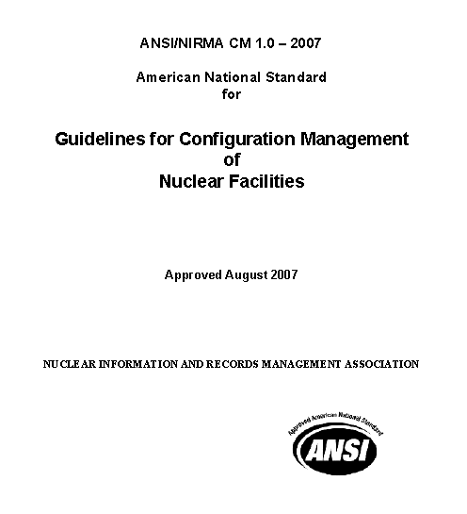
CM Responsibilities 3/5
ANSI/NIRMA
CM 1.0-2007

Slide 82
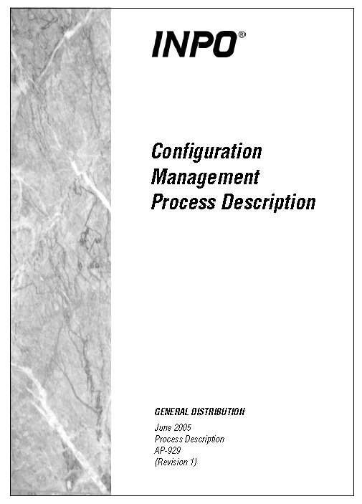
CM Responsibilities 4/5
AP-929

Slide 83
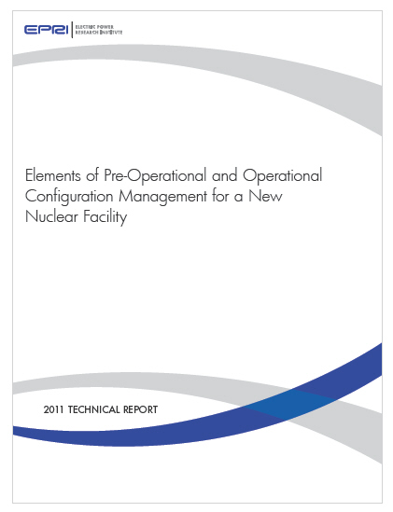
CM Responsibilities 5/5
TR 1022684

Slide 84
7 – Examples – CM Gone Bad

Slide 85
CM Examples 1/4
General Motors Ignition Switch
  http://www.foxnews.com/leisure/2014/07/31/lawyer-sues-general-motors-on-behalf-658-plaintiffs-over-faulty-ignition/
  http://GMIgnitionUpdate.com
Relation to Config Mgt
  GM knew of some of the problems
  Eventually made changes to the switches
  Did NOT change part number to show fixed switch
  Difficulty in tracking which cars were affected
Notes:
Story of General Motors and their change of a part without changing the part number. Related to ignitions that suddenly stopped the car’s engine and in some cases led to an accident and then injury and some fatalities.

Slide 86

CM Examples 2/4
Poster Child For CM “Gone Wrong”

Slide 87

CM Examples 3/4
Early Indicators That CM Was Not Being Applied
  Millstone NPP Shutdown (early 1996)
  The Plant had been routinely off-loading a Full Core during Refueling
  (heat load concern)
  Unfortunately, this was Not in their License.
  More unfortunately, a whistleblower had been
  unsuccessful at convincing utility management
  and the NRC that there was an issue.
  Until he took his story to Time Magazine
  Facing extreme political & public pressure, the NRC shut all 3 units down.
  NRC subsequently issued a 10CFR50.54(f) letter to all utilities to reassure the NRC under oath that their plant was operating in accordance with Licensing Basis – A Big Deal

Slide 88

CM Examples 4/4
The Impact to the Utility from this Event?
Unit 1 shut down permanently
Unit 2 and 3 were shut down for over 2½ years
The Northeast Utilities stock price dropped from about $25 per share to about $7
The Utility was fined $10M
Billions of dollars in lost revenues and
recovery costs
Utility eventually sold units to Dominion
Scream (1893) by Edvard Munch

Slide 89
Configuration Management:
“It’s what you do now
When you don’t have to do anything
That let’s you be
What you want to be
When it’s too late to do anything about it.”
Warren Owen, Exec. VP Duke Power (Retired)
Notes:
This is a quote from a retired Duke Power executive that underscores the necessity of a questioning attitude and forward thinking required to make CM a success.

Slide 90
Questions?
Pyetje?
Հարց
Bыnpocu
Klausimai?
问题
سوالات
Otázka?
Întrebări?
Kérdések?
Вопросы?
सवाल
Postavljanje vprašanj?
¿Pregunta?
문제
питатння?
Notes:
This slide show or slightly different earlier versions have been presented at IAEA workshops in Korea, China, Russia, Ukraine, Czech Republic, Hungary and Argentina. “Questions” has been translate into language of those who have attended . Translations may not be accurate.
Pyetje? Albanian
Հարց Armenian “haags”
Bыnpocu Bulgarian “vŭpros”
问题 Chinese “Wèntí”
Otázka? Czech
Kérdések? Hungarian
सवाल Indian (Hindi) “Selbat”
문제 Korean “munje”
Klausimai? Lithuanian “klausimas”
سوالات Pakistan (Urdu)
Întrebări? Romanian “intrabaree”
Вопросы? Russian “vopros”
Postavljanje vprašanj? Slovenian
¿Pregunta? Spanish
Питатння? Ukrainian “pytannya”

