Slide 1
Investment Model for Moving to a Data–Centric Configuration and Asset Information Management System
Renuart Consulting
4626 Harbour Village Blvd.
Ponce Inlet, FL 32127
June 8, 2015
Bob Renuart – Renuart Consulting Tom Esselman – LPI, Inc.

Slide 2
Agenda
Data Centric CMIS Investment Model Project Description
Benchmarking
End States
Investment Model Structure
Investment Costs
Hard and Soft Savings
Use Cases
Breakout Session

Slide 3
Value Proposition
Business Problem
Plant Personnel spend up to 40% of their day searching documents to find the critical information needed to make day-to-day decisions and support plant activities
Solution
Benchmark the Nuclear Industry and other high-risk Industries to understand the business problem and develop a Probabilistic Investment Model to support a Data-Centric Configuration Management System.
Benefits
Our Model shows an opportunity savings of $6 Billion for 100 operating U.S. nuclear power plants over the next 20 years of operation and more than $1 Billion for 4 new nuclear builds over their projected life.

Slide 4
Project Description
Decisions are made on data, not documents. Data needed for day-to-day decisions should be centralized, accurate, change controlled, and easily accessible.
A “data-centric” CM system will provide all plant activities with reliable, controlled data – the “single source of truth”.
Need to define the cost of installing and maintaining a data-centric system from different starting points.
Need to define both the “hard” and “soft” savings that will result from a data-centric system.

Slide 5
Project Approach
Benchmarking – 9 Operating Nuclear Plants, 2 New Build Nuclear Plants, 3 International New Build Utilities, 3 Large High-Tech Data-Centric Non Power Industries, 4 Solution Providers, and the National Institute of Standards and Technology (NIST).
Validate the costs to build a data centric model with different end states based on industry best practices.
Benchmarking defined the opportunity for savings and validated data against other industry studies and experience.
Create a Probabilistic Investment Model and validate results.
Prepare Use Cases based on different plant current states and desired end states.
Independent Expert Panel that provides input on the model and challenges the assumptions.

Slide 6
Potential CM End States – Each State Builds on the Prior State
Electronic Document Centralization
Documents -Tags Cross Referenced
Data Centralization
Relationship Model
2D/3D Model Integration with data model
2D/3D Model Authoring Tool Integration
Notes:
The benchmarking of solution providers and end users generated a huge amount of data. Our challenge was how to parse the benefit data in a way that it would be useful for both operating and new-build plants. We defined these 6 end states in the order that seemed most logical for implementation. While each end state would not have to be fully achieved before working on the next end state, they do build upon each other as I will describe next.

Slide 7
Potential CM End States (cont.)
Electronic Document Centralization
Master Document List (MDL) – “Critical Documents” in electronic format; all documents indexed in a centralized document control system
Documents -Tags Cross Referenced
Expand Master Equipment List (MEL) to include other tag types (piping components, cable #s, weld #s, etc.)
Cross Reference Tags to Critical Documents
Notes:
End State 1 focuses on document centralization and electronic access. While our goal is data centricity, I think you would all agree that you need to get the documents and records in electronic order before expanding the data model. Benchmarking revealed that all operating plants have a mixed media of electronic, microfilmed and paper documents and records. None had fully achieved a centralized Master Document List with all the documents in different media indexed in one place. All had started electronic conversion, but many fell short of electronic converting all the critical documents that the end users needed to manage their work areas.
End State 2 focuses on tag-document cross referencing. The typical Master Equipment List at a nuclear plant contains about 150,000 tags per unit which includes primarily process components such as pumps, valves, instruments and vessels. There are upwards of an additional 150,000 tagged items that include piping components, cable numbers, weld numbers, electrical devices, etc, that are needed to support asset management programs that should be added to the Master Equipment List. Cross referencing the tag to the supporting documents with electronic access was identified as a huge time savings.
End State 3 focuses on data centralization into a single source of truth. Our benchmarking revealed that even though all the operating plants have migrated to a Computerized Maintenance Management System, they still have upwards of 25 siloed databases that record properties on tagged components, creating a serious configuration management gap to try to maintain all of these databases consistently. We also found that there is still a lot of mission critical data properties managed in documents. Even when the data is available in data format it is often published in a controlled document such as tables in procedures that adds unnecessary change management overhead.

Slide 8
Potential CM End States (cont.)
Data Centralization
Centralize siloed databases with the MEL Database.
“Mine” and validate other mission critical data contained in documents
Notes:
End State 1 focuses on document centralization and electronic access. While our goal is data centricity, I think you would all agree that you need to get the documents and records in electronic order before expanding the data model. Benchmarking revealed that all operating plants have a mixed media of electronic, microfilmed and paper documents and records. None had fully achieved a centralized Master Document List with all the documents in different media indexed in one place. All had started electronic conversion, but many fell short of electronic converting all the critical documents that the end users needed to manage their work areas.
End State 2 focuses on tag-document cross referencing. The typical Master Equipment List at a nuclear plant contains about 150,000 tags per unit which includes primarily process components such as pumps, valves, instruments and vessels. There are upwards of an additional 150,000 tagged items that include piping components, cable numbers, weld numbers, electrical devices, etc, that are needed to support asset management programs that should be added to the Master Equipment List. Cross referencing the tag to the supporting documents with electronic access was identified as a huge time savings.
End State 3 focuses on data centralization into a single source of truth. Our benchmarking revealed that even though all the operating plants have migrated to a Computerized Maintenance Management System, they still have upwards of 25 siloed databases that record properties on tagged components, creating a serious configuration management gap to try to maintain all of these databases consistently. We also found that there is still a lot of mission critical data properties managed in documents. Even when the data is available in data format it is often published in a controlled document such as tables in procedures that adds unnecessary change management overhead.

Slide 9
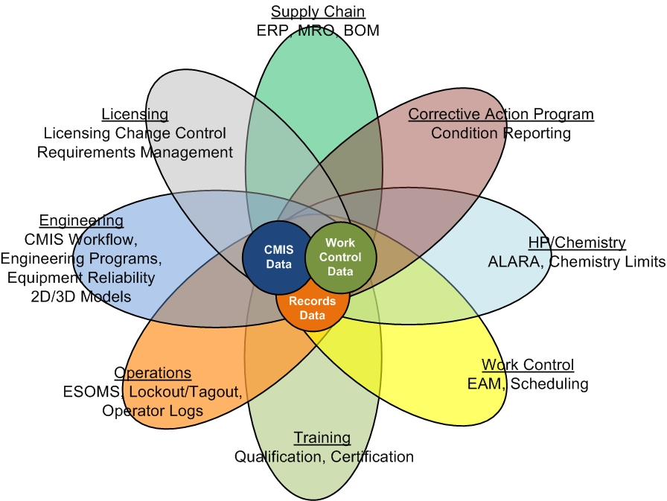
Data Centralization
API
API
API
Notes:
Achieving a single source of truth for most plants is embodied in 2 or 3 databases, one for work control, one for records management, and one for configuration management. The key is that the information is changed in one location and shared with each other through application program interfaces.
The petals in the diagram are to indicate the different types of programs each department may need to draw from the single source of truth in their respective applications.

Slide 10
Potential CM End States (cont.)
Relationship Model
Major Transition requiring moving from a “Tabular” data structure to an Object-Relationship data structure such as SmartPlant Owner/Operator (SPO).
Benefit:
Ability to build a lifecycle data model that relates licensing requirements to design to procurement to installation to O&M.
Ability to perform lifecycle impact reviews if anything is changed in the relationship “Chain”
The Relationships build Knowledge into the database by relating:
Licensing Requirements to Design Information
Document Design Outputs to Document Design Inputs
Design Requirements to Asset Tests and Inspections
Notes:
End states 1-3 can for the most part be achieved using databases such as Maximo, Asset Suite, and SAP. End State 4 takes data modeling to the next level in an object-relationship structure.
Benefits – Read Bullets
The relationships build knowledge into the database by relating:
Read Bullets – Lets look at an example

Slide 11
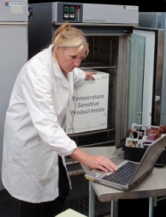
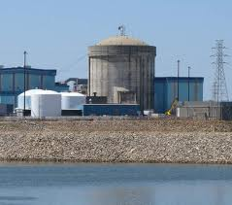
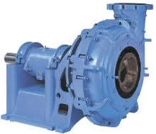
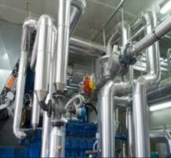
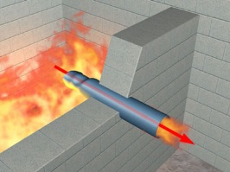
Properties in an Object-Relationship Model
Inservice
Test Program
Environmental
Qualification
License Application
Requirement
Test Frequency
Test Method
Test Parameters
Alert, Action Limits
Qualification Method
EQ Zone Rating
CCS Pump Sizing Calculation
Design Pump Properties
Design Disch Press
Design Flowrate
Design NPSH
Flow Diagram
Serial 6791
Test Results
Discharge Press
Flowrate
Room Properties
Normal Temp, Humid
Accident Temp, Humid
Rad Levels
Location:
Aux Building
Bldg 12
Level 5
Room 12561
Division 1
CCS Pump
VS2-CCS-MP-01A
Serial 6792
Gould
Model CP-C-4020
Purchased Pump Properties
Vendor Model Disch Press
Vendor Model Flowrate
Vendor Model NPSH
Division 2
Wall, Ceiling, Floor
Properties
Serial 6793
Fire Barrier
Shield Wall
Missile Shield
Component Cooling Water (CCS)
Spare:
Notes:
Lets put together multiple objects with some of their properties and typical relationships. To illustrate the multi-dimensional structure of a typical Object-Relationship Model I will graphically show an example beginning with a “Click” Licensing Requirement to develop a safety related cooling water system in accordance with NRC General Design Criterion 44
“Click” The commitment is associated with the flow diagram prepared during preliminary engineering and “Click” the detailed component sizing calculations generated during detailed engineering with the data that describes the components, in this example a cooling water pump.
The engineering data is associated with the “Click” Pump Tag Number on the Piping and Instrument Drawing.
[complete model build]
.

Slide 12
Potential CM End States (cont.)
2D/3D Model Integration
Identify areas to be modeled and maintained
Create ability to view models
Hot Spot Tags for accessibility to data model
2D/3D Model Analysis Tool Integration
Ability to conduct engineering design and analysis from the models and update data
Notes:
End State 5 focuses on integrating the 2D/3D models with the single source of truth. For new builds End State 5 is a no brainer. However our benchmarking revealed that new builds had not fully achieved End States 1-4 because of not defining in enough detail to the Architect-Engineer the information turnover requirements needed to operate and maintain the plant.
We found that some operating plants have 3D laser scanned models for inaccessible areas of the plant as a planning tool for major modifications such as steam generator replacement. Maintaining these models and hot spotting key components will provide much of the benefits for information accessibility that a vector 3D model would provide.
End State 6 integrates the 3D model with the analysis tools after the plant goes operational. We didn’t get enough data to analyze the cost benefit of End State 6, but this would be the logical next step after achieving End State 5 for a new build with a vector 3D model.

Slide 13
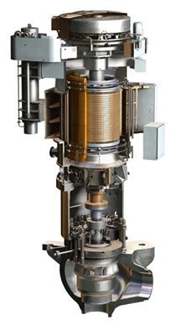
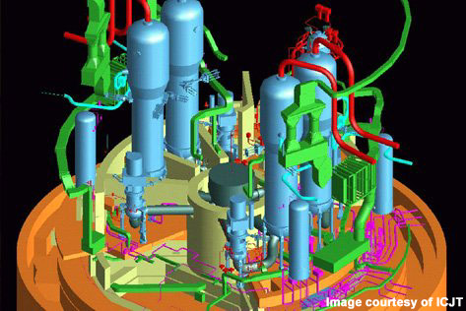
Data/Documents Accessible from the 2D/3D Model
2D Model
P&ID
Reactor Coolant Pump
PLT1-RCP-MP-01A
Pump Data Properties
XXX
XXX
XXX
XXX
XXX
XXX
XXX
XXX
XXX
XXX
XXX
XXX

Slide 14
Additional Opportunities
In addition to greatly improved access to accurate data, our Benchmarking demonstrated other benefits
Electronic Workflows
Collaboration Among Teams
Notes:
Up to this point End States 1-5 were analyzed for the benefit of being able to reduce the 35-40% time an engineer or work planner spends just looking for and validating the data-centric answer.
We also found that significant improvements in productivity could be achieved with electronic workflow and team collaboration.

Slide 15
Electronic Workflow
There can be significant benefits in Change Management by using Electronic Workflows
Major productivity tool for review and approval of work products: New and Revised Documents, Design Changes, Licensing Changes, etc.
Ability to monitor work step queues
Electronic Signatures
Sophisticated Workflow models can be designed to automatically retrieve some of the data needed to make decisions using “Smart Forms”
Notes:
Read the Bullets

Slide 16
Collaboration Among Teams
Integrates work among diverse but affected teams that enhance accuracy and increase efficiency.
Remote access and update from multiple EPCs to a single 3D Model eliminates many interface errors and provides better assurance of an integrated model.
Having all EPC information in a central repository facilitates Turnover to the Client
Notes:
Read the Bullets

Slide 17
Progressive Benefit for Each Information Management Improvement
3D
Model
Relationships
Critical Document Electronic Conversion, Centralization, Access
Data Centralization
Document-Tag Cross Referencing
Document Centric
Collaboration
Workflow Enhancements
Time to Find and Verify Data
Notes:
In summary, this pyramid diagram is a graphical summary depicting the incremental reduction in time for finding and verifying data for each of the end states. We also get gains in efficiency by leveraging the single source of truth in electronic work flows and electronic collaboration.
I am going to turn the presentation to Tom who will review the investment model and how we integrated the end states into use cases.

Slide 18
Investment Model Structure
Tom Esselman

Slide 19
Configuration Management Probabilistic Investment Model (CMPI)
The “Value of the Investment” is the difference between the cost of installation and the reduction of costs due to improvements in the process.
This will be done on an NPV basis.
NPV = NPV (Savings) - NPV (Investment)

Slide 20
NPV (Savings) - NPV (Investment)
Savings – reduction in person-hours and risk reduction
Investment – Capital and O&M to implement

Slide 21
…But It is not Deterministic
It needs to be probabilistic.
It is not enough to know the “mean value” of the NPV. That will probably show that the investment is profitable.
You need to know the likelihood that the investment will be profitable.
The probability that the NPV is positive is the “probability of success”.
Renuart Consulting

Slide 22
Investment Categories
Software Costs
Start-up Labor
Ongoing Labor and Support

Slide 23
Investment Model
LABOR COSTS | Start-Up (Staff per Year)
 | Year |  |  |  |  | Distr | $ per person
Initial Set-Up | CY-4 | CY-3 | CY-2 | CY-1 | CY
Configure Software | 3 | 3 | 3 | 3 | 3 | L3 | $150,000
Data Mining | 0 | 3 | 3 | 3 | 3 | L3 | $130,000
Data Validation | 0 | 2 | 2 | 2 | 2 | L3 | $130,000
SME Evaluation and Input | 3 | 3 | 3 | 3 | 3 | L3 | $180,000
Software Validation | 2 | 2 | 2 | 2 | 2 | L3 | $150,000
Scanning Documents | 0 | 0 | 0 | 0 | 0 | L3 | $ 80,000
Training | 0 | 0 | 2 | 2 | 2 | L3 | $200,000
Year | CY-4 | CY-3 | CY-2 | CY-1 | CY
Percentage Benefit of Savings | 0% | 0% | 0% | 20% | 35%
 |  |  |  | CY = | Completion Year

Slide 24
Distributions for Investments
L1
L2
It is more likely that it will cost more than expected.
L3

Slide 25
Savings
Hard Cost Reductions – direct person-hour reductions
Soft Cost Reductions – indirect but real savings

Slide 26
Hard Cost Savings
Hard Cost Reductions
Person-hour Reduction due to Direct Access to Accurate Data
Person-hour Reduction from Electronic Work Process Redesign
Benefits
Engineering changes
Operability Decisions
PRA
Equipment Reliability
Margin Management
Programs like Flow Accelerated Corrosion
Many others

Slide 27
Hard Cost Savings
Engineering Functions Considered
Programs
Systems Engineering
Design Changes
Engr. Evaluation (Operability, PRA Coding, OE Evaluations, etc.)
Procurement Engineering
Work Planning
Outage Planning

Slide 28
Hard Savings Model
SAVINGS |  | Equiv. people per year |  | MH Reduction with Data Retrieval (%) |  | MH Reduction with Work Process Redesign (%)
 |  |  |  | Get the data, resolve conflicts, verify, identify impacted disciplines |  | Electronic Approvals, resource loading, 3D model, electronic mock-up, collaboration
Programs |  | #/Staff | Distr | MH Reduction with Data Retrieval (%) | Distr | MH Reduction with Work Process Redesign (%) | Distr
Regulatory | Environmental Qualification | 0.25 | N2 | 15% | L-2 | 8% | L-3
 | MSPI (Mitigating System Perf. Index ) | 0.25 | N2 | 8% | L-2 | 8% | L-3
 | Station Blackout | 0.25 | N2 | 8% | L-2 | 8% | L-3
 | External Events | 0.50 | N2 | 8% | L-2 | 8% | L-3
 | Appendix J | 0.50 | N2 | 8% | L-2 | 8% | L-3
 | Maintenance Rule | 0.50 | N2 | 8% | L-2 | 8% | L-3
 | License Renewal/Aging Management | 0.25 | N2 | 8% | L-2 | 8% | L-3
 | NFPA 805 | 1.00 | N2 | 15% | L-2 | 10% | L-3
ASME Code Programs | In-Service Testing | 0.50 | N2 | 12% | L-2 | 8% | L-3
 | IWE/IWL | 0.50 | N2 | 12% | L-2 | 8% | L-3
 | Pressure Testing | 0.50 | N2 | 12% | L-2 | 8% | L-3
 | Repair/Replacement | 0.00 | N2 | 12% | L-2 | 8% | L-3
 | Snubber Testing | 0.50 | N2 | 12% | L-2 | 8% | L-3

Slide 29
Hard Savings Model
SAVINGS | Man-Hours per Year |  |  | MH Reduction with Data Retrieval (%) |  | MH Reduction with Work Process Redesign (%) |  | Cost per Man-Hour
 |  |  |  | Get the data, resolve conflicts, verify, identify impacted disciplines |  | Electronic Approvals, resource loading, 3D model, electronic mock-up, collaboration
Engineering Evaluations | # Items/ Year | Current MHs per Item (approx.) | Distr | MH Reduction with Data Retrieval (%) | Distr | MH Reduction with Work Process Redesign (%) | Distr | Cost per MH
Operability Determinations | 20 | 72 | N2 | 23% | L-2 | 10% | L-3 | $90
Work Week PRA Coding | 52 | 30 | N2 | 15% | L-2 | 10% | L-3 | $90
Operating Experience Evaluations | 35 | 40 | N2 | 23% | L-2 | 10% | L-3 | $90
Field Change Notices | 50 | 72 | N2 | 23% | L-2 | 10% | L-3 | $90
Procedure Changes | 50 | 72 | N2 | 23% | L-2 | 10% | L-3 | $90
Prepare response to urgent request | 60 | 60 | N2 | 23% | L-2 | 10% | L-3 | $90
Condition Reports | 250 | 40 | N2 | 15% | L-2 | 10% | L-3 | $90
Contractor Oversight | 25 | 40 | N2 | 15% | L-2 | 10% | L-3 | $90

Slide 30
Soft Cost Savings
NRC
Green
Rating
Unplanned Outage Time
Insurance Premium
Reduce
Rework
Refueling Outage Time

Slide 31
Soft Cost Savings
Soft savings should be expected to occur with improved access to accurate information and improvised work processes.
The soft cost reductions could include items such as:
reduction of regulatory risk
reduction in forced outage times
reduction of refueling outage time
Improved regulatory ratings
others

Slide 32
Distributions for Savings
L-1
L-2
It is more likely that you will save less than expected.
L-3

Slide 33
Use Cases
Five Use Cases have been prepared based on the benchmarking.
Use Case 1: End State 1⁺ to End State 3 (Operating Plant)
Use Case 2: End State 1⁺ to End State 4 (Operating Plant)
Use Case 3: End State 1⁺ to End State 5 (Operating Plant)
Use Case 4: End State 1⁺ to End State 5 (New Plant)
Use Case 5: End State 1⁺ to End State 5 (New Plant)
Each Use Case Model will be provided to a User so that their plant specific data can be entered and analyzed.

Slide 34
Use Case 3 – Example
Use Case 3 will be shown as an example:
Existing Operating Plant
Current State is primarily document-centric environment with some progress made to centralize data
Want to move to End State 5 – a 3D Model of the Nuclear Island with “hotspotting”.
Use 3D laser scanning to capture geometry.

Slide 35
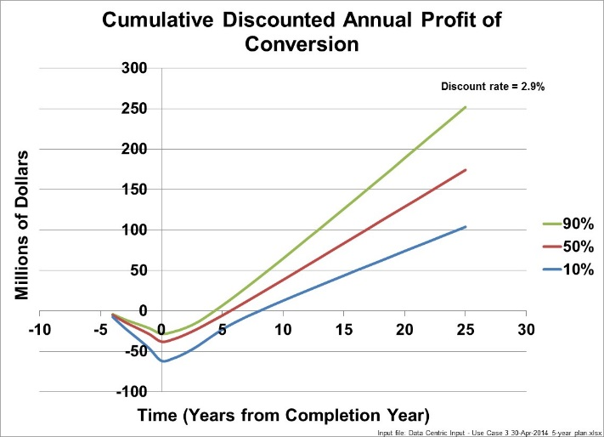
Use Case 3 - Hard and Soft Savings

Slide 36
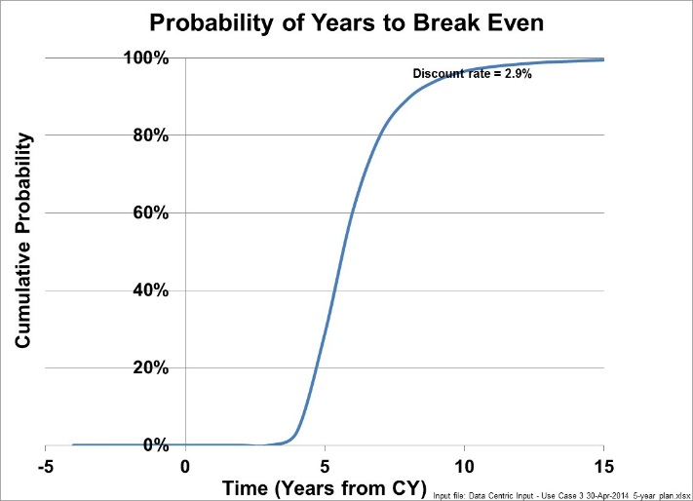
Use Case 3 - Hard and Soft Savings

Slide 37
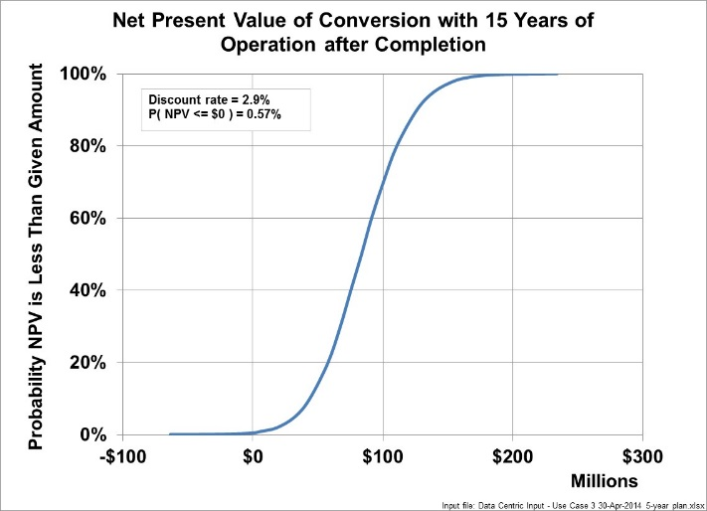
Use Case 3 - Hard and Soft Savings

Slide 38
Closing
The EPRI Probabilistic Investment Model
Demonstrates that moving to a Data Centric Model can be cost beneficial.
Provides unlimited flexibility in changing cost and savings assumptions.
Is industry neutral and is available online to EPRI Members.
Renuart Consulting

Slide 39
Breakout Session TM-2 10:30 AM
General Discussion on issues and challenges with moving to a data-centric system at current plants.
Roadmap if interested in developing a cost benefit model for a plant-specific Use Case.
How to determine where you are?
How to determine where you want to go?
How to get data?
How to populate the model and run it?
Renuart Consulting

Slide 40
Where to Get More Information?
EPRI Website - www.epri.com, Report 3002003126
Bob Renuart – Renuart Consulting, renuartconsulting@gmail.com
Tom Esselman – LPI, Inc. tesselman@lpiny.com
Renuart Consulting

