Slide 1
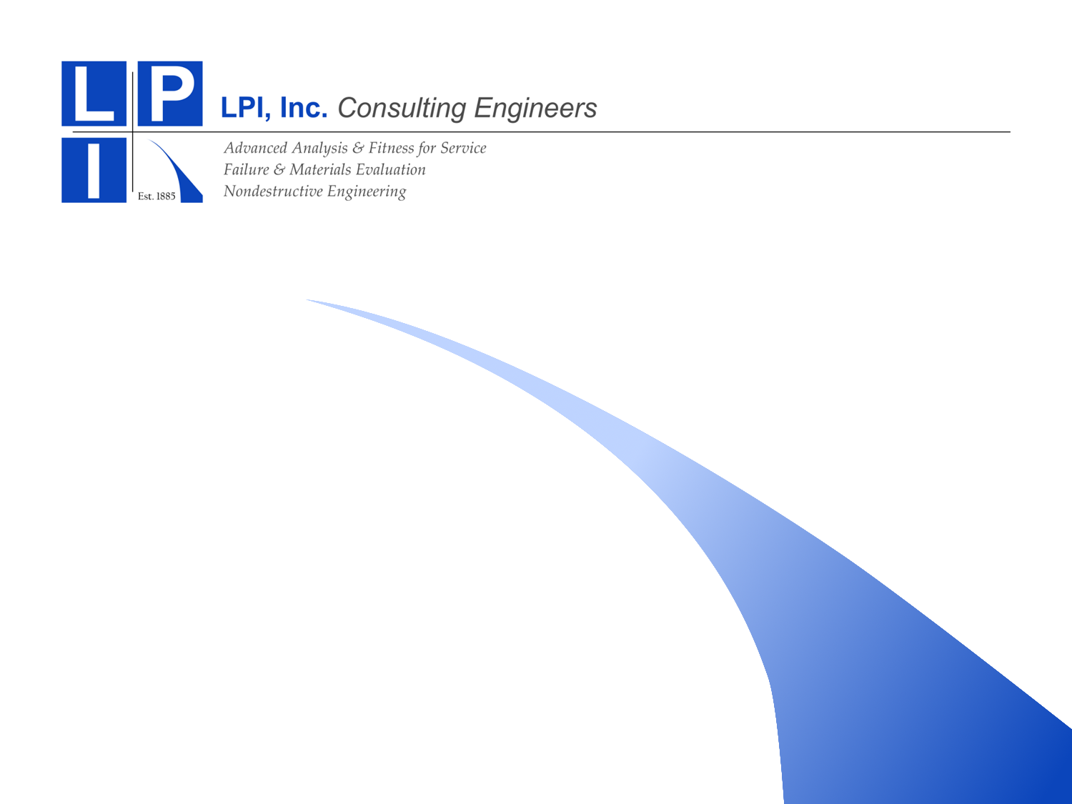
Investment Model for Moving to a Data–Centric Configuration and Asset Information Management System
Breakout Session
Renuart Consulting
4626 Harbour Village Blvd.
Ponce Inlet, FL 32127
June 9, 2015
Bob Renuart – Renuart Consulting
Tom Esselman – LPI, Inc.

Slide 2
Roadmap
Where you are?
Where do you want to be?
How do you get data?
How to populate the model and run it?
How to get the money?

Slide 3
Roadmap
Current State
Future State
Define “Current State” and “Future State”.
Don’t define how to get there.
Define this carefully. Write it down.

Slide 4
Potential CM End States – Each State Builds on the Prior State
Electronic Document Centralization
Documents -Tags Cross Referenced
Data Centralization
Relationship Model
2D/3D Model Integration with data model
2D/3D Model Authoring Tool Integration
Notes:
The benchmarking of solution providers and end users generated a huge amount of data. Our challenge was how to parse the benefit data in a way that it would be useful for both operating and new-build plants. We defined these 6 end states in the order that seemed most logical for implementation. While each end state would not have to be fully achieved before working on the next end state, they do build upon each other as I will describe next.

Slide 5
Where Are You?
End State 1
  Have you achieved electronic conversion of all the documents needed on a regular basis?

Slide 6
Where Are You?
End State 2
  To what extent have you cross referenced documents to tags?
  Have you expanded the tag cross references beyond process tags, e.g., cable tags, weld number tags, electrical device tags, etc?
  Did you realize the benefits of finding the information for a particular tag better with the cross reference versus the old way of doing a text search for the tag in the document management system?

Slide 7
Where Are You?
End State 3
  How many siloed databases do you have?
  Do you have issues maintaining them up to date when the plant is changed?
  Are all the databases considered as affected information resources that need to evaluated in a design change impact review?
  If the design and program data were centralized and change controlled, could you eliminate the need to publish in documents?

Slide 8
Where Are You?
End State 4
  Who has gone to an object-relationship model?
  What was the driving factor for going to relationship model?
  How much time do you estimate an engineer saves doing an impact review with a relationship model?

Slide 9
Where Are You?
End State 5
  How many plants have integrated their 2D models with information access through the tag number?
  How many plants have developed 3D models?
  For what purpose?
  Are they being maintained?
  Are they hot spotted to the equipment database?

Slide 10
Future States
Electronic Document Centralization
Documents -Tags Cross Referenced
Data Centralization
Relationship Model
2D/3D Model Integration with data model
2D/3D Model Authoring Tool Integration
Notes:
The benchmarking of solution providers and end users generated a huge amount of data. Our challenge was how to parse the benefit data in a way that it would be useful for both operating and new-build plants. We defined these 6 end states in the order that seemed most logical for implementation. While each end state would not have to be fully achieved before working on the next end state, they do build upon each other as I will describe next.

Slide 11
Roadmap
Current State
Future State
Once “Current State” and “Future State” are defined, begin to define the path that you will follow.
Can include software, computer systems, staff, cultural changes, and others.

Slide 12
Roadmap
Current State
Future State
How do you get this done?
  Get data.
  Populate the cost-benefit model and run it.
  Present the results.
  Get the money.

Slide 13
How Do You Get Data?
Get endorsement from management for data collection.
Set up a broad range of interviews.
Generally do interviews one person at a time. Look for confirmatory or contradictory data.
“What do you do? How much time do you spend? How much time will we save if we move to the future state?”

Slide 14
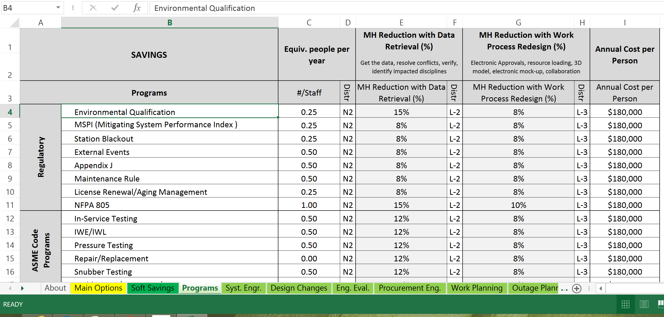
Input Worksheet

Slide 15
How Do You Define Distributions?
L-1
L-2
It is more likely that you will save less than expected.
L-3

Slide 16
How Do You Define Soft Cost Savings?
Soft savings should be expected to occur with improved access to accurate information and improvised work processes.
The soft cost reductions could include items such as:
  reduction of regulatory risk
  reduction in forced outage times
  reduction of refueling outage time
  Improved regulatory ratings
  others

Slide 17
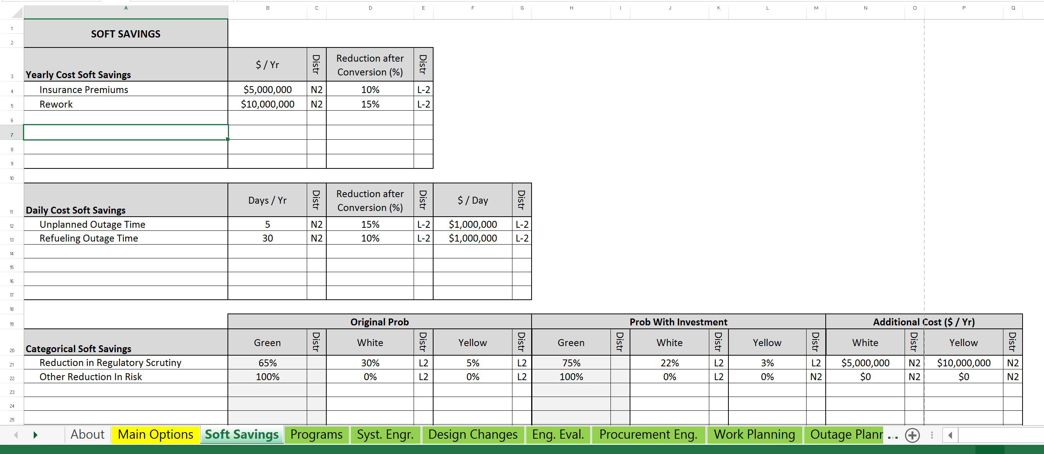
Enter Soft Savings

Slide 18
Complete Data Input
Assign Distributions.
Use User’s Manual to select other input like number of iterations, discount rate, correlations between input and savings, and others.

Slide 19
How Do You Define Investments?
LABOR COSTS | Start-Up (Staff per Year)
 | Year |  |  |  |  | Distr | $ per person
Initial Set-Up | CY-4 | CY-3 | CY-2 | CY-1 | CY
Configure Software | 3 | 3 | 3 | 3 | 3 | L3 | $150,000
Data Mining | 0 | 3 | 3 | 3 | 3 | L3 | $130,000
Data Validation | 0 | 2 | 2 | 2 | 2 | L3 | $130,000
SME Evaluation and Input | 3 | 3 | 3 | 3 | 3 | L3 | $180,000
Software Validation | 2 | 2 | 2 | 2 | 2 | L3 | $150,000
Scanning Documents | 0 | 0 | 0 | 0 | 0 | L3 | $ 80,000
Training | 0 | 0 | 2 | 2 | 2 | L3 | $200,000
Year | CY-4 | CY-3 | CY-2 | CY-1 | CY
Percentage Benefit of Savings | 0% | 0% | 0% | 20% | 35%
 |  |  |  | CY = | Completion Year

Slide 20
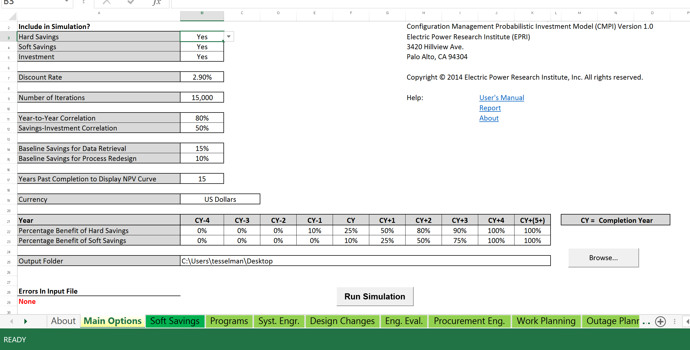
Make Runs

Slide 21
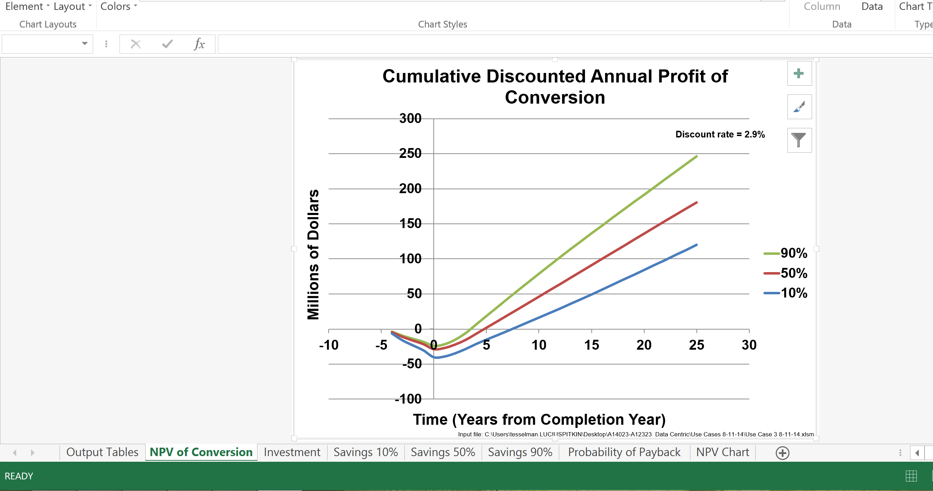
Output

Slide 22
Use Cases
Five Use Cases have been prepared based on the benchmarking.
    Use Case 1: End State 1⁺ to End State 3 (Operating Plant)
    Use Case 2: End State 1⁺ to End State 4 (Operating Plant)
    Use Case 3: End State 1⁺ to End State 5 (Operating Plant)
    Use Case 4: End State 1⁺ to End State 5 (New Plant)
    Use Case 5: End State 1⁺ to End State 5 (New Plant)
  Each Use Case Model will be provided to a User so that their plant specific data can be entered and analyzed.

Slide 23
Where to Get More Information?
EPRI Website - www.epri.com, Report 3002003126
Bob Renuart – Renuart Consulting, renuartconsulting@gmail.com
Tom Esselman – LPI, Inc. tesselman@lpiny.com

