Slide 1
Implementation of a New Configuration Management System at NWMO
CMBG 2015 Conference , Arizona
10-June-2015

Slide 2
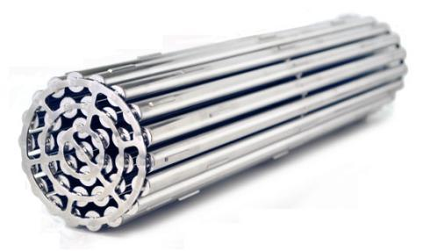
Today’s Presentation
Canada’s Civil Nuclear Program
About the NWMO
About nuclear fuel
Canada’s plan
Safety and security
Selecting a site
Implementation of CM system at NWMO

Slide 3
Canada’s Civil Nuclear Program
3

Slide 4
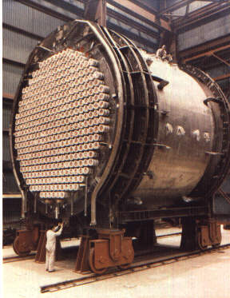
CANDU Reactor
22 CANDU Reactors
Number of Research Reactors
About 5,000 fuel bundles per reactor
Each bundle stays in reactor for about 15 to 18 months

Slide 5
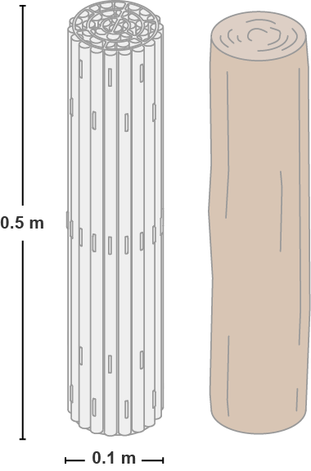
CANDU Fuel
One fuel bundle . . .
Is about the size of a fireplace log
Can power 100 homes for a year
Contains about 20 kg uranium
Used nuclear fuel is a potential health risk for a very long time.
It must be safely contained and isolated from people and the environment, essentially indefinitely.
Notes:
~ 20 kg natural uranium dioxide (UO₂)
~ 0.5 m length
~ 1 million kWh ~ 100 homes for a year

Slide 6
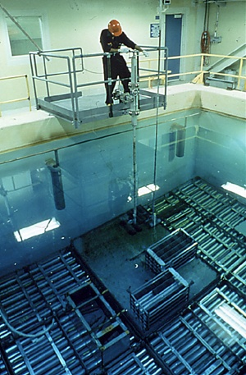
Wet Storage
Used nuclear fuel initially very hot and highly radioactive
Stored in water pools for cooling and shielding
Pool water kept separate from other water
After 7 to 10 years, used fuel cool enough to move to dry storage

Slide 7
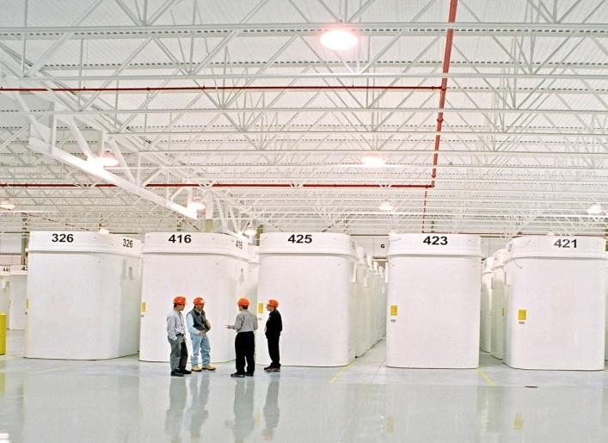
Dry Storage
Notes:
Photo: Used Fuel Storage at OPG western waste Management Facility – Kincardine, ON
To be clear we are talking about used nuclear fuel only (not other nuclear wastes such as low and intermediate level waste).
Used nuclear fuel remains a potential health risk for a very long time and it must be safely contained and isolated from people and the environment, essentially indefinitely.
This material is the fuel source for nuclear power. This is an image of a nuclear fuel bundle.
Canada’s 2 + million used nuclear fuel bundles - a by-product of nuclear electricity production - are safely stored, on an interim basis, at licenced storage facilities in Canada.
Image to the right is of OPG’s WWMF in Kincardine...

Slide 8
About the NWMO

Slide 9
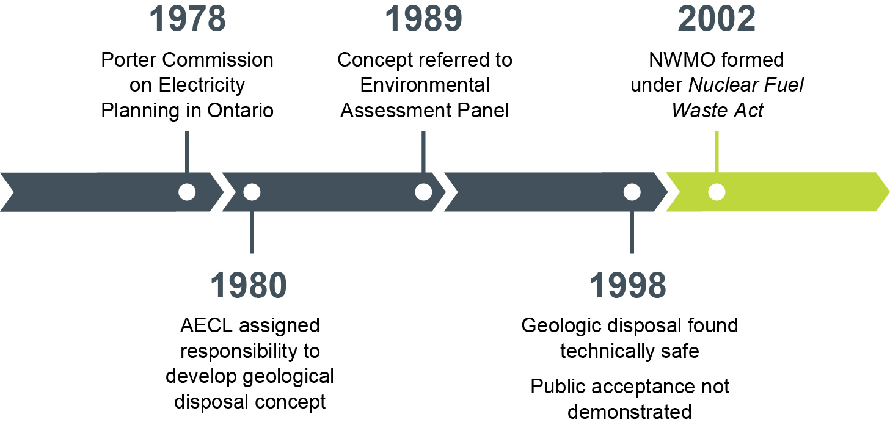
How We Got Here
Notes:
The long-term management of used nuclear fuel has a long history in Canada.
In 1978, the Ontario government appointed Arthur Porter to chair a Royal Commission on Electric Power Planning in Ontario.
One of his recommendations called for a major program of research into the disposal of used nuclear fuel.
That led to the establishment of the Canada/Ontario Nuclear Fuel Waste Management Program which assigned responsibility to Atomic Energy of Canada Limited for researching and developing the immobilization and disposal of radioactive wastes.
By 1989, AECL had developed the concept and it was referred to an Environmental Assessment Panel chaired by Blair Seaborn
Over 10 years a series of workshops, open houses and three phases of public hearings were held, and a Scientific Review Group examined the scientific and engineering aspects of the disposal concept. In 1998 Seaborn concluded that:
- from a technical perspective, safety of Deep Geological Disposal had been on balance adequately demonstrated, but from a social perspective it had not.
- The concept had not been demonstrated to have “broad public support.”
The Panel recommended that a Nuclear Fuel Waste Management Agency be established to manage and coordinate the full range of activities relating to the long-term management of nuclear fuel wastes.
As a result, in 2002 the Government of Canada passed the Nuclear Fuel Waste Act.

Slide 10
NWMO: Who We Are
Formed in 2002 as required by Nuclear Fuel Waste Act
Funded by Canada’s nuclear energy corporations
Operates on a not-for-profit basis
Guiding Principles for site selection:
Technical Safety
Informed and willing host community
Our mission is to develop and implement collaboratively with Canadians, a management approach for the long-term care of Canada’s used nuclear fuel that is socially acceptable, technically sound, environmentally responsible, and economically feasible.

Slide 11
Canada’s Plan
11

Slide 12
The NWMO Study
NWMO conducted a 3 year national study to see what people think:
More than18,000 Canadians contributed (2002 – 2005)
2,500 Aboriginal people participated in the dialogues
120 information and discussion sessions (every province and territory)
What Canadians said:
Safety and security is the top priority
Action needs to taken by this Generation
Approach must be adaptable – allow improvements based on new knowledge or societal priorities
Notes:
Nuclear Fuel Waste Act (NFWA) required NWMO to engage Canadians in review of different approaches for managing used fuel
To recommend an approach and
To implement the approach selected by government

Slide 13
Adaptive Phased Management (APM)
APM emerged from dialogue with citizens and experts – best met key priorities
A Technical Method
A Management System
Centralized containment and isolation of used nuclear fuel in deep geological repository
Continuous monitoring
Potential for retrievability
Optional step of shallow underground storage
Flexibility in pace and manner of implementation
Phased and adaptive decision-making
Responsive to advances in technology, research, Aboriginal Traditional Knowledge, societal values
Open, inclusive, fair siting process – seek informed, willing host community
Sustained engagement of people and communities throughout implementation
APM selected by Federal government June 2007
Notes:
Guided by the values and objectives Canadians said were important for decision-making about managing used nuclear fuel, a recommendation was put forward to Ottawa in 2005. It is called Adaptive Phased Management, and it was approved by the government in June 2007.
Adaptive Phased Management is both a technical method and a management system.
Technically it has as its end-point containment and isolation of used nuclear fuel in a deep geological repository in a suitable rock formation (such as the granite of the Canadian Shield, or Ordivician Sedimentary rock – which surrounds much of the Canadian Shield.); the used fuel should be continuously monitored, and it should be retrievable for an extended period of time.
Just as important is the management system. Canadians said it needs to be flexible in how it is implemented; decision-making should be phased and adaptive so that it is responsive to advances in technology, new research, Aboriginal Traditional Knowledge or changing societal values; the facility should be located in an informed and willing host community selected through an open, inclusive and fair siting process. And, interested and potentially affected citizens and communities need to be engaged in decision-making throughout implementation of the plan.
This is the plan adopted by the Federal Cabinet in 2007 (order in council is on our wall).
With that, NWMO was directed to begin implementation of the plan.

Slide 14
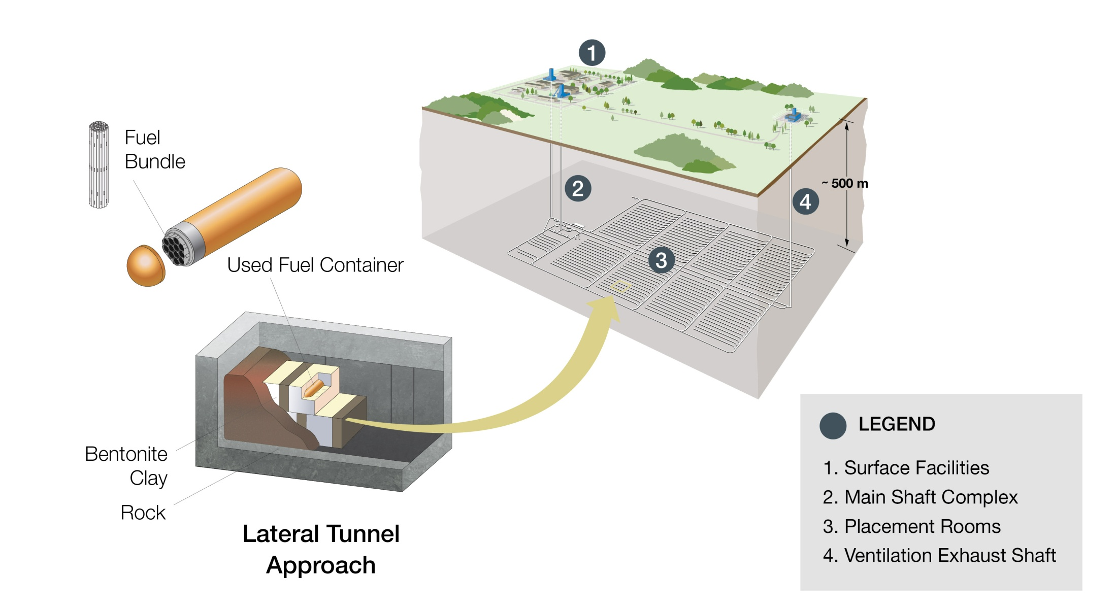
Deep Geological Repository (DGR)
Notes:
Repository concept:
Crystalline or sedimentary rock
Underground demonstration of repository technology
Surface area ~100 hectares
Subsurface area ~2 km x 3 km
Multiple-barrier system
Long-lived containers
Extended monitoring
Used fuel retrievable
Federally mandated: National infrastructure project
Investment of $16 to 24 billion
Will operate as a centre of expertise
Highly regulated - ensure safety
High technology
Sustainable over more than 100 years
Long-term partnership between NWMO and community
Fosters community well-being

Slide 15
Safety and Security
15

Slide 16
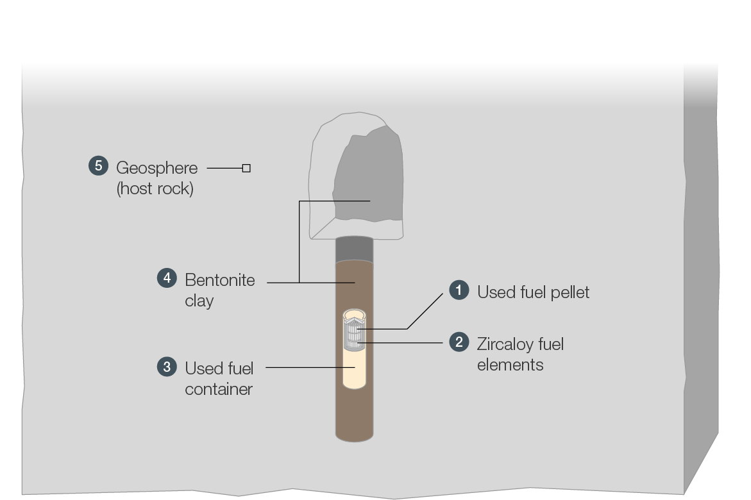
Multiple Barriers to Contain and Isolate
Natural barrier
Protects repository from surface events (natural & human)
Isolates used fuel for very long times
Formed millions of years ago
Natural swelling clay, fills void spaces
Reduces minute flow of groundwater
Act as a sponge, if container fails
High Density Ceramic
Extremely Durable
Does not readily dissolve
Fuel pallets held in sealed tubes
Zircaloy is extremely strong
Zircaloy is corrosion resistant
Durable & long lived deep underground
Corrosion resistant outer shell (copper)
Strong inner vessel (steel)

Slide 17
Containers Investigated
European 288 Bundles
Reference 360 Bundles
Canadian 48 Bundles

Slide 18
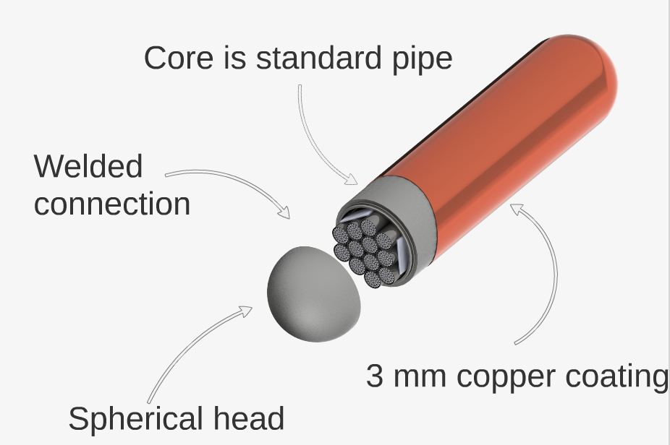
Canadian Container

Slide 19
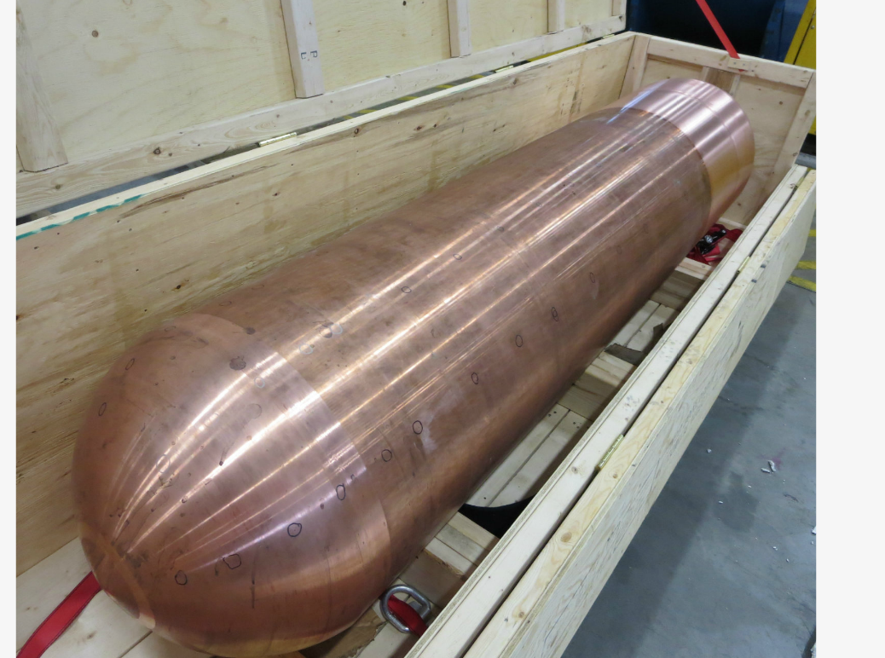
Container Prototypes

Slide 20
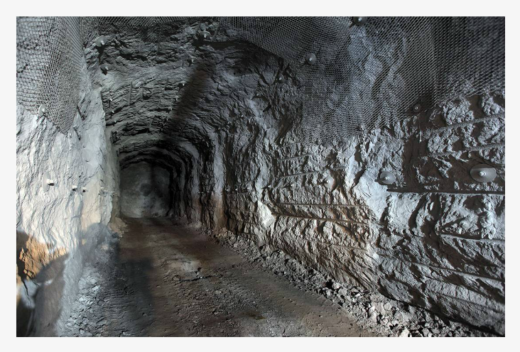
Repository Emplacement
Drill and Blast

Slide 21
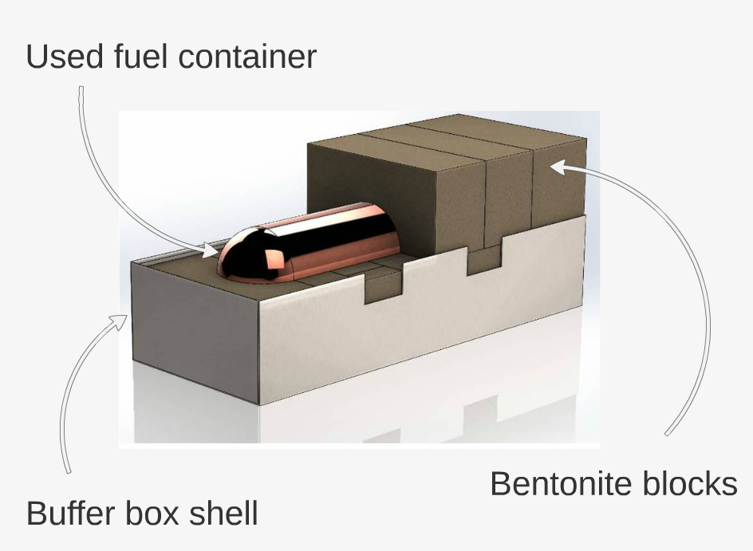
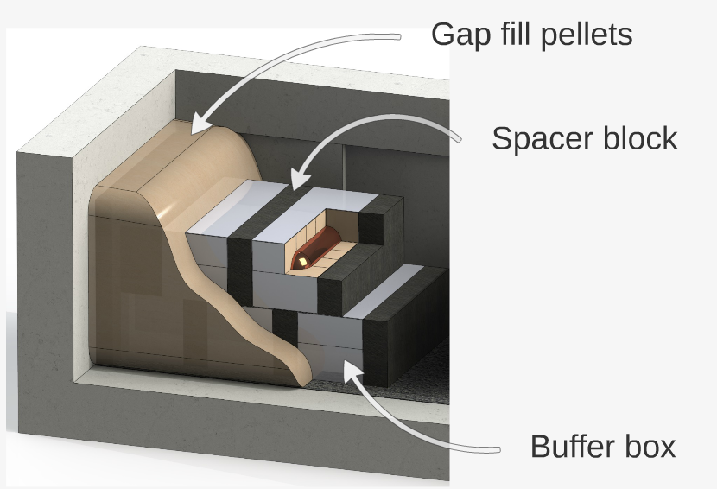
Emplacement System
Underground Emplacement System
Emplacement Package

Slide 22
Key suitable host rock characteristics
Sufficient volume of competent rock at sufficient depth
Low groundwater movement at repository depth
Resilience to earthquakes
Resilience to ice ages
Resilience to land movement (uplift, erosion etc.)
Favourable chemical composition of rock and water at repository depth etc.
Notes:
22

Slide 23
Preliminary Assessments
SAFETY
BEYOND SAFETY
Geoscientific Suitability
Engineering
Transportation
Environment and Safety
Social, Economic and Cultural
Potential to find a suitable site ?
Potential to safely design and construct the facility?
Potential for safe and secure transportation?
Potential to manage any environmental effects, and ensure health and safety of people and the environment?
Potential to foster the
well-being of the
community and region, and to lay the foundation for moving forward?
ABORIGINAL TRADITIONAL KNOWLEDGE
DIALOGUE AND ENGAGEMENT

Slide 24
Selecting a Site
24

Slide 25
Site Selection Process: Initiated May 2010
Seeking an informed and willing host community with a suitable geologic formation
Developed through two-year public dialogue
Multi-stage technical and socio-economic assessment approach
Phased process over many years
Communities expressed interest to participate
Communities can choose to leave the process
The project will only proceed with interested community, First Nation and Métis communities and surrounding municipalities
working in partnership.

Slide 26
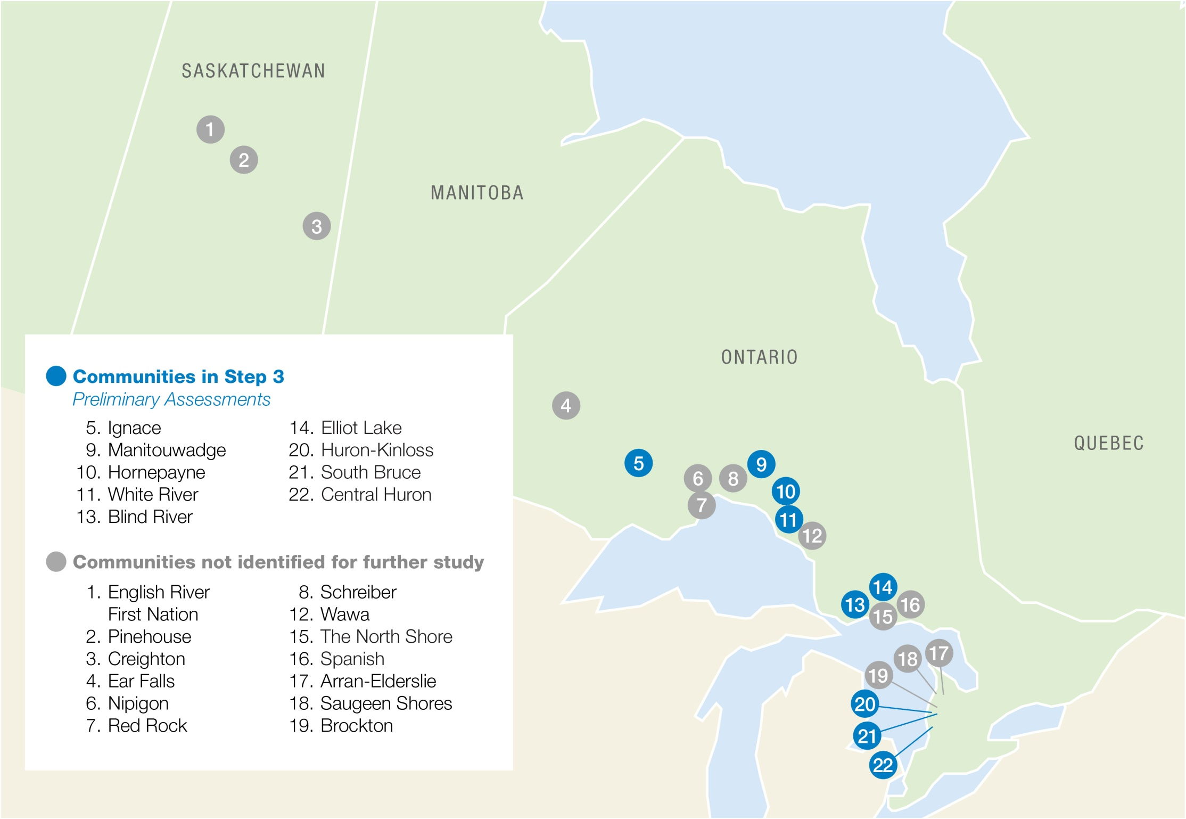

Slide 27
Implementation of a CM system at NWMO

Slide 28
Uniqueness
Reactor Safety Commandment:
“Nuclear Energy is unique and special”
“Nuclear Repositories are more UNIQUER and SPECIAL”
Development of nuclear repositories is driven by overwhelming regulatory and societal requirements and considerations
Long term safety assessments are for Really Long Time Periods (e.g. Glaciations cycles which happens in thousand of years etc.)
Preservation of knowledge challenged by extra ordinarily long project cycles (~ 35 to 50 years)
Retention period for preserved knowledge – there is no end of life
Changing perception of stakeholders over time
Resiliency to future operational and societal changes

Slide 29
Why does NWMO needs a CM system?
Used SharePoint to manage documents, needed a CM system to manage SolidWorks 3D data
Needed a system that efficiently store and link engineering data (and its associated hierarchy) in a data-centric environment
Needed a system to manage requirements as an individual entity and not as a document
Review/Verification/Approval process to be controlled via workflows within the system to provide traceability and maintain history (no more marked-up hard copies search missions)
Application of digital signatures to be controlled via workflows within the system
Extensive audit history for future reference

Slide 30
Project Planning & Scope Definition
Budget allocation and project approval
Creation of the Core Implementation Team which included members from:
Management
Engineering
Information & Technology (be good with them, they are your best friends, their involvement is key to project success)
Records Management
Performance Assurance
Core Implementation Team jointly prepared a Scope of Work to document key project requirements and freeze project scope and project schedule.
Notes:
1. Get top of the house on your side, they are a good driving force for the user community to accept change.

Slide 31
Vendor Selection
Request for Proposal (RFP) was placed on public domain to invite proposals from prospective vendors
Vendors were provided with the SOW document and Requirements Checklist to prepare proposals
Vendors were requested to provide presentation on how the proposed system satisfies the needs listed in the Requirements Checklist (demonstration of a facility lifecycle scenario)
Proposals submitted by the proponents were evaluated by representatives from management, engineering , IT, Procurement, Legal, Performance Assurance and Project Controls groups

Slide 32
Project Implementation Plan
Phase 1 – Sandbox Testing (Dec 2013 – Jun 2014)
Develop Data Model (metadata, document templates, document numbering schemes etc.)
Development of review/approval workflows by NWMO staff based on their current engineering management procedures
Review and approval of workflows by Design Authority and Performance Assurance Director
High level Software Configuration to support Phase 1 testing
User training for expanded team members
Functionality Testing
Core team recommendation
Management approval for implementation of phase 2

Slide 33
Project Implementation Plan
Phase 2 – Full Implementation (July 2014 – May 2015)
Confirm Requirements (detail out general requirements listed in SOW so it can be tested)
Freeze Phase-2 Requirements
Full fledge software configuration
Training of NWMO “Super-Users”
High level testing of configured system during development
User Acceptance Testing (module based)
Reconfiguration based on UAT results
NWMO “Super-Users” to train rest of NWMO users
Migration of the application from UAT to Production mode

Slide 34
CM System – Brief Synopsis
Software modules that are currently implemented to support configuration management at NWMO are:
Document Control Module
Engineering Change Control Module
Master Equipment List Module
Requirements Management Module

Slide 35
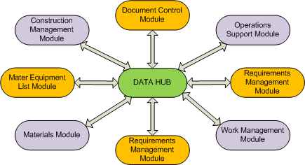
“HUB” Architecture
ECC Module
Interconnected relationship between the modules to create Relationships (or Links) between objects

Slide 36
Document Control Module
Single unified information repository for all document types
Integration with MS Word, Adobe PDF and SolidWorks
Version and Revision Control
Version: RA, RB, R000A etc. for C&D process
Revision: R000, R001 etc. for digital signatures and Release
“Google” like search features (text and wild character searches)
Maturity Statuses assigned based on Workflow advancement
Manage comments, dispositions and disposition acceptance
Smart distribution – MS Outlook email notification with Live Link sent to the task owing user
“Check-in” and “Check-out” controls to maintain data integrity
Initiate and auto populate metadata on MS Word document templates

Slide 37
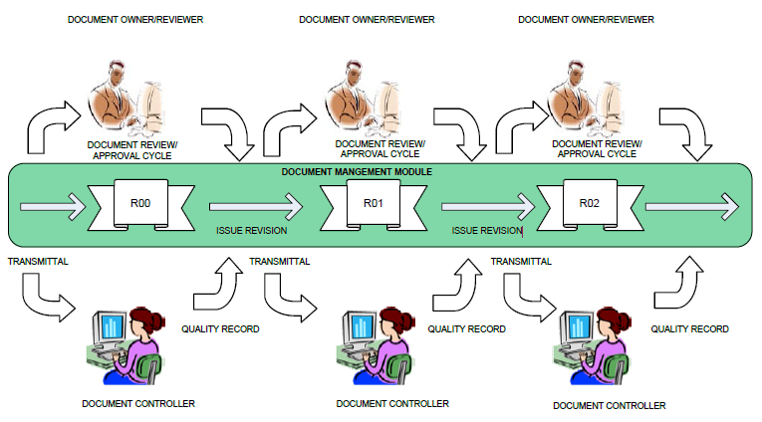
Document Control Module - Workflows
Internal Document Workflow
External Document Workflow
Quick Release Workflow

Slide 38
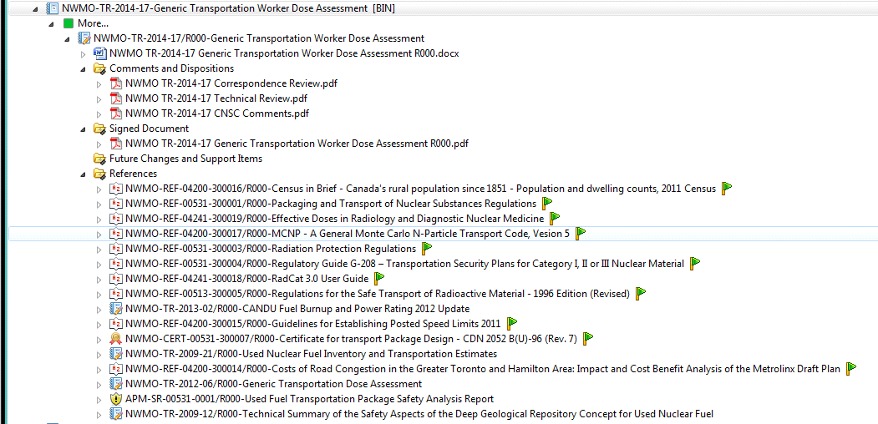
Document Control Module – Folder Structure

Slide 39
Document Control Module – Workflow Task
Assigned participant receives a MS Outlook email with a link for the task that is to performed.

Slide 40
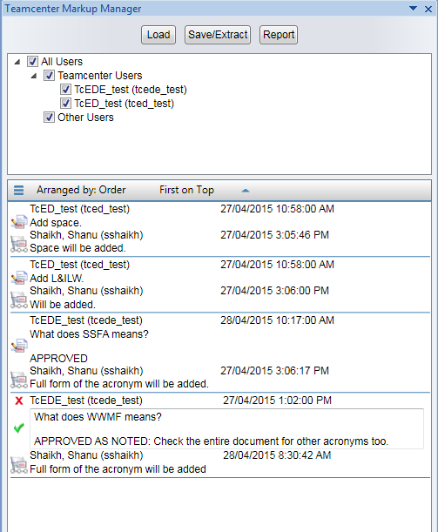
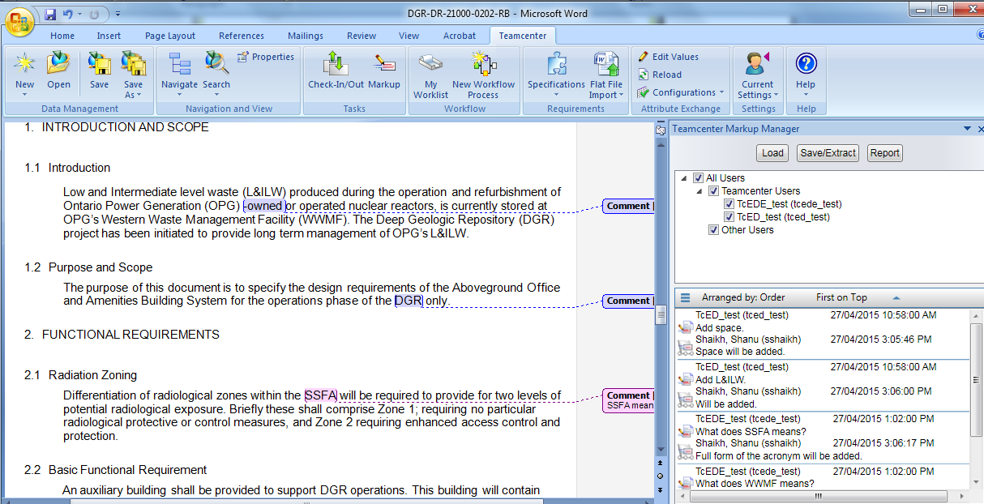
Document Control Module – C&D Process

Slide 41
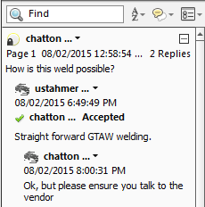
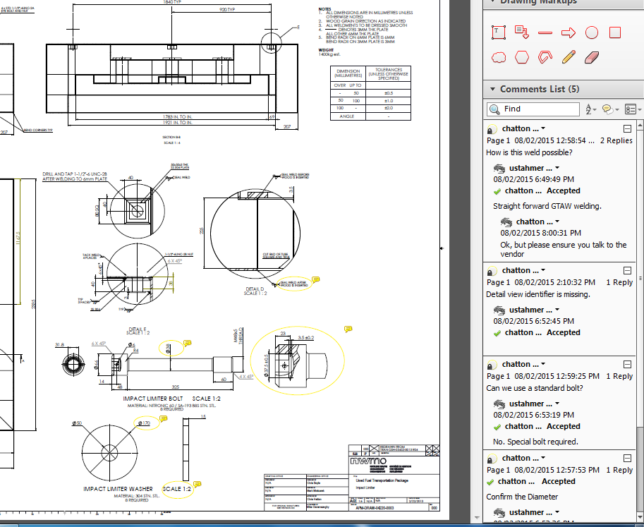
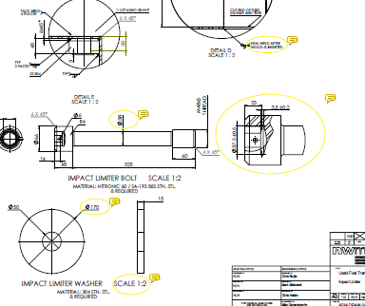
Document Control Module – C&D Process

Slide 42
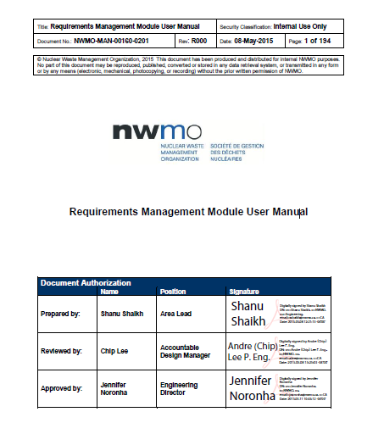
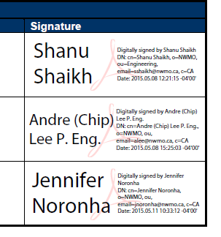
Document Control Module – Digital Signatures

Slide 43
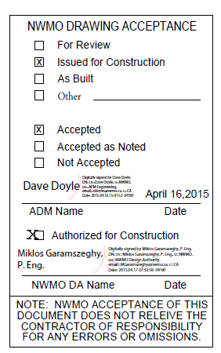
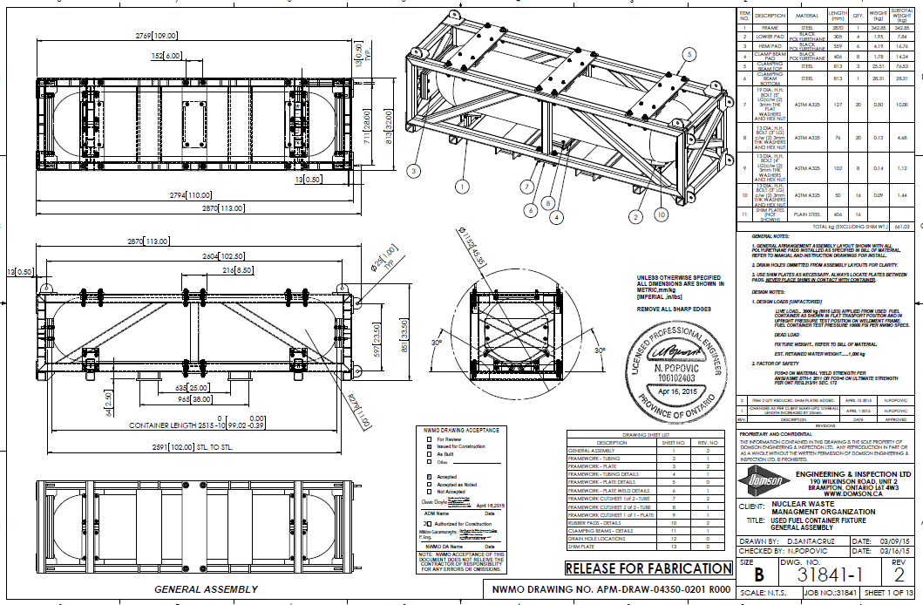
Document Control Module – Digital Signatures

Slide 44
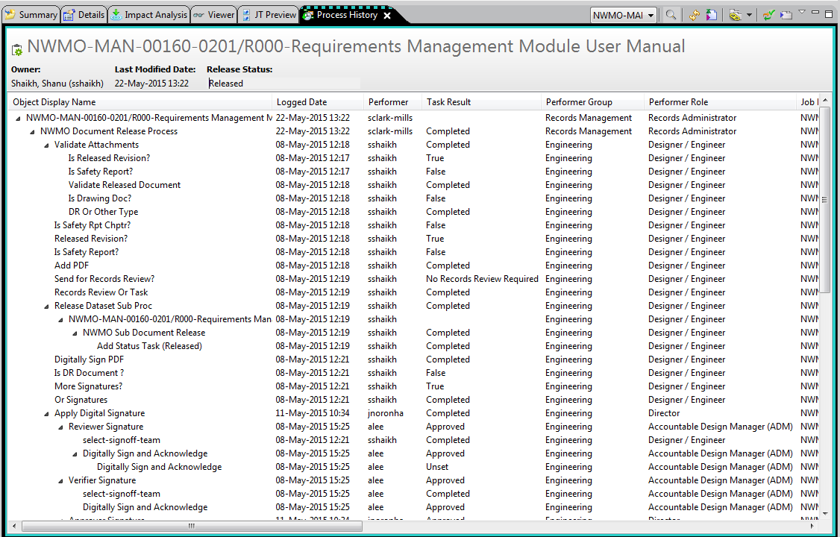
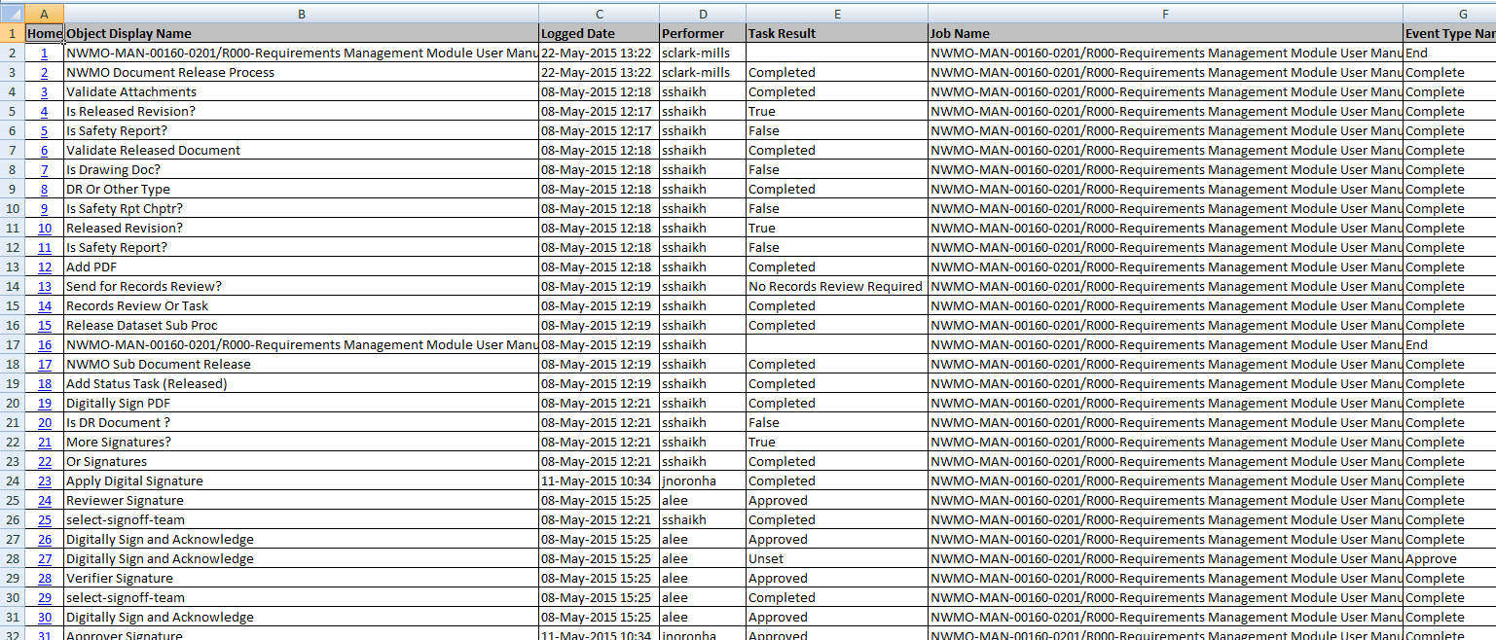
Document Control Module – Audit History

Slide 45
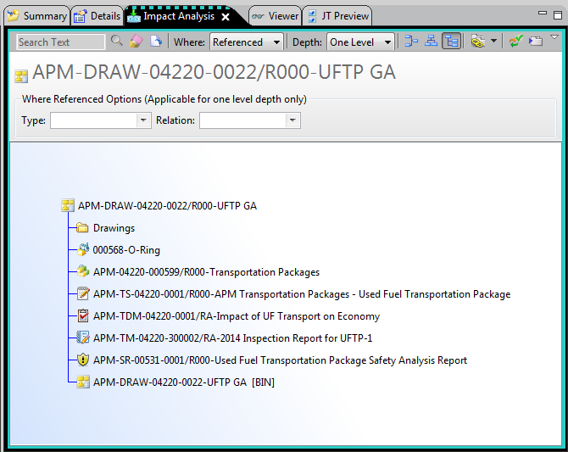
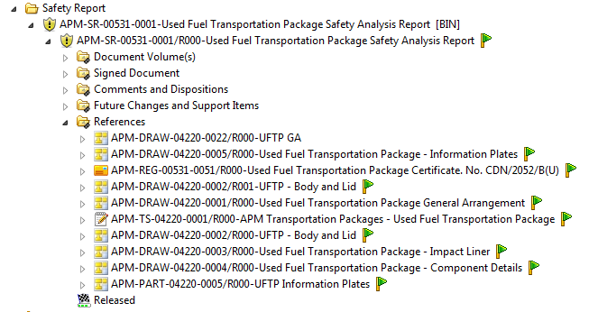
Document Control Module – Impact Analysis
Links can be created between document objects, requirement object, change objects and MEL objects

Slide 46
Requirements Management (RM) Module
Design requirements are initiated in MS Word and then imported in the CM system where they are decomposed into individual requirements and paragraphs with unique IDs
Cross linking capability – Each requirement can be linked to other requirement, document objects, MEL objects and change objects
Hierarchical tree structure produced in the RM module
The tree structure can be exported out in NWMO DR template to produce a DR document that can signed/sealed and issued to regulatory bodies

Slide 47
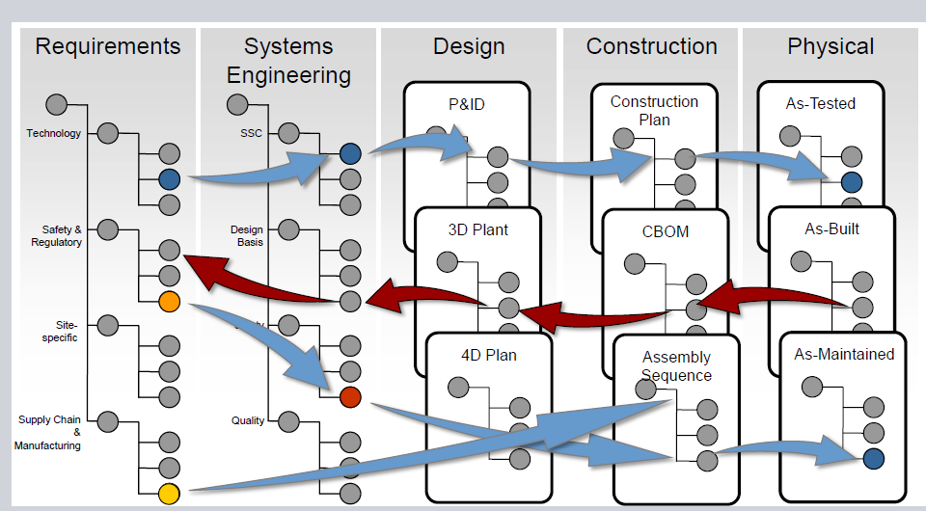
Requirements Lifecycle Traceability

Slide 48
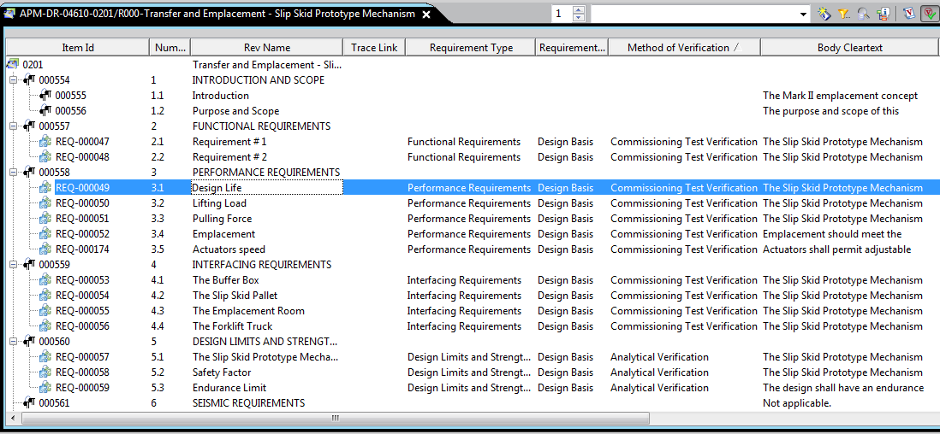
Requirements Structure Manager

Slide 49
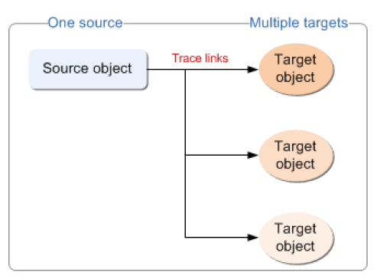
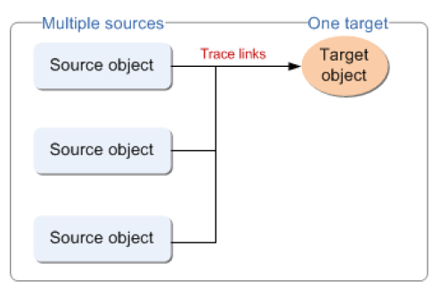
RM Module – Trace Links
A trace link establishes a directional relationship between two business objects (requirement, document, MEL and DCN objects)
In this relationship, one business object Defines a condition with which the other business object(s) must Comply
A given business object may define some objects and itself may also comply with other objects

Slide 50
Requirements Review and Approval
When the requirement structure is ready for review, it is exported out in NWMO’s Design Requirement template in MS Word. Then it is sent out for review using the Document Release workflow discussed in previous slides
Reviewers provide comments on the MS Word export file, which are dispositioned by the author and then resent back to the reviewers for disposition acceptance
The requirement structure is then updated based on comments, re-exported in MS Word and finally Adobe PDF is created, which sent out for digital signatures
There is a provision in the workflow to export the document out for application of Professional Engineer’s seal

Slide 51
Advantages of Managing Requirements
Organizing Requirements into a structure can assist in:
Minimizing the number of requirements
Understanding large amount of data efficiently (data is decomposed into bits of information)
Grouping of similar or standard requirements (consistency)
Detecting duplications and irrelevant data
Eliminating conflicts between requirements
Maintaining requirements iteration (revisions) efficiently
Evaluating, Categorizing and Linking of requirements
Reusing of standard requirements across various project
Ref: Hull, E., Jackson, K and Dick, J (2011) – Requirements Engineering (Third Edition)

Slide 52
Overall Lessons Learned
Top Down Approach is essential for project success
Regular communication with project team and future user community
Included core project team in development of requirements and Sandbox Phase testing
Include core project team in decision making (i.e. vendor selection)
Promptly respond and disposition issues initiated by core project tean
Targeted training sessions – only train what is required
Support Squads to provide user support after deployment (in most cases issues are user related; resolve them before they blow-up)
Issue user friendly manuals (use case based with snapshots and detailed instructions)

Slide 53
Overall Lessons Learned
“Change is difficult to Accept”, remind users frequently of why we are using the CM system (this will keep the morale high during initial teething pains)
Not all users learn at the same pace. Be patient with users who need more attention and practise
Ensure workflows to be configured are reviewed and approved by all required stakeholders (making adhoc changes is time consuming and expensive)
If permitted, perform preliminary testing on the workflows during development
Thoroughly test the configured workflows thru all negation loops (negation loops are most prone to errors and issues)

Slide 54
Overall Lessons Learned
Allot ample time for system testing and fixing of issues discovered during testing
Ensure programmers perform a sanity test on the configured workflows prior to issuing it for UAT testing
Ensure vendor is contractually obliged to maintain the project team
Clearly define IT and Business Admin boundaries (pen it down in the form of a procedure)
If possible, use local vendors to minimize logistical issues

Slide 55
Questions?
Thank You
55

