Slide 1

The Status and Prospect of Nuclear Power in Korea
2015 CMBG Conference
June 8, 2015
Sungun Cho
rootofchosun@gmail.com

Slide 2
Contents
1. History of Nuclear Power in Korea
2. Status of Korea’s Nuclear Industry
3. Prospect of Nuclear Power in Korea
4. Summary

Slide 3
Part 1
History of Nuclear Power in Korea
3

Slide 4
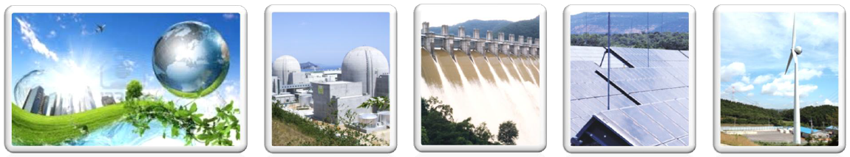
Introduction of KHNP
What is KHNP?
KHNP : Korea Hydro & Nuclear Power Company
- Korea’s largest power generator, sole utility for nuclear power
Established: April 2001 (separated from KEPCO)
Facilities: Nuclear, Hydro, Pumped Storage, Renewable
Employees: 9,808 (as of Dec. 2014)

Slide 5
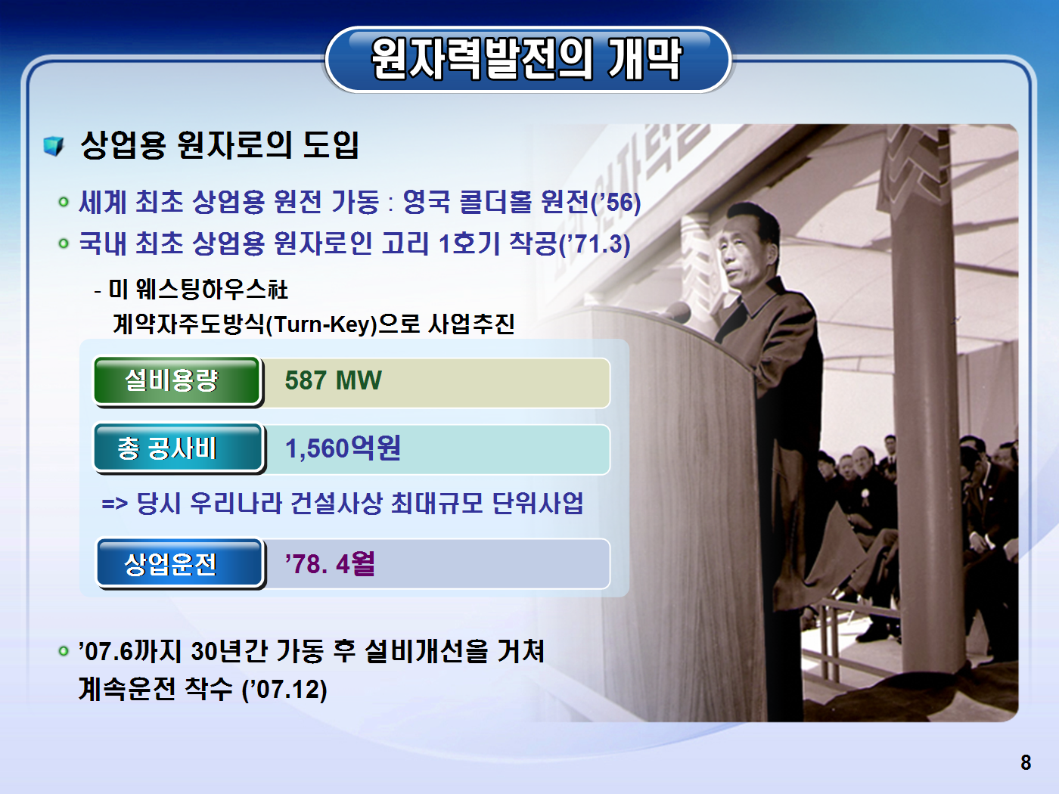
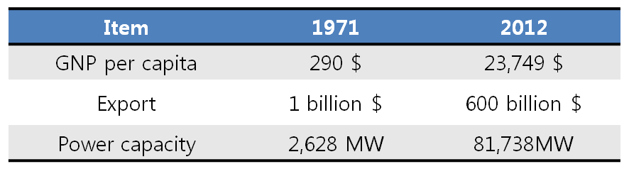

Beginning of Nuclear Power in Korea
Research reactor
TRIGA MARK Ⅱ(Jul. ‘59)
Commercial reactor
Kori #1
Capacity : 587MW
Construction period: 7 years (Mar. ’71 ~ Apr. ’78)
Project type: Turnkey (Westinghouse/USA)
Construction cost: 320 million $
(foreign capital: 170 million $)
※ Life-extended after 30 years of operation (Dec. ‘07)
<1971 vs. 2012, Korea>

Slide 6
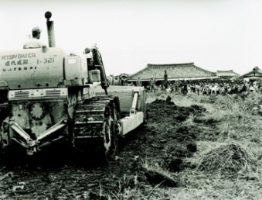
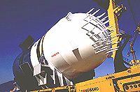
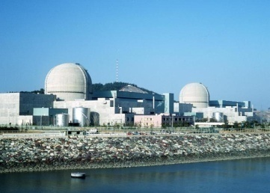
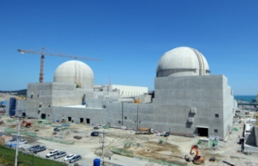
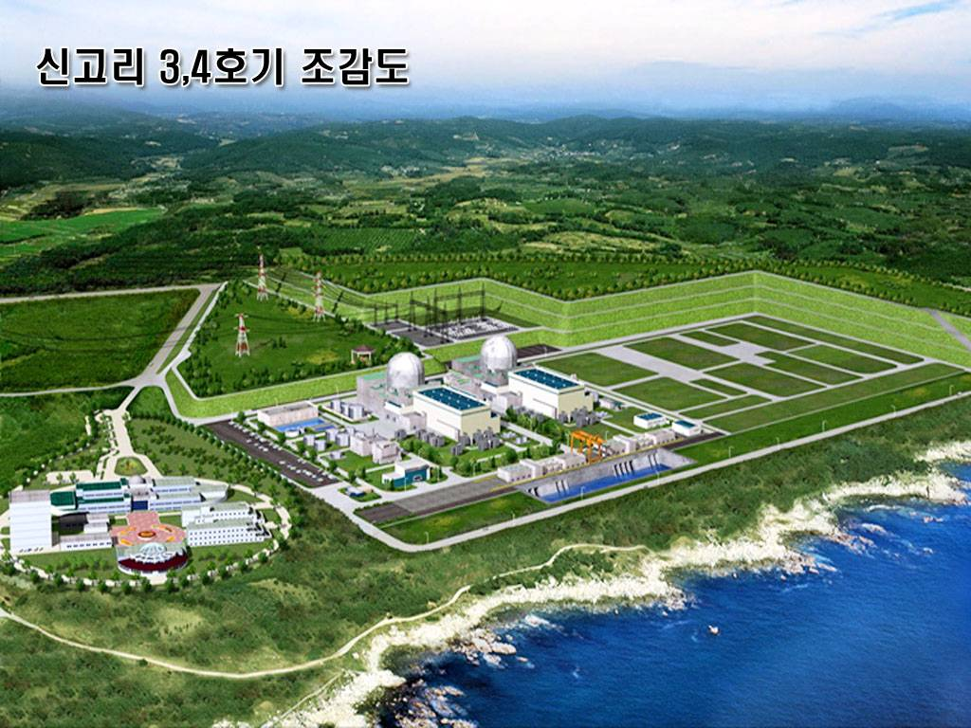
History of Nuclear Power in Korea
1970s
1980s
1990s
2000s
2012
Foreign Technology
Dependence
Technology
Accumulation
Technology
Self-Reliance
Technology
Advancement
Complete
Technology
Independence
Turnkey Approach
Non-Turnkey
Approach
Development
of OPR1000
Development
of APR1400
Nu-Tech 2012
- Led by Foreign
Contractors
Development of APR+
Localization of Core
Technologies
[RCP, MMIS, Core
Design Codes]
- Joint
Implementation
- Led by Local
Contractors
Export to UAE (2010)
Completion of
First APR1400 (2013)
Completion of
Kori #1 (1978)
Completion of
First OPR1000 (1995)

Slide 7
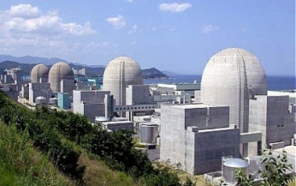
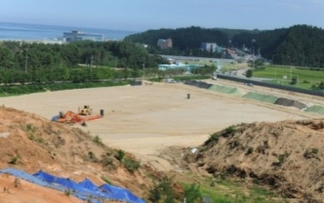

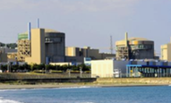
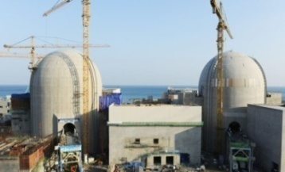

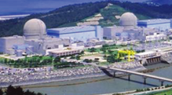
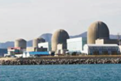
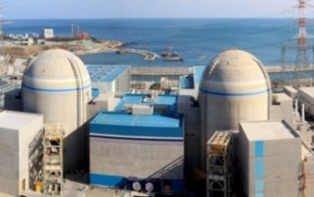
Nuclear Sites in Korea
(as of May 2015)
Operating
23 Units
20,716MW
Constructing
5 Units
6,600MW
Planning
4Units
5,600MW
Hanul 1,2,3,4,5,6
Shin-Hanul 1,2
Shin-Hanul 3,4
Uljin
Wolsong 1,2,3,4
(PHWR)
Shin-Wolsong 1
Shin-Wolsong 2
Wolsong
Yeonggwang
Busan
Hanbit 1,2,3,4,5,6
Kori 1,2,3,4
Shin-Kori 1,2
Shin-Kori 3,4
Shin-Kori 5,6

Slide 8


NPP Capacity in Korea
Capacity[MWe]
25,000
NPP Capacity [MWe]
20,000
15,000
10,000
5,000
0
'78
'83
'88
'93
'98
'03
'08
'12
'15

Slide 9
Reactor Types & Suppliers
NPPs |  | Capacity (MW) | Type | Suppliers |  | Plant A/E | Commercial Operation
 |  |  |  | NSSS | TBN
Ⅰ.Kori | #1 #2 #3 #4 SK #1 SK #2 | 587 650 950 950 1000 1000 | PWR | W | GEC | Gilbert | '78. 4 '83. 7 '85. 9 '86. 4
 |  |  |  |  |  | Bechtel
 |  |  |  | DHIC/WH | DHIC/GE | KOPEC/S&L | '11. 2 '12. 7
Ⅱ. Wolsong | #1 #2 #3 #4 | 679 700 700 700 | PHWR | AECL | Parsons | Canatom | '83. 4 '97. 6 '98. 6 '99. 9
 |  |  |  | DHIC/AECL | DHIC/GE | AECL/KOPEC
 | SW #1 | 1000 | PWR | DHIC/WH | DHIC/GE | KOPEC/S&L | '12. 7
 | SW #2 | 1000 | PWR | DHIC/WH | DHIC/GE | KOPEC/S&L | '15. 7(Plan)
Ⅲ. Hanbit | #1 #2 #3 #4 #5 #6 | 950 950 1,000 1,000 1,000 1,000 | PWR | W | W | Bechtel | '86. 8 '87. 6 '95. 5 '96. 1 '02. 5 '02.12
 |  |  |  | DHIC/CE | DHIC/GE | KOPEC/S&L
 |  |  |  | DHIC/WH | DHIC/GE
Ⅳ. Hanul | #1 #2 #3 #4 #5 #6 | 950 950 1,000 1,000 1,000 1,000 | PWR | Framatome | Alstom | Framatome/Alstom | '88. 9 '89. 9
 |  |  |  | DHIC/CE | DHIC/GE | KOPEC/ S&L | '98. 8 '99.12 '04. 7 '05. 4
 |  |  |  | DHIC/WH | DHIC/GE

Slide 10
Part 2
Status of Korea’s Nuclear Industry

Slide 11
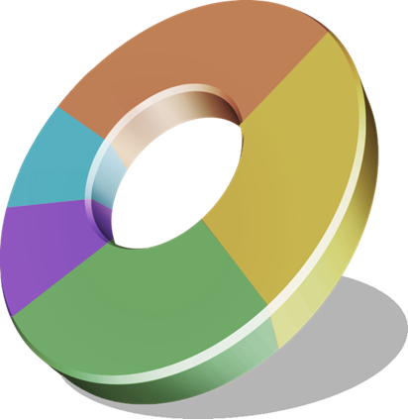
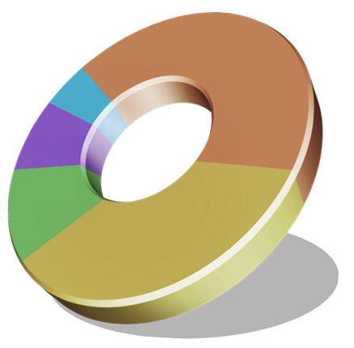
Generation Mix in Korea
(as of Dec. 2014)
Installed Capacity
Electricity Generation
Nuclear
20,716MW
Nuclear
156,407GWh
(22.2%)
(30.0%)
Oil
Others
(3.0%)
Coal
Others
(11.7%)
(29.0%)
(6.0%)
Oil
Gas
Coal
(4.6%)
Gas
(22.0%)
(32.5%)
(39.0%)
Others : Hydroelectric, Renewable, etc.
Others : Hydroelectric, Renewable, etc.
TOTAL: 93,216MW
TOTAL: 521,971GWh
Nuclear power is used as a base load

Slide 12

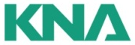
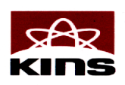









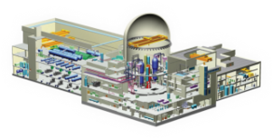
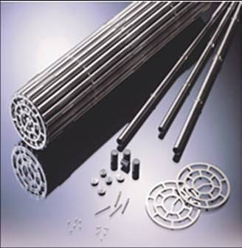
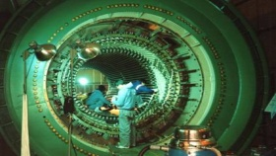
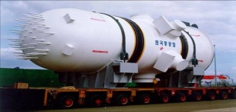





Structure of Korea’s Nuclear Industry
  Korea is one of the few countries in the world that have continuously and aggressively implemented NPP projects since the 1970s
International
Cooperation
NSSC (Nuclear Safety & Security Commission)
Utility Project Management
Commissioning
O&M
Research and Development
Licensing
Nuclear Safety
Inspection
Design and Engineering
Nuclear Fuel
Maintenance and Services
Equipment Manufacturing
Construction

Slide 13



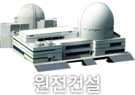







Reactors under Construction &
Planning
Construction
Planning
KOREA
Sep. 2016
Mar. 2021
Mar. 2022
Shin-Kori 3
Shin-Kori 4
Shin-Kori 5
Shin-Kori 6
APR1400
APR1400
Shin-Kori 7
Shin-Kori 8
APR+
APR+
Shin-Kori
Apr. 2017
Apr. 2018
Shin-Hanul 1
Shin-Hanul 2
Sep. 2022
Sep. 2023
APR1400
APR1400
Shin-Hanul 3
Shin-Hanul 4
APR1400
APR1400
Shin-Hanul
July 2015
Shin-Wolsong 2
OPR1000
Shin-Wolsong
May 2017
May 2018
UAE 1
UAE 2
APR1400
APR1400
May 2019
May 2020
UAE 3
UAE 4
APR1400
APR1400
UAE

Slide 14

Construction Performance of NPPs
Project Cost & Period Reduction
Cost
About 30%
Cost Reduction
Period
From 64 months to 52 months
Period Reduction
YGN #3,4
(’95, ’96)
UCN #5,6
(’04,’05)
SWN #1,2
(’12,’13)
Korea has completed 23 NPP projects within the planned schedules & costs
Notes:
The capital cost of nuclear power generation is a huge expenditure. However, Korea has been able to reduce this by 30% over the past ten years through repetitive construction of NPPs and applying new construction technologies.

Slide 15










Operation Performance of NPPs
KHNP’s operational capability competes with top global players
Worldwide Nuclear Generation Capacity¹
Nuclear Capacity Factor¹
(Unit : MW)
99,098
91.7%
91.2%
90.7%
Ranked
5th
63,130
82.3%
84.99%
42,569
78.7%
80.5%
77.4%
75.5%
17,042
20,716
24,253
72.2%
72.6%
12,003
13,168
13,553
Germany Ukraine Canada China Korea Russia Japan France USA
2009 2010 2011 2012 2013 2014
Collective Radiation Dose²
Korea ranks 5th in the world in terms of
generation capacity.
KHNP maintains close insight & regulation
circumstance regulatory agencies
(NSSC, MOTIE, IAEA, INPO, WANO, etc).
World Avg. (2010.01 ~ 2013.12) = 0.81
KHNP Avg. (2010.01 ~ 2013.12) = 0.57 (48 months)
2013
2012
World Avg
0.80
0.72
KHNP Avg
0.53
0.56
0.55
KHNP has a record of over 35 years of
operation without higher level accident by INES
0.46
0.43
0.41
※ NSSC: Nuclear Safety & Security Commission, MOTIE: Ministry of Trade, Industry & Energy
1. IAEA Load Factor as of June 2014. Company data, as of June 2014 2. World Nuclear Association. Company data for Korea.

Slide 16

Strengths of Korea’s Nuclear Industry
1
Government’s Strong Policy
ensures consistency in nuclear projects
2
Robust Supply Chain
for the entire NPP life cycle
Premier
NPP
3
Qualified Human Resources
investing in HRD from early stages of NPP adoption
4
Reliability
proven by the world’s best operation performance
5
Economic advantage
with optimized construction duration and costs

Slide 17
Part 3
Prospect of Nuclear Power in Korea

Slide 18

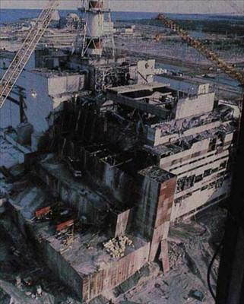

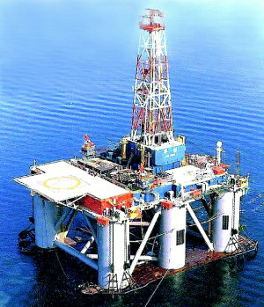

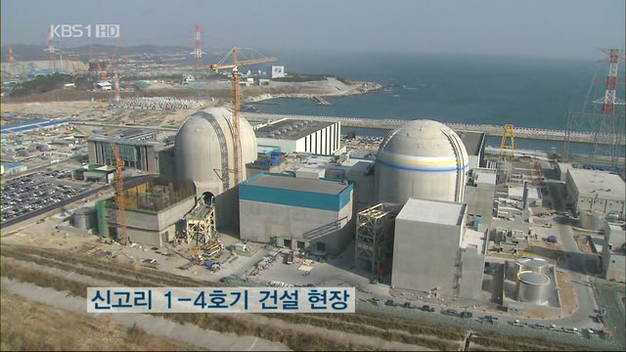

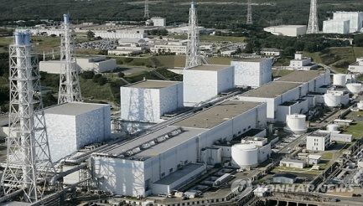
Global Nuclear Industry Environmental Change
Slowdown of the Nuclear Industry
US TMI accident(1979), Chernobyl accident(1986)
➢ US and Europe stopped new builds
Environmental Change
Rising demands on alternative energy due to high oil prices
Enhanced awareness of international community and
environmental organizations to prevent global warming
The 2nd Nuclear Renaissance
Increased global use of nuclear power
➢ Existing nuclear holders resumed new builds and
more countries introduced initial nuclear power
Fukushima Nuclear Accident
Low impact on other countries’ nuclear policies except
for Germany, Italy, Switzerland and Japan according to a
survey from the World Energy Council

Slide 19
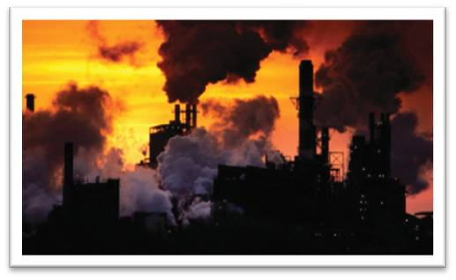
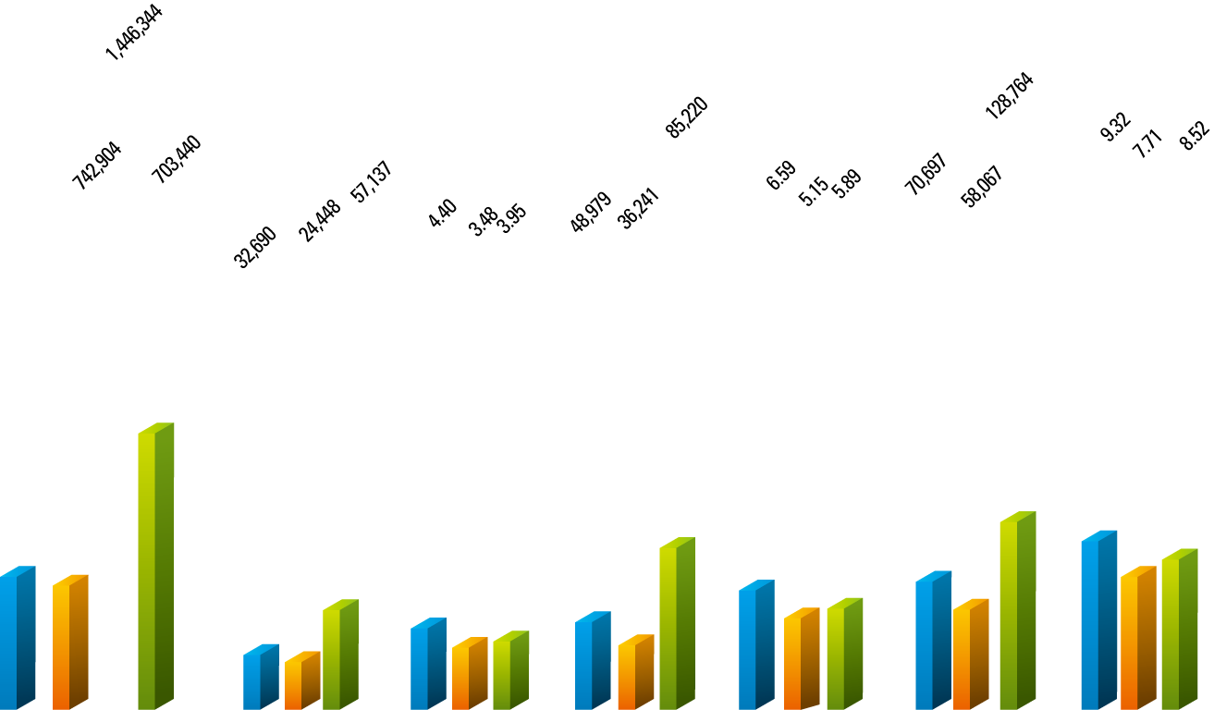
CO₂ Emissions by Power Generation Source
Nuclear : A clean energy with low CO₂ emissions
A realistic alternative to address environmental problems
caused by global warming
CO₂
(g/kWh)
Low CO₂ Emission
991
782
800
549
400
70
57
14
10
0
Coal
Oil
Gas
Bio
Solar
Wind
Nuclear

Slide 20


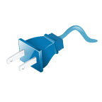
Low Price of Electricity with Nuclear Power
Economic efficiency
Sales price (¢/kWh): Nuclear is the cheapest
49.8
14.8
11.0
10.3
9.7
6.7
3.2
Solar
Oil
Gas
Hydro
Wind
Coal
Nuclear
Contribution to national economy
217% rise in consumer price
23.3% rise in electricity price
1982
2011

Slide 21
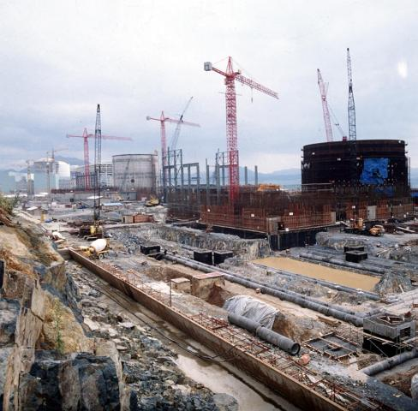
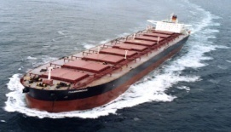

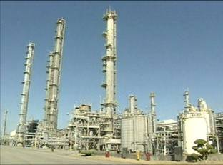




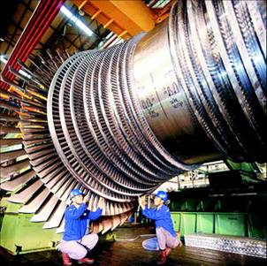
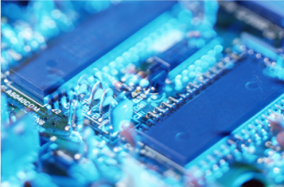
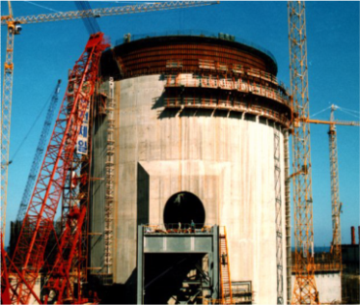
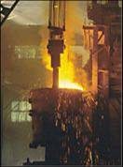
Ripple Effect of NPP Construction
Classification | Contents
No. of Parts | 5 million
No. of Work Activities | 80,000
Project Period | 10 years
Manpower | 10 million MD
Concrete | 880,000 m³
Reinforced Bar | 140,000 ton
Classification | Contents
Reinforced Bar | 140,000 ton
Cable | 6,100 ㎞
Pipe | 416 ㎞
No. of Companies | 300
Site Area | 880,000 m²
※ Construction of 2 Units (APR1400)
Chemistry
Shipbuilding
Machinery
Metal
Electronics
Construction

Slide 22


Drivers for Nuclear Energy
Energy Demand
Steady growth in electricity capacity
Economy
Low price of electricity and high capacity factor
Great ripple effect from NPP construction
Climate Change
Low CO2 emissions
Security of Supply
Several years’ supply of fuel can be easily and inexpensively stored
Uranium available in number of countries
Exhaustion of fossil fuels

Slide 23

Recent Issues against Nuclear in Korea
Effects of Fukushima nuclear accident in 2011
Frequent failures in NPP Equipment
CGID Counterfeited Certificate in 2012, 2013
Penalty for Inadequate Configuration Management
Difficulties in maintaining
public trust and acceptance

Slide 24

Efforts to Continue Nuclear Power
Increase Safety of NPPs
Practicing Safety-First Management
Implementing Post-Fukushima Measures
Applying advanced engineering program
Energy Demand Forecast
GHG-Free
Energy
Energy Security
Cheap Energy
Until New & Renewable energy
can fully replace fossil energy,
Continuous “Nuclear Power Generation” is Necessary
Secure Public Acceptance
-Enhancing safety culture
-Reinforcing internal/external
communications
-Improve work transparency
Prerequisites for Optimum Energy Mix

Slide 25
Summary
Since first introducing NPPs in the 1970s, Korea has continuously constructed NPPs for 40 years
This has contributed to the nation’s economic development
Korea has achieved technology independence, and has become a world-class nuclear power nation through its strong supply chain, qualified human resources, and outstanding operational performance
Nuclear power is crucial to secure economical, stable, and environment-friendly energy
Korea will continue to pursue nuclear power by reinforcing NPP safety and increasing public acceptance

Slide 26



