Slide 1
Design Change Construction & Completion Management (Outline and related procedures)
Hanul NPP Engineering Center
Notes:
Hello, My name is moon ki, yeo. I am working to mechanical Design team seven years ago. Everybody was known Design Change

Slide 2
Content
Design Change Construction Request
Design Change Construction Management
Design Change Completion Management

Slide 3
Introduction
Purpose
This document provides guidelines regarding standards
And procedures necessary for construction, follow-up
Responses and completion of the design change document.
Scope
It applies to the design change construction, follow-up responses(procedure revisions, simulator application operator training and facility master establishment & revision) and tasks for completion including the original drawing revision.

Slide 4
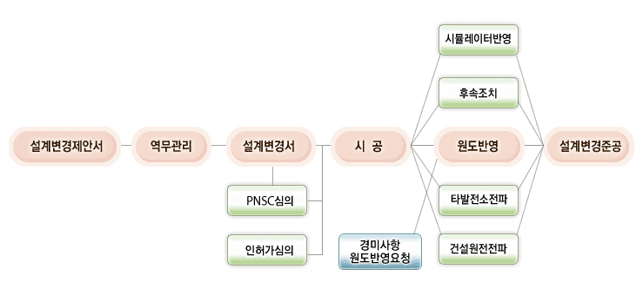
Procedure
Design Change Construction & Completion
Design Change Proposal
Design Change Package
construction
Original Drawing Change
Completion

Slide 5
Procedure
Design Engineering Department | Related Department | Quality Assurance Department | Construction Engineering Department
Notice
1
Construction
Review of
Operating procedure, education,
Equipment master
Performance
test
Reflection of drawing, documents revision
Review of completion
documents
Completion of drawing,
Document etc.
2
Transfer to library
3
Completion of design change

Slide 6
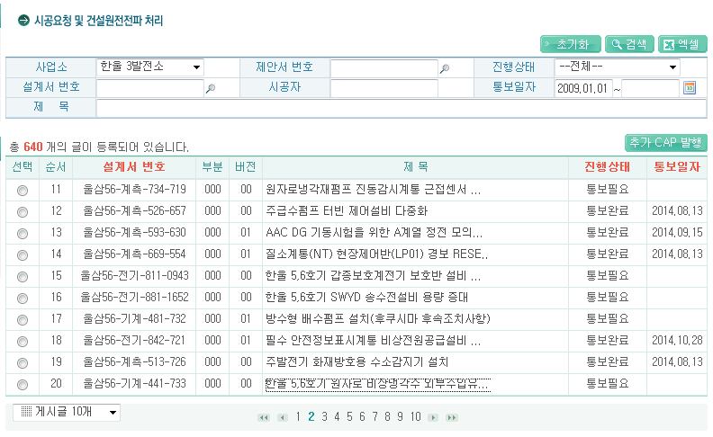
Design Change Construction Request
Searching Informations

Slide 7
Design Change Construction Request
Notice Button
When the design change document is approved, the leading design team issues the notice, the notice“e-CAP”
Is automatically issued in accordance with the date of work and the corresponding team implements the notice and inputs the results on the e-CAP

Slide 8
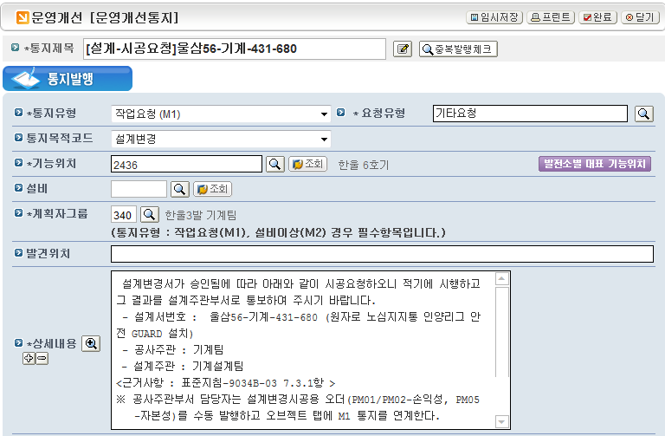
Design Change Construction Request
Completion button
Automatically formation
Construction Engineering Department
Input

Slide 9
Procedure
Design Engineering Department | Related Department | Quality Assurance Department | Construction Engineering Department
Notice
1
Construction
Review of
Operating procedure, education,
Equipment master
Performance
test
Reflection of drawing, documents revision
Review of completion
documents
Completion of drawing,
Document etc.
2
Transfer to library
3
Completion of design change

Slide 10
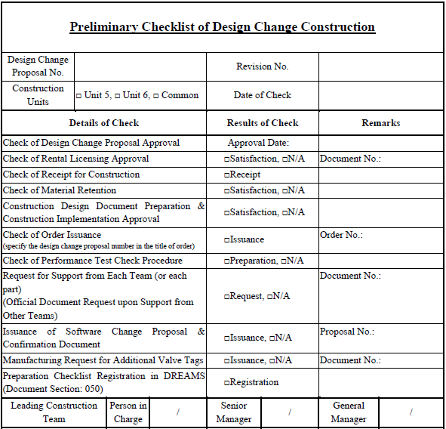
Design Change Construction Management
The leading construction team Performs the design change items requested in accordance with “Preliminary Checklist of Design Change Construction”, register them on DREAMS(Document Section : 050)

Slide 11
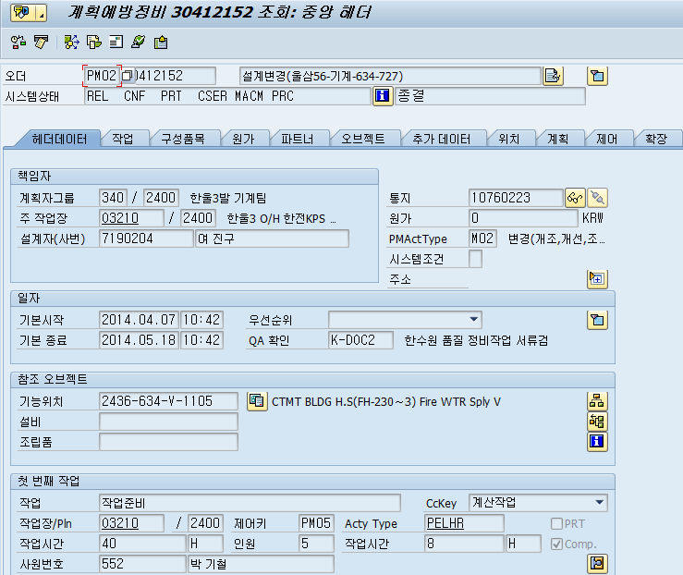
Design Change Construction Management
Issues the work order.
The leading construction team gives the corresponding team(construction support team) a workings notice if necessary
When a performance test is necessary, after completion of the work, the leading construction team carries out the test along with the leading design team, facility operation team and quality assurance(technical) team

Slide 12
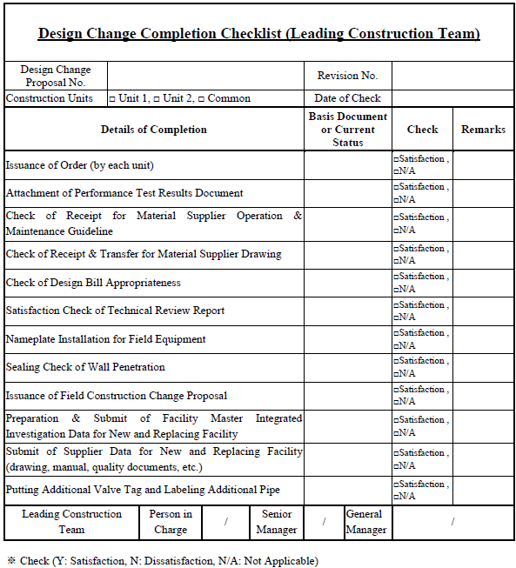
Design Change Construction Management
The leading construction team completes the design change, checks all the related documents in accordance with “Design change completion checklist”within two months and requests the leading design team for the completion

Slide 13
Design Change Construction Management
In completion of the design change document, the leading construction team uses the design change document registration menu of ECMS to register the document as follow
Document section upon completion request by each unit
: odd unit 070 / even unit 080
2) Document section upon completion request for twin & common units : 090

Slide 14
Design Change Construction Management
3) Train completion : It is identified by the last number of the document section for the twin and common units
Train completion of odd unit : document section 071(A), 072(B)··
Train completion of even unit : document section 081(A), 082(B) ·
Train completion of twin & common units : document section
: 091(A), 092(B) ··

Slide 15
Design Change Construction Management
The leading construction team designates the approval line as shown below, using the approval function “Document Approval”in DREAMS or ECMS for the completion document of the design change and requests the approval.
Line 1 : senior manager of the leading construction team
2) Line 2 : general manager of the leading construction team
3) Line 3 : review by related teams
Mandatory review teams : operation supporting section, general manager of quality assurance team, procedure related team
Optional review teams : construction support, tasks related teams
4) Line 4 : general manager of the system engineering team

Slide 16
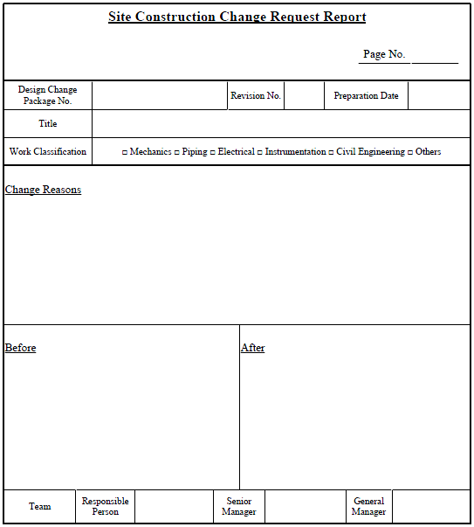
Design Change Construction Management
The lead construction team describes site construction change request items on the related item section of the design change packages and attaches those items to the site construction change request report, upon requesting construction completion.
If necessary, the lead design team provides data including revised drawings for site construction to the lead construction team.

Slide 17
Design Change Construction Management
“Site Construction Change Request Report” should be numbered the same as first design change packages. But, document should be numbered as document section 031~ 040
The path for requesting approval should be as follows
1) Line 1 : senior manager of the design change package preparation team
2) Line 2 : general manager of the design change package preparation team
3) Line 3 : general manager of the quality assurance team or related teams
4) Line 4 : general manager of the lead design team

Slide 18
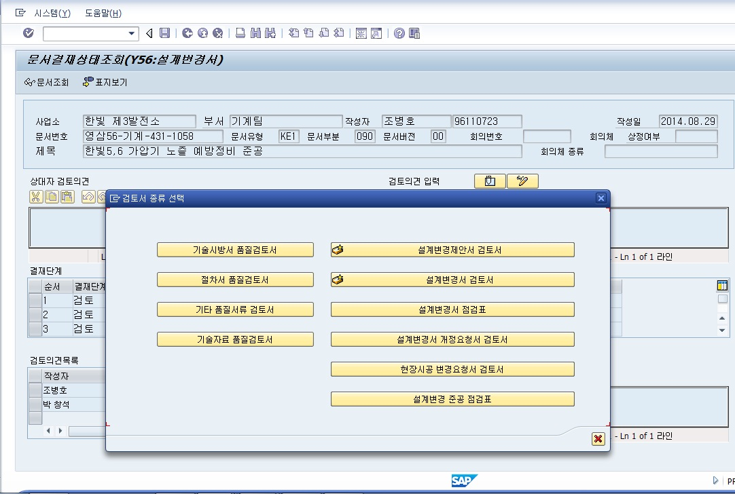
Design Change Construction Management
1
Reviewing according to design change completion
checklist (lead construction team)
1
2
Click on #1, and then on #2 in the “select review report type” pop-up window,
and enter the checklist of the corresponding team.

Slide 19
Design Change Construction Management
2
Reviewing according to design change completion
checklist (lead construction team)
Design Change Completion Checklist (lead construction team)
Check Item | Supporting Document or Status | Verification | Remark
Check that work order is attached |  | □ Sat., □ N/A
Check operating experience/design change at other plants and units |  | □ Sat., □ N/A
Check that performance test result document is attached |  | □ Sat., □ N/A
Check that material supplier’s operation/maintenance manual is handed over |  | □ Sat., □ N/A
Check that material supplier’s drawing is received |  | □ Sat., □ N/A
Check whether a tag is attached to the component installed in the field |  | □ Sat., □ N/A
Check whether EQ and SQ are needed |  | □ Sat., □ N/A
Check that software configuration change notification is closed out |  | □ Sat., □ N/A
Check that wall penetration is sealed |  | □ Sat., □ N/A
Check the local construction change request |  | □ Sat., □ N/A
Check training on details of design change |  | □ Sat., □ N/A

Slide 20
Design Change Construction Management
4
Reviewing according to design change completion
checklist (lead design team)
Design Change Completion Checklist (lead design team)
Check Item | Check Result | Remark
Check whether the FSAR is revised or not | □ Sat., □ N/A
Check operating experience/design change at other plants and units | □ Sat., □ N/A
Check that revision of the setpoint list is completed | □ Sat., □ N/A
Check that EQ and SQ are needed | □ Sat., □ N/A
Check that the design change is incorporated into the original drawing. - including check that the design change is incorporated into the local construction change request | □ Sat., □ N/A
Incorporate the drawing revision into the original drawing | □ Sat., □ N/A
Check whether Design Report is issued and revised - including the certification of Registered Professional Engineer (RPE) | □ Sat., □ N/A
Check whether Design Calculation is issued and revised | □ Sat., □ N/A
Check whether Stress Report is issued and revised | □ Sat., □ N/A
Check whether Safety Analysis Report is issued and revised | □ Sat., □ N/A

Slide 21
Design Change Construction Management
5
Reviewing according to design change completion
checklist (Mechanical Engineering Team)
Design Change Completion Checklist (Mechanical Engineering Team)
Check Item | Supporting Document and Status | Verification | Remark
Additional pipe labeling |  | □ Sat., □ N/A
Check whether the existing equipment master is discarded |  | □ Sat., □ N/A
Check whether development/revision of the corresponding procedure is completed |  | □ Sat., □ N/A
Check whether Design Report is issued and revised - including the certification of Registered Professional Engineer (RPE) |  | □ Sat., □ N/A
Check whether Design Calculation is issued and revised |  | □ Sat., □ N/A
Check whether Stress Report is issued and revised |  | □ Sat., □ N/A
Check whether Safety Analysis Report is issued and revised |  | □ Sat., □ N/A

Slide 22
Procedure
Design Engineering Department | Related Department | Quality Assurance Department | Construction Engineering Department
Notice
1
Construction
Review of
Operating procedure, education,
Equipment master
Performance
test
Reflection of drawing, documents revision
Review of completion
documents
Completion of drawing,
Document etc.
2
Transfer to library
3
Completion of design change

Slide 23
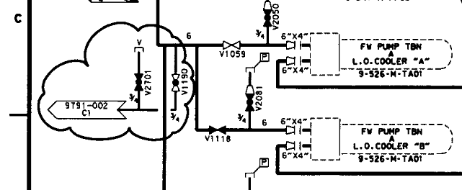
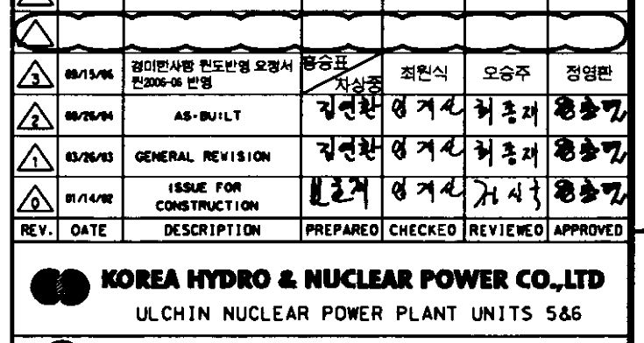
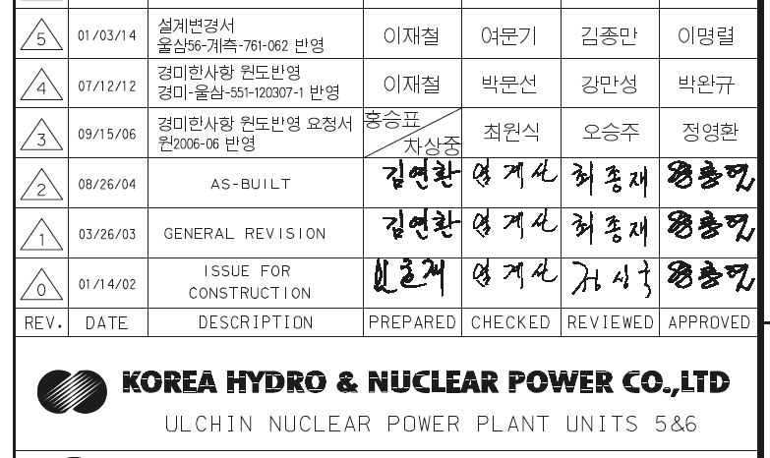
Design Change Completion Management
The leading design team receives documents from the leading construction team after completion of the design change and reviews irregularities before applying to the original drawing as follows
The changed contents are marked on the drawing
2) The design change proposal number and reason of change are
recorded on the blank for modifications of the original drawing

Slide 24
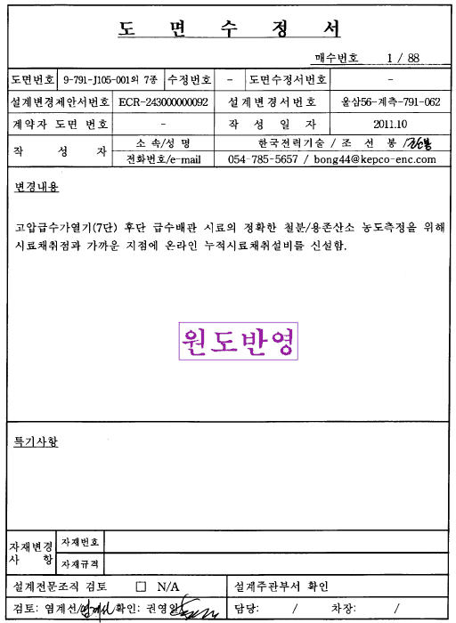
Design Change Completion Management
3)“Application of Original Drawing” is recorded on the modified drawing after the application of the original drawing is completed

Slide 25
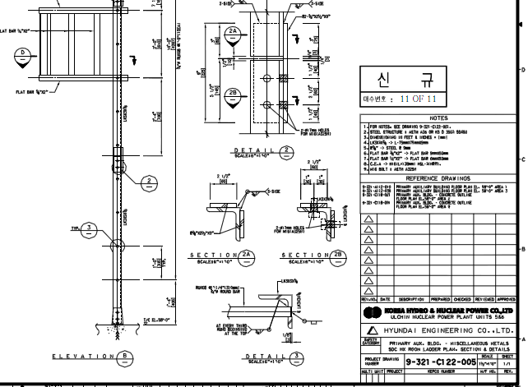
Design Change Completion Management
4) If the additional modification is not possible during the drawing modification, another original drawing or a partly detailed original drawing can be prepared

Slide 26
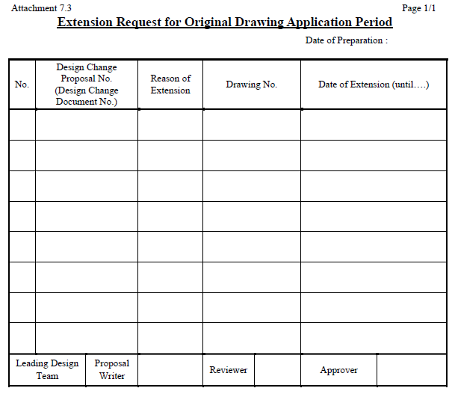
Design Change Completion Management
5) The drawing to be modified is applied to the original drawing within two months after the construction document was received. However, it can be extended by one month further when requested using the “Extension Request for Original Drawing Application Period” to obtain approval from the leading design team

Slide 27
Design Change Completion Management
The leading design team determines the need of the period extension for facility operation and modifies the following drawings first, then distributes or registers them in DREAMS
Light Water Reactor Power Plants
- P&ID
- SOD (System Operation Diagram)
- EWD (Elementary Wiring Diagram)
- SLD (Single Line Diagram)
- CLD (Control Logic Diagram)
- electrical load list and total list of set points
Heavy Water Reactor Power Plant
- OF (Operating Flow sheet)
- FS (Flow Sheet)
- ED (Elementary Diagram)
- LD (Logic Diagram)
- total List of set points

Slide 28
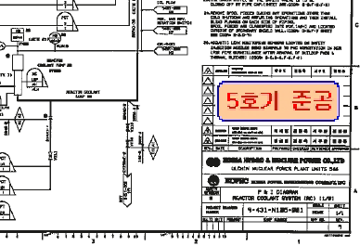
Design Change Completion Management
When just one unit is completed, the leading design team modifies the plant drawing necessary for the facility operation, stamps “X Unit Completion” on the drawing and registers in DREAMS or distributes the drawing document to the corresponding unit

Slide 29
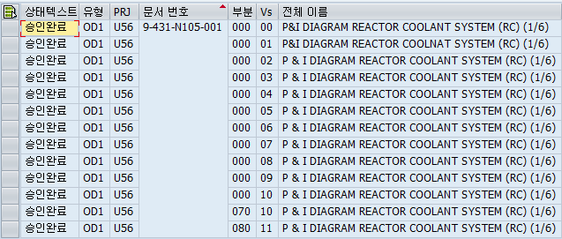
Design Change Completion Management
For the drawing registration in DREAMS, follow the document type(*D*) of the data management for each plant.
For the registration of the document section, apply the document section at the time when the completion request took place and for the version registration, apply the final version of the corresponding drawing

Slide 30
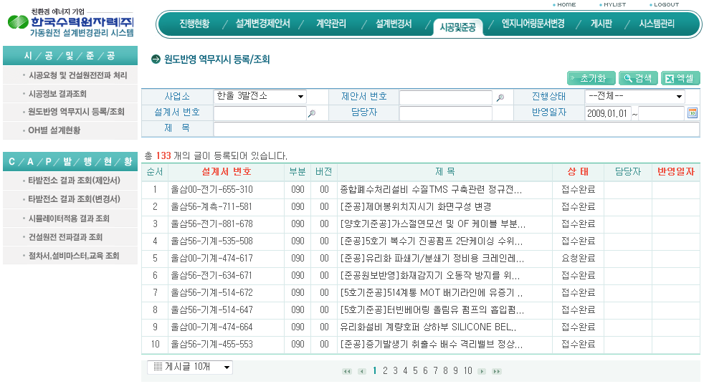
Design Change Completion Management
The leading design team searches complete design change construction

Slide 31
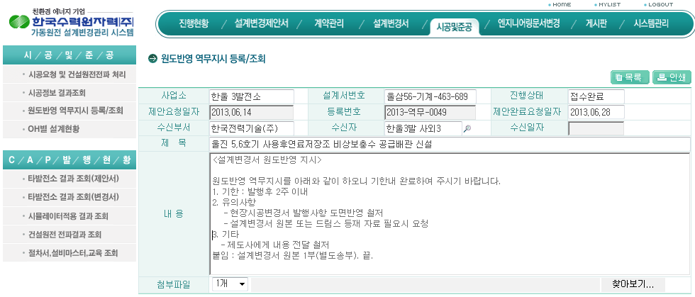
Design Change Completion Management
Automatical Input
Drawing revision instructions to draftsperson
The leading design team applies modifications of the design change proposal, which has been approved for completion request of the twin or common units, to the original drawing.

Slide 32
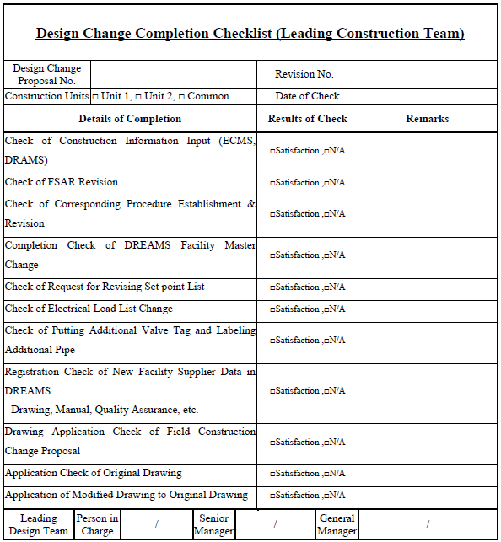
Design Change Completion Management
When the original drawing application is completed, the leading design team prepares and attaches “Design Change Completion Check list”before signing on the cover of the design change proposal.

Slide 33
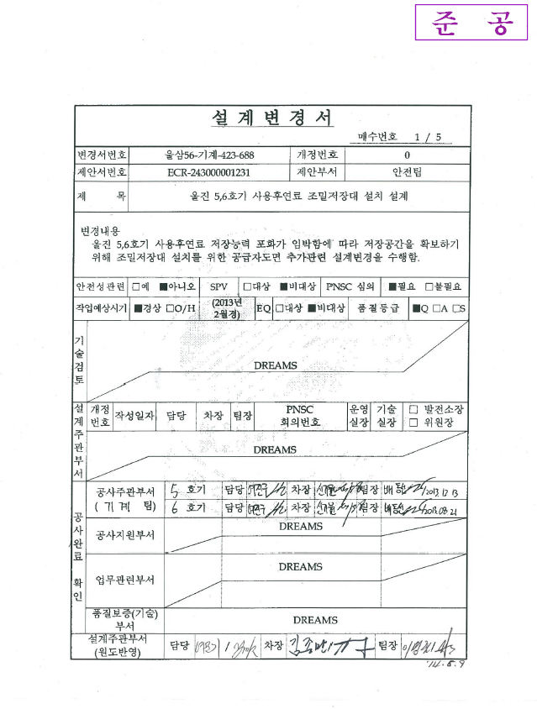
Design Change Completion Management
‘Completion’ Stamp
Next, the team stamps ‘Completion’ on the design change related documents, registers them in DREAMS(Document Section 100 Creation) and transfers the DCP documents to the data room in accordance with Date Transfer Procedures
signature

Slide 34
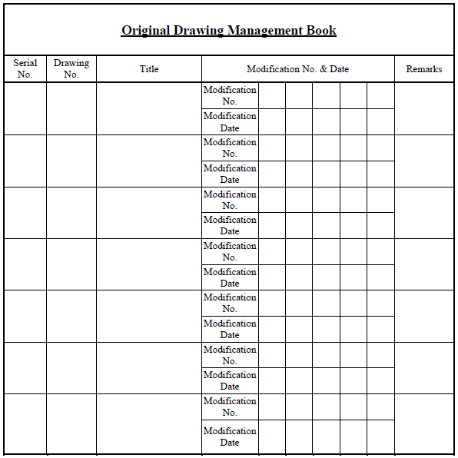
Design Change Completion Management
The leading design team records the approved original drawing on
“Original Drawing Management Book”and transfers it to the plant data room.
If the original drawing book needs to be replaced with the computer file, the management items of the corresponding form should be recorded.

Slide 35
Thank You!
KHNP Engineering Center

