Slide 1
Introduction to CMIS, an Electronic Design Change Process
Presented by:
Mark Gillis (FirstEnergy) and Brad Diggans (Rolls-Royce)

Slide 2
Topics of Discussion
What is CMIS?
General Capabilities
Key Features
Industry Sharing
Data Integration
Summary

Slide 3
What is CMIS?
Configuration Management Interface System
A paperless, web-based solution to manage the engineering design change and equivalent change process
Standard Platform in use by 31 Units
In use since 2001

Slide 4
General Capabilities:
Creation Wizard
Search for Modifications
Matrix of Forms to work with
Digital Forms
User Security

Slide 5
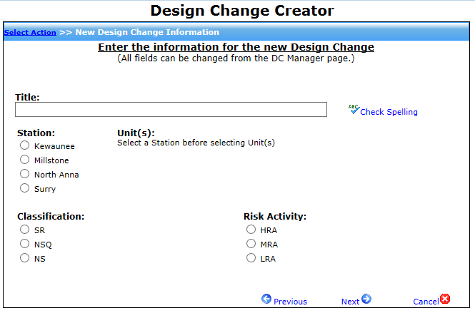
General Capabilities – Create Wizard:
Auto generated modification numbers
Creation Wizard walks users through a set of questions on the creation of a Modification to determine type of change
Step-by-step wizard guides the user through entering in the baseline information needed to create a Modification
Information entered through the wizard can be updated after the modification is created
Baseline information is replicated on many forms (enter once, use often)

Slide 6
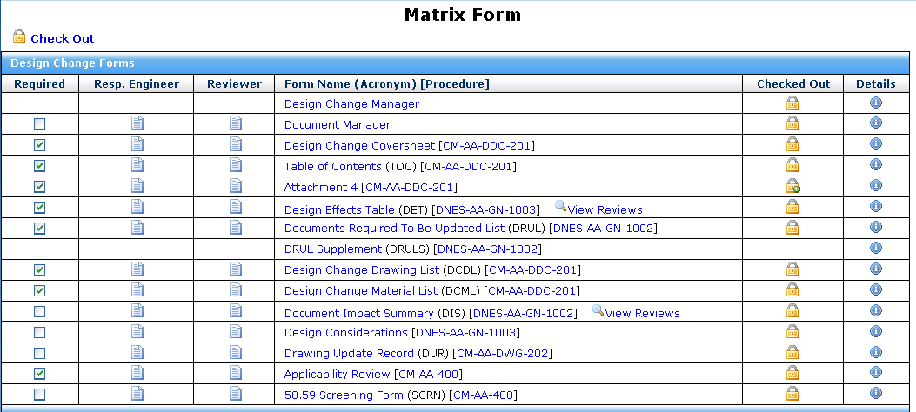
General Capabilities – Matrix:
Index of required and optional forms with links to view / edit
Represents sequence of forms in final package

Slide 7
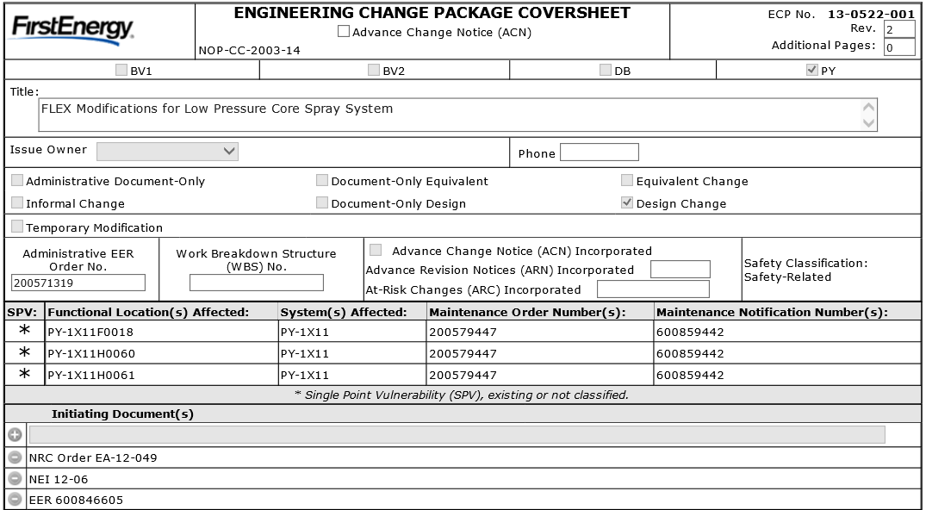
General Capabilities – Forms:
CMIS replaces MS Word templates with a paperless, web-based format
Information stored in tables vs traditional form
CMIS becomes official version of form with backup word templates available on site
Fields display or hide based on Modification Status, Revision and Type
No data loss with form revisions
History Tracking
CMIS helps enforce procedural compliance
Titles adapt to form purpose
Helpful hints display on screen but do not print

Slide 8
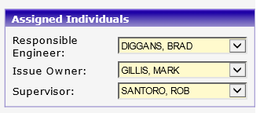
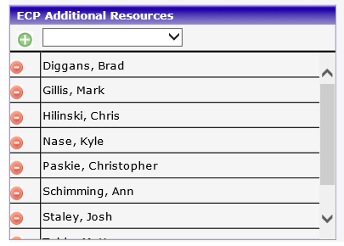
General Capabilities – User Security:
Define Security Access for each Individual
Control Site Access
Assign Principal individuals responsible for Modification
Names auto-populate on Forms as applicable
Manage addition Team Members with full edit capability
If not associated, User will be read-only

Slide 9
Key Features:
Frequent Auto-Save / Master Abort
Electronic Signatures
Modification Manager
Document Manager
Review Process
Generate Modification Package
Cloning

Slide 10
Key Feature – Auto Save / Abort
CMIS makes a copy of form data when a form is “checked out”. Original data is not disturbed during editing
All changes on the copy are auto-saved every 60 seconds
User can “Check In” to replace the original form data with their changes OR “Abort” to discard all changes
Form remains “Checked Out” with all changes saved in CMIS, even if user is disconnected or shuts down their computer
Other users only see “Checked In” data

Slide 11
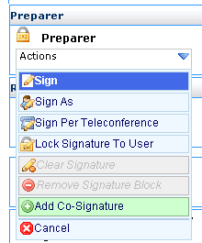
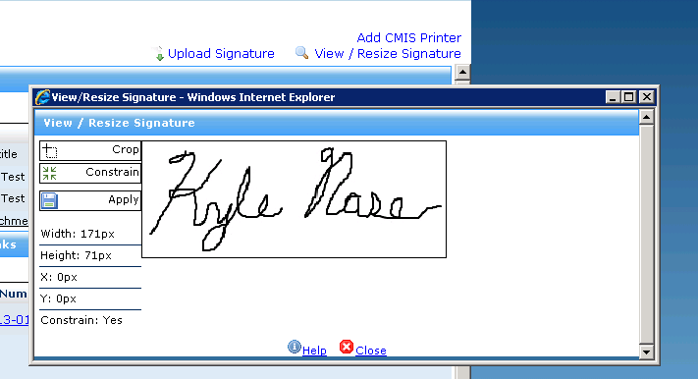
Key Feature – Electronic Signatures
Ability to electronically sign documents without having to print it out first
Select signature option on form
Upload and crop signature
See signature appear on printed PDF

Slide 12
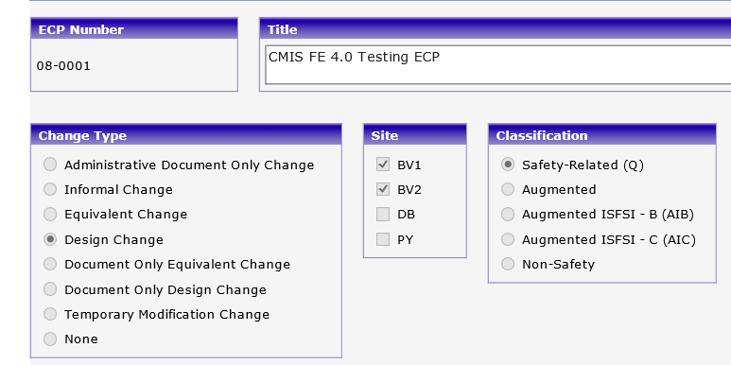
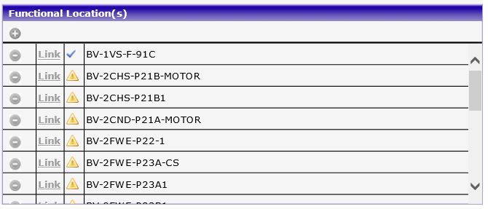
Key Feature – Modification Manager
Single data entry point for common data used on multiple forms, ensures consistency
Change Type & Classification drives required Forms on Matrix (required vs optional vs N/A)
Manage affected SSCs in one location
Automatically generate BOM
Initiates Master Equipment List Updates

Slide 13
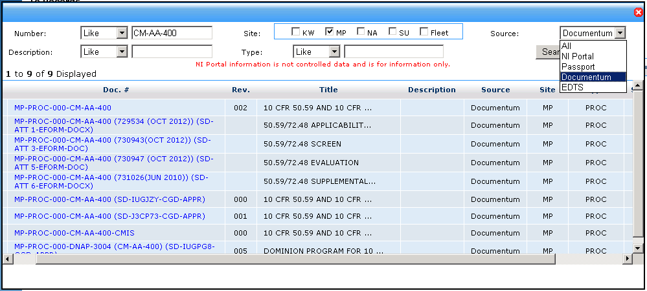
Key Feature – Document Manager
Document/Drawing Search Capabilities
One-stop document searching capability
Integrates with multiple Document Management Systems
Selecting from site databases eliminates manual entry errors
Documents auto-sort
Documents will show on required Forms as appropriate
Click to view Documents directly

Slide 14
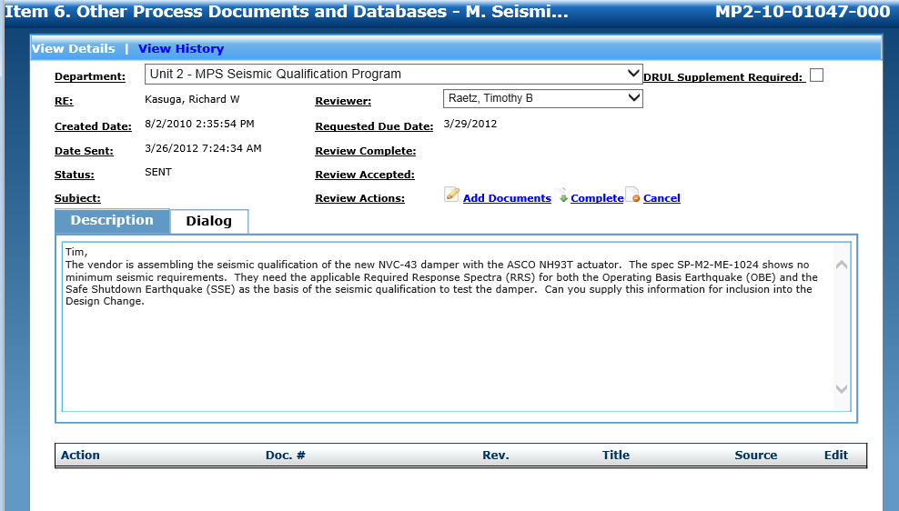
Key Feature – Review Process
Built in Work Flow to send and receive notifications for Program/Department Review
Email or in-app notifications
Gather impacted document lists from appropriate Program or Department SME
Resp. Engr. Accepts feedback and it is automatically incorporated into Modification

Slide 15
Key Feature – Package Generation:
All required reviews and forms must be completed prior to final package generation
CMIS combines Forms in the standard order / sequence, user attaches additional documents and drawings, then CMIS publishes as one single PDF file
CMIS affixes a header to each page to align with Utility Records requirements including mod title, mod/doc. #, and page numbers for overall PDF
Send Modification package electronically (paperless) to document management department

Slide 16
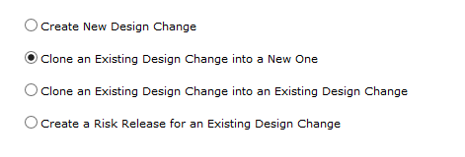
Key Features – Cloning:
Create Standard Templates to be used for multiple modifications
Clone Template or existing Modification into a new Modification
Eliminates Copy/Paste Errors
Saves considerable engineering time
Ensures Data Integrity and Consistency

Slide 17
Industry Sharing – Features
Ability to search, view and clone modifications from other fleets and sites
Eliminates Research time and provides up to a 70% head start to Station Modification Forms
Currently contains over 3,700 industry industry solutions, and growing…

Slide 18
Industry Sharing – Solution Sources
Utilities sharing solutions include:
Constellation
DTE
Energy Northwest
FENOC
PGE
PPL
PSEG
TVA
Xcel Energy
Vendor solutions through Rolls-Royce engineering are also included

Slide 19
Summary – CMIS Key Benefits
Improves Data Integrity and Efficiencies
Reduces Human Performance Errors
Eliminates administrative burden
Enter once - use often, minimizes copy-paste errors
Pull data from site data stores, minimizes typos
All users can see all mods, even those in development
Standard look & feel helps end users (Planners, Installers)
Established tool in use by the Nuclear Industry for over 15 years
31 Participating Units
Platform Independent – integrates with Enterprise Management Systems and Document Management Systems
Leverages existing interfaces with POMS

Slide 20
Summary – Nuclear Promise
Standard Design Modification Goals:
Standard Process and Forms for the Industry
Standard Designs/Templates (design once / implement many concept)
Standard Electronic web-based internet platform to host Forms, accessible to all utilities and vendors
Ability to share solutions
Improve efficiencies
Common Qualification across industry for utilities and vendors
Minimize administrative burden
Standard look & feel for end-users (Planners, etc.)

Slide 21
Questions?

