Slide 1
Introduction and Overview
SMR-160
Pierre Oneid,
Holtec International, Chief Nuclear Officer
SMR, LLC, President
CMBG: Monday, June 6, 2016

Slide 2
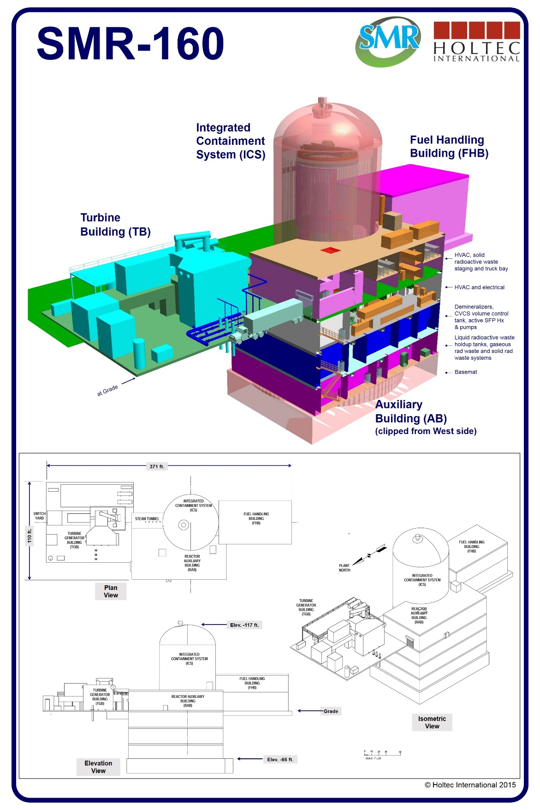
SMR-160

Slide 3
Overview of SMR-160
SIMPLER – far less equipment and commodities than other LLWRs or SMRs
    With Integrated Spent Fuel Management, unlike any other NPP in the world or design
SAFER – core damage frequency orders of magnitude smaller than Gen-III LWRs
    With the Holtec International Integrated Containment System
COST EFFECTIVE – less than half the price of current new build LLWRs
    Based on Level-II commodity cost estimate and construction schedule
PRACTICAL – no new materials (MSRs, LMRs, GasRs), no new fuel cycles, no new reprocessing techniques, technologies or facilities
CERTAIN – Holtec International is the largest capital nuclear equipment exporter in the US
    SMR manufacturing with the new Holtec Technology Center, HMD, others
INVESTED PARTNERS – Mitsubishi Electric, PSEG Power, URS, others
QUALITY – ask our clients: PSEG, EDF, Southern, TVA, CFE, others
    They will tell you – Holtec delivers, every time

Slide 4
Overview
SMR-160 is a 160 MWe light water reactor that uses lightly enriched uranium to produce 525 MW of thermal energy in a reactor core that employs 96 full length fuel assemblies.
SMR-160 is intended to serve as a distributed energy source that dispenses with the need for expensive high capacity transmission lines over long distances, making the electric grid more resistant to natural disasters or acts of sabotage.
A typical SMR-160 uses cooling water from a local natural source such as a lake, river or ocean to condense its exhaust steam. However, it can also be deployed in water-challenged regions by using air as the condensing medium.
Because SMR-160 is walk away safe, it can be sited next to population centers without any threat to the local environment or populace. Placing SMR-160 close to cities and towns will reduce transmission losses and enable the plant’s workers to live in the local community. An SMR-160 installation takes up less than 4.5 acres of land - a fraction of the land area required by other NPPs on a per megawatt basis.

Slide 5
Overview
SMR-160 achieves extreme safety by eliminating vulnerabilities that have been the source of prior accidents in nuclear plants, namely pumps and motors to run the plant's safety systems. Instead of pumps and motors, SMR-160 relies on gravity to run all safety significant systems in the plant. Because gravity can't fail, an SMR-160 plant is assured to remain safe under every operating and accident scenario.
Replacing motors and pumps (that make a nuclear plant a menagerie of piping loops and networks) with gravity driven fluid flow systems not only hardens the plant against disasters like those that befell Fukushima, Chernobyl and TMI, but leads to huge reductions in the plant's overnight, operating and maintenance costs.
The core strengths and innovation of SMR-160 are inherent safety, security, constructability and simplicity of operation. The design is driven by the principal criterion that all safety systems must be powered by natural circulation. The passive design feature is effective in all operational modes, including off-normal and accident conditions, and applies to all safety-related systems of SMR-160.

Slide 6
Innovative Features of
SMR-160
Core located deep underground.
A Passive Containment Cooling System integrates decay heat removal from the spent fuel pool and reactor core under off-normal conditions, including station blackout.
A unique Integrated Containment System, providing certain unlimited cooling for postulated transients and beyond design basis accidents, with robust protection against natural disasters (flood, wind, storm) and man-made attacks (aircraft and missiles).
The plant can be started without off-site power (i.e., it is "Black start" capable).
A large inventory of water around and over the reactor core, with a gravity driven water replenishment system, makes the scenario of an uncovered reactor core non-credible.
Easy access to critical components for in-service inspection and testing in compliance with the Code.
No penetrations in the lower region of the Reactor Vessel; hence no pathway for inadvertent or accidental drainage of reactor water.
Absence of boric acid in the plant helps increase the plant's service life (longevity) which is estimated to be well over 100 years.
On-site underground storage of used fuel in welded multi-purpose canisters.

Slide 7
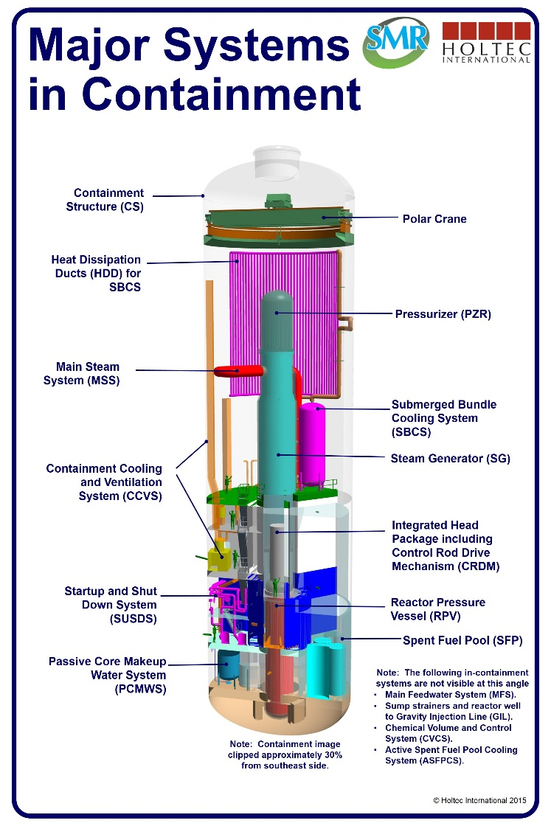
Innovative Features of
SMR-160
No large diameter piping in the reactor coolant loop, rendering a large break loss of cooling accident non-credible.
All vital components, including the Steam Generator, the Pressurizer and the Control Rod Drive Mechanisms (CRDMs) readily accessible.
An unlimited coping period that secures the SMR-160 from human performance errors and from Fukushima or 9/11-type events.
Fewer auxiliary systems greatly reducing capital and operational costs.
Major Systems in Containment

Slide 8
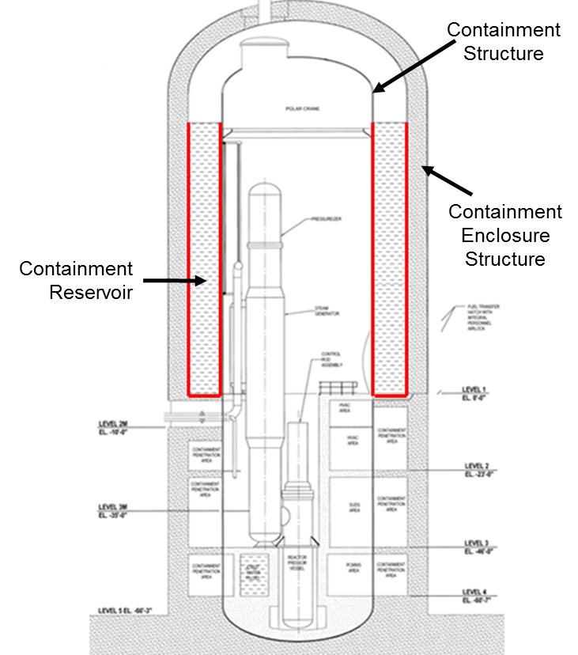
Integrated Containment System
Integrated Containment Cooling System
  Uses convective and conductive heat transfer modes to efficiently reject heat for off-normal transients, providing for an unlimited plant coping period
Comprised of
  Inner Containment Structure
  Annular Containment Reservoir
  Outer Containment Enclosure Structure

Slide 9
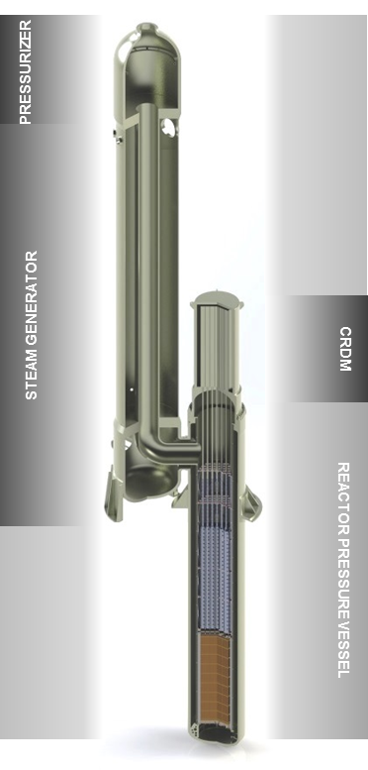
NSSS Operational Reliability
SMR-160 incorporates a large diameter, tall riser within a reactor vessel/steam generator stack, with an extremely simple reactor core and reactor vessel internals that eliminates all large pipes and reactor coolant pumps.
The design incorporates a unique evolutionary vessel-to-vessel connection (Holtec patent), designed to ASME Section III, Class I code requirements, to eliminate large piping in the RCS.
The offset vessel-to-vessel configuration provides simple access to both reactor and steam generator components and internals for refueling and Section XI inspections.

Slide 10
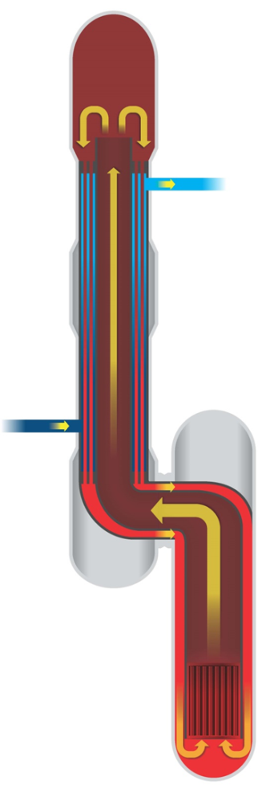
NSSS Operational Reliability
RCS riser is nearly 105’ tall which facilitates a large thermo-siphon pressure head (aggregate pressure driver ≈ 5 psi). A high pressure head guarantees turbulent flow in the reactor core (essential for predictable fuel performance) (Holtec patent).
Steam Generator (SG) secondary side consists of pre-heating, boiling and superheating sections arranged in counter-current flow with the reactor coolant, with design features to minimize internal stresses (Holtec Patent).
All major components (RPV, SG) are designed to practical transportation limits (less than 12 ft. diameter, less than 350 tons).
FLOW TURNS INTO THE TUBES OF THE HEAT EXCHANGER STACK
COOLANT COOLS FLOWING DOWN SUPERHEATER TUBES
(SUPERHEATING STEAM ON SHELLSIDE)
SUPERHEATED
STEAM OUT
COOLANT COOLS FLOWING DOWN STEAM GENERATOR TUBES
(PRODUCING STEAM ON SHELLSIDE)
HOT COOLANT RISES TO THE TOP OF STACK THROUGH CENTRAL RISER
FEEDWATER
IN
HOT COOLANT ENTERS THE HEAT EXCHANGER STACK
COLD COOLANT FLOWS BACK DOWN THROUGH DOWNCOMER REGION
HOT COOLANT RISES FROM THE CORE

Slide 11
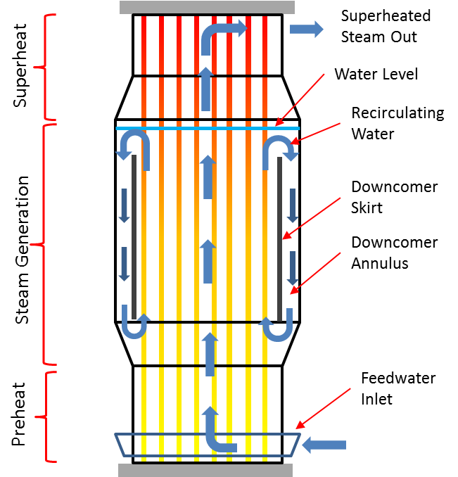
Steam Generator Design
The steam generator and the superheater have been integrated into one heat exchanger
Use of straight tubes (plain surface)
Easy inspection access to the tubesheet
Shipping weight is less than 350 tons
Rail shippable based on our transportation study
The pressurizer is flanged and bolted to the top of the steam generator/superheater
½ inch Inconel 690 [TT] tubes have been produced and used in nuclear steam generators
Re-circulating Feature of the Steam Generator

Slide 12
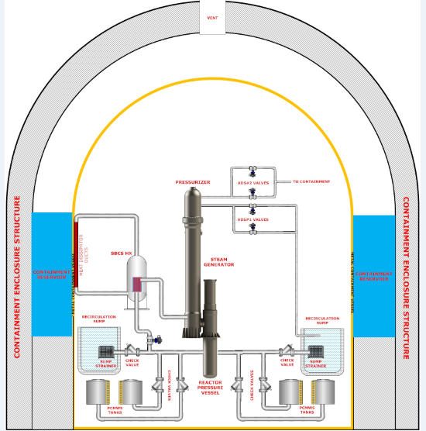
Decay Heat Removal
Passive Core Cooling System. Two independent subsystems are used to efficiently dissipate residual heat when the normal heat rejection path from the core is lost.
Submerged Bundle Cooling System (SBCS)
Passive Core Makeup Water System (PCMWS)
  Passive Core Makeup Water Tanks and Recirculation Sumps
  Automatic Depressurization with Gravity Injection Lines

Slide 13
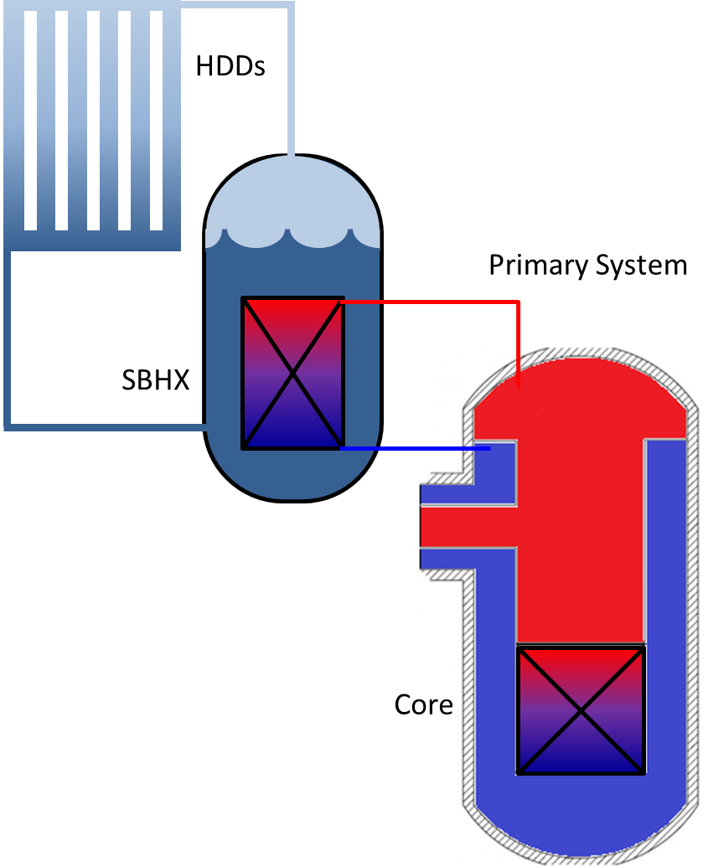
Submerged Bundle Cooling System
Submerged Bundle Cooling System (SBCS) is a closed loop, pressurized system comprised of three major parts:
    1) Submerged Bundle Heat Exchanger (SBHX)
    2) Discrete set of HDDs integrally connected to the inner wall of the Containment Structure
    3) Reactor Pressure Vessel
SBCS uses primary coolant in the RCS to extract the thermal energy from the core while completely residing within the containment.
Heat Dissipater Ducts (HDDs) are simple heat exchangers made from extruded anodized steel half pipes. Discrete sets of HDDs are welded on the inside surface of the Containment Structure to transmit heat from inside the ducts to the Containment Reservoir (Holtec patent).

Slide 14
Essential SMR-160 Plant Data
Nominal electric power output: 160 MW(e)
Reactor thermal power: 525 MW(t)
Reactor coolant inlet temperature: 384.5°F
Reactor coolant outlet temperature: 600.0°F
Reactor coolant flow rate: 7.1 Mlb/hr
Steam generation rate: 1.55 Mlb/hr
Cycle steam pressure and superheat: 335 psia, 167.4°F
Refueling cycle length: 18-24 mths

Slide 15
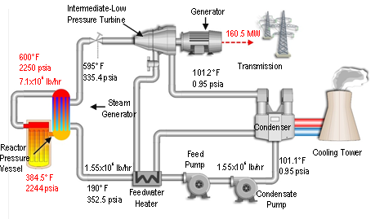
Normal Operations
The primary coolant is driven by natural circulation without the use of RCPs.
The secondary side is driven by forced circulation using the feed water pumps.
Steam is produced at a relatively low pressure, 335 psi, but with considerable superheat, 170°F.
Due to the significant superheat, Moisture Separator Reheaters are completely eliminated.
Minimum feed heating (two feedwater heaters) is used which simplifies plant operation.

Slide 16
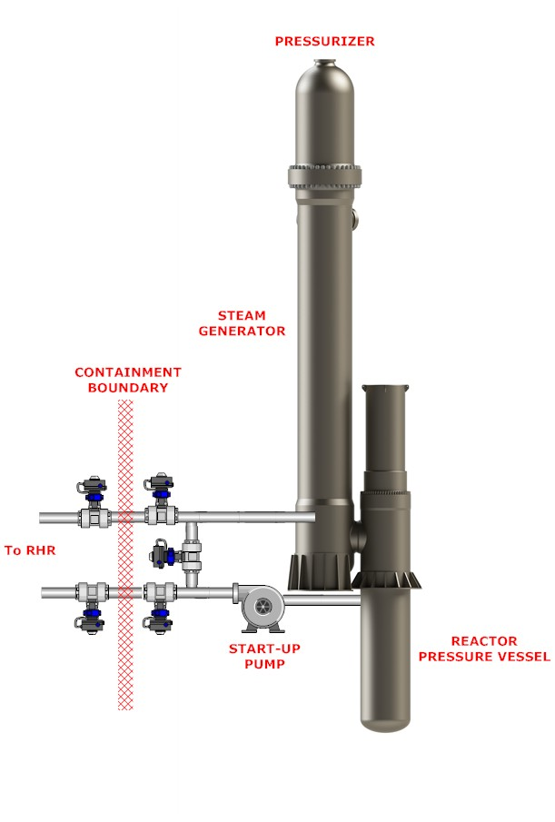
Start-Up
Start-up with nuclear heat and forced circulation
  Forced circulation (20% rated full power flow) is established using the start-up pump.
  The control rods are withdrawn to point of adding heat and the heat up rate is controlled by rod position.
  The startup pump is secured when the RCS flow exceeds 40%.
  When the SG secondary side temperature is greater than 240°F, steam is bypassed around the MSIV to warmup the steam lines and the steam turbine.
  When the SG is at normal operating pressure / temperature, steam is admitted to steam turbine to produce power.

Slide 17
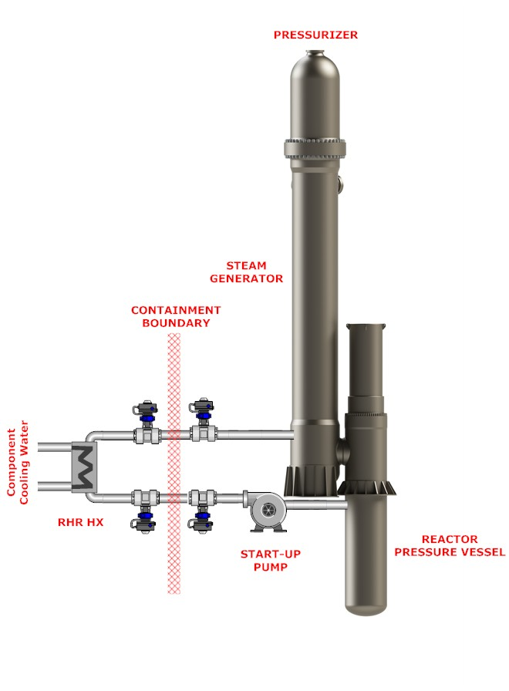
Shutdown
The control rods are fully inserted to shutdown the core.
The steam generator is initially used to remove the decay heat.
  The steam produced by the steam generator after reactor shutdown is sent to the condenser (bypass mode).
  The condensate from the condenser is returned to the steam generator using the main feedwater system.
The start-up pump is used to ensure thermal equilibrium of RCS and transfers heat to the residual heat removal heat exchanger.
The residual heat removal heat exchanger is sized to cooldown the RCS to less than 125°F within 96 hours after shutdown.

Slide 18
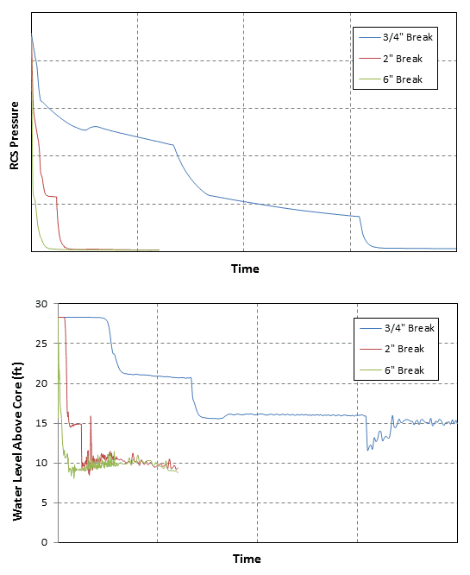
Loss of Coolant Accident (LOCA)
SMR-160 safety logic will detect a LOCA, signal reactor trip, and initiate Engineering Safety Feature Actuation
Safety features include injection from Passive Core Makeup Water Tanks (PCMWT) and opening of Automatic Depressurization System (ADS)
Long-term water recirculation is provided by opening of a Gravity Injection Line (GIL) after RCS depressurization
The reactor core remains covered for the full spectrum of breaks from blowdown to passive injection through recirculation phases
ADS1
ADS2

Slide 19
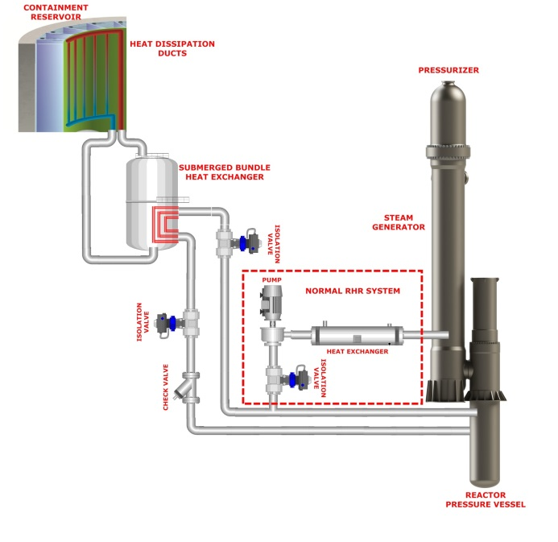
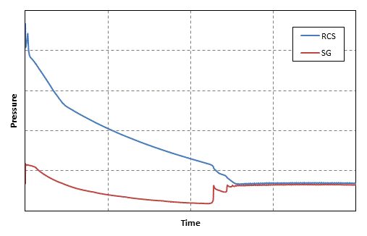
Non-LOCA
An example of this kind of accident is a Loss of Load event, resulting in the sudden isolation of secondary and reactor trip.
The Submerged Bundle Cooling System (SBCS) is used for decay heat removal.
The SBCS is a closed loop pressurized system that rejects heat passively to the Containment Reservoir.
The Loss of Load event demonstrates that safe shutdown can be achieved without venting the RCS to containment.

Slide 20
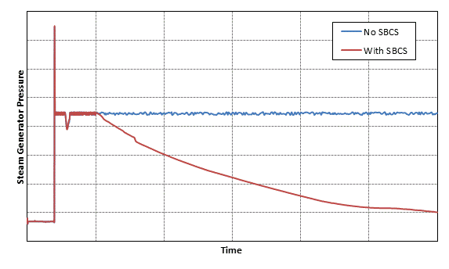
Steam Generator Tube Rupture (SGTR)
An SGTR is an accident at normal operating conditions involving the complete severance of a single SG tube.
The Submerged Bundle Cooling System (SBCS) is actuated to mitigate this accident on the signal of either low Pressurizer pressure or level.
The SBCS is capable of quickly depressurizing below the secondary safety valve setpoint terminating the flow from primary to secondary.
The SMR-160 passively mitigates an SGTR event without a significant off-site radioactive mass release.
Termination of Radioactive Release to Environment
Notes:
The listed items are the general design criteria for designing SMR-160 SSCs

Slide 21
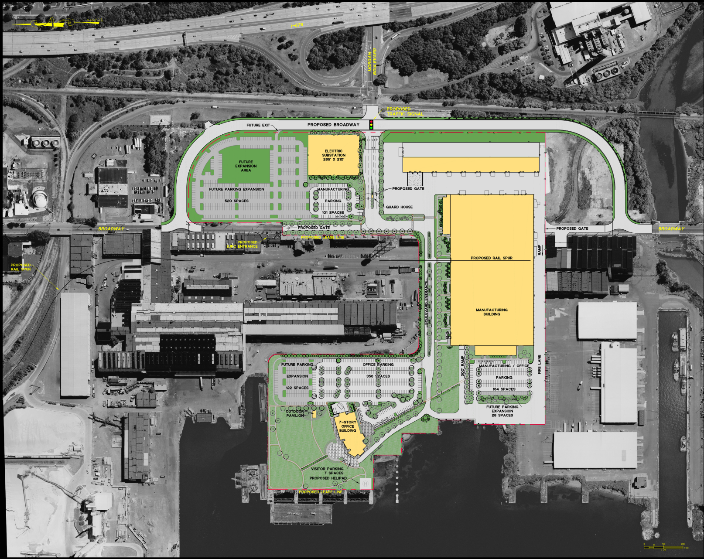
Holtec Technology Center
Notes:
The listed items are the general design criteria for designing SMR-160 SSCs

Slide 22
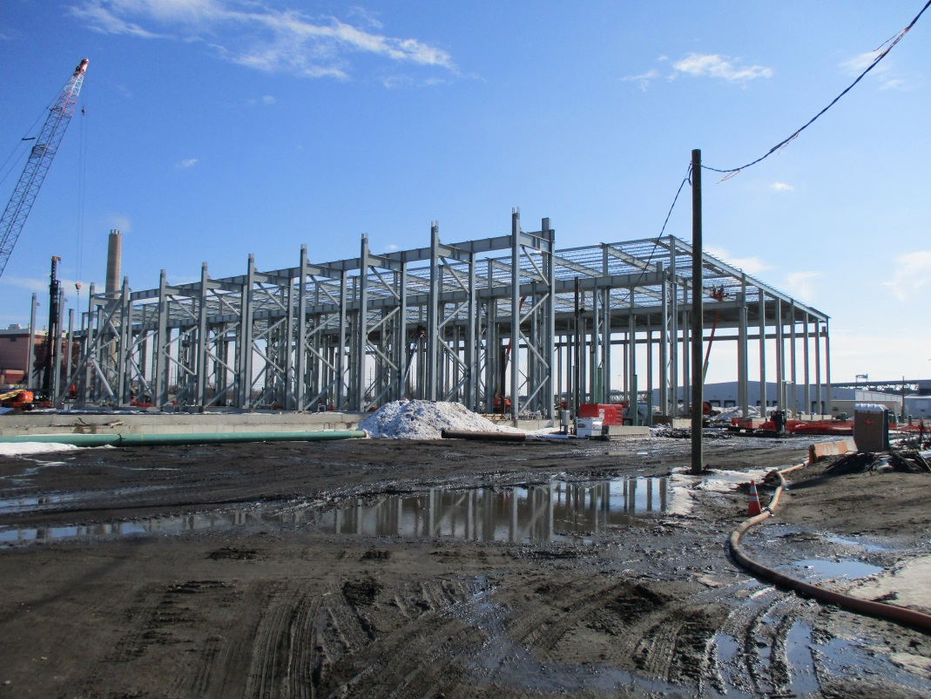
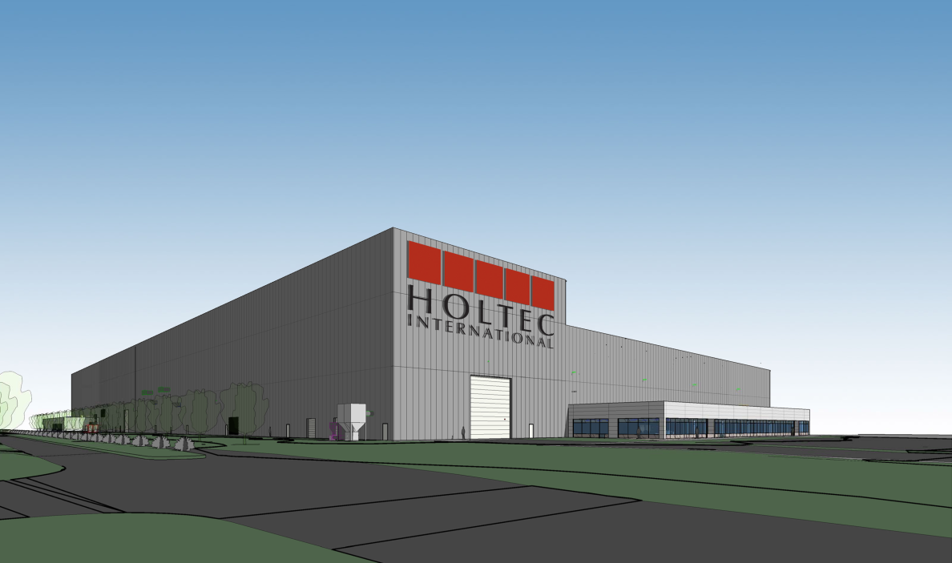
Holtec Technology Center
Notes:
The listed items are the general design criteria for designing SMR-160 SSCs

Slide 23
Overview of SMR-160
SIMPLER – far less equipment and commodities than other LLWRs or SMRs
    With Integrated Spent Fuel Management, unlike any other NPP in the world or design
SAFER – core damage frequency orders of magnitude smaller than Gen-III LWRs
    With the Holtec International Integrated Containment System
COST EFFECTIVE – less than half the price of current new build LLWRs
    Based on Level-II commodity cost estimate and construction schedule
PRACTICAL – no new materials (MSRs, LMRs, GasRs), no new fuel cycles, no new reprocessing techniques, technologies or facilities
CERTAIN – Holtec International is the largest capital nuclear equipment exporter in the US
    SMR manufacturing with the new Holtec Technology Center, HMD, others
INVESTED PARTNERS – Mitsubishi Electric, PSEG Power, URS, others
QUALITY – ask our clients: PSEG, EDF, Southern, TVA, CFE, others
    They will tell you – Holtec delivers, every time

