Slide 1
How NextEra Energy’s Operational Model System Improved Content Management
PGD Operational Excellence Team
OpModel Project Team
June 8, 2016
Notes:
Slide 1: Good morning!! Thank you for coming to our Workshop! We are excited to see everyone and we want this session to be both informative and interactive. Feel free to ask questions as we go along and we should also have time at the end for additional questions. To encourage people not to be shy, we brought along some prizes for people who ask questions or share their own experiences and learnings.

Slide 2
Operational Model Workshop Agenda
Presenter Introductions
NextEra Power Generation Division Overview
OpModel Case Study
“Why” – Understanding the reason for change
“What” – Defining the scope
“Who, When, Where, How”
Lessons Learned and Key Takeaways
Notes:
Slide 2: We recently completed development and implementation of a new Operational Model System in NextEra Energy’s Power Generation Division. We want to share with you how it is helping us manage our knowledge content and convey learnings around project and change management. We put the presentation together in a “Case Study” type of format.

Slide 3
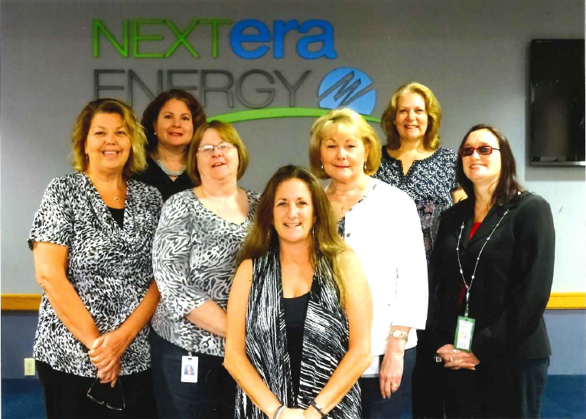
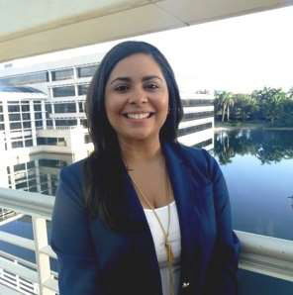
Current PGD Opeartional Excellence Team
Power Generation Division’s Operational Model Project Team was cross-functional with 25 team members
Barbara Parkkonen
Janet Booher
Terry Jamison
Dawn Arida
Sherry Slaughter
Roxanne Castano
Tami Varckette
Your PGD Document Management Team
Notes:
Slide 3: Before we get started, I want to introduce my co presenters:
Kelley Schoonover was the OpModel Project Manager. She has been with the company 6 years and is a mechanical engineer from the University of Miami. She has recently been promoted to Sr. Engineer on our Combustion Turbine Fleet Team.
Adriana Falcon was our Production Assurance Leader responsible for the Document Mgmt Team who helped with development, testing, implementation, and ongoing training and support. Adriana is an Industrial Engineer from Univ of Florida and has been with the company for 8 years. She has recently been promoted to Sr. Production Assurance Specialist at our newest combined cycle power plant in Port Everglades, FL that will be going commercial in 2016.
Tami Varckette is also with us to assist in answering any questions about current state post Go Live and to help give out prizes! Tami is our current Production Assurance Leader who replaced Adriana in the Doc Mgmt and KS role in PGD. Tami has been with the company 20+ years and has extensive knowledge of power plant operations.

Slide 4
Operational Model Workshop Agenda
Presenter Introductions
NextEra Power Generation Division Overview
OpModel Case Study
“Why” – Understanding the reason for change
“What” – Defining the scope
“Who, When, Where, How”
Lessons Learned and Key Takeaways
Notes:
Slide 4: To understand the context and reason for improving our OpModel, we wanted to give you a very brief overview of what we do at NextEra and PGD.

Slide 5
Nextera Energy’s Power Generation Division (PGD) is responsible for all non-nuclear generation operations
NextEra Energy
14,000 employees
Florida Power & Light
NextEra Energy Resources
Power Generation Division
~ 2,500 employees
Fossil & Solar Operations
FPL Operations
Wind Operations
Engineering & Technical Services
Production Assurance & Business Services
Central Maintenance
PGD’s structure maximizes both economies of scale and asset value, while providing best-in-class capabilities
Notes:
Slide 5: NextEra Energy is a Fortune 500 Company with over 14,000 employees headquartered in Juno Beach, FL. The parent company has two subsidiaries, FPL and NextEra Energy Resources. FPL is a regulated utility that covers all of Florida Operations while the NEE Resources subsidiary covers all the non-regulated generation outside the state of Florida. Our business unit, Power Generation Division, is part of both groups.
Click animation: Our business unit has about 2,500 employees, some FPL and some NextEra Energy Resources and our headquarters is also in Juno Beach, FL. We are responsible for all the company’s non-nuclear generation. We’re organized into three operating fleets and we have three central technical and maintenance support teams that keep those three fleets operating efficiently and reliably.

Slide 6
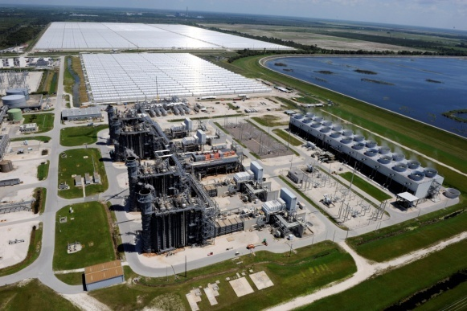
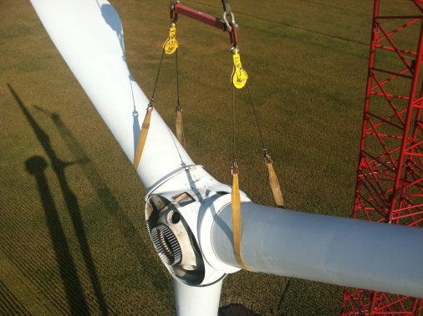
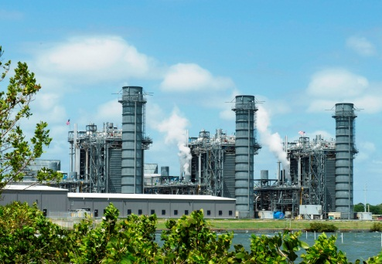
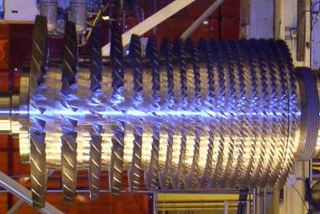
Power Generation Portfolio (non-nuclear)
PGD is a leading operator of fossil, wind and solar assets
(3.4%) 1,400 MW Solar
(28.2%) 11,500 MW Wind
(68.4%) 27,900 MW Fossil
About one third of PGD’s portfolio mix consists of renewable energy from the wind and sun in the US, Canada and Spain
Notes:
Slide 6: Our division is a leading operator of fossil, wind, and solar assets and about 1/3 of all our generating assets are from renewable energy from the wind and sun. In fact, we are the largest generator of solar power in the US and the largest generator of wind power in the world!

Slide 7
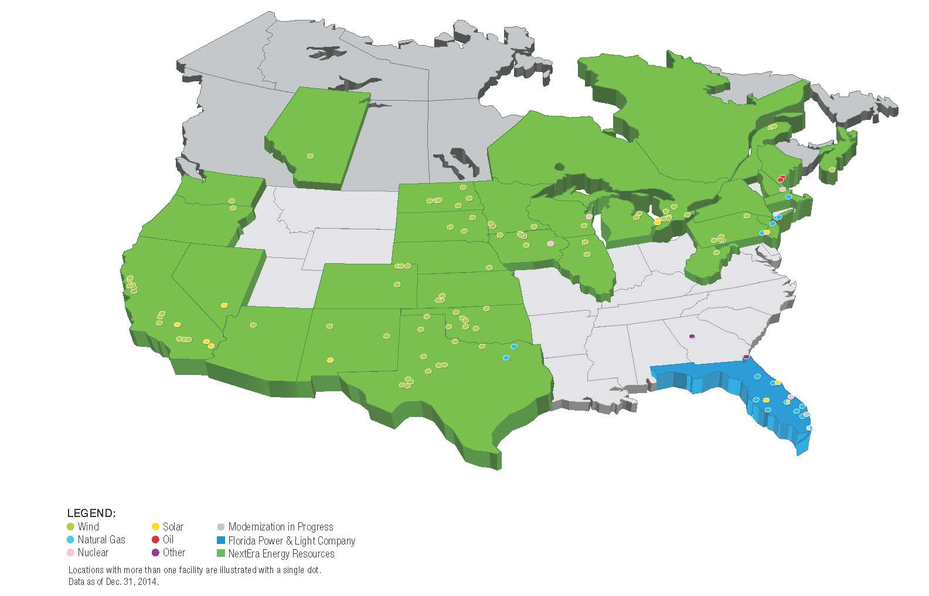
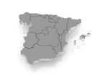
PGD owns and operates a diverse fleet of fossil & renewable power plants generating over 40,000 MW of electricity
Spain
PGD’s electrical generation has more than doubled since the 1990’s
Notes:
.
Slide 7: This is a visual view of our generating plants in the US, Canada, and Spain. We have doubled our generation over the past 20 years while holding our employee population almost flat. We’re continuing to grow our generating capacity especially on the renewable side at a fast pace so our need for quick and efficient knowledge transfer is great and challenging.

Slide 8
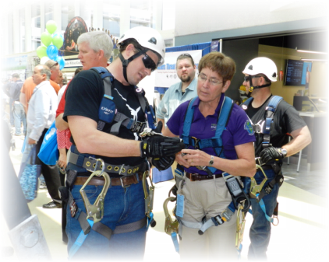
PGD – Mission, Vision, Strategies and Shared Values
Strategies:
Culture
People
Attract, retain and develop a diverse team that delivers operational excellence
Safety
Create a caring culture where safety is a personal value both in and beyond the workplace
Regulatory
Stewardship
Demonstrate exemplary corporate stewardship by doing the right thing in all regulatory areas
Production
Deliver certainty in generation through the use of standardized processes, best operating practices and focused execution
Profitability
Maximize the value of the generation fleet by improving each unit’s position in the market
Growth
Support corporate growth of the generation business and deliver high quality, low cost generation
Shared Values:
We Are Committed to Excellence • We Do the Right Thing • We Treat People with Respect
Vision:
To be best-on-the-planet in every metric used to measure the performance of our mission.
Mission:
Deliver certainty of operations and maintenance for all NextEra Energy’s non-nuclear assets.
Notes:
Slide 8: In PGD, our Strategic Mission is to deliver certainty of operations and maintenance and do this in a way that demonstrates our Shared Values of being Committed to Excellence, Doing the Right Thing, and Treating people with Respect.
Click Animation: Our VISION is to be the best on the planet in every metric we measure to accomplish our mission and includes all of the strategies you see here.
Our Employee Engagement surveys showed we had issues with some inefficient work processes that included ease of access to our collective knowledge. If left uncorrected, this would hamper our mission to be best on the planet and would further compromise employee engagement. Hence the OpModel Project was launched.
Now Kelley is going to explain more about our reasons for improvement, but first, we want to test out one of the interactive tools we brought along with us. Everyone please get out your smart phones.

Slide 9
Operational Model Workshop Agenda
Presenter Introductions
NextEra Power Generation Division Overview
OpModel Case Study
“Why” – Understanding the reason for change
“What” – Defining the scope
“Who, When, Where, How”
Lessons Learned and Key Takeaways
Notes:
Next section – discuss how PGD improved content management through the OpModel Project – review like a Case study

Slide 10
OpModel Roadmap to Improved Content Management
2012
Document Management Process MILAR
(Map, Improve, Lean, Automate, Replicate)
Q2 2012
Document Management System and OpModel Voice of the Customer Survey
Q4 2012
PGD Knowledge Management Maturity Assessment
2013
Definition of OpModel Project Mission, Functional Requirements, Software Selection
Q1 2014
Process Reviews, SME Focus Groups, Structure Development, Change Management
Q2 and Q3 2014
Document Migration, BETA Testing, Training, Roadshows, Change Management
Oct. 15, 2014
OpModel
powered by D2
Go-live!!
2015
Running the Business, Change Management and Continuous Improvement
2008-2011
Employee Engagement Surveys
Opportunities: Work Processes, Tools, Resources
We are here 2016
Our Journey to understand “Why”
Notes:
Overall journey/timeline…
Started at understanding the Why behind PGD’s need for content management and ultimately the Opmodel project

Slide 11
Reason for Improvements
OpModel – “Why” – Understanding the reason for change
Employee Engagement Surveys
High-bar for improvement: Work Processes, Tools, and Resources
MILAR (Map, Improve, Lean, Automate, Replicate) and Voice of the Customer Surveys
Feedback indicated a need for new document organization method and an improved user interface
Knowledge Management Maturity Assessment
2+ APQC Maturity State: Localized and Repeatable Practices
Notes:
No systematic structure for OpModel
Prior attempts have been “application centered” vs. “structure centered”
No System or Global Process Owners (GPO) to monitor and manage health and accuracy of the processes and process documents
No System Management Tools to easily assess, monitor, manage the system and content health
Folder structure architecture not intuitive leading to “I can’t find it”

Slide 12
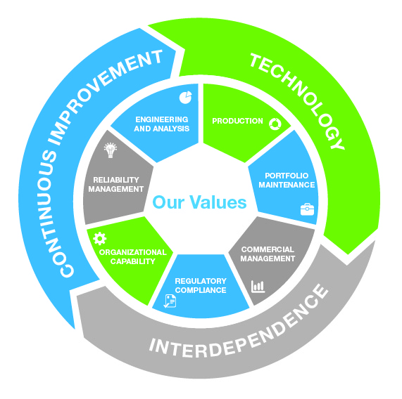
PGD creates its own identity through distinctive characteristics
OpModel – “Why” – Understanding the reason for change
Operational Model (OpModel)
Interdependence
Plants
Central Organization
Central Maintenance
Long-standing Focus on Quality
Six Sigma
Risk Management
Leveraging Technology
Improve Performance
Detect and Prevent Failures
Power Generation Division Operational Model
Our values are at the center of everything we do, and integrated into each category.
Notes:
Feedback (surveys, process evaluations, deep-dives), coupled with PGD’s own identity of innovation, focus on processes and quality, and interdependency, we began developing the Knowledge Sharing Initiative (next slide) ….

Slide 13
Knowledge Sharing Initiative
OpModel – “Why” – Understanding the reason for change
Tools and Resources
Technology Infusion: iPod Touch Mobile applications
PGD OneSearch (federated search tool)
Employee ShareNet (ESN)
Process, Tools and Resources
Knowledge Sharing Steering Committee
Asset Management System
Work Management System
Processes and Tool
OpModel
Tie your initiatives back to reason for improvement!
Notes:
The Knowledge Sharing Initiative was directly tied back to our reasons for improvement….survey feedback , need for speed and efficiency, as well as strategic planning….
Our Lead Team provided a vision for our organization which included moving to the next generation in our applications :
Mobile
Metadata
Asset management

Slide 14
Why do we need a new OpModel?
OpModel – “Why” – Understanding the reason for change
Focus on voice of the customer feedback
No systematic structure for OpModel
“Application centered” vs. “structure centered”
No System or Process Owners
to monitor and manage health and accuracy of the processes and process documents
No System Management Tools
to easily assess, monitor, manage the system and content health
Folder structure architecture not intuitive leading to “I can’t find it”
Need to build a solid process framework to promote sustainability while leveraging technology!
Notes:
One of the initiatives was to improve our Opmodel - it wasn’t working for us as well as it should have been….

Slide 15
OpModel Roadmap to Improved Content Management
2012
Document Management Process MILAR
(Map, Improve, Lean, Automate, Replicate)
Q2 2012
Document Management System and OpModel Voice of the Customer Survey
Q4 2012
PGD Knowledge Management Maturity Assessment
2013
Definition of OpModel Project Mission, Functional Requirements, Software Selection
Q1 2014
Process Reviews, SME Focus Groups, Structure Development, Change Management
Q2 and Q3 2014
Document Migration, BETA Testing, Training, Roadshows, Change Management
Oct. 15, 2014
OpModel
powered by D2
Go-live!!
2015
Running the Business, Change Management and Continuous Improvement
2008-2011
Employee Engagement Surveys
Opportunities: Work Processes, Tools, Resources
Our journey to define “What”
We are here 2016

Slide 16
Industry Standard of an Operating Model
OpModel – “What” – Defining the scope
“Operational models are designed to reflect the operations of a business, structuring the information and knowledge the organization tracks and uses to make strategic decisions and guide performance. It helps leaders and other employees understand how all the different pieces of the business work together, build scenarios to test strategy and improvement projects, and measure current performance.”
John A. Miller, CEO of Arkonas, collaborator with APQC
The Operational Model IS the way we do business in PGD and it’s essential to our quest for “Best on Planet” performance.

Slide 17
What is the OpModel
OpModel – “What” – Defining the scope
Understand what you want and create a Mission and Vision
Definition: The Family of Standards that defines the way PGD does work
Mission of the OpModel Project
Have a simple system that will allow everyone to find what they need easily
Integrate into PGD culture and daily activities
Have a structure and standards that keep the OpModel System updated, relevant and useful
Have an environment that drives the OpModel into the PGD culture
Have a culture and tool that enables the right people to find the right information at the right time.
Notes:
McDonald’s example of handbook and baking burgers same way

Slide 18
OpModel Improvements and Functional Requirements
OpModel – “What” – Defining the scope
Best Practice!
Knowledge Governance Document
Clear definition of what goes where, help people help themselves
New OpModel Process Structure
Simpler structure focusing on function and goal of work vs. who is executing the work
Attributes and Taxonomy
Move away from linear, one-dimensional folders to better search and filter results
Customizable Interface
Personalize views specific to each users’ needs
Automated Workflows and Reviews
Faster, simpler validation of process documents
Notes:
Once we got the vision, it was our job to define the appropriate scope – it is important to have a mission and vision with clear scope to ensure project meets expectation and expectations are managed. → Gov. Document – BEST PRACTICE
How do we want to do this…
Improve structure/organization of how we managed content. -- > something that allowed us to logically organize our documents, as well as teach the way we do business (goes back to purpose of the OpModel)
Create tool to facilitate managing the content – with key features/functional requirements (ie: Attributes, workflows, reviews, etc)
Understand the vision for the OpModel Project and interaction with other key projects including NEXTeam and Knowledge Sharing.
Align/integrate activities and outcomes of all projects in order to reduce duplication, confusion, or rework.
Understand necessary steps to meet OpModel deadlines.

Slide 19
OpModel Roadmap to Improved Content Management
2012
Document Management Process MILAR
(Map, Improve, Lean, Automate, Replicate)
Q2 2012
Document Management System and OpModel Voice of the Customer Survey
Q4 2012
PGD Knowledge Management Maturity Assessment
2013
Definition of OpModel Project Mission, Functional Requirements, Software Selection
Q1 2014
Process Reviews, SME Focus Groups, Structure Development, Change Management
Q2 and Q3 2014
Document Migration, BETA Testing, Training, Roadshows, Change Management
Oct. 15, 2014
OpModel
powered by D2
Go-live!!
2015
Running the Business, Change Management and Continuous Improvement
2008-2011
Employee Engagement Surveys
Opportunities: Work Processes, Tools, Resources
“Who, Where, When, and How”
We are here 2016
Notes:
This is where the physical changes take place – but it can also become an emotional/touchy-feely one…

Slide 20
Pulse Check on Change
OpModel – “Who, Where, When, and How”
During a change management process, remember that each person reacts differently to change
Change gets to our “gut”
Check yourself and your team about your feelings towards change and take into consideration when building your change management plan
Your change management plan should involve key stakeholders as early in the project as practical
Notes:
Change doesn’t always have to effect something physcially only (change to the tool, organization method), but it can effect emotionally and mentally too….
Explain that during change management process (as we explain here and what you may experience) you need to constantly check yourself and team to remember that each person reacts differently to change — even when we are only reading or hearing words that represent change.
Change gets to our “gut” as much as it gets to our heads – and many of our strongest reactions come from there. Reactions that arise from our “gut” are just as valid as those that arise from our heads.

Slide 21
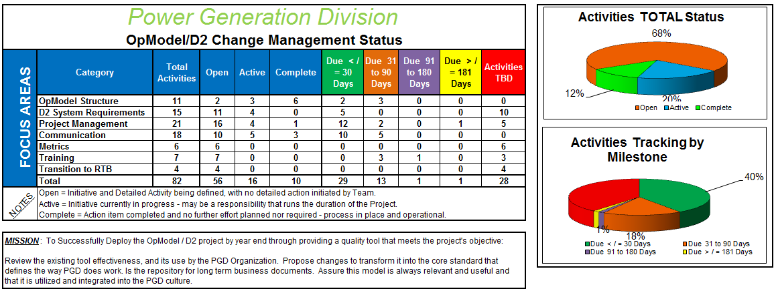
Change Management Team and Plan
OpModel – “Who, Where, When, and How”
Involve every level of the organization to take ownership of changes
Cross-functional Team
25 members including corporate IM, ISC and Integration Professional Services
Change Agents
Users at every level take part in decisions, therefore they own improvements
Detailed, actionable items
“the devil is in the details”
Cadence of Accountability
Share progress and challenges weekly – be as transparent as possible
Notes:
We know what we need to go after, but how – how do we reach everyone?

Slide 22
Change Management Communication Plan
OpModel – “Who, Where, When, and How”
Our audience was diverse – diversifying our methods
Email reminders and summaries
Annual meetings, leadership meetings, monthly playbooks
Video/advertisements, quizzes, games and prizes (gamification)
Online and offline training: LMS, uPerform videos, office hours
SharePoint
Roadshows at plant sites
Have focused topics with focused audiences
Structure changes vs. system changes
Role changes
Don’t underestimate the power of human interaction

Slide 23
Benefits to Change in the Structure
OpModel – “Who, Where, When, and How”
Emphasize the details of “what’s the benefit to me!”
Focus on functional areas of work vs. who is executing the work
256 Global Processes → 7 Categories
Aligns with how we are running our business and executing work now
Processes further describe the particular ways we are executing and supporting that function
Allows for future development and growth
More intuitive and easy for people to understand and ultimately search

Slide 24
Benefits to Change in the System
OpModel – “Who, Where, When, and How”
Emphasize the details of “what’s the benefit to me!”
Saves time
Processes, reports, and drawings stored in a single location with a single interface
Eliminates redundancy
Versioning capability eliminates the need for multiple files with various revisions
Easier file sharing
Everyone has access to view ALL approved documents
Right click and share via email
Make documents available to team members outside PGD via links on CoP sites (our Employee ShareNet)
Improve document search
Full-text search queries attributes, titles, and content of all documents

Slide 25
OpModel Roadmap to Improved Content Management
2012
Document Management Process MILAR
(Map, Improve, Lean, Automate, Replicate)
Q2 2012
Document Management System and OpModel Voice of the Customer Survey
Q4 2012
PGD Knowledge Management Maturity Assessment
2013
Definition of OpModel Project Mission, Functional Requirements, Software Selection
Q1 2014
Process Reviews, SME Focus Groups, Structure Development, Change Management
Q2 and Q3 2014
Document Migration, BETA Testing, Training, Roadshows, Change Management
Oct. 15, 2014
OpModel
powered by D2
Go-live!!
2015
Running the Business, Change Management and Continuous Improvement
2008-2011
Employee Engagement Surveys
Opportunities: Work Processes, Tools, Resources
Arrived at Destination…..
We are here 2016

Slide 26
Change Management Through Go-Live
OpModel – “Who, Where, When, and How”
It’s not over once you Go-Live!
“Hyper-care” – technical and process components
Dedicated resources at least several weeks post-deployment
Prioritize feedback
Continuous Communication
Assume everything you sent before deployment was not fully absorbed
Reiterate key points, be available for questions, and get in front of your users
Be prepared to revise and clarify existing training, documentation, or other materials
Improve content from feedback
Change Management is even more important during and post go-live

Slide 27
OpModel Roadmap to Improved Content Management
2012
Document Management Process MILAR
(Map, Improve, Lean, Automate, Replicate)
Q2 2012
Document Management System and OpModel Voice of the Customer Survey
Q4 2012
PGD Knowledge Management Maturity Assessment
2013
Definition of OpModel Project Mission, Functional Requirements, Software Selection
Q1 2014
Process Reviews, SME Focus Groups, Structure Development, Change Management
Q2 and Q3 2014
Document Migration, BETA Testing, Training, Roadshows, Change Management
Oct. 15, 2014
OpModel
powered by D2
Go-live!!
2015
Running the Business, Change Management and Continuous Improvement
2008-2011
Employee Engagement Surveys
Opportunities: Work Processes, Tools, Resources
We are here!
Into the future…

Slide 28
Post Go-Live Voice of the Customer Survey
OpModel – “Who, Where, When, and How”
Its not over once you go-live!
Survey sent to PGD five months after deployment
Questions focused on training, search, communication and continuous improvement
Findings:
Searches – new way of searching was a culture shock
Training – LMS module length was at times cumbersome
Communication – verbal ( face-to-face) and email are best way to send information to our teammates
Action Plan:
Conduct face-to-face training at sites (attributes, advanced search, my search, public search and work flow)
Configuration changes – navigation page, tool tips, help docs.

Slide 29
Operational Model Workshop Agenda
Presenter Introductions
NextEra Power Generation Division Overview
OpModel Case Study
“Why” – Understanding the reason for change
“What” – Defining the scope
“Who, When, Where, How”
Lessons Learned and Key Takeaways

Slide 30
Key Takeaways
How did the OpModel Improve Content Management?
Developed knowledge sharing governance
What to keep, where to keep, who reviews, how often to review
Improved organization of content
Restructured how content was categorized (attributes)
Enhanced ability to find content
New search tools and organization of material
Identified and purged “ROT” (redundant, outdated, trivial)
New tool to find ROT and process of how to remove it
New tool Prevents “ROT” through versioning
Develops synergies with other KM platforms
Allows sharing content with other business units through live links within our CoPs
Notes:
Slide 38: One of the substantial benefits of our OpModel Project was to spur development and implementation of a good knowledge sharing governance. We address what knowledge we keep, which storage repository should be used for each type of knowledge, who owns it, who reviews it, how often it is reviewed, and how long to retain it. We documented and proceduralized all of this and put it into our OpModel as a new process requirement for all our knowledge types. We think we’ve developed a best practice document. If anyone is interested in the details, we have handouts available of our governance you can take after the session. We’ve also made it available to APQC electronically.
In our OpModel itself, we restructured how our process and procedures were organized and categorized and greatly simplified the number of global processes we have.
Not only did we improve our ability to find new content, we inadvertently developed a tool to find ROT (redundant, outdated, trivial) material and implemented a process to remove it.
The new OpModel also prevents new ROT accumulation through versioning and through our governance process.
We found we developed synergies with other knowledge sharing platforms. For instance, other business units will often ask us for help with processes and procedures we’e developed. In the past, we would have to print out these documents and scan them or hard mail them to the other business units. They had no way of knowing when these documents became ROT, plus it took time to send them the documents. Now, we have found it is easy to link to the requested documents in the OpModel through our Communities of Practice sites, making the documents easily accessible to a larger audience and ensuring what they see is always the up-to-date knowledge.

Slide 31
Key Takeaways
The OpModel Project – Lessons Learned in Change Management
Acknowledge this will be a challenge
As much as people say they want change, there will still be confusion, pushback, complaints – IT’S NOT PERSONAL!
Know about your diverse organization
Take time to get a pulse on how your team likes to learn and receive information → face-to-face communications
Plan ways to engage the most skeptical, least tech savvy, visual learners
Face-to-face discussions, roadshows, office hours
Utilize Marketing & Communication teams – budget for it
Make it fun – contests and small prizes go a long way
Notes:
Slide 39: We learned quite a few lessons in Change Mgmt during development and implementation of the project. I think Kelley, Adriana, and the Team did an outstanding job enlisting CHANGE AGENTS months before implementation. They helped us do Beta Testing and served as OpModel Champions where they resided in headquarters and at plant sites.
It was STILL a challenge. People will still push back when significant change occurs and you have to have thick skin and not take it personally. Addressing each need and each concern in a kind, patient, calm manner really helps win people over.
A diverse organization like ours has a lot of different learning styles and preferences. There is not a “one correct way” of communicating and training others. We found that multiple approaches tailored to the individual needs and cultures of the users was most effective.
We pulled in resources that we don’t usually engage to help with change mgmt. like our company’s marketing and communications department. They made the video for us and helped with other visual messaging. Remember to budget for these and then make it as fun as you can. We got the idea for gamification here at APQC last year and implemented this a couple of months before “Go Live” to get people familiar with new terms and structures. A little bling goes a long way!

Slide 32
Key Takeaways
The OpModel Project – Lessons Learned in Change Management
Have engagement from the top levels (PGD Lead Team)
Keep them accountable
Discussion and buy-in will change the “you need to fix it” response to a “what can we do so that we can figure this out”
Understand their communication expectations
Feedback and changes are bound to happen
Use your change management process to evaluate and prioritize next steps
Clearly understand what is a must have vs. a nice to have
Notes:
Slide 40: With any project like this, it is essential to get your executive leadership team involved, supportive, and invested in project success. Hold them accountable by frequently keeping them informed of progress, of issues or roadblocks and let them know what you need help to accomplish.
We learned that no matter how prepared we think we are, changes, small setbacks, and the desire for scope creep will occur. With a good change mgmt. process and plan, you can quickly evaluate, prioritize, correct, and adjust as needed to keep the project on track. If necessary, you can adjust next steps and expectations.

Slide 33
Key Takeaways
The OpModel Project – Lessons Learned in Change Management
Have clear transition from “hyper-care” to “running the business” and understand support needed
Knowledge transfer of “why we did things that way”
Closing business work orders and final invoices
Understand what personnel you’ll need (technical, process, business) and percent of their time – be conservative
Plan and budget for future improvements
New ideas will be generated as tool is used
Follow-up action items will be identified
Continue to drive Change Management by seeking out VOC and continuously addressing concerns and opportunities
Notes:
Slide 41: Once you “Go Live” with a project, it’s not nearly over and you have to be prepared for resources and the plan for “hyper care” and for how you will get back to the normal “running the business” as we call it.
You also need to build in the time and plan for knowledge transfer of what you did, how you did it, and why you did it as well as documenting future recommendations.
Then there’s always the fun part of properly closing out a project financials “NOT”, and then seeking out the truly fun tasks of continuing to obtain VOC feedback and suggestions to resolve any follow-up issues.

Slide 34
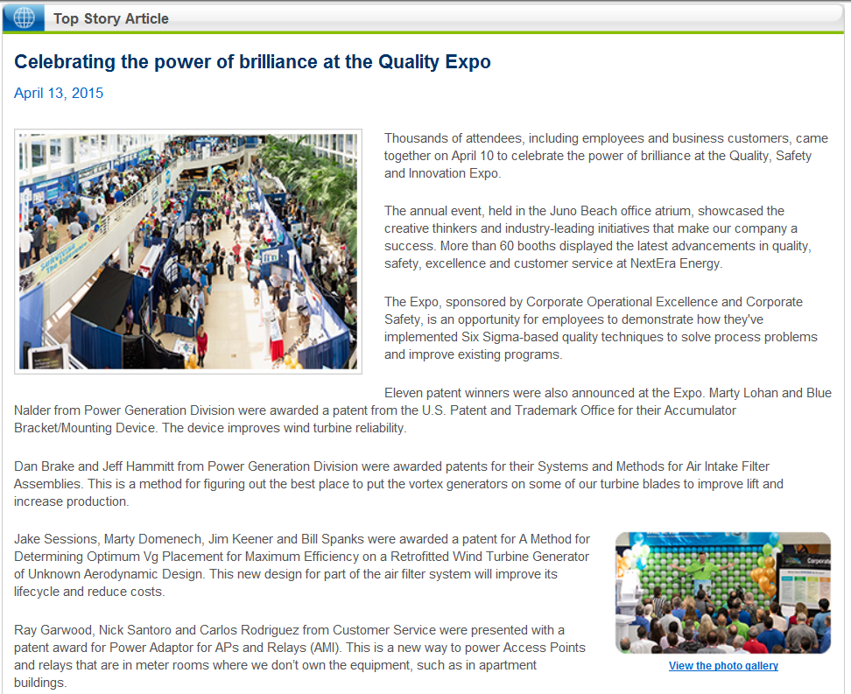
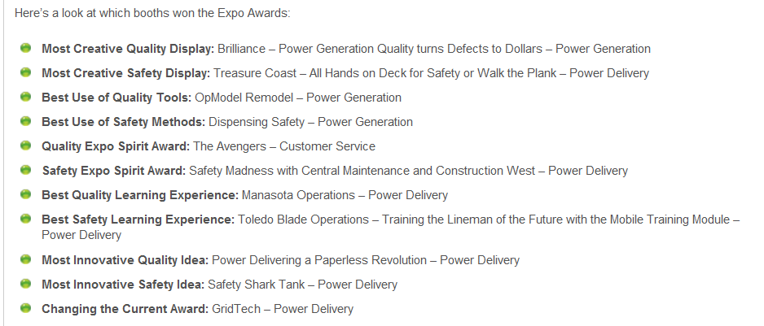
The OpModel Project – Execute and see the results!
Celebrate and share your success!!
2015 Quality and Safety Expo Award Winner:
Best Use of Quality Tools
Notes:
Slide 42: AND DON’T FORGET TO CELEBRATE SUCCESS!!
We showcased our OpModel Remodel at our company’s Safety, Quality, and Innovation Expo this month and won the company award for Best Use of Quality Tools for our display exhibit that explained what we had done with the OpModel.
Our VP also took the entire Development and Change Mgmt Team out to dinner at a high end, fancy, waterfront restaurant and Kelley and Adriana gave each team member commemorative gifts.
Thank you and we would like to answer any additional questions you have. Remember, we still have prizes to give away.

Slide 35
The OpModel Project – LIVE Demonstration
Getting Started Live Demonstration
Accessing the OpModel (D2)
Setting Temporary Path and Checkout Path
Searching
Public Search
My Saved Searches
Creating Search
Filtering Search Results
Favorites
Versioning
Edit Existing
Checkout and Check in from File
Add New Process
Workflows and Outlook Notifications
HELP

Slide 36
Questions?

Slide 37
Appendix

Slide 38
OpModel Process Structure – New and Improved
PGD OpModel – Overview of new simplified structure
Categories are focused on functional areas of work vs. who is executing the work
Aligns with how we are running our business and executing work now
Processes further describe the particular ways we are executing and supporting that function
Allows for future development and growth
More intuitive and easy for people to understand and ultimately search

Slide 39
Key Terms and Definitions
PGD OpModel – Overview
Operational Model – The family of standards that defines the way PGD does work
Standards – A combination of processes, procedures, instructions and guidelines that define the purpose, actions required and expected outcome of a task or set of tasks
Category – One of seven major functional groups of the Operational Model; each group represents the compilation of standards that defines that particular area of work
D2 – The next version (upgrade) of Documentum, the platform for PGD office of record for long term PGD business and Process documents
Understanding terminology will allow everyone to “speak the same language.”
Notes:
Understand the vision for the OpModel Project and interaction with other key projects including NEXTeam and Knowledge Sharing.
Align/integrate activities and outcomes of all projects in order to reduce duplication, confusion, or rework.
Understand necessary steps to meet OpModel deadlines.

Slide 40
Folder-based OpModel Process Structure Legacy
PGD OpModel – Overview of Original OpModel Structure
Team focused
Folder based
Separate tabs for global and local documents
Drill down to correct location
Non-standard formats

Slide 41
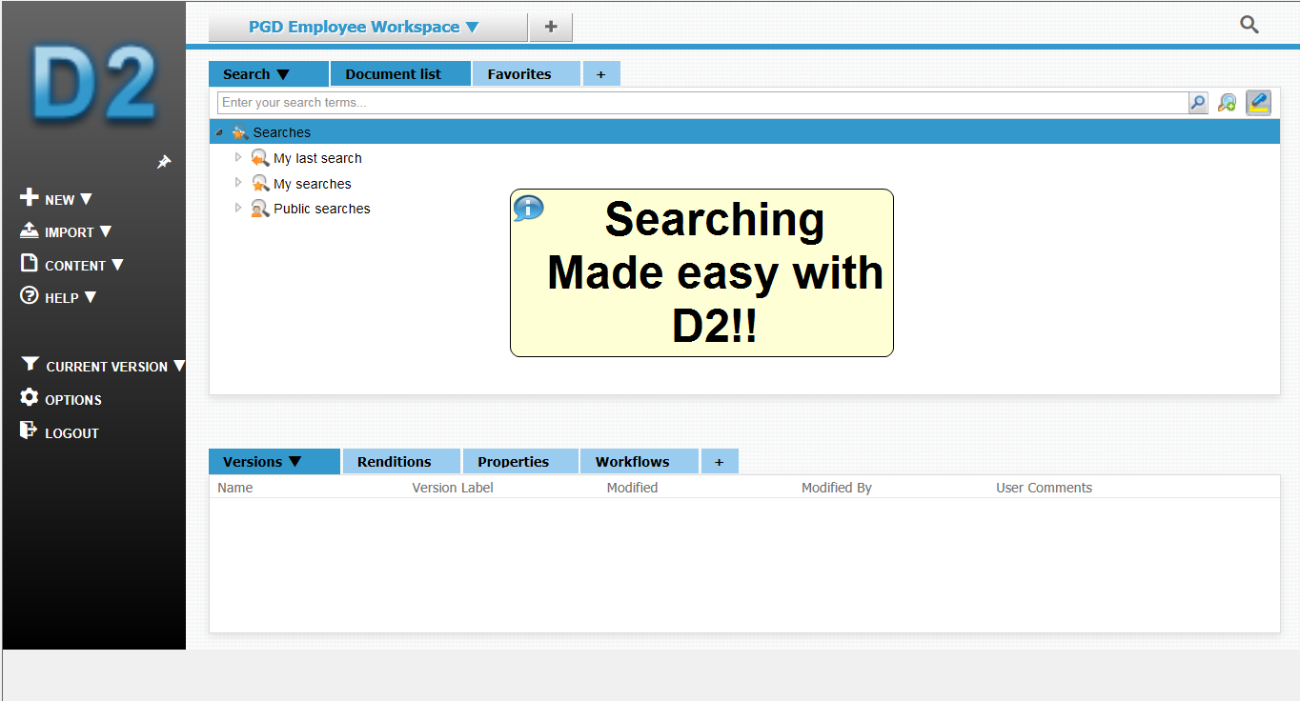
Searching
PGD OpModel – Overview of New OpModel Interface
New and Improved
Full text search
All attributes available to search
Highlights key words
Saved searches include both personal and public searches

