Slide 1
2016 Configuration Management Benchmarking Group Conference
23rd Annual
Integrated Supply Chain
Procurement Engineering
June 7, 2016

Slide 2
Agenda
Integrated Supply Chain (ISC)
ISC – Technical Services (TS)
ISC TS Procurement Engineering (PE) Functions
Item Equivalency
Commercial Grade Dedication
PE/ENG Interface Meeting and Review

Slide 3
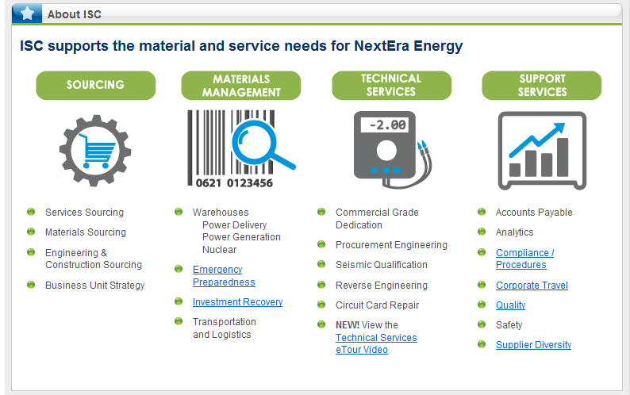
Organization
Integrated Supply Chain (ISC)
ISC Supports the NextEra Energy Enterprise – Centralized Organization

Slide 4
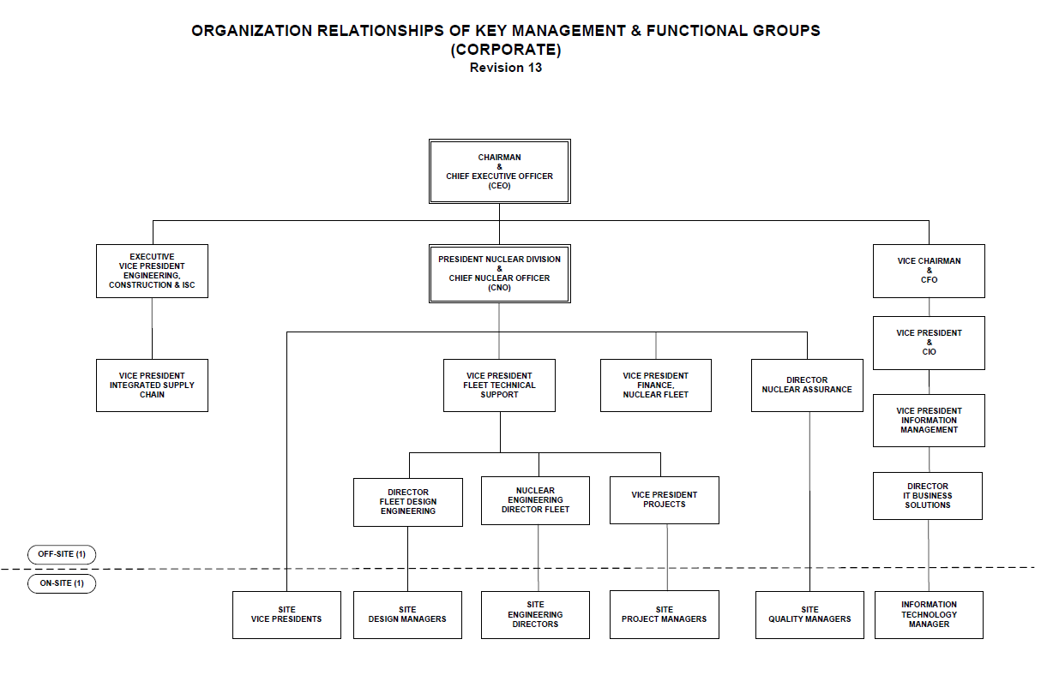

Quality Assurance Topical Report (QATR) - Organization
Integrated Supply Chain and Procurement Engineering support defined in Quality Assurance Topical Report.
Procurement Engineering is part of Integrated Supply Chain which is a support organization

Slide 5
Quality Assurance Topical Report
Vice President Integrated Supply Chain (ISC)
  This position reports to the CEO through the Executive Vice President Engineering, Construction and ISC and is responsible through ISC directors for the following:
    Procurement engineering
    Coordinating contract activities
    Negotiating, generating, and issuing procurement documents for required items and services supporting the operation, licensing, maintenance, modification, and inspection at the nuclear plants, and for materials and equipment to support the Nuclear Division staff
    Review of procurement documents to assure that technical and quality requirements are incorporated into the procurement documents that it authorizes
    Performance of receipt inspection to verify that purchased items comply with procurement document requirements (except at stations where receipt inspection is performed by the Nuclear Oversight Organization)
    Controlling materials received at each nuclear plant site in accordance with company policy and procedures

Slide 6
Organization
Integrated Supply Chain (ISC) – Technical Services (TS)
ISC Technical Services
  Corporate Procurement Engineering (PE)
    Direct Plant Support
  Corporate Procurement Engineering & Dedication (CPED)
    Focused Plant Support
      Commercial Grade Dedication and Seismic Testing
      Reverse Engineering
      Circuit Card Repair
      Special Testing
        Shelf Life Extension
        In-storage Maintenance testing
        Forensics
        On Site Testing
    Quality Control Inspection and Technical Specialist
ISC – TS Procurement Engineering – External to Nuclear Fleet – Centralized Support Organization

Slide 7
Purpose and Scope
Integrated Supply Chain (ISC) – Technical Services (TS)
PE control activities are necessary to:
  Ensure that purchased plant items and services are subject to the appropriate quality and technical requirements.
  Ensure that plant configuration is maintained.
  Ensure that original qualifications are maintained, or appropriately evaluated if they cannot be maintained.
Scope:
  Tasks assigned to PE in support of procurement and configuration control activities.
    Tasks assigned to PE are related to procurement of items and services for Safety Related (SR) and Quality Related (QR) plant equipment (plant System, Structure or Component), and design/configuration control for SR, QR and Not Nuclear Safety (NNS) plant equipment (plant System, Structure or Component).
    Tasks assigned to PE are related to procurement of items and services for Important to Safety (ITS) plant equipment (plant System, Structure or Component), and design/configuration control of ITS and Not Important to Safety (NITS) plant equipment (plant System, Structure or Component).
Purpose and Scope – Excerpt from PE Quality Instruction

Slide 8
EPRI Procurement Engineering Timeline
Integrated Supply Chain (ISC) – Technical Services (TS)
EPRI Joint Utility Task Group (Plant Support Engineering)

Slide 9
Generic Letter 89-02
GL 89-02 provides the basis for the formation of Procurement Engineering.
The GL described 3 characteristics of effective procurement and dedication programs:
  The involvement of engineering staff in the procurement and product acceptance process
  Effective source inspection, receipt inspection, and testing programs
  Thorough engineering-based programs for review, testing, and dedication of commercial-grade products for suitability for use in safety-related applications.
The NRC required engineering involvement in the parts procurement process to help prevent counterfeit and fraudulent parts from entering the nuclear supply chain.
Most sites formed a Procurement Engineering group to keep system and design engineering focused on their core functions rather than procurement issues.

Slide 10
Procurement Engineering – Core Functions
Material and Services
  PE Evaluation – Based on Approved Design
    Quality Level Determination
    Procurement requirements to support Purchase Order development
      Technical requirements
      Quality requirements
    Procurement Method
      Appendix B (Safety Related)
      Commercial with Commercial Grade Dedication (Safety Related)
      Commercial (Quality and Not Safety Related)
    Receiving and Inspection Requirements
      Documentation
      Acceptance Criteria
        Critical Characteristics for CGD
      Additional testing

Slide 11
Procurement Engineering – Core Functions
Resolution of Supplier Questions/Issues
  Bid Exception Review (Prior to Purchase Order)
  Supplier Deviation Notice (Purchase Order with Supplier)
  May result in Item Equivalency Evaluation or Engineering Change
Resolution of Receiving and Inspection Questions/Issues
  Clarifications
  Discrepancies
  May result in Item Equivalency Evaluation or Engineering Change

Slide 12
Procurement Engineering Supplemental Functions
Item Equivalency Evaluations
  Supplemental support to Nuclear Engineering Change Process
Supports resolution of part obsolescence or plant enhancements
Identification of cost savings
Evaluations for material shelf life extensions
Technical support for QA supplier audits

Slide 13
Item Equivalency Evaluation

Slide 14
Item Equivalency Evaluation
The NextEra Items Equivalency Evaluation process is controlled by QI-4-NSC-9, Procurement Engineering Control.
The Item Equivalency Evaluation (IEE) determines the acceptability of alternate replacement plant items by evaluating changes in form, fit and function. Changes in design, manufacturing processes, and configuration are also evaluated.
The IEE Checklist (NSC Form #4025 or equivalent) is used to determine that an IEE can be performed solely by PE, with Nuclear Engineering support or solely by Nuclear Engineering via the design change process.
The IEE (NSC Form #4026 or equivalent) should be used to document the IEE details when the IEE can be performed by PE.

Slide 15
Item Equivalency Evaluation
An IEE shall assure that interfaces, interchangeability, fit, form, function, and material are not adversely affected or contrary to applicable regulatory, code or design requirements.
  1. Interface(s)/Interchangeability – Interface(s) with other items and/or procedures and processes. For example, if an operating procedure says to “push a button” and the replacement item is designed such that it works on the principle of “toggle a switch,” interchangeability is affected.
  2. Fit – Mounting, connections to existing plant equipment and the space that is occupied by, or required to support operation of an item.
  3. Form – Shape, size, dimensions, mass, weight and other physical parameters that uniquely characterize an item.
  4. Function – Performance characteristics, process and range of operation of an item.
  5. Material – New material(s) of construction must meet or exceed the functional requirements of the original material(s).
  6. Training attribute – The IEE will identify where training may be necessary prior to the installation and/or operation of the replacement item. Training may be required where man-machine interfaces differ from the original configuration.

Slide 16
What Can’t be Processed using an IEE
An IEE cannot be used to evaluate changes to fit/form/function and/or process/logic parameters that are outside of approved design tolerances or preengineered solutions.
    1. Informational calculations can be used to confirm that changes are within approved design tolerances.
    2. Changes that are outside approved design tolerances or pre-engineered solutions must be evaluated by Nuclear Engineering. These changes will be processed or supplemented by Nuclear Design Engineering through an approved design change process. Examples of these changes include: complex pipe routing, seismic calculations, environmental qualifications, set points, process design parameters, power requirements, monitoring, and operations or licensing/design criteria.

Slide 17
What Can’t be Processed using an IEE
An IEE cannot make changes to the content or requirements contained in the Tech Specs, UFSAR, or other licensing documents; nor can an IEE make changes to a procedure containing information on how SSCs are operated or controlled, if the procedure is described in the UFSAR.
  A UFSAR Change Request shall be submitted to update the UFSAR to remove or update the information to ensure the IEE is not in conflict with the UFSAR. The UCR shall be approved prior to completion of the IEE.
In addition, an IEE cannot be used as the basis for making changes to the Tech Specs, UFSAR, or other licensing documents, or UFSAR procedures described above. Changes to these documents must be made independent of the IEE using an applicable design change process.

Slide 18
What Can’t be Processed using an IEE
An IEE cannot add or delete plant equipment or components or authorize items to be abandoned in place. Addition or deletion of fittings, terminal lugs, fasteners, mounting brackets, etc. as required to allow installation of an equivalent item is acceptable provided their use does not adversely affect the function of the replacement item or result in exceeding approved installation tolerances and any impact on seismic qualification is included in the evaluation.
An IEE shall not be used to support the replacement of plant components when design and/or specification information fails to clearly establish that the replacement item will not impact the design basis of the SSC.
Items that are required to maintain the ‘as qualified’ EQ configuration may not be processed under the IEE process alone. Changes to the EQ documentation shall be processed as an EQ Evaluation/EQ Document Package revision in accordance with applicable facility Nuclear procedures and must be approved prior to approval of the IEE.

Slide 19
Gaps Identified in the IEE Process
Maintenance Instructions are not getting into the Work Orders
Material requiring additional engineering input was being issued to the field without proper controls and notification
  Motors requiring breaker and overload evaluation
  Mounting and Installation instruction needed from engineering
Approved alternate models were not being linked to the equipment tags and vendor manual and draws were not being updated with the replacement part information

Slide 20
IEE Process Flow Chart
Flow Chart for IEE process developed by Tech Services and Corporate Engineering
See the separate flow chart for obtaining engineering support

Slide 21
Requests for Engineering Input
Based on the IEE screening or in the course of the IEE engineering input may be needed to determine if a difference in characteristics is acceptable, i.e. change in motor amps, change in weight, material change, etc.
The request for engineering support should be made using an AR-ECR.
An engineering hold should also be placed on any open work order that will be impacted by the IEE.
The hold on the WO will also make the issue visible through the T-week schedule.
Upon completion of the AR by engineering, the AR response should be reviewed by PE and the IEE updated as necessary.

Slide 22
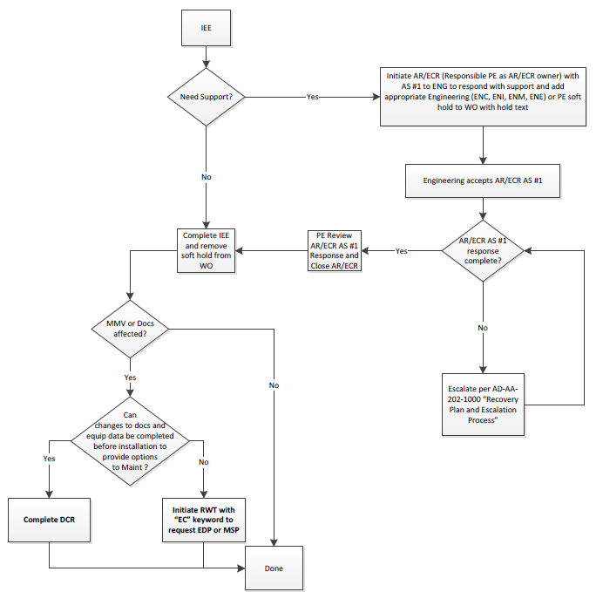
Requests for Engineering Input
Reference NUG NSC 4001 Attachment 1

Slide 23
Configuration Management
There has been some issues with configuration management related to the implementation of IEEs.
Because PE did not know when IEEs would be implemented, updating the approved alternate panel (D033) and adding any drawings and vendor manuals was left to the “As Building” process.
In many cases this was not being done in a timely manner or done at all.
The Corporate Engineering and Configuration Management group requested PE assistance in resolving the issue moving forward by completing the EC-DCR when the IEE is complete.
The EC number should be listed in the IEE.

Slide 24
Configuration Management
When completing an IEE for a host component the following may need to be updated.
  Approved alternate on the Approved Models List
  New drawing or vendor manual added to Documents panel
  Update to existing drawing or vendor manual to identify the approved alternate
When completing an IEE for a piece part existing drawings or vendor manuals may need to be updated.
  Identify alternate part number
  Identify alternate material

Slide 25
Configuration Management
Reference NUG NSC 4001 Attachment 1

Slide 26
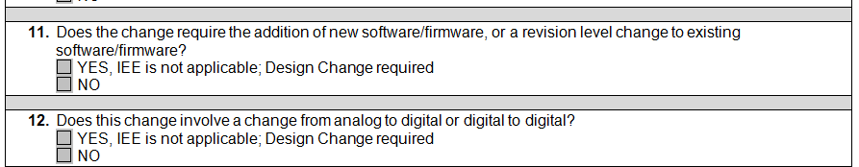
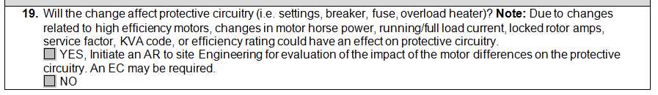
Changes to the IEE Screening
Made the questions more direct relating to digital items and cyber security. Need to be aware of any items that have software or firmware either imbedded in them or that is needed for the equipment to function. This software or firmware needs to be controlled by name and revision.
All digital items are outside of the scope of an IEE.
Additional direction provided specifically for motors. Changing motor characteristics, especially due to high efficiency motors has cause issues with protective circuitry not being evaluated.

Slide 27
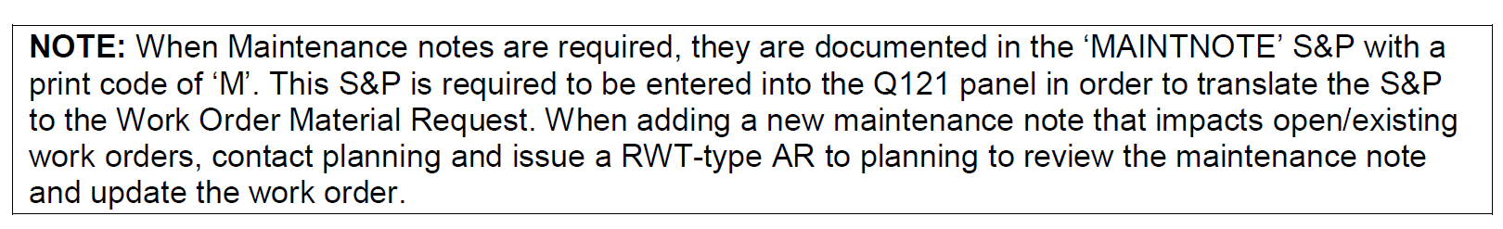
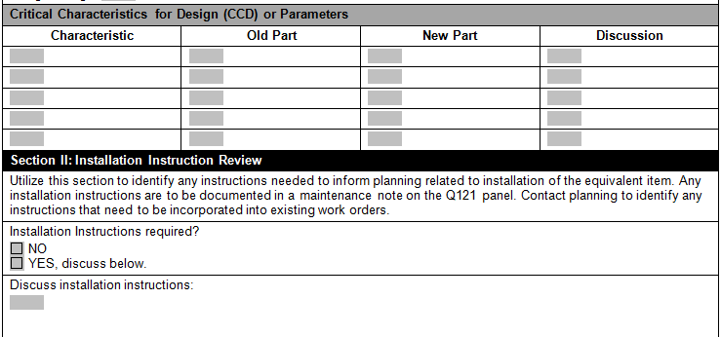
Changes to IEE Form
The following note was added to NUG NSC 4001
Direction of added to the Installation instruction section of the IEE

Slide 28
Item Equivalency Evaluation Summary
Need to know what the installed component or part is. PE cannot do an IEE is the installed part is unknown.
An IEE compares an item to an item. It cannot add or remove parts from a system. It cannot require changes to upstream or downstream components in order to make the replacement work.
An IEE is not used to correct an existing plant design deficiency. The IEE approves an equivalent part and either part evaluated in the IEE is acceptable for use in the plant. If it is desired to no longer use a specific part in the plant, then an EC is required.

Slide 29
Item Equivalency Evaluation Summary
Item Equivalency Evaluations are documented in a PE Evaluation.
The PE Evaluation, including the IEE, becomes a QA Record once approved.
IEEs for Safety Related and Quality Related material have 3 signatures (preparer, independent reviewer, and approver), same as an EC.
The independent reviewer must also be 50.59 screener qualified.
PE issues an EC-DCR to update the D033 panel in NAMS with approved alternate models.
PE issues an EC-DCR to add drawings, and update vendor manuals and drawings associated with the IEE and applicable equipment tag.

Slide 30
Commercial Grade Dedication

Slide 31
What is a Commercial Grade Item
Per 10CFR21, Rev 2, 1995
For nuclear power plants licensed pursuant to 10CFR, Part 50
A structure, system, or component, or part thereof that affects its safety function, that was not designed and manufactured as a basic component.
CGIs do not include items where the design and manufacturing process require many in-process inspections and verifications to ensure that defects or failures to comply are identified and corrected.
NEI clarified a commercial grade item as:
An item is a commercial grade item if its critical characteristics can be verified during the dedication process.

Slide 32
CGI Acceptance Methods
Method 1 – Special Tests & Inspections
Method 2 – Commercial Grade Survey
Method 3 – Source Verification
Method 4 – Supplier/Item Performance Record
These methods are consistent with ASME NQA-1a-2009 Part II, Subpart 2.14, Section 600 “Methods of Accepting Commercial Grade Items and Services”
NRC Generic Letter 89-02 also endorses these methods.

Slide 33
What is Dedication
Per EPRI NP-5652
Dedication is the point in time after which a commercial grade item is accepted for safety related application, and deficiency reporting becomes the responsibility of the party performing the acceptance.
Per 10CFR21, Rev 2
Dedication is an acceptance process undertaken to provide reasonable assurance that a commercial grade item to be used as a basic component will perform its intended safety function, and in this respect, is deemed equivalent to an item designed and manufactured under an 10CFR50, App. B QA program.
Dedication does not perform design acceptance or validation.

Slide 34
NRC GL 89-02
Actions to Improve the Detection of Counterfeit and Fraudulently Marketed Products
NRC GL 89-02 conditionally endorses the CGD guidelines contained in EPRI NP-5652.
Paragraph C of GL89-02
The NRC staff believes that licensees who use methods similar to those described in EPRI NP-5652 to verify the critical characteristics of commercial grade items intended for safety related applications have the basis for effective dedication programs.
Properly implemented, the EPRI guidelines, as modified below, establish methods which satisfy existing requirements of Appendix B to 10 CFR Part 50 as they apply to the dedication process of commercial grade items.

Slide 35
NRC GL 89-02
Actions to Improve the Detection of Counterfeit and Fraudulently Marketed Products
NRC modifications to EPRI NP-5652
Method 2, Commercial Grade Survey of Supplier, should not be used as a basis for acceptance if the supplier does not have a documented and properly implemented commercial quality control program.
Method 2 should not be employed as a basis for accepting items from distributors unless the part manufacturer was included in the survey.
Method 4, Acceptable Supplier/Item Performance Record should not be used alone unless the historical record is based on industry performance data directly applicable to the critical characteristics and the manufacturer’s control processes have been audited.

Slide 36
NRC IP 43004
The following from NRC IP 43004 are factors that are to be considered when identifying critical characteristics for dedication:
The important design, material, and performance characteristics that have a direct effect on the item’s ability to accomplish its intended safety function.
Active/passive safety related function, long-term reliability/durability, system safety/non-safety interfaces, and system compatibility under all design basis conditions.
Any changes in design, material, or manufacturing processes that could impact the functional characteristics of the item.
Appropriate interface with the vendor to identify and characterize the design and functional parameters of specific parts.
The number and nature of the critical characteristics are to be based on the intended safety function, application requirements, complexity, credible failure modes and effects, and performance requirements of the item.

Slide 37
NRC IP 43004
All critical characteristics (i.e. those that are important for the item to perform its safety function, as determined in the technical evaluation) are to be verified. Not all design requirements need to be considered critical characteristics; however, licensees or applicants mist assure the suitability of all parts, materials, and services for their intended safety related applications.
Post-installation testing, functional tests before installation, and/or operational test after installation may be performed to verify critical characteristics of the CGI.
Seismic and environmental qualification should be treated as critical characteristics to be verified.

Slide 38
EPRI 3002002982 / NP-5652
Guideline for that Acceptance of Commercial Grade Items in Nuclear Safety Related Applications
3.3 Purpose and Limitations of Commercial-Grade Dedication
  Commercial-grade item dedication is an acceptance method used to obtain reasonable assurance that an item will be capable of performing its intended safety-related function(s). Commercial- grade item dedication occurs after the design and qualification activities are complete.
  Commercial-grade dedication is not intended for use in establishing design, verifying the acceptability of design, or qualifying design. The technical evaluation and acceptance processes are two of the five elements depicted in Figure 3-2 that ensure the overall quality of plant equipment.

Slide 39
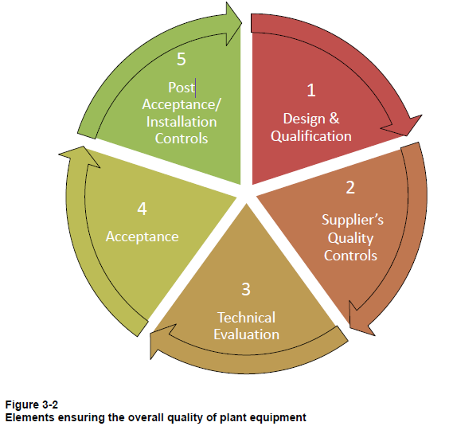
EPRI 3002002982 / NP-5652
Guideline for that Acceptance of Commercial Grade Items in Nuclear Safety Related Applications

Slide 40
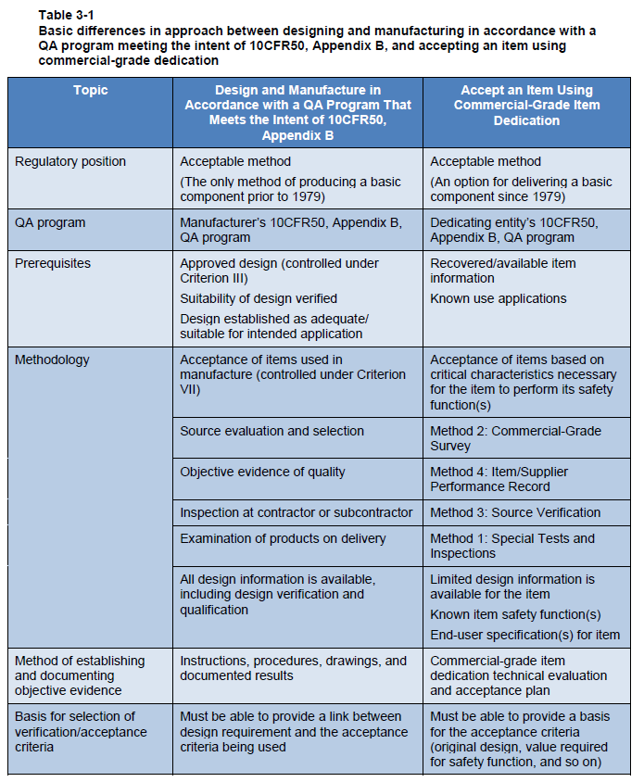
EPRI 3002002982 / NP-5652
Guideline for that Acceptance of Commercial Grade Items in Nuclear Safety Related Applications

Slide 41
EPRI 3002002982 / NP-5652
Guideline for that Acceptance of Commercial Grade Items in Nuclear Safety Related Applications
Critical Characteristics
The primary purpose of identifying critical characteristics during commercial-grade dedication is to determine which characteristics are necessary to provide reasonable assurance that the item being dedicated is capable of performing its intended safety function(s).
A critical characteristic is defined in 10CFR21 as “those important design, material, and performance characteristics of a commercial grade item that, once verified, will provide reasonable assurance that the item will perform its intended safety function”.

Slide 42
EPRI 3002002982 / NP-5652
Guideline for that Acceptance of Commercial Grade Items in Nuclear Safety Related Applications
Critical Characteristics vs Design Characteristics
The intent of selecting critical characteristics for acceptance is to identify the characteristics relative to safety function(s) from a larger population of critical characteristics for designs. Verification of all critical characteristics for designs is not required in order to achieve the reasonable assurance necessary to accept a commercial-grade item.
Critical characteristics (selected for acceptance) are typically a subset of the design characteristics and are based on the item’s safety function(s) and complexity. However, when the safety function(s) or end use(s) are unknown, critical characteristics selected for acceptance may include all design characteristics.

Slide 43
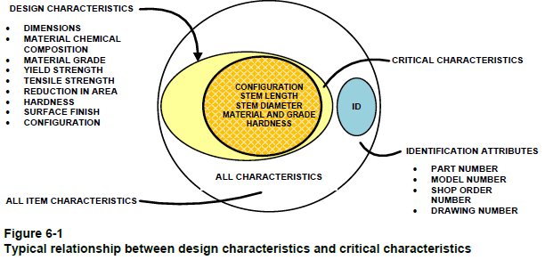
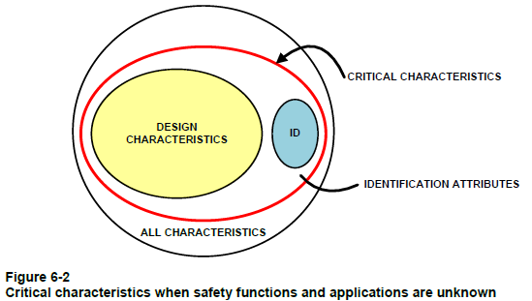
EPRI 3002002982 / NP-5652
Guideline for that Acceptance of Commercial Grade Items in Nuclear Safety Related Applications

Slide 44
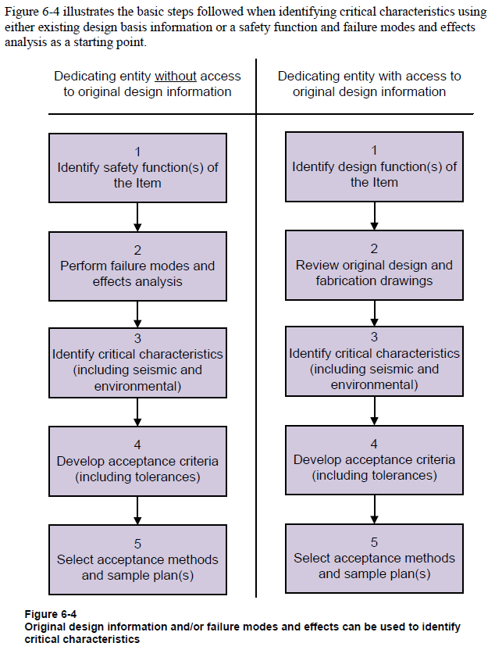
EPRI 3002002982 / NP-5652
Guideline for that Acceptance of Commercial Grade Items in Nuclear Safety Related Applications

Slide 45
QI-4-NSC-9
Procurement Engineering Control
5.5 Commercial Grade Dedication Evaluation:
  5.5.1 The Commercial Grade Dedication (CGD) is an acceptance process that is performed in conjunction with the basic PE evaluation to provide reasonable assurance that the item being procured is acceptable and will perform its intended safety function(s).
  5.5.3 CGD cannot be used if one or more of the critical characteristics required to provide reasonable assurance cannot be verified (i.e. design and manufacturing process requires in-process inspections and verifications to ensure that defects or failures to comply are identified and corrected).

Slide 46
QI-4-NSC-9
Procurement Engineering Control
5.5.4 The CGD evaluation shall include the following:
  1. Identification that the item is commercial grade
    A. The CGD process must be initiated by determining and documenting the basis for identification of the subject item as a Commercial Grade Item (CGI)
    B. This action will ensure the item meets the definition of a CGI as provided by 10 CFR Part 21 and is acceptable for further processing under the CGD program. NSC Form #4021 “Commercial Grade Item Review” shall be used to document the basis.

Slide 47
QI-4-NSC-9
Procurement Engineering Control
2. The item’s safety classification
3. Failure Modes and Effects Analysis (FMEA)
  A. FMEA involves postulating failures for the item being evaluated that would prevent it from performing its safety-related function(s). Understanding how an item might fail helps determine the characteristics necessary to avoid failure. FMEA is particularly useful when access to the decision-making process that led to the design and production of an item is not available.
4. Critical characteristics of acceptance (CCA)
5. CCA acceptance criteria
6. CCA acceptance criteria tolerance
7. The CCA acceptance/verification method(s)

Slide 48
PE Commercial Grade Dedication
The Commercial Grade Dedication Process is an industry accepted practice with extensive EPRI and NRC guidance.
The NRC accepts Commercial Grade Dedication through 10CFR21 and has endorsed the existing EPRI guidance on CGD.
Procurement Engineering’s procedures and CGD implementation is in line with the NRC expectations and EPRI guidance.
Procurement Engineering has successfully completed NOS and NRC audits

Slide 49
Commercial Grade Processing
Analysis of Available Approved Design Information
  Specifications
  Drawings
  Technical and Installation Manuals
  Maintenance Procedures
  Equipment Database Information
  Calculations
  Seismic and Environmental Qualification Documents
  Historical Procurement Data
    Original PO
    Receipt Inspection
All Critical Characteristics necessary to provide reasonable assurance must be validated.

Slide 50
Commercial Grade Processing
Maintaining original qualification – Seismic and Environmental
  Dedication is not qualification
    Design suitability determined prior to initial procurement
  Validation of critical characteristics to ensure with reasonable assurance that once installed the item will not adversely affect the original qualification
    EPRI Report TR-1112579, Critical Characteristics for Acceptance of Seismically Sensitive Items (CCASSI)
  Validation by functional testing (Method 1) of representative sample
    Seismic
    Environmental
Issues during dedication
  Discrepancy review by PE
  Item differences may surface
    Resolution of change outside of dedication (Acceptance Process)
    Handled by IEE or EC Process (Change Process)
    Would require review for revision of CGD Plan and retest of items
All Critical Characteristics necessary to provide reasonable assurance must be validated.

Slide 51
PE CGD – Interface Review
Need for stronger relationship between PE and Nuclear Engineering
  PE/ENG Interface Meeting Team and Charter
    Meet Biweekly
    Track items (Condition Reports, Plant Issues/Comments, etc.)
    Discuss for lessons learned
    Developed Interface Review form for CGD
      Intent to define PE medium and high risk items
      Identify compensatory actions
      Obtain Corporate Functional Area Manager (CFAM) Design Review or initiate discussions
      Ensure Nuclear Engineering is engaged in our processes
      Utilize Form 4032 to document review

Slide 52
Procurement Engineering – Breakout Session
Procurement Engineering provides procurement requirements and maintains approved plant design/configuration.
Is PE under Supply Chain at your facility?
What type of interactions with PE?
What functions performed for PE?
Configuration Management Issues – PE Related?
Discussions/questions on:
  Procurement Engineering – Technical and Quality
  Item Equivalency – Does not change design
  Commercial Grade Dedication – An Acceptance Process
  PE/ENG Interfacing
  Analog to Digital or Digital to Digital – Equivalent? Performed by PE?
  Enhancement Request – How do you handle?
Procurement Engineering is a support organization

Slide 53
Attachments
Commercial Grade Item Review Form – 4021
IEE Applicability Review Form – 4025
IEE Form – 4026
CPED Engineering Interface Review Form - 4032

Slide 54
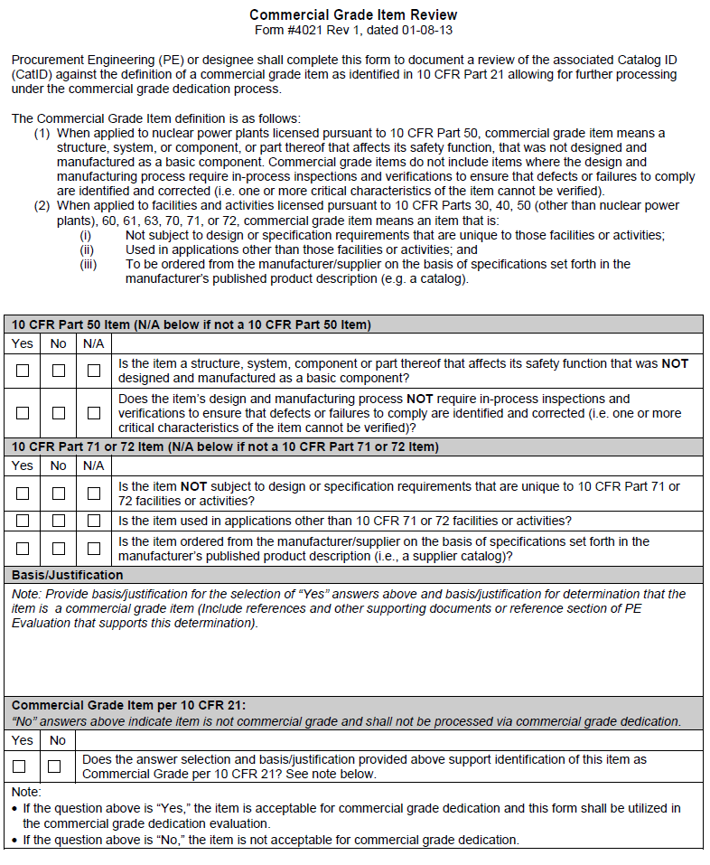
Commercial Grade Item Review Form - 4021

Slide 55
IEE Applicability Review Form - 4025

Slide 56
IEE Applicability Review Form - 4025

Slide 57
IEE Applicability Review Form - 4025

Slide 58
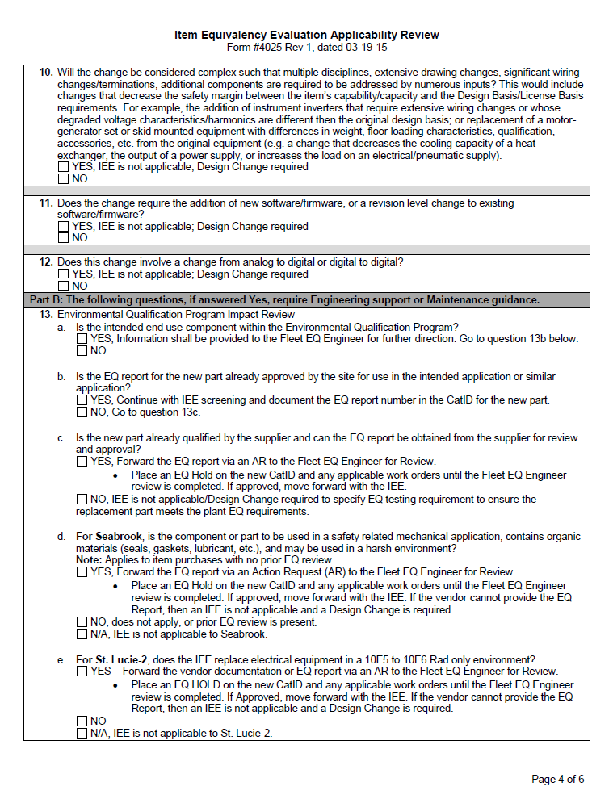
IEE Applicability Review Form - 4025

Slide 59
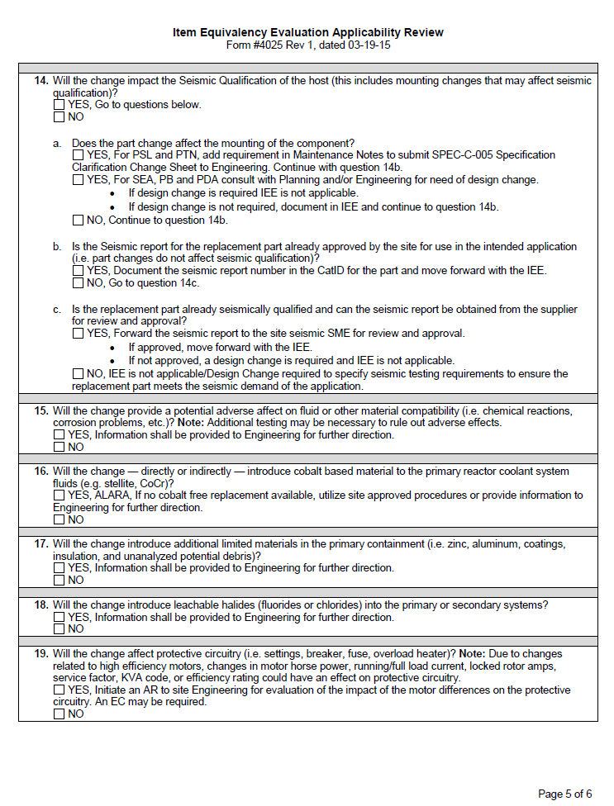
IEE Applicability Review Form - 4025

Slide 60
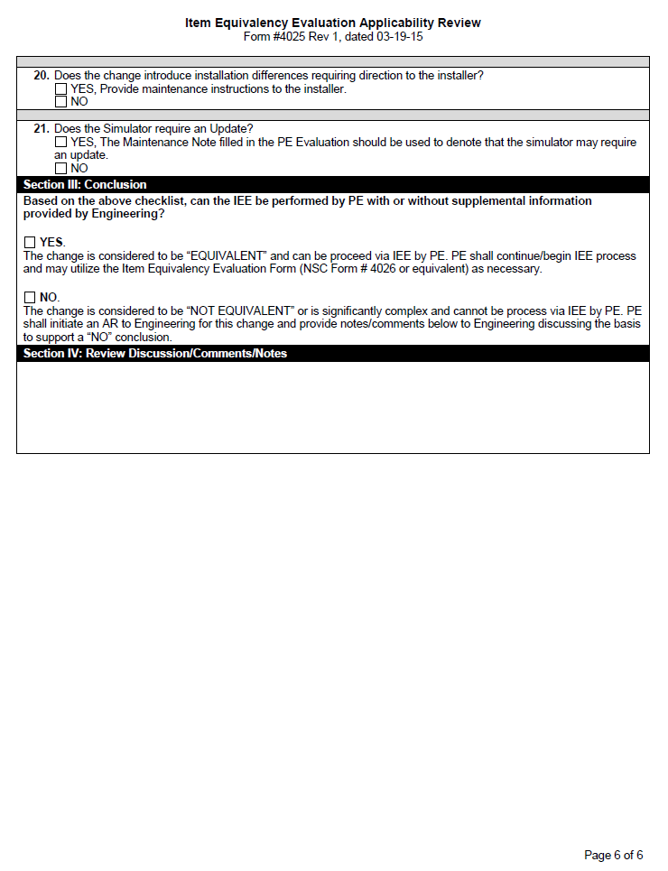
IEE Applicability Review Form - 4025

Slide 61
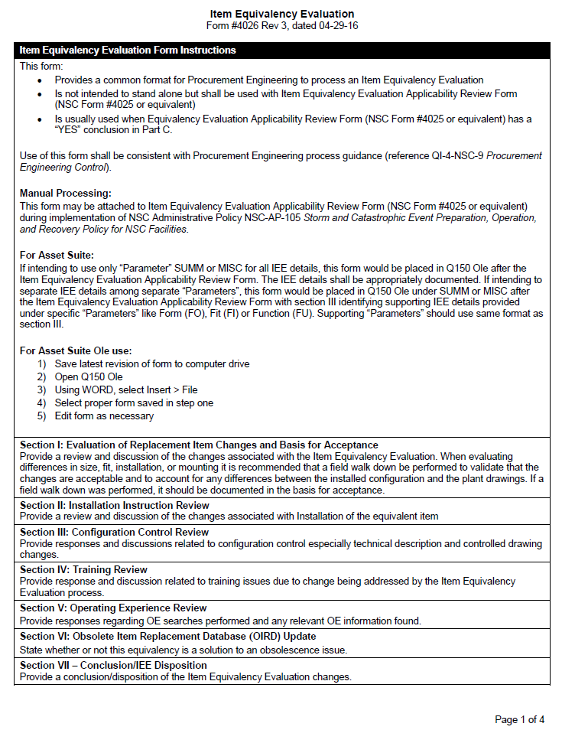
IEE Form - 4026

Slide 62
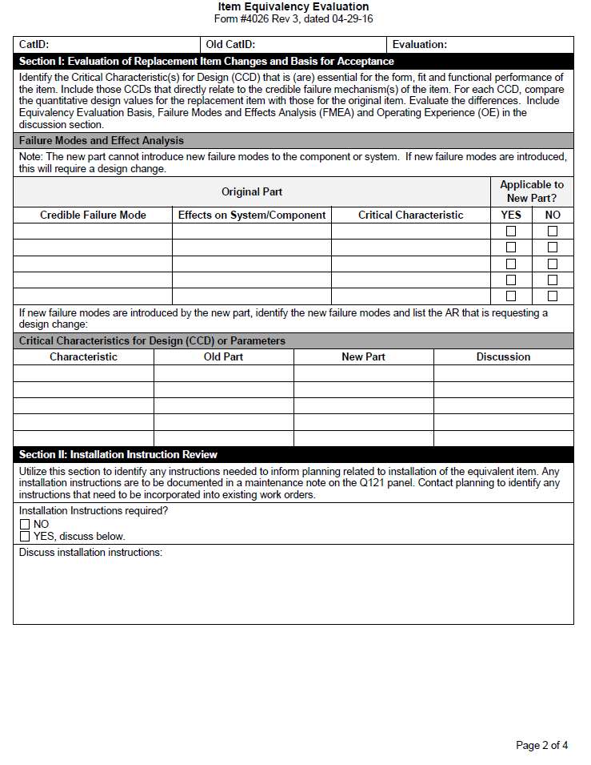
IEE Form - 4026

Slide 63
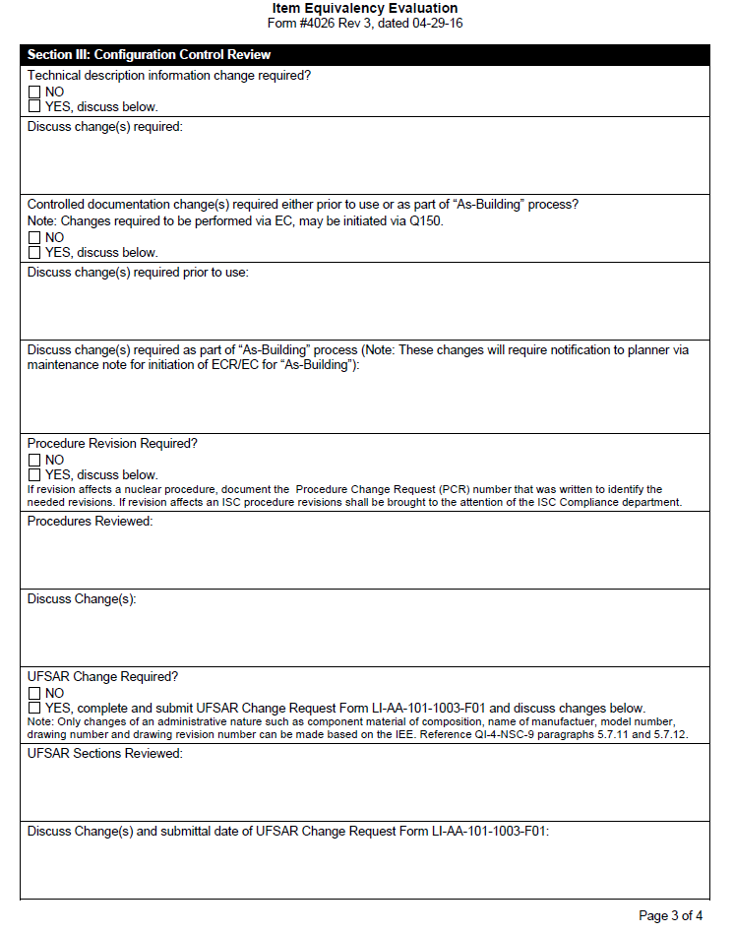
IEE Form - 4026

Slide 64
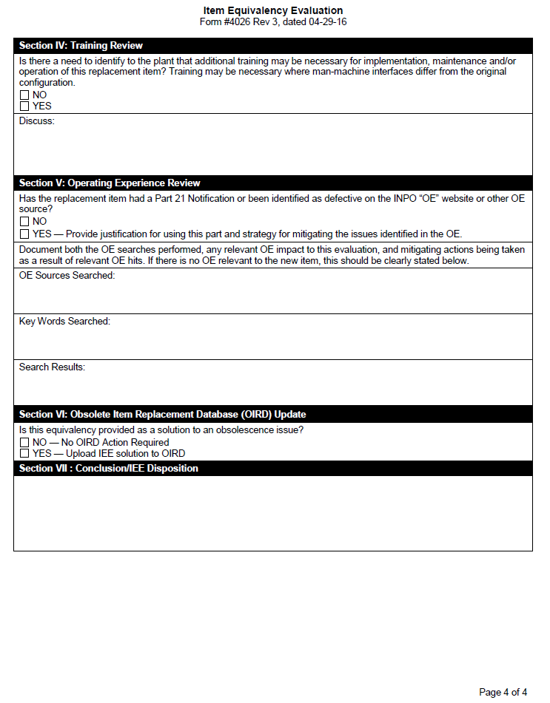
IEE Form - 4026

Slide 65
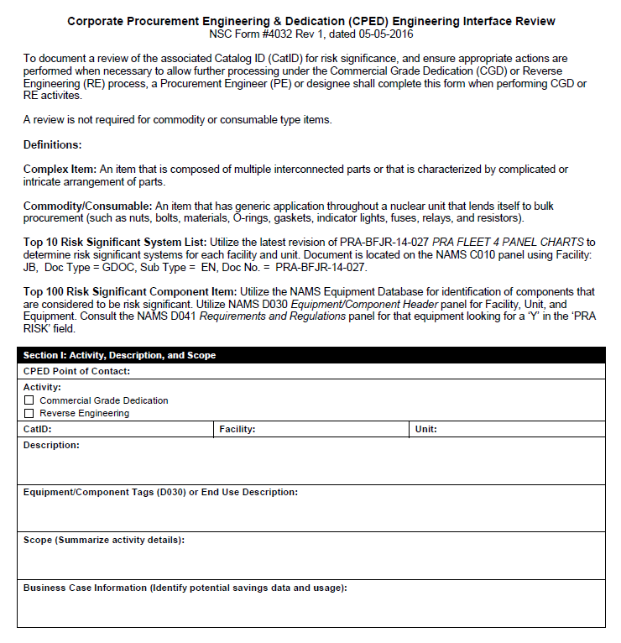
PE CGD – Interface Review Form - 4032

Slide 66
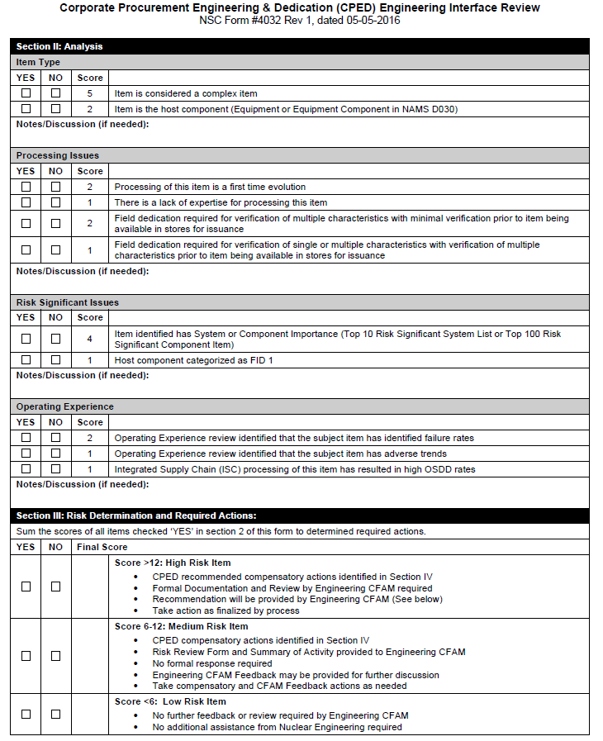
PE CGD – Interface Review Form - 4032

Slide 67
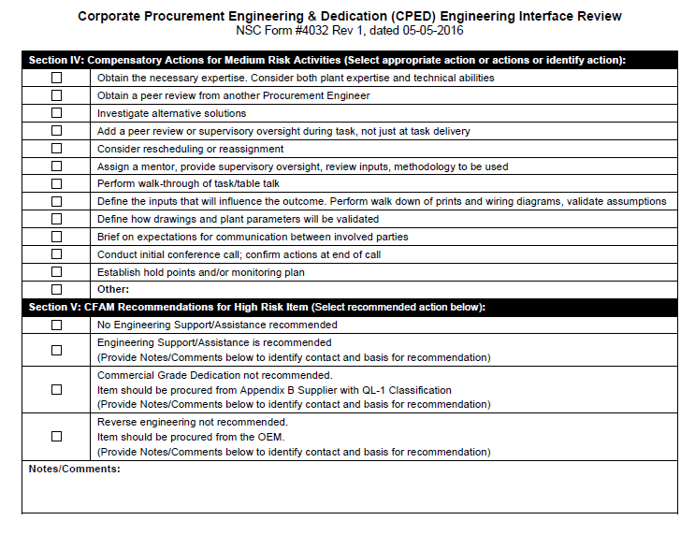
PE CGD – Interface Review Form - 4032

Slide 68
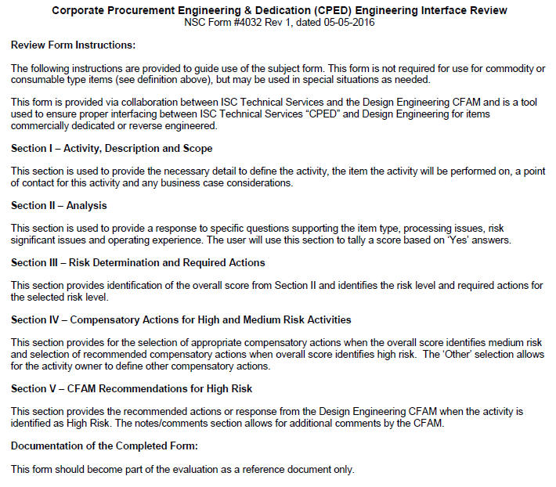
PE CGD – Interface Review Form - 4032

