Slide 1
Nuclear Fleet: Configuration Management Benchmarking Group 2016
June 6, 2016

Slide 2
Environment for Nuclear Operators
LOWER
Natural
Gas
Prices
RISING
Regulatory
Costs
FLAT
Electricity
Use
1

Slide 3
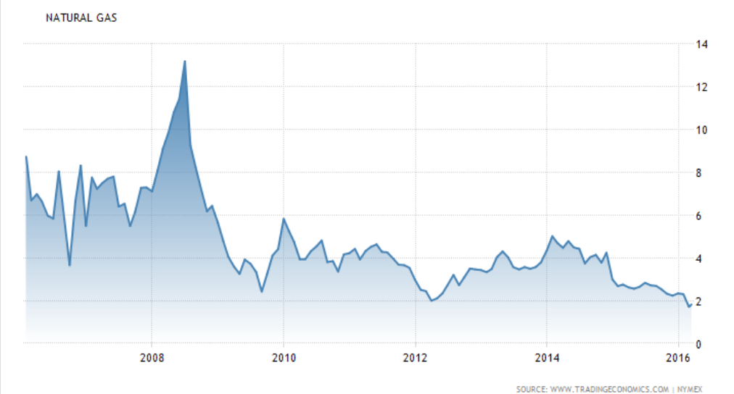
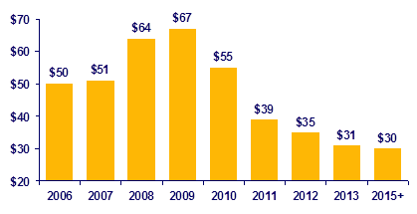
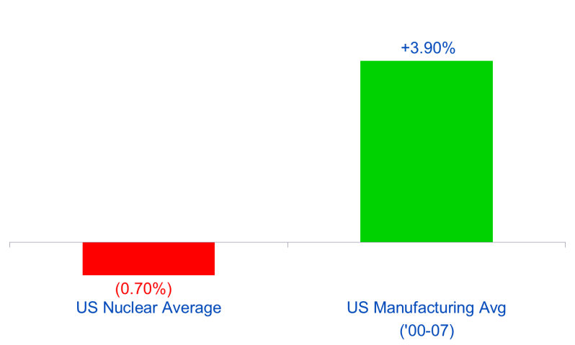
The environment has, in fact, become more challenging
Natural gas at all-time lows
Competing technologies more competitive
Source: NYMEX
Source: NextEra Energy
Natural Gas Prices ($/MMBtu)
Cost of Wind Generation ($/MWh)
NGK25
Regulatory requirements rising
And, a history of relatively poor productivity
Source: Internal Plan
Source: EUCG and US Bureau of Labor and Statistics
Regulatory Capex (% of Total)
Annual Change in Labor Productivity
Industry viability at risk without changing
2

Slide 4
Benchmarking Analysis
A benchmarking analysis against industry leaders allowed us to quantify cost reduction potential
Cost/MWh vs. Total Plant Capacity
Top Performance
3

Slide 5
Nuclear Sites At Risk across the Industry
The market has become more challenging, putting several plants at significant risk – 15-20 plants at risk since 2013.
Fitzpatrick
2015, 838 MW
RE Ginna
(582 MW)
VT Yankee
2014, 619 MW
KeWaunee
2013, 566 MW
Pilgrim
2014, 685 MW
Davis Besse
889 MW
Indian Pt.
(2,336 MW)
Fort Calhoun
(478 MW)
Quad Cities
(1,819 MW)
Byron
(2,300 MW)
Oyster Creek
2019, 615 MW
Perry
1,230 MW
Wolf Creek
(1,175 MW)
Clinton
(1,065 MW)
San Onofre
2013, 2,686 MW
Retired / Planned Retirement
At Risk
Crystal River
2013, 838 MW
4

Slide 7
Delivering the Nuclear Promise
The Delivering the Nuclear Promise initiative will identify efficiency measures and adopt best practices and technology solutions to improve operations, reduce electric generating costs and prevent premature reactor closures and is embedded into our Continuous Improvement Program
Address long term, lingering efficiencies
Opportunity to relook and rethink fundamental processes
Deliver a safe, reliable, economic form of energy for the world.
Nuclear
Contributes to grid stability
Assured baseload capacity
No greenhouse affect
Has some of the best, brightest and dedicated people

