Slide 1
Configuration Management (CM) Standard Performance Measures
Performance Indicators for the Nuclear Promise Design Process
Developed by the Configuration Management Indicator Working Group (CMIWG) for the Design Oversight Working Group (DOWG)
May 2017

Slide 2
INTRODUCTION
The Design Oversight Working Group (DOWG) in coordination with INPO formed a Configuration Management Indicator Working Group (CMIWG) to benchmark current industry Configuration Management (CM) indicators, and to develop a CM indicator industry template.
These indicators are in support of the Standard Design Process (SDP) Efficiency Bulletin 17-06, issued March 6, 2017.
These indicators allow management to identify negative trends such as high influx of engineering work for closeout, increases in backlogs, age and number of temporary modifications, Engineering Change (EC) quality, and untimely processing of engineering deliverables.

Slide 3
INTRODUCTION
The CMIWG used the following steps to develop the common CM indicators:
Benchmarking and collation of current industry CM design change process indicators
Identification of existing key leading and lagging indicators for CM in use across the industry
Determined the indicators that were common across the industry

Slide 4
INTRODUCTION
Assessed the usefulness of outlier indicators for inclusion in the common CM indicators
Develop basis documents for each CM indicator
Piloted the CM indicators for three months in 2016 using data from five sites
Made adjustments to the indicators/thresholds, as required

Slide 5
INTRODUCTION
The Configuration Management Indicator Working Group (CMIWG) focused its initial key metric recommendations on indicators that are commonly available or readily created using available data, whenever possible.
An additional focus was monitoring performance associated with the industry’s new Standard Design Process (SDP).
And an ultimate goal was to provide indicators that can identify shortfalls and enable comparison and benchmarking across stations.

Slide 6
INTRODUCTION
Use of numeric values or quantities and performance thresholds with color assignments are to provide a simple portrayal of performance in reports and communications to varying target populations.
In some cases, thresholds were not established at initial roll-out pending collection of sufficient industry-wide data to establish those thresholds.
Sites will submit CM indicators to the INPO Consolidated Data Entry (CDE) group on a monthly basis.

Slide 7
INTRODUCTION
In the short term, email the "Summary Report to Industry" tab of the CM data spreadsheet to <CDE@inpo.org> . In the long term, enter the data from the "Summary Report to Industry" tab directly into the CDE website.
The CDE group at INPO will produce waterfall graphs to compare stations. The DOWG will conduct periodic reviews of the waterfall graphs.
Data to display for an Industry Comparison Waterfall is reflected on each of the eight configuration management indicator basis documents in the industry guidance document, such as:
  total of overdue documents
  total number of ECs turned over not closed
  total number of installed temporary modifications

Slide 8
CM Indicators
Based on industry inputs, the following list of CM indicators was developed:
EC Delivery
EC Quality
EC Worklist Stability
Impacted Document Updates
SDP Throughput: ECs in Design Phase
SDP Throughput: Approved and not Installed (Planning & Installation/Testing Phases)
SDP Throughput: ECs Installed and not Closed
Temporary Modifications
The chart on the next page provides a visual representation of where the indicators are used in the design process.

Slide 9
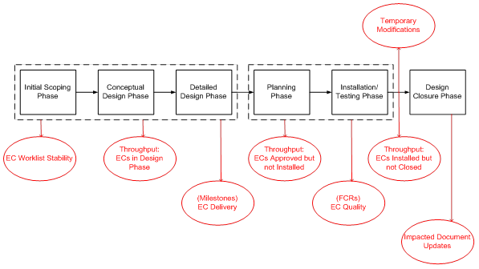
CM Indicators

Slide 10
CM Indicators
Efforts were made to determine if these performance measures were either a “lagging” indicator or a “leading” indicator, and if the indicator would be displayed for a “unit” or a “station”. Results are shown below:

Slide 11
Engineering Change (EC) delivery
This indicator provides an overall measure of Design Engineering performance at timely delivery of Engineering Changes (ECs) to meet the station’s needs.
It measures effectiveness of implementing modifications and takes the place of separate outage milestone indicators used in the industry:
  Adherence to outage milestones
  Schedule commitments for late add outage ECs
It is not applicable to Design Equivalent Changes, Commercial Changes or Temporary Modifications.
It tracks Design Changes from Outage EC Approval milestone and Design Changes with Recovery Plan milestones until outage end.
The “Delivery Commitment” for Outage Design Changes is defined as:
  the “Outage Management Design Complete Milestone” for Design Changes identified at Outage Scope Freeze.
  the Recovery Plan Commitment EC completion date for Late Add Design Changes.

Slide 12
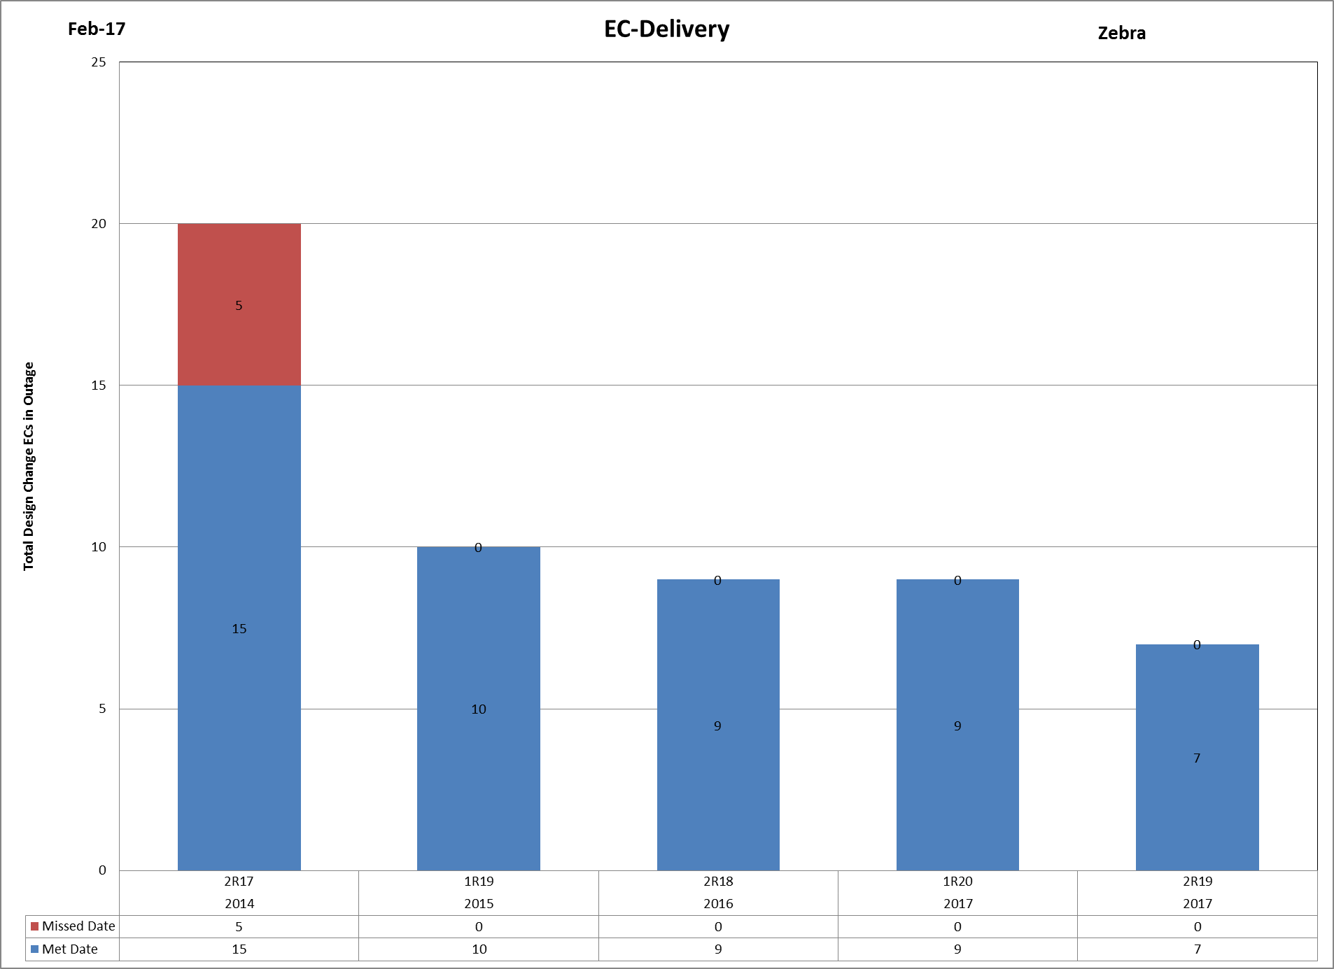
Engineering Change (EC) delivery

Slide 13
Engineering Change (EC) quality
Engineering Change (EC) Quality Indicator is a measure of site EC quality. Each Field Change Request (FCR) is scored by subtracting points from 100 based on FCR significance.
The site EC Quality Indicator is a numerical average of the FCR scores initiated during a given month for all ECs between approval and closeout.
Reasons for FCRs include factors such as errors during EC preparation, planning, or implementation, construction preference, supplier equipment changes, and scope changes.
Planned or Administrative FCRs are counted for information but do not result in a point deduction for determining the EC Quality Indicator.
Individual FCR Score: 100 – FCR Points lost
Site EC Quality Indicator: 100 - Sum of FCR Points lost / (Number of all FCRs - Number of Planned/Admin FCRs)

Slide 14
Engineering Change (EC) quality
The FCR reason codes are as follows:
(PA) Planned or Administrative Change; (-0 points)
(CP) Construction or Installation Preference; (-5 points)
(SE) Supplier Equipment Change; (-5 points)
(SC) Scope Change; (-10 points)
(PC) Planning or Construction Error; (-15 points)
(DN) Design Error – non Consequential; (-15 points)
(TE) Engineering Change (EC) Testing Error; (-20 points)
(DC) Design Error - Consequential; (-40 points)
For an FCR that could have multiple reason codes, list only the “worst offender” of the reason codes that could apply.
Number of points lost for a particular FCR reason code is subtracted from 100 points.

Slide 15
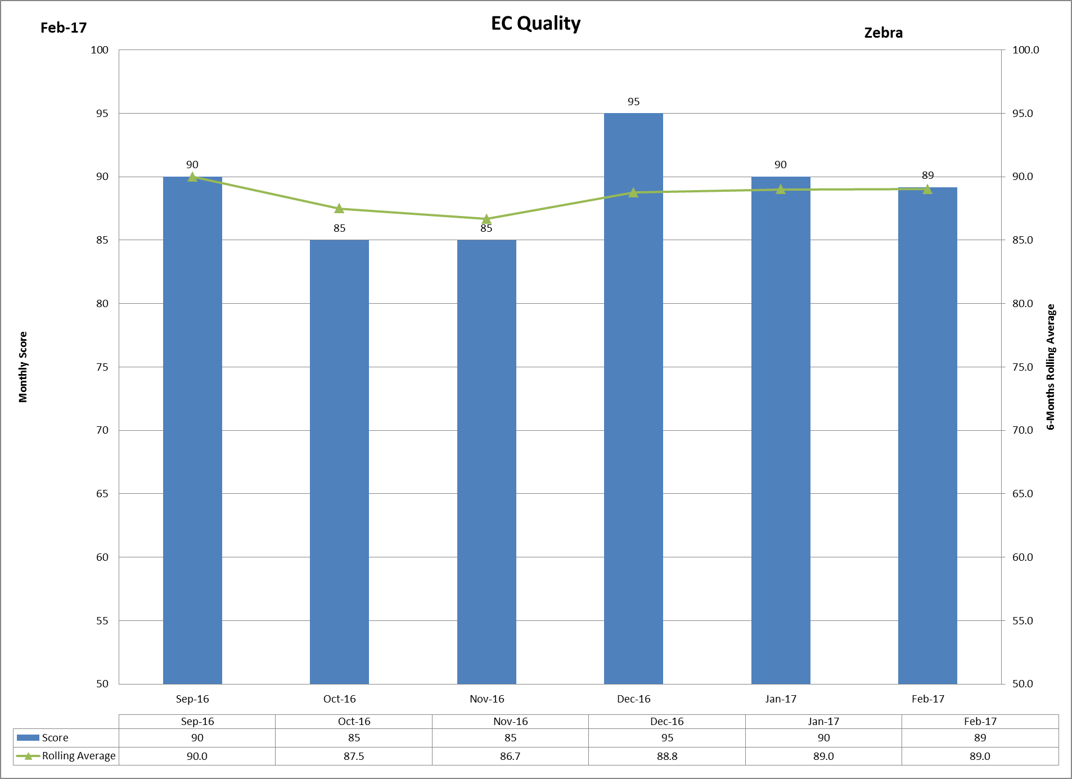
Engineering Change (EC) quality

Slide 16
Engineering Change (EC) quality
Spreadsheet example. Latest data shown to the right with aging data rolling off on left side of the spreadsheet for a twelve-month period.
Mar-16 | Apr-16 | May-16 | Jun-16 | Jul-16 | Aug-16 | Sep-16 | Oct-16 | Nov-16 | Dec-16 | Jan-17 | Feb-17
N/A | N/A | N/A | N/A | N/A | N/A | 90 | 85 | 85 | 95 | 90 | 89
 |  |  |  |  |  | 90.0 | 87.5 | 86.7 | 88.8 | 89.0 | 89.0
 |  |  |  |  |  | 0 | 0 | 0 | 0 | 0 | 1
Feb-17 |  |  |  |  |  | Example Monthly Engineering Change (EC) Quality Scoring |  |  |  |  |  |  | Zebra
 |  |  |  |  | Reason for Field Change Request (FCR)
FCR Number | EC Number | EC Title / Description | Site / Corp / Vendor Engineering | Date FCR Approved | Planned or Administrative Change (PA) | Constuction or Installation Preference (CP) | Supplier Equipment Change (SE) | Scope Change (SC) | Planning or Construction Error (PC) | Design Error - Non Consequential (DN) | EC Testing Error (TE) | Design Error -Consequential (DC) | Points Lost | FCR Score (100 - Points Lost)
 |  |  |  |  | - 0 Points | -5 Point | -5 Points | -10 Point | -15 Points | -15 Points | -20 Points | -40 Points
494736FCR083 | 494736 | U1 TURB CONTR | Vendor A | 2/6/2017 | 1 |  |  |  |  |  |  |  | 0 | 100
494736FCR085 | 494736 | U1 TURB CONTR | Vendor A | 2/8/2017 | 1 |  |  |  |  |  |  |  | 0 | 100
494736FCR087 | 130622 | U1 TURB CONTR | Vendor B | 2/10/2017 | 1 |  |  |  |  |  |  |  | 0 | 100
494736FCR091 | 130622 | U1 TURB CONTR | Vendor A | 2/14/2017 |  | 1 |  |  |  |  |  |  | 5 | 95
494736FCR091 | 130622 | U1 TURB CONTR | Vendor B | 2/14/2017 |  | 1 |  |  |  |  |  |  | 5 | 95
494736FCR095 | 130622 | U1 TURB CONTR | Vendor A | 2/20/2017 | 1 |  |  |  |  |  |  |  | 0 | 100
530593FCR018 | 530593 | U1 FP TURB CONTR | Vendor A | 2/20/2017 | 1 |  |  |  |  |  |  |  | 0 | 100
535141FCR023 | 535141 | U2 MAIN TURB CONTR | Vendor B | 2/22/2017 |  |  | 1 |  |  |  |  |  | 5 | 95
806772FCR001 | 806772 | CAP REMOVALS | Vendor B | 2/23/2017 |  |  |  |  |  |  |  | 1 | 40 | 60
806772FCR001 | 806772 | CAP REMOVALS | Vendor A | 2/27/2017 |  |  | 1 |  |  |  |  |  | 5 | 95
806772FCR001 | 806772 | CAP REMOVALS | Vendor B | 2/28/2017 |  |  | 1 |  |  |  |  |  | 5 | 95
806772FCR001 | 806772 | CAP REMOVALS | Vendor A | 2/28/2017 | 1 |  |  |  |  |  |  |  | 0 | 100
806772FCR001 | 806772 | CAP REMOVALS | Vendor B | 2/28/2017 | 1 |  |  |  |  |  |  |  | 0 | 100
 |  |  |  | Total | 7 | 2 | 3 | 0 | 0 | 0 | 0 | 1 | 65 | 89

Slide 17
EC work list stability
This indicator provides an overall measure of cross-functional performance at maintaining Engineering Change (EC) work list stability.
It typically is an indication of weakness in long-range planning that can result in an increased number of Fast Track modifications, and shows instability in the EC work list.
It monitors late add ECs against milestones (Fast Track Modifications) by looking for late additions or deletions of Design Changes outside of established outage scope freeze milestones are monitored.
Design Equivalent Changes, Commercial Changes, Temporary Modifications, Admin Changes and FCRs are not included.
The calculation is the “Sum of Design Changes added or deleted after scope freeze for a particular outage”
A Separate outage milestone should not be necessary since this indicator will take its place.
The chart will include the last 2 completed outage per Unit in addition to the on-going outage planning.

Slide 18
EC work list stability

Slide 19
Impacted Document Updates
This indicator provides an overall measure of station performance at maintaining design configuration through monitoring of document update performance.
It measures adherence to effective configuration control practices and the incorporation of ECs into:
  Drawings;
  Calculations;
  other impacted documents such as vendor manuals defined by the individual utility.
Impacted Document Updates:
  Total Overdue Documents > Station Update Goal
Document Updates Sub-Indicators:
  Overdue Drawings: # Drawing Updates (All Types) Exceeding Station Goal Timeframe
  Overdue Calculations: # Calculation Updates Exceeding Station Goal Timeframe
  Overdue Other Documents: # Other Document Updates Exceeding Station Goal Timeframe
Sum of Overdue Documents = # Overdue Drawings + # Overdue Calculations + # Overdue Other Documents

Slide 20
Impacted Document Updates

Slide 21
Standard Design Process (SDP) Throughput
Standard Design Process (SDP) Throughput — This indicator measures the quantity and duration of engineering changes (EC) that are in the design development and implementation phases.
It is actually three of the eight CM indicators used to measure throughput and is an indicator of total cycle time:
Aligned with SDP product types (Design Change, Design Equivalent Change, Commercial Change). This is an indicator if the lower-tier processes when appropriate are applied.

Slide 22
Standard Design Process (SDP) Throughput
Engineering Changes by type in each phase (In design phase, Approved and not installed, Installed and not closed). This is an indicator of total cycle time.
Engineering Changes needed for multiple units at a station need to be planned to determine if one engineering change will be developed for multiple units by a process such as staging, or if one engineering change will be developed for each unit or even for a separate division or train.
The Standard Design Process Throughput will be reflected by four separate graphs:
    In Design Phase
    Designs Approved Not Installed
    Designs Installed Not Closed

Slide 23
Standard Design Process (SDP) Throughput – In Design Phase
This indicator tracks the number of Engineering Changes (ECs) in development.
An EC is counted from the task assignment through approval/issued change package (ready for WO planning and implementation).
Data to be collected is the quantity of ECs in design phase reported in these categories:
  Design Changes
  Design Equivalent Changes
  Commercial Changes
Total = Sum of all ECs with the Initial (Revision 0) between task assignment and approval/issued change package for all EC types.

Slide 24
Standard Design Process (SDP) Throughput – In Design Phase

Slide 25
Standard Design Process (SDP) Throughput – Designs Approved Not Installed
This indicator tracks the Quantity and Duration of Engineering Changes (ECs) that have been delivered by Engineering to be implemented in the plant (Planning and Installation/Testing Phases).
The phase of this indicator begins when an EC is approved for implementation, and ends when it is implemented and operational in the plant. This indicator is a measure of the timely use of Engineering products in the plant.
Data to be Collected
Quantity of ECs approved and not installed Backlog reported in these categories:
ECs approved and not installed at end of report month as Design Changes
ECs approved and not installed at end of report month as Design Equivalent Changes
ECs approved and not installed at end of report month as Commercial Changes

Slide 26
Standard Design Process (SDP) Throughput – Designs Approved Not Installed

Slide 27
Standard Design Process (SDP) Throughput – Designs Installed Not Closed
This indicator tracks the Quantity and Duration of Engineering Changes (ECs) in closeout after implementation.
The timeframe of this indicator will begin when an EC is implemented and operational in the plant, and end when all actions associated with the EC are either complete or tracked through an approved tracking mechanism.
This indicator is a measure of Engineering ownership and control of the Engineering Change closeout process.
Closeout is defined as the process for ensuring all documents affected by an EC have been updated/revised or tracked for update, and the change package is placed in a “closed” status (or equivalent) in the utility system.

Slide 28
Standard Design Process (SDP) Throughput – Designs Installed Not Closed

Slide 29
Standard Design Process (SDP) Throughput – Designs Installed Not Closed
Data to be Collected
Quantity of ECs in closeout Backlog reported in these categories:
ECs in closeout at end of report month as Design Changes
ECs in closeout at end of report month as Design Equivalent Changes
ECs in closeout at end of report month as Commercial Changes
Average duration in this phase for ECs in closeout Backlog reported in these categories:
ECs in closeout at end of report month as Design Changes
ECs in closeout at end of report month as Design Equivalent Changes
ECs in closeout at end of report month as Commercial Changes

Slide 30
Standard Design Process (SDP) Throughput – Designs Installed Not Closed

Slide 31
Temporary Modifications
This indicator monitors the number of Temporary Modifications installed longer than one refueling cycle.
It measures adherence to effective configuration control practices.
The total number of open Temporary Modifications is also reported.
This indicator excludes procedurally controlled Temporary Configuration Changes and Temporary Changes in Support of Maintenance and program administrative Temporary Mods.
The graph shows:
  Total number of installed Temporary Mods
  Total number of open Temporary Mods greater than one refueling cycle

Slide 32
Temporary Modifications

Slide 33
Summary & Conclusions
An overall picture of CM performance necessitates the inclusion of specific details for each indicator.
Depiction of the indicators in tabular, worksheet, or matrix form is needed to convey the appropriate parameters to highlight where shortfalls to the utility targets may exist.
This level of detail is needed for action on the indicators. Action should be promulgated for the specific gaps identified as a result of the station CM Indicator process.

Slide 34
Summary & Conclusions
The indicators allow management to identify negative trends such as high influx of engineering work for closeout, increases in backlogs, age and number of temporary modifications, Engineering Change (EC) quality, and untimely processing of engineering deliverables.
Sites will submit CM indicators to the DOWG on a monthly basis through the Nuclear Community web based site.
Participants can view the industry results to ascertain their Site’s performance in relation to industry performance.

Slide 35
Questions???
Configuration Management Indicator Working Group (CMIWG) members who can assist in responding to questions from the industry are:
Harry Willetts – Duke (lead)
Tom Czerniewski – Entergy
Kevin Groom & Ashley Taylor – TVA
Dave Kettering – Energy Northwest
Mike Hayes & Dan Redden – Exelon
Michael Macfarlane – Southern
Sophie Gutner – Dominion
Jim Petro – DC Cook
Ray George – INPO
Site contacts for your station will be provided by your utility.

