Slide 1
CM INPO Perspective CMBG - June 2017
Terry Schuster, Manager

Slide 2
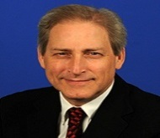
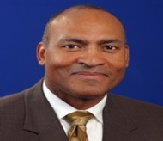
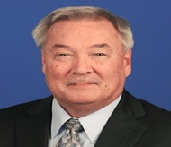
ENGINEERING AND CONFIGURATION MANAGEMENT (4N)
LIAISON AND SECONDEE ENGINEERS
Terry Schuster
Department Manager
Ashley Roques
Admin Coordinator
Thomas Roddey
Assistant Department Manager
Andrew Hayward
New Brunswick
Vinny Kim
KHNP
LOANED EMPLOYEES
PERMANENT EMPLOYEES
Photo
Coming
Soon
Clint Alday
Waterford
Tim Long
Hatch
Joe Mathew
Xcel Energy
Carl Faller
Craig Faulkner
Nathan Zohner 6/17
Vacant
Vacant
Ken Robinson
Calvert Cliffs
Bill Suslick
Catawba
Gary Garrett
Ray George
Bill Nowicki

Slide 3
Agenda
2017 Focus Areas
Plant Evaluation & WANO Peer Review Trends
Areas for Improvement (AFI)
Nuclear Fuel Reliability
Consequential Engineering Errors

Slide 4
2017 Focus Areas
Improving Fuel Performance (key industry issue)
4.0 Reviews during Plant Evals/Peer Reviews for failed fuel response
Fuel Integrity Review Visits
Operating Experience in IERs & industry meetings
Management of Critical Safety Functions
Design Basis management, focused on CSFs
Using WANO Design Informed Review methodology
Technical Conscience – not a focus area, however
We will continue tagging EN.1 and EN.2 AFIs
Team review approach during plant evaluations
Notes:
“Prevention” of Foreign material intrusion into open systems, pool or reactor cavity, and due to internal system degradation will be focused on. Maintenance will be assisting in these reviews, where applicable.
Team review approach during plant evaluations, as TC applies to all departments making technical decisions

Slide 5
Notes:
Note that these results are for a 2 year period and in 2015 that included PDs

Slide 7
Notes:
Note the thoroughness peaks and the peak for Operational Configuration control coinciding with management of Configuration Changes

Slide 8
AFI Trends - 4th QTR 2016
Performance issues in:
Engineering Fundamentals- EN.1
Critical thinking, decision making, and thoroughness
Engineering leadership and technical authority
Configuration Management
Engineering product quality
Operational configuration control
Temp changes made to plant by non-engineering workers
Notes:
From the prior slides:
Critical Thinking and Thoroughness in Decision making is still a key driver of Configuration Management failures failure modes include identifying and validating assumptions, identification of critical parameters that affect the decision or design change, proper consideration of risk – where high potential consequence of the decision would drive additional review, considering all options, and identifying what was the worst that could happen as a result of a decision or design change
Engineering Leadership and Tech Authority is another key AFI area
Configuration management, CM has two areas that stick out The first Eng Product Quality is really a result of the previously discussed Critical Thinking category. The second area is Temporary configuration changes in the plant that were not implemented properly, in most cases without the involvement of engineering. Occasional problems with TCOAs also

Slide 9
2017 Fuel Performance Update
Notes:
From an INPO perspective Engineering owns fuel performance and reactor engineering even if they do not report to them directly.

Slide 10
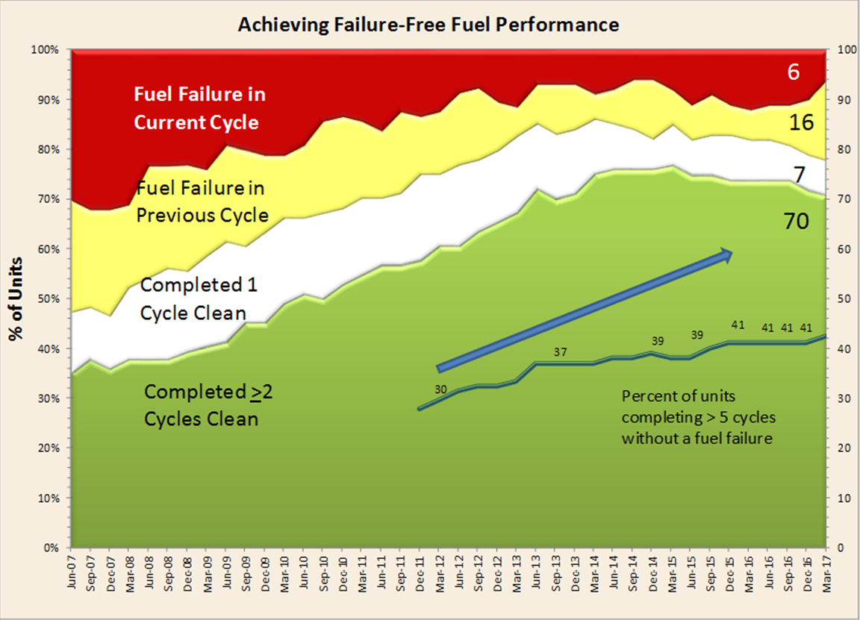
Notes:
At end of 2016 10 failures – 5 BWRs, 5 PWRs. Trend has declined and is not improving. In the last year or so, there has been a constant number of failures (between 8 and 10 existing in each quarter). Every outage season several failures are removed and then several failures occur in the following months.
SQN, Cook and LaSalle have removed their leaking fuel with SQN and Cook restarting. Wolf Creek has recently announced a new failure not shown above. They completed 9 cycles without a failure.
Performance was presented at the CEO Conference in November

Slide 11
Adverse Trend in Nuclear Fuel Failures
Decline in Nuclear Fuel performance since January 2015, trend apparent in mid 2015
Completed 2016 with 10 cores with failed fuel
Over half of these failures are believed to be caused by debris fretting
All of the recent BWR failures are attributable to debris
Significance
One of three barriers between high activity radionuclides and the public is degraded
Potential Consequences:
Longer reactor shutdown cleanup periods for outages
Regulatory concerns with higher exposure fields and hot particles
Higher maintenance & refueling outage costs due to dose
Notes:
Since the beginning of 2015, nuclear fuel performance has declined. This declining trend became recognizable in the latter half of 2015. The number of reactor cores operating with failed fuel increased from a historically low value of five in December 2014 to ten cores in December 2016.
Significance – degradation of one of the three barriers between high activity radionuclides and the public.
Consequences
Three mid-cycle outages to remove failed fuel, in the past year.
One BWR required two mid-cycle maintenance outages to remove failed fuel before offgas stack radiological release limits might be reached
One core is operating with 4 failures currently.
Other potential consequences:
increased reactor coolant activity for up to five operating cycles
higher dose rates during refueling and maintenance activities
exposure to hot particles during refueling outage
development of new radiological hot spots, and
longer reactor shutdown cleanup periods for refueling outages

Slide 12
Adverse Trend in Nuclear Fuel Failures
Debris fretting of fuel cladding by foreign material is currently the only cause of BWR fuel failures
PWR fuel failure causes are a combination of failure types:
Debris fretting
GTRF and baffle wall jetting (returning cause)
Baffle bolt degradation (new cause)
Notes:
Foreign material can be introduced through two pathways, external or internal. Externally generated, during open system maintenance, refueling activities or dry cask campaigns or internally generated, from degrading improperly designed or operated components. Foreign material introduced through open system maintenance work, where the opened system leads to the reactor (Preventable with right standards and reinforcement of those standards) In some cases, internal degradation of a valve, gasket/seal or strainer has generated the debris
PWR Failure types:
Debris, preventable
Baffle wall jetting – Armor fuel assemblies(interim) – upflow conversion (Returning cause last seen in 80s/90s)
Baffle bolt degradation – inspection, replace (New cause)
GTRF – implement a more robust fuel design
Actions:
Conduct at least six fuel integrity review or assist visits to obtain information on fuel failure causes and to provide feedback to stations regarding the effectiveness of planned actions to prevent recurrence of failures.
Prevention of future fuel failures is a focus of these review visits. In the past, these visits have resulted in recommendations for improvement that include strengthening the focus on foreign material control and standards for maintenance work. Control of this material and excluding it from systems leading to the reactor is highly dependent on the awareness and standards of the workers and supervision performing open system work.
Thorough reviews of failed fuel utility response will also be conducted during INPO plant evaluations and WANO peer reviews.
Active participation in the EPRI Fuel Reliability Program to communicate INPO's perspective on industry’s performance and the need for increased scrutiny of foreign material exclusion program implementation to address current fuel failure trends.
Fuel failure presentations during the annual INPO reactor engineer’s workshop spurred discussions to address causes and corrective actions to prevent recurrence.
Updated the Supplier Participant Advisory Committee (SPAC) on current industry nuclear fuel performance, stressed the importance of operating fuel failure free and requested supplier and service provider support in preventing future fuel failures.
INPO Maintenance outage review visits will observe FME behaviors during open system work.
Conclusion - Further INPO and industry attention is needed to better understand and address all the causes of failed fuel without delay. As has been shown in the past, the causes of foreign material introduction into the reactor can be addressed in a proactive manner, and future failures can be avoided with station and corporate leadership attention

Slide 13
Adverse Trend in Nuclear Fuel Failures
INPO Actions
Resumed fuel integrity review visits
4.0 reviews of failed fuel responses during evaluations
Active participation in EPRI Fuel Reliability Program
Updated SPAC on current performance and requested support
Outage review visit observations of FME behaviors
Industry Actions
Understand & address failed fuel causes without delay
Use Industry Operating Experience and prevent fuel failures
Notes:
Foreign material can be introduced through two pathways, external or internal. Externally generated, during system maintenance, refueling activities or dry cask campaigns or internally generated, from degrading improperly designed or operated components. Foreign material introduced through open system maintenance work, where the opened system leads to the reactor (Preventable with right standards and reinforcement of those standards) In some cases, internal degradation of a valve, gasket/seal or strainer has generated the debris
PWR Failure types:
Debris, preventable
Baffle wall jetting – Armor fuel assemblies(interim) –upflow conversion (Returning cause last seen in 80s/90s)
Baffle bolt degradation – inspection, replace (New cause)
GTRF – implement a more robust fuel design
Actions:
Conduct at least six fuel integrity review or assist visits to obtain information on fuel failure causes and to provide feedback to stations regarding the effectiveness of planned actions to prevent recurrence of failures.
Prevention of future fuel failures is a focus of these review visits. In the past, these visits have resulted in recommendations for improvement that include strengthening the focus on foreign material control and standards for maintenance work. Control of this material and excluding it from systems leading to the reactor is highly dependent on the awareness and standards of the workers and supervision performing open system work.
Thorough reviews of failed fuel utility response will also be conducted during INPO plant evaluations and WANO peer reviews.
Active participation in the EPRI Fuel Reliability Program to communicate INPO's perspective on industry’s performance and the need for increased scrutiny of foreign material exclusion program implementation to address current fuel failure trends.
Fuel failure presentations during the annual INPO reactor engineer’s workshop spurred discussions to address causes and corrective actions to prevent recurrence.
Updated the Supplier Participant Advisory Committee (SPAC) on current industry nuclear fuel performance, stressed the importance of operating fuel failure free and requested supplier and service provider support in preventing future fuel failures.
INPO Maintenance outage review visits will observe FME behaviors during open system work.
Conclusion - Further INPO and industry attention is needed to better understand and address all the causes of failed fuel without delay. As has been shown in the past, the causes of foreign material introduction into the reactor can be addressed in a proactive manner, and future failures can be avoided with station and corporate leadership attention
A focus on preventing the next fuel failure, without delay, is the key to improving industry fuel performance.

Slide 14
Consequential Engineering Errors

Slide 15
Consequential Engineering Events
Notes:
System and Design Engineering functions responsible for over 80% of the errors
Engineering service providers are responsible for approximately 15% of the errors

Slide 16
Generation Losses
Notes:
Downward trend Approximately $125 million dollars worth of lost revenue, still on the table.

Slide 17
INPO and Industry Initiatives for Reducing Consequential Errors
Review and Assist visits
Project Review and Digital Upgrade Assist visits
Other Initiatives
SCRAM reduction, AC Power Reliability, Program Management Effectiveness
Evaluation/Peer Review Technical Conscience strengths/ weaknesses feedback
Supplier Performance Improvement Initiative
Advanced Engineering Training
Notes:
These activities can affect Technical evaluation preparation, reviews of evaluations, and organizational standards for performance of engineering tasks

Slide 19
Notes:
Engineering Fundamentals/Eng Product Quality performance leveling off. EN.2 AFIs have increased. Margin management AFIs disappeared in 2016. Operational Configuration Control issues still exist in 2016.

Slide 20
Notes:
Definite decrease in number of AFIs in 2016

Slide 21
AFI trends as of 4th QTR 2016
Next slide depicts trends in AFIs Only from 2011 to end of 4th QTR 2016.
Notes:
Includes EN, CM, and ER tagged AFIs
“Other” includes engineering-related AFI tagged to OF, OE, and LF
30 fewer AFIs were initiated in 2016 than previous year.
CM and ER both dropped significantly in 2016
EN and “other” (OE, LF, OF) increased slightly (these tend to be “2nd week” AFIs)
 | 2011 | 2012 | 2013 | 2014 | 2015 | 2016
EN | 17 | 13 | 14 | 14 | 9 | 11
CM | 29 | 39 | 23 | 23 | 30 | 16
ER | 61 | 74 | 52 | 55 | 59 | 38
Other | 1 |  | 1 |  | 2 | 3
Notes:
EN.1 and EN.2 AFIs have increased slightly in number
CM AFIs have reduced in number by a factor of two

