Slide 1
State of Configuration Management
U.S. Nuclear Regulatory Commission
Anton Vegel, EDUARDO URIBE, Chris Smith
Division of Reactor Safety, Region IV

Slide 2
Discussion Topics
Introduction: NRC: what we do!
Normal Operating Conditions
RFOs and Other Outages
Conclusion

Slide 3
Introduction
NRC Mission:
License and Regulate the civilian use of nuclear materials in the United States to protect public health and safety, promote the common defense and security, and protect the environment.
Inspection Goals: Thorough, Independent, and Focused on Safety and Security
Plant Configuration Control is key contributor to nuclear safety and security
NRC Inspections evaluate and assess configuration management

Slide 4
Normal Operating Conditions
Maintenance Activities
Reverse-Engineering
Modification for installed equipment
New Designs
Addressing new rules and regulations

Slide 5
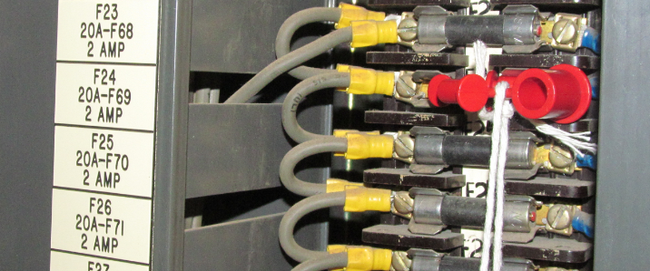
Maintenance Activities
Notes:
Component identification to perform maintenance activities is critical for the success of the activity and goal. Labeling contributes to the success and failures of maintenance activities and operator actions. One weakness in labeling and configuration can be easily lost.

Slide 6
Reverse-Engineered
Notes:
It becomes an enormous challenge to verify that the operation of what is supposed to be a like for like component is truly like for like or equivalent. As seen from the picture, the one on the left contains a number of discrete components vs the one on the right with a single bridge rectifier, which was underrated. This makes it even more crucial to ensure that testing satisfies the sites needs and requests as wells as vendor oversight.

Slide 7
New Designs for New Requirement
Notes:
When new equipment is installed, engineering may have a grasp of what is needed to make the appropriate connections, but when it is relied on operators to perform the actions under a high stressed scenario, troubleshooting is not ideal. This picture shows how open ended cables need to be connected, but the appropriate labeling does not exist to ensure operators can make the connections quickly.

Slide 8
RFOs and Other Outages
Outage Hazards
Impairments
Valve and Other Tagouts

Slide 9
Outage Control of Hazards
Notes:
Outages bring lots of movement in and out of the power block. Placing scaffolding around Hydrogen bottles may not be ideal and could lead to a devastating event.

Slide 10
Impairments
Notes:
Impairments have to happen, however, when evaluating for the impairment, the level of the evaluation needs to met the level of significance and complexity of the activity going on. Here is a picture of an impairment evaluated with only one door open at a time. This was a loss of configuration control. The change that occurred was from a 1 hr fire watch to a continuous fire watch.

Slide 11
Valves and other Tagouts
Notes:
The need for valve alignments are far and few, however, when they do occur, concurrence verification is crucial for the operation of the plant. Opportunities for identifying misalignments is how the industry can prevent these kind of scenarios.

Slide 12
Questions?

Slide 13
Conclusion
Fundamentals
Communications
Field Walkdowns
Questioning Attitude
Do not assume
Configuration Management
Shutdown and Operating

