Slide 1
Standard Design Process (SDP) Interfacing Procedures Ashley Taylor TVA

Slide 2
Overview – SDP Interfacing Procedures
General Requirements
“Primary” Interface Procedure
Other Interfacing Procedures
Lessons Learned
Breakout Preview

Slide 3
SDP Interfaces
Codes & Standards
Guidelines & Descriptions
Procedure & Process
Resource Manual
IP-ENG-001
Interfacing Procedures
Notes:
This interface diagram was used as part of the SDP site training, and today’s topic will focus on the center of the pyramid, specifically the Utility interface procedures for the Standard Design Process, IP-ENG-001. These interfacing procedures serve a number of purposes, which will be described in subsequent slides.

Slide 4
Interfacing Procedures - General Requirements
Sect. 1.0 of IP-ENG-001: “…This procedure is to be utilized in conjunction with Utility-specific procedures that implement interfacing processes that support the design control, Engineering Change and configuration management processes.”
Sect. 6.0 of IP-ENG-001: Lists “key generic utility interfaces in which the various phases of the Standard Design Process require the use of Utility-specific procedures, programs and processes (if applicable) to develop the product necessary to support the change package or otherwise perform the interfacing activity.”

Slide 5
Utility “Primary” Interface Procedure
Endorses industry procedure IP-ENG-001 as written, including the associated forms
Technical, cross-discipline and commitment reviews / approvals of interface procedure “include” the industry procedure
Provides cross-references of the generic SDP terminology to Utility-specific terms
Provides Utility-specific guidance on SDP roles and responsibilities (e.g., titles, designees, etc.)

Slide 6
Utility “Primary” Interface Procedure (cont.)
Provides references to Utility-specific interfacing procedures (including those referenced in Sect. 6.0 of IP-ENG-001)
Provides Utility-specific transition instructions (e.g., design changes already in progress, “sunset” provisions, etc.)
Provides reference to any Utility-specific Licensing and Quality Assurance program commitments which are addressed in the industry procedure

Slide 7
Utility “Primary” Interface Procedure (cont.)
Options:
Create New Utility Procedure
+ “Easy” for procedure users (i.e., just use new procedure for “new” design changes, existing procedure for “old” ones)
- May have to revise other interfacing Utility procedures to reference the new procedure
Revise Existing Utility Procedure
Must clearly delineate which sections of procedure apply to “new” versus “old” process during transition period
+ May not have to revise other interfacing Utility procedures which reference existing Utility procedure for design changes

Slide 8
Other Interfacing Procedures
Sect. 6.0 of IP-ENG-001 lists key generic utility interfacing processes used in the SDP but (e.g., Calculation process, Drawing process, etc.)
Utilities will continue to follow their Utility-specific procedures for these processes until standardized
In some cases, IP-ENG-001 will provide suggested guidance on what to include in a Utility-specific procedure for a specific process (this can be used at Utility discretion to enhance their current procedures)

Slide 9
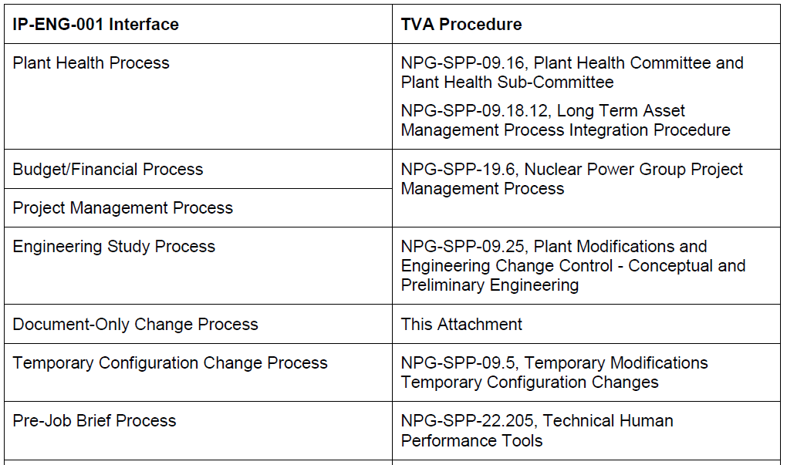
Cross-Reference to Utility Procedures Example

Slide 10
Interfacing Procedures - Lessons Learned
May need to create or update Utility procedure(s) if a Utility does not currently have a formal procedure for all the interfacing processes referenced in Sect. 6.0 of IP-ENG-001
Many of the SDP procedure “issues” identified during the pilot related to the interfacing procedures vs. SDP
Recommend performing “table top” reviews / walk-throughs of “primary” interface procedure with relevant SMEs to ensure there are no gaps or deltas
Other Lessons Learned

Slide 11
Breakout Preview
Review actual examples of Utility “primary” interface procedures using different approaches
New procedure
Revision to existing procedure
Solicit feedback and operating experience from other utilities regarding interfacing procedures
Answer any specific questions relating to the process of creating / revising interface procedures

Slide 12
QUESTIONS?

