Slide 1
SDP Software
Presented by Bill Clover and Brad Diggans
Bill Clover
Brad Diggans
Exelon Corporation
William.Clover@exeloncorp.com
Rolls-Royce Nuclear Engineering Services
Brad.Diggans@Rolls-Royce.com

Slide 2
SDP Overview
To Deliver the Nuclear Promise, Efficiency Bulletin: 17-06, “Implement Standard Design Change Process” was created.
SDP implementation July 2017
Software pilot targeted implementation September 2017
Utility selected software implementation July 2018
Standard Design Process (SDP) IP-ENG-001 delivers a standard and graded approach to the design change process
Design Oversight Working Group (DOWG) is responsible for maintaining the process

Slide 3
Software Expectations
Promote/implement design sharing mechanism.
Cloud based software platform accessibility
Engineering Change (EC) abstract listing by utility/site to enable search and promote communication
Common format
Enable re-use with limited editing
Reduce vendor costs in common design change processing
Automate/streamline SDP Process Forms
Facilitate, automate and streamline the SDP
Promote cafeteria data display to reduce unneeded content
Flexible solution – Tailor to existing software
Enable stitch-in use of SDP base components into existing utility software in use if desired
Allow full use and/or replacement if no or poor solution exists
Automated final records capture
Rollup of EC content to single PDF format
Output Key Performance Indicators to measure SDP effectiveness

Slide 4
Software Overview
Scope included in Software mirrors SDP scope
Automate lifecycle process for the following SDP outputs:
Common Design Change
Design Change
Design Equivalent Change
Commercial Change
Field Change Request (FCR)
Advance Work Authorization (AWA)
Comment/Impact Review forms
Excluded Scope
Document Only Changes
Extent of use varies by utility given the existing design change software in use
Fully automate the process from cradle to grave.
Stand alone software for utilities that choose to replace entire design change software
Provide defined portion of EC with remainder captured in existing utility system

Slide 5
Key Features
SSO (Single Sign On) for users
Seamless to users is the goal
Promote use of URL that automatically opens the SDP EC from the SDP software
Provides EC cloning capabilities
Facilitates industry sharing
Automatically creates reviews based upon results of the Design Attribute Review (DAR)
Allows Stakeholders (other departments) to provide direct input to EC Sections
Interfaces with existing Utility software to feed source data to SDP:
EC metadata (Number, Rev, Title, key fields)
Components
Work Orders
Controlled/Uncontrolled Documents (optional)

Slide 6
Key Features (Continued)
Complete package generation, including Attachments
Attach external forms and documents as needed
Capability to mark attachments for utility sharing
Electronic Signatures for reviewers of software forms and Attachments
Digital transfer of SDP output back to utility
Utility can determine end point and further consumption
May be continuation of approval in utility base software
May be final record ported to utility records system
Configuration controls
Enables use of existing software Affected Document List (ADL) and Affected Equipment List (AEL) features
Enables Affected Document closure tracking
Integrated status tracking of EC (i.e. Prepare, Approved, Implemented, Closed)

Slide 7
Utility Software Considerations
Cloud Software – New Territory for many
Limitations at each company on exposure and extent of exposure
Research this FIRST before finalizing scope and budget
Interface Design
Utility specific based on software currently in use
One way or two way interface will dictate complexity and COST
EC Package Approval Process
What are you approving?
Design Package, ADL, AEL, Markups?
How – In SDP or in Base software
Long term configuration controls
Determine use of existing systems for configuration control
Consider number of software systems that must be used (e.g. Document Pending Change and Document EC incorporation management)

Slide 8
SDP Software Overview

Slide 9
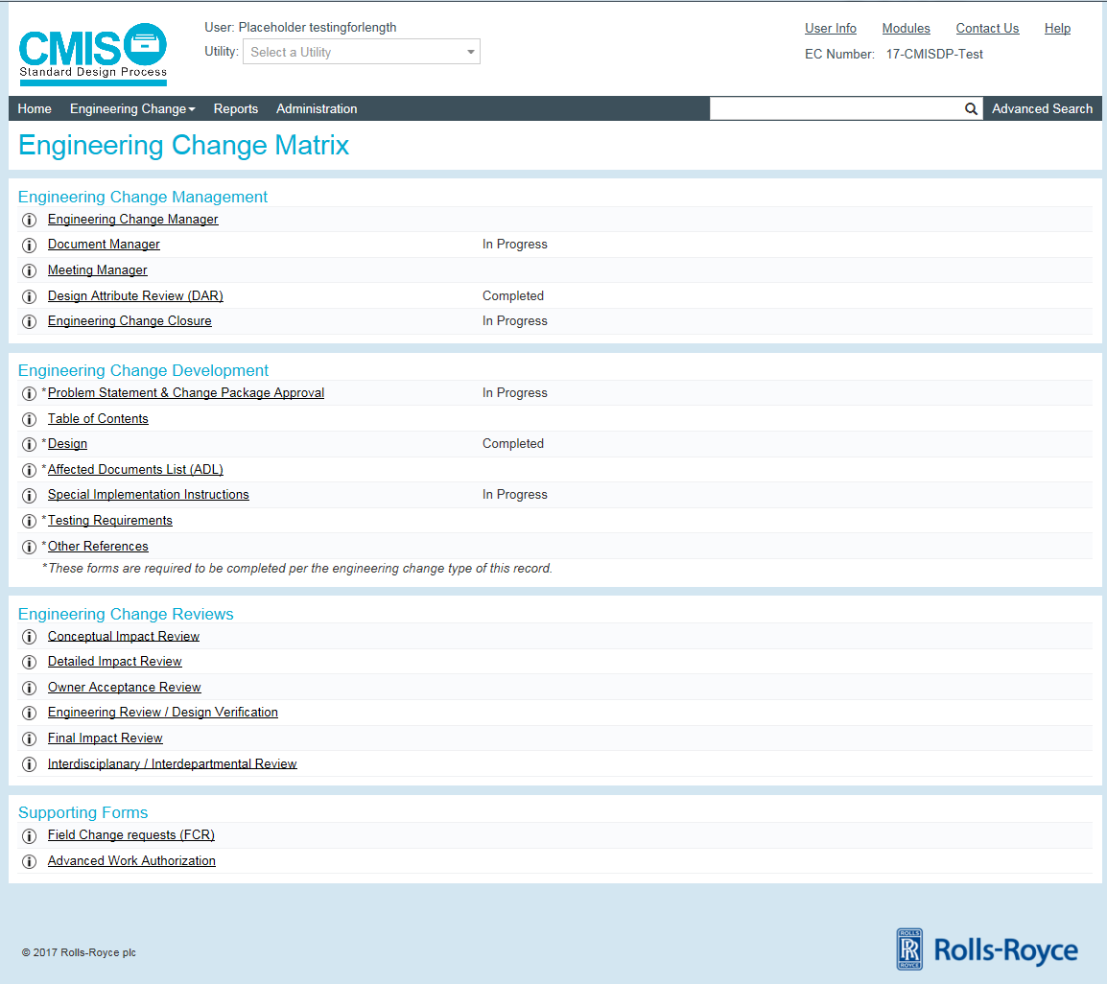
Engineering Change Matrix

Slide 10
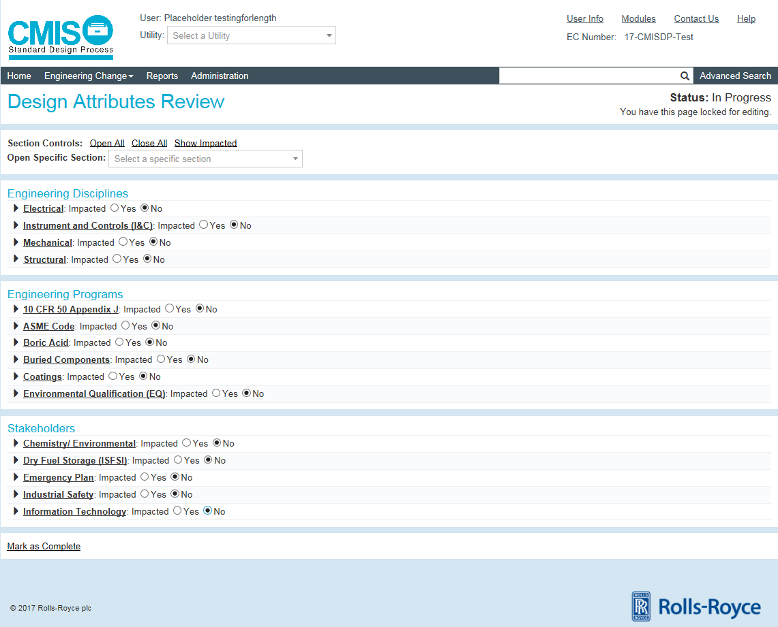
Design Attribute Review (DAR)

Slide 11
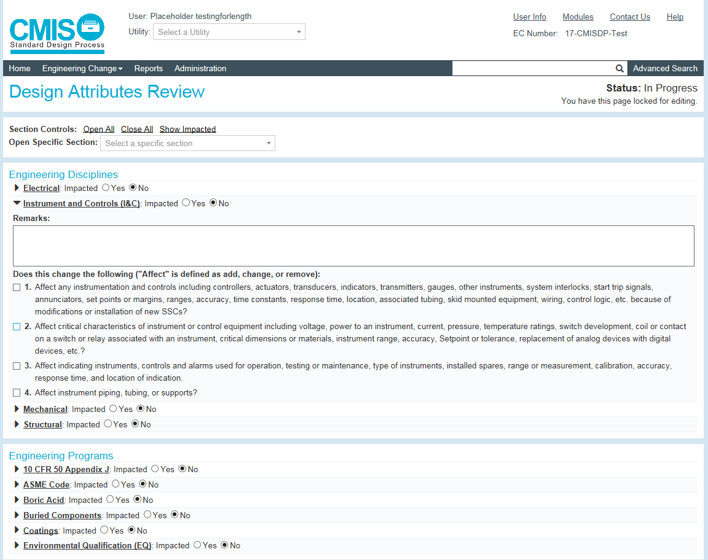
Design Attribute Review (DAR)

Slide 12
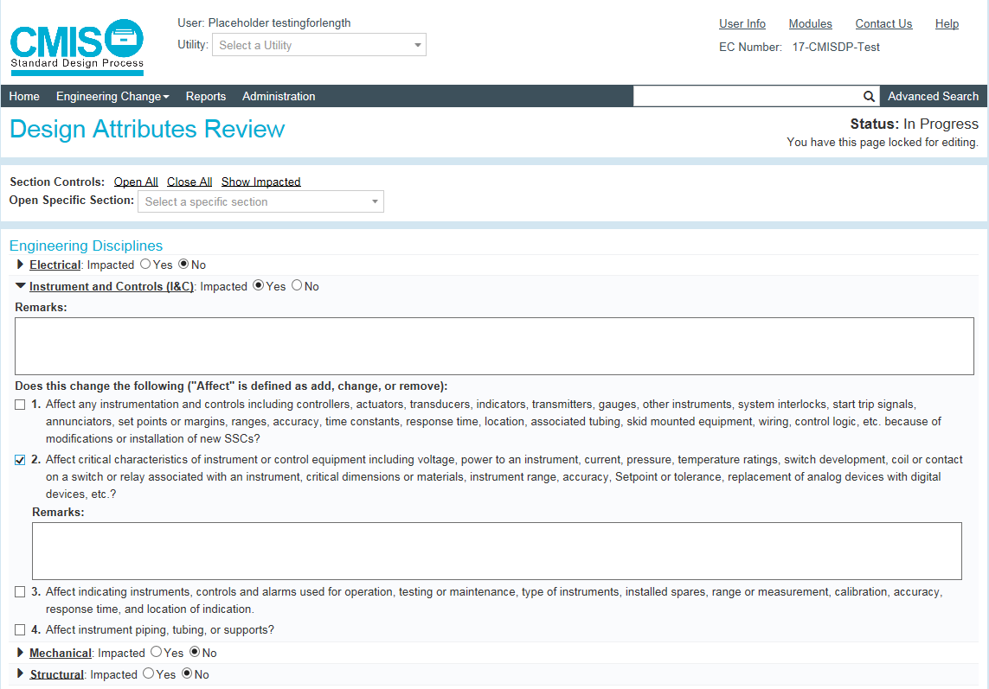
Design Attribute Review (DAR)

Slide 13
SDP Meetings
Completion of DAR initiates Department Impact Reviews and Meetings
Responsible Engineer / Responsible Supervisor will determine required meetings/reviews based upon the complexity and risk of the EC
Kickoff Meeting
Conceptual Impact Review
Detailed Impact Review
Final Impact Review
Plant Review Board
Coordinated by Meeting Manager
Reviews completed in Engineering Change Reviews

Slide 14
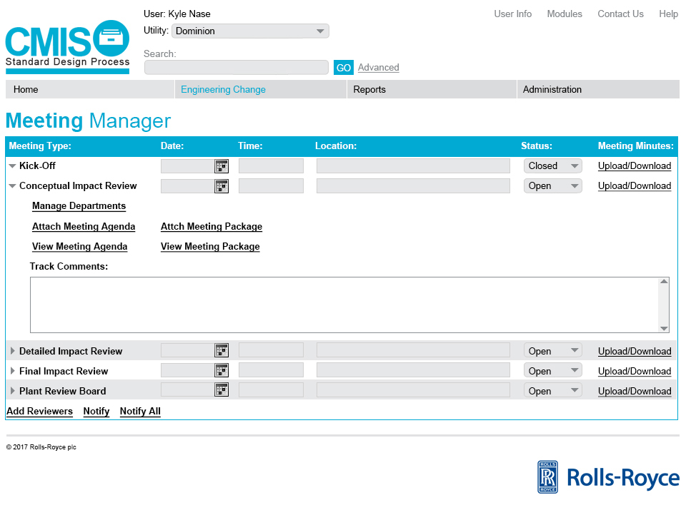
Meeting Manager

Slide 15
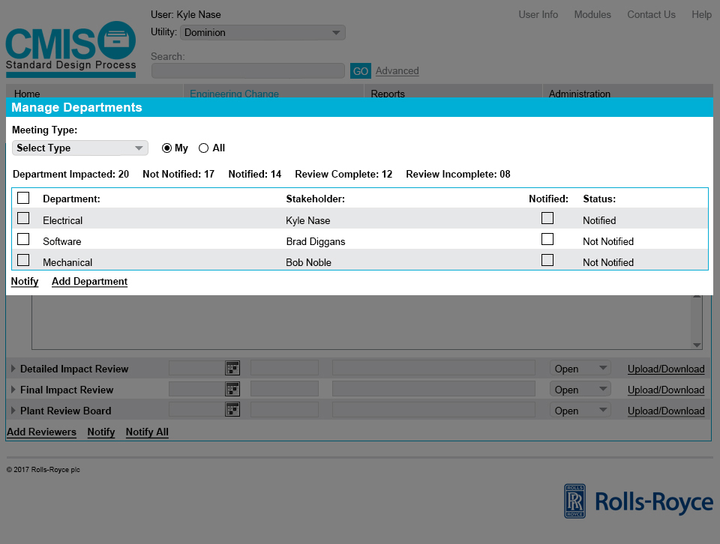
Meeting Manager

Slide 16
Engineering Change Reviews
Engineering Change Reviews allow for the performance of the following types as needed:
Department Impact Reviews
Conceptual Impact Review
Detailed Impact Review
Final Impact Review
Interdisciplinary and Interdepartmental Reviews
Design Verification / Engineering Review
Owner Acceptance Review
Approver Review (Vendor and/or Utility)
Plant Review Board
Plant Manager or Site VP Approval
Automates Review workflow
The Responsible Engineer / Responsible Supervisor can notify Reviewers/Approvers within the software

Slide 17
Conceptual Impact Review Workflow
In Meeting Manager, notify Conceptual Impact Reviewers
Manage Departments auto-populates from DAR

Slide 18
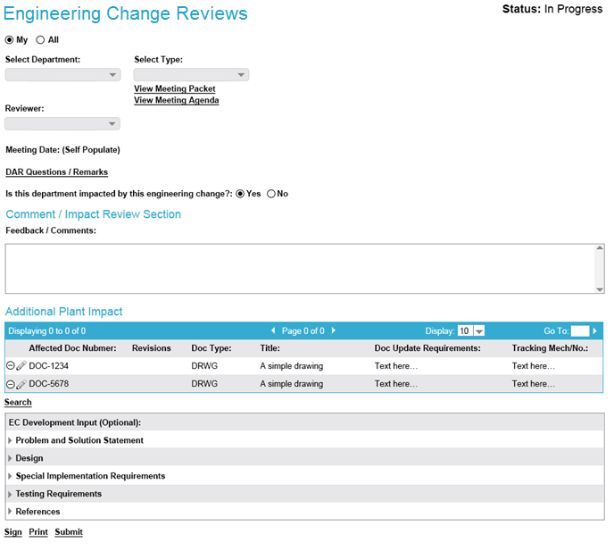
Conceptual Impact Review Workflow

Slide 19
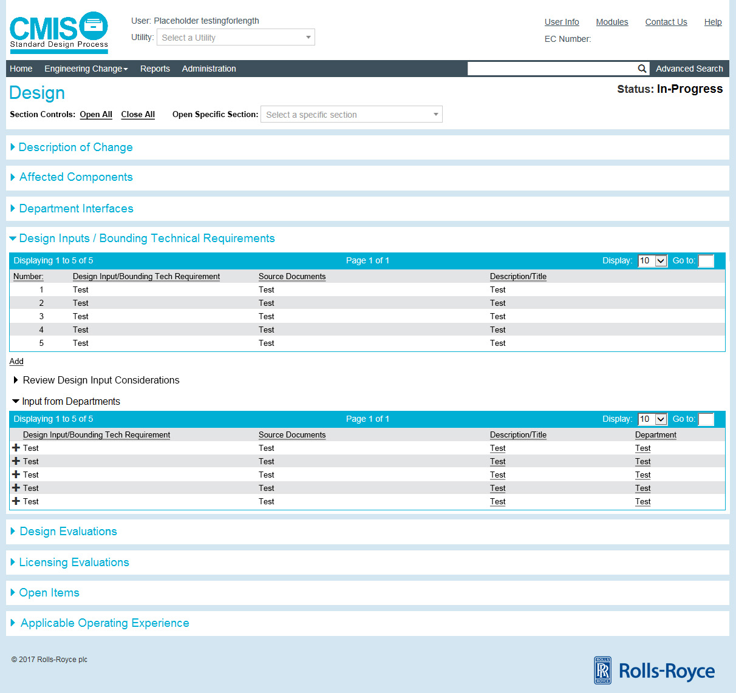
Conceptual Impact Review Workflow

Slide 20
Department Impact Reviews
Department Impact Reviews
Based upon the results of the Design Attribute Review
Departments are notified by RE or Meeting Manager
Custom Stakeholders can be created
Stakeholders can:
View Meeting Agenda/Meeting Package
Provide Feedback/Comments
Identify Affected Documents
Provide EC Development Input
Input is compiled per EC Section for the RE
Include Attachments
Sign Final Impact Review
SDP Comment/Impact Review form

Slide 21
Interface Overview
Required Interfaces
User Sign-In
Component
Implementing Work Order(s)
EC Transmittal to Records
Optional Interfaces
Document Lists and Files
Existing Design Process
Initiating Documents
Action Tracking Database
Long Term Asset Management
Learning Management System
Request for Engineering Assistance

Slide 22
User Sign-In
User information and data is required for authentication into the CMISDP software
User data will be populated using a single sign-on cloud management system.
E.g. Microsoft Azure
For contractors that do not have a utility LAN ID, they will have the option to create an account, but they will require an on-site representative to activate them within the software to properly authenticate those accounts

Slide 23
Components and Work Orders
Components, Equipment, or Functional Locations will be integrated into the application.
Component data will be provided in real time or close to real time format from utility databases
Work Orders (WO) or Work Order Tracking numbers will be integrated into the application
Components associated to work orders would be provided through cross reference relationships provided by the utility through the data interface.
Work order data will be provided in real time or close to real time format from utility databases

Slide 24
Synchronized Tables
1
Rolls-Royce
Utility
(*Requires Utilities to Track Changes)
COMP
WS
2
Internet
WS
COMP
MEL
3
1
4
Trigger
Single Comp
Group Comp
Live Searching
2
(Potential Performance Issues)
1
WS
Criteria
Internet
2
WS
Criteria
3
EMS
MEL
Search
Results
6
Results
5
Results
4
ACK 7

Slide 25
EC Submittal
Completed Engineering Changes within the application will be generated as a single PDF file
This file along with the associated metadata will be sent from software to the utility
Can be provided to either a SFTP location or through a web service API

Slide 26
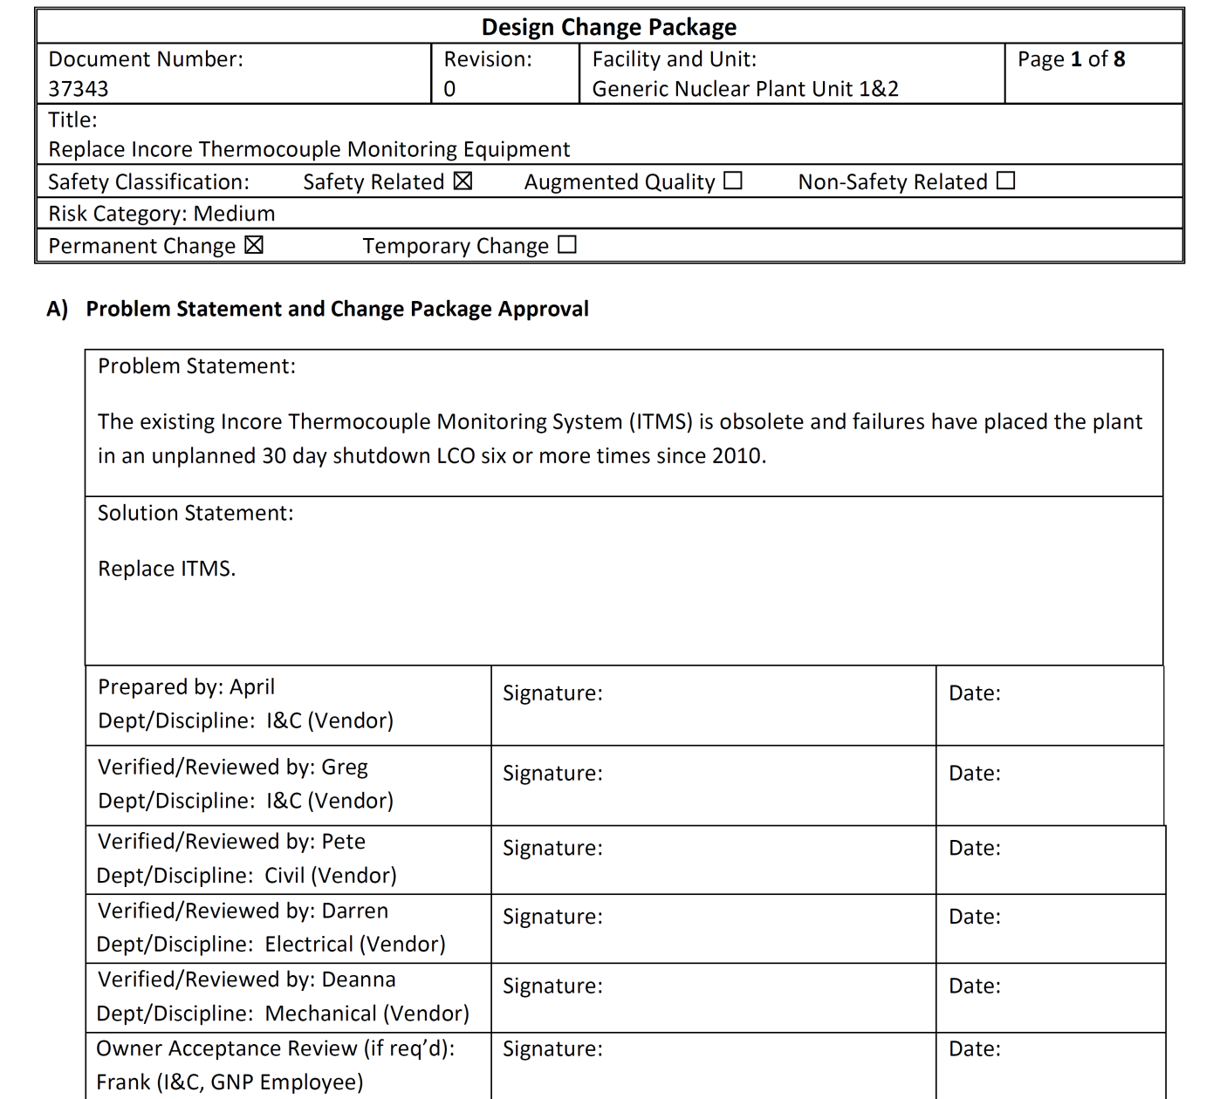
EC Submittal

Slide 27
Document Lists and Files
Document lists will be populated from multiple sources, including but not limited to:
Affected Documents List (ADL)
Equipment to Document relationship
Controlled Document listings (varies by utility)
Asset Suite
Bentley eB
Documentum
PDMS
Calculation databases
Maximo, etc.

Slide 28
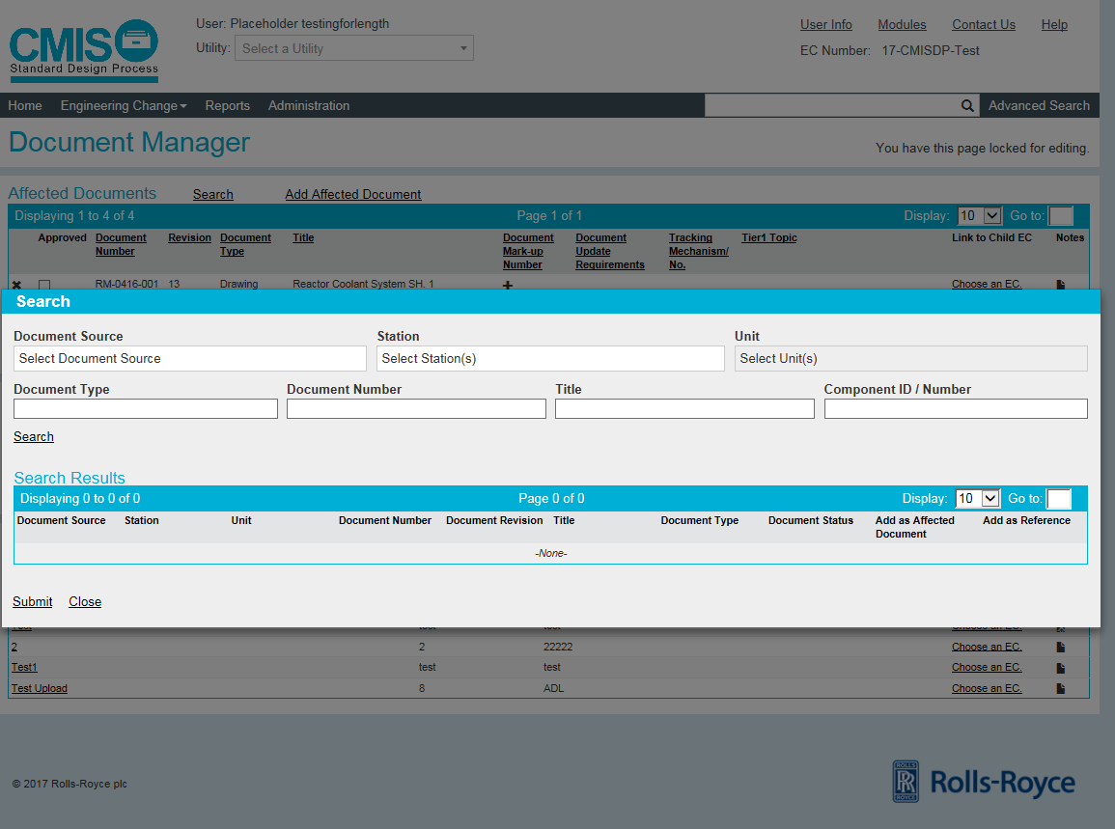
Document Lists and Files

Slide 29
Existing Design Process
For utilities that currently have software solutions outside of the standard design process, those software solutions may be integrated with the new application
Existing design modification data will be provided in real time or close to real time format from utility databases
EC Number/Revision
Status
Safety Class
Title

