Slide 1
Lessons Learned in Vendor Oversight
Jesse Hutchison, Ameren Missouri Callaway Energy Center

Slide 2
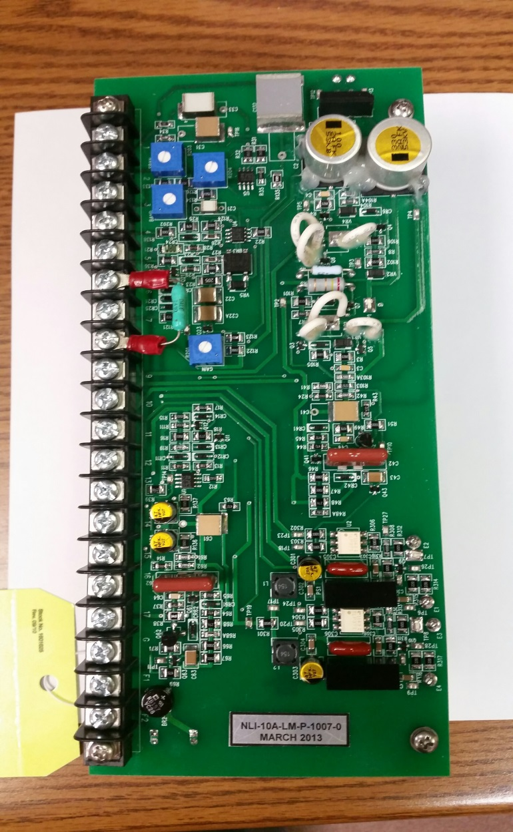
Case Study on Modutronics Cards

Slide 3
Timeline
Timeline
10/2010 - Health Issue initiated for new Modutronics cards
6/2011 – Health Issue and solution approved (Reverse Engineer Cards)
1/2012 - Issued Purchase Order to Vendor
2/2012 – One of the old Modutronic Cards shipped to Vendor for reverse engineering
10/2014 – Engineering Approved Reverse Engineered Cards for installation
10/2014 and 11/2014 – Installed two Cards in plant during RF20
12/2014 – One of the new Cards failed during a plant trip (bridge rectifier to DC Motor field failed)
3/2015 - Lower Tier Cause evaluation determined failure to be infant mortality based on Vendor Analysis and review of bridge rectifier design
3/2015 – Vendor analysis recommended changing out 1.5A Bridge Rectifier with new 4A Bridge Rectifier to add “margin”.

Slide 4
Timeline
Timeline Continued
3/2015 – Vendor started on design of new “Hybrid” Modutronics cards with 4A bridge rectifier
3/2015 – Received INPO AFI in Engineering Oversight of Vendor Activities
8/2015 – Second Modutronics card failed after a Plant trip
8/2015 – New “Hybrid” Modutronics card installed to replace failed board (ALHV7)
8/2015 - New “Hybrid” Modutronics card installed to replace additional reverse engineered board (ALHV5) (No more cards installed with undersized bridge rectifier)
8/2015 – Formal Root Cause Team developed to determine cause of failure
8/2015 – Root Cause Team identified that Bridge Rectifier for DC valve motor field was undersized
9/2015 – NRC Special Inspection of Aux Feedwater System

Slide 5
Bridge Rectifier Circuit

Slide 6
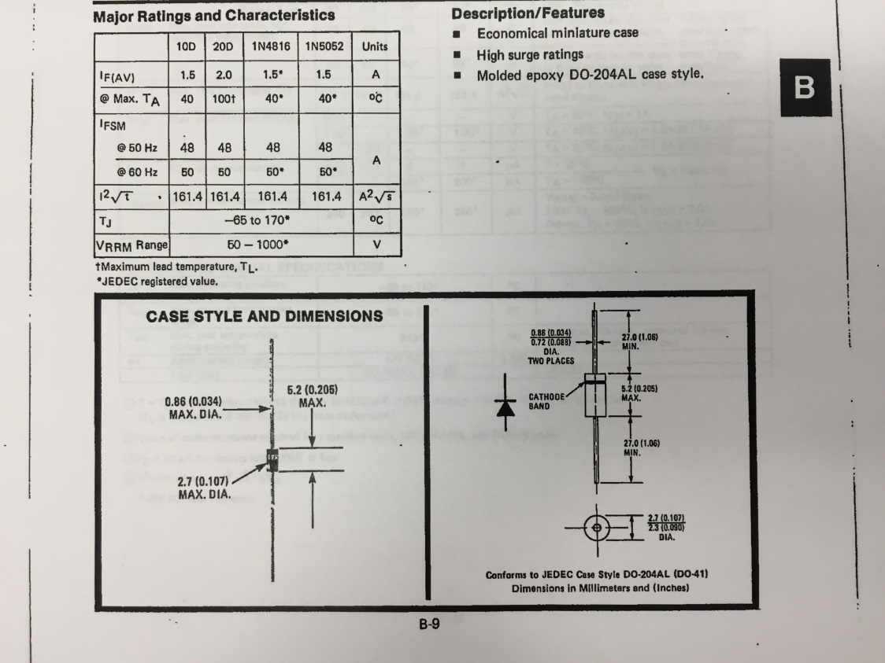
What Happened
Original
Replacement

Slide 7
Failed Bridge Rectifiers
First Failure
Second Failure

Slide 8
Swiss Cheese
System Engineer who started process left engineering. Turned over to new Systems Engineer.
New System Engineer was working directly with Vendor to procure and test new Cards.
One of the old Modutronics cards was shipped to vendor to reverse engineer along with emails containing drawing and other documentation. No formal vendor correspondance was used (only emails).
Design Engineering was not directly involved in procurement of new Cards until 3 years into the process
Qualification testing performed at Vendor Facility never tested/loaded the bridge rectifier circuit
Callaway performed burn-in testing on the new cards for 50 hours, however bridge rectifier circuit was never loaded
Original CR was downgraded so that formal root cause team was not required during first card failure. Cause was determined to be infant mortality of bridge rectifier using lower tier cause analysis.
Bridge Rectifier Vendor data sheet had misleading information that led engineering to believe bridge rectifier was sized correctly

Slide 9
More Swiss Cheese
Vendor analysis received 3/2015, clearly stated that “both bridges failed due to excessive heat buildup from the load current they were seeing”, however, neither the Vendor nor Callaway recognized this as Part 21 reportable. Furthermore, neither party recognized this as a clear design deficiency. It was simply identified as a “low margin” issue.
Callaway Engineering never visited the Vendor facility during the entire Modutronics Reverse Engineering project.
During the NRC special inspection, the Vendor was contacted and asked for the detailed design information used to reverse engineer the cards. The Vendor stated that the Design Engineer had left the company and that they had lost the original design information.

Slide 10
Corrective Actions for Modutronics Failures
Provided guidance for “Proof Testing” Reverse Engineered products
Clarified responsibilities for the Responsible Engineer vs. Qualification Engineer
Seminars to Clarify Roles and Responsibilities around Technical Conscience Principals for Ops, Maintenance and Engineering (INPO 10-005)
Corrective Actions for INPO AFI on Vendor Oversight

Slide 11
INPO AFI in Oversight of Vendor Activities
INPO Statement – “In some cases there has been incomplete engineering oversight of vendor activities. This has resulted in design changes that did not perform reliably when implemented and need for engineering rework when documents were accepted that did not meet requirements. Contributing were lapses in vendor engagement, insufficient owners review and knowledge deficiencies among the responsible engineers.”

Slide 12
Corrective Actions for INPO AFI
Implement Project Management Principles into Design Engineering
The Design Engineer is the project manager and has the responsibility for managing Scope, Cost, Schedule, Procurement, and Risk.
Detailed Purchase Order Requirements
Use Formal Correspondence for important information (Not Emails)
Weekly or Bi-Weekly Phone Calls with Vendor
Level 2 Project Schedules
Visits to Vendor Facilities to witness assembly, testing and ensure project deliverables
Implemented Procurement Visual Management Tool (Status Boards)

Slide 13
Procurement Tracking Status Board

Slide 14
What we learned
Be engaged and intrusive when using Vendors
Even if the Vendor makes mistakes, you are responsible once you install it in your plant
Reverse Engineering has a lot of risk. It should only be used as a last resort.
It is OK to reverse engineer analog circuit cards as a “Black Box” design from your vendor. Just make sure that every change is clearly documented and understood.

Slide 15
Successes
Identifed Fan Blades installed backwards during Fan testing at Vendor facility
Identified incorrect fan mounted on Seismic table at Vendor facility getting ready for testing
Engineer at Vendor site for 3 weeks to ensure Letdown throttle valve was fabricated in time for RF21
Eliminated unqualified Vendor from EDG Relay Reverse Engineering Project by including detailed breakdown of critical characteristics in Purchase Order

Slide 16
Questions

