Slide 1
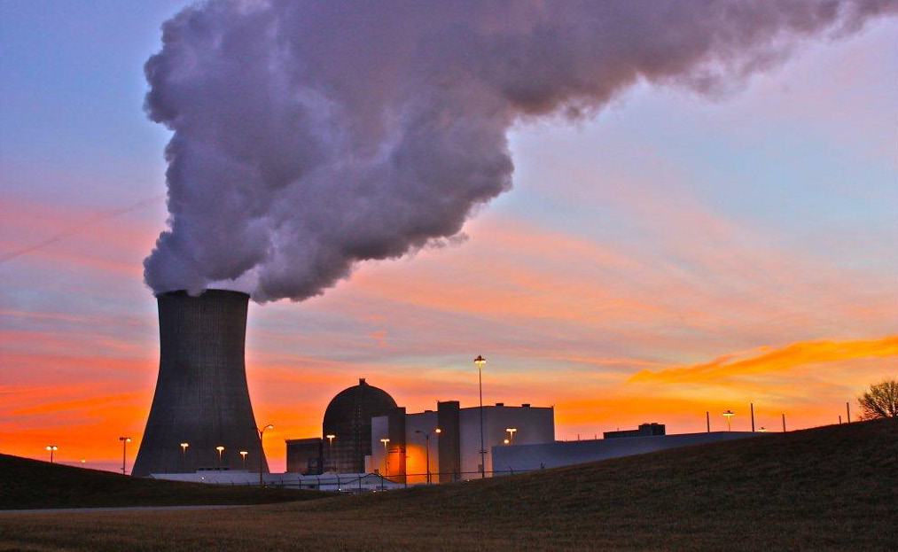
WELCOME 환영 ようこそ
24TH ANNUAL CMBG CONFERENCE
Hosted by:

Slide 2
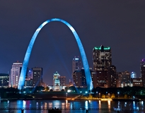
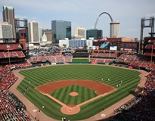
Conference Logistics
Safety
Conference Agenda
Building Layout
Breaks
Lunch
Monday Night Dinner at Landry’s
Tuesday Night Event

Slide 4
2017 Conference Statistics
Countries Represented
USA, South Korea, Japan, U.K., U.A.E
90 Conference Participants
48 First Time Attendees
Diverse distribution between utility and vendor participants
21 Utilities have hosted the conference
Conference held in 16 states plus Canada

Slide 5
Conference Etiquette
Turn off/silence cell phones and pagers
Be on time for presentations and breakouts
Use breaks for checking in with office and networking with fellow conference participants
Participate by attending all presentations and breakout periods

Slide 6
2017 CMBG
Gateway to CM Excellence

