Slide 1
Engineering & Configuration Management
Terry Schuster, Manager
CMBG June 25, 2018

Slide 2
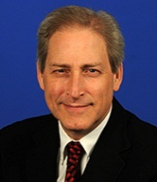

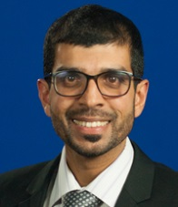
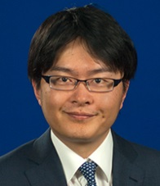
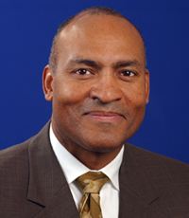

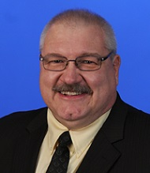
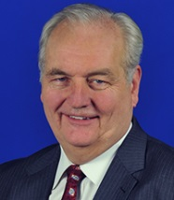


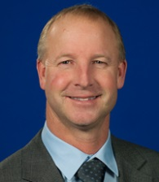
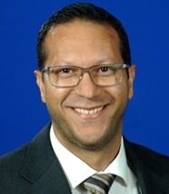
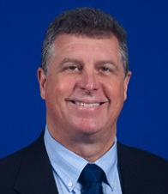

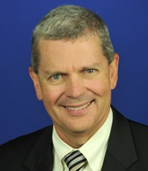
ENGINEERING AND CONFIGURATION MANAGEMENT (4N)
Terry Schuster
Department Manager
SECONDEE/LIAISON ENGINEER
Ashley Douglas
Admin Coordinator
Thomas Roddey
Assistant Department Manager
Hesham Al Blooshi
ENEC
Shohei Onitsuka
Hitachi
PERMANENT EMPLOYEES
LOANED EMPLOYEES
Carl Faller
Craig Faulkner
Ray George
John Harmon
Diablo Canyon
Joe Mathew
Xcel Energy
Craig Neuser
Point Beach
VACANT
Luis Guevara
Ken Robinson
Calvert Cliffs
John Vukovics
River Bend
Jim Wade
Vogtle

Slide 3
Agenda
2018 Focus Areas
Plant Evaluation & WANO Peer Review Trends
  Areas for Improvement (AFI)
Nuclear Fuel Reliability
Consequential Engineering Error Reduction

Slide 4
2018 Focus Areas
  Improving Fuel Performance (key industry issue)
  4.0 Reviews during Plant Evals/Peer Reviews for failed fuel response
  Fuel Integrity Review & Assist Visits
  Operating Experience in IERs & industry meetings
  Utility specific recommendations
  Management of Critical Safety Functions
  Design Basis management, focused on CSFs
  Using WANO Design Informed Review methodology (WANO Peer Reviews only)
Notes:
“Prevention” of Foreign material intrusion into open systems, pool or reactor cavity, and due to internal system degradation will be focused on. Maintenance will be assisting in these reviews, where applicable.
Team review approach during plant evaluations, as TC applies to all departments making technical decisions

Slide 5
2017 AFI Trends
Performance issues in:
EN.1 - Engineering Fundamentals
  Critical thinking, thoroughness, Operational Risk Management & their impact on decision making
EN.2 - Eng Leadership & Technical Authority
Configuration Management
  Operational configuration control
    Temp changes made to plant by non-engineering workers continue into 2018

Slide 6
2018
Fuel Performance Update

Slide 7
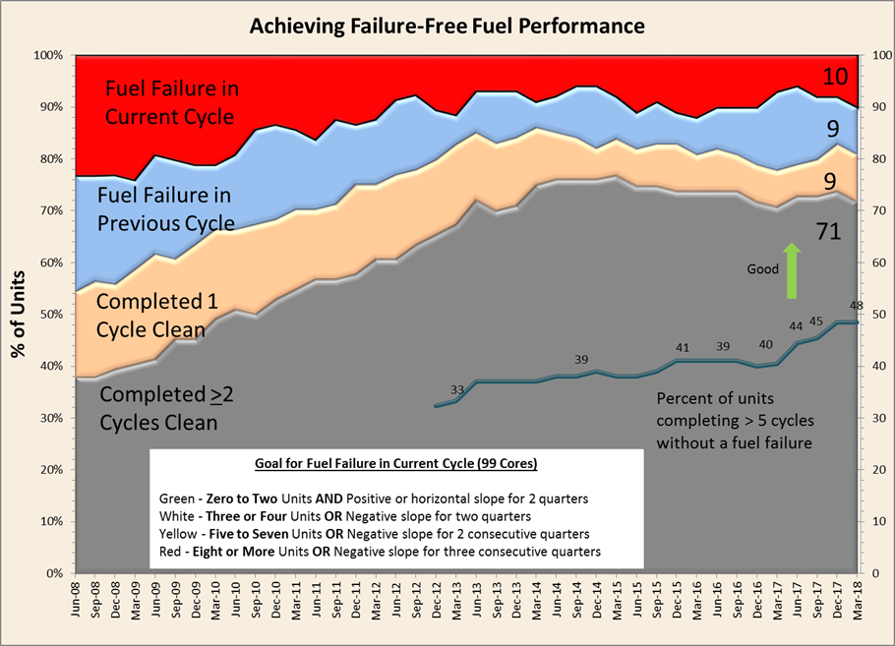
Notes:
At the end of 2017, there were 8 cores with failed fuel
Today, there are 10 cores. 6 BWRs and 4 PWRs

Slide 8
Adverse Trend in Nuclear Fuel Failures
  Debris fretting of fuel cladding by foreign material is common cause of 10 current BWR and PWR fuel failures
  5 of 6 BWRs with failed fuel are PFD plants
  Several PWR fuel failure causes:
    Debris fretting is most probable cause category
  Four key causes of Debris
    External introduction during system or pool work
    Internal degradation of components
    Design vulnerability within systems leading to core
    New reactor vessel fill flow paths during outages
Notes:
Foreign material can be introduced through two pathways, external or internal. Externally generated, during open system maintenance, refueling activities or dry cask campaigns or internally generated, from degrading improperly designed or operated components. Foreign material introduced through open system maintenance work, where the opened system leads to the reactor (Preventable with right standards and reinforcement of those standards) In some cases, internal degradation of a valve, gasket/seal or strainer has generated the debris
PWR Failure types:
Debris, preventable
Baffle wall jetting – Armor fuel assemblies(interim) – upflow conversion (Returning cause last seen in 80s/90s)
Baffle bolt degradation – inspection, replace (New cause)
GTRF – implement a more robust fuel design
Actions:
Conduct at least six fuel integrity review or assist visits to obtain information on fuel failure causes and to provide feedback to stations regarding the effectiveness of planned actions to prevent recurrence of failures.
Prevention of future fuel failures is a focus of these review visits. In the past, these visits have resulted in recommendations for improvement that include strengthening the focus on foreign material control and standards for maintenance work. Control of this material and excluding it from systems leading to the reactor is highly dependent on the awareness and standards of the workers and supervision performing open system work.
Thorough reviews of failed fuel utility response will also be conducted during INPO plant evaluations and WANO peer reviews.
Active participation in the EPRI Fuel Reliability Program to communicate INPO's perspective on industry’s performance and the need for increased scrutiny of foreign material exclusion program implementation to address current fuel failure trends.
Fuel failure presentations during the annual INPO reactor engineer’s workshop spurred discussions to address causes and corrective actions to prevent recurrence.
Updated the Supplier Participant Advisory Committee (SPAC) on current industry nuclear fuel performance, stressed the importance of operating fuel failure free and requested supplier and service provider support in preventing future fuel failures.
INPO Maintenance outage review visits will observe FME behaviors during open system work.
Conclusion - Further INPO and industry attention is needed to better understand and address all the causes of failed fuel without delay. As has been shown in the past, the causes of foreign material introduction into the reactor can be addressed in a proactive manner, and future failures can be avoided with station and corporate leadership attention

Slide 9
Adverse Trend in Nuclear Fuel Failures
  INPO Actions
    Resumed Fuel Integrity review visits and more Assist visits
    4.0 reviews of failed fuel responses during evaluations
    Sharing Operating Experience in EPRI & all Engineering Mtgs
    Revising IER L4 16-9 with new insights / June 2018
    Active participation in EPRI Fuel Reliability Program
    Outage review visit observations of FME behaviors (maintenance)
  Industry Actions
    Understand & address failed fuel causes without delay
    Strongly consider comprehensive foreign material recovery actions for multi-cycle fuel failures
    Use Industry Operating Experience and PREVENT fuel failures
Notes:
Foreign material can be introduced through two pathways, external or internal. Externally generated, during system maintenance, refueling activities or dry cask campaigns or internally generated, from degrading improperly designed or operated components. Foreign material introduced through open system maintenance work, where the opened system leads to the reactor (Preventable with right standards and reinforcement of those standards) In some cases, internal degradation of a valve, gasket/seal or strainer has generated the debris
PWR Failure types:
Debris, preventable
Baffle wall jetting – Armor fuel assemblies(interim) –upflow conversion (Returning cause last seen in 80s/90s)
Baffle bolt degradation – inspection, replace (New cause)
GTRF – implement a more robust fuel design
Actions:
Issue revised IER with new insights gained from site evaluations and visits focusing on fuel failures past and present
Conduct at least five fuel integrity review or assist visits to obtain information on fuel failure causes and to provide feedback to stations regarding the effectiveness of planned actions to prevent recurrence of failures.
Prevention of future fuel failures is a focus of these review visits. In the past, these visits have resulted in recommendations for improvement that include strengthening the focus on foreign material control and standards for maintenance work. Control of this material and excluding it from systems leading to the reactor is highly dependent on the awareness and standards of the workers and supervision performing open system work.
Thorough reviews of failed fuel utility response will also be conducted during INPO plant evaluations and WANO peer reviews.
Active participation in the EPRI Fuel Reliability Program to communicate INPO's perspective on industry’s performance and the need for increased scrutiny of foreign material exclusion program implementation to address current fuel failure trends.
Fuel failure presentations during the annual INPO reactor engineer’s workshop spurred discussions to address causes and corrective actions to prevent recurrence.
Updated the Supplier Participant Advisory Committee (SPAC) on current industry nuclear fuel performance, stressed the importance of operating fuel failure free and requested supplier and service provider support in preventing future fuel failures.
INPO Maintenance outage review visits will observe FME behaviors during open system work.
Conclusion - Further INPO and industry attention is needed to better understand and address all the causes of failed fuel without delay. As has been shown in the past, the causes of foreign material introduction into the reactor can be addressed in a proactive manner, and future failures can be avoided with station and corporate leadership attention

Slide 10
Consequential Engineering Errors

Slide 11
Notes:
Fort Calhoun Unit 1: IsoPhase Bus Duct Cooling Fan Tripped –old design issue
Perry: An Agastat Relay Extended Inoperability of A Diesel Generator Due to Voltage Setpoint Drift
Wolf Creek Unit 1: Two Control Room Air Conditioning Trains Inoperable Due to Failure to Meet Surveillance Requirement
Fort Calhoun Unit 1: Auxiliary Feedwater Valve Did Not Open When Given Open Signal
Fort Calhoun Unit 1: Auxiliary Feedwater Pump Tripped Shortly After Starting
Waterford Unit 3: 4KV Fast Bus Transfer Failure River Bend Unit 1 Automatic Reactor Scram Due to Low RPV Water Level
Columbia Gen Sta Unit 2: Flow Accelerated Corrosion Discovered in Reactor Water Cleanup System Piping
Cooper: Unit 1 Loss of Shutdown Cooling While in Mode 4
Pilgrim: Unit 1 Manual Scram Due to Degraded Condenser Vacuum Surry Unit 1 Service Water Intrusion into Safeguards Area Basement
Fort Calhoun Unit 1: Misapplication of the Reactor Vessel Head Inspection Code Requirements

Slide 12
Strategies to further Reduce CEEs
Collected Utility/Station Case Studies for industry use or modeling of site specific training
  Best practices include relating failures to Technical Conscience principles, and site engineering management presentation of material
Case Studies now on INPO Eng Dept Website
Future – Sharing Insights and Lessons Learned
  Perform analysis of 2017 CEEs (85)
  Issue Level 4 IER & use Webinar to communicate insights gained from analysis of 2017 industry events

Slide 13
Critical Thinking Failure Modes
A year earlier CEE analysis of 2015/16 data identified same issues as AFI analysis
When evaluating a plant condition or modifying the plant, failure to:
  Identify or validate assumptions
  Identify critical parameters or attributes
  Identify high risk/potential consequence
  Consider all options to address or modify
  Consider what is the worst that could happen
Notes:
Put your own eyes on it.
Write down the critical aspects of a components performance or a design change, and later make sure you have adequately addressed it, monitored it, etc
Risk assessement result may affect both the level of review and the choice by the decision maker’s decision, given options
Silver bullet single choice, may not be the best one, or right one
For every action there is a reaction
What Tech Conscience Principle is at play here? What role does supervision or the manager have?

Slide 14
INPO and Industry Initiatives for
Reducing Consequential Errors
  Review and Assist visits (Prevention)
    Project and Digital Upgrade Assist visits
  Other Initiatives
      SCRAM reduction, AC Power Reliability, Program Management Effectiveness
      Evaluation/Peer Review Technical Conscience strengths/ weaknesses feedback
      Advanced Engineering Training
Notes:
These activities can affect Technical evaluation preparation, reviews of evaluations, and organizational standards for performance of engineering tasks
Project Review Visits (PRV): For stations that are undertaking significant projects, review visits will be scheduled to provide an independent check that lessons learned from IER 14-20 Rec-3 are being appropriately applied. The intent is to be proactive in helping member stations in avoiding significant technical errors and consequences
Managing projects with enterprise risk. Completed three (WC, FCS and Prairie Island) Major/FOAK modification, consequence, etc.
EN vendor oversight and support Vendor/owner transparency, project manager proficiency, etc.
Technical conscience health
Technical conscience Review Visits (TCRV): The intent is to intervene in the early stages of decline to prevent or minimize the number of consequential events by identifying faint signals for the stations that may be showing weaknesses in Technical Conscience. Completed one (PSEG) -Technical decision weaknesses
Design Basis Review Visits (DBRV): The intent is to prevent consequential events and loss of regulatory margin because of weak understanding and maintenance of the design and licensing requirements. These review visits will focus on performance objective defined in CM.1 and lessons learned from IER. Planned – Columbia, Palisades, Salem
Columbia Design Basis Review Visit – Because of performance issues identified during the last evaluation, Columbia is considered vulnerable to consequential events and loss of regulatory margin because of weak understanding and maintenance of the design and licensing requirements. Working with the station leadership team a one-week review visit is scheduled for August 3, 2015.
Palisades: Not designed to SRP, pre-GDC, Weak engineering, high engineering leadership turnover and design engineering personnel. No power uprate recent scrutiny in design basis area by NRC or others.
Salem 1&2: Not designed to SRP, pre-GDC, Weak engineering, high engineering leadership turnover and design engineering personnel. No power uprate recent scrutiny in design basis area by NRC or others. Last plant evaluation identified weaknesses in technical conscience.

Slide 15
What could happen with Configuration Management?
With engineering reorganizations,
transition of design organization reporting relationships,
remote monitoring of plant performance and condition,
& fewer engineers directly supporting the stations
How will you know if a course correction is necessary? What might indicate a problem is developing?

Slide 16


