Slide 1
ENG-008: Standard Digital Engineering Process
Process Overview and Status Update for the CMBG
June 25th, 2018
Ashley Taylor- TVA

Slide 2
Review: Where We Are Today
There are three broad issues with the application of digital technology preventing many digital mods from consideration:
  The regulatory framework for CCF – RIS 2002-22, Supplement 1, including for many SR systems
  Inconsistent modification processes between peer utilities reduces our ability to share design content and use economies of scale – NISP-EN-04 and EPRI Digital Engineering Guide
  Organizational structures and processes are not optimized or scalable for the technologies we are deploying – ENG-008 further work
The convergence of these industry initiatives affords us an unprecedented opportunity to move the industry forward. In so doing, we can significantly reduce costs using digital technology to reduce SPVs and improve plant performance and availability.

Slide 3
ENG-008 Efficiency Opportunity
Desired end-state—
  The standard digital engineering process, including both the NISP-EN-04 and EPRI Digital Engineering Guide, is used across the industry to the benefit of each stakeholder.
  Solutions to common digital design issues are developed and shared.
  Key stakeholders, including independent engineering service providers (ESP), are engaged and supportive of digital modifications, resulting in lower design and implementation costs.
  Common training material is available to all stations and ESPs.
  Common set of minimum requirements for software and digital equipment are developed and used.

Slide 4
ENG-008 Efficiency Opportunity
Value proposition (vision of excellence)—
  Improve quality of digital modifications through a scalable and robust technical framework.
  Improve regulatory stability by increasing the understanding of the processes used to develop digital modifications.
  Reduce costs by enabling:
    sharing of digital modification content,
    standardized training and qualification structures,
    ESPs to become proficient to a single process,
    equipment manufacturers and system integrators to develop standardized product offerings, and
    standardized Cyber Security assessments.

Slide 5
Integrated Digital Engineering
Architecture
Analysis – Hazard/SPV/CCF
Long Range Plan
Project
Management
Programs
O&M
Requirements Engineering
Digital
Engineering
Guide (DEG)
Systems
Engineering
Based
Risk
Based
Graded
Approach
Procurement
Human Factors Engineering (HFE)
Optimized Digital
Engineering
Organization
Cyber Security
Data Communications
Plant Integration
Engineering
Design &
Change Process
(SDP)
Testing
Configuration Management
Life Cycle Management

Slide 6
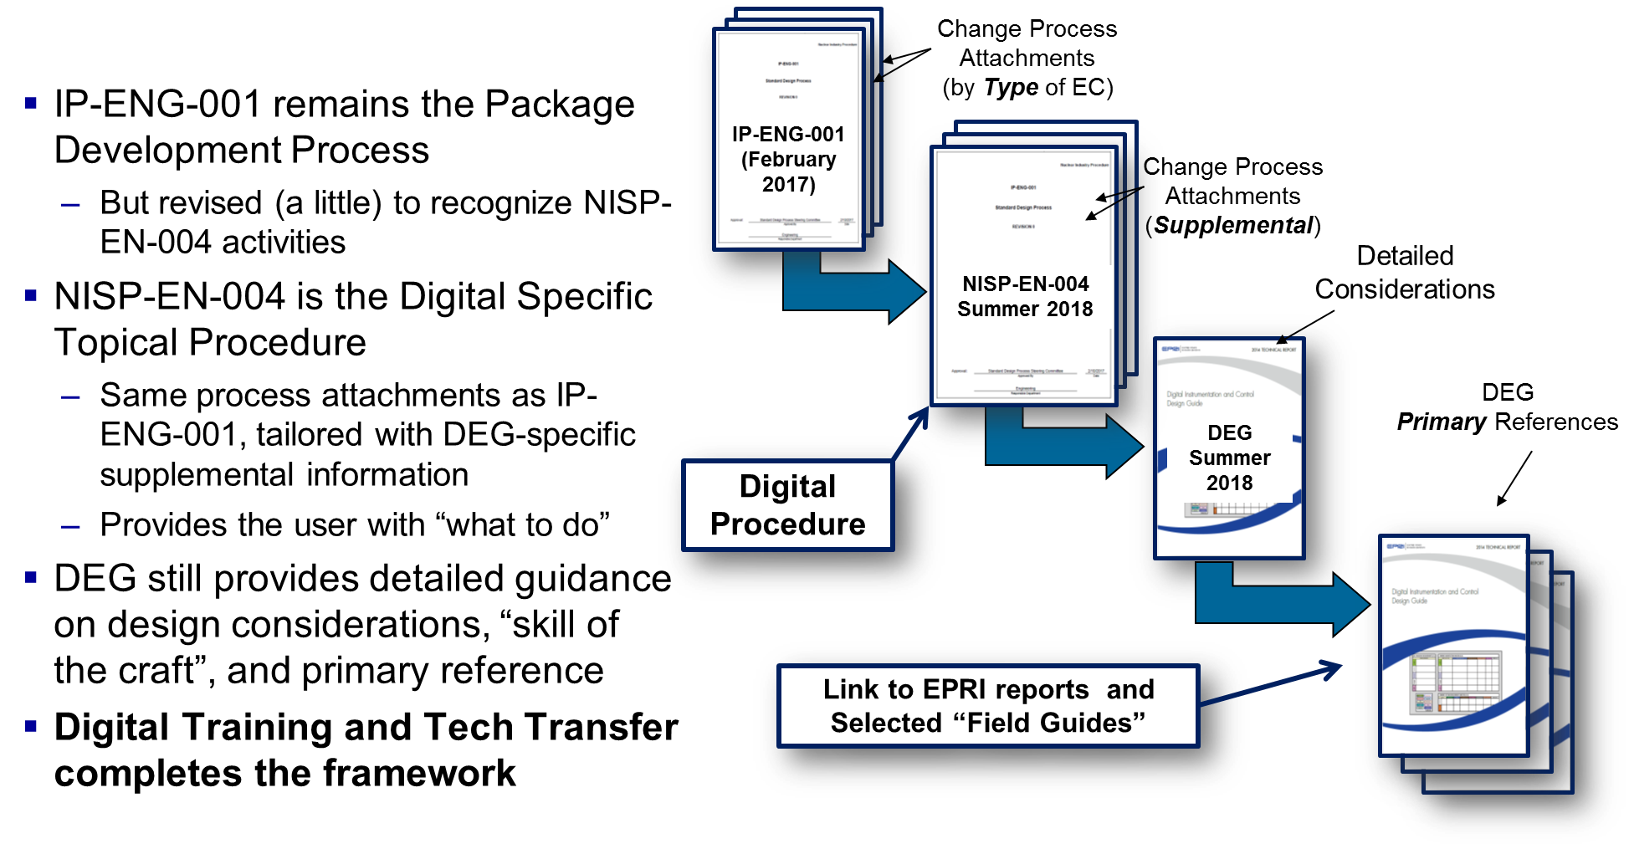
Overall Architecture
Procedure
Guidance

Slide 7
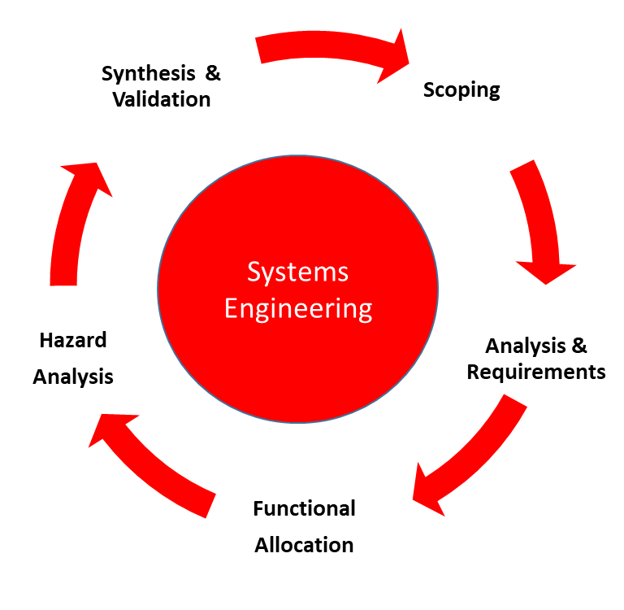
EPRI Digital Engineering Guide (DEG)
Chapter 1 thru 3 Framework
  Graded Approach
    Configurability determination
    Consequence determination
    Activity Applicability determination
    Structured Information guidance
Chapter 4 – Systems Engineering
  Modeled after EPRI 3002008018 and ISO/IEC/IEEE 15288:2015
  Synthesizes various ISO/IEC/IEEE standards
  Chapter 4 is the foundation for all remaining chapters
Chapters 5 thru 12 – Topical Guidance
  Procurement
  Human Factors Engineering
  Data Communication
  Cyber Security
  Plant Integration Design
  Testing
  Configuration Management
  Digital Obsolescence Management

Slide 8
NISP-EN-04
Follows IP-ENG-001 flowchart format
Intended to be used with IP-ENG-001
Describes supplemental details for digital design to existing steps from the IP-ENG-001, adds steps when needed
Attachments 7-10 determine the activities to be performed based on configurability and consequences and how to document them, if at all, providing the “what to do”
These activities align with the EPRI DEG, which provides a “how to do”
Separate, optional checklist created as a placekeeping tool for the results of this review, similar to the DAR but for concepts and activities

Slide 9
NISP-EN-04 Graded Approach
Step 1: Configurability Screen
  Low (A Few Settings)
  Medium (Wide Range of Settable Parameters)
  High (Custom Application Software)

Slide 10
NISP-EN-04 Graded Approach
Project
Replace L&N Paper Recorder with Yokogawa DX2000
Common Design Package - Indication Only, No Data Communications
Digital Engineering Guide Activities
Configurability
RE/RS Decision
3
I&C Programs, Plans and Lifecycles
Low
Med
High
Step 1: Configurability Screen
  Low (A Few Settings)
  Medium (Wide Range of Settable Parameters)
  High (Custom Application Software)
Step 2: DEG Activity Applicability
  Activity Not Applicable – Technology/Function does not exist
  Activity Conditional – See each DEG Section Guidance
  Activity Required
3.1
I&C Program Management
3.1.1
I&C Strategic Plan
N
C
R
Common Design Package
3.1.2
Equipment & Vendor Selection Criteria
C
C
R
Yokogawa DX 2000 /xx/yy/zz/aa/bb
3.1.3
HFE Program Plan
C
per HFE checklist and/or DEG Chapter 7
3.1.4
Cyber Security Plan
C
Applicable
3.2
Standard Design Process
3.3
Systems Engineering Process
R
3.3.1
Vee Model Activities
R
Yes - see EPRI example
3.4
3.3.2
Process Model Activities
Yes - see EPRI example
System Development Lifecycle (SDLC)
C
3.4.1
Development Activities in the Generic SDLC
C
No
3.5
3.4.2
Verification & Validation Activities in the Generic SDLC
No
Graded Approach
R
3.5.1
Technology Configurability
R
See configurability screen
3.5.2
DEG Activity Selection
R
This screen
3.6
3.5.3
Risk Reduction
See DEG section guidance
Vendor Oversight
3.7
3.6.1
Develop Vendor Oversight Plan
N
C
R
if 3rd party qual/CGD
Technical Transfer
3.7.1
EPRI Computer Based Training
C
C
R
Yes
3.7.2
EPRI Classroom Training
C
C
R
Yes
4
3.7.3
Vendor Training
N
C
R
Read the manual
Analyses
4.1
Initial Scoping Phase
R
4.1.1
Perform Problem/Needs Analysis
Obsolescence driven
4.1.2
Develop I&C Insights from Existing Analyses
C
C
R
HRA or SFA
4.1.3
Perform Operating Experience Review
R
Yes
4.2
4.1.4
Develop Hazard Analysis Plan
N
C
R
No
Conceptual/Common Design Phase
4.2.1
Develop or Confirm Preliminary Hazard Analysis
C
C
R
No formal FMEA, but document failure mpdes in the package
4.2.2
Assess CCF Susceptibility
R
if in multiple division - and include CCF P/Ls to the extent possible in common design
4.3
4.2.3
Perform CCF Coping Analysis (if needed)
R
if susceptible
Detailed Design Phase
R
4.3.1
Develop or Confirm Detailed Hazard Analysis
C
see 4.2.1
4.3.2
Identify & Resolve Single Point Vulnerabilities (SPV)
R
TBD
4.3.3
Resolve Remaining Hazards
R
see 4.2.1
4.4
4.3.4
Verify Hazard Analysis Results
verify results of 4.2.1
Planning Phase
C
4.4.1
Update PRA
R
application-specific
4.5
4.4.2
Validate Hazard Analysis Results
see 4.2.1
Installation/Testing Phase
R
4.5.1
Validate Hazard Analysis Results
bench test
4.6
Closeout Phase
4.7
Operations and Maintenance Phase
For each activity in the DEG, this form provides suggested applicability by configurability category.
However, RE/RS have the final decision.

Slide 11
NISP-EN-04 Graded Approach
Step 1: Configurability Screen
  Low (A Few Settings)
  Medium (Wide Range of Settable Parameters)
  High (Custom Application Software)
Step 2: DEG Activity Applicability
  Activity Not Applicable – Technology/Function does not exist
  Activity Conditional – See each DEG Section Guidance
  Activity Required
Step 3: Consequence Screen
  Low: Does not meet High Consequence Criteria
  High: Meets Risk and Impact thresholds for High Consequences

Slide 12
Relative Depths of SDP and DEG Guidance
DEG
The SDP is relatively silent on several EC lifecycle phases, leaving them to site-specific procedures. The DEG provides guidance throughout the whole EC lifecycle. NISP-EN-04 will provide the “glue” between the SDP and the DEG.
SDP

Slide 13
Digital Design Process Overview
Technology
Configurability
(Likelihood)
Applicability of Topic
Medium
Risk
High
Risk
High
Transitional
Risk
Medium
Risk
The Process is Activity Based
If Applicable, then…
  Consider Risk
  Drives level of Rigor and Documentation
  Rigor is defined as assurance methods that reduce the likelihood of error
  Many activities can be completed without an artifact
Medium
Low
Risk
Transitional
Risk
Low
Low
High
Potential Consequence of Error

Slide 14
Progress to Date
Developmental & integration workshops are complete
Site tabletop pilots are complete, Engineering vendors included
Comment period open on Draft B of procedures
Remaining Items:
  DOWG issue approve NISP-EN-04 – 7/18/18
  EPRI Publish DEG (3002011816) – 10/1/18
  Develop Phase 1 CBT and EPRI one-day courses – 9/15/18
  Issue procedure Efficiency Opportunity, standard qualification, NISP-EN-04 – 8/3/18
  Issue organizational Efficiency Opportunity – 8/3/18
  Regional Workshops – August & September
  Industry Implementation – 6/1/19

Slide 15
QUESTIONS?

Slide 16
Example #1
Digital Relay Replacement
  Configurability: LOW
  Consequences: LOW
  Required Activities beyond basic design process:
    Address Cyber Security Requirements – DEG Section 8, document in IP-ENG-001 form sections
    Identify any Interface Requirements (EMI, EQ, Cable, etc.) – DEG Section 9, document in IP-ENG-001 form sections
    Review Obsolescence Plans – no documentation required, update existing plans as needed

Slide 17
Example #2
Recorder Replacement
  Configurability: MEDIUM – procured with unneeded features removed
  Consequences: LOW
  Required Activities beyond basic design process:
    Human Factors Considerations – DEG Section 6, document in IP-ENG-001 form sections
    Address Cyber Security Requirements – DEG Section 8, document in IP-ENG-001 form sections
    Identify any Interface Requirements (EMI, EQ, Cable, etc.) – DEG Section 9, document in IP-ENG-001 form sections
    Review Obsolescence Plans – no documentation required, update existing plans as needed

Slide 18
Example #3
Adding a Feedwater Distributed Control System (DCS)
  Configurability: HIGH
  Consequences: HIGH
  Required activities beyond basic design process:
    Plan for discovery – DEG Section 4, Project Plan
    Requirements, Function, Hazard, CCF Analysis – DEG Section 4, System Requirements Spec, FMEA, Hardware Req Spec, Software Req Spec, V&V Report
    Procurement and Vendor Oversight Strategy – DEG Section 5, Procurement Spec, Critical Digital Review, Vendor Oversight Plans
    Human Factors – DEG Section 6, Stakeholder Requirements Spec, Project Plan
    Data Communications – DEG Section 7, part of #2 items above
    Cyber Security – DEG Section 8, document in IP-ENG-001 form sections
    Plant Integration Design – DEG Section 9, part of #2 items above
    Digital Testing – DEG Section 10, Test Plan, part of #2 items above
    Digital Configuration Management – DEG Section 11, Project Plan
    Digital Obsolescence Planning – DEG Section 12, Obsolescence Risk and Mgmt Assessment, Update existing plans

Slide 19
Example #4
Safety Related Chiller Replacement
  Configurability: MEDIUM
  Consequences: LOW
  Required activities beyond basic design process:
    Requirements, Function, Hazard, CCF Analysis – DEG Section 4, System Requirements Spec, FMEA, V&V Report (CONDITIONAL)
    Procurement and Vendor Oversight Strategy – DEG Section 5, Procurement Spec, Critical Digital Review, Vendor Oversight Plans (CONDITIONAL)
    Data Communications – DEG Section 7, part of #1 items above (CONDITIONAL)
    Cyber Security – DEG Section 8, document in IP-ENG-001 form sections
    Plant Integration Design – DEG Section 9, part of #1 items above (CONDITIONAL)
    Digital Testing – DEG Section 10, Test Plan, part of #1 items above (CONDITIONAL)
    Digital Configuration Management – DEG Section 11, Project Plan (CONDITIONAL)
    Digital Obsolescence Planning – DEG Section 12, Obsolescence Risk and Mgmt Assessment, Update existing plans (CONDITIONAL)

