Slide 1
Plant Vogtle Units 3 and 4
Alex Thirkell

Slide 2
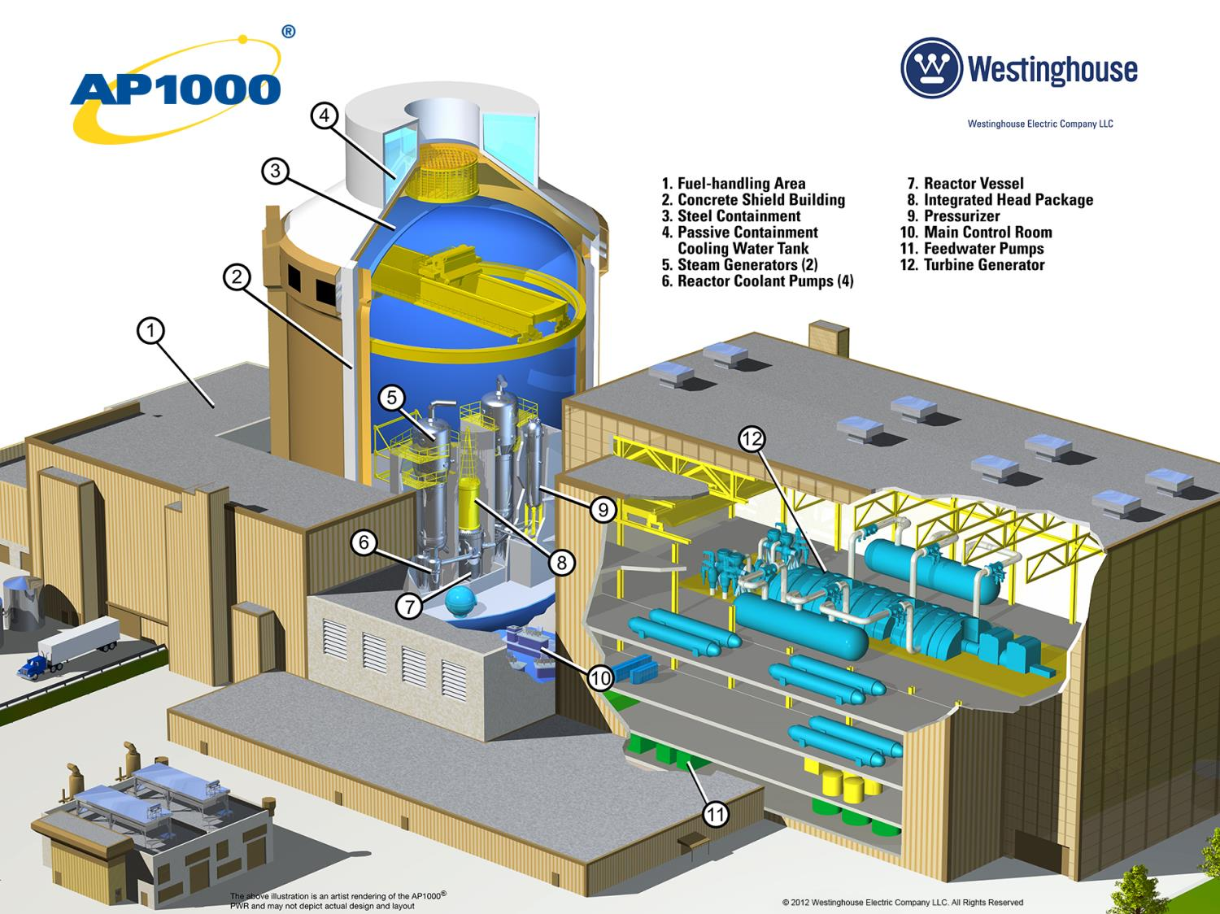

Slide 3
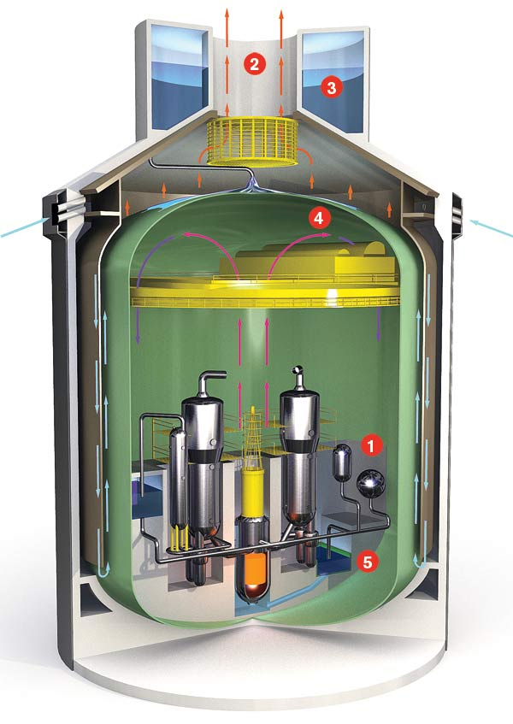
AP1000 (Advanced Passive) Design
AC electrical power not required for safe shutdown
Operator actions not required for 72 hours to maintain core and containment cooling
The NRC’s Fukushima 90-day Task Force noted the AP1000 design already met most of its recommendations
Differences to V1&2:
Containment Structure
RCS System
Main Control Room

Slide 4
Vogtle 3 and 4 Overview
Two units: 1,117 MW each
Technology: Westinghouse AP1000
Location: Waynesboro, GA
When completed, Vogtle 1-4:
Will be the largest nuclear
energy facility in the U.S.
Expected to power 1+ million
homes and businesses
Operating life: 60-years
Owners:
Georgia Power 45.7% 3. MEAG Power 22.7%
Oglethorpe Power 30% 4. Dalton Utilities 1.6%

Slide 5
Vogtle 3 and 4 Timeline
2006 Southern Nuclear files for Early Site Permit with NRC
2009 Georgia PSC approves construction of Units 3 and 4
NRC issues Early Site Permit Preliminary site work begins
2012 NRC issues Construction and Operating License (COL) Full construction begins
2017 Westinghouse Bankruptcy Project Management shifts to Southern Nuclear
2021 Unit 3 expected to begin commercial operation
2022 Unit 4 expected to begin commercial operation

Slide 6
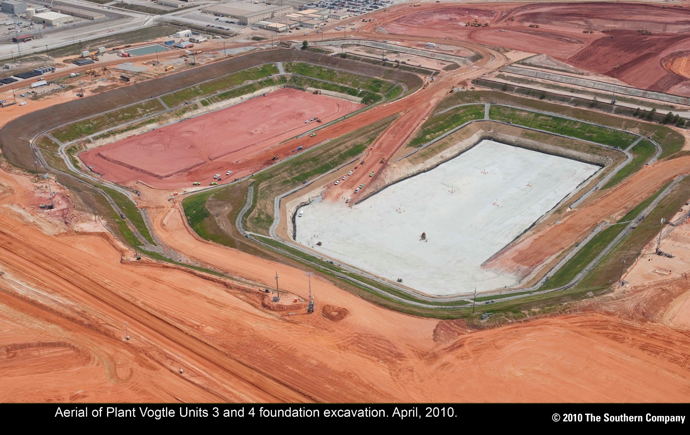
Vogtle 3&4 – April 2010

Slide 7
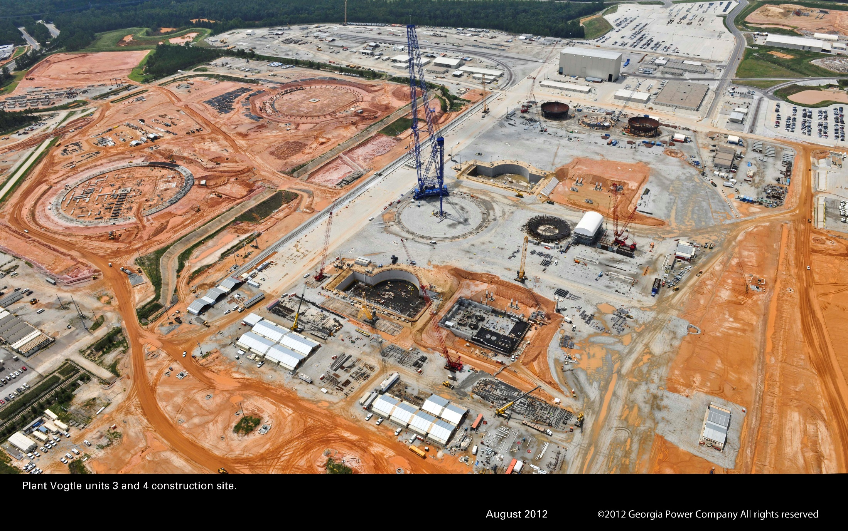
Vogtle 3&4 – August 2012

Slide 8
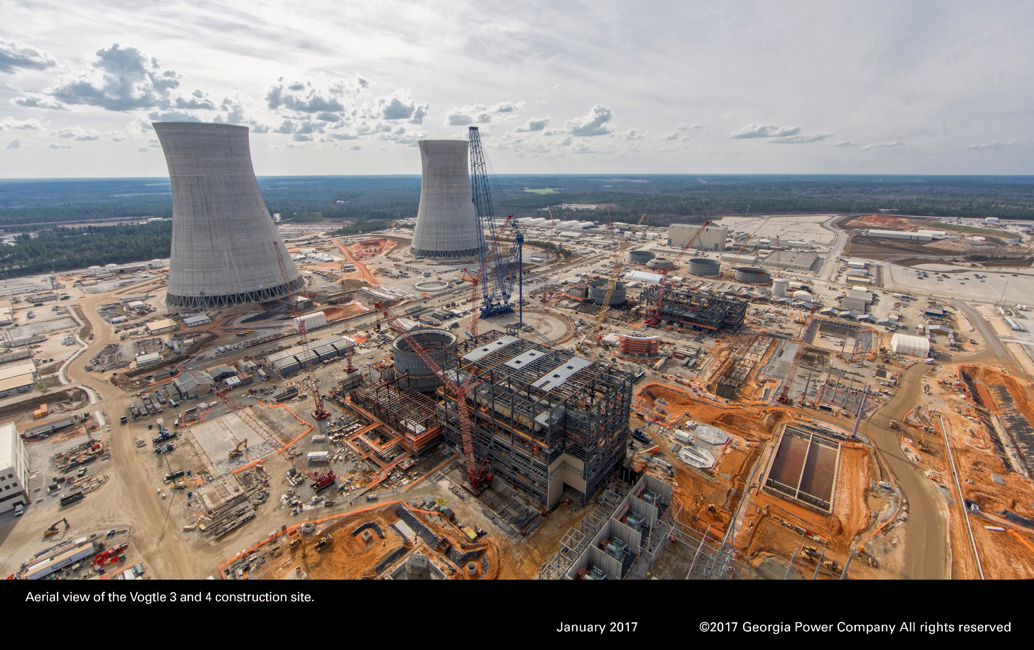
Vogtle 3&4 – January 2017

Slide 9
2017 Project Timeline
March - Westinghouse filed for bankruptcy
July - Transition of project management from Westinghouse to Southern Nuclear and Georgia Power
August - Board approvals, filed recommendation to complete Vogtle 3&4 to Georgia Public Service Commission (PSC)
October - Bechtel selected as primary construction contractor
December - Georgia PSC unanimously approves Georgia Power’s recommendation to complete Units 3 and 4
Received Toshiba Parent Guarantee of $3.68 billion

Slide 10
Project Update
Construction is over 50 percent complete
Westinghouse provides design, engineering and support services
Bechtel selected as the primary construction contractor
Target In-service dates
Unit 3 – November 2021
Unit 4 – November 2022
Projected Capital Forecast is $7.3 billion (GPC %)
Customer rate impact continues to be less than 10%
Production tax credits (PTCs), Toshiba Parent Guarantee, and additional DOE Loan Guarantee

Slide 11
Construction Update
Safety
52 million man-hours worked without a lost-time injury
Major Initiatives
Craft Per Diem
Process Improvements
Initial Test Program (ITP) Readiness

Slide 12
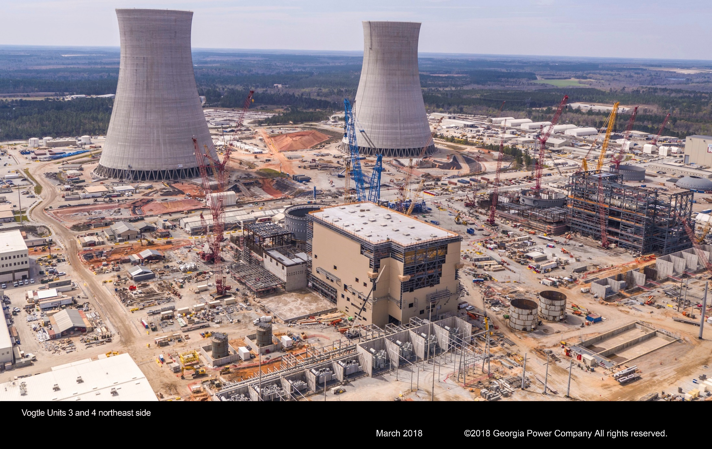
Vogtle 3&4 – March 2018

Slide 13
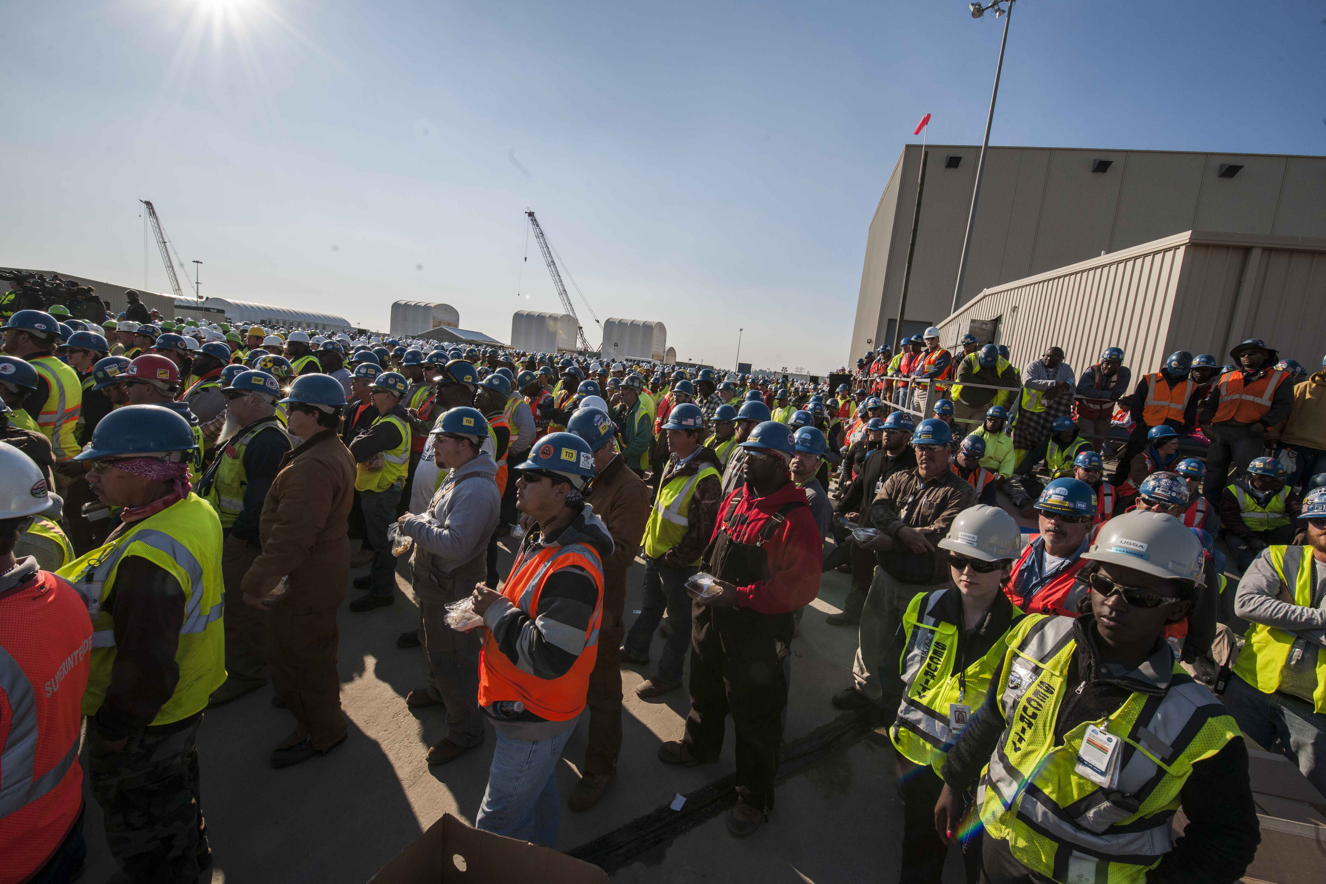
Economic Benefits
Vogtle 3 and 4 construction employs more than 8,000 people on-site
Will create 800 new careers once the units come online
Local community benefits

Slide 14
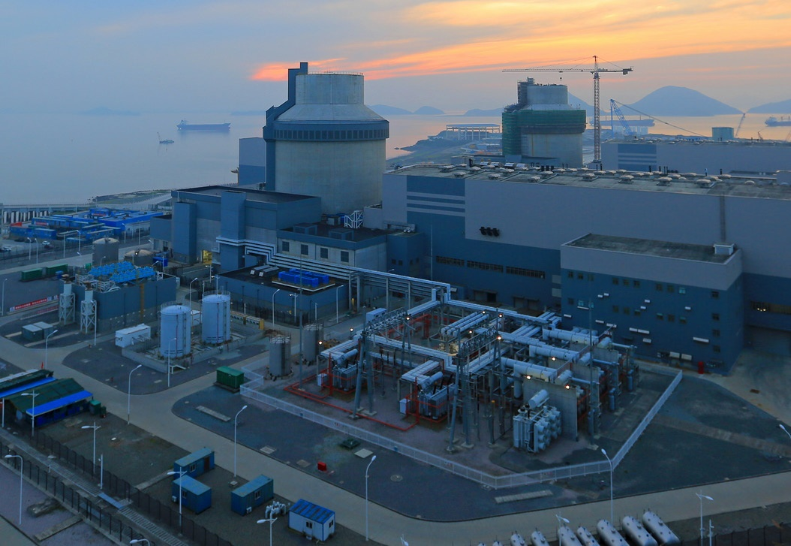
Sanmen Nuclear Power Station 6 unit site (2 complete) Sanmen, China Fuel Load Unit 1: April 2018 Commercial Operation: Late 2018
AP1000s in China

Slide 15
China Lessons Learned
Resolution of First of a Kind Equipment issues
Structural module redesign
Electrical layout design and cable separation
Nuclear island piping issues
Initial Test Program benefits – Test procedures, test data and schedules shared

Slide 16
AP1000 Fuel
Westinghouse Design – 14’ Fuel Assemblies
17x17 fuel rod configuration
AP1000 Reactor uses 157 assemblies and a rate output of 3400 MW thermal
1st Cycle Core designed to mimic a core with once and twice burned fuel assemblies:
Accomplished by having 5 different fuel enrichments
IFBA and WABA extensively used
IFBA: Integrated Fuel Burnable Absorber
WABA: Wet Annular Burnable Absorber

Slide 17
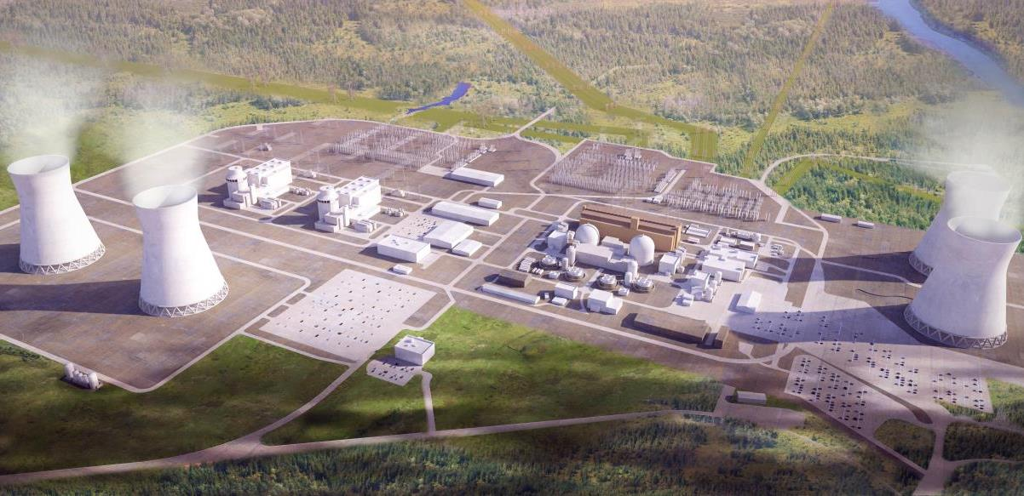
More photos, videos and 360 site tour available at:
https://www.georgiapower.com/company/plant-vogtle/showcase.html

