Slide 1
WBN U2 Main Condenser Failure
Bryce Cusick
June 2018
Notes:
Tips:
Presentation title should be Arial font, 40 points
Title on this slide should be kept short and on a single line
All fonts throughout presentation should be Arial font
The TVA Color Palette theme color is already selected in TVA’s template

Slide 2
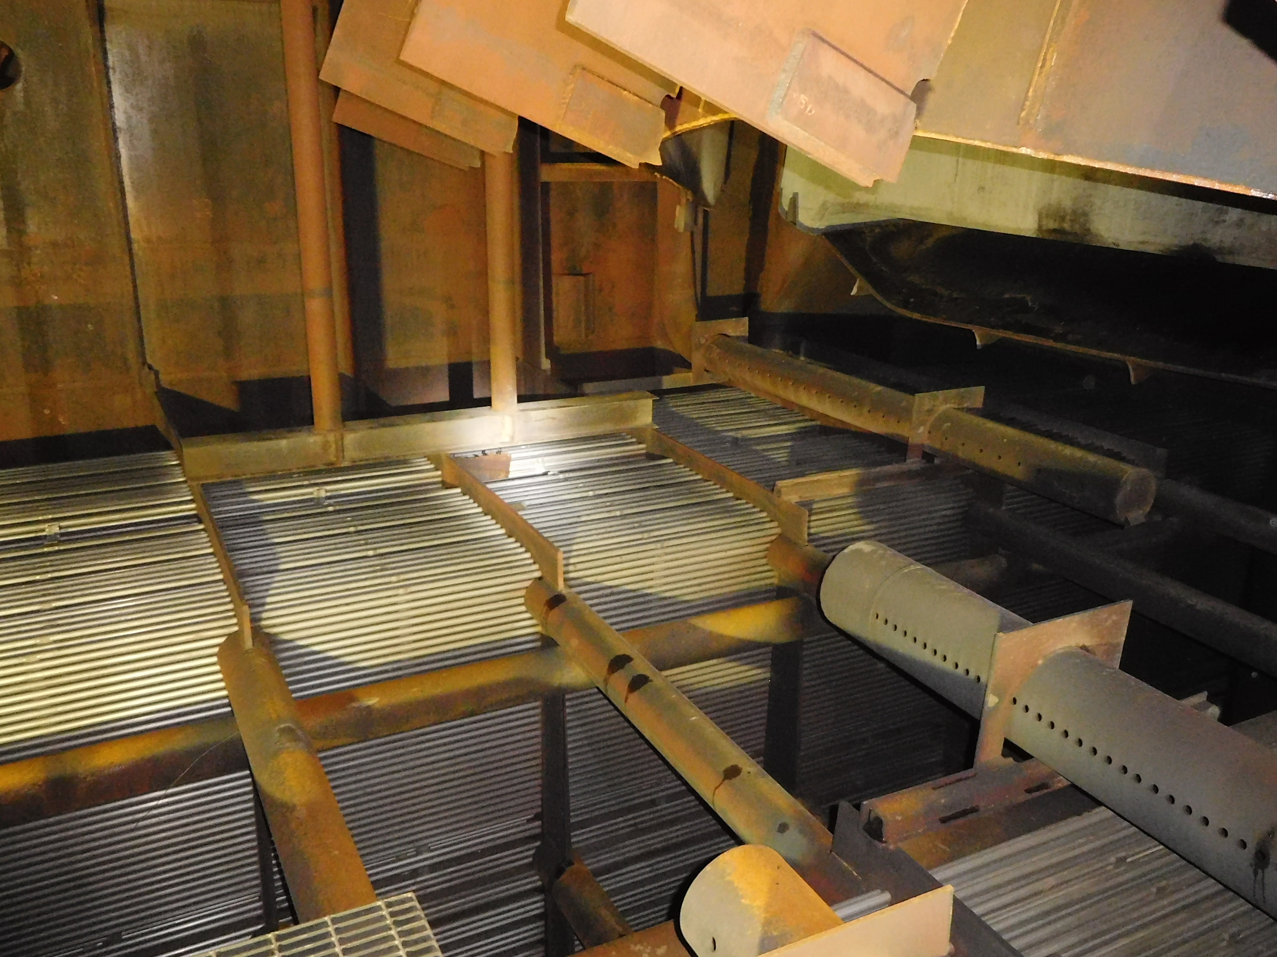
Event Summary
On March 23, 2017 at 0014, while at ~18% power during power ascension from a forced outage, a structural failure of the Watts Bar Unit 2 Main Condenser B zone south wall resulted in a turbine trip due to rapid loss of condenser vacuum and an extended forced outage to facilitate repairs.
The main condenser B zone south wall lower gusset plate materials failed in an overload condition.
The main condenser neck support structure was inadequate to maintain integrity within specification due to a latent error in the original design. This resulted in cracking and failure of the lower gusset plates.
Notes:
Tips:
Slide title should be Arial font, 32 points
Title should be kept short and on a single line if at all possible
To change the image, right click on it and click Change Picture.

Slide 3
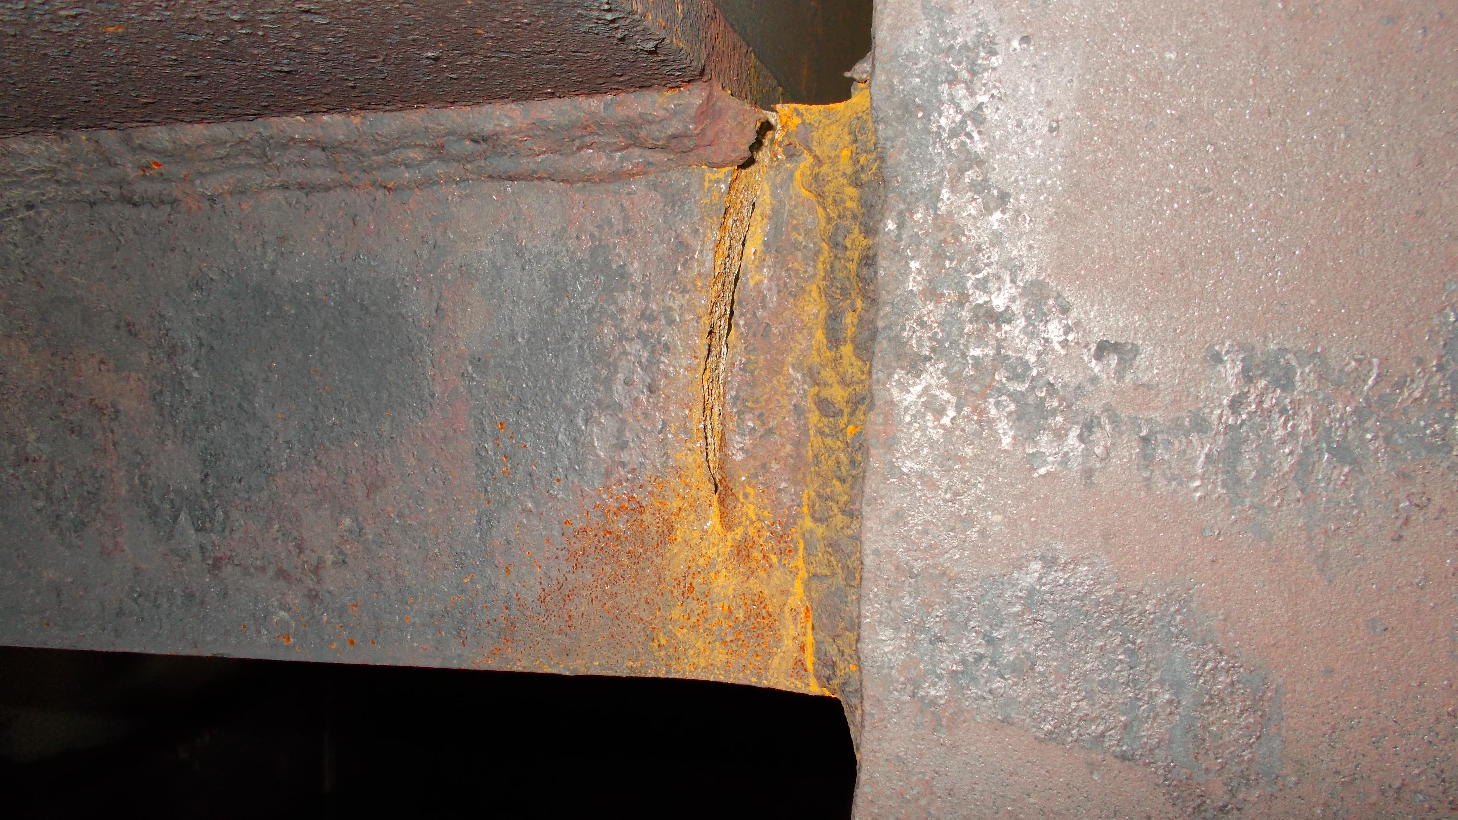
Pre-Failure Fatigue Crack

Slide 4
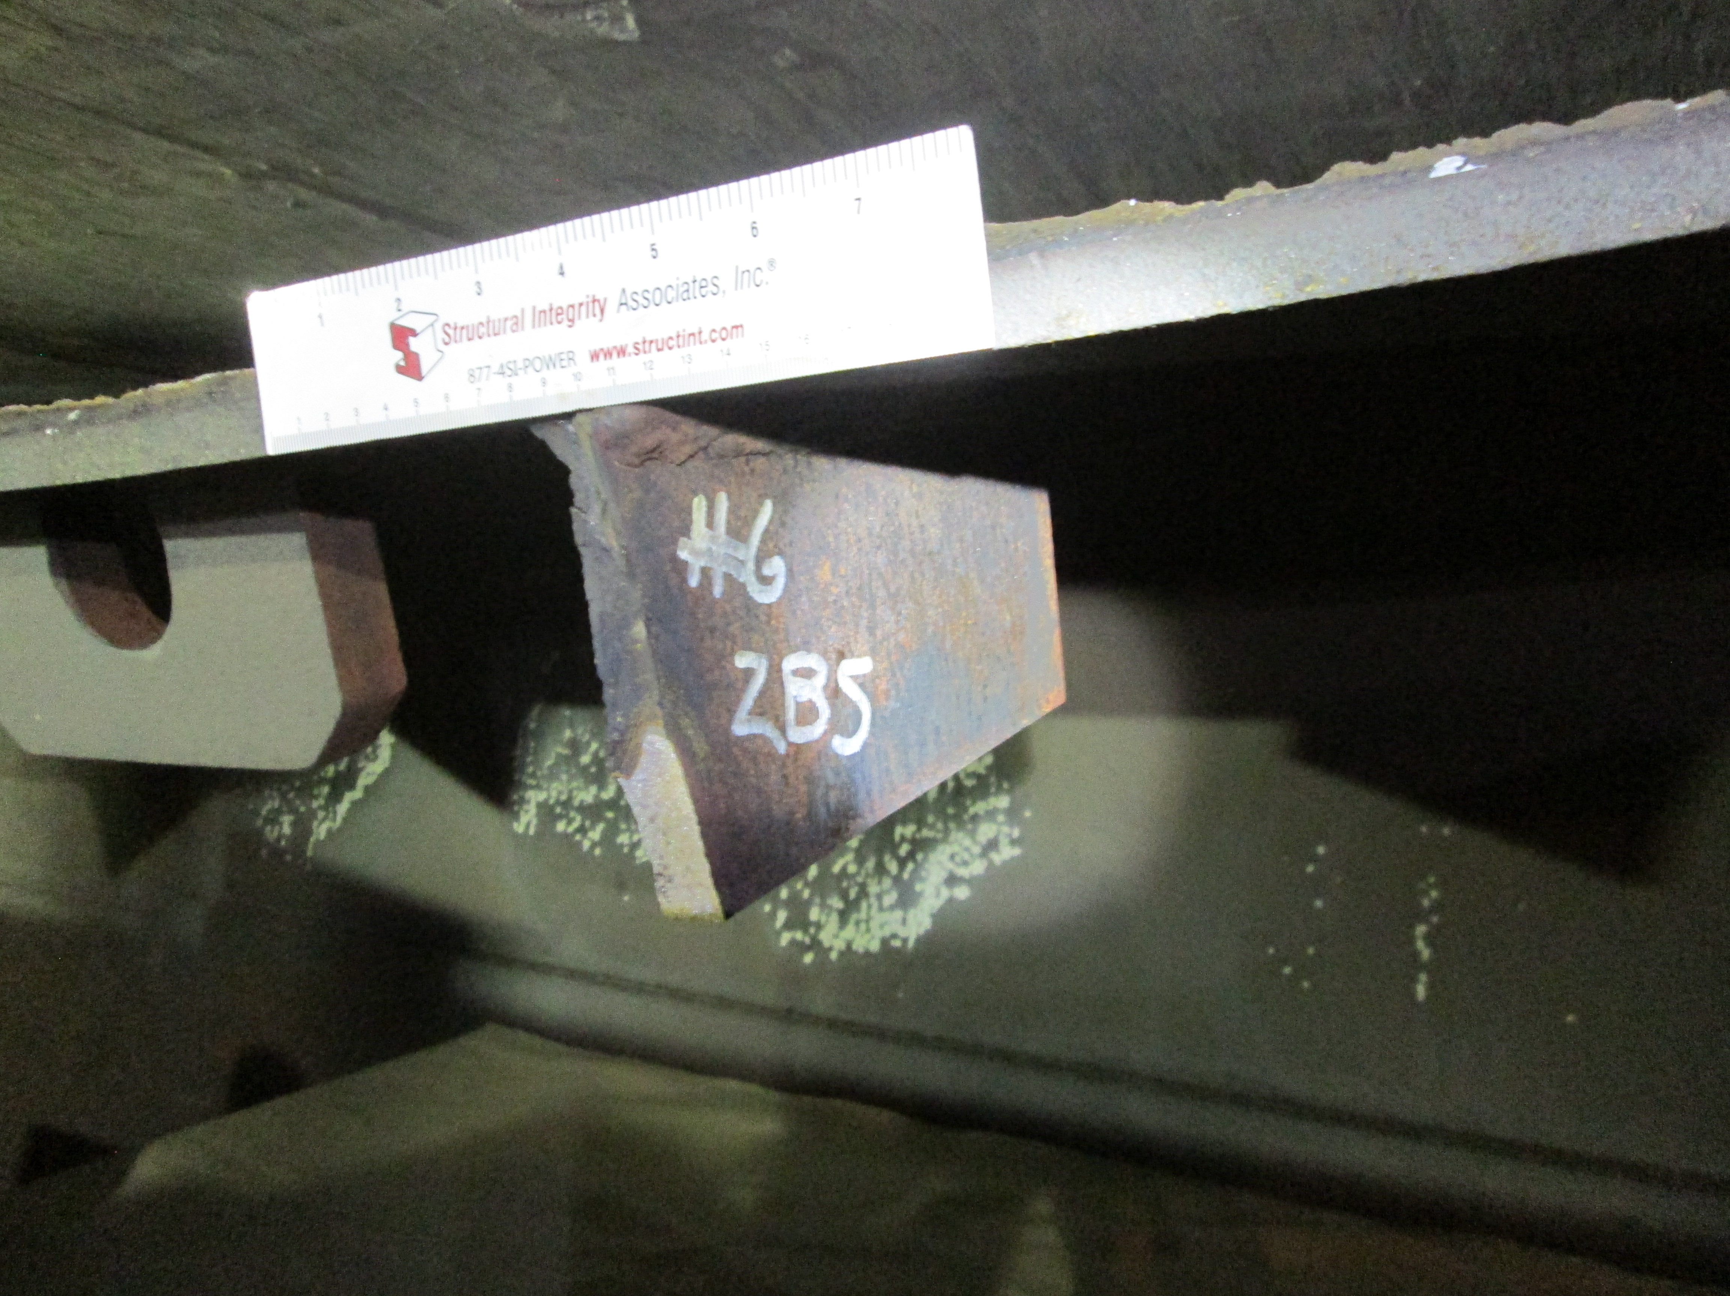
Post Failure Fatigue Crack

Slide 5
Initial Inspection

Slide 6
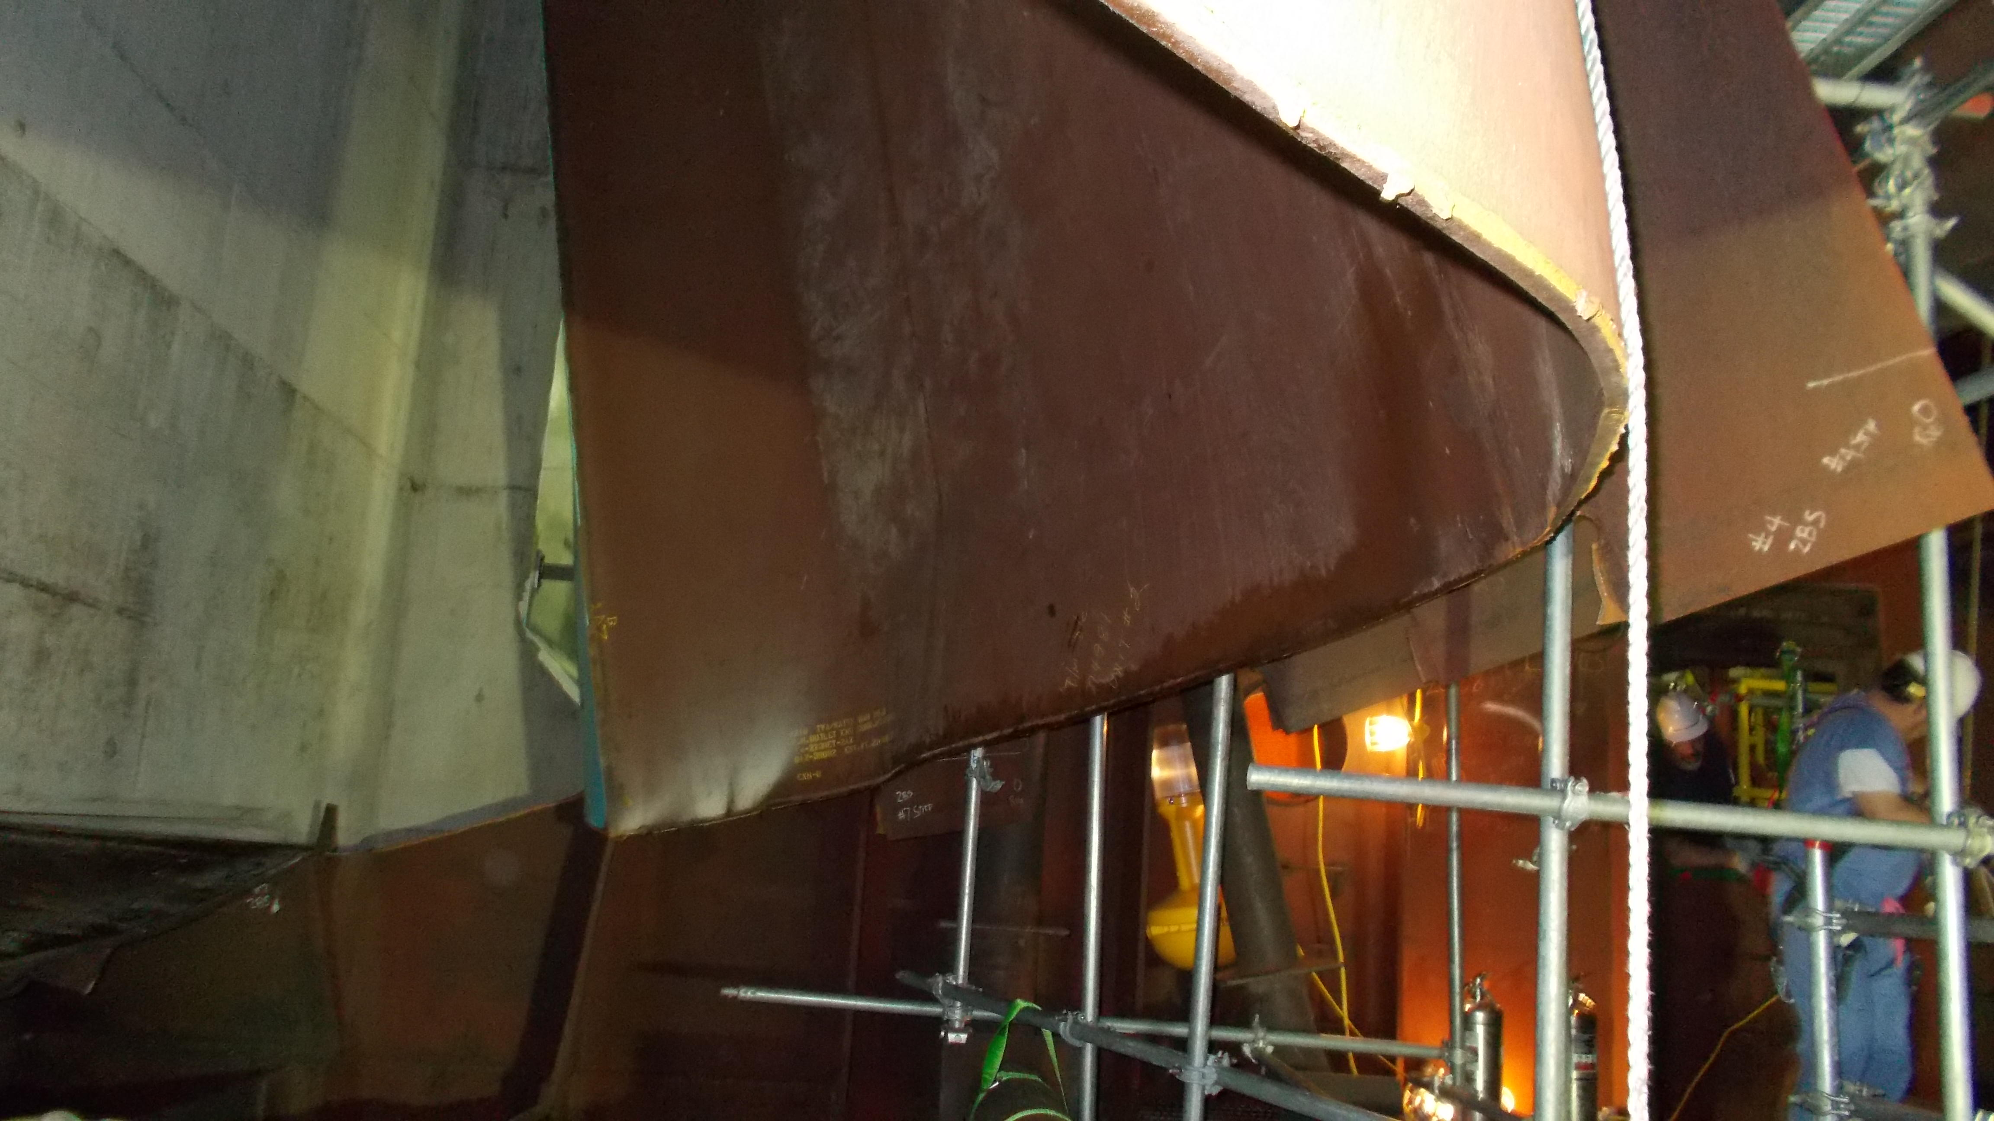
Extent of Damage

Slide 7
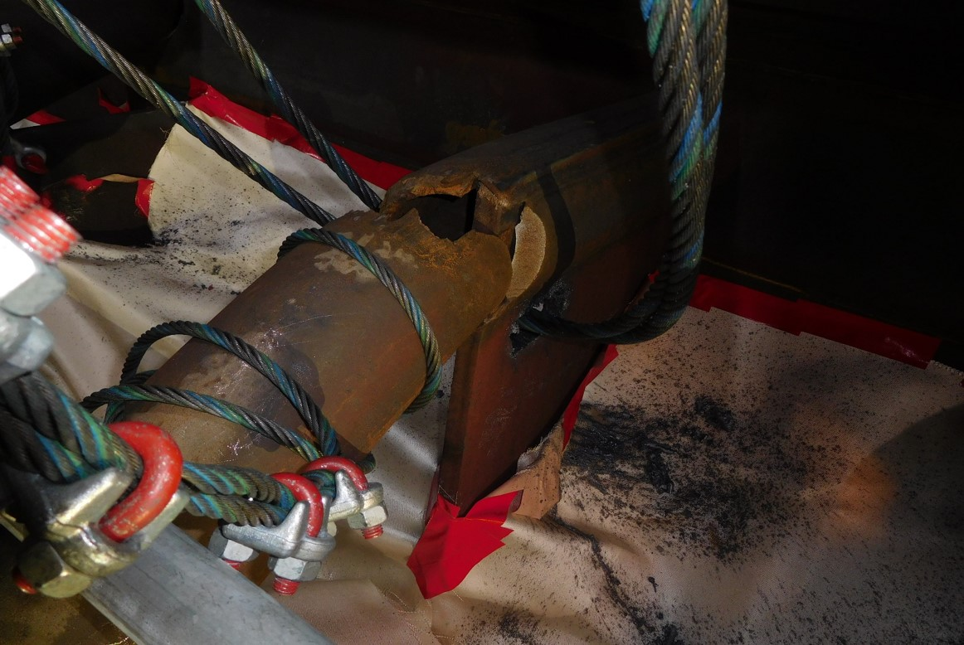
Extent of Damage

Slide 8
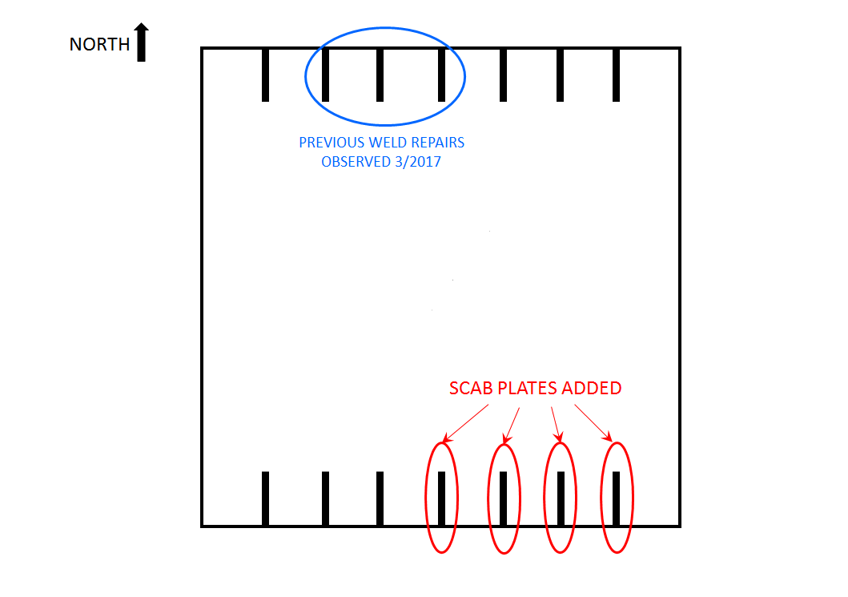
Cause
Unit 1 History
Less than adequate technical evaluation and documentation of the cracks identified in gusset plates and rib welds during Unit 1 operational history to include cause determination, potential consequences, and repair methodologies.

Slide 9
Consequences
The condenser repair resulted in a forced outage duration of more than 120 days.
Emergent Repairs were made to Unit 1, which was in a Refueling Outage at the time of the Unit 2 Failure.
Redesign of lower gusset plate is more resistant to fatigue.

Slide 10


