Slide 1
Welcome to the 2020 CMBG Virtual Conference
We will begin at 5:00 GMT. Please take a moment to review the list below.
Reduce Distractions
Please silence cell phones, beepers, etc.
Minimize email and other business
Respect Participants and Presenters
Please return from breaks on time
Mute your microphone when not talking
Virtual Conference Q&A & Interactive Polling
Join at: Slido.com #CMBG20 Passcode: CMBG20
Slido will give us real time info and help you with your conference experience!
Utilize live polls
Submit questions for presenters as the presentation goes on

Slide 2
Safety Brief
Environment
Take a moment to clear any slip, trip or fall hazards in your home workspace or office.
Clear any potential desk hazards, such as drinks close to your workstation or other electronics.
Ergonomics
There will be a break between each presentation.
Take this opportunity to stand up, stretch, or get a drink.
Managing Potential Distractions
We understand that working from home has its own challenges.
Take time to prioritize family first.
Event will be recorded in case anyone misses the event and wants to catch up later.

Slide 3
Audience Interaction
Introducing our meeting app Slido
Join at: Slido.com
#CMBG20
Passcode: CMBG20

Slide 4
Conference Agenda
Time | Duration | Topic | Presenter
5:00 PM GMT | 10 minutes | Conference Welcome | Brad Diggans
5:10 PM GMT | 45 minutes | Update from INPO | Mark Fowler
5:55 PM GMT | 5 minutes | Break
6:00 PM GMT | 45 minutes | SIEP Issue Resolution | Eric Turner
6:45 PM GMT | 5 minutes | Break
6:50 PM GMT | 30 minutes | DOWG & Digital Design Process | Ashley Taylor
7:20 PM GMT | 5 minutes | Break
7:25 PM GMT | 30 minutes | Calculation Process Improvement | Penny Selman
7:55 PM GMT | 5 minutes | Break
8:00 PM GMT | 30 minutes | Digitalization of Shin-Kori | Young Ju Son
8:30 PM GMT | 10 minutes | Conference Summary & Closing | Brad Diggans
8:40 PM GMT | ------------- | Conference End
This conference will be recorded.

Slide 5
CMBG Mission & Steering Committee
Mission Statement:
To provide a forum for the exchange of information which is useful to practitioners of nuclear facility configuration management and to act as the CM Community of Practice for the nuclear industry.
Current Steering Committee:
Chairman – Paul Davis (PSEG)
Vice Chairman – Andrew Neal (SNC)
Conference Host – Brad Diggans
David Epperson (Ameren)
Kent Freeland (Nawah Energy)
Mike Hayes (Exelon)
Laurent Perkins (Bentley)
Jon Sears (APS)
Young Ju Son (KEPCO E&C)
John Taylor (TVA)
Dave Weber (Energy Northwest)
Honorary Steering Committee Member: Mike Dickson (Duke Energy)
Website: http://www.cmbg.org/

Slide 6
ANSI-NIRMA CM 1.0-2007 (R2015)
Status Update:
Proposed Revision to CM Standard sent out to Consensus Body for review (Sept. 15th)
Next Steps
Per procedure the reviewers have 3 months to complete the review and submit the Ballot (~Dec.15th)
A request was made in the communication email to complete the review within 2 months if possible
Once the Ballots are received, we’ll need to see if there are any that indicate OBJECT (Hopefully None!)
If so, those Ballots MUST identify the issue(s) and provide proposed text to resolve the objection(s)
We will need to review the objections and proposed changes and determine how to resolve each issue:
We’ll contact the reviewer to understand the issue(s)
Work to reach a resolution everyone can accept
For changes that are not substantive we can make them and proceed to submit our documentation for ANSI for approval
For substantive changes, we might have to reroute the updated proposed revision for a 2nd round of review and ballot.
Contact Laurent.Perkins@Bentley.com if you have any questions

Slide 7
Configuration Management - Update
Mark Fowler,
Manager – Engineering & Configuration Management
CMBG October 2?, 2020

Slide 9
Agenda
Plant Evaluation & WANO Peer Review Trends
Areas for Improvement (AFI)
2020 Focus Areas
Nuclear Fuel Reliability
Consequential Engineering Error Reduction
Intake Cooling Water Blockage
Future of Configuration Management

Slide 10
2019/20 AFI Trends
Performance issues in:
EN.1 - Engineering Fundamentals
Critical thinking, thoroughness, Operational Risk, communicating risk, advocating for system and component improvements
EN.2 - Eng Leadership & Technical Authority
Oversight and intrusiveness
Configuration Management
Very few adverse elements in CM.1, 2 & 3
Increased emphasis and AFIs in CM.4 or new NF.1, 2

Slide 11
2020 Focus Areas
Improving Fuel Performance (key industry issue)
IER 19-6 Debris Induced Fuel Failures
Reviews during Plant Evals/Peer Reviews for failed fuel response
Fuel Integrity Review & Assist Visits
Utility specific recommendations
Discussed at Various Industry Meetings
Training for Team Leaders and CM Evaluators
Notes:
“Prevention” of Foreign material intrusion into open systems, pool or reactor cavity, and due to internal system degradation will be focused on. Maintenance will be assisting in these reviews, where applicable.
Team review approach during plant evaluations, as TC applies to all departments making technical decisions

Slide 12
Improving Fuel Performance
Early Results for Reviews
Recommendation 2b - Alter standards to establish outage planning practices, design control procedures, operating procedures, maintenance procedures, degraded equipment response practices, and water cleanliness controls specific to preventing debris and addressing resident debris that could threaten fuel integrity
Procedure changes not complete
Awaiting changes to standard design change process
Procedure reviews not complete to determine if changes are required

Slide 13
Improving Fuel Performance
Early Results for Reviews
Recommendation 3 – Confirm corporate and station leaders foster continuous learning specific to fuel reliability, in general, and prevention of debris-induced fuel failures, in particular. By doing this, leaders ensure broad understanding of related excellence standards; emphasize the cross-functional nature of this challenge and the necessary training; and ensure that all policies, practices, and procedures are up-to-date, understood, and subject to training
Training not effective
Training not complete
No training/alternate actions for supplemental employees
Training needs analysis not performed due to incomplete procedure changes

Slide 14
Improving Fuel Performance
Early Results for Reviews
Recommendation 4a – Senior leaders create an environment that encourages workforce engagement and ownership of fuel reliability standards. Confirm that managers, supervisors and workers understand the causes and consequences of debris-induced fuel failures and that they, in turn, demonstrate ownership of station fuel performance by proactively finding and fixing related problems
Self-assessment of FME program not performed
Procedure not revised to perform time based self-assessment that includes the four program elements from the IER

Slide 15
Fuel Performance History

Slide 16
Fuel Performance Successes
56 % of cores have operated for > 5 cycles without a fuel failure
During 2nd and 3rd quarter no PWR cores operated with a fuel failure
At the end of 2020, barring any failures, only 2 cores will have active fuel failures – lowest since 2012
If no failures occur between now and end of spring refueling outages, could see ZERO active failures for 1st time ever!

Slide 17
Consequential Engineering Errors

Slide 18
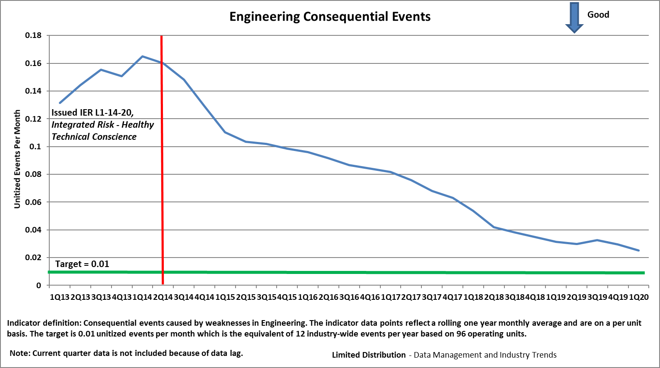

Slide 19
INPO and Industry Initiatives for Reducing Consequential Errors
Review and Assist visits (Prevention)
Project and Digital Upgrade Assist visits
Other Initiatives
SCRAM reduction, AC Power Reliability, Program Management Effectiveness
Evaluation/Peer Review Technical Conscience strengths/ weaknesses feedback
Raise engineering leadership awareness of proficiency challenge
Notes:
These activities can affect Technical evaluation preparation, reviews of evaluations, and organizational standards for performance of engineering tasks
Project Review Visits (PRV): For stations that are undertaking significant projects, review visits will be scheduled to provide an independent check that lessons learned from IER 14-20 Rec-3 are being appropriately applied. The intent is to be proactive in helping member stations in avoiding significant technical errors and consequences
Managing projects with enterprise risk. Completed three (WC, FCS and Prairie Island) Major/FOAK modification, consequence, etc.
EN vendor oversight and support Vendor/owner transparency, project manager proficiency, etc.
Technical conscience health
Technical conscience Review Visits (TCRV): The intent is to intervene in the early stages of decline to prevent or minimize the number of consequential events by identifying faint signals for the stations that may be showing weaknesses in Technical Conscience. Completed one (PSEG) -Technical decision weaknesses
Design Basis Review Visits (DBRV): The intent is to prevent consequential events and loss of regulatory margin because of weak understanding and maintenance of the design and licensing requirements. These review visits will focus on performance objective defined in CM.1 and lessons learned from IER. Planned – Columbia, Palisades, Salem
Columbia Design Basis Review Visit – Because of performance issues identified during the last evaluation, Columbia is considered vulnerable to consequential events and loss of regulatory margin because of weak understanding and maintenance of the design and licensing requirements. Working with the station leadership team a one-week review visit is scheduled for August 3, 2015.
Palisades: Not designed to SRP, pre-GDC, Weak engineering, high engineering leadership turnover and design engineering personnel. No power uprate recent scrutiny in design basis area by NRC or others.
Salem 1&2: Not designed to SRP, pre-GDC, Weak engineering, high engineering leadership turnover and design engineering personnel. No power uprate recent scrutiny in design basis area by NRC or others. Last plant evaluation identified weaknesses in technical conscience.

Slide 20
Intake Cooling Water Blockage

Slide 21
Actions
Deploy communication strategy to inform the industry of this adverse trend
Insights articles
Letter from INPO EVP
Discuss at EVP meeting
Carry intake cooling water performance as a focus area for EN/CM
Form an industry working group
Discuss drivers
Develop industry actions

Slide 22
Future Configuration Mgmt.
Is Engineering as or more effective working remotely?
What does current industry CM performance mean?
Input from this group

Slide 23
For Q&A:
Join at: Slido.com
#CMBG20
Passcode: CMBG20
Or, scan this QR Code
Please use Slido to enter any questions that you have at this time.
Please note that if we don’t get to your question, we will collect all questions and get a response back to all attendees in a follow-up email following the conference’s conclusion.

Slide 24
Break

Slide 25
TVA SIEP Issue Resolutions
Eric Turner, Manager Engineering Support
Sequoyah Nuclear Power Station

Slide 26
Tools
Maximo
Work Management Software
CMISDP – SIEP application
Engineering Change Software
Enterprise Content Management (ECM)
Records Management Software

Slide 27
SIEP Process
TVA Adopted the new SIEP Process and has been implementing for about 12 months
Seen as a success in leveraging a robust equivalency process which allows minor configuration document updates
Procurement Engineering is qualified and enrolled in the accredited engineering training program
TVA also qualified key personnel in our EFIN/Rapid Response engineering department
Allow additional resources to perform the new Item Equivalencies

Slide 28
ISSUES
Updating documents that are impacted
Tracking document updates
Method of updating the drawings due to ECM limitations
Set point and Scaling document updates
CMISDP – Interaction with ECM
Equivalencies would not automatically go to ECM (TVA IT and PKMJ fixed this issue)
Packages now go automatically into ECM
Training other impacted groups
Planning, Design Engineering and Engineering Support

Slide 29
Resolutions - Documents
Tracking document updates
Maximo is used to track when document updates are needed for an IEE. This is done by canceling the obsolete item in Maximo so it can no longer be used for procurement.
Then log notes are added to the item which point the planner to the new item created, the IEE package number, and that they need to review the Maintenance Instructions section of the IEE.
Planning’s procedure was revised to give these instructions.
A copy of the IEE is also sent to the planner if an open Work Order is written for the item being canceled.
TVA created a new Work Completion Statement (WCS) form that was specific for Item Equivalency Evaluation (IEE) because the Engineering Change Package (ECP) form was too specific.
This form is used to communicate details from craft to engineering

Slide 30
Resolutions - Documents
The Maintenance Instructions section of the IEE is used to direct Planning to include a step to the WO to submit the IEE WCS form to Engineering Support.
TVA experience is craft will not fill out the form unless Work Package directs it
Once a WCS is received by Engineering Support, the 90 days to update the documents start.
TVA ECP closure process has a 90 day requirement
Engineering support tracks the document updates and ensures they are updated before the 90 days.

Slide 31
Resolutions - Drawings
Method of doing the drawing changes
Note: TVA does not perform IEE’s on items that impact Category 1 drawings or “primary” drawings. These are considered to be operations critical so they screen out of the IEE process.
These are the only drawings that have a 15 day update limit at TVA.
At first TVA was using the already in place Drawing Change Authorization (DCA) method to mark up drawings. This did not work out due to limitations with ECM.
DCA’s are used for design changes to make new drawings or to mark-up existing drawings for proposed changes
Allows use of construction notes that may not be incorporated in the final revision.

Slide 32
Resolutions - Drawings
Due to having this issue it was determined that the DCA process was an administrative burden for design, engineering support and PEG.
The process was further simplified by attaching sketches or mark ups to the IEE for Planning and Maintenance to use.
Once a WCS is received, admin changes are created to update the drawings with the already created sketches or drawing mark ups.
This solved the complexity issue, ECM issue and gets the drawings updated after the work is complete
TVA Admin Change process allows a drawing change to as-built if authorized by a design change or IEEE. Mainly used to correct legacy documentation errors.

Slide 33
Resolutions – SSD’s
Set Point and Scaling Document (SSD)
SSDs updates were not considered at first but it was soon realized that opportunities to take advantage of the IEE process were being missed.
SSD’s are instrument drawings that identify instrumentation details and setpoints
Calibration sheets for maintenance are created based on the SSD’s
These documents typically require an ECP to change

Slide 34
Resolutions – SSD’s
The procedure controlling SSD updates was revised to allow limited changes under the IEE process. The following questions were added to the procedure for SSDs in addition to the screening in NISP-EN-02. A “yes” to these questions kicks the change to the design change process.
1. Is there a reduction in design margin?
2. Did any process setpoint (or a reset performs a function that is important to safety) change?
3. Did the process input (i.e., 0 - 400 inwc) or output (i.e., 4 - 20 ma) change?
4. The Acceptable As Left or Acceptable As Found for the loop or any instrument requires changing?

Slide 35
Resolutions -Training
Training
Procurement Engineers were trained on the changes, the new software and were given a desktop guide along with the revised procedures.
Lunch and learn sessions were given to engineering management at the sites to go over impacts to the rest of engineering (design, systems and engineering support.
Planning management and leads were also briefed at each site and planners reached out to PEG when needed for the first few IEEs they worked through.

Slide 36
Questions?
Please use Slido to enter any questions that you have at this time.
Please note that if we don’t get to your question, we will collect all questions and get a response back to all attendees in a follow-up email following the conference’s conclusion.
For Q&A:
Join at: Slido.com
#CMBG20
Passcode: CMBG20
Or, scan this QR Code

Slide 37
Break

Slide 38
DOWG Update
CMBG
October 9, 2020
Ashley Taylor

Slide 39
IN PROGRESS
Standard Design Process, IP-ENG-001 Revision 2 –
Includes debris-induced fuel failure IER items
Adds more references to the new digital process, NISP-EN-04
References to NERC considerations
Standard Item Equivalency Process, NISP-EN-02 Revision 1 –
Expand use of digital item equivalencies
Will start revision in November, following issuance of EPRI report 3002018279
Standard Digital Design Process, NISP-EN-04 –
EB Implementation: considering extensions beyond April 2021
Savings will be different than SDP - industry-wide, not project specific

Slide 40
FUTURE
Address SPAC feedback
Common database for installation specifications
Common database for maintenance-type testing
Business case for standard 50.59 programs
Business case for standard Doc Only Changes
Business case for standard non-TMOD temporary configuration changes
Other ideas?

Slide 41
COMMUNICATION
Know your DOWG rep – feedback welcome
Nuclear Community
https://community.nantel.org/working_groups/design_oversight_working_group_dowg/
988 members as of 9/4
All the DOWG documents
Open to SPAC members
Industry Sharing with CMISDP
Recent enhancements to module to track requests
Make sure your utility has a point of contact setup for requests

Slide 42
DOWG Members
Company/Utility/Alliance | Representative | Email
Arizona Power - Palo Verde - STARS Alliance | Allan Hartwig | Allan.Hartwig@aps.com
Entergy | Andy Mihalik | amihali@entergy.com
TVA | Ashley Taylor - Chair | ajtaylor@tva.gov
Energy Harbor | Colin Keller | kellerc@firstenergycorp.com
Energy Northwest - Columbia - USA Alliance | Dan Long | djlong@energy-northwest.com
Southern Nuclear | David Gambrell | dlgambre@southernco.com
PSEG | James Boyer | James.Boyer@pseg.com
Duke | Mark Grantham | Mark.Grantham@duke-energy.com
Xcel | Mohammad Molaei | Mohammad.Molaei@xenuclear.com
Exelon | Rich Hall - Vice Chair | richard.hall@exeloncorp.com
NextEra | Scott Forman | Scott.FORMAN@fpl.com
Dominion | Ethan Treptow Tim Knoebel | ethan.a.treptow@dominionenergy.com timothy.j.knoebel@dominionenergy.com
MPR - represents eng vendors | Pete Carlone | pcarlone@mpr.com
NEI - resource | Steve Geier | seg@nei.org
INPO - resource | Sudesh Gambhir | GambhirSK@inpo.org

Slide 43
Questions?
Please use Slido to enter any questions that you have at this time.
Please note that if we don’t get to your question, we will collect all questions and get a response back to all attendees in a follow-up email following the conference’s conclusion.
For Q&A:
Join at: Slido.com
#CMBG20
Passcode: CMBG20
Or, scan this QR Code

Slide 44
Break

Slide 45
Calculation Process Improvement
Penny Selman
October 21, 2020
Notes:
Tips:
Presentation title should be Arial font, 40 points
Title on this slide should be kept short and on a single line
All fonts throughout presentation should be Arial font
The TVA Color Palette theme color is already selected in TVA’s template

Slide 46
TVA Current Calculation Process
Notes:
Current TVA Process summed up in one picture
Largely a paper-based process that does not take advantage of modern tools available OR modern electronic document and storage capabilities
Therefore 2 years ago TVA contracted with PKMJ to develop another module in the CMIS platform to perform electronic calculations.

Slide 47
What is the CMIS Calculation Module?
Primary Calculation Library
Automated Package Assembly
Pulls records from our QA Record storage
Synchronized with the QA Record
All related documents “live” with the calculation in the CMIS Calculation Module
Auto form generation
Auto page numbering and labeling
Electronic Signatures
Interface Reviews
Automation of the calculation process
Notes:
Tips:
Slide title should be Arial font, 32 points
Title should be kept short and on a single line if at all possible
To change the image, right click on it and click Change Picture.

Slide 48
Why Undertake Such a Big Project?
All the reasons why…
Calculations are the most expensive engineering product with millions of dollars spent each year
Decrease human errors
Efficiency gains
Easy storage of native files
Automate interface review
Automate signature process
Automate records publishing
Legibility

Slide 49
What is within the scope?
All Engineering Calculations
Design Engineering Calculations
Civil, Electrical, I&C, Mechanical
PRA Calculations
Nuclear Fuels
All Vintages
Electronic
Legacy – typed
Legacy - handwriten
Notes:
Tips:
Slide title should be Arial font, 32 points
Title should be kept short and on a single line if at all possible
To change the image, right click on it and click Change Picture.

Slide 50
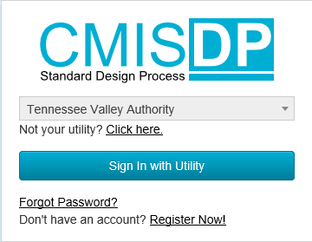
TVA CMISDP-Calculation Module
Demonstration
Create a new calculation

Slide 51
Break

Slide 53
For Q&A:
Join at: Slido.com
#CMBG20
Passcode: CMBG20
Or, scan this QR Code
Please use Slido to enter any questions that you have at this time.
Please note that if we don’t get to your question, we will collect all questions and get a response back to all attendees in a follow-up email following the conference’s conclusion.

Slide 54
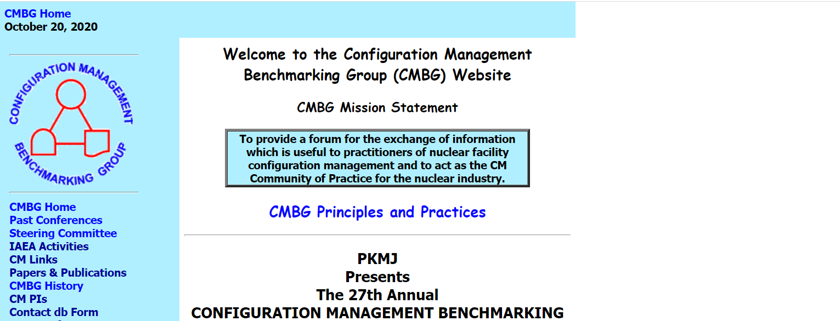
Conference Closing
Conference Close Out
We will send a survey to all those that participated today to get your feedback on the conference soon.
We will also send responses to all of today’s questions that we couldn’t get to via email in the next week or so.
CMBG Website
Be sure to check out the CMBG website for all of today’s presentations! These will be listed within the next few weeks.
Website: http://www.cmbg.org/

Slide 55
Configuration Management Benchmarking Group
Annual Meeting
Sheraton Station Square – Pittsburgh, PA
Tentatively June 2021

Slide 56
Thank you for joining us today for the 27th Annual Configuration Management Benchmarking Group Conference! We hope to see everyone at the 2021 conference next year.

