Slide 1
The DOWG, The SDP, and Lessons Learned
Ashley Taylor, DOWG Chair
July 2021

Slide 2
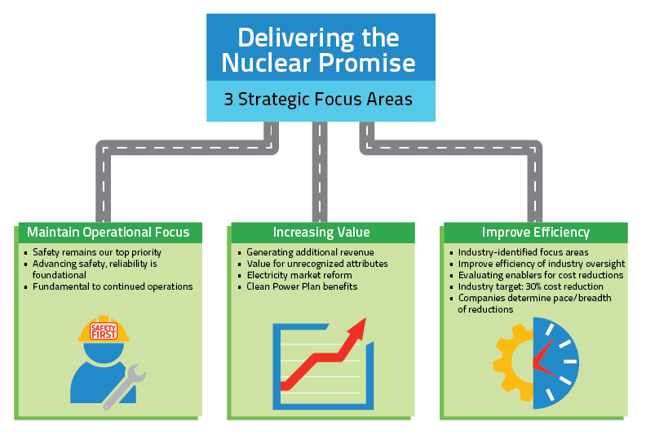
History
In December 2014, a US Nuclear industry collaborative effort was launched to accomplish:

Slide 3
History
A working group was created to work on ENG-003, Standard Design Process (SDP), communicated through Efficiency Bulletin (EB) 17-06. Color codes were assigned and EB 17-06 was one of the few coded red, meaning it was required for all utilities. Others had different colors and were deemed recommended or optional. The working group consisted of representatives from every fleet, both alliances, NEI, INPO, and MPR, who volunteered to collect input from and represent all the engineering service providers (ESP, EOC, A/E firm, Eng Vendor, etc.). The vision of the working group was to:
Implement a standard plant modification process to promote efficient use of engineering resources and streamlined engineering changes.
Simplified design process common to all stations
Industry-wide training applicability
Standardized process software
Facilitate sharing of information between stations

Slide 4
History
The working group removed all the expectations and process added to manage behavior from our various processes and started with the minimum requirements for an engineering change package (ECP). The IP-ENG-001 procedure and associated forms including the Design Attribute Review (DAR) were issued, the EB 17-06 was processed, and a Resource Manual was created. In addition, a standard mentoring guide was created, training courses developed and distributed, webcasts and regional workshops provided, generic change management plans communicated, common design software was started, and pilots were supported to ensure no fatal flaws. On March 8, 2017, the working group transitioned to become the Design Oversight Working Group (DOWG) to take over future standardization work and maintenance of the industry documents.
INPO, NEI, and EPRI do not own the documents, the DOWG does. Any comments, questions, and suggestions need to go to your DOWG representative.
The DOWG is a sibling organization to the Equipment Reliability Working Group (ERWG) and the Nuclear Obsolescence Working Group (NUOG) all under the parent Executive Oversight Committee (EOC), currently led by Elliot Flick of Exelon.

Slide 5
Expansion
The DOWG worked with PKMJ to create a software package that was cost shared with participating utilities to implement the SDP electronically. Many utilities were able to modify their existing software to accomplish electronic packages, but several use CMISDP (Configuration Management Information Standard Design Process) to create and manage their packages electronically. Most utilities have subscribed to the industry sharing portion of this software.
The DOWG formed a subcommittee to create and issue the Standard Item Equivalency Process (SIEP), NISP-EN-02. This included an associated mentor guide and change management support as well.
Most recently, the DOWG worked with EPRI on their revision to the EPRI Design Engineering Guide (DEG) and creation and issuance of the Standard Digital Design Process, NISP-EN-04. The DEG is an EPRI document, but the NISP-EN-04 is a DOWG document. Change management for this process is in progress, with expected implementation by the end of August 2021.

Slide 6
Lessons Learned
Change Management is ongoing
Some felt like there were new roles created in SDP, but more often groups were forced to fulfill all their responsibilities
Turnover of managers, new engineers, new stakeholders
Stakeholder engagement
Communication is key
DAR organizations may not line up exactly with your organization
Knowledge based process is full of gray areas, process SMEs are important
Many try to revert back and want to add in more process
Everyone needs to read the procedure, including Attachment 9 and the Resource Manual, in addition to any utility interface procedure
Since issued in 2017, minimal technical editing has been needed, most related to expansion of DAR and industry OE

Slide 7
Resources
Nuclear Community website for benchmarking/questions, DOWG documents, trending
https://community.nantel.org/working_groups/design_oversight_working_group_dowg/
Need to register: first approval is to the Nuclear Community, second is for the DOWG
Available to SPAC vendors, international plants
DOWG Representative (see next slide)
INPO Website has links to the Webcasts – from home page, choose Browse By link for DNP
Common SDP training on NANTeL
CMISDP Industry Sharing
Successes at Palo Verde and across the STARS alliance for cloning
PKMJ started an industry team to improve usability, in development currently
It will only benefit you if you use it

Slide 8
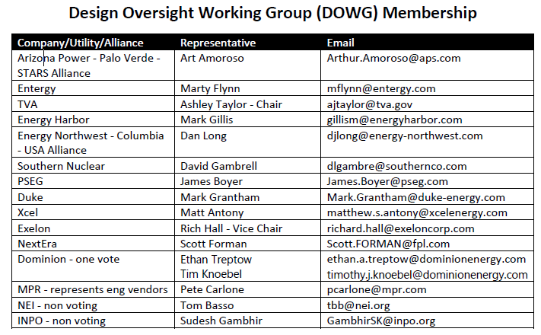

Slide 9
Future
IP-ENG-001 R3
Created subcommittee in last DOWG Meeting to address comments received to date
Send your comments to your DOWG Representative in the next few months to be considered in this revision
Database of Installation Specifications
Post-Mod Testing

