Slide 1
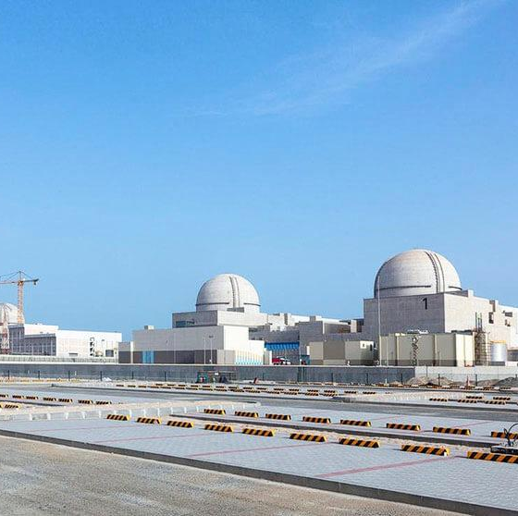
Configuration Management Operating Experience (OE)
Kent R. Freeland, P.E.
Principal Design Configuration Management Engineer
Barakah NPP
Abu Dhabi
United Arab Emirates

Slide 2
What is Operating Experience?
Experience:
“The only source of knowledge is experience.” – Albert Einstein
“What you get when you didn’t get what you want …” – Everybody else
Well, not quite … Operating Experience (OE) can:
Fine tune Machine and Human Performance in Nuclear Power
Reinforce Desired Behavior through “Storytelling”
Help Lead to Discovery & Solving of Problems in a Timely Manner
Leverage Industry-Wide Knowledge by Sharing of OE
Offer Learning Opportunities not Easily Obtained Otherwise
Turn Tacit into Explicit Knowledge for Knowledge Management

Slide 3
Sources of Operating Experience …
INPO – INPO 97-011, Operating Experience (OE) Program and Construction Experience (CE) Program Descriptions
IAEA – NUCLEUS & NS-G-2.11, A system for the Feedback of Experience from Events in Nuclear Installations IAEA Safety Guide
WANO - GL 2003-01, Guidelines for Operating Experience at Nuclear Power Plants

Slide 4
Operating Experience Examples that have Lack of Configuration Management as a Root Cause

Slide 5
Configuration Management at Nuclear Power Plants
Mature Operating NPP 1978 - Michigan, USA
Westinghouse 2-Unit Model 61 four-loop PWR plants, 1050 mW – Midwest USA
Situation
CM compliance issues found by INPO during license renewal review. The plant:
lacked drawing and document configuration with physical plant
lacked Master Equipment List (MEL) of plant components for design data
demonstrated incomplete tracking of design changes
lacked direct ties to design basis, particularly for key shutdown systems and SG blowdown
work orders could not be connected or assigned directly to a component
Apparent Causes
Lack method to synchronize drawing updates and plant changes with design changes/design basis or USNRC RG’s
Subsequent shutdown by USNRC after receiving INPO 4 Rating for loss of plant configuration management

Slide 6
Configuration Management at Nuclear Power Plants
Mature Operating NPP 1978 - Michigan, USA
Westinghouse 2-Unit Model 61 four-loop PWR plants, 1050 mW – Midwest USA
Remedies
Reorganized Engineering Department to include CM Department
Conducted partial DBR (Design Basis Reconstitution) by plant walkdown and document review
Purchased and deployed large nuclear-based enterprise ERP software for MRO and CMIS
Impacted license renewal progress and estimated to cost over $200M USD in fixes and lost generation revenue
Conclusion
Failure to recognize the key role of CM throughout life of the plant
Underestimated impact that loss of design integrity would impact INPO ratings and license renewal
Tremendous loss of revenue, time and manpower.

Slide 7
Configuration Management at Nuclear Power Plants
PHWR Shutdown and Restore 1971 – Ontario, Canada
CANDU 4-Unit Model 500 PHWR plants, 500 mW – Eastern Canada
Situation
Found in 1997 by regulators to have poor design control and virtually no supporting documentation for design changes:
triggered by upgrades being made to shutdown systems (CANDU 500’s do not have full-volume containment)
lacked Master Equipment List (MEL) of plant components and design changes history
demonstrated incomplete tracking of parts and component qualification and Q-Listing
basic loss of configuration management, plant changes, materials control and work control
Apparent Causes
Again, a lack of methods to synchronize drawing updates and plant changes with design changes and design basis
CANDU plants are a turnkey design from captive Designer and EPC (AECL/OPG), and thus CM compliance had less emphasis or perceived importance, similar to the Barakah design environment.

Slide 8
Configuration Management at Nuclear Power Plants
PHWR Shutdown and Restore 1971 – Ontario, Canada
CANDU 4-Unit Model 500 PHWR plants, 500 mW – Eastern Canada
Remedies
Major reorganization and financial losses to OPG triggered reorganization and government bailout
Conducted full DBR (Design Basis Reconstitution) by plant walkdowns, design basis, component parts and document reviews.
Deployed Asset Suite (Passport) MRO/ERP software for CMIS to populate Equipment and design data.
Impacted plant life through shutdown of all 8 Pickering units (4 to never restart), estimated $5B USD in CM and Materials projects, plant modifications, asset losses, plant closures and lost generation revenue. Forced OPG into deregulation.
Conclusion
Assumption that smaller nuclear power plants do not require the features or diligence that larger units have (such as containment, etc.) including a rigorous CM program
Tremendous expenditure of resources and impact on company viability.

Slide 9
Configuration Management at Nuclear Power Plants
Nuclear Power Plant under Construction 1987 – Texas, USA
Westinghouse 2-Unit Model 61 four-loop PWR plants, 1200 mW – Southwest USA
Situation
After nearly 10 years of construction, it was discovered at 80% completion that virtually no drawings or design data existed that reflected the true plant physical equipment content; there was virtually no FCI that represented the plant configuration.
lacked drawing and document configuration with physical plant
lacked Master Equipment List (MEL) of plant components for design data
Could not show cohesive design basis or plant design to investors, regulator or other stakeholders
Apparent Causes
Owner changed EPC and A/E firms twice during construction
No Configuration Management program for construction by EPC
Owner deferred all responsibility for CM to EPC and constructor with little oversight

Slide 10
Configuration Management at Nuclear Power Plants
Nuclear Power Plant under Construction 1987 – Texas, USA
Westinghouse 2-Unit Model 61 four-loop PWR plants, 1200 mW – Southwest USA
Remedies
Required reconstitution of complete plant design by the third EPC and Engineer, mobilizing 3,000 engineers to reconstitute design, drawings and physical plant – basically redesign the plant on paper.
Previous EPC released with litigious compensation and damage settlements.
Caused 5-year delay in plant completion and commissioning.
Contracted CM restoration management and software to expensive consultants at high cost.
Conducted full DBR (Design Basis Reconstitution) by painstakingly plant walkdown, design review and document updates
Developed basic MRO and CMIS software repository and software solution.
Impacted plant completion and commissioning by 5 years; loss estimates go to $5B+ USD on top of $3B+ already invested (1980’s dollars).
Conclusion
Rivaled the Airbus A380 CM legend for expense, lost time, delays and damage to reputation

Slide 11
Thanks for Attending CMBG 2021!
Questions …?

