Slide 1
50.59 & 72.48 Standardization Review and Digital Implementation
July 13, 2022

Slide 2
Background/Definitions
10 CFR 50.59 “Changes, Tests, and Experiments”
Establishes the conditions under which licensees may make changes to their facility or procedures and conduct tests or experiments (collectively referred to as activities) without prior Nuclear Regulatory Commission (NRC) approval
10 CFR 72.48 “Changes, Tests, and Experiments”
Establishes the conditions under which an Independent Spent Fuel Storage Installation (ISFSI) licensee, Monitored Retrievable Storage (MRS) installation licensee, or a spent fuel storage cask certificate holder may make changes to the ISFSI facility, MRS, spent fuel storage cask design, or procedures; and conduct tests or experiments without prior NRC approval
Additional Information:
10 CFR 50.59 and 10 CFR 72.48 review processes identify the threshold for which a regulatory (NRC) review is required.
Review under the 50.59 and 72.48 processes are not a final determination of Safety for the proposed activity.

Slide 3
US Industry Guidance for Implementation
Additional Information:
The Nuclear Energy Institute (NEI) is the policy organization of the nuclear technologies industry including plant operators and many other stakeholder organizations.
Regulatory Guides 1.187 and 3.72 both endorse NEI guidance with exceptions and clarifications.
10 CFR 50.59 “Changes, Tests, and Experiments” (Plant/Facility Changes)
Regulatory Guide 1.187, Rev. 3 (Issued June 2021) endorses NEI Guidance per NEI 96-07, Rev. 1 as generally acceptable for use
NEI 96-07 provides guidance for implementing 10 CFR 50.59 by establishing clear definitions and criteria for evaluating when NRC approval is required
10 CFR 72.48 “Changes, Tests, and Experiments” (Spent Fuel Storage)
Regulatory Guide 3.72, Rev. 1 (Issued September 2020) endorses NEI Guidance per NEI 12-04, Rev. 2
NEI 12-04 provides guidance for implementing 10 CFR 72.48 and was prepared to ensure fidelity with guidance provided for 10 CFR 50.59

Slide 4
What does the Guidance tell us?
Applicability Determination
Allows licensees to know what criteria excludes an activity from being screened further
When elements of an activity fall under another program/regulation, the elements that do not fall under that program are evaluated per 50.59/72.48
Screening
Provides the criteria to assess whether the activity is adverse through screening questions (i.e., Is the change adverse?)
Evaluation
Identifies eight (8) criteria that must be addressed to evaluate the effects of a proposed activity (i.e., How adverse is the change?)

Slide 5
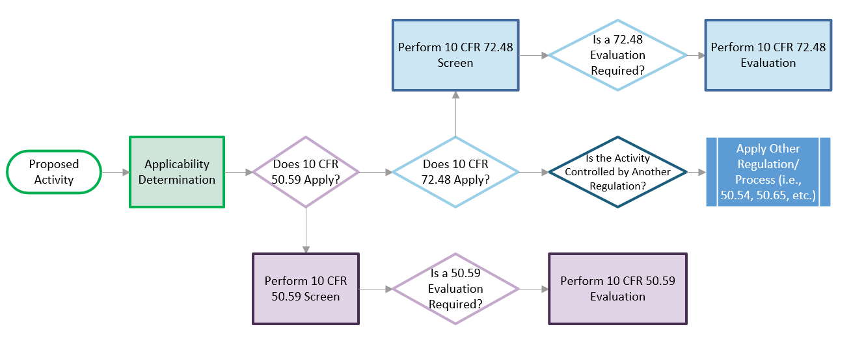
Summarized Process

Slide 6
Can we Create a Common Form?
To determine what is feasible, we evaluated all applicable forms for (3) three different utility processes covering:
Applicability Determination
50.59/72.48 Screen
50.59/72.48 Evaluation
Our review identified common themes / sections across all of the forms
However, utilities have made commitments to the NRC in terms of how responses are generated or have administered their processes in a way that suits their own program(s), which makes each form unique
We believe that adopting the exact same form across all utilities isn’t feasible in the short-term, but that a common design could allow all forms to be configured on a per-utility basis digitally using a common software structure

Slide 7
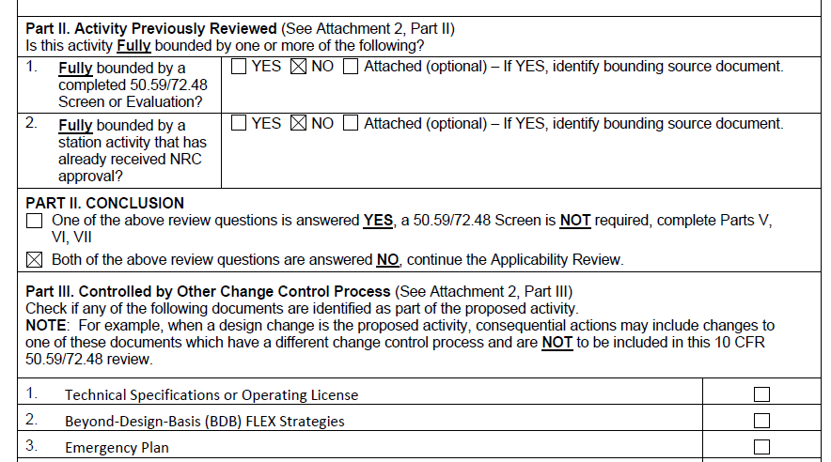
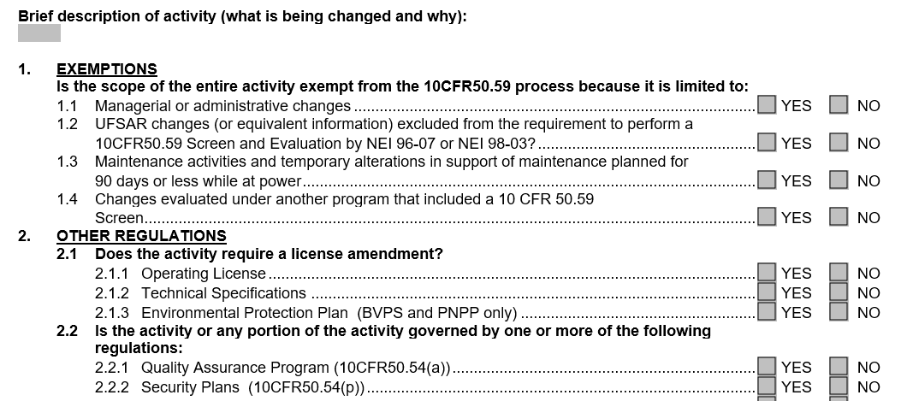
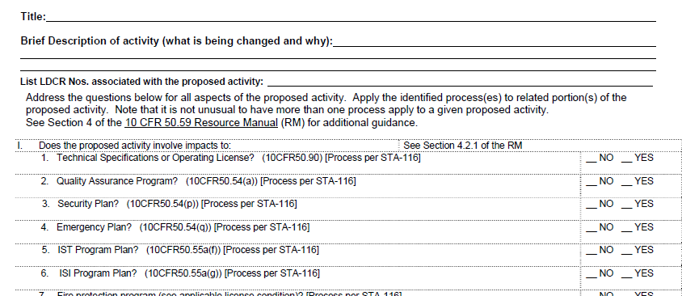
Applicability Determination
Header information is generally common
Title
Initiating Activity
Brief Description
Forms vary in format, but are generally questions with fixed responses (Yes, No, N/A, See attached, etc.)
Digital Form would include:
Header Information
Configurable Questions with Custom Header / Topic Text
Database configured with valid responses per question / set of questions
Ability to configure whether questions have responses which are multiple choice, completion, or a combination

Slide 8
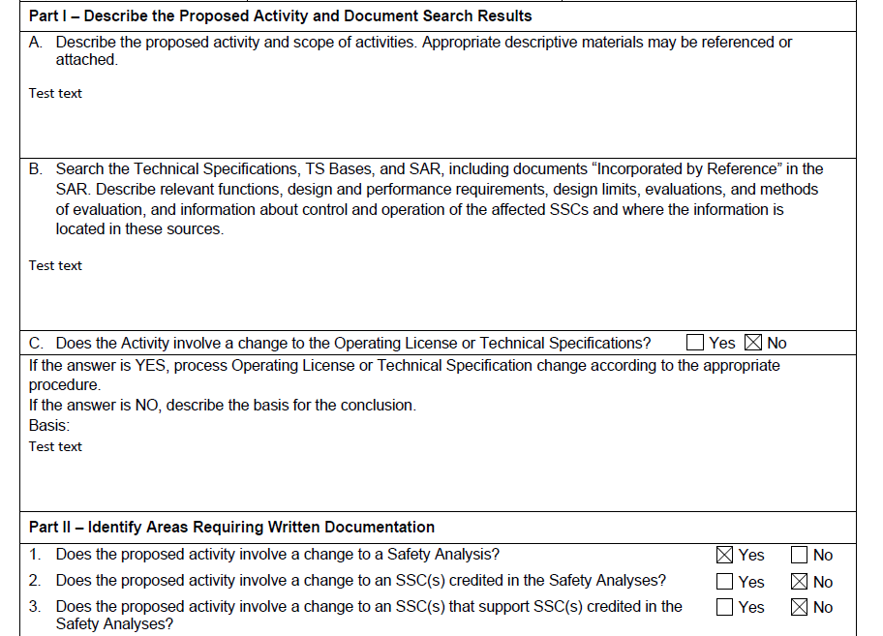
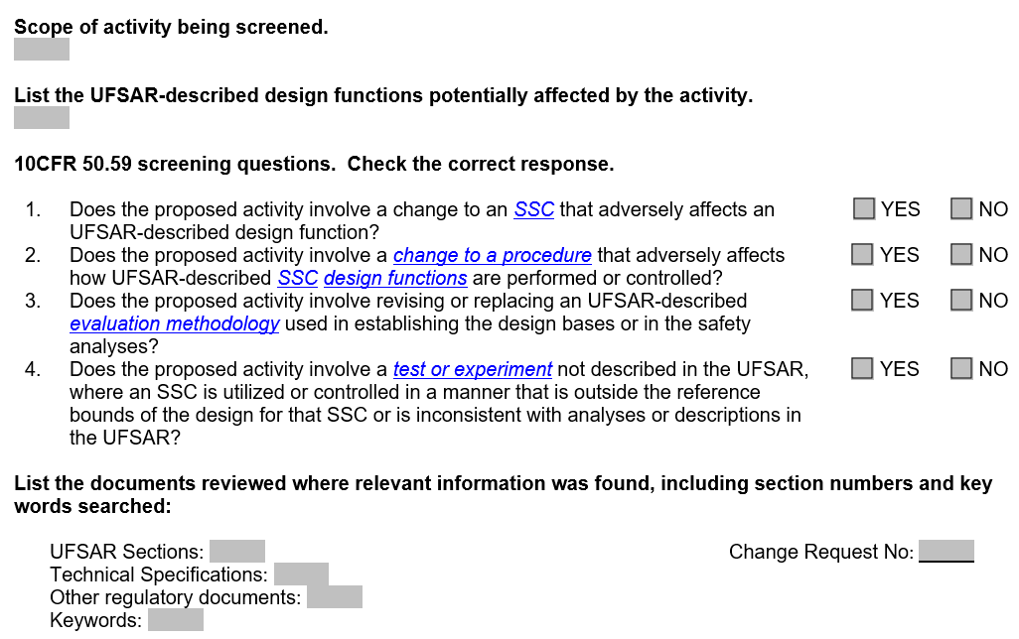
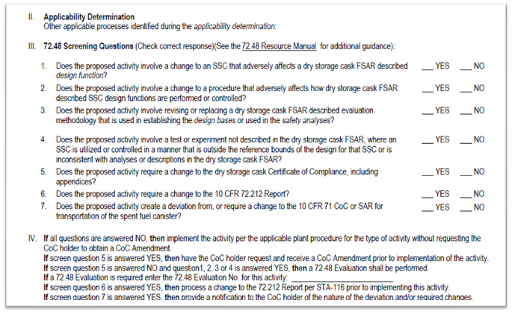
50.59 / 72.48 Screening
Some Utilities have combined 50.59/72.48 Screening into the same form, others have kept them separate
Screening questions are not exactly the same in all cases (added question for DBLFPB)
One utility added Evaluation Questions (Yes/No) to the Screening Form for Preparer to consider
Digital Form should take a similar approach as Applicability Determinations
With the expectation that this form should support longer responses and/or attachments due to the engineering rigor required

Slide 9
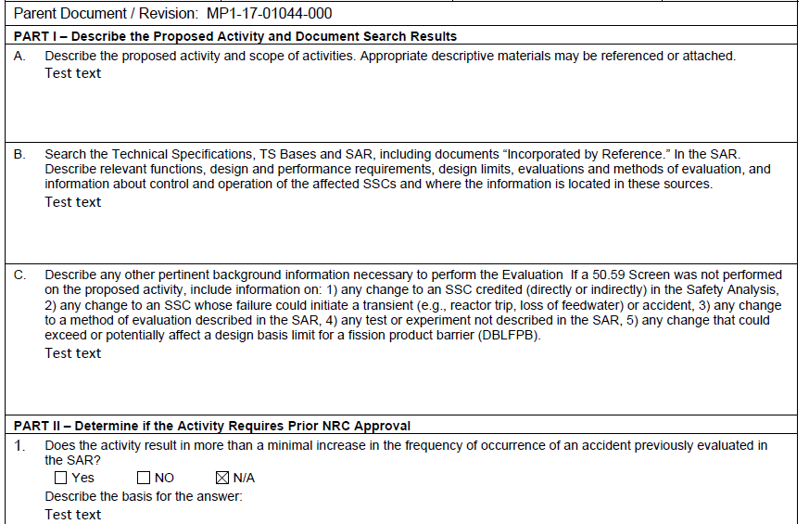
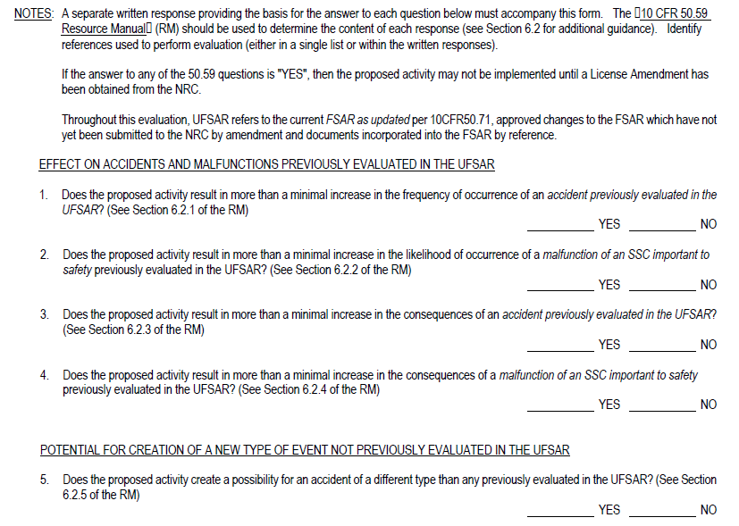
50.59 / 72.48 Evaluation
Generally, these forms were the most similar to each other
Description of activity
Screening questions
Approvals
Differences between the utilities included:
What signatures required? (Review Board / Meeting, Regulatory Affairs, etc.)
Signatures on first page per an Executive Summary or at the end?
Risk Reviews captured directly on the form?
Digital Form to be modularized to cover the different form structures while allowing the same overall content to be covered

Slide 10
Conclusion
Full Standardization is not recommended due to utility commitments and administration of the Industry Guidance (NEI 96-07, NEI 12-04)
Industry forms are similar enough to support standard software solution and approach
Common form and approach would facilitate easier reviews during NRC Audits of 50.59 / 72.48 Programs
Standardization could reduce training required for EOC’s or if personnel switch positions between utilities
Even with the differences on a per utility-basis, there would be value in benchmarking and sharing work in this area with the appropriate controls in place due to the underlying industry guidance being applied

Slide 11
Questions?
Matthew.Yarlett@Westinghouse.com

