Slide 1
Engineering and Configuration Management Update to CMBG
Scott Hawn,
Manager – Engineering
CMBG October 21, 2020

Slide 2
ENGINEERING (4N)
Scott Hawn, Department Manager
SECONDEE/LIAISON ENGINEER
Justin Grove, Assistant Department Manager
Kiesha Lunceford, Admin Coordinator
PERMANENT EMPLOYEES
LOANED EMPLOYEES
Sudesh Gambhir
Ray George
Kevin Aucoin STP
Dave Bartlett
PSEG
Jim Brown TVA
Rick Harb Constellation
Brian Kern
Martin Nganga
Samuel Nakamine
TVA
©2022 Institute of Nuclear Power Operations
Updated January 2022

Slide 3
Agenda
2022 Focus Areas:
Nuclear Fuel Reliability
Consequential Engineering Error Reduction
Intake Cooling Water Blockage
AFI Trends
Resiliency

Slide 4
Fuel Reliability

Slide 5
2022 Focus Areas – Fuel Performance
Improving Fuel Performance (key industry issue)
IER L2-19-6, Preventing Debris-Induced Fuel Failures
Reviews during Plant Evaluations/Peer Reviews for failed fuel response
Fuel Integrity Review and Assist Visits
Discussed at various Industry Meetings
Notes:
“Prevention” of Foreign material intrusion into open systems, pool or reactor cavity, and due to internal system degradation will be focused on. Maintenance will be assisting in these reviews, where applicable.
Team review approach during plant evaluations, as TC applies to all departments making technical decisions

Slide 6
Fuel Reliability - Current State
Seven Active Fuel Failures
Six BWRs / One PWR
Four of the BWRs have had a failure within the past 5 years.
Fuel Reliability Goals
Achieve = 95% currently failure free
Sustain = 90% operate failure free for > 2 cycles
94% of PWRs meet goals
48% of BWRs meet goals
Outliers - Seven BWR units contributed to roughly 33% of fuel-failure cycles for the industry in the past 6 years.
Notes:
“Prevention” of Foreign material intrusion into open systems, pool or reactor cavity, and due to internal system degradation will be focused on. Maintenance will be assisting in these reviews, where applicable.
Team review approach during plant evaluations, as TC applies to all departments making technical decisions

Slide 7
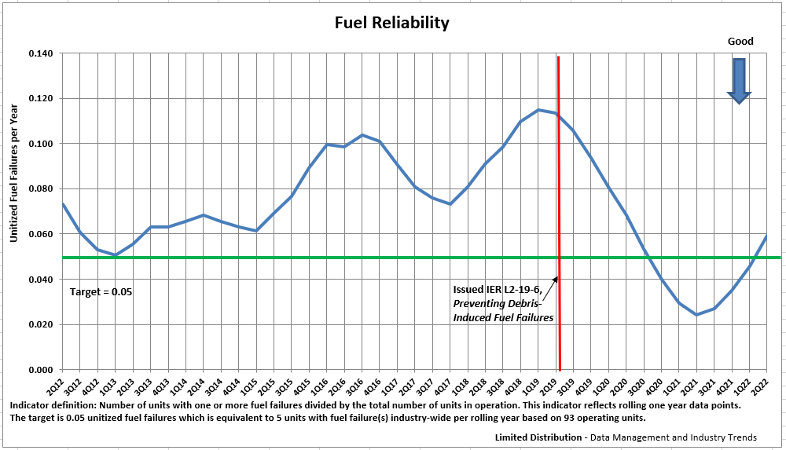
Recent uptick in poor performance

Slide 8
Fuel Reliability – Next Steps
BWR industry webcast held May 18, 2022
BWR industry steering committee formed and met June 8-9, 2022 at INPO
Engineered feature survey for BWRs
BWR fuel reliability heat map
Identifying best practices for BWR strategies to achieve and sustain high levels of fuel performance

Slide 9
Consequential Engineering Events

Slide 10
Consequential Engineering Events
Goal - Reduce the unitized Engineering Consequential Events (ECEs) per year to 0.21 in 2022. The target is 0.21 unitized events per year is equivalent to 20 industry-wide events.

Slide 11
Challenges
Reclassification of components as part of Value-Based Maintenance
Not recognizing passive SPVs
Inadequate review of risk associated with field changes
Not addressing degraded conditions in a timely manner
Stakeholder engagement

Slide 12
Initiatives for Reducing Consequential Errors
Issued INPO IER L2-21-04, Improving Plant Reliability
Issued Engineering Warning Flags – linked to INPO 19-003, Staying On Top values
Issued WELL Sheet for Proficiency
Other Initiatives
SCRAM reduction, AC Power Reliability, Program Management Effectiveness
Notes:
These activities can affect Technical evaluation preparation, reviews of evaluations, and organizational standards for performance of engineering tasks
Project Review Visits (PRV): For stations that are undertaking significant projects, review visits will be scheduled to provide an independent check that lessons learned from IER 14-20 Rec-3 are being appropriately applied. The intent is to be proactive in helping member stations in avoiding significant technical errors and consequences
Managing projects with enterprise risk. Completed three (WC, FCS and Prairie Island) Major/FOAK modification, consequence, etc.
EN vendor oversight and support Vendor/owner transparency, project manager proficiency, etc.
Technical conscience health
Technical conscience Review Visits (TCRV): The intent is to intervene in the early stages of decline to prevent or minimize the number of consequential events by identifying faint signals for the stations that may be showing weaknesses in Technical Conscience. Completed one (PSEG) -Technical decision weaknesses
Design Basis Review Visits (DBRV): The intent is to prevent consequential events and loss of regulatory margin because of weak understanding and maintenance of the design and licensing requirements. These review visits will focus on performance objective defined in CM.1 and lessons learned from IER. Planned – Columbia, Palisades, Salem
Columbia Design Basis Review Visit – Because of performance issues identified during the last evaluation, Columbia is considered vulnerable to consequential events and loss of regulatory margin because of weak understanding and maintenance of the design and licensing requirements. Working with the station leadership team a one-week review visit is scheduled for August 3, 2015.
Palisades: Not designed to SRP, pre-GDC, Weak engineering, high engineering leadership turnover and design engineering personnel. No power uprate recent scrutiny in design basis area by NRC or others.
Salem 1&2: Not designed to SRP, pre-GDC, Weak engineering, high engineering leadership turnover and design engineering personnel. No power uprate recent scrutiny in design basis area by NRC or others. Last plant evaluation identified weaknesses in technical conscience.

Slide 13
IER L2-21-4 Gap
Over the past three years, there have been several consequential events each year because of equipment malfunctions or failures
IER Purpose
Improve plant reliability and minimize precursors to more serious events by:
Renewing our focus on reducing equipment-related consequential events
Bottom Line: The IER is about changing the culture and strengthening the intolerance for equipment failures.

Slide 14
IER L2-21-4 Recommendations
This IER has been developed as a cross-functional industry concern
The industry actions are to be developed with a cross functional approach
Each station will be evaluated, in a cross-functional approach
INPO recommendations owners have been assigned to multiple departments

Slide 15
Event Analysis: Key Drivers
Risk recognition and reduction
Workers and first-line leaders not recognizing risk when performing tasks
Decision-making
Corporate and site leaders not driving consequence-bias behaviors
Vendor and supplemental personnel oversight
Utility oversight not identifying deficiencies
Sustainable Parts Quality Process
Corporate and site leaders not resolving vulnerabilities in procurement, inspection, testing and storage
Notes:
15 of 24 are tied to Risk Recognition
2 Critical thinking

Slide 16
L2 IER: Recommendations
Set Direction for Cross-functional Solutions
Apply Continuous Learning
Improve Self-awareness and Self-correction to Prevent Consequential Events
Conduct analysis
Periodic trending
Understand drivers for events
Training performance analysis when appropriate
Strengthen Risk Recognition and Elimination when Preparing and Performing Tasks
Cross functional evaluations of PMs
Risk reviews of design changes
Work documents include risk evaluations

Slide 17
L2 IER: Recommendations
Enhance Risk Elimination Bias in Decision-Making
Validate Sustainable Parts Quality Process
Establish High Standards in Vendor and Supplemental Personnel Oversight
Design/Engineering Products
Field Work
Notes:
Plant modifications at Zebra sites have contributed to the industry events cited in the IER.
These events have been caused by:
Lack of thorough risk identification (4c),
Inadequate actions taken to address identified risk (4C)
Inadequate vendor oversight. (Rec 7)
Lack of stakeholder engagement/recognizing proficiency gaps

Slide 18
Next Steps
Industry to submit responses:
Required: February 22, 2022
Conduct Industry Response Reviewer Training
Expected to complete: February 2022
Conduct Recommendation Evaluation Training
Expected to complete: March 2022
Response Reviews Completed by INPO
Expected to complete: March 2022
Functional Areas Present Status at Industry Meetings
Expected to Complete: June 2022
Begin Recommendation Reviews/Evaluations
Begins: January 2023

Slide 19
ERCE Recommendation Review
REC | OWNER | Summary for IRIS Coding | Number of IRIS records tagged
1 | OR | Inadequate cross-functional behaviors | 1
2 | OR | Inadequate use of OE and industry best practices | 1
3a | ER | Inadequate vulnerability identification | 6
3b | ER | Inadequate trending | 2
3c | OR | Inadequate CAP | 1
3d | TR | Inadequate training | 0
4a | OP, OF | Inadequate MA (Work instructions quality, Risk step oversight) Inadequate decision-making | 5
4b | ER | Inadequate PMs | 9
4c | EN, CM | Inadequate design changes | 1
5 | OR | Inadequate decision-making | 1
6 | ER | Inadequate parts quality | 2
7a | EN, CM | Inadequate vendor performance | 3
7b | MA, WM | Inadequate supplemental worker performance | 1

Slide 20
Engineering AFI Trends

Slide 23
Engineering Gaps To Excellence
Engineers do not demonstrate critical-thinking skills to identify operational risks
Engineers are not thoroughly assessing equipment failure modes
Engineers provide inaccurate or insufficient information to decision makers

Slide 24
Engineering Excellence Themes
Strong culture of recognizing and mitigating risk
Engineers empowered to close gaps
Strong culture of advocacy
Opportunities to acquire knowledge and improve skills
Culture of innovation
Strong operational focus
Development of critical thinking and decision-making skills

Slide 25
Engineering Leader Excellence
Influence the Organization
Own Plant Technical Issues
Protect the Engineering Process
Create a Culture of Challenging Decisions, Assumptions, Analyses
Insist on Cross-functional Engagement
Foster a Culture of Continuous Learning
Notes:
95% of your assets walk out the gate every day.
How do you ensure that you have right capacity and capability to prevent, detect and handle problems of an aging fleet?
IER 14-20 : Cause week TC throughout the organization
Millstone example on design basis

Slide 26
Steady, Consistent Pressure

Slide 27
Looking Forward - Resiliency

Slide 28
INPO Strategy
Industry Great Challenge 1: Uneven and outlier performance – some chronic
Failure to recognize or effectively address causes of events – preventing consequential events
Site and Corporate Leadership that is unresponsive to, or incapable of closing performance gaps – correcting weak performance
Supplemental products and services that fall short of industry standards – consistently delivering high quality service and parts
(New) Lack of a comprehensive approach to address resiliency vulnerabilities ― improve defenses against external forces
Notes:
2030 End States:
* Staying on Top culture is deeply embedded
* Significant reduction in consequential events
* Significant improvement in bottom quartile industrywide Performance Indicator Index (PII)
* Teaching and learning excellence achieved

Slide 29
Improve defenses against external forces
Focus on four shaping initiatives:
Set Standards
Measure and Compare Performance and Sustainability
Facilitate Continuous Improvement
Self Regulatory Authority

Slide 30
Questions?

