Slide 1
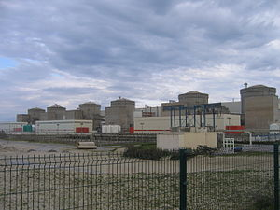
Knowledge Transfer Benchmarking for Nuclear Power
Kent R. Freeland, P.E.
Consulting Engineer
AREVA

Slide 2
What is Nuclear Knowledge?
Engineering and Scientific Facts
Industry-Wide Knowledge and OE
State Regulator Requirements
Research and Advisory Organizations (EPRI, INPO, IAEA)
Experience (OE) of Owner/Operator Staff
EPC, Vendor and Supplier Information and Tacit Knowledge of Construction. Components, Processes and Services
Knowledge Management Program and Infrastructure

Slide 3
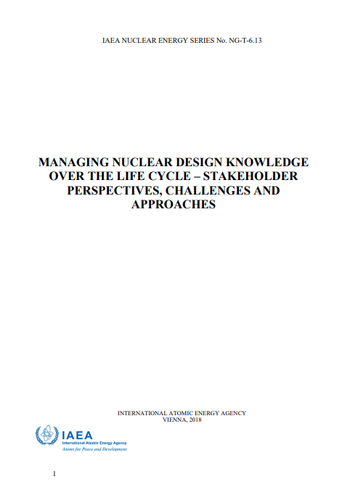
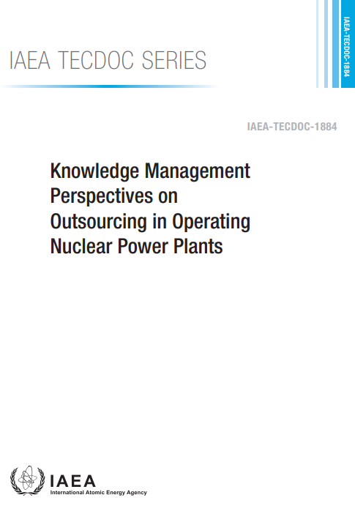
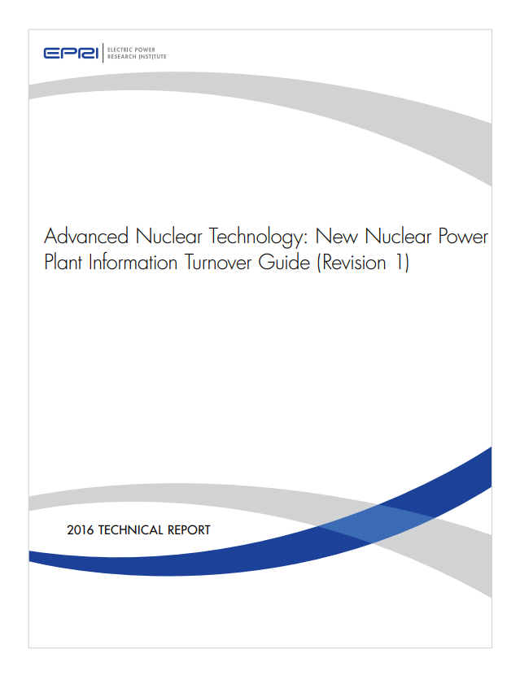
Industry References …
IAEA TG-6-13
IAEA TECDOC-1884
EPRI Handover/Turnover Guide

Slide 4
Why is Knowledge Transfer Important?

Slide 5
Nuclear Knowledge Must Transfer to Owner Operator …
Nuclear Equipment, Processes and Requirements are special and unique – only a small number of engineering suppliers and workers understand the construction, licensing and operation of NPP’s.
The Owner/Operator must understand the plant because it is the legal license holder, not the constructor or vendor, and the O/O is ultimately responsible to the regulator and public for safe and reliable operation.
This requirement competes with the opposing desire of the supplier or constructor to guard and preserve as much of their Intellectual Property and Proprietary Processes as possible (“Trade Secrets”).
In addition to this, many nations view their nuclear knowledge as a strategic resource or security issue, and are reluctant to release nuclear knowledge to foreign operators, even if they are under binding treaties, contract agreements or NDA’s.

Slide 6
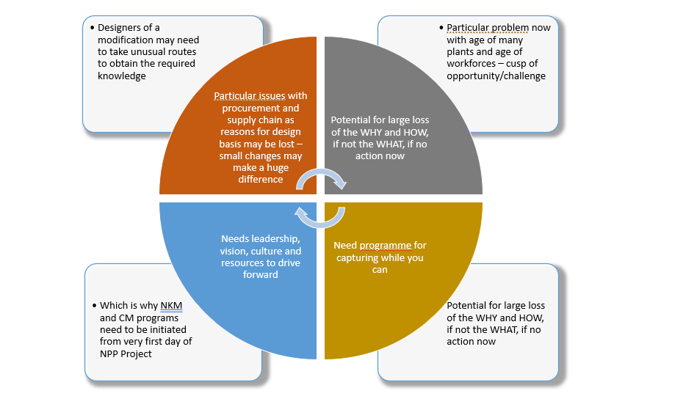
Why is Knowledge Transfer Important?

Slide 7
Types of Nuclear Knowledge Transfer: Some will be more difficult to obtain than others …
Many of these data types are operational and will change over plant life, but must be available in a baseline configuration. Suppliers can be reluctant to provide for commercial reasons, keeping them internal against future NPP work.
Design Requirements and Criteria in detail above the minimum PSAR requirements for issue of construction license.
EPC design documents, drawings, alarm setpoints and calculations. Many of these may no be specifically scheduled in the commercial contract or agreements.
Construction Work Order data to establish precise baseline plant configuration management at commissioning or other freeze points.
Procurement and parts specifications, qualification, approved spares lists and stock history.

Slide 8
What Hinders Nuclear Knowledge Transfer?
Owner Operators and Electric Utilities often do not develop detailed contract terms in the areas of Design Engineering Knowledge Transfer or Configuration Management during bidding and proposal periods of the new NPP construction.
Constructors and EPC’s often use proprietary (and old) software and databases to track construction progress, parts and cost.
Data may be turned over to the Owner at turnover or plant commissioning, but often cannot be utilized well due to software incompatibility and varying Owner IT infrastructure.
Equipment and performance data from EPC and suppliers, in any event is purely history at that point and serves little configuration management benefit.

Slide 9
What is Special about Nuclear Knowledge Sources?
Even the most mature and experienced NPP operators outsource and contract the bulk of the design and construction of each plant.
At most the utility or operator may act as their own “Owner’s Engineer” to assist in design review and knowledge capture, but this still requires the cooperation of the external design and supply organizations.
Nuclear suppliers and service providers are particularly protective of their intellectual property (as they interpret this) and thus access to knowledge may also rely on tacit knowledge shared by nuclear professionals in the Owner’s employ or other sources.

Slide 10
Establishing Sustainable Knowledge Transfer Processes and Relationships
Understanding the long-term knowledge and information needs of the new NPP, major outsourced design changes or component procurement changes, in order to answer the next item …
EPC and supplier contracts should require transfer of all required drawings, schematics, data, testing and qualification documents based upon a thorough review of design knowledge needs.
Consider usefulness of design knowledge and the media used to deliver. For example, 3D model turned over from designer has little value if the Owner does not have CADD and design ability to maintain the model.

Slide 11
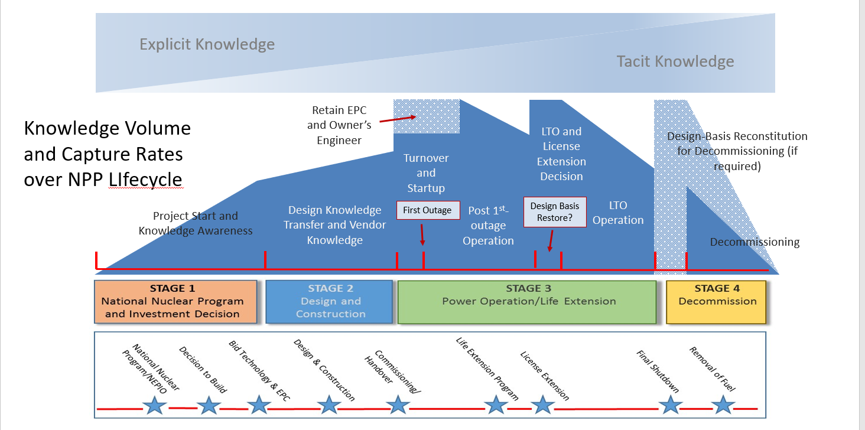
Establishing Sustainable Knowledge Transfer Processes and Relationships
Potential Knowledge Loss

Slide 12
Thanks for Attending CMBG 2022!
Questions …?

