Slide 1
North American Young Generation in Nuclear
Aleisha McAteer, Account Engineer
Westinghouse-Pittsburgh Chapter President

Slide 2
What Drives Us
Our Vision
Developing leaders to energize the future of nuclear
Our Mission
NAYGN provides opportunities for a young generation of nuclear enthusiasts to develop leadership and professional skills, create life-long connections, engage and inform the public, and inspire today’s nuclear technology professionals to meet the challenges of the 21st century.
2022

Slide 3
Our History
Founded in 1999 by seven young professionals
Targeting professional development, public information, knowledge transfer, recruiting and networking opportunities
Over a hundred local chapters facilitated by a board of directors affectionately known as The Core.
The organization has conducted hundreds of thousands of hours of activities to educate the public and provided development opportunities at the local, regional, national and continental level.
2022

Slide 4
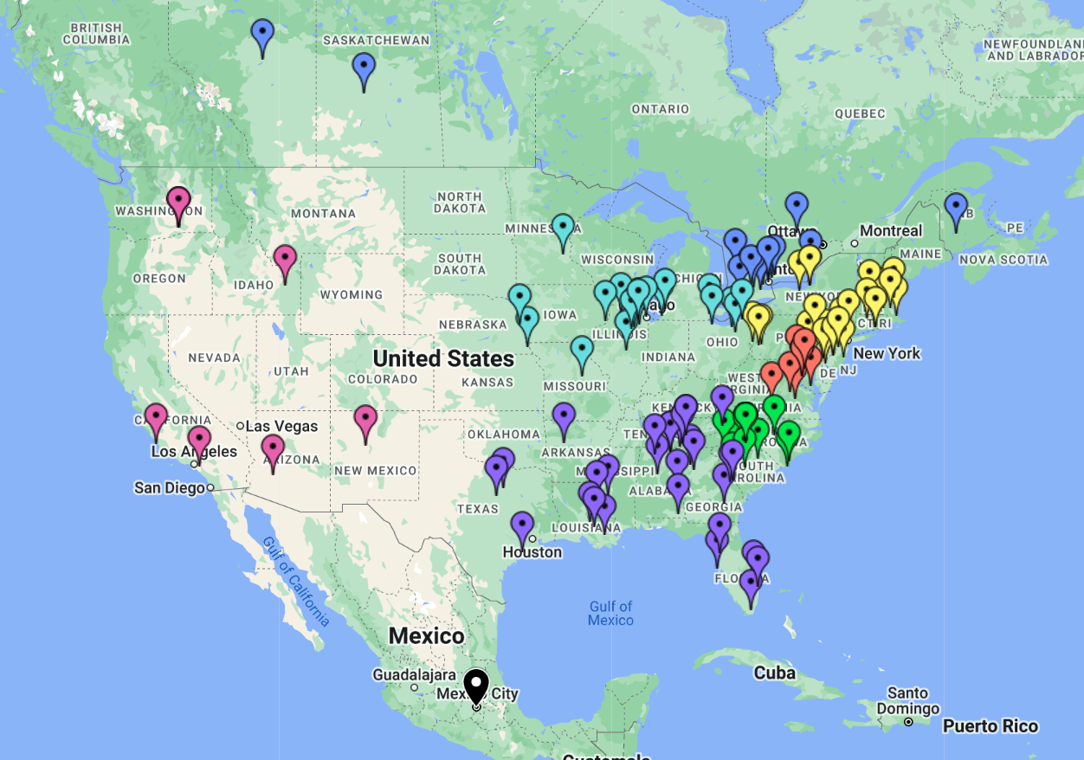
Over 100 NAYGN Chapters
2022

Slide 5
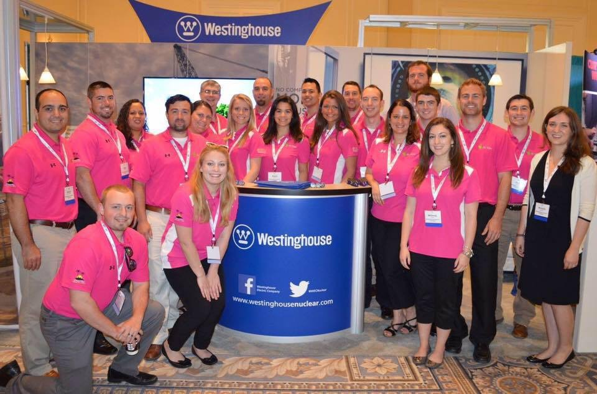
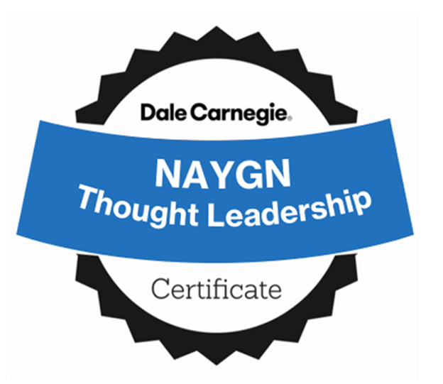
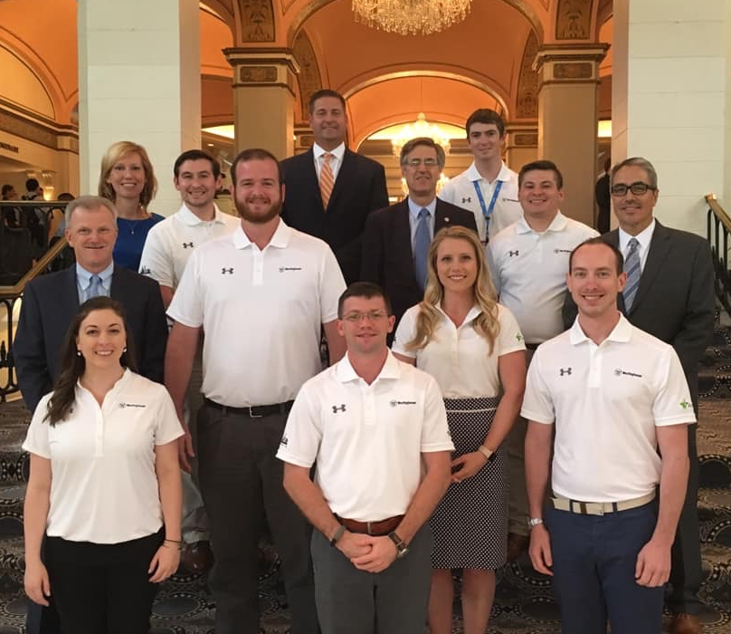
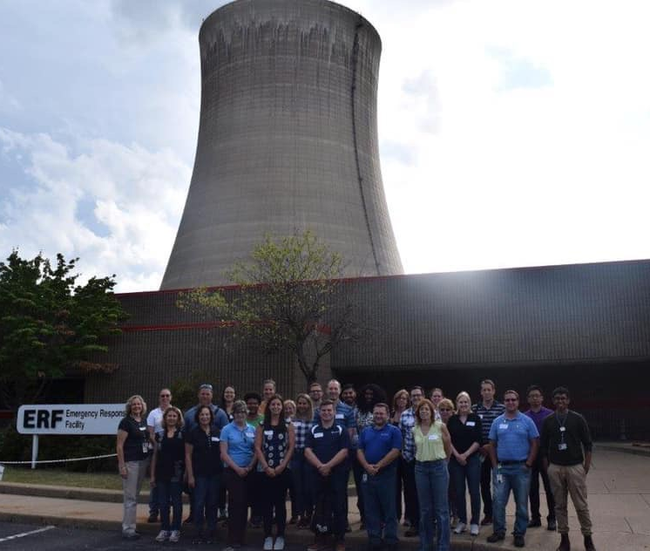
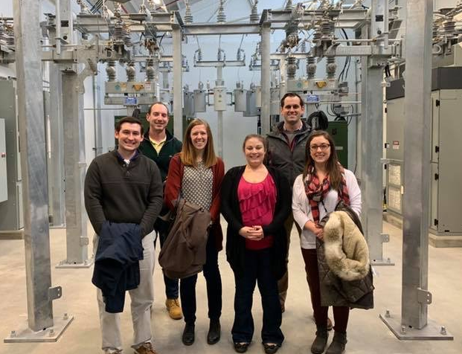
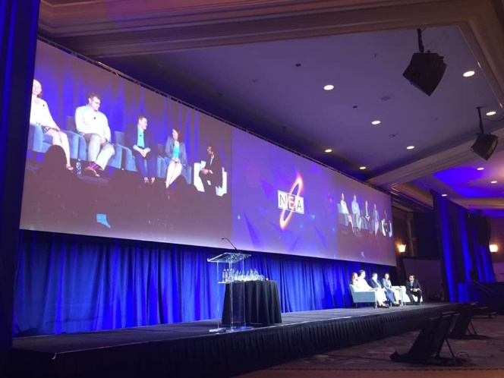
Professional Development
2022

Slide 6
Mentorship and Knowledge Transfer
Local chapter mentorship
National Atomic Mentoring Program
Founded by Duke Energy chapter
Twelve-week program with four components
One-on-one mentoring meetings
Job shadowing
Task-based leadership activity/project
Pay It forward
2022

Slide 7
NucLEADers
Founded by Westinghouse-Pittsburgh Chapter in 2021
2020 career survey requested more PD training
National focused on communications and leadership training
Two ‘badges’ for each grouping of courses
Cohort connector sessions
Application project
20 NucLEADers in 2021, second cohort launches July 2022
Nominated for Top Industry Practice Award & GWSA
Do you have what it takes to be a NucLEADer?
2022

Slide 8
NucLEADers
2022

Slide 9
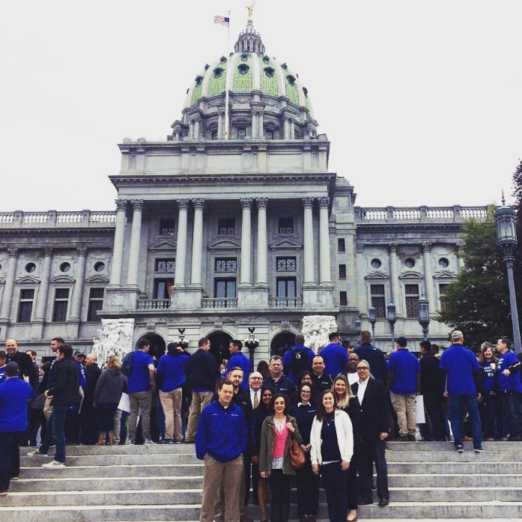
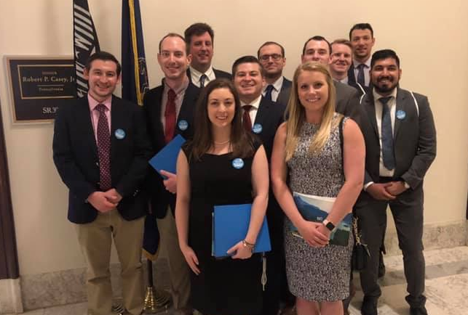
Clean Energy Advocacy
2022

Slide 10
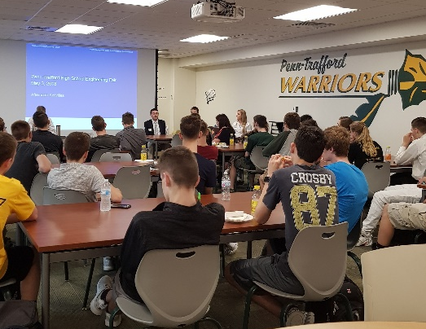
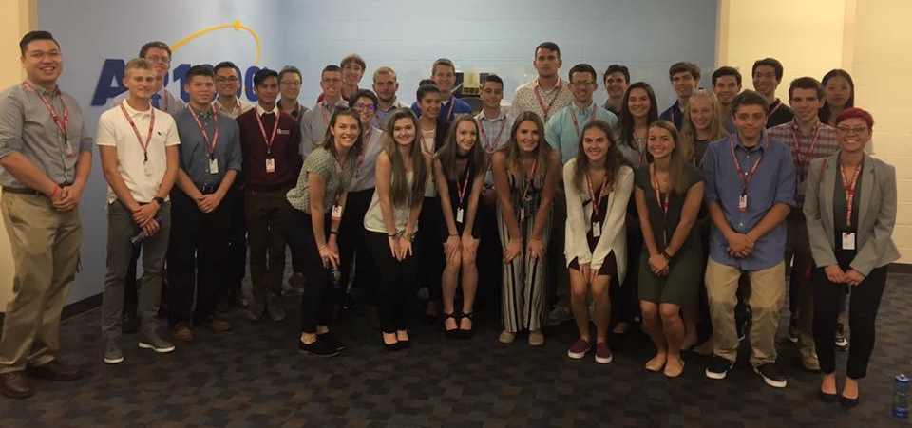
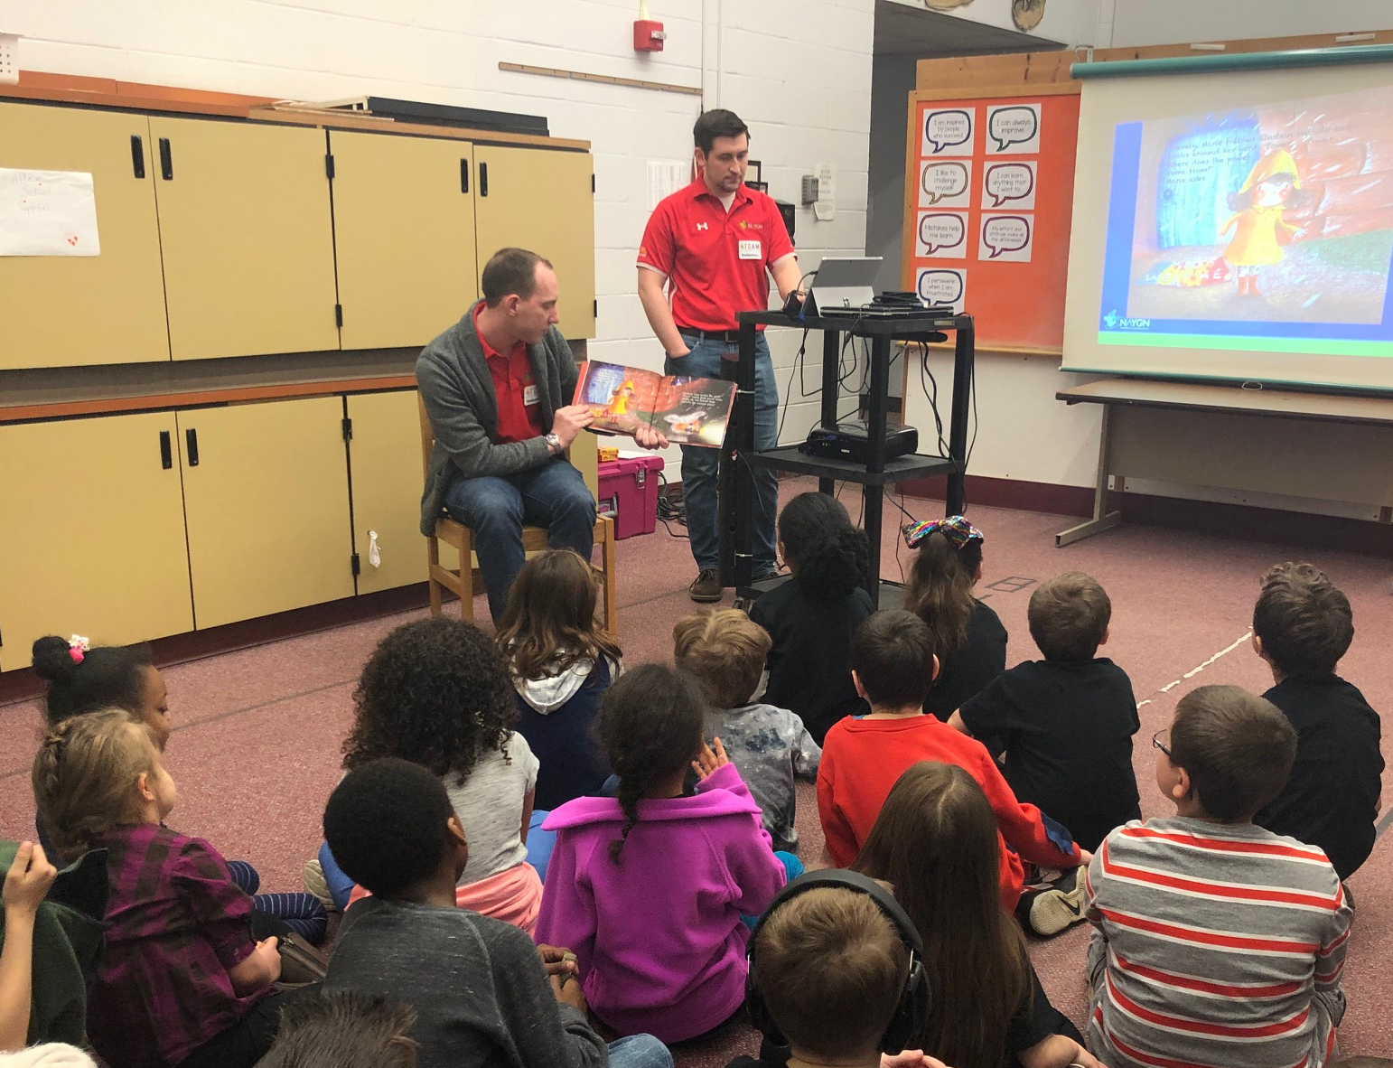
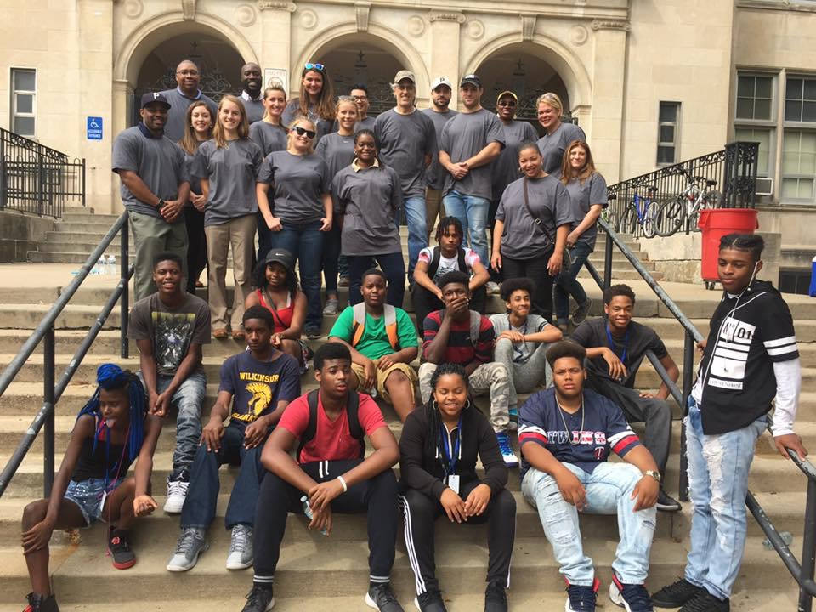
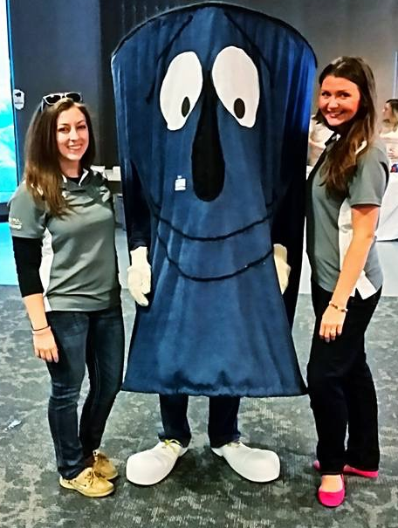
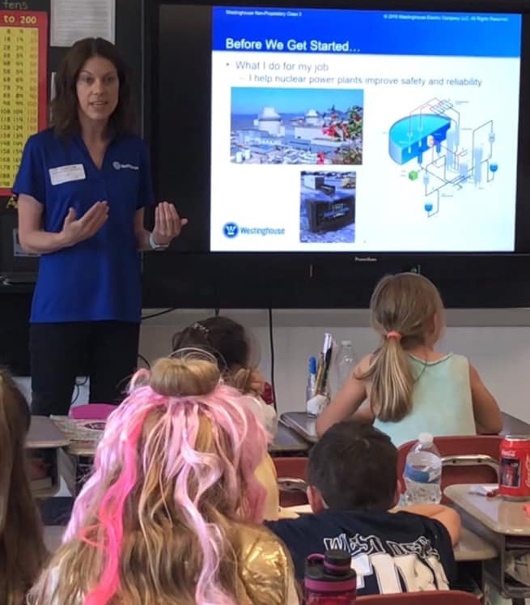
Community Outreach
2022

Slide 11
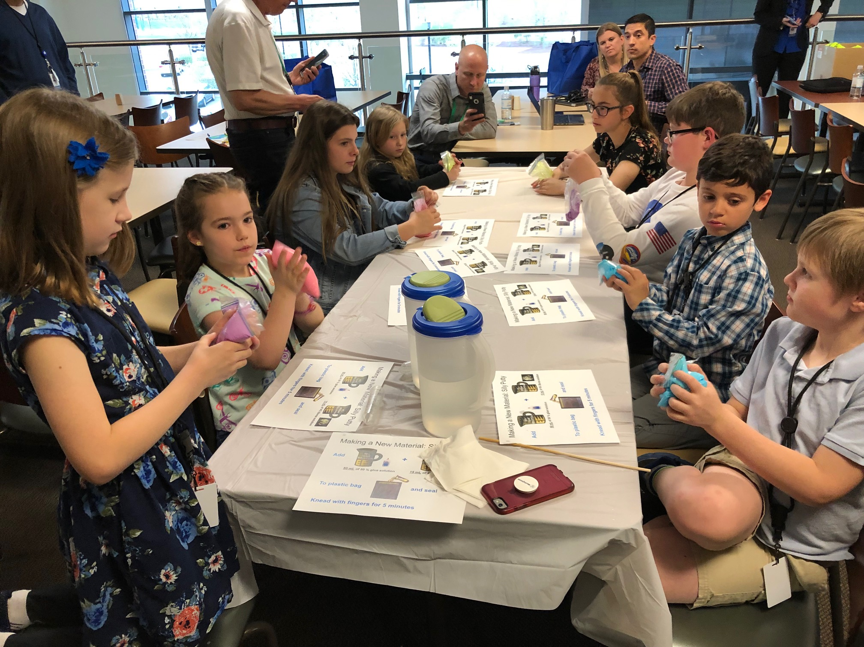
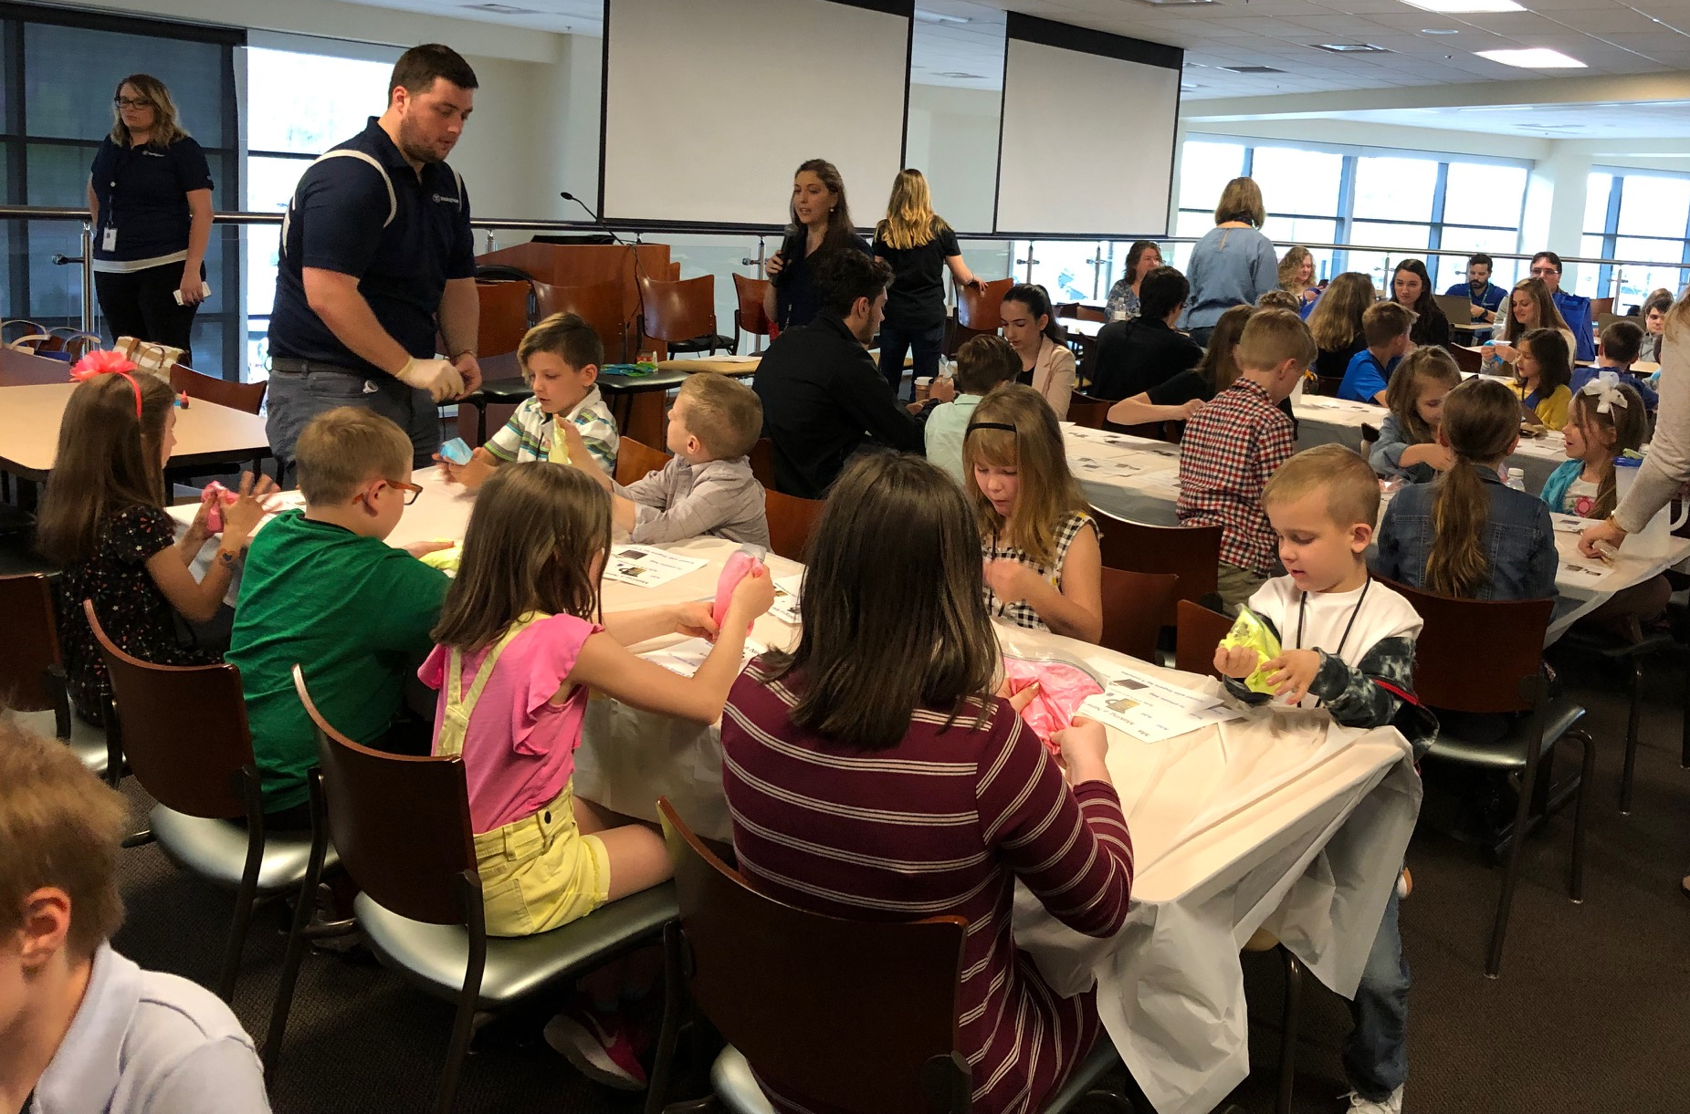
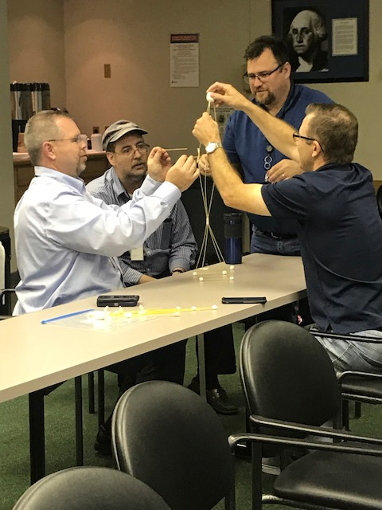
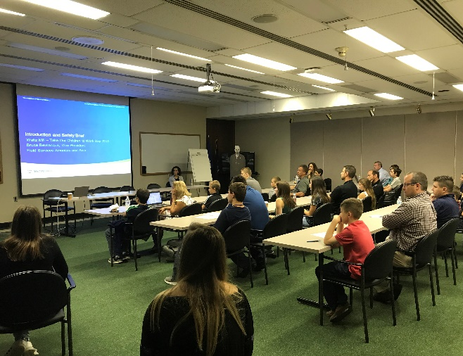
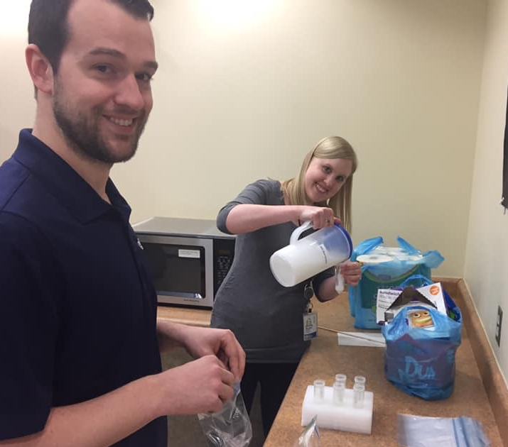
Take Our Children to Work Day
2022

Slide 12
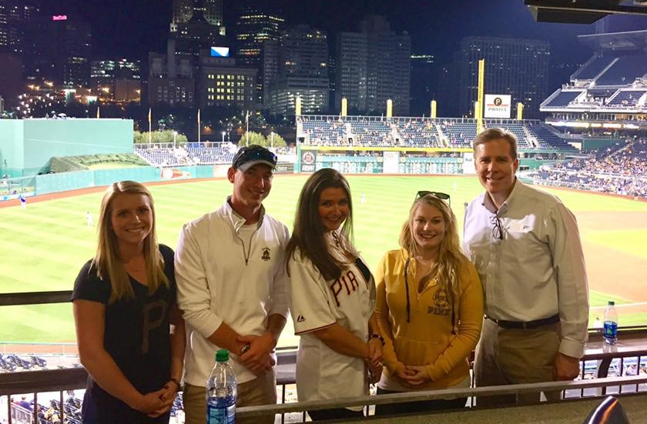
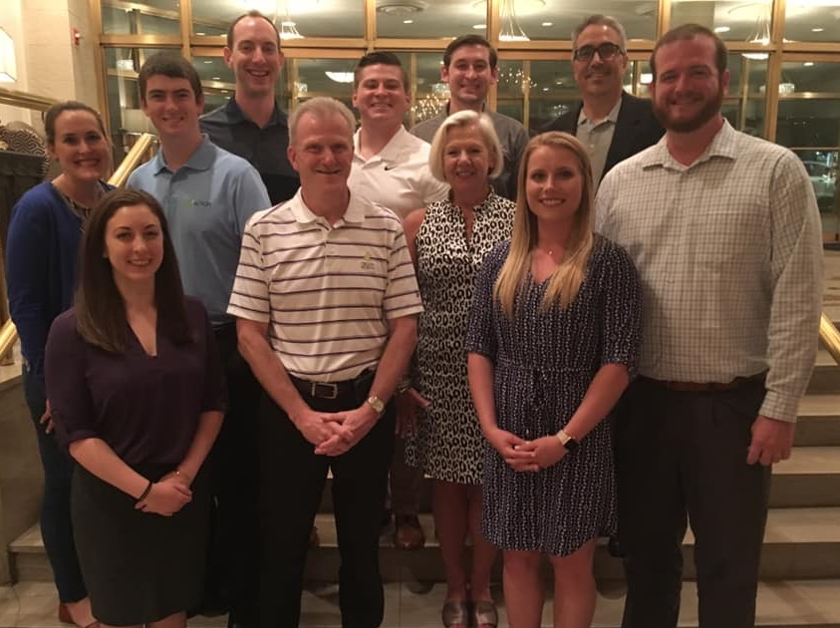
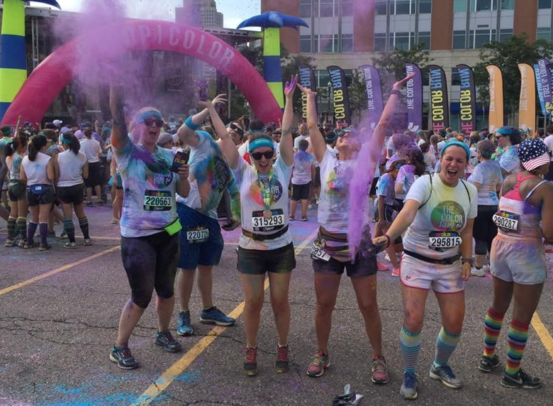
Networking
2022

Slide 13
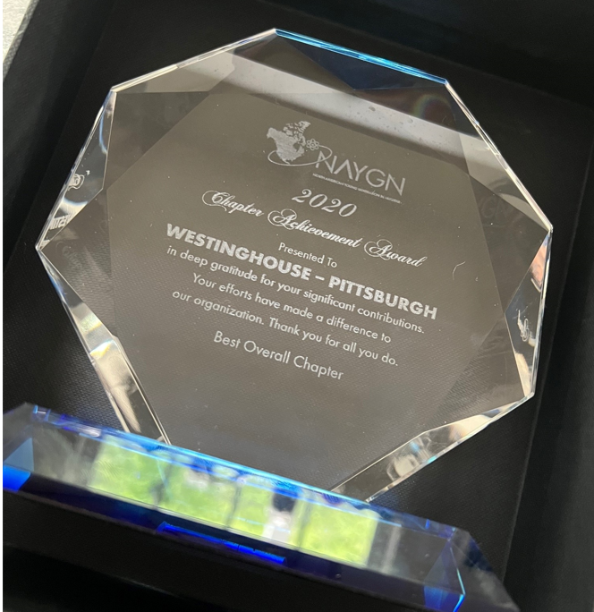
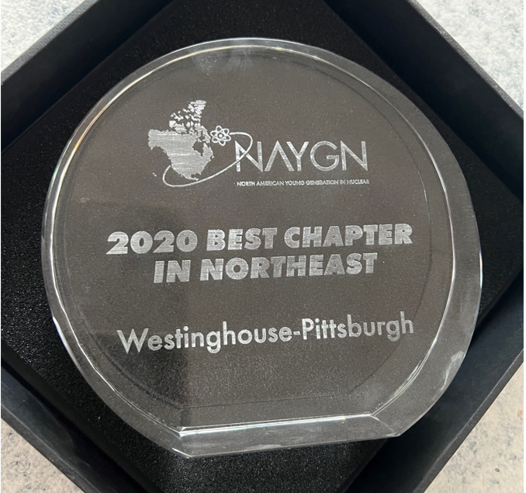
City of Champyinz
2020 – Best Chapter in Region
2020 – Best Chapter Overall
2021 – Best Chapter in Region
2022

Slide 14
Follow Us!
Instagram
@na_ygn
TikTok
@na_ygn
LinkedIN
North American Young Generation in Nuclear, Inc.
Facebook
Pittsburgh Young Generation in Nuclear
North American Young Generation in Nuclear (NAYGN)
Yammer
Westinghouse Young Generation in Nuclear
2022

Slide 15
Questions?
Aleisha McAteer, NAYGN President
mcateeam@westinghouse.com
724.858.6025
2022

