Slide 1
10CFR50.69 Implementation
Carrie Gilbreath
Southern Nuclear

Slide 2
CATEGORIZATION PROCESS

Slide 3
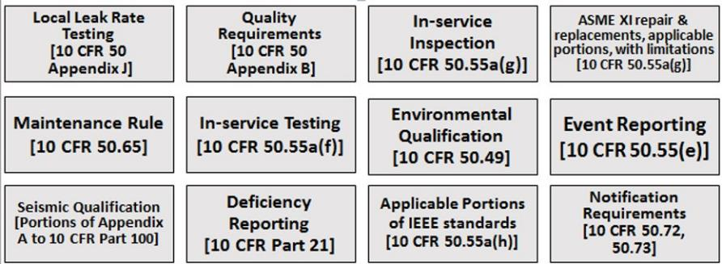
10 CFR 50.69 IMPACTS

Slide 4
Where do savings come from?
Projects
Reduce capital costs
Programs
Remove components from special treatment programs and extend or eliminate PMs
Procurement - Daily and Outage
Reduce parts cost by 80%
Examples: Vogtle MSIV Actuators, Hatch Plant Service Water Piping
Example: Equipment Qualification Program, In-Service Testing
Solve obsolesce issues
Cut lead time in half or more
Right Work at the Right Time!

Slide 5
Vogtle Categorized Systems
System | RISC-1 | RISC-2 | RISC-3 | RISC-4 | Total
Nuclear Service Cooling Water | 247 | 16 | 2541 | 644 | 3448
Component Cooling Water | 84 | 12 | 539 | 422 | 1057
Containment Spray | 97 | 0 | 202 | 80 | 379
Chemical & Volume Control System | 822 | 91 | 1739 | 1197 | 3849
Essential Chilled Water System (Mechanical) | 4 | 0 | 1344 | 242 | 1590
Nuclear Instrumentation System (Electrical / I&C) | 20 | 0 | 16 | 68 | 104
Radiation Monitor System (Electrical/I&C) | 0 | 0 | 364 | 755 | 1119
Post-Accident Monitoring System (Electrical / I&C) | 22 | 2 | 0 | 0 | 24
Main Steam | 232 | 8 | 3205 | 0 | 3445
Emergency Diesel Generators | 297 | 8 | 2224 | 1408 | 3937
Nuclear Sampling – Liquid | 0 | 0 | 111 | 1650 | 1761
Notes:
It takes 4-6 months to categorize a system.

Slide 6
Farley and Hatch Categorized Systems
System | RISC-1 | RISC-2 | RISC-3 | RISC-4 | Total
Farley Containment Spray | 123 | 0 | 217 | 114 | 454
Farley Radiation Monitors | 0 | 0 | 73 | 854 | 927
Farley Penetration Room Filtration | 0 | 0 | 338 | 40 | 378
Farley Emergency Diesel Generator | 676 | 0 | 2158 | 301 | 3135
Farley Main Feedwater | 0 | 0 | 180 | 1412 | 1592
Farley Main Steam | 326 | 118 | 714 | 1355 | 2513
Hatch Plant Service Water | 195 | 18 | 2830 | 1904 | 4947
Hatch Emergency Diesel Generator | 155 | 11 | 1095 | 210 | 1471

Slide 7
Implementation Approach at SNC and Goal
O&M funded, level of effort, with contract support
Categorize 2-3 Systems categorized per station per year, as funding is available
Goal will be 30 at each station
17 for Vogtle
25 for Farley
29 for Hatch
Proactive use of 50.69 in Design process
MSIV Project Example
Maximize Preventative Maintenance Benefits
Seamless proactive RISC3 procurement in Outage and Daily activities

Slide 8
Programs Alternative Treatment Examples

Slide 9
50.69 Alternative Treatments – Programs
Programmatic Progress and Savings
Plant | # of Systems Approved | # of Components Removed | Approximate PM Savings (Life of Plant)
Vogtle 1&2 | 13 | EQ: 426 IST: 332 Appendix J: 20 MOV: 26 ISI Pres. Test: 5719 ISI Supports: 2900 Snubbers: 336 | $20,415,751
Farley | 6 | EQ: 124 IST: 8 | $861,778​
Hatch | 2 | EQ: 16 IST: 24 | $109,423​

Slide 10
50.69 Alternative Treatments – Procurement
Procurement Savings
Plant | # of Systems Approved | Approximate Procurement Savings for Installed Parts | Approximate Procurement Savings Opportunity (Life of Plant)
Vogtle 1&2 | 13 | $2,483,980 | $6,258,360
Farley | 6 | $240,978 | $4,182,280
Hatch | 2 | $149,046 | $2,000,000

Slide 11
Implementation Tips and Lessons Learned
Think 50.69 early and often, especially in Design space.
Salvaging Opportunities vs. Maximizing Benefits
Include all affected departments in change management for 50.69
Team Sport
Align PRA model updates with 50.69 Periodic Review
Make it easy!!
Use what is in place
Do not add more process than what is needed
Ensure easy reinstatement of special treatments if needed

Slide 12
50.69 Industry Groups and Events
NEI 50.69 Implementation Task Force
Collaboration requested with DOWG on 50.69 in SDP
NEI 50.69 Licensing Task Force
BWROG 50.69 Subcommittee
PWROG Risk Management Committee
Key Dates:
EPRI 50.69 Workshop in Charlotte, NC - September 13-14. 2023
PWROG/BWROG 50.69 Summit in Scottsdale, AZ December 3-4, 2023

Slide 13
Questions?
Descope me!
Descope me!
Descope me!

