Slide 1
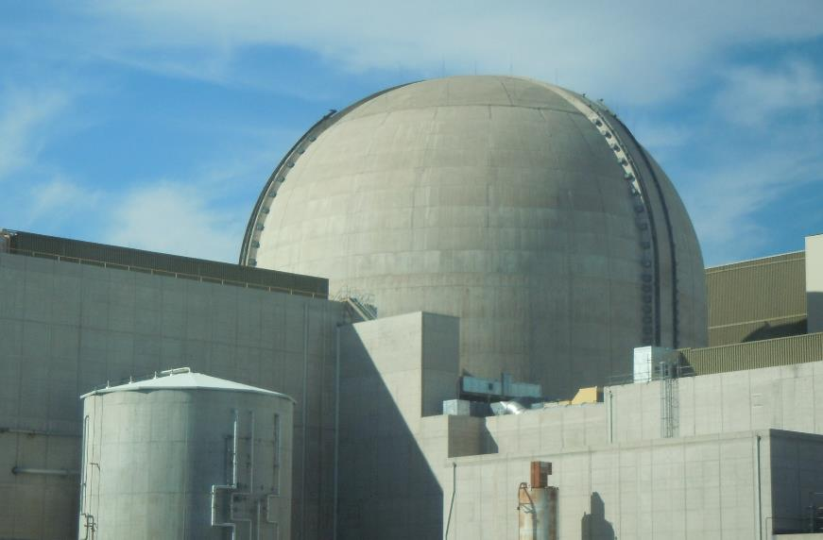
Palo Verde FLEX Modifications
Presented by:
Gene Eimar, Shift Manager - Retired
1

Slide 2
Presentation Topics
Primary Plant Modifications
Secondary Plant Modifications
Spent Fuel Pool Cooling Modifications
Electrical System Modifications
2

Slide 3
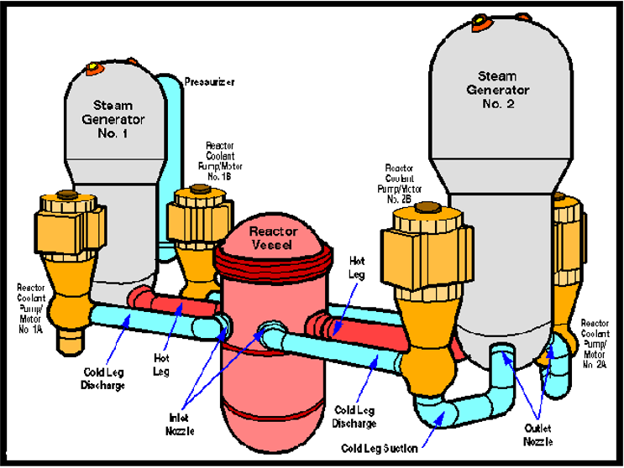
PRIMARY PLANT MODIFICATIONS
3

Slide 4
Primary RCS Makeup Connections
M
RWT
2A COLD LEG
M
M
M
HPSI “B”
M
M
2B COLD LEG
M
M
CH “A”
1A COLD LEG
M
M
M
HPSI “A”
1B COLD LEG
M
4

Slide 5
Alternate RCS Makeup Connections
M
RWT
2A COLD LEG
M
M
M
HPSI “B”
M
M
2B COLD LEG
M
M
CH “A”
1A COLD LEG
M
M
M
HPSI “A”
1B COLD LEG
M
5

Slide 6
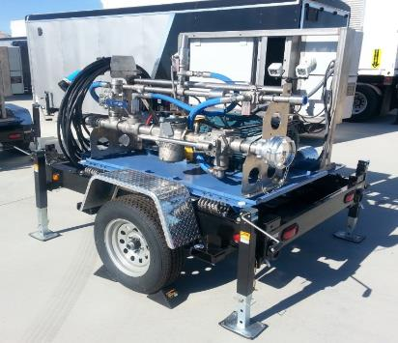
FLEX RCS Makeup Pump
Hydra-Cell Positive Displacement Pump
Max capability = 37 gpm @ 1200 psi @ 1150 RPM
Baldor 480 VAC, 3 phase, 30 HP Motor
Variable Frequency Drive to control RPM
Pump, Motor, suction and discharge hoses contained on trailer.
6

Slide 7
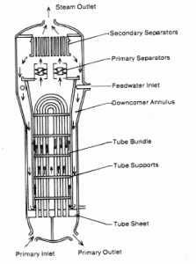
Secondary Plant Modifications
7

Slide 8
Primary SG Feed Connections
CST
M
M
SG #1
SG #2
RMWT
M
M
AUX FW “A”
AUX FW “B”
M
M
M
M
8

Slide 9
Alternate SG Feed Connections
CST
M
M
SG #1
SG #2
RMWT
M
M
AUX FW “A”
AUX FW “B”
M
M
M
M
9

Slide 10
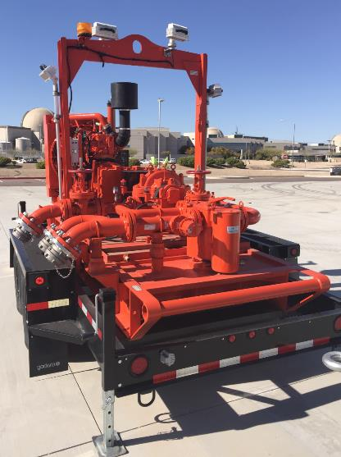
FLEX SG Feed Pump
Pump Model – Godwin
Engine – John Deere
225HP @ 2200 RPM
McCrometer 4” flow meter
370 gpm @ 340 psi
10

Slide 11
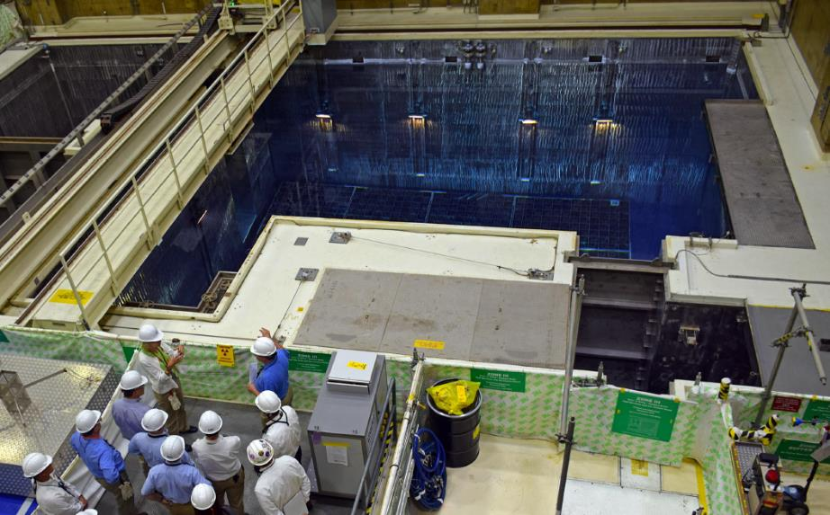
Spent Fuel Pool Cooling
11

Slide 12
FLEX SFP Makeup Paths – Upper Modes
RWT
SFP
12

Slide 13
FLEX SFP Makeup Paths – Lower Modes
*100 hours after shutdown
CST
AUX FW “A”
RMWT
AUX FW “B”
SFP
13

Slide 14
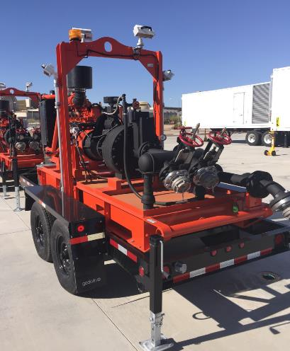
FLEX SFP Makeup Pump
Pump Model – Godwin
Engine – John Deere
156HP @ 2200 RPM
McCrometer 4” flow meter
300 gpm @ 165 psi
14

Slide 15
Electrical Modifications
480 VAC Connections
4160 VAC Connections
RCS Makeup Pump
15

Slide 16
Electrical Alignment
ESF Transformer
4160 SWITCHGEAR
480VAC Load Center
480VAC Load Center
480VAC Load Center
16

Slide 17
480 VAC Electrical Alignment
480VAC Load Center
480VAC Load Center
480VAC Load Center
FLEX 480VAC DG
FLEX 480VAC DG
17

Slide 18
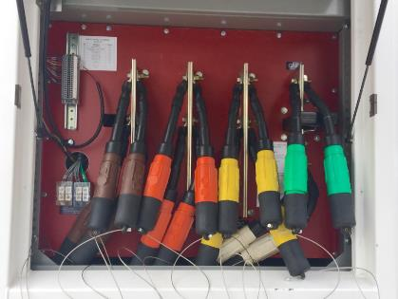
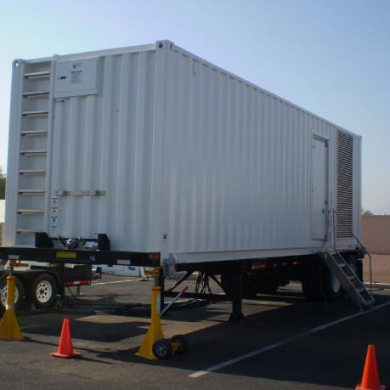
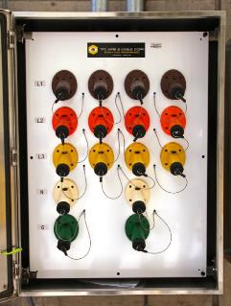
480 VAC Generator
18

Slide 19
Alternate Electrical Alignment
FLEX 4160 VAC
Turbine
Generator
ESF Transformer
Manual Transfer Switch
4160 SWITCHGEAR
19

Slide 20
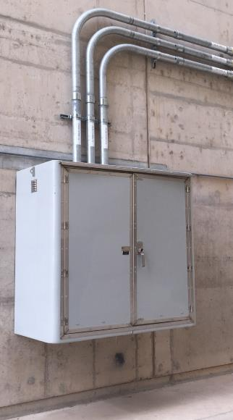
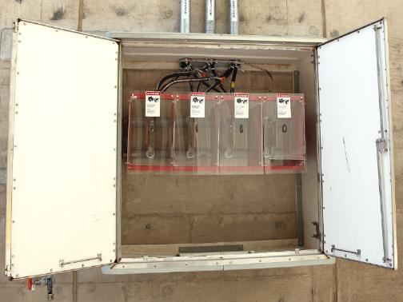
4160 VAC Bus Connection Box
20

Slide 21
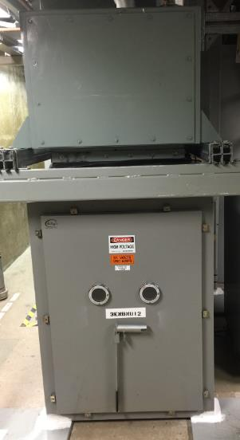
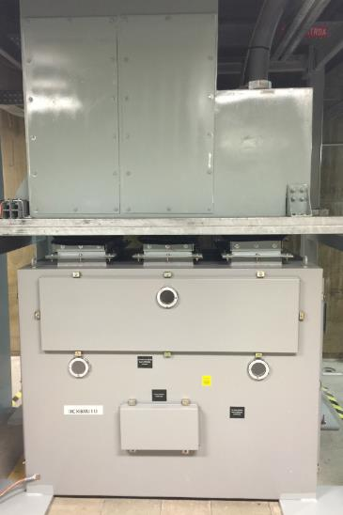
4160 VAC Manual Switch
21

Slide 22
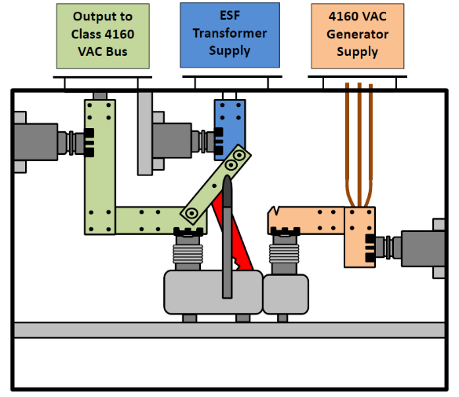
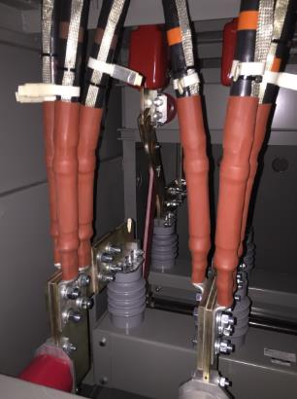
4160 VAC Manual Switch
ESF Transformer Position
22

Slide 23
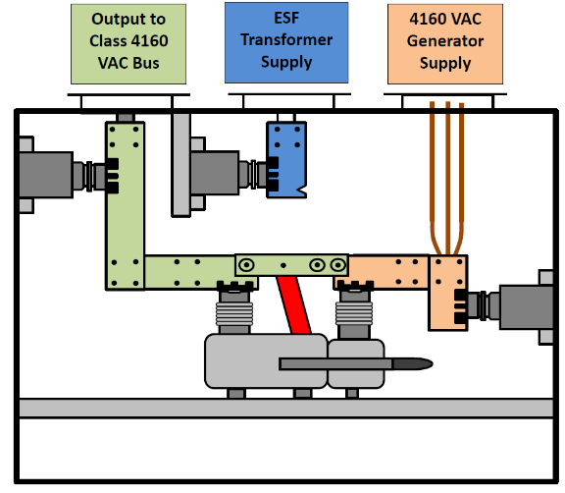
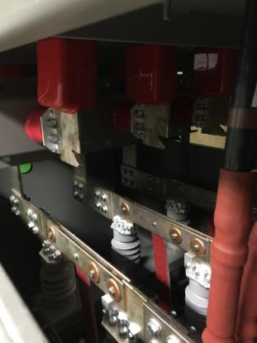
4160 VAC Manual Switch
Portable Generator Position
23

Slide 24
RCS Makeup Pump Electrical Connections
480VAC Load Center
480VAC MCC
FLEX RCS Primary Pump
FLEX RCS Alternate Pump
24

Slide 25
FLEX Staging Areas
FLEX SG Feed
PLANT NORTH
FLEX SFP M/U
“A” SPRAY POND
CST
FUEL BLDG
CNMT
BLDG
TURBINE BLDG
RWT
AUX BLDG
“B” SPRAY POND
RW BLDG
CONT BLDG
SERV BLDG
DG BLDG
FLEX RCS M/U
RCA Yard
FLEX GENERATORS
Protected Area Boundary
25

Slide 26
Presentation Topics
Primary Plant Modifications
Secondary Plant Modifications
Spent Fuel Pool Cooling Modifications
Electrical System Modifications
26

Slide 27
Questions?
27

