Slide 1

Development of Advanced 3D Models for Cyber Plant
in Saeul NPP Units 3&4 and Practical Usage
2023. 06. 28
DAEYOUNG JEONG
(KEPCO E&C, South Korea)

Slide 2
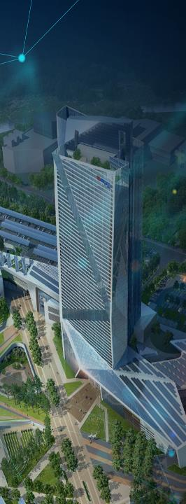

TABLE OF CONTENTS
1
Introduction
2
Management Procedure
3
Enhancement Plan
4
Validation Process
5
Practical Usage of Cyber Plant
6
Conclusion

Slide 3
Introduction

Slide 4

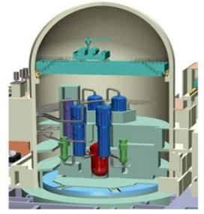
01
Introduction
Purpose of Cyber Plant
It is required to meet the new restricted regulation for nuclear power plant operation
It is needed to establish Cyber Plant to assure the safety of nuclear power plant operation
Cyber plant is 3D digitalization of existing nuclear power plant
It can be used for Training, Effective Operation and Preventative Maintenance
Existing NPP
Cyber Plant
VR System
Training System
3D Digitalization
Effective Operation
Preventative
Maintenance

Slide 5
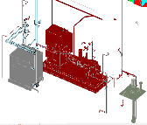
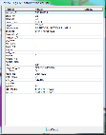
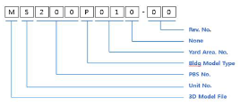
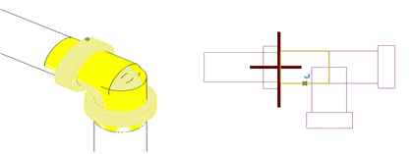

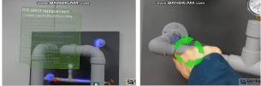
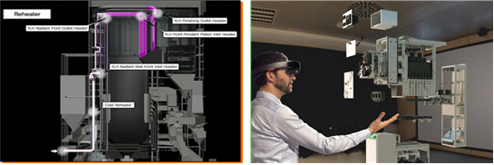
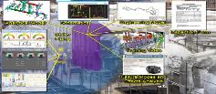

01
Introduction
Status of SN 3&4 Cyber Plant Project
KEPCO E&C Cyber Plant Development
Management Procedure
Enhancement Plan
Validation Process
Model File Numbering System
Components Numbering System
Components Propertites
Color of 3D Models
Establishment of New 3D Models
Standardization of Commonly used 3D Models
Reconstructing Piping Joint Shape
Integration and Advanvement
Consistency Check related with Tag Numbering Sytem of Project Participants
Application of Colors to Applicable Components
Conversion and Transfer 3D Models file to Cyber Plant
Existing
3D Models
New
3D Models
KHNP Application of Cyber Plant Technology
VR Application on Operation Phase
Device Disassemble on Decommissioning Phase
Information HUB

Slide 6
01
Introduction
Status of SN 3&4 Cyber Plant Project
KEPCO E&C Cyber Plant Development
Management Procedure
Enhancement Plan
Validation Process
Model File Numbering System
Components Numbering System
Components Propertites
Color of 3D Models
Establishment of New 3D Models
Standardization of Commonly used 3D Models
Reconstructing Piping Joint Shape
Integration and Advanvement
Consistency Check related with Tag Nubering Sytem of Project Participants
Application of Colors to Applicable Components
Conversion and Transfer 3D Models file to Cyber Plant
Existing
3D Models
New
3D Models
KHNP Application of Cyber Plant Technology
VR Application on Operation Phase
Device Disassemble on Decommissioning Phase
Information HUB

Slide 7
Management Procedure

Slide 8
02
Management Procedure
Management Procedure Concept
Model file Numbering System
Advanced 3D Models for cyber plant
Consistency
Components Numbering System
3D Integrated Models
Reality
Components Properties
Compatibility
Color of 3D Models
Availability to manage Advanced 3D Models for cyber plant

Slide 9
02
Management Procedure
Model file numbering system
V-3-321-A-01B-00 (sample)
O-O-OOO-O-OOO-OO
File Type
Unit No.
PBS No.
Model Type
Serial No.
Revision No.
Index | SN 3&4 | Cyber Plant
File Type | M : 3D Model | V : Cyber Model
Unit No. | Unit number | Unit number
PBS No. | Physical breakdown structure number | Physical breakdown structure number
Model Type | Components Type | Components Type
Serial No. | Area No. (ex. M-3-321-A-010-00) | Area No. + Subsystem No. (ex. V-3-321-A-01B-00)
Revision No. | File revision number | File revision number
Discipline | Subsystem No. | Description
Civil | B | Anchor Bolt
 | C | Conduit Opening
 | L | Sleeve
 | S | Sheath
 | T | Tendon
Architecture | D | Door

Slide 10
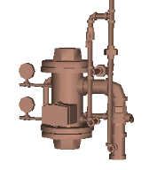
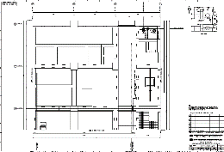
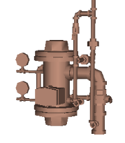
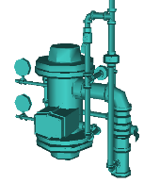

02
Management Procedure
Components numbering system
SN 3&4
Cyber Plant
For DWG.
9-691-V-4519
9-325-P191-181(Pan DWG.)
9-691-V-4519
3-691-V-4519
4-691-V-4519

Slide 11
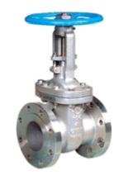
02
Management Procedure
Components properties
Task
- Identify the information of each components for operation
- Define the properties of common and specific data
Scope (Sample)
Common Data |  | Specific Data
Component No. | 3/4-535-V-0013 | Flow rate (Lbs/Hr) | 1,300
Function | Containment ISO. | Pressure(psig) | 60
Classification | Safety Related | Temperature(°F) | 300
Specification No. | 9-145-P206A | Valve type | Gate
Manufacture | SAMSHIN | Diameter(in) | 6
DWG No. | 9-P206A-DG-A01-05 | End Type | Buttweld
Active or Passive | Active | Actuator Type | MOV
3/4-535-V-0013

Slide 12
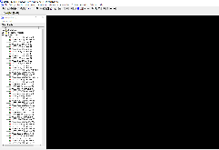
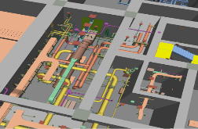
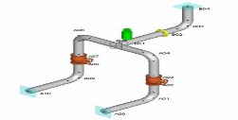
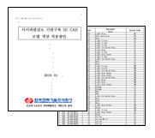
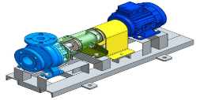
02
Management Procedure
Color of 3D Models
SN 3&4
Cyber Plant
Software
Piping
Components

Slide 13
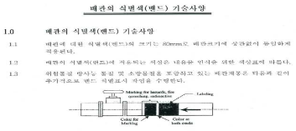
02
Management Procedure
Color of 3D Models
Piping
- Classify the color of piping with respect to the fluid of system in accordance with
design specification
- Color Band (Sample)
< Color bands for Piping in design specification >
The color applied to pipe identification depends on a color chart
for content recognition.
Fluid Type | System | Color name | Color
Demineralized Water, Fresh Water | CC, CD, CP, CT, AX, DM, DG-Water | Light Blue
Radioactive, Radwaste | DE, FC, WV, WX, WY | Dark Red
Fire Fighting (CO₂ , Haloge, Water) | CO, FP | Red
HVAC vent and drain etc. | VC, VD, VE, VF, VG, VK, VO, VP, VQ | Grey
Steam and Hot Water | RC, SI, CS , IW | Yellow

Slide 14
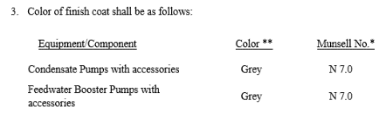
02
Management Procedure
Color of 3D Models
Components
- Classify the color of components with respect to applicable purchase specification
- Color Band (Sample)
< Requirement of color in purchase specification >
Component | Color
Condensate Pumps | Grey
Feedwater Booster Pumps | Grey
Spec. No. | Component Type | Description | System | Color
9-132-M210 | PP | Circulating Water Screen Wash Pump | SW, CL
9-133-N204 | HX | Containment Heat Exchanger | CS, CC, FC
9-531-M208 | PP | Feedwater Booster Pumps | CD, FW, WT
9-596-M224 | FT | Filter | IA
 | LP | Air Compressors Local Control Panel | IA
9-691-M258 | VV | Relief Valve for Diesel-Driven Fire Pump | FP

Slide 15
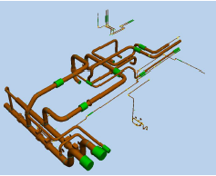
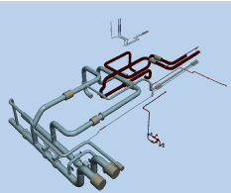
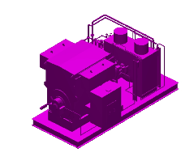
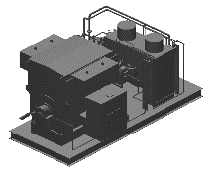
02
Management Procedure
Color of 3D Models
Piping
Components (Sample : Feedwater Booster Pump)
SN 3&4 NPP
Cyber Plant
SN 3&4 NPP
Cyber Plant

Slide 16
Enhancement Plan

Slide 17
03
Enhancement Plan
Purpose
Advanced 3D Models are required for cyber plant to utilize VR system with reality
By enhancement plan, it is available to establish advanced 3D Models
Work flow
Integrated 3D Models
Advanced 3D Models
New 3D Models
Integration
Advancement
Existing 3D Models
in SN 3&4

Slide 18
03
Enhancement Plan
New 3D Models
Task
- Development of new 3D Models which should be developed additionally for
advanced 3d models
- New 3D Models include door, louver, anchor bolt, etc.
Scope (Sample)
No. | Department | New 3D Models | Quantity | Remark
1 | Architecture | Door & Louver | 1,705
2 | Civil | Anchor Bolt Tendon & Sheath Sleeve | 32,310
3 | Electric | Lighting & Fire Detectors | 12,937
4 | I&C | Instrument | 22,012
5 | Piping | Plumbing Pipe & Fixture Weld Joint Configuration | 793,900
6 | Common | Design Base Drawing RCS Piping Welding | 160
Total |  |  | 863,024

Slide 19
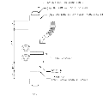
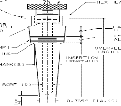
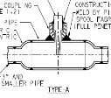
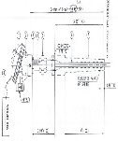
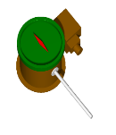
03
Enhancement Plan
New 3D Models
Work Flow for New 3D Models
No. | Title | Type
1 | General Requirement | -
2 | Bracket | 37
3 | Flow | 11
4 | HVAC | 9
5 | Level | 17
6 | Pressure | 8
7 | Rack & Support | 15
8 | Sample | 8
9 | Temperature | 11
10 | Pneumatic | 5
11 | Fabrication | 10
Total |  | 131
Instrument Installation Drawing
Instrument List
Supplier Drawing
Site Configuration
3D Modeling Cell

Slide 20
















03
Enhancement Plan
New 3D Models
Standardization
- Standardization of commonly used components
Component | Type | DWG. | Standardization
Lightning Fixture | HM-A2, CM, LFH-A
Fire Detector | Heat Detector, Flame Detector
Instrument | LIT, TS

Slide 21
03
Enhancement Plan
New 3D Models
Result of Standardization

Slide 22
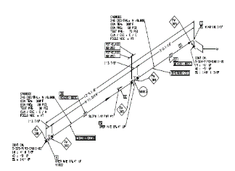
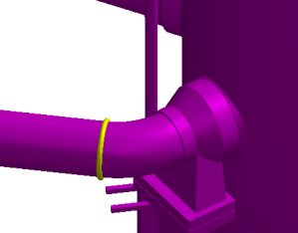
03
Enhancement Plan
New 3D Models
Reconstruction
- Difficulty to figure out the weld point of existing piping joint shape
- Detailing the piping joint shape for advanced 3D Models
SN 3&4 NPP
Reconstruction by DWG
Cyber Plant

Slide 23
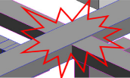
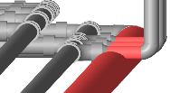
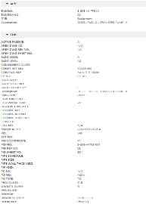
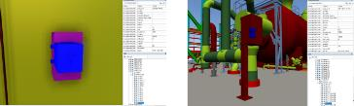
03
Enhancement Plan
3D Models Integration & Advancement
Task
- Integration of the existing models and new models
- Check the interference among 3D Models
- Review and remove duplicate objects
- Entity the attributes of integrated 3D Models
Advanced 3D Models
Integrated 3D Models
Review integrated 3D Models interference
Entity the attributes
New 3D Models
+
Remove duplicate objects
SN 3&4 3D Models

Slide 24
Validation Process

Slide 25
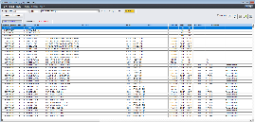
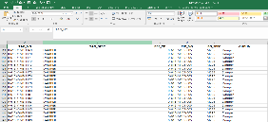
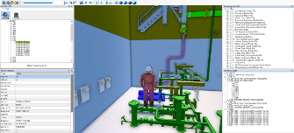
04
Validation Process
3D Models Validation Process
Task
- Comparison between KHNP and KEPCO E&C database
- Application of colors to 3D Models in accordance with management procedures
- Conversion of 3D Model file format for application of the operation program
Comparison between KHNP and KEPCO E&C database
Application of colors to advanved 3D Models
Conversion of Format for Operating Program

Slide 26
Cyber Plant Practical Usage

Slide 27
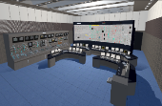
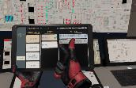
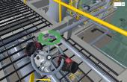
05
Cyber plant practical usage
VR Operation Procedure Training System
3D Model Advancement
VR System
Scenario
Utilizing Cyber Plant 3D Model
MCR Realization
Detailing Site Facility and Layout Model
Produce MMI Display
Build Symbols and Attributes
Function of VR Interaction
User Interface
Data Collecting
Verify Operation Procedure
Generate Operating Scenario based on VR
Procedure
Interlocking with Simulator
VR Training Integrated Management System
RCS Fill and Vent
Severe Accident Management Guide
Abnormal(Loss of Condenser Vacuum and Operation in Plant Fire)
Analysis and Verify Interlocking Data/Attributes
Develop Interlocking System

Slide 28
Conclusion

Slide 29
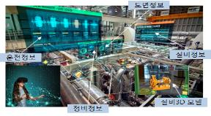
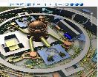


06
Conclusion
CLASH CHECK
SN34 Reflection
KEPCO E&C
SN 3,4
3D MODEL
INTEGRATED 3D MODEL
3D Models Data Transformation
Conversion of Format for Operating Program
Piping Joint Reconstruction
Comparison between KHNP and A/E components data
NEW 3D
MODEL
Management
3D Models Enhancement
3D Models Validation
KHNP
VR 3D MODEL
Cyber Plant Appication

Slide 30


Thank You

