Slide 1
Palo Verde Young Generation in Nuclear
Megan Lubbers – President
Joshua Pollock – Secretary

Slide 2
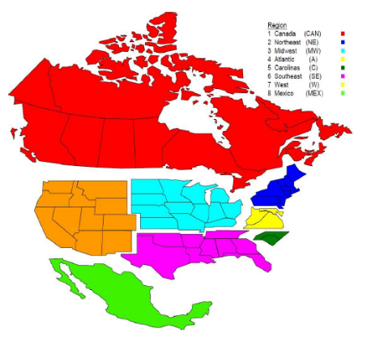
THE WEST REGION
Eleven (11) states in the West Region
Nine (9) NAYGN Chapters in the West Region:
Curtiss Wright
Enercon Services, Inc.
Energy Northwest
Framatome
Idaho National Laboratory
NuScale Power
Pacific Gas and Electric (PG&E) - Diablo Canyon
Palo Verde Generating Station
TerraPower
Notes:
There are 11 states in the west region. There are only a total of 3 operating nuclear power plants across the west region, Diablo Canyon, Energy Northwest, and Palo Verde Generating Station. Even though power usage has been at an all time high, with no sign of decline, there are 31 facilities in the west region undergoing decommissioning.

Slide 3
PVYGN Mission Statement
Palo Verde Young Generation in Nuclear (PVYGN) is a branch of North American Young Generation in Nuclear (NAYGN). We aim to unite professionals working in the nuclear industry and provide them opportunities to develop leadership and professional skills, create meaningful connections that encourage retention, engage the public in nuclear technology, and support the site-specific goals.

Slide 4
Background/Role of PVYGN
PVYGN was established in 2005
First Palo Verde Employee Engagement group
~100 active members as of 2022
PVYGN fosters inclusion and promotes employee engagement
Four core areas
Professional Development
Safety
Community Outreach & Public Information
Team Building

Slide 5
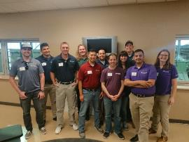
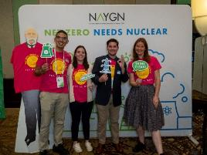
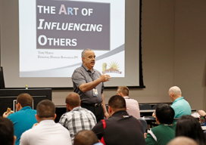
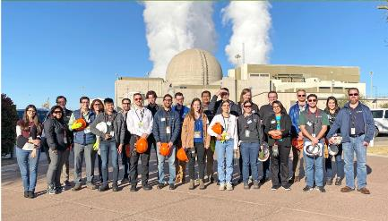
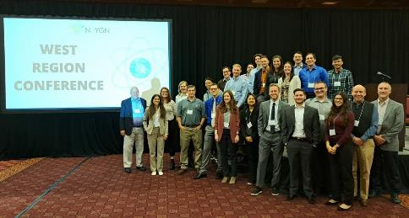
Professional Development
Notes:
PVYGN aims to help you develop new skills, stay up-to-date on current trends, and advance your career through continuing education and career training, workshops, tours of other industries, networking events, professional society involvement, NAYGN national or regional conferences around the country. Other events that we’ve done in the past are waste facility tours, Community Service Fund involvement, solar plant tours, shooting range on-site with security officers, and coffee chats with executive leadership.

Slide 6
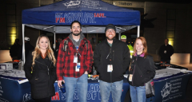
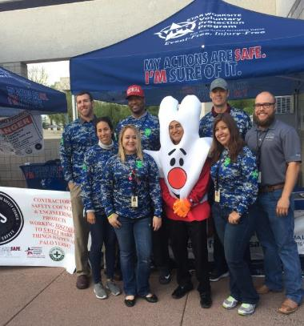
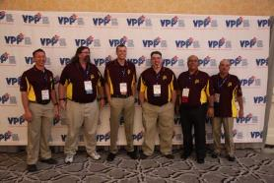
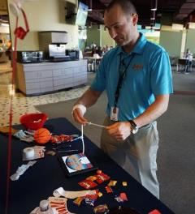
Safety
Notes:
PVYGN Safety interfaces with the Voluntary Protection Program (VPP). The VPP aims to foster trust and confidence in Palo Verde’s relationship with the Arizona Division of Safety & Health (ADOSH). So, what exactly does this entail? This isn’t required of members, but once a quarter inspections of an assigned area to ensure clean and safe working conditions. Some people use this as a small get-to-together with their coworkers and provides you the opportunity to get qualified as an “Area Safety Inspector”, which looks good on your APTMS (Annual Performance Tracking and Management System)

Slide 7
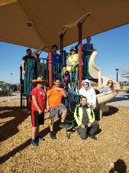
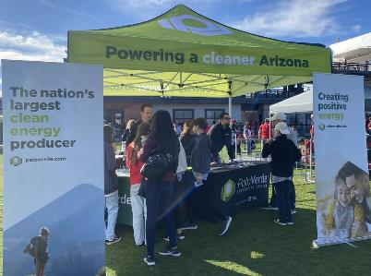
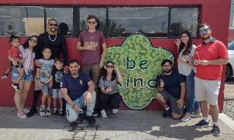
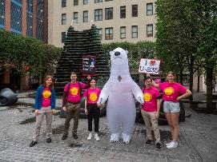
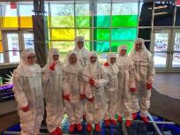
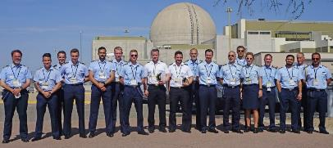
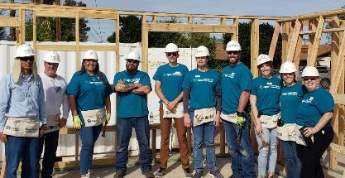
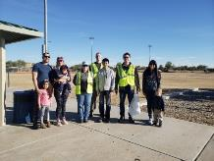
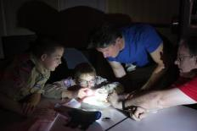
Community Outreach & Public Information
Notes:
This is the branch of PVYGN that is concerned with raising public awareness about nuclear energy, developing strong relationships within the community and organizations that represent them, and provide external networking opportunities.
These events can range from assisting boy or girl scouts with STEM badge related activities, cleaning up Falcon Park in Goodyear that APS owns, judging science fairs, etc.

Slide 8
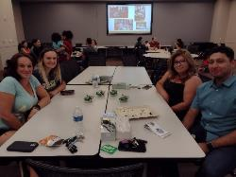
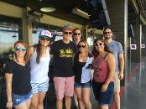
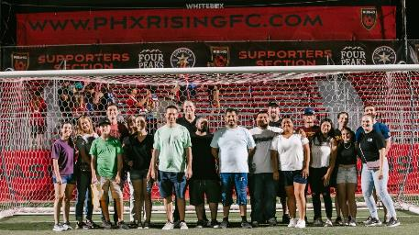
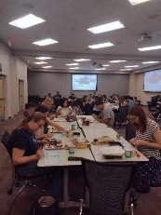
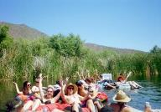
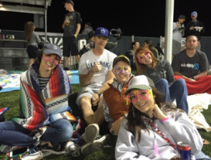
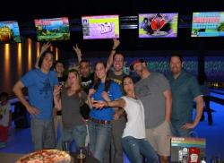
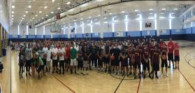
Team Building
Notes:
One of the best parts about being in PVYGN, there is a sizable budget strictly allocated to Team Building events. There isn’t really a limitation to what type of team-building event we can do, we’ve done pretty much everything you can do think of: basketball tournaments, bowling, concerts, rock climbing, tubing/waterparks, Top Golf. Disclaimer: APS will not pay for alcohol, so tread lightly on that front.

Slide 9
Membership
Every Palo Verde employee is welcome to join!
We want to pursue any event suggestions from our members!
Voting members
35 & under or less than 10 years of experience in the nuclear industry
Must be registered with NAYGN (it’s free)
Contact Josh to join our mailing list!
Joshua.Pollock@aps.com

Slide 10
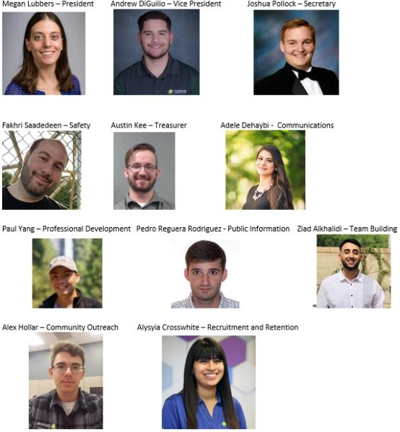
2023 PVYGN Officer Team

Slide 11
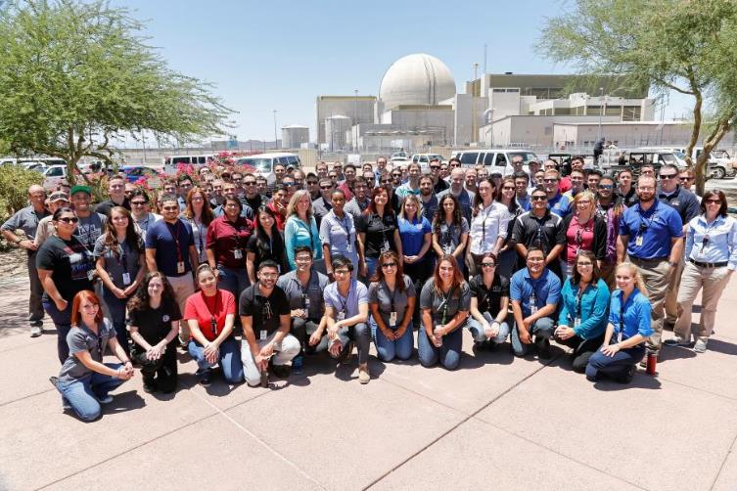
Questions?
Notes:
Last note, don’t be hesitant in reaching out to anyone about anything that you are interested in. People want to help you and see you succeed. Joining an employee engagement group whether it be PVYGN, Engineering Excellence, PV-WiN, or others, especially during Legacy is a great way of meeting people with more experience at PV and can offer you rewarding connections that you never know might come in handy one day. Any questions?

