Slide 1
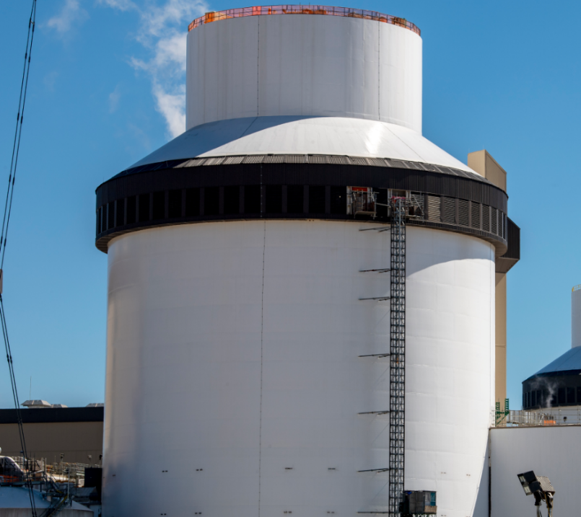
Plant Vogtle 3 & 4 Update
CMBG Conference - June 2023
Presented by: Andrew Neal & Cory Murray

Slide 2
Vogtle 3 & 4 Quick Facts
Two units
1,110 MW
each
Technology Westinghouse AP1000
Location Waynesboro Georgia
Workforce
▸ 9,000+ workers at peak
▸ 800 permanent jobs expected when both units are operating
Once completed, Vogtle 1-4
▸ Will be the largest nuclear energy facility in the U.S.
▸ Expected to power 1+ million homes and businesses
Operating life
Expected 60-80 years

Slide 3
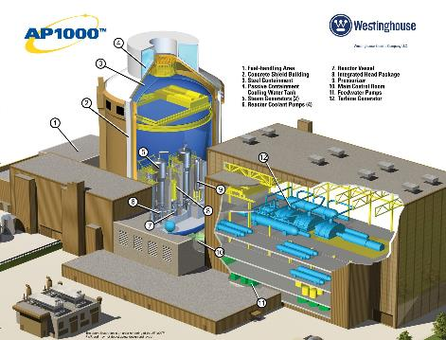
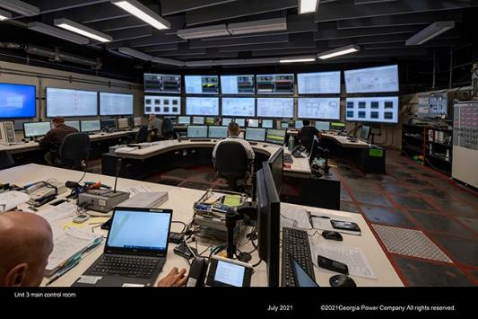
Westinghouse AP1000 Technology
The AP1000® Plant is a two-loop pressurized water reactor (PWR) that uses a simplified, innovative and effective approach to safety.
Plant simplifications yield fewer components, cable and seismic building volume, all of which contribute to considerable savings in capital investment, and lower operation and maintenance costs.
AC electrical power is not required for safe shutdown.
Operator action not required for 72 hours to maintain core and containment cooling.

Slide 4
Unit 3 direct construction is 100% complete
Total project construction approximately 99% complete
Projected Unit 3 in-service date: June 2023
Projected Unit 4 in-service date: Late fourth quarter 2023 or first quarter 2024
As of March 2023

Slide 5

Recent Major Milestones
Unit 3
August
NRC issues historic 103(g) finding
October
Fuel Load Completed
Design Authority Turned over from Westinghouse to Southern Nuclear
April
Unit 3 successfully synchronized and connected to the electric grid, producing electricity for the first time
January
NRC issued dual unit licenses to 72 Operators at Vogtle 3&4
May
Unit 3 reached 100 percent energy output for the first time
July
Final ITAAC submitted to the NRC
March
Initial Criticality is achieved
2022
2023
July
Last major structural iron was placed in Unit 4
November
Closed Vessel Testing completed
Turbine on Turning Gear completed
March
Hot Functional Testing started
February
Completed last major concrete placement on the project
May
Hot Functional Testing completed
August
Open Vessel Testing completed
December
Cold Hydro Testing completed
Unit 4

Slide 6
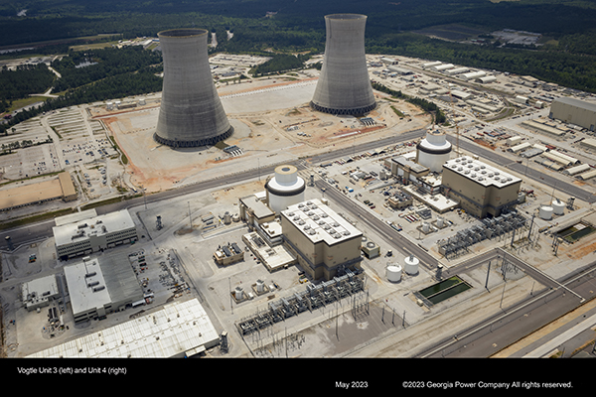
Next Steps for Vogtle 3&4

Slide 7
Upcoming Major Milestones
Unit 3
Declare Commercial Operations
3R01 Refueling Outage
Unit 4
Design Authority Turnover
Submit Final ITAAC and receive 103(g) finding from the NRC
  Once completed, Southern Nuclear will submit documentation that all inspections, tests and analyses have been performed and all acceptance criteria, collectively known as ITAACs, have been met on Vogtle Unit 4 as required by Southern Nuclear's Combined Operating License.
Begin Fuel Load
Startup Testing
Declare Commercial Operations

Slide 8
Design Change Process and Configuration Management Challenges During Unit 3 Startup

Slide 9
Design Authority Turnover (DATO) and CM Challenges
Westinghouse Electric Company (WEC) turned over Design Authority for Unit 3 on October 13th, 2022 to Southern Nuclear Company (SNC)
This meant using SNC’s process to perform design changes going forward
This presented many challenges to configuration management of the plant
  Site organizations were still in construction mindset
  Pending design changes from WEC were still in process
  Temporary modifications from the Initial Testing Program (ITP) were installed and needed converted to SNC’s process
  The volume of incoming needed changes was large
  SNC Design Engineering required a transition period to learn the Standard Design Change Process
  WEC procedures and processes were designed for construction, not operating units
The solution was to proactively create a new transitional design change process to bridge the gap between WEC and SNC design authority

Slide 10
Creating a New Design Change Process
SNC uses the NMP-ES-095 procedure as the interface for IP-ENG-001, the Industry Standard Design Change Process
It was anticipated that use of the Standard Design Change Process would not be feasible for the plant startup transitional period due to sheer number of required changes needed and tight turnaround time
SNC Design Engineering proactively created the B-GEN-ENG-038 design change process to cover the gap between DATO and Commercial Operation Declaration (COD)

Slide 11
B-GEN-ENG-038 Change Process Overview
Hybrid Southern Nuclear/Westinghouse Change Process
WEC developed a system within their WNEXUS software that allows SNC to perform Owner’s Acceptance Reviews (OARs) of design products
Allows the use of CMISDP (Configuration Management Interface - Standard Design Process) software to process design changes produced by WEC within the requirements of Southern Nuclear
Utilizes Westinghouse’s design change process, qualifications, quality assurance and years of expertise to produce needed design changes to supplement SNC in-house design changes
Sunsets at Unit 4 COD; Vogtle 3&4 will begin using NMP-ES-095 at that time

Slide 12
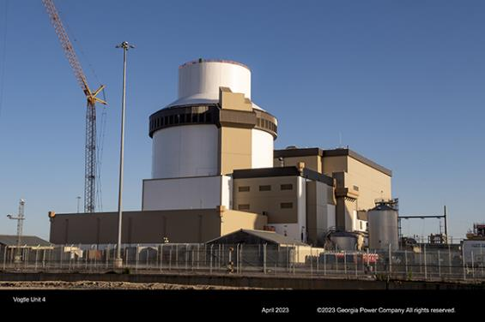
B-GEN-ENG-038 Results
Process has worked successfully for Design Engineering to meet the demands of the plant during startup
The new process was used to create over 450 changes since DATO (completed or currently in-process)
New Design Engineers were able to get design qualified and experience for post-COD

Slide 13
Design Change Breakdown
Change Type | Approximate Number of Changes*
DCPs | 156
DECPs | 38
CCPs | 47
DOCs | 137
ADCs | 95

Slide 14
Challenges and Lessons Learned
All the challenges faced and conquered will ensure a smoother transition for Unit 4
Communicating and learning a new process site-wide was challenging, but organizational cooperation and knowledge was strengthened
Utilizing a shared software between WEC and SNC to perform design change reviews and signoffs was convenient and efficient; cut down on back-and-forth draft file delivery
Discovered the WEC 50.59 screening process was not adequate for Vogtle 3&4’s specific needs; required SNC design engineering to have a recovery effort to correct this
Maintaining design document updates between WEC and SNC was a significant challenge in early stages, but has become a strength

Slide 15
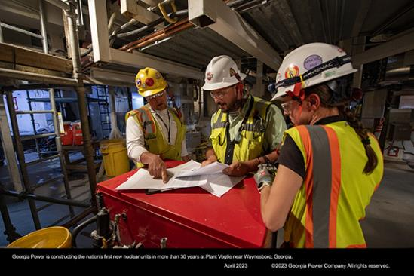
Questions?

Slide 16
Cautionary Note Regarding Forward-Looking Statements
Certain information contained in this release is forward-looking information based on current expectations and plans that involve risks and uncertainties. Forward-looking information includes, among other things, statements concerning future operations of and the projected in-service date for Plant Vogtle Units 3 and the projected fuel load timing for Unit 4. Georgia Power cautions that there are certain factors that can cause actual results to differ materially from the forward-looking information that has been provided. The reader is cautioned not to put undue reliance on this forward-looking information, which is not a guarantee of future performance and is subject to a number of uncertainties and other factors, many of which are outside the control of Georgia Power; accordingly, there can be no assurance that such suggested results will be realized. The following factors, in addition to those discussed in Georgia Power's Annual Report on Form 10-K for the year ended December 31, 2022, and subsequent securities filings, could cause actual results to differ materially from management expectations as suggested by such forward-looking information: the potential effects of the continued COVID-19 pandemic; the ability to control costs and avoid cost and schedule overruns during the development, construction, and operation of facilities or other projects, including Plant Vogtle Units 3 and 4, which includes components based on new technology that only within the last few years began initial operation in the global nuclear industry at this scale, due to current and/or future challenges which include, but are not limited to, changes in labor costs, availability and productivity, challenges with the management of contractors or vendors, subcontractor performance, adverse weather conditions, shortages, delays, increased costs, or inconsistent quality of equipment, materials, and labor, contractor or supplier delay, the impacts of inflation, delays due to judicial or regulatory action, nonperformance under construction, operating, or other agreements, operational readiness, including specialized operator training and required site safety programs, engineering or design problems or any remediation related thereto, design and other licensing-based compliance matters, including, for Plant Vogtle Unit 4, inspections and the timely submittal by Southern Nuclear of the Inspections, Tests, Analyses, and Acceptance Criteria documentation and the related investigations, reviews and approvals by the NRC necessary to support NRC authorization to load fuel, challenges with start-up activities, including major equipment failure, or system integration, and/or operational performance, continued challenges related to the COVID-19 pandemic or future pandemic health events, continued public and policymaker support for projects, environmental and geological conditions, delays or increased costs to interconnect facilities to transmission grids, and increased financing costs as a result of changes in market interest rates or as a result of project delays; the ability to overcome or mitigate the current challenges at Plant Vogtle Units 3 and 4 that could further impact the cost and schedule for the project; legal proceedings and regulatory approvals and actions related to construction projects, such as Plant Vogtle Units 3 and 4, including Public Service Commission approvals and NRC actions; under certain specified circumstances, a decision by holders of more than 10% of the ownership interests of Plant Vogtle Units 3 and 4 not to proceed with construction; the notices of tender by Oglethorpe Power Corporation and the City of Dalton of a portion of their ownership interests in Plant Vogtle Units 3 and 4 to Georgia Power, including related litigation; the ability to construct facilities in accordance with the requirements of permits and licenses (including satisfaction of NRC requirements), to satisfy any environmental performance standards and the requirements of tax credits and other incentives, and to integrate facilities into the Southern Company system upon completion of construction; the inherent risks involved in operating and constructing nuclear generating facilities; the ability of counterparties of Georgia Power to make payments as and when due and to perform as required; the direct or indirect effect on Georgia Power's business resulting from cyber intrusion or physical attack and the threat of cyber and physical attacks; catastrophic events such as fires, earthquakes, explosions, floods, tornadoes, hurricanes and other storms, droughts, pandemic health events, political unrest, wars or other similar occurrences; and the direct or indirect effects on Georgia Power's business resulting from incidents affecting the U.S. electric grid or operation of generating or storage resources. Georgia Power expressly disclaims any obligation to update any forward–looking information.

