Slide 1
Water Resources at Palo Verde Generating Station
Brad Berles
Palo Verde Water Resources General Manager

Slide 2
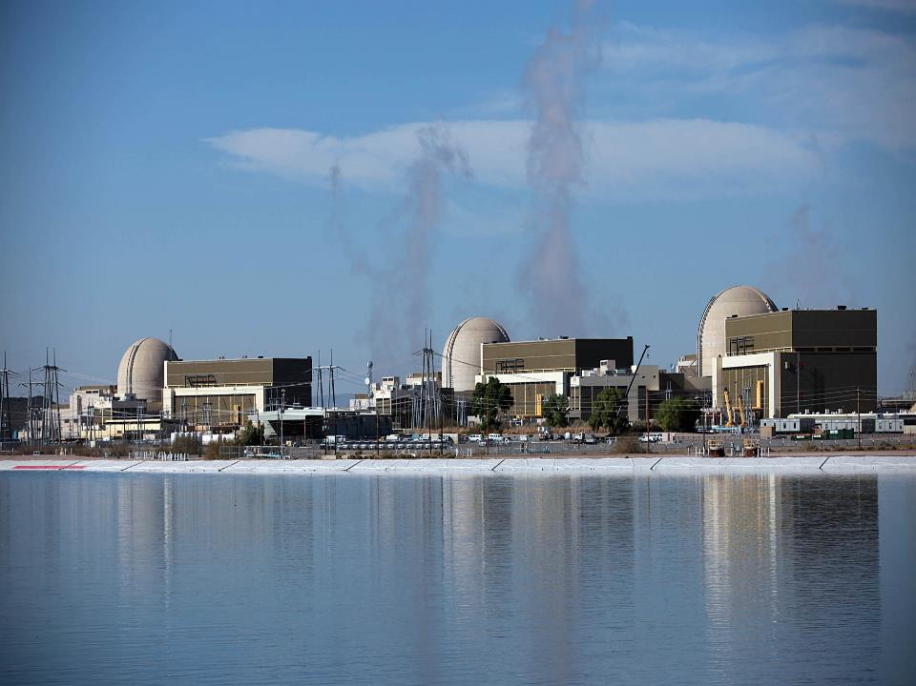
Water in the Desert

Slide 3
Why Water Resources?
Traditional power generation requires water… A lot of water!
Most power plants are located next to a large body of water.
Palo Verde is located in the middle of the Sonoran Desert.
Water Resources provides Palo Verde with a body of water.

Slide 4
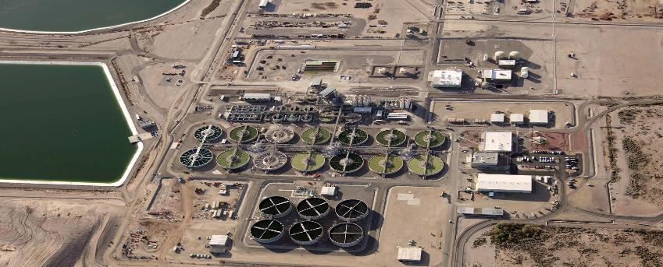
Water Resources Overview
Palo Verde Water Resources (WR) is a 90 MGD tertiary treatment plant that reclaims treated effluent from the cities of Phoenix, Scottsdale, Tempe, Mesa, Glendale and Tolleson.

Slide 5
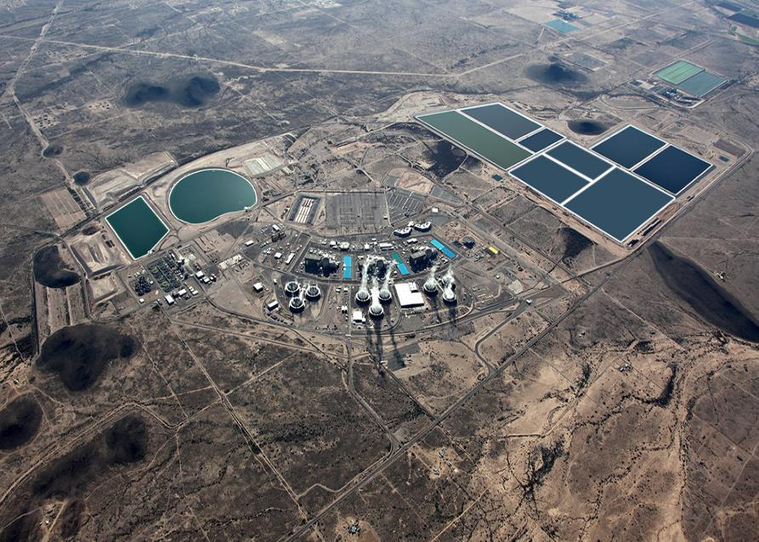
Redhawk Power Plant (APS)
1,000 MW CC
Mesquite Power Plant (SRP & Sempra)
1,000 MW CC
85 Acre Reservoir
Capacity 2,300 AF
45 Acre Reservoir
Capacity 1,075 AF
220 Acre Evap Pond #2 5,009 AF
Essential Spray Ponds
250 Acre Evap Pond #1 5,218 AF
180 Acre Evap Pond #3
6,542 AF
Water Resources
Cooling Towers
Notes:
Palo Verde is located ~ 50 miles west of Phoenix
Site property is 4,200 acres of retired farm land
Most prominent feature are the impoundments for water/wastewater storage totaling 780 acres, 130 acres for treated water and 650 acres for blow down
The smaller water storage next to each unit are the Essential Spray Ponds which are the ultimate heat sink
On the upper right hand portion of the photo are two 1,000 MW PP’s, the upper one is the Redhawk plant owned by APS and the lower is the Mesquite plant owned by Sempra and SRP. PV supplies treated effluent to the Redhawk plant

Slide 6
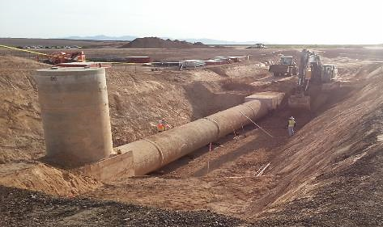
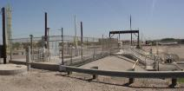

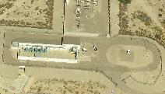
Water - How does it get here?
28.5 miles of gravity flow with 100-foot elevation drop, 8 miles pumped flow with 150-foot elevation increase
91st Ave Wastewater Treatment Plant
6 miles of 114” gravity flow pipe
8 miles of 66” pressure flow pipe
22.5 miles of 96” gravity flow pipe
Hassayampa Pump Station

Slide 7
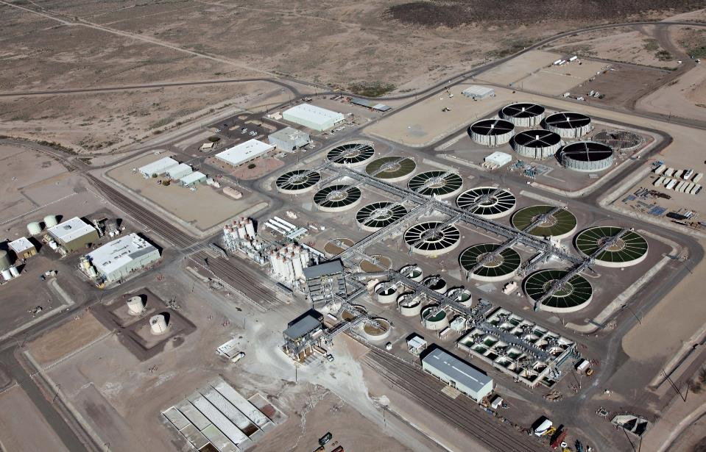
- Water from 36.5 miles of pipe.
- Trickling Filters remove ammonia.
- 1st and 2nd stage Clarifiers remove
phosphates, magnesium, silica, and calcium
through chemical treatment.
- Sulfuric acid (reduces pH) and
chlorine (controls biological growth) added.
- Gravity Filters remove suspended solids.
- Water flows to 85 & 45 acre storage reservoirs.
Water Resources Process

Slide 8
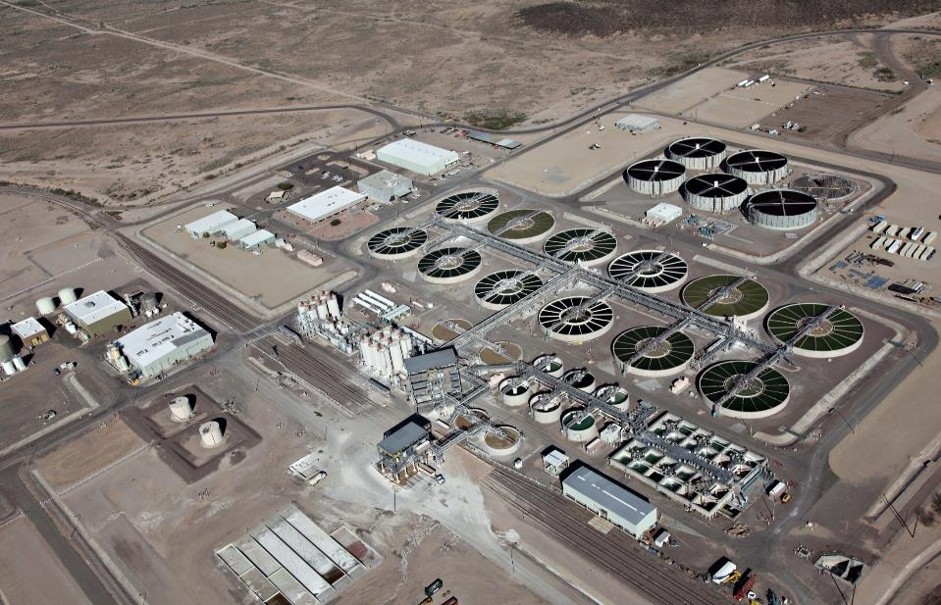
Domestic and demineralized water treatment.
WRF Chemical storage and feed.
Site chemical storage and feed.
Solids handling and removal.
Water Resources Process

Slide 9
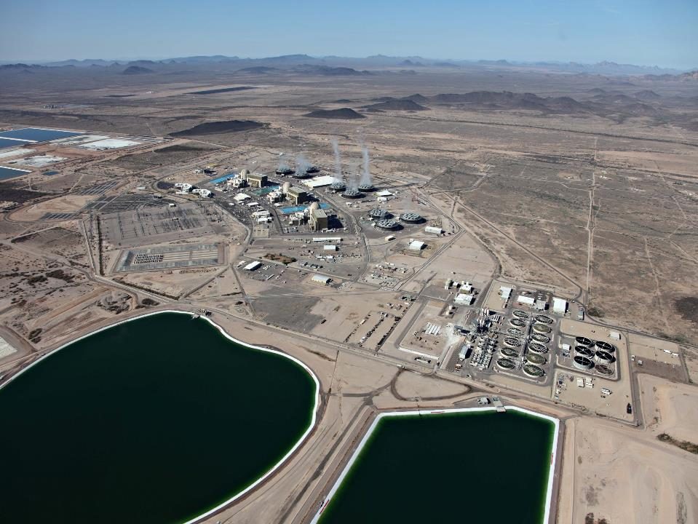
Water evaporates leaving behind solids.
Chemistry controlled by additions and blowdown.
Water evaporates in cooling towers removing heat.
Treated effluent used to cool condensers, and plant cooling water heat exchangers.
Pump stations pressurize makeup header.

Slide 10
Cooling Water Treatment
Softening of wastewater treatment plant (WWTP) effluent is a necessity. Softening is performed to:
  Minimize scaling potential
  Maximize water use
Scale Forming Constituents | Influent Quality (ppm) | Effluent Quality (ppm) | Cooling Tower Quality (ppm)
Calcium (as CaCO₃) | 200 | 100 | 2200
Magnesium (as CaCO₃) | 150 | 25 | 750
Silica | 20 | 4 | 120
Phosphate | 10 | <1 | 10
Chloride | 375 | 375 | 11000
TDS | 1000 | 1000 | 28000

Slide 11
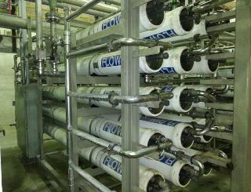
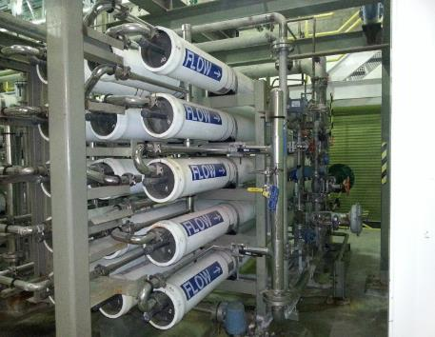
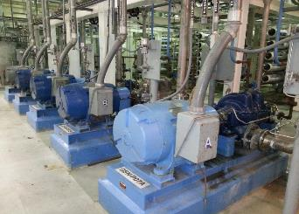
Ancillary WR Systems
Domestic Water
  Reverse osmosis units fed from on-site wells to provide all potable water needs, in addition to demin water needs

Slide 12
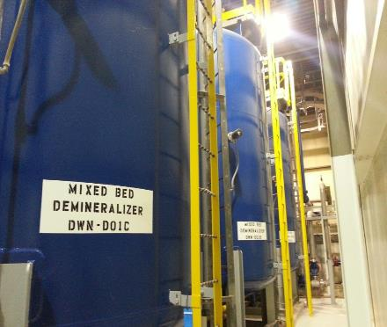
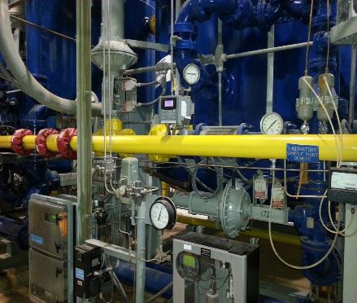
Ancillary WR Systems
Demineralized Water
  Mixed bed demineralizers are utilized to meet high purity water requirements for the site

Slide 13
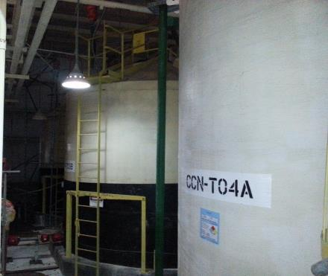
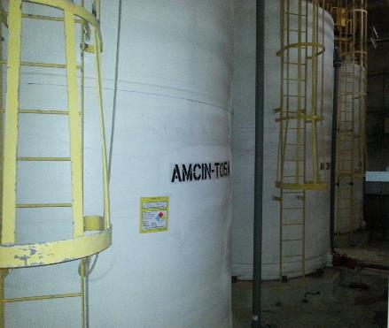
Ancillary WR Systems
Chemicals
  8% Hypochlorite (Bleach) and 8% Caustic provided to the site for disinfection and demineralizer regeneration needs

Slide 14
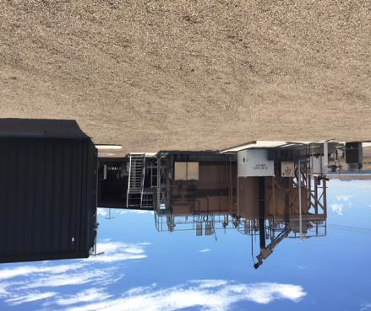
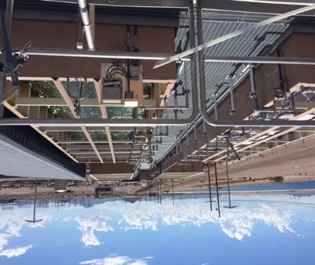
Ancillary WR Systems
Sewage Treatment Plant (STP)
  Water used in domestic facilities across the site discharge to the on-site STP where it is treated and returned to the WR influent to be used as cooling water

Slide 15
Configuration Management
WR Maintenance and Operations utilizes Procedure WRMA-8ZZ01, WR Maintenance Work Control
Provides the direction and guidelines necessary to implement the control of work, processing of work orders, and performance of work orders
WR Engineering utilizes two documents side-by-side to aid them through the design process:
WREN-8ZZ06 – Identifies the requirements and describes the overall processes for initiation, disposition, detailed design, implementation and closure of plant changes at PVGS-WR
IP-ENG-001 – Nuclear industry’s Standard Design Procedure (SDP), which was officially adopted by WR in Feb. 2021
Water Resources Design Package (WDP) options:
Design Equivalent Changes (DECs)
Commercial Changes
Design Changes
Temporary Modifications

Slide 16
Configuration Management
Notable points with design change process:
Environmental Screenings must be completed prior to the start of installation
A 50.59 Screening, when required, must also be completed prior to implementation
Commercial Changes account for most of the WDP’s implemented at WR
Under emergent situations and with Management approval, WR can perform work under an “Expedited WDP”. Ultimately, all steps in the procedure will be performed
If plant changes meet the screening criteria for document only changes, WR can implement “Paper-Change Only Process”
After revising WREN-8ZZ06 and incorporating the SDP in early 2021:
  have improved and streamlined our design change process
  seen a reduction in manhours by utilizing the commercial change WDP
  improved interdepartmental relationships by optimizing work and improving our processes

Slide 17
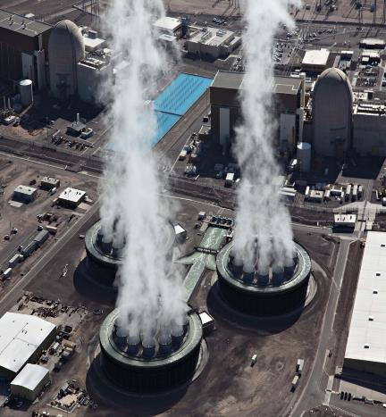
Cooling Water Statistics
2022 Cooling Water Intensity
  748 gallons/MWh
2022 Cooling Water Use
  73,000 acre-feet
2022 Cooling Water Cycles of Concentration (COC)
  26.1 average cycles
  25,000–30,000 PPM TDS
  7,000–12,000 PPM Cl

Slide 18
Cycles of Concentration

Slide 19
Water Supply Impacts

Slide 20
Water Supply Impacts

Slide 21
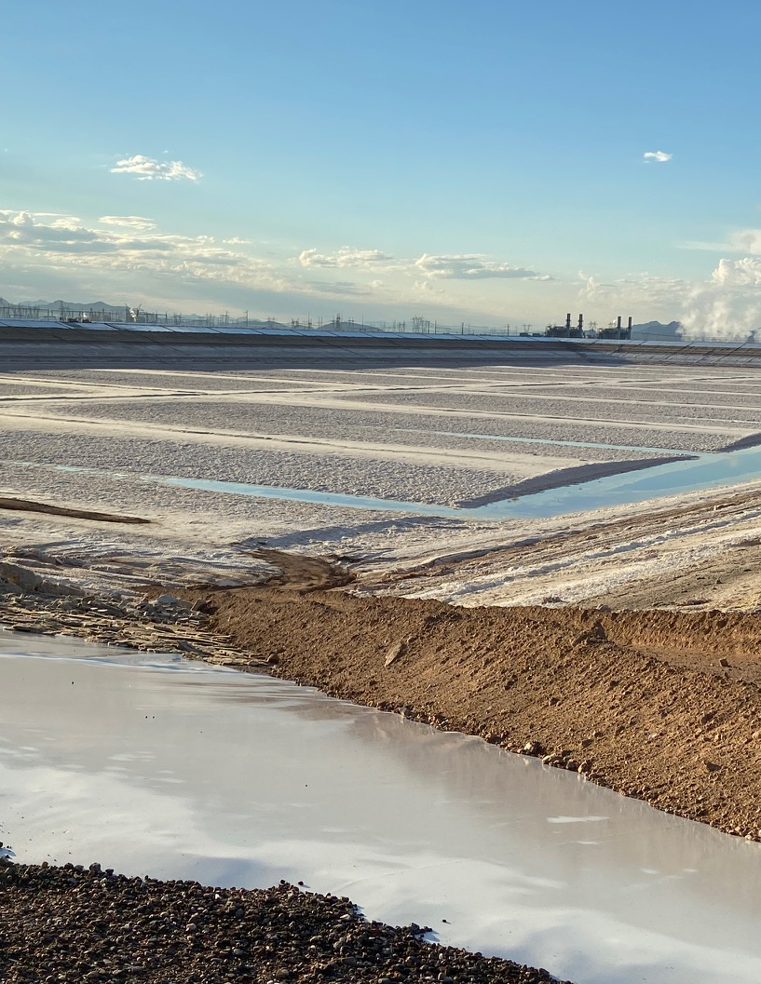
Water Supply Impacts

Slide 22
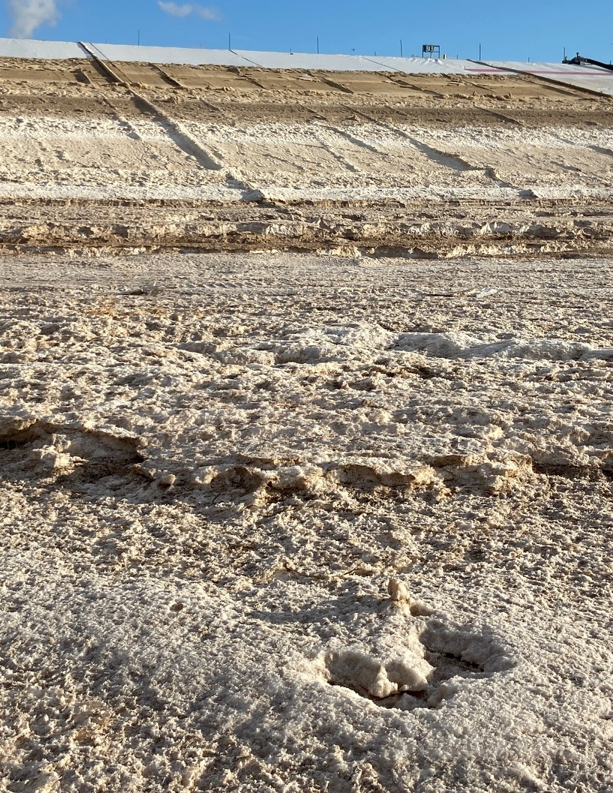
Water Supply Impacts

Slide 23
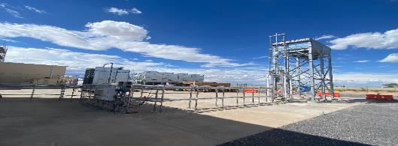
How To Preserve Our Water Resources?
Reduce how much water is needed
  Operational Efficiency/Pre-treatment => More CoC
  Temperatures => Dry cooling to augment cooling towers
    Reduced water temps leads to less evaporative loss, improved condenser performance, and more megawatts

Slide 24
How To Preserve Our Water Resources?
Alternate sources of water
  PV is the largest reuser of water in Arizona, what else can we do and how do we measure the impacts?
    Local Brine Management partnerships (on-going)
    Poor Quality Groundwater (discounted)
    Local Groundwater (not desirable)
    Sandia National Lab PV Water Cycle Model

Slide 25
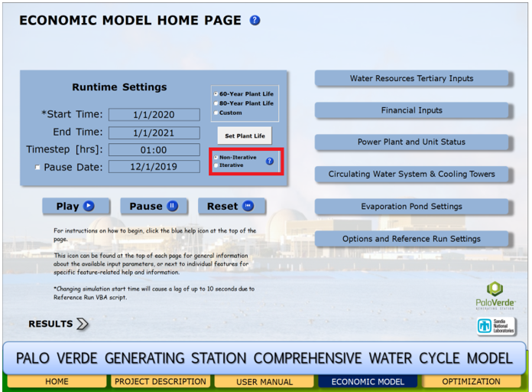

Slide 26
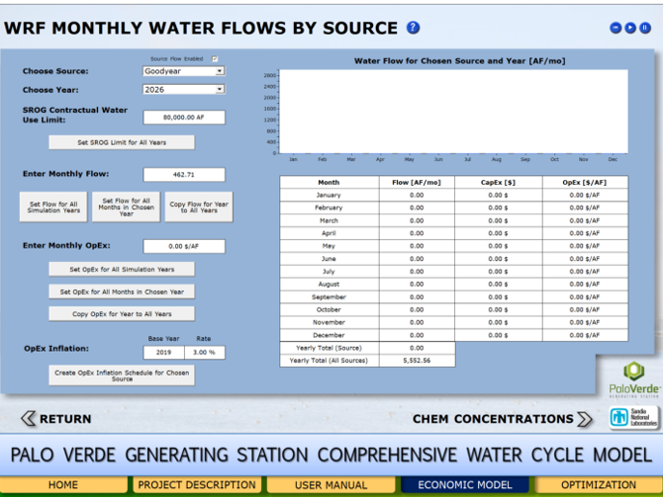

Slide 27
How To Preserve Our Water Resources?
Recycle as much water as possible
  Treat cooling tower blowdown (~29,000 mg/l TDS) to recover 60%, 80%, 90+% of the water
  Current technologies are either inefficient in recovery, tend to have high electricity demand, or have high infrastructure and operating costs > result in negative ROI’s
  What new developments address these short-comings to turn the ROI positive (or at least less negative)?

Slide 28
QUESTIONS??

