Slide 1
U.S. Women in Nuclear
Jamie McMichael,
Owner & State Regulatory Services Analyst
Palo Verde Women in Nuclear Chapter Chairperson

Slide 2
U.S. Women in Nuclear (U.S. WIN) is an organization of women and men who work in nuclear energy and technology fields around the United States. Our vision is aimed at positioning the United States for the future of nuclear energy and technology through the advancement of women. U.S. WIN’s objectives are to: • Drive a culture in nuclear energy and technology in which women and men succeed • Create professional development and networking opportunities for career advancement • Enhance understanding and awareness of the value of nuclear energy and technology

Slide 3
U.S. WIN Objectives at Palo Verde
Professional Development
Seminars/Webinars
Resume Workshops
Public Outreach
Educational
STEAM Events
Networking
Monthly Coffee Chat
EEC Open House
U.S. WIN Conference
Paint & Sip
Light Up the Holidays
Notes:
Palo Verde Women in Nuclear (PVWIN) promotes an environment in which all employees are able to succeed while encouraging public awareness about nuclear energy and technologies, promoting diversity within the nuclear field and providing a network through which employees can further their professional development.
Public Outreach aligns with U.S. WIN Core Initiative of Advocacy for Nuclear Energy & Technology
Aligns with PV – Our Principles
Professional Development → Learn and Improve
Public Outreach → Be Forward Looking
Networking → Succeed Together

Slide 4
Goals
Members of PVWIN are committed and willing to devote time and energy to the following activities:
Professional development opportunities
Encourage science, technology, engineering and energy education
Offer support to members who are striving for professional excellence
Work with education centers and community organizations
Work with PV committees/organizations and local organizations
Notes:
Professional development of the chapter members as well as the development of others within the Palo Verde community.
Encourage science, technology, engineering and energy education throughout the primary, secondary and collegiate education levels.
Offer support to PVWIN members who are striving for professional excellence by providing formal updates, communicating items of interest members, and providing guidance on continuing educational opportunities.
Work with education centers and community organizations to promote careers in science, engineering and nuclear energy. (West-MEC, Hermanas, etc) (members volunteer at boy-scout/girl-scout badge events)
Work with Palo Verde committees/organizations and local organizations to provide and educate APS Employees and the public with information on nuclear energy and the nuclear industry.

Slide 5
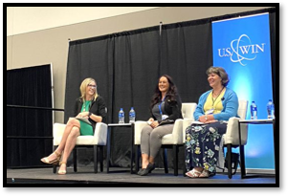
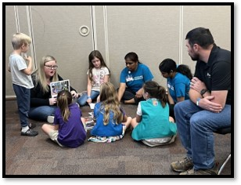
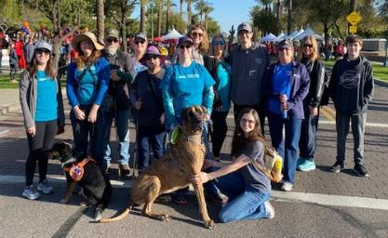
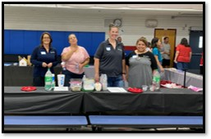
Recent PVWIN Activities
Notes:
Monthly Coffee Chat
Quarterly Meetings
Brown Bag/Lunch & Learn
Professional Development Opportunities
Interview IQ Bookclub
PD Week in September

Slide 6
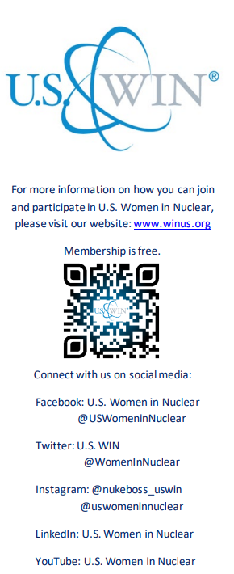
How to Join!
E-mail: PVWIN@aspc.com

Slide 7
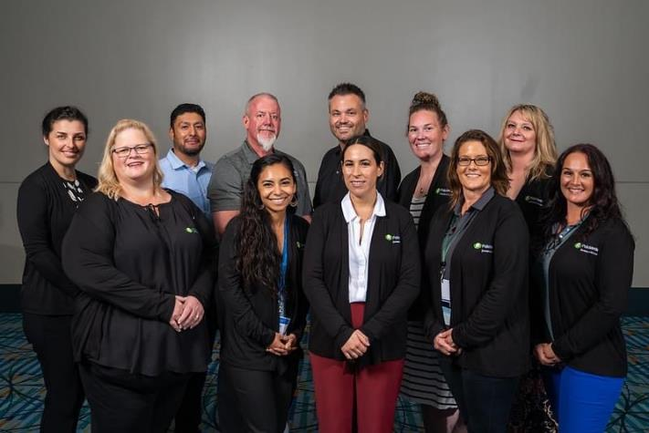
U.S. WIN Conference 2023
Hosted by Palo Verde Generating Station
Notes:
PVWIN has the fortunate opportunity to host the 2021 USWIN Conference.
We will work closely with NEI and USWIN to plan and prepare for this event and will provide many professional development opportunities for our members to include attendance, serving as facilitators and organizers, etc.

