Slide 1
Digital Modernization Update
Charles Melton
Tuesday July 23, 2024
CMBG Conference
8:45-9:15am

Slide 2
Agenda
DADS, DG, 7300
Overview
Implementation Lessons Learned
Design Closeout Lessons Learned
In Flight and Future Modifications
Closing

Slide 3
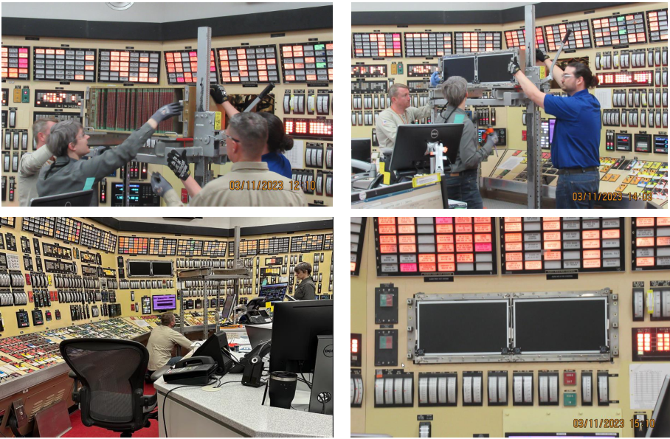
Digital Rod Position Indication(DRPI) Advanced Display System (DADS) Plant Farley and Vogtle
Overview-
The DADS provides functional redundancy, additional maintenance functions such as rod drop timing and troubleshooting, and shorter maintenance times while keeping the same fit and function of the original design.
Implementation Lessons Learned
Increase focus on software and hardware testing
(Software Gap with switch configuration and RX Trip)
Less reliance on original measurements for MCB
Get operations involved earlier for GUI changes
Obtain US vendor Documentation within MS Schedule.
Consider 24 hr. mod support.
Design Closeout Lessons Learned
Consider Project Resources and Schedule
Drawing, Calc, and Document (LDCR) updates
Paint and Labeling re-work and Open MWO’s
Notes:
Problem
The Westinghouse Digital Rod Position Indication (DRPI) display system is original to the plant. The circuit cards in the DRPI system have never been replaced, and due to the age of the cards failure is very likely. Loss of rod indication requires flux maps to be performed and the unit be down powered to ≤ 50 percent rated thermal power until the repair is completed.
Solution
Replace the DRPI display system with the Westinghouse DRPI Advanced Display System (DADS). The DADS provides functional redundancy, additional maintenance functions, and shorter maintenance times while keeping the same fit and function of the original design.
C11-F02
LL
Design
Early Availability of Vendor Documents
RX Trip Wiring and Trigger with Software
Software Gap with Switch Configuration
Measurement Gap on MCB- Bezel
Implementation (OE)
Sliding Links on Terminal Blocks
Field cables not labeled per drawing
Test Monitor cards not responding as planned
Loose Amphenol Connection

Slide 4
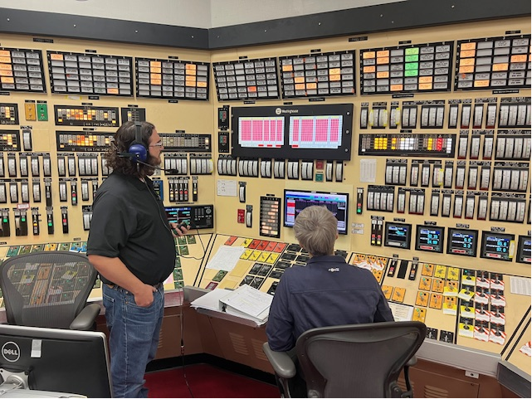
Digital Rod Position Indication(DRPI) Advanced Display System (DADS)- Plant Farley and Vogtle

Slide 5
Digital Gateway- Plant Vogtle, Farley, and Hatch
Overview
Upgrade the equipment in all Digital Gateway cabinets to new SNC standard equipment in accordance with fleet's Digital Modernization Strategy architecture. An additional data diode will be installed to separate data destines for the business LAN to alleviate unnecessary bandwidth allocation and data capacity for plant systems that feed the plant computer.
Implementation Lessons Learned
Consider point to point spreadsheet for terminations on unscheduled equipment
Address legacy Issues early with walkdowns and associated document searches
Cyber- Verify Long Lead Procurement, Solidify Install details with craft, Prepare CDA Assessments early
Collaborate with Procurement to classify digital hardware into commodity Items
Ensure inventory in warehouse before install
Create Development Center
Ensure Test Writers for obsolete systems are available
Design Closeout Lessons Learned
Work Order Closure associated with Cyber PMCR’s and Maximo issues
Drawing conflicts with other in-flight designs – Dwg and calc incorporation
Cabling and labeling re-work
Notes:
Problem
The equipment utilized by the Level 4, Level 3, and Level 2 Boundary Isolation Device (BID) cabinets has reached its end of life and will not be in compliance with the fleet's Cyber Security Plan (CSP) for SNC. Without support from the OEM, challenges will persist in maintaining these devices as required by the fleet CSP. The servers/operating systems, network switches, and data diodes are past their end of life and replacements are not available. Firewalls are also past their end of life and had extended vendor support until 2nd quarter 2022. Failure of any of these devices could result in loss of remote logging/information gathering, which will require more in-person walkdowns of equipment, or loss of data flow to/from the Integrated Plant Computer (IPC) from/to multiple systems. In addition, it is anticipated that the usage of the BIDs will increase with new design changes as part of the fleet's Digital Modernization Strategy, challenging the bandwidth the existing BID equipment is capable of supporting.
Solution
Upgrade the equipment in all BID cabinets to new Southern Nuclear Company (SNC) standard equipment in accordance with fleet's Digital Modernization Strategy (NMP-ES-038-GL07, Attachment 7), architecture for SNC. This includes a Splunk SIEM software, Palo Alto firewalls, OWL data diodes, DELL servers, Synology servers, Cisco switches, and Dell KVMs and KMMs. Installation of a data diode to separate data destined for the business LAN will alleviate unnecessary bandwidth allocation and data capacity for plant systems that feed data to the IPC. A reliable, redundant power distribution strategy for Vogtle has been designed such that critical components will function in the event of a loss of power to one of the power distribution units. The critical components addressed in the redundant power distribution strategy can be found below in Table 1.
Current BIDs system has redundant power at the component level for the data diodes only. This package provides redundant power for critical components shown in Table 1 below. The redundant power supplies provide power to these critical components to ensure the design function of BIDs and data flow will be maintained during a loss of power event, which increases the overall reliability and availability of the Digital Gateway.
P45
LL
Ensure resources are available for Plant Computer and Cyber Testing, Fiber and CAT 6 Wiring
PMs are created for updated components ( Closeout)
CDA Assessments are prepared and reviewed as early as possible
Legacy Issues( unlabeled Fiber/Cat 5, abandoned/retired in place equipment and cables) and designs that affect your project are know and addressed before implementation
Procurement of Long Lead Items in ALOM
Pick Items in warehouse and store in alternate locations for testing
Point to Point Wiring Spreadsheet for Craft
Layout in Front or Back of cabinet for components
Consider cache overflow for component that continue to send data during implementation
If possible, move all components to be front facing. This will help in troubleshooting and walkdowns to identify issues.
Get Cable tags specifically for CAT 6cable to prevent them from falling off.
Verify Installers
Ensure you have alternative vendors for power and ethernet cables
Understand that without an active directory, every audit configuration will have to be tested Individually
Ensure cables/equipment for your project are designated for your use only
Consider point to point spreadsheet.
Clear Cache when components are rebooted.
Testing and affected groups( Operations, Rx Engineering)
Create Development Center

Slide 6
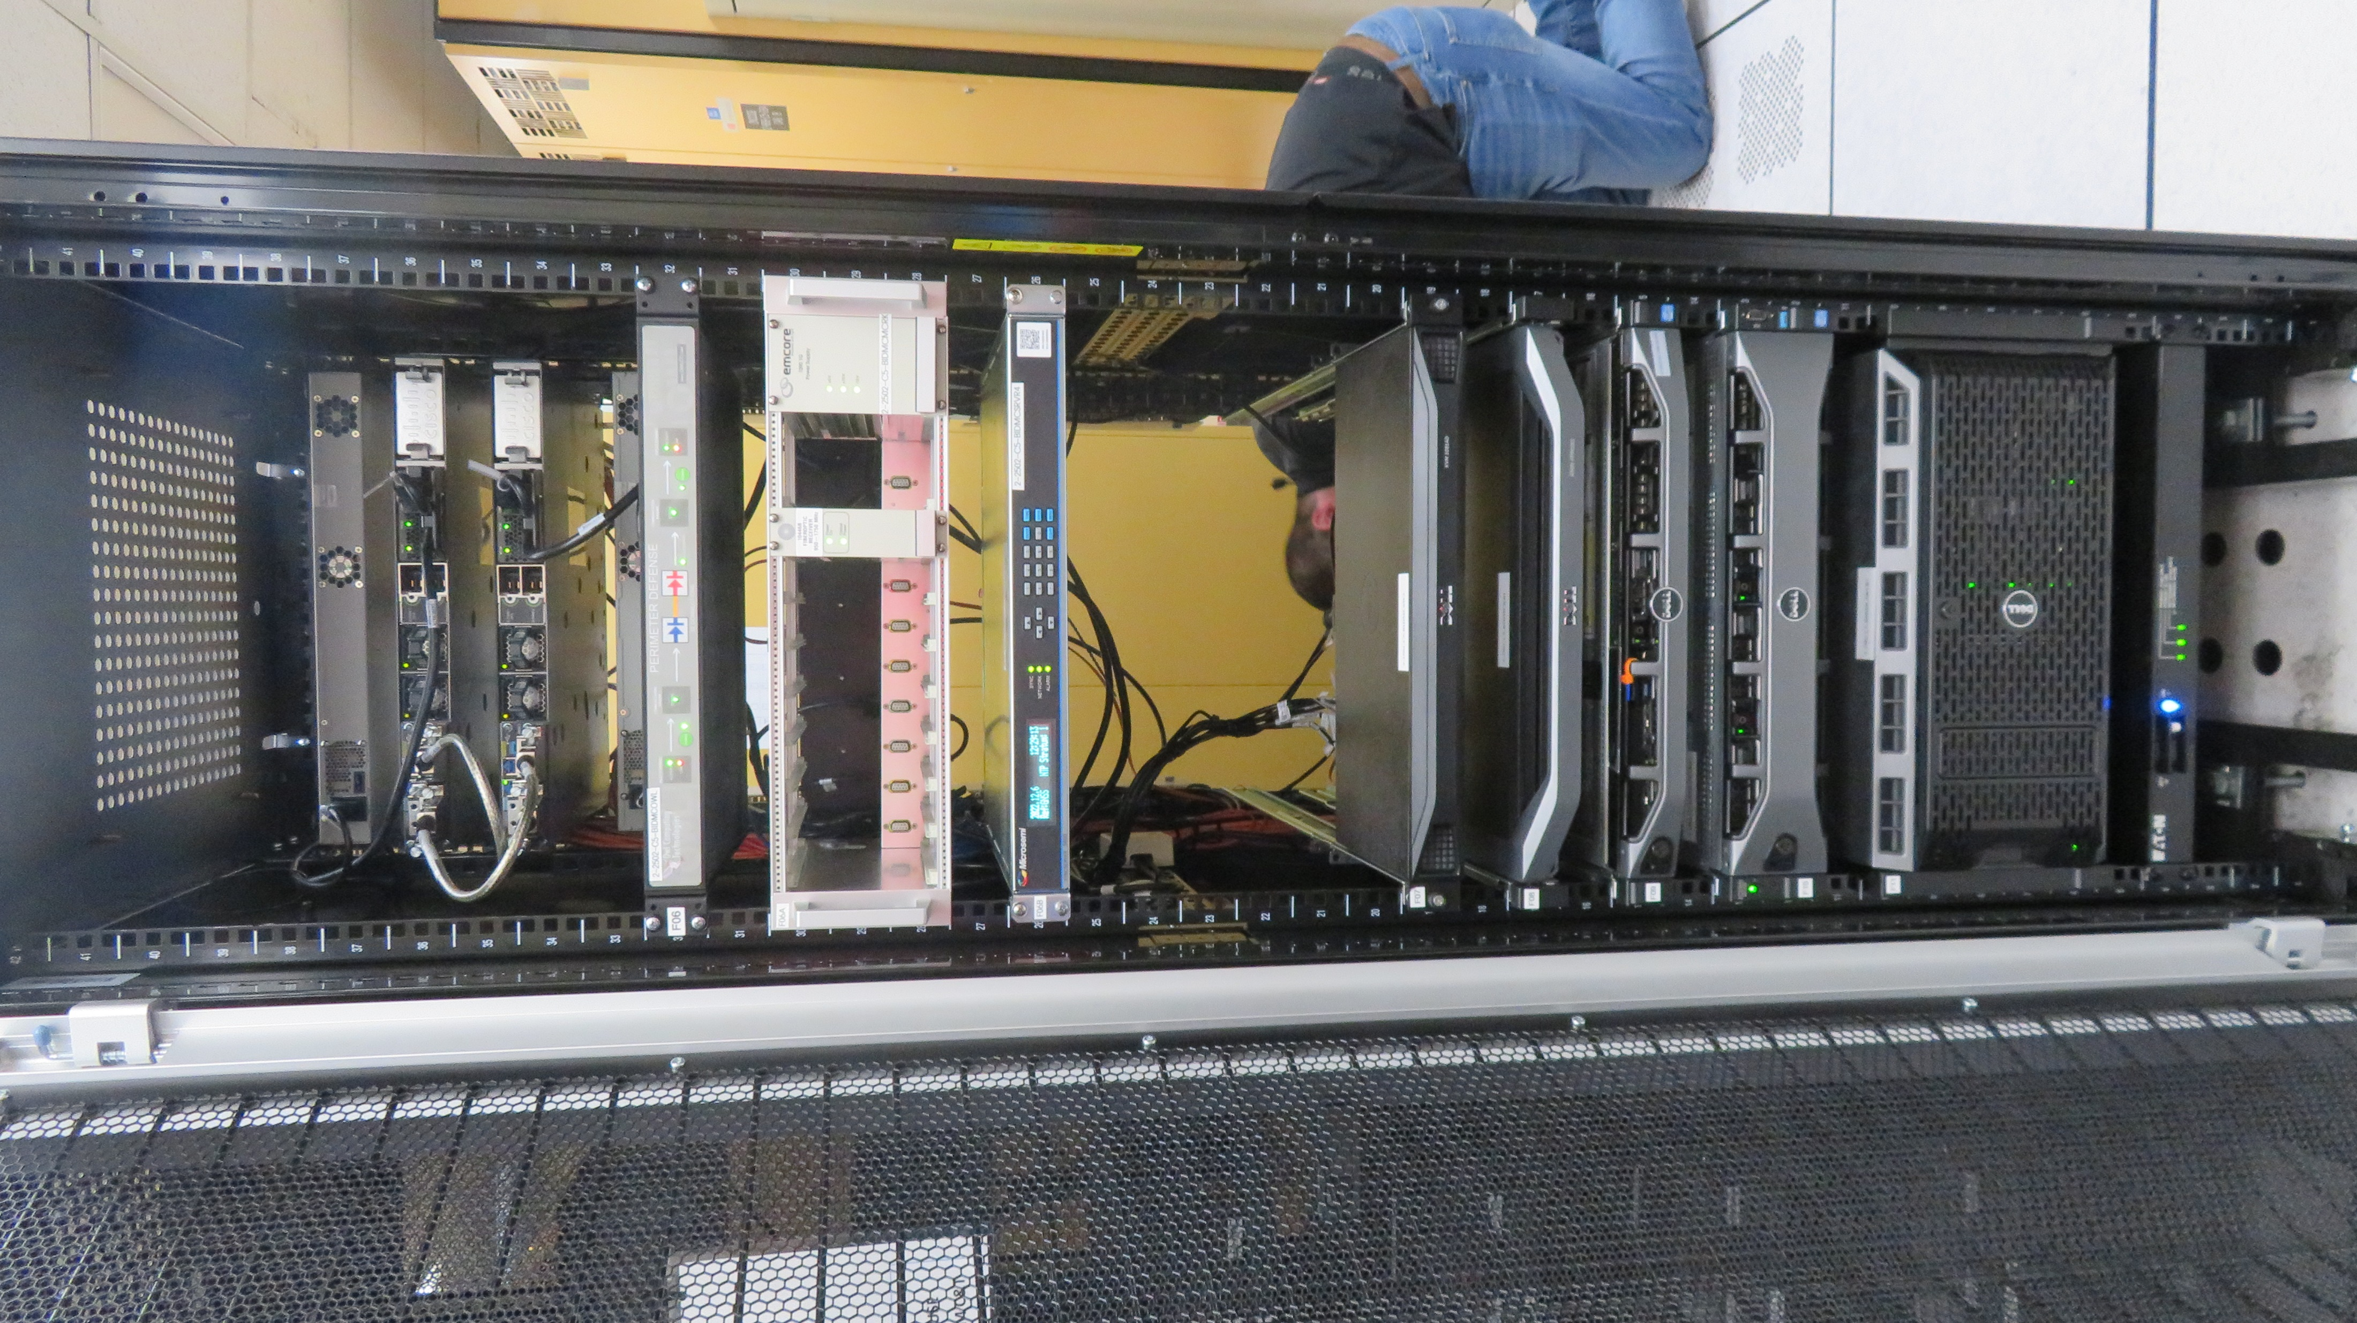
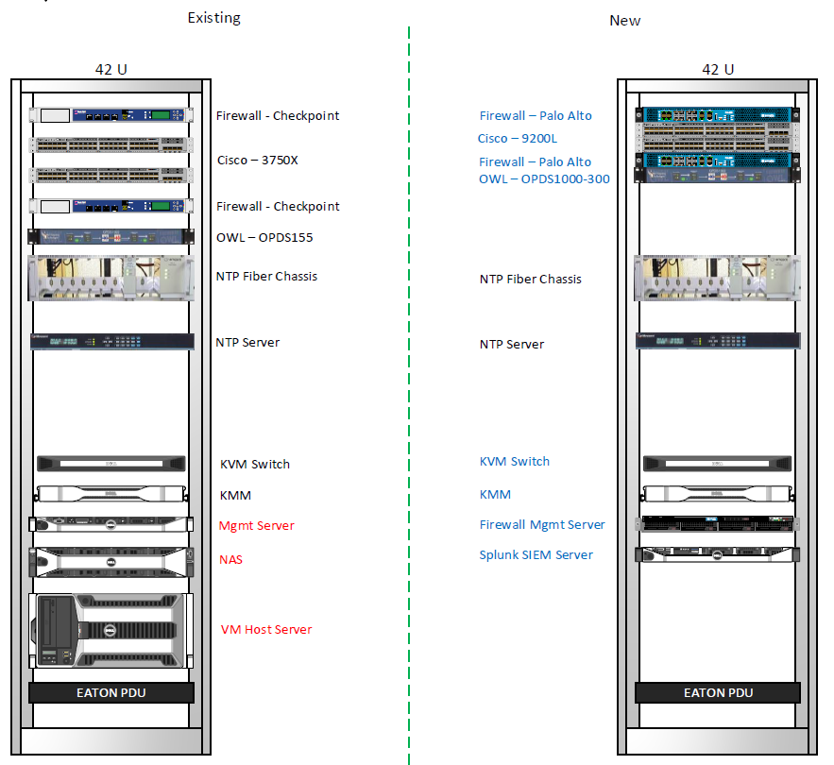
Digital Gateway- Plant Vogtle, Farley, and Hatch

Slide 7
7300 Control Replacement and Steam Generator Feed Pump (SGFP) Speed Control- Plant Farley
Overview
Upgrade equipment for the nuclear steam supply system (NSSS), digital electrohydraulic (DEH) turbine control system, and the steam generator feed pump (SGFP) control systems with digital Westinghouse Ovation technology as part of the SNC fleet modernization strategy. This will ease the burden on maintenance, improve the interface with operations, and reduce the number of single points of failure within the control system.
Implementation Lessons Learned
Lead breakouts to ensure that interfaces are clearly understood, and design inputs /testing requirements are verified. Last minute tuning and software changes should be done with caution
Increase knowledge and discuss ownership of Contingency Plans, Plant Computer and Cyber Test development/ Execution
Ensure adequate time is available to plan next Unit/Site Design to incorporate Lessons Learned involving incomplete testing and legacy errors
Cyber- Long Lead Procurement, Install details, Testing per site config
Design Closeout Lessons Learned
Ensure resources for closeout aren’t shifted to next unit install
Plan for changes to PM’s and Work Orders from addition and Deletion of Locations/Assets
Plan for multiple closeout revs and impact review delays due to the outage
Notes:
Problem
The nuclear steam supply system (NSSS) and the steam generator feed pump (SGFP) control systems at SNC are vintage systems and are reaching the end of their design life. The technology has become obsolete and is no longer supported by the original equipment manufacturer (OEM). There are also many single points of failure within the control systems.
Solution
The nuclear steam supply system (NSSS) and the steam generator feed pump (SGFP) control systems are being replaced with digital Westinghouse Ovation technology as part of the SNC fleet modernization strategy. The new control systems will ease the burden on maintenance, improve the interface with operations, and reduce the number of single points of failure within the control system. The Digital Electro Hydraulic (DEH) turbine control system will be "refreshed" to match the Ovation software version and network switches utilized for the NSSS upgrade.
C22
Better More Invasive Walkdowns
Validate Breaker Panel Interfaces
Door Misalignment Additional
Measurements and create contingencies where possible
.Inability to walkdown certain aspects online- try to plan ahead in outages before implementation or unplanned outages.(MCB Measurements, Wire Wrap issues)
Alignment with Vendors, More in-depth review on design inputs and testing requirements for low risk items as well as high risk.
U2 lessons learned successfully incorporated into U1 cut FCR count in half.
Multiple FCRs performed on Unit 1 that were a result of inadequate Unit 2 implementation or unknowns due to incomplete testing on Unit 2 due to non-functioning legacy equipment.
Reduce updates or repurposing FCRs for the same or similar topic to avoid confusion (FCR014, FCR016, FCR019)
Regular Changes to the design package leading up to the outage (necessary to incorporate U2 lessons learned) caused challenges to planning and some misses.
Wire wrap planning included attachments which were copies of design documents but cleaned up for ease of install. These were copied over with some errors and omissions
Westinghouse provided last minute tuning recommendations which caused challenges during the outage.
More invasive and effective Walkdowns related to the Cable Spreading room.
Evaluation of assumptions within the design enabled early outage discovery. However, steam dump early discovery was not effectively addressed by the site prior to it causing an impact.

Slide 8
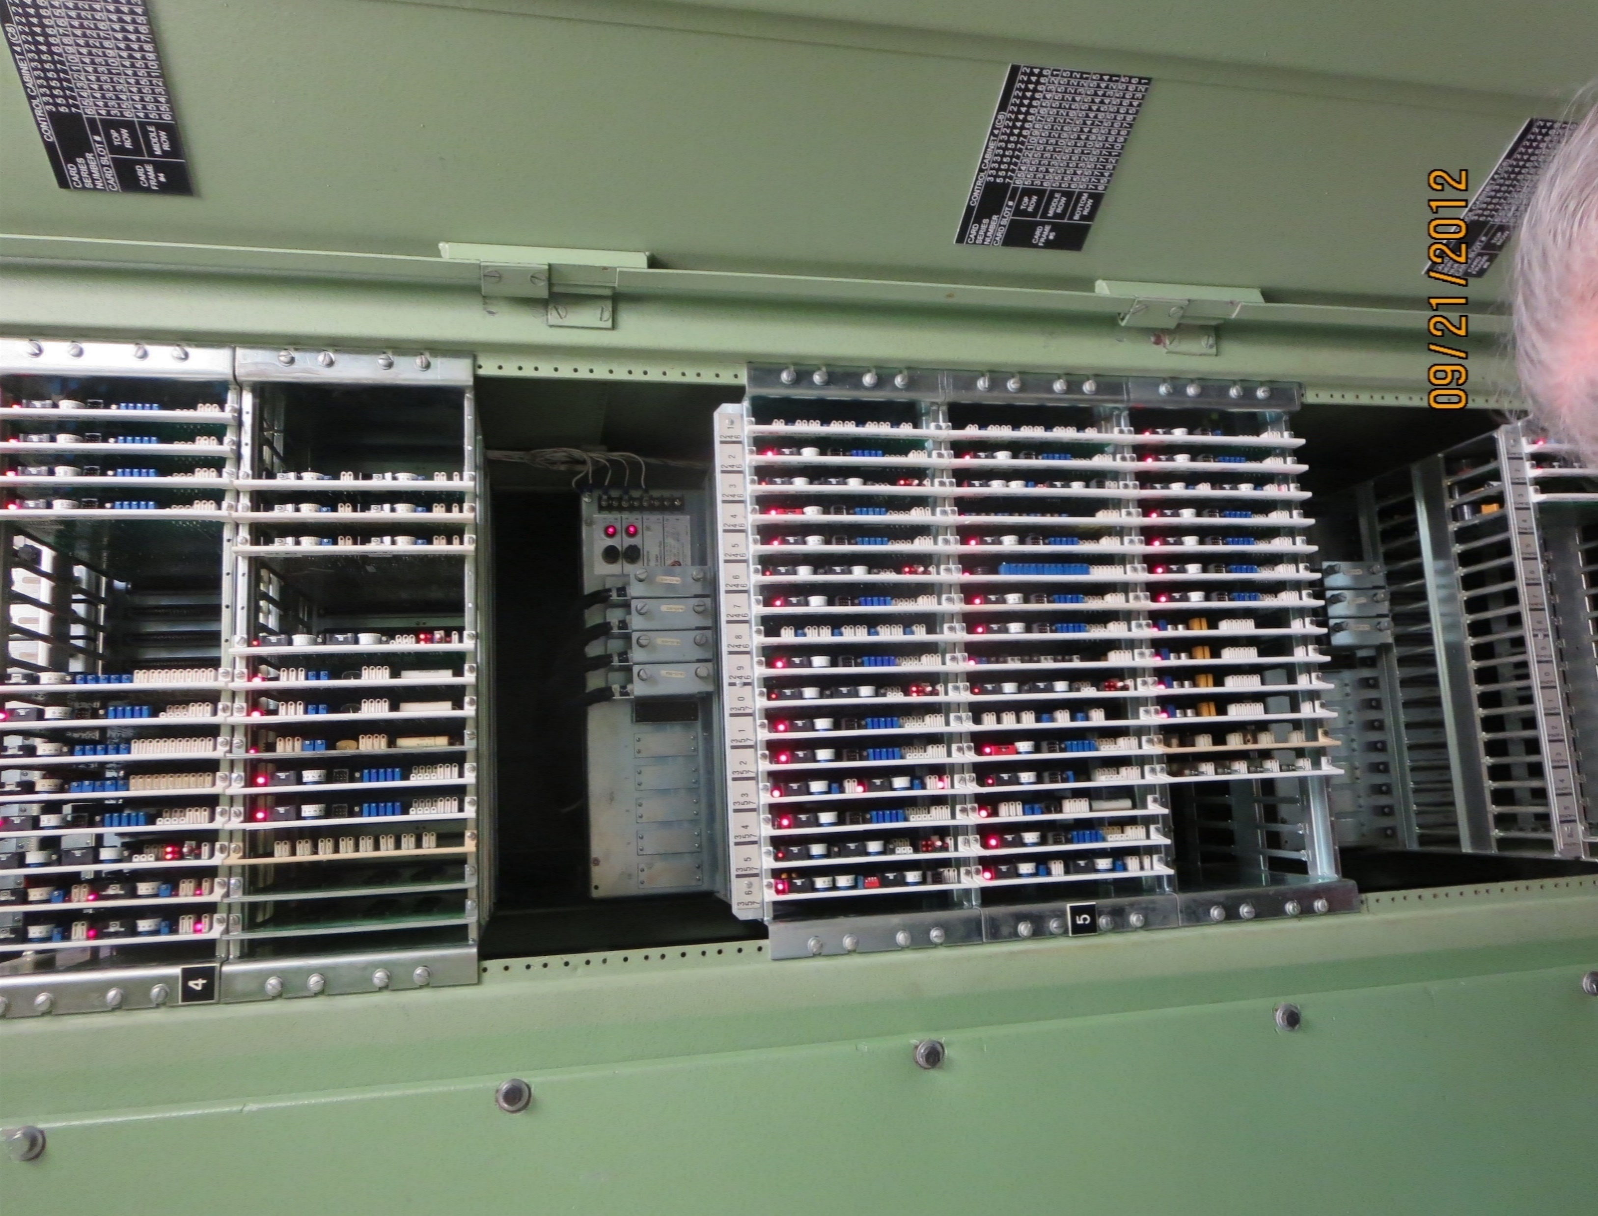
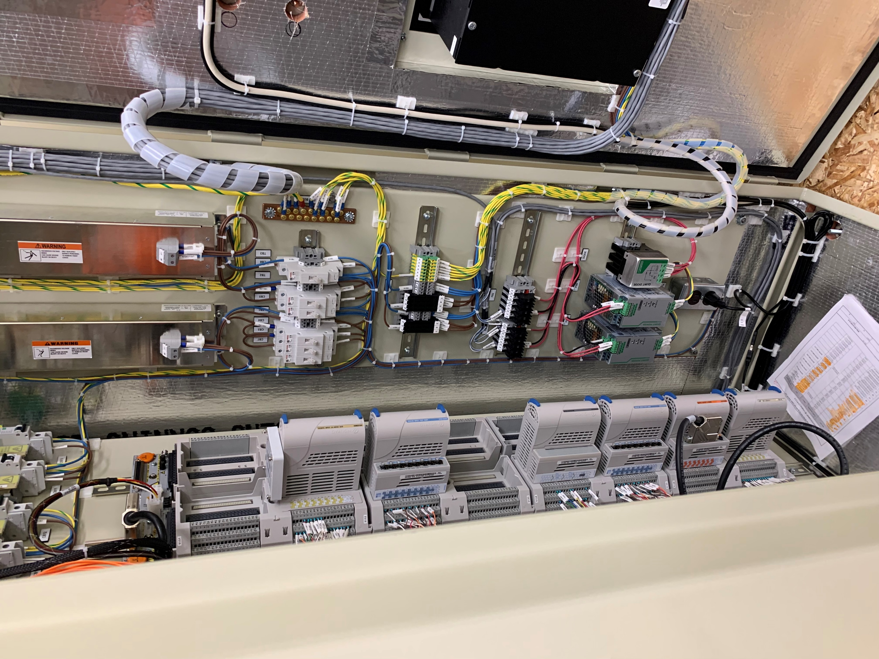
7300 Control Replacement and Steam Generator Feed Pump (SGFP) Speed Control- Plant Farley
Notes:
Problem
The nuclear steam supply system (NSSS) and the steam generator feed pump (SGFP) control systems at SNC are vintage systems and are reaching the end of their design life. The technology has become obsolete and is no longer supported by the original equipment manufacturer (OEM). There are also many single points of failure within the control systems.
Solution
The nuclear steam supply system (NSSS) and the steam generator feed pump (SGFP) control systems are being replaced with digital Westinghouse Ovation technology as part of the SNC fleet modernization strategy. The new control systems will ease the burden on maintenance, improve the interface with operations, and reduce the number of single points of failure within the control system. The Digital Electro Hydraulic (DEH) turbine control system will be "refreshed" to match the Ovation software version and network switches utilized for the NSSS upgrade.
C22

Slide 9
In Flight and Future Modifications
Site | Project | Description | Unit 1 | Unit 2
Hatch | Main Control Room Vision | Hatch MCR Common Design | 2023 | 2023
 | Feed Water Heater Level Control | FW Heater Controls on Ovation: | 2024 | 2023
 | Demin's | Condensate Demineralizer Control on MCB | 2024 | 2025
Farley | Main Control Room Vision | Hatch MCR Common Design | 2023 | 2023
 | Nuclear Steam Supply/ Steam Generator Feed Pump | 7300 NSSS- Controls and Feed Pump Controls on Ovation | 2024 | 2023
 | Annunciators | Annunciator System on Ovation with updated Displays | 2027 | 2026
 | Rod Control | Rod Control Logic on Ovation | 2027 | 2028
Vogtle | Main Control Room Vision | Hatch MCR Common Design | 2023 | 2023
 | Nuclear Steam Supply/ Steam Generator Feed Pump | 7300 NSSS- Controls and Feed Pump Controls on Ovation | 2027 | 2028
 | Annunciators | Annunciator System on Ovation with updated Displays | 2028 | 2029
 | Feedwater Heater/7300/Balance of Plant | FW Heater controls and BOP on Ovation | 2029 | 2028
 | Main Turbine/Steam Generator Feed Pump Turbine/ Exciter | MK6e Integration into Ovation | 2029 | 2028

Slide 10
Closing
Comments/Questions?

