Slide 1
Plant Modernization
Some Key Findings to Date
Configuration Management Benchmarking Group
Chicago, Illinois
Robert Austin
EPRI
July 23, 2024
Notes:
Objective: overview of EPRI findings to date on modernization
Payoff: Maybe not what you think, or maybe it is.

Slide 2
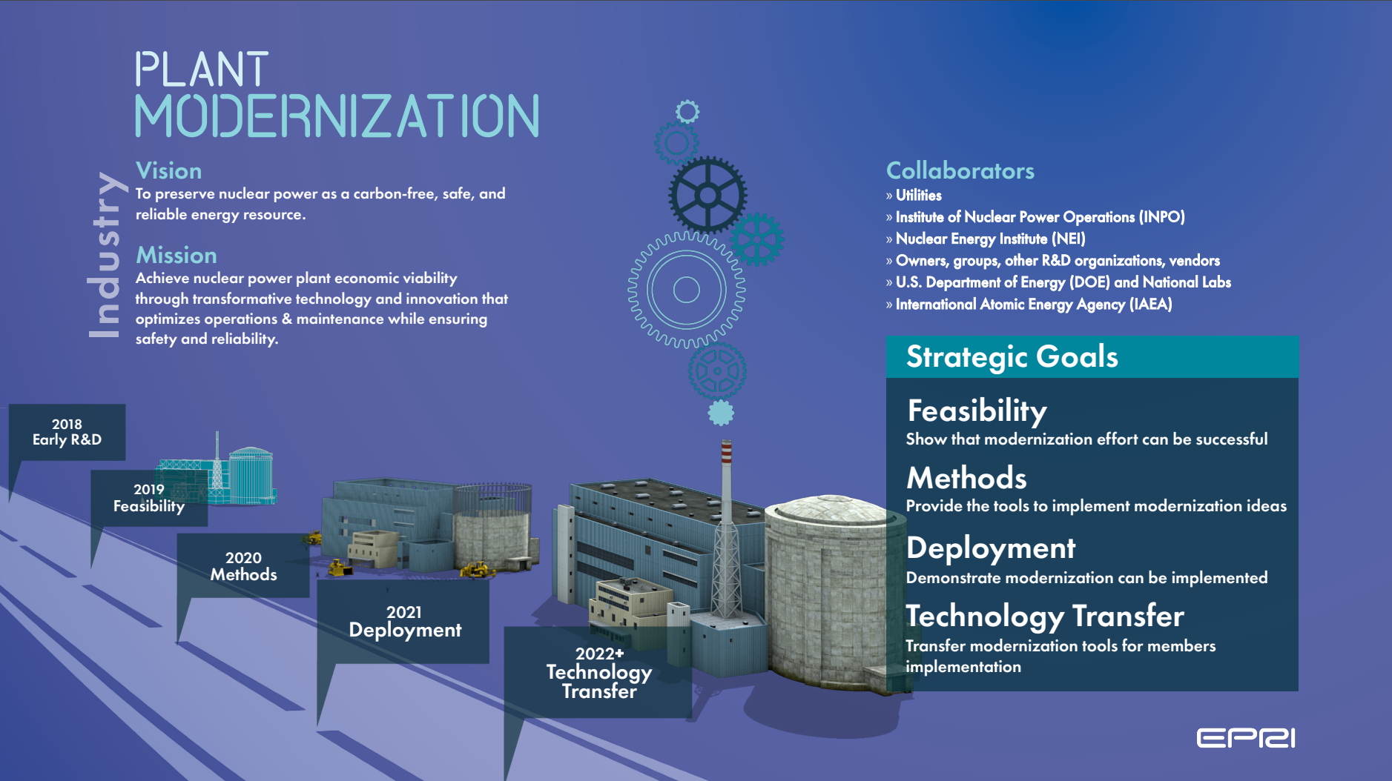
Transition to Digital Transformation
Notes:
Culmination of 5+ years of focused R&D. Key questions: how can we deploy modernization?
Implemented at many utilities.

Slide 3
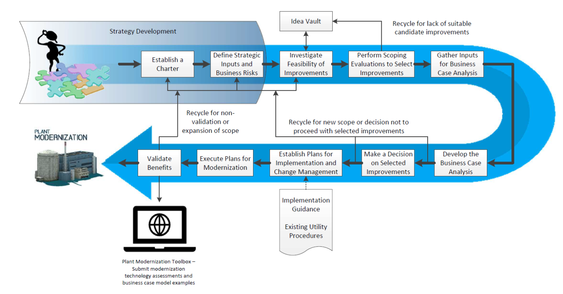
Overview of Plant Modernization Approach: Modernization Process
Strategy Development
Project Selection
Project Execution
Modernization Strategy Development & Implementation Technical Report (3002020908)
Notes:
Process has been enhanced, but overall stood the test of time so far.

Slide 4
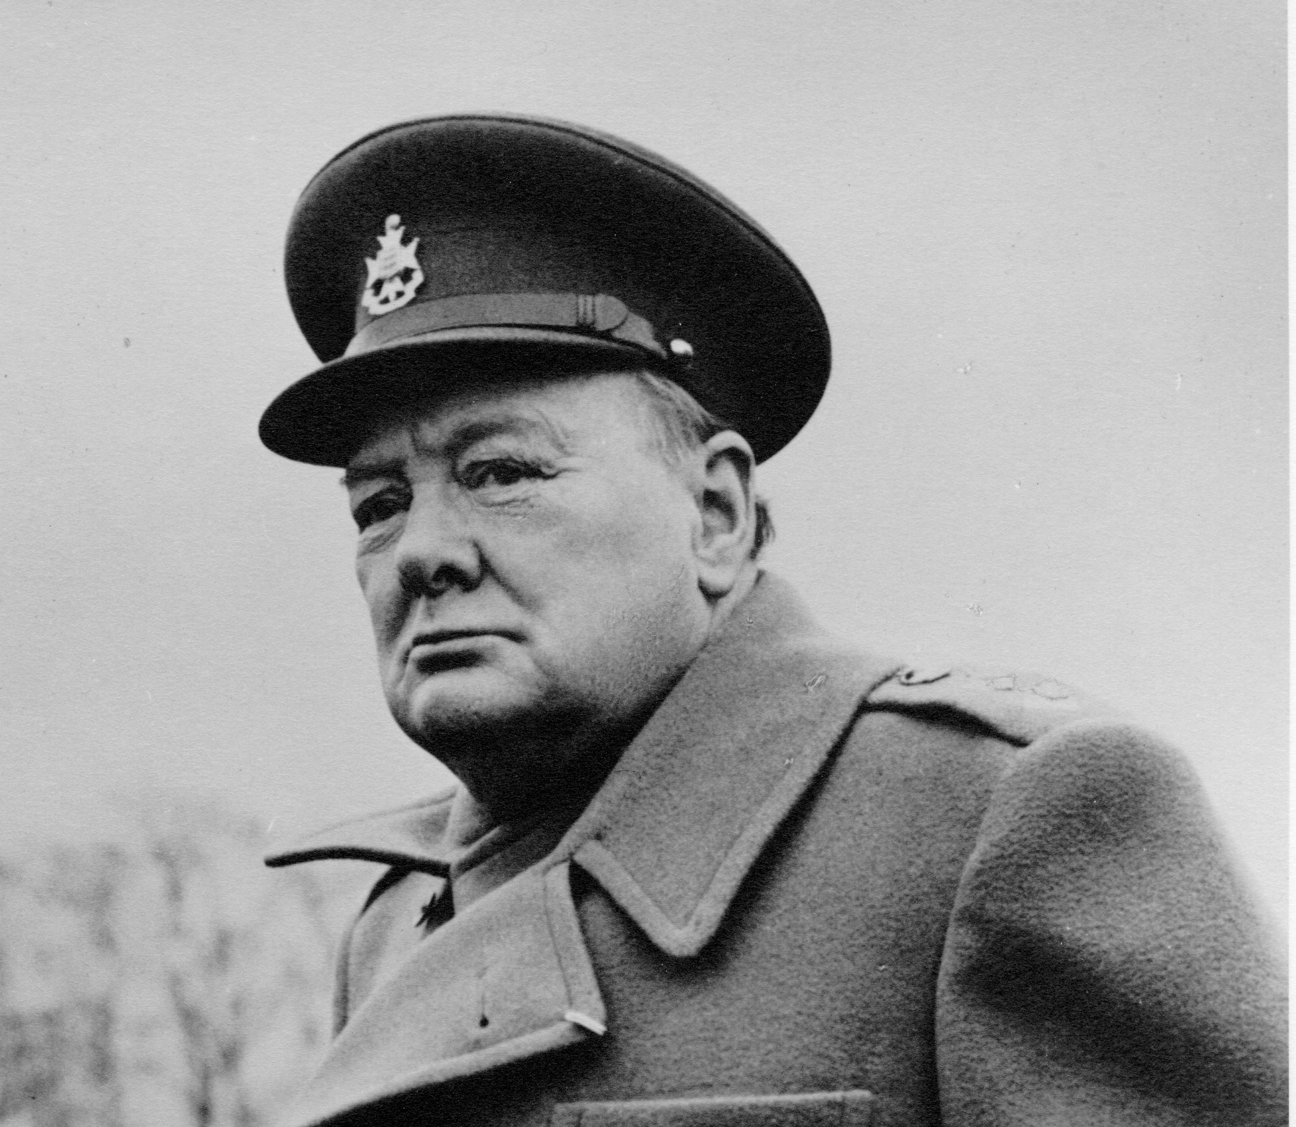
Strategy Development
Establish a charter
  Otherwise, no one will agree on what’s important & priorities
Key inputs & business risks
  Everyone is different
  What are YOUR station’s key themes?
    Remaining station life?
    Major project proficiency?
    Other major projects?
    Do you have a comprehensive list?
New processes HAVE to fit into existing station process – not be one more thing
Executive leadership CRITICAL

Slide 5
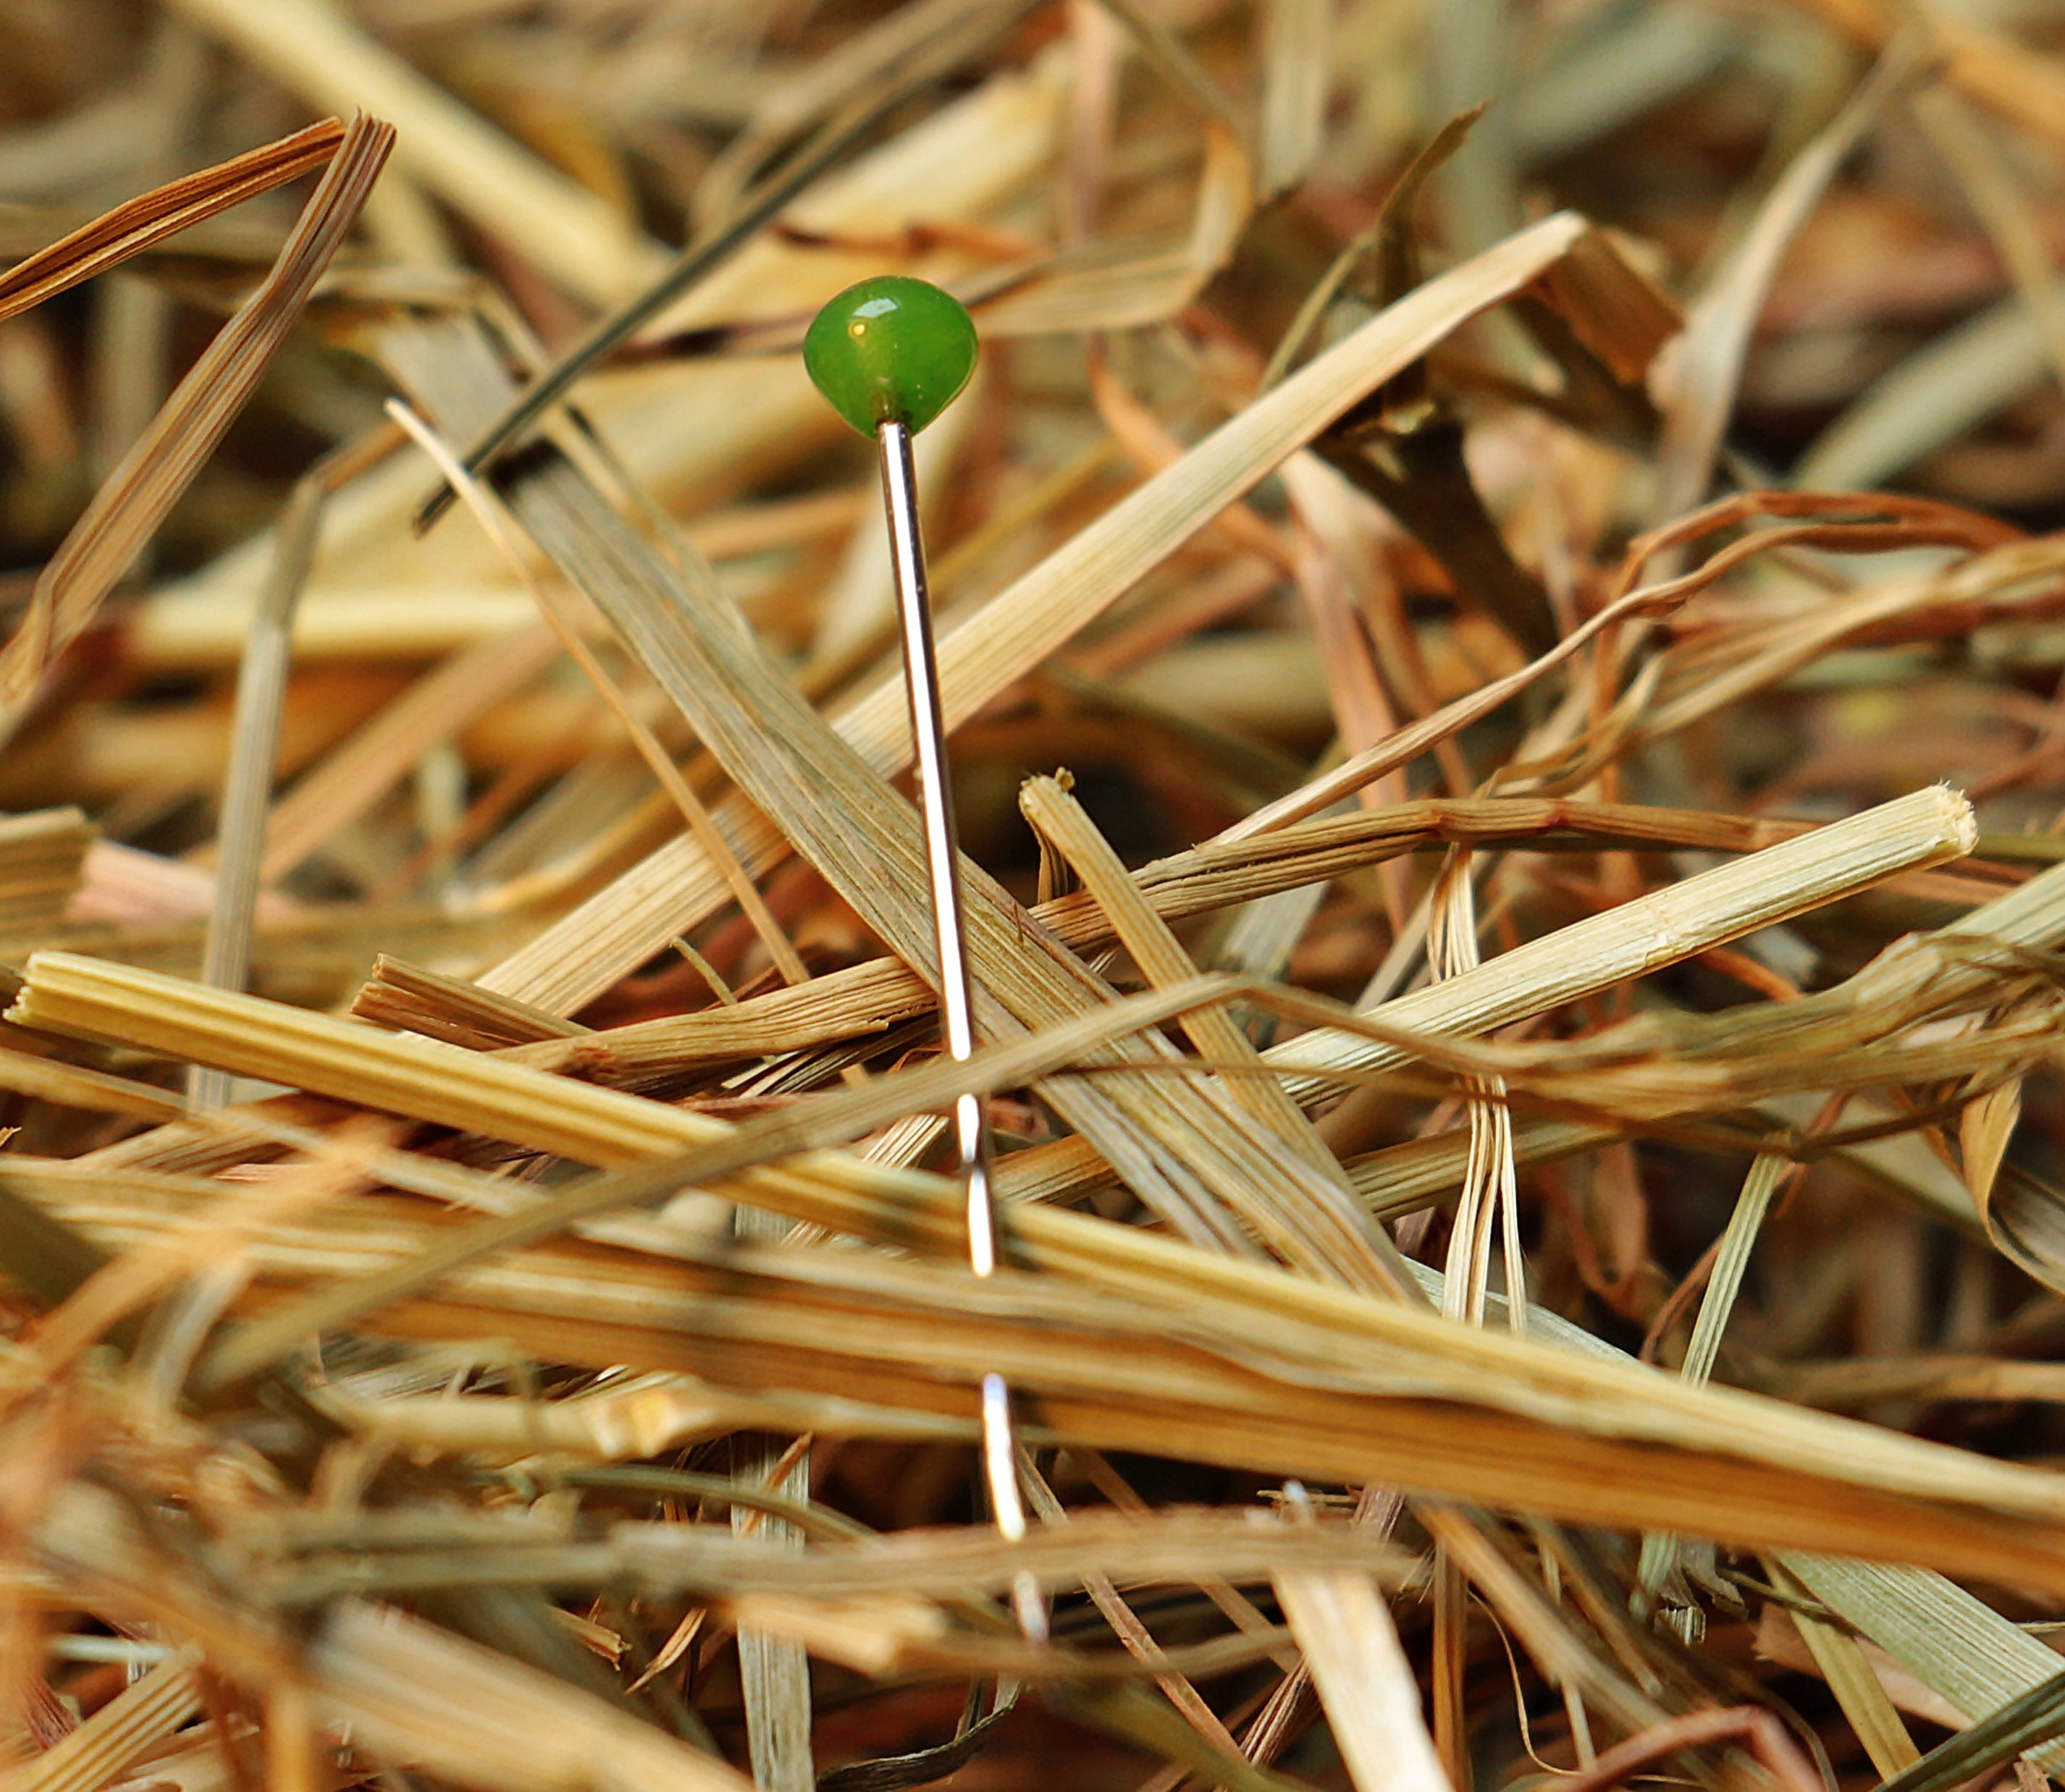
Project Selection – Identify Improvements
There is no shortage of good ideas
  EPRI has identified over 200 (!) candidate ideas
  Source NEI TIP, EPRI Technology Transfer, literature review, EPRI R&D, etc.
But where to start?
  Cannot implement everything at once
Shortage of innovative ideas is NOT a problem

Slide 6
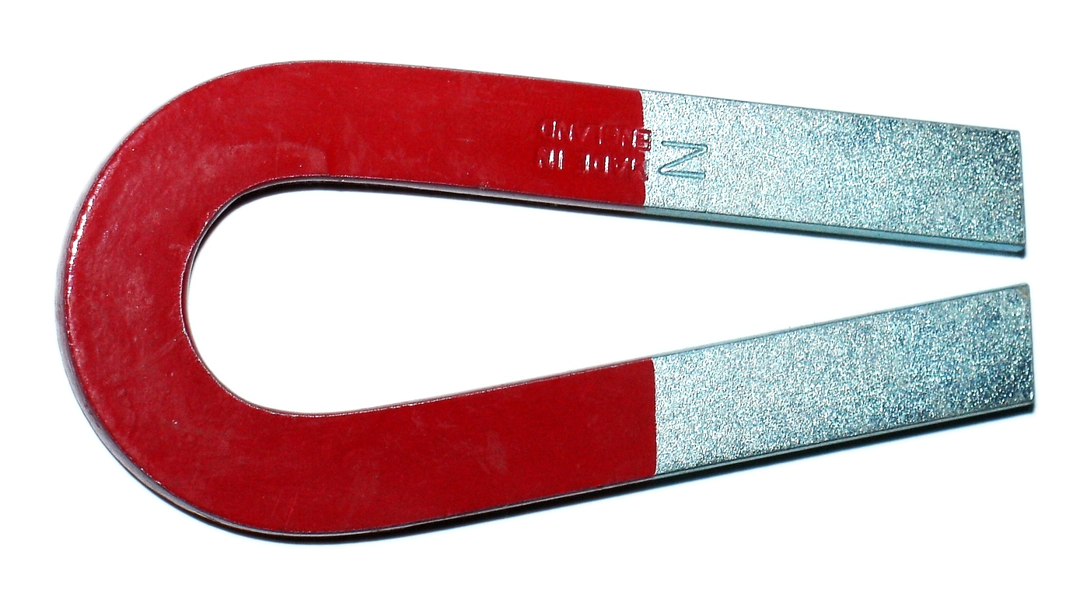
Project Selection – Select Improvements
Eliminate ideas that are not within station “key themes”
  E.g., if the station only has 10 more years of licenses life, major modifications probably do not make sense
    But don’t forget these in case life extension
Simple screening system
  Payback, cost to implement, degree of maturity required, etc.
On-line business case tool
Some of the best ideas are the most prosaic
  E.g. risk analysis to reduce inspection burden
  Not as cool as robots, but better immediate payback
Needle in a haystack’s easy - just bring a magnet

Slide 7
EPRI’s ”Magnet”: Process for Screening Ideas
Step 3: Investigate Feasibly of Idea
  Go/no-go decision
    Applicable?
    Align with overall strategy / key themes?
    Belong in modernization process?
  Disposition
    Send to other process?
    Proceed to scoping evaluation?
    Idea Vault?
Step 4: Perform Scoping Evaluation
  Alternatives assessment
  Interviews with potential end-users
  Interviews with potential project team
  Interviews with stakeholders
  Qualitative/Quantitative Scoring
  Prioritization/Disposition

Slide 8
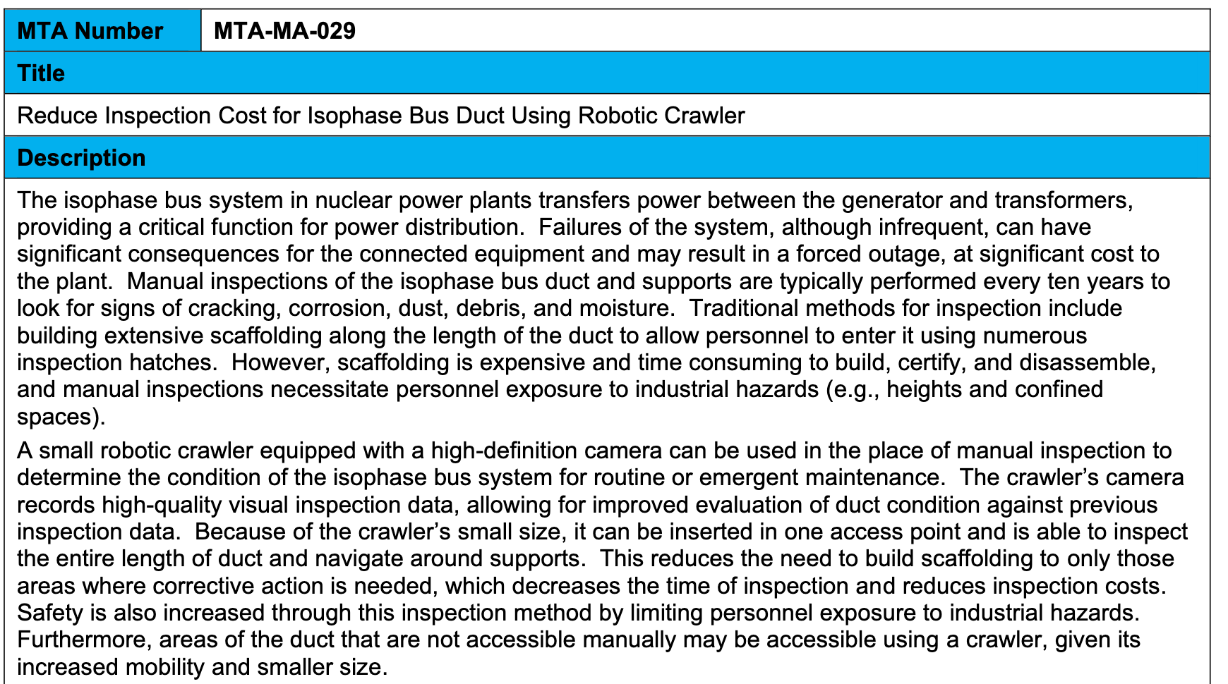
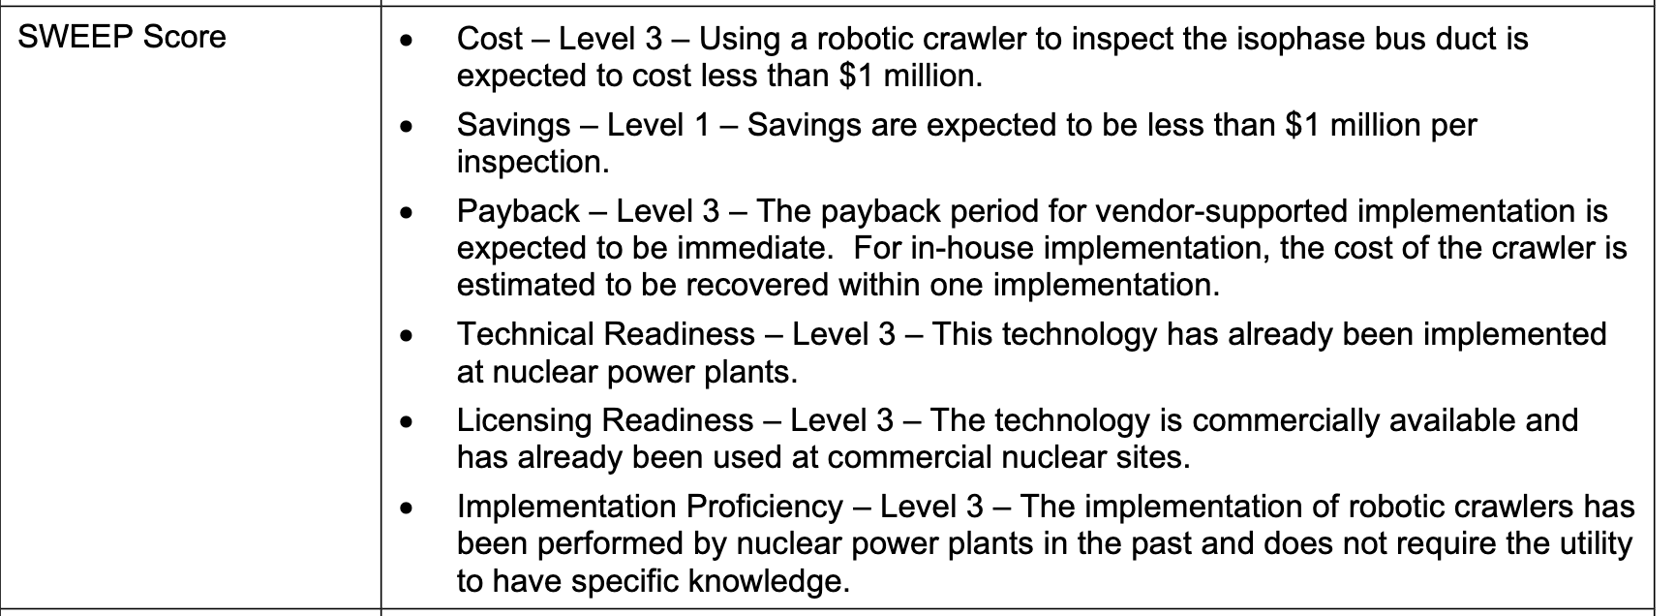
EPRI Modernization Technology Assessment (MTA) &
“SWEEP Score” for Applicability & Screening
From: https://nuclearplantmod.epri.com/mta
”Full” Business Case Not Always Needed

Slide 9

Project Selection – Gather Inputs & Business Case
Business cases identify key project parameters for success, for example:
  What is required usage for EWP to pay for itself?
  How much generation risk is needed for M&D to make sense?
  What does the per sensor installation cost have to be for the project to be worthwhile?
Benefits are not strictly efficiency
  Improve safety, nuclear & industrial
  Improve employee productivity
  Improve employee retention / attraction
    Attrition WILL happen; this helps station to deal with it
  Avoid wastage of parts
  Reduce obsolescence
  Establish consistent designs for sensors, etc.
  Reduce generation risk
It’s not about the money

Slide 10
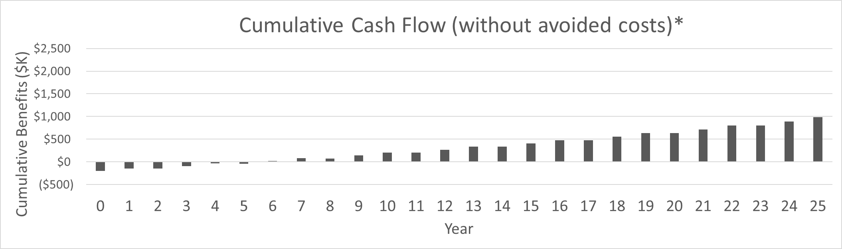
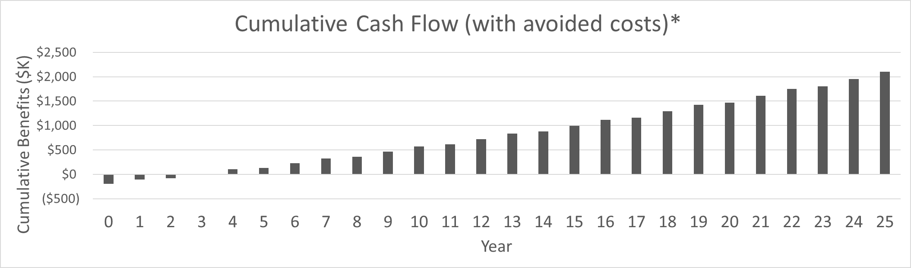
BCAM Example – Large Motor Monitoring
OLM Technologies in Analysis:
  Electrical Signature Analysis
  Vibration Analysis
Inputs:
  Implementation Costs
    Hardware/Software: $108K
    Engineering: $87K
  On-Going costs:
    Software: N/A
    Maint.: 5% of sensor costs
Annual PM Labor Efficiencies:
  352 Maintenance labor hours ($35,200)
  106 Engineer labor hours ($14,840)
Direct Outage Cost Savings:
  $52k of Contract Labor Savings
Key Assumptions:
  Number of medium-voltage motors per unit: 21
  Systems Included: ECI Recovery, Condensate Extraction, Service Water, Condenser Cooling, Maintenance Cooling, Moderator, Boiler Feed, and Circulating Water (CANDU plant)
  Circulating Water and Condensate Motors include deferred PM savings and avoided cost
  M&D Program Costs NOT included
Avoided Cost Assumptions:
  Using NERC-GADS data, EPRI projected costs avoided by preventing a portion (25%) of forced outages and derates for Multiple Systems
NPV | $179K/unit
NPV | $541K/unit
Key Takeaways:
  Motor refurbishment frequencies are delayed in time by the implementation of ESA and Vibration Analysis which saves the facility costs associated with motor rebuilds and leads to a positive business case, even without including avoided costs.

Slide 11
BCAM Example - Categorization
  1. Excellent return on investment (ROI)
Business Process Automation
Cycle Isolation
Electronic Work Packages
Containment Drone Inspection
Thermal Performance Improvement via DVR
  2. Good ROI over time with a large investment
  M&D Centers
  Digital I&C Safety Systems
  Centralized Training
  3. Rapid but Small ROI
  FAC, Hx, SW Monitoring
  Virtual NDE
  Risk Informed ISI
  Turbine Maintenance Reduction
  4. Marginal ROI
  Automated Chemistry
  Tendon Sensors
  ERO Field Monitoring
Some items are better than others

Slide 12
BCAM Example - Bundle & Save?
How items are sequenced & bundled is important

Slide 13
Execute & Validate
Use station processes - enhance and integrate with existing
Digital Engineering Guide (DEG) & other EPRI resources can aid with detailed planning & implementation
Return to the beginning
Modernization is a cycle… there is no end
Potential for agile project methods
Nuclear plants are REALLY good at execution once they decide what to do

Slide 14

How EPRI can help
Plant Modernization Benchmarking & Assessment Supplemental Project
Plant Modernization Base Program
Base Research Projects
Member Workshops
BCAM/MTA Generation
Benchmarking utility peers and assessment of utility modernization process
Member Workshops
Plant Modernization Strategy Development EPRI Application
Modernization Strategy Development
Identification and Screening of Modernization Technology Candidates
Business Case Evaluations on Modernization Technologies
Additional Research Projects
Digital Transformation Research Initiative (DXRI) Supplemental Project
Strategy and guidance; focus enabling technologies, people, process, and data
Holistic approach for implementation of DX applications
Forum to bring together subjec matter experts across disciplines

Slide 15
