Slide 1

Design CMIS Improvement and Changes
from SUN 3&4 to SHN 3&4
31st Configuration Management Benchmarking Group
July 2024, Chicago, IL
Chungsuh Ku – KEPCO E&C, South Korea
Notes:
Welcome to our presentation on Design CMIS Improvement and Changes from Saeul Nuclear Power Plant unit number 3 and 4 to Shin Hanul Nuclear power plant unit number 3 and 4. This is being presented at the 31st Configuration Management Benchmarking Group meeting in July 2024 in Chicago, Illinois. My name is Chungsuh Ku from KEPCO E and C in South Korea.

Slide 2


Contents
1
Introduction
2
Changes for Improvement
3
Design CMIS Application
4
Establishing DCMIS of SHN 3&4
5
Future Plan of Enhanced DCMIS

Slide 3
01
Introduction
CM Projects
DCMIS
  Design Configuration Management Information System
Saeul NPP 3&4 (SUN 3&4) Design CMIS Project (Current)
  Establish Configuration Management Process and System of SUN 3&4 (previous SKN 5&6)
  Digitalization and Correlation of Technical Requirements
  Milestone: Feb.2019 ~ Jul.2024 (In progress, extended to 2025 for completion)
Shin-hanul NPP 3&4 (SHN 3&4) Design CMIS Project (Upcoming)
  Establish Configuration Management Process and System of SHN 3&4
  Digitalization and Correlation of Technical Requirements with extended scope
  Milestone: 2024 ~

Slide 4
02
Changes for Improvement
Input Scope of Design Requirement
Input Scope of Design Requirement - Top-Tier Level
SUN 3&4
SHN 3&4
Doc. Category | Scope of Input
10CFR | 10CFR 20, App. A, App. B 10CFR 50 App. A, App. B 10CFR 100, App. A Additional as needed
Code & Std. | Applicable codes and standards as needed (Only Doc.No., Title, and Issue year)
Doc. Category | Scope of Input
10CFR | (Same as SUN 3&4) Needed items of 10CFR 50 and Appendix can be added
Code & Std. | Design Criteria and Standard according to GDC Appendix D
※ Other top-tier documents are same as SUN 3&4 except above.
Input Scope of Design Requirement - Plant Level
SUN 3&4
SHN 3&4
Doc. Category | Scope of Input
Contract (Plant Level) | Attachment 2 Design Guideline | 1.0 design overview is excluded from input
GDC (Plant Level) | Ch. 2 ~ Ch. 9 Appendix D
Doc. Category | Scope of Input
Contract (Top-Tier Level) | (Same as SUN 3&4)
GDC (SSC Level) | Chap. 1 (Added) Appendix A, B, C (Added)

Slide 5
02
Changes for Improvement
Input Scope of Design Requirement
Input Scope of Design Requirement - SSC Level
SUN 3&4
SHN 3&4
SDC
P.O. Spec.
SDC
P.O. Spec.
Standard
Appendix
C.P. Spec.
Design Spec.
C.P. Spec.
Design
Spec.
GDC
※ SSCs pertaining to 61 Systems, Structures, Special Topic
※ Entire significant A/E documents without limitation
Category | Amount
P.O. Spec. | 103
C.P. Spec. | 12
SDC | 48
Design Spec. | 1
Total | 164
Category | Amount
P.O. Spec. | 184 (+81)
C.P. Spec. | 21 (+9)
SDC | 108 (+60)
Design Spec. | 6 (+5)
Standard Appendix | 24 (+24)
General Design Criteria | 13 (+13)
Total | 356 (+192)

Slide 6
02
Changes for Improvement
Input Scope of FCI
Scope of Facility Configuration Information
SHN 3&4
SUN 3&4
Doc | Scope of Input
FSAR | FSAR chapters/sections are the same as SUN 3&4, but DB registration is only for KEPCO E&C's contributions.
TPG | (Same as SUN 3&4)
Cal. Summary | - Calculations summary are excluded.
A/E Design Doc. | Select as basic design documents according to EP-6.01. - G/A & Site/Plot Plan (FBS : 186) P & ID (FBS : 105) Single Line Diagram (FBS : 140) Control Logic Diagram (FBS : 158) C & ID (FBS : 157) Main Control Complex Equipment Arrangement (FBS : 164) System Function Description (FBS : 403) | DB registration type - Drawing: per Documents - Document: per Requirements
 | o Only for structure-related FSAR same level relations, drawings and design reports are linked per document if necessary.
Supplier Design Doc. (Doc unit) | Limited to drawings and documents directly related to requirements among supplier design documents - DG : General Arrangement/Outline Drawing DC : Seismic Calc. for Seismic Cat. II items ER-A : Dynamic Qualification Report ER-B : Environmental Qualification Report ER-C : Justification document for Aging Condition ER-E : EMI/RFI/ESD/SWC Test Report TR-E : EMI/RFI/ESD/SWC Test Report (Non-Safety)
Doc. | Scope of Input
FSAR | 1.0 Introduction and General Description 2.0 Site Characteristics 3.0 Design of Structures, Components, Equipment and Systems 5.0 Reactor Coolant System 6.0 Engineering Safety Feature 7.0 Instrumentation and Control 8.0 Power System 9.0 Auxiliary Systems 10.0 Steam and Power Conversion Sys. 11.0 Radioactive Waste Management 12.0 Radiation Protection 15.0 Accident Analysis 16.0 Technical Guidelines 18.0 Human Factors Engineering | Only register paragraphs that need to be related with requirements in the database. (A/E scope FSAR)
TPG | 2.0 Acceptance Criteria
Cal. Summary | Plant Operational Information Values
A/E Design Doc. | Not included
Supplier Design Doc. | Not included

Slide 7
02
Changes for Improvement
Change of Design Requirement Hierarchy
Changed from 3 levels of top-tier level, plant level, and SSC-level in SUN 3&4
to 2 levels of top-tier level and SSC-level in SHN 3&4.
Insufficient plant-level relation scope for licensing regulations and industry standards led to issues tracking top-tier level requirements in SSC-level relation.
SUN 3&4
SHN 3&4
Nuclear law, notices, rules
License requirements
Industry Standards and Codes
Nuclear Energy Act, Notices, Rules
Licensing requirements
Industry Standards and Codes
Contracts (Project Owner Requirements)
Top-Tier
Top-Tier
Contracts (Project Owner Requirements)
GDC (General Design Criteria)
IR (A/E-SD Interface requirements)
Plant
P.O. Spec.
C.P. Spec
SDC
GDC (General Design Criteria)
IR (A/E-SD interface requirements, SD scope)
SSC
P.O. Spec.
C.P. Spec.
SDC
SSC

Slide 8
02
Changes for Improvement
Change of Design Requirement Hierarchy
License Documents Centered Design Requirement Relations
SUN 3&4
SHN 3&4
Top-Tier Level
Top-Tier Level
Plant Level
SSC Level
Design Requirement
Design Requirement
Standard Appendix
P.O.
Spec.
C.P.
Spec.
SSC Level
P.O.
Spec.
C.P.
Spec.
SDC
Design
Spec.
SDC
Design
Spec.
GDC
FSAR
TPG
Cal.
Summary
FSAR
Facility Configuration Information
A/E
Drawing
Supplier
Document
Facility Configuration Information
A/E Document
(Other than SSC Level docs)
Supplier
Drawing

Slide 9
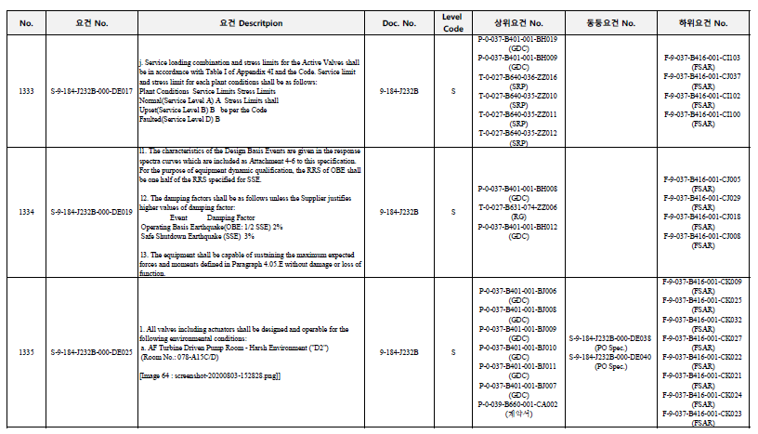
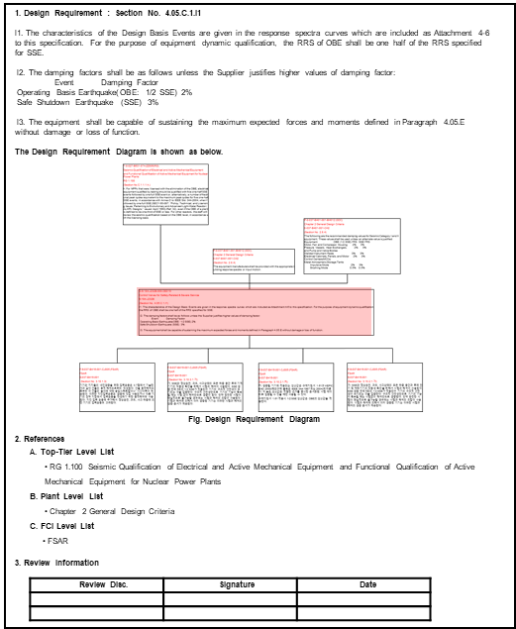
02
Changes for Improvement
Improvement of Design Requirement Management Report
Format change of Requirement Management Report
SUN 3&4
SHN 3&4
Option 1. Excel Table Format
Responsible person, approver, related discipline by requirement
Detail information for each related requirement
Design requirement management report format was centered on requirement number by Level (T, P. S, F)
Upper and lower related requirements are written as requirement numbers, making it impossible to intuitively identify information.
User-oriented design requirement management report is not effective for usage.
Option 2. Report template format per requirement
Relation information diagram
Visualization of related information
Detailed information by related requirement
Review information
Responsible person, approver by requirement
Related discipline review information

Slide 10
03
Design CMIS Application
Utilization of Design Process
Quality Improvement of Purchase Specification
Design Process of Purchase Specification
CMIS Utilization
Check quality (typos, numbering system, etc.) by design requirement
Establishment of design requirement data
Relate design requirements to design criteria
Review compliance with design criteria
Interdisciplinary review and approval of relation by design requirement
Issue CI of design requirement management report when issuing purchase specification for contract
Invitation Spec. Issue
Design Requirement Relation
Evaluation
Addendum issue as needed
Contract Spec. issue
Relate design requirements to FCI
Review of compliance with design requirements in FCI
Interdisciplinary review and approval by FCI
FCI Relation
Submission of Supplier Doc. And Data
Addendum issue as needed
Review whether the related information changes when design requirements change
Update related information and provide it to the project owner when the related information needs to be changed
Track and manage FCI when design requirements are changed
Final issuance of design requirement management report when issuing purchase specification for completion
A/E Review and Approval
Change Management
Construction Spec. Issue

Slide 11
03
Design CMIS Application
Utilization in Design Process
Improvement of License Documents
CMIS Establish and Utilization
Requirement Relation
License Document Centered
Create Database of licensing document design information
Relate design requirements to license document design information
Review the consistency between the design information in the licensing document and the design requirements
Secure traceability between licensing documents, design requirements, and design standards
Track related design requirements and quickly identify design criteria when answering license queries
Secure reliability by using data-based design configuration management system when responding to licensing authorities
Top-Tier Level
SSC Level
Relate to Design Requirements
P.O.
Spec.
C.P.
Spec.
Standard Appendix
SDC
Design
Spec.
GDC
FSAR
Relate between license documents and FCI
Review the consistency between license documents and FCI
Secure traceability of FCI centered on licensing documents
Relate FCI
A/E
Drawing
Supplier
Document
Change management of license documents when design requirements change
Reviewing the impact of changes to the license document on the FCI
A/E Document
(Other than SSC Level Doc.)
Supplier
Drawing
Change Management

Slide 12
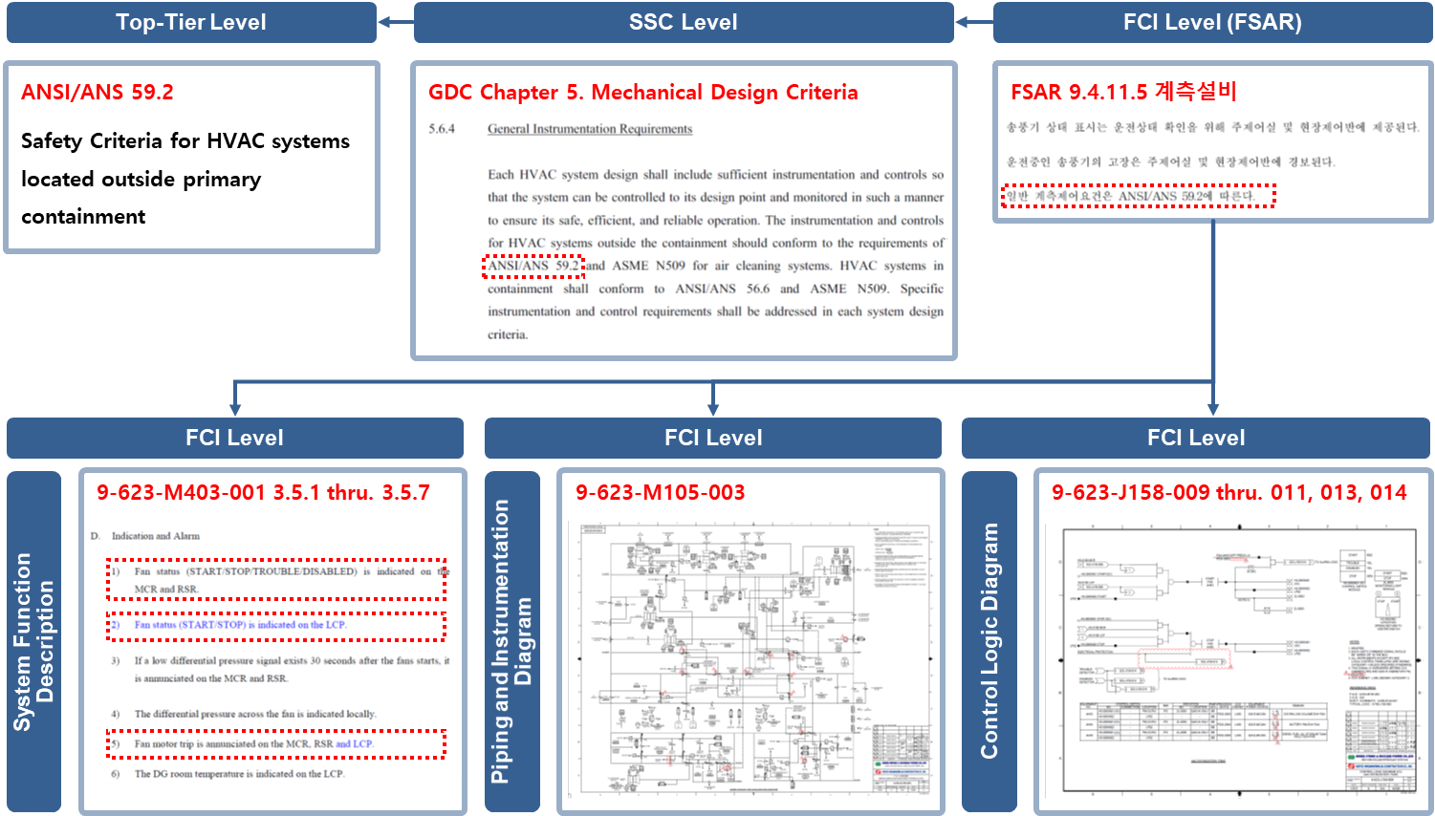
03
Design CMIS Application
Utilization of Design Process
Example : Seismic Cat. I AAC D/G HVAC Instrument
License Document Requirements
FSAR 9.4.11.5 Instrumentation
The fan status indicators are provided in the control room and on-site control panel to check the operating status. Failure of an operating fan shall be alarmed to the control room and site control panel.
General instrumentation requirements are in accordance with ANSI/ANS 59.2.

Slide 13
04
Establishing DCMIS of SHN 3&4
Workflow of Establishing DCMIS of SHN 3&4
CMIS Establishing Workflow
Extract Requirements from documents
Design Criteria Review
Dataization of FCI
Dataization of Design Criteria
Review requirements
Registration of FCI in the System
Registering Design Criteria
Dataization of Requirements
Relate and review Design Requirements to FCI
Register Design Requirements
Relate Design Requirements
Relate FCI
Change Management
Design Requirement-Design Basis Relation and Review
Register Design Requirements
Relate and review License Document to FCI
Interdisciplinary Review of Related Data
Review and Approve Design Requirements
Approval of Related Data
Approval of Related Data

Slide 14
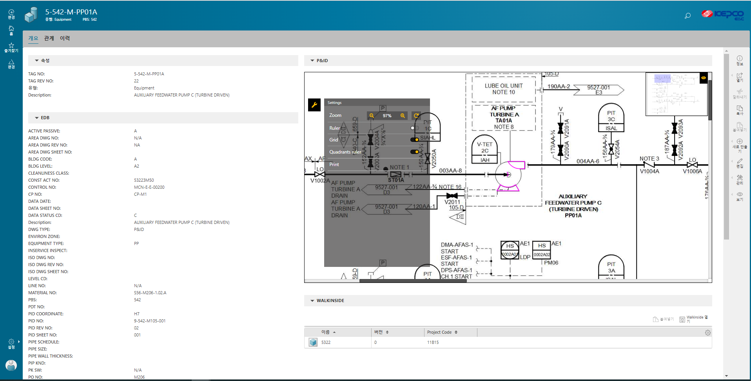
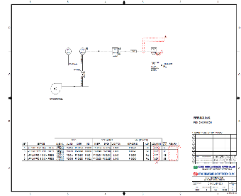
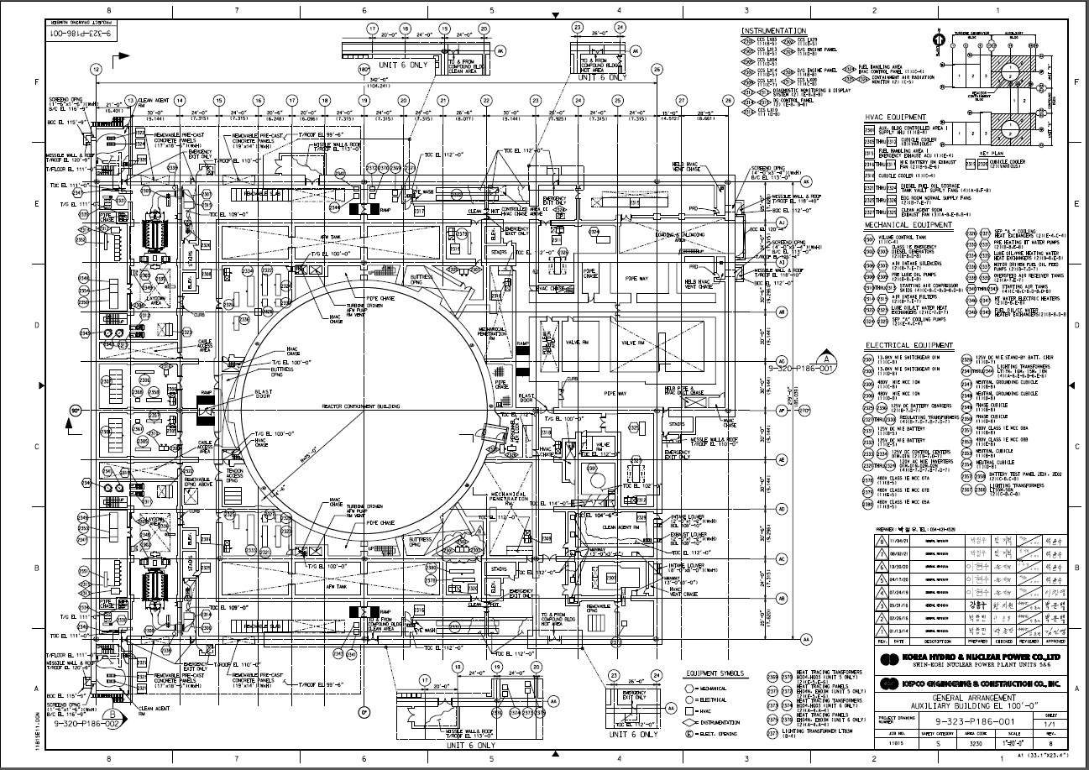
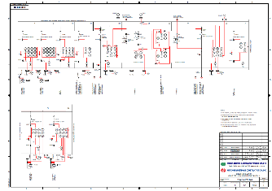
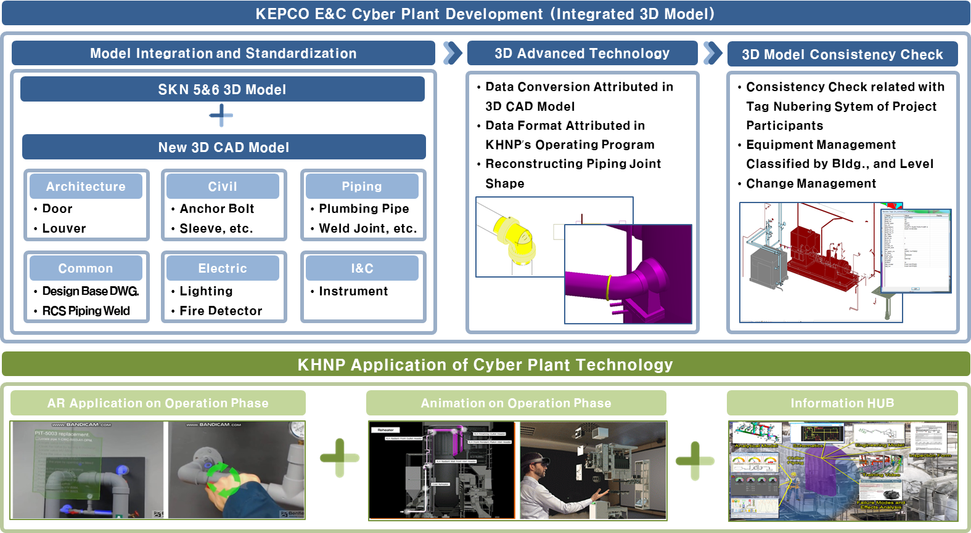
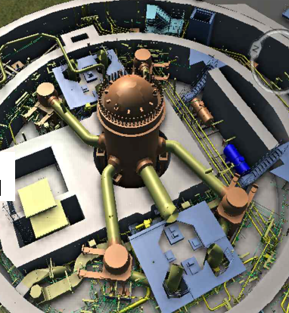
05
Future Plan of Enhanced DCMIS : Nav.
SUN 3&4 Navigation Tools
Extension of Navigation Tools
Piping and Instrumentation Diagram (P&ID)
Advanced Piping and Instrumentation Diagram (P&ID)
Link
C&I Diagrams (J157)
Transmitter
I/P Converter
Local Indicator
Instrument included in MMIS
Systematic
Pump
Heat Exchanger
Tank / Vessel
Valve
I&C Device
Etc.
General Arrangement Drawings (P186)
Single Line Diagram (E140)
Equipment
- Electrical
- Mechanical
- HVAC
- Instrumentation
Electrical Equipment
Transformer
- Load Center
- Switch Gear
- Etc.
Items not Included in P&ID
Electrical Equipment
Instrumentation Equipment
Advanced 3D-Model
Intuitional
3D-Model
The navigator tools based on digitalized drawings can be expanded and customized at the requirements of Owner.
Cyber Plant Project
Adoption of Advanced 3D Model Technology
The Best Way to Access the Facility Configuration Information regardless of Document Types

Slide 15
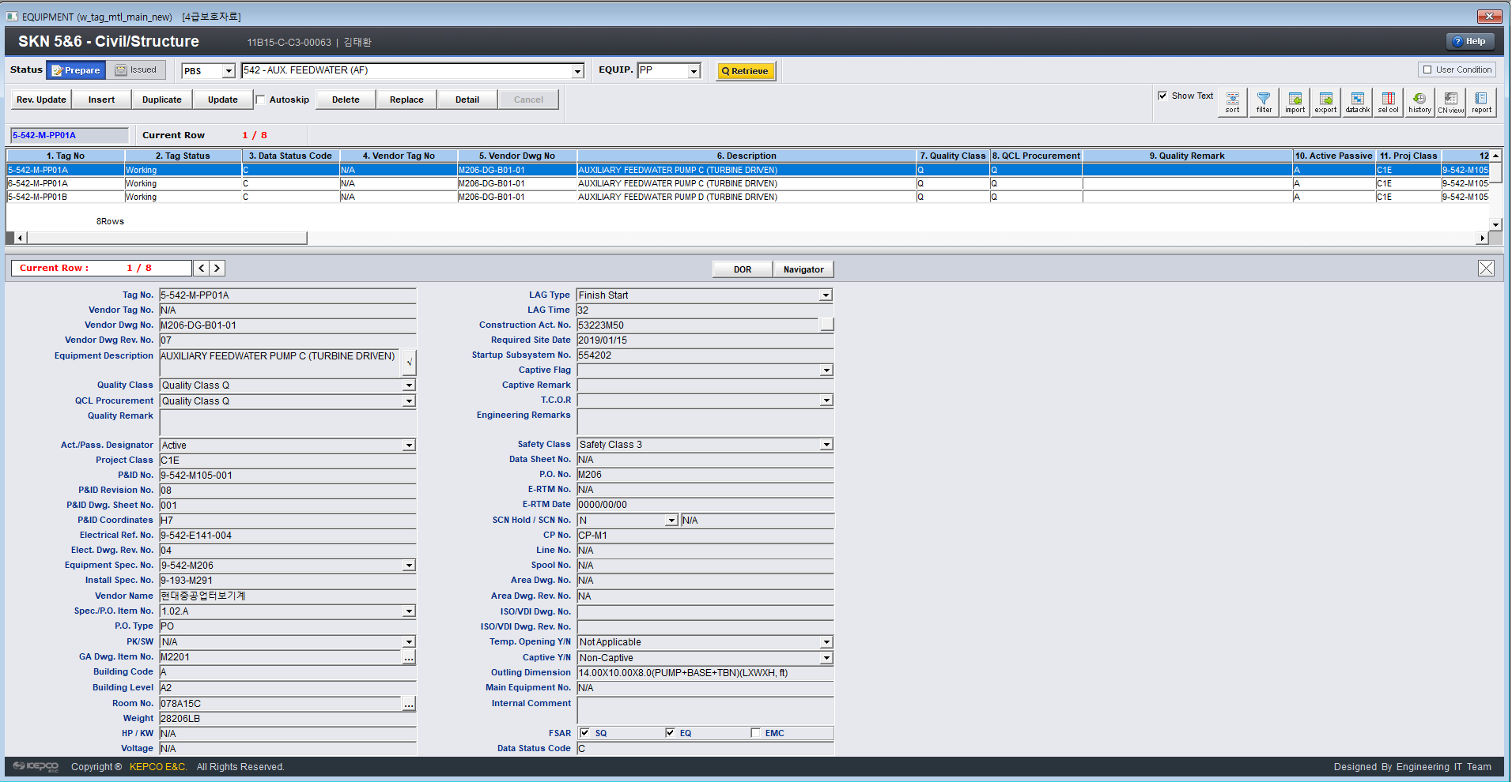
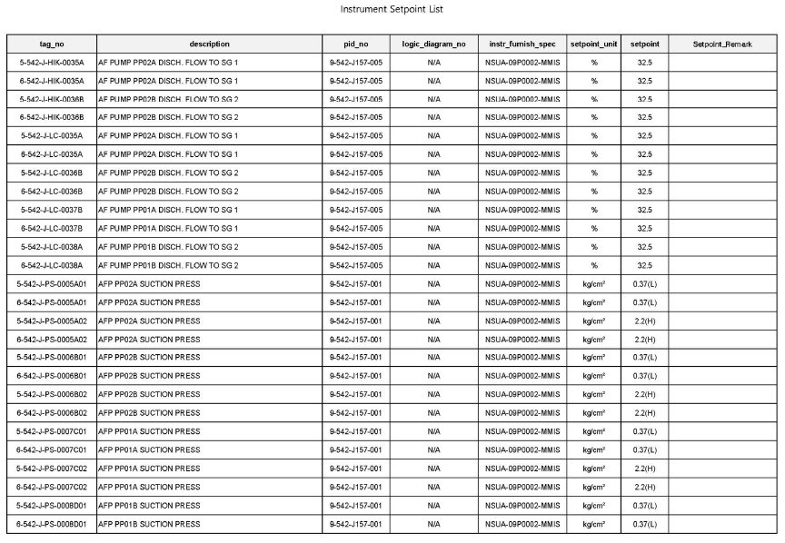
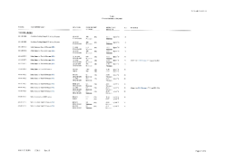
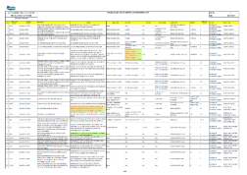
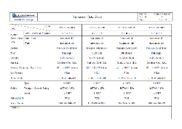
05
Future Plan of Enhanced DCMIS : Data
SUN 3&4 Attributes
Diversification of Attributes Based on the Owner’s Needs
KEPCO E&C Engineering Data Base (i-EDB)
Part List
Owner
Work Order Management
Maintenance Experience
Part List
including
Spare Parts
Consistency
Supplier
Material Management
Design
Sales Experience
Set Point
A/E
T/G
Single Source of Truth
NSSS
Linkage
- Floc
- Related Documents
Management
Set Point
Suitability
BOP Supplier
Owner
Based on the Owner’s needs and status of engineering data, the method of engineering works can be defined.
Determined by the Owner

Slide 16
Q & A
csku@kepco-enc.com

