Slide 1
TVA’s Digital Design Process
Adoption of NISP-EN-04 and EPRI’s DEG

Slide 2
Introduction
Eric Wiens, P.E.
TVA
Digital Design Manager

Slide 3
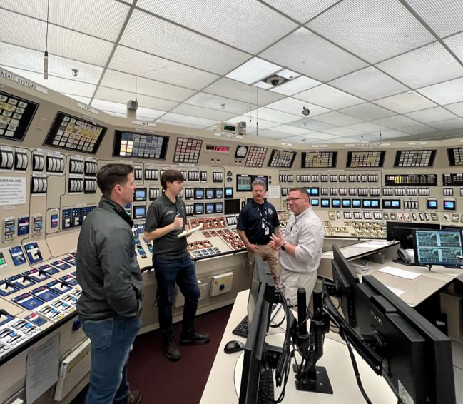
TVA’s Digital Design Process
Topics
TVA’s Digital Modifications over the years
Past Challenges
TVA’s Digital Design Process Old vs. New
Example project wins
Future process enhancements
TVA’s Digital Modernization Strategy

Slide 4
Digital Modifications at TVA over the years
“TVA has performed a series of digital upgrades over the past decades realizing many benefits, such as addressing analog equipment obsolescence and improving plant reliability and performance” - TVA’s Digital Modernization Implementation Strategy
Notes:
Read quote…

Slide 5
Digital Modifications at TVA over the years
Digital Safety Related Applications
SQN and WBN Eagle 21 (Process Protection System)
Various Single Loop Controllers
Inadequate Core Cooling Monitoring Systems
BFN NUMAC Neutron Monitoring
Turbine-Driven Aux Feedwater Gov Controls
HVAC Controls
Radiation Monitors
Smart Transmitters
Digital Recorders
Digital Relays
Breaker Controls

Slide 6
Digital Modifications at TVA over the years
Digital Non-Safety Related Applications
Distributed Control System (DCS) – Foxboro I/A
SQN & WBN Feedwater flow, SG level, Chemical Volume Control System, Rod Control, and others
BFN Recirc Speed, Feedwater, Heater Level, and others.
Main Feedpump Turbine Controls – Siemens / Foxboro (SQN & WBN)
Reactor Feedpump Turb Controls - Woodward
Digital EHC at BFN, SQN, and WBN – Woodward / Foxboro
Turbine Supervisory Instrumentation (TSI) - Bentley Nevada
Variable Frequency Drive for Recirc controls (BFN)
WBN Rod Position Indication System
Various Single Loop Controllers
Digital Valve Positioners
Various PLC applications
Various Smart Transmitters
Digital Indicators and Recorders
Radiation Monitor Upgrades
PC Based Systems for Outage Testing
Generator and Switchyard Protection Relays
Plant Process Computer upgrades
Plant Annunciator Upgrades

Slide 7
Digital Modifications at TVA over the years
That’s a lot of great upgrades…
Why change the process?

Slide 8
Past Challenges
“If we try to implement a Digital Modernization strategy now with the current design change process, it will fail”
Notes:
In 2022 the newly formed Digital Design team with help from S&L set out to gather data from 230+ stakeholders on the modernization of TVA’s fleet. One of the most impactful quotes came from BFN’s Senior Design Manager.

Slide 9
Past Challenges
Project Risks
Last-minute “digital-related” discoveries causing schedule delays and increased costs
Can’t get over SCCF challenges and have to change course to analog
Unnecessary Customizations
Custom, first-of-a-kind, analog solutions were made just for TVA to avoid digital components.
Invalidated many platforms' significant, positive operational history by customizing them into platforms that had limited or no operational history.
Analog requirements for digital systems - digital system being constrained to only mimic analog system functionality in many cases, missing many of the advantages of digital technologies.
Division of Responsibilities
Who controls what settings?
Lack of In-House Knowledge
Overreliance on Vendor Expertise – Many systems treated as black box turn-key systems with very little technical understanding of how they function or why they're configured the way they are
Overreliance on contract engineering firms to perform digital modifications
Notes:
Much of the past challenges with digital modifications always seem to happen “too late”. We heard a lot of “if we would have known sooner…”. These surprises typically occurred with skids and mechanical modifications like Travelling Water Screens for example. The “digital” mods like DCS upgrades seem to have less of these surprises.

Slide 10
TVA’s Digital Design Process
Old Process
New Process
Software Categories
Configurability & Consequence
NISP-EN-04
Avoid Safety-Related Digital
Qualitative Assessment
RIS 2002-22
No Digital Equivalencies Allowed
Digital-to-Digital Allowed with SME Form
NISP-EN-02
If Digital, Screen into 50.59 Eval
Relatively Simple Digital Device
NEI 96-07
Notes:
Generalized methods of addressing higher level NRC requirements - OLD vs. NEW
Line 1 – TVA’s old process used software categories based on capabilities and usage (i.e. performs calculations without verification to support Tech Spec). The new process adopts NISP-EN-04 and the DEG’s approach to using Configurability and Consequence to determine required activities.
Line 2 – TVA had a culture of avoiding digital due to many projects not being able to get around CCF or identifying the need to address CCF very late in the design and causing a re-design to analog to avoid addressing CCF. New process proactively uses the Qualitative Assessment as a roadmap for vendor information items in conjunction with CDRs when we expect to screen in to an Eval for SCCF.
Line 3 – Old process was if it was digital, it screened out of equivalency. Now, with NISP-EN-02 we can do digital-to-digital equivalency evaluations with the use of a “Digital SME” form when someone with a digital qual reviews and provides input.
Line 4 - "If it’s Digital, it will screen into 50.59 Eval" -> Now, using updated NEI 96-07 Screening guidance for digital ("relatively simple digital mods") .

Slide 11
TVA’s Digital Design Process
Current Culture
In-Progress Shifts
Checklist & Document Driven
Critical Thinking & Systems Engineering
EPRI DEG
Mentality of “what’s required”
Mentality of “what benefits the project”
DG-E18.1.25
Isolated “Brainstormed” Solutions
Strategy-Informed Fleet Digital Solutions
TVA’s Digital MIS
Notes:
Line 1 - Other than our Safety Related commitments still require, we have VERY few required documents now, whereas our old process was all about "SDD, SRS, SQAP" that comply with IEEE standards. This gives us much more flexibility to use a wider range of vendor info, design inputs, etc. Regardless of document title or format. It also protects against "having all of the documents" without actually doing the design (for example, BFN CB Chiller mod that's in progress where they checked all of the classic document boxes, but the actual critical thinking and design process decisions contained in them were very inadequate). As Dave Hooten has said before, documents won't protect your system from having errors and omissions, but the systems engineering process does.
Line 2 - Old process: "What digital activities are required?" -> New Process: "What digital activities benefit the project?". We have had good success the last year or so in getting CDRs, engineering studies, and other conditional/options activities performed when they'd be beneficial. That's a big culture change. Line 3 - Consider 1 for the MIS – Old Process: "Brainstorm Problem Solutions" -> New Process: "Use the Digital MIS for Strategy".
The biggest change from old, traditional SQA process to the new systems engineering process as implemented at TVA with the DEG Information Item Tool (IIT) is that we are forced to think about and address activities. Previously, most activities were built into the required documents with a few exceptions, and we would focus more on what documents were absolutely required and less on the activities they were intended to be documenting. From a reviewer’s perspective, the NISP-EN-04 process (with DEG IIT) makes it much easier to determine omissions or gaps in the design than with traditional SQA.

Slide 12
TVA’s New Digital Design Process
Industry Standards
TVA Interfacing Procedures
Plant Modifications
Plant Modifications
IP-ENG-001
Standard Digital Engineering Process
NPG-SPP-09.3
TVA Standards and Guides
NISP-EN-04
Digital Design Guide
EPRI DEG
DG-E18.1.25
3002011816
Equivalency Evaluations
Standard Item Equivalency Process
NEDP-8.4
NISP-EN-02
Notes:
The DEG and NISP establish many of the requirements and TVA Standards are evolving into guidance

Slide 13
TVA’s New Digital Design Process
Digital Design Guide
Initial Scoping
Conceptual Design
Detailed Design
Installation & Testing
Operation & Maintenance
DG-E18.1.25
Project Management
Procurement
Design
Notes:
I would add a BIG disclaimer here that since this is the systems engineering process, these are approximate, but regardless of any project gates or milestones, it is understood to be an iterative process that likely will require revising decisions made in the previous phase(s).

Slide 14
TVA’s New Digital Design Process
Digital Design Guide
Initial Scoping
Conceptual Design
Detailed Design
Installation & Testing
Operation & Maintenance
DG-E18.1.25
Project Management
Project Management
NPG-SPP-19.6
Procurement
Design
Engineering Studies
NPG-SPP-09.25

Slide 15
TVA’s New Digital Design Process
Digital Design Guide
Initial Scoping
Conceptual Design
Detailed Design
Installation & Testing
Operation & Maintenance
DG-E18.1.25
Project Management
Procurement
Procurement
DS-E18.1.25.15
Development of Requirements / Vendor Selection
DG-E18.1.25.3
Critical Digital Reviews
Design
DG-E18.1.25.12
Defensive Design Measures & Good Practices
DG-E18.1.25.13

Slide 16
TVA’s New Digital Design Process
Digital Design Guide
Initial Scoping
Conceptual Design
Detailed Design
Installation & Testing
Operation & Maintenance
DG-E18.1.25
Project Management
Procurement
HMI Graphics Design
DG-E18.1.25.10
Design
Configuration Control
DS-E18.1.25.5
Qualitative Assessments
DS-E18.1.25.14

Slide 17
TVA’s New Digital Design Process
Digital Design Guide
Initial Scoping
Conceptual Design
Detailed Design
Installation & Testing
Operation & Maintenance
DG-E18.1.25
Project Management
Procurement
Digital System Testing
Design
DG-E18.1.25.6

Slide 18
TVA’s New Digital Design Process
Digital Design Guide
Initial Scoping
Conceptual Design
Detailed Design
Installation & Testing
Operation & Maintenance
DG-E18.1.25
Life Cycle Management
Project Management
NPG-SPP-09.18.5
Procurement
Equivalency Evaluations
NEDP-8.4
Design
Computer Software Control
NPG-SPP-12.7

Slide 19
TVA’s New Digital Design Process – Safety-Related
Digital Design Guide
TVA is still committed to Reg Guide 1.152 Rev 3 and still meet requirements of IEEE 7-4.3.2 guidance for SR modifications in addition to NISP-EN-04.
Initial Scoping
Conceptual Design
Detailed Design
Installation & Testing
Operation & Maintenance
DG-E18.1.25
Safety Related Requirements
DS-E18.1.25.1
Commercial Grade Dedication
Safety Related
DS-E18.1.25.7
D3 & Segmentation Analysis
Software Based Tools
DG-E18.1.25.11
DG-E18.1.25.9
Notes:
This may be confusing to some, so general disclaimer that we are committed to Reg Guide 1.152 Rev 3 in our NQAP and still meet the requirements of it and IEEE 7-4.3.2 guidance for safety related mods IN ADDITION TO NISP-EN-04. In other words, we use NISP-EN-04 still, but also require the specific documents and couple of additional regulatory requirements imposed by Reg Guide 1.152.

Slide 20
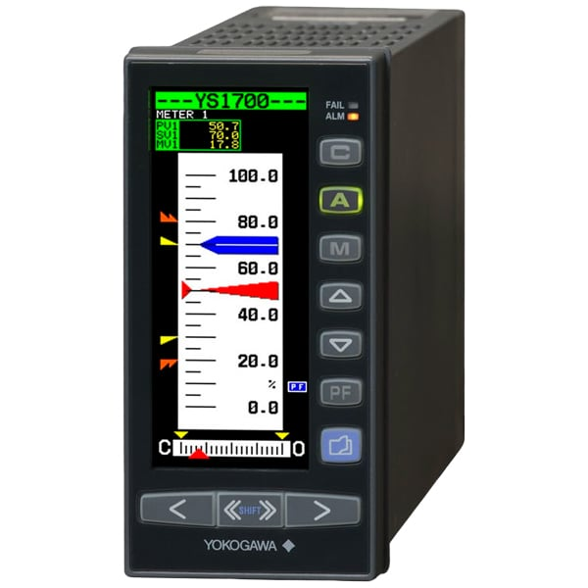
Success Stories
GEMAC Replacements with Yokogawa YS1700
BFN Control Rod Drive Flow Control
High Configurability / High Consequence
DEG Information Item Tool identified upfront the need for a Critical Digital Review (CDR) and FMEA from the vendor early in the process
Functional Configuration Audit – revealed undocumented needs and requirements, like an essential PMs, with a diverse group of stakeholders (ops, maintenance, design, systems)
ECP completed on-schedule and on-budget
Installed with minimal FCRs
Successful operation so far!
Notes:
Note – we have projects ongoing that started in the old process and grandfathered in and new projects that use our new process… anecdote but project that used our old process seem to keep having issues… we got all the deliverables required but they didn’t have much to do with making sure the programmable device was programmed correctly. Brain storming testing vs. tracing testing

Slide 21
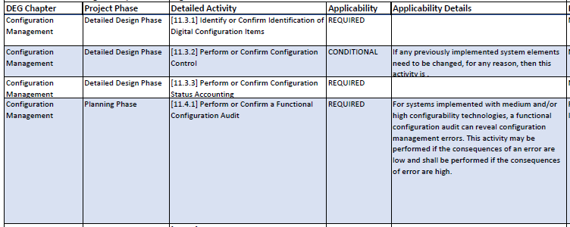
Configuration Management Items the DEG improved
This activity has already produced invaluable insights from stakeholders that would otherwise not be engaged in configuration management until well after the design change package is issued.
Notes:
DEG activity 11.4.1 – Perform or confirm a functional configuration audit. Although slightly modified at TVA to occur earlier than implementation phase and instead at the very end of detailed design, this activity has already produced invaluable insights from stakeholders that would otherwise not be specifically engaged in configuration management until well after the design change package is issued, and possible after implementation. This is essentially an ad-hoc audit/meeting where applicable stakeholders discuss configuration parameters, their bases, which organization is managing configuration settings with which vehicle (procedure, drawing, etc.), and which parameters are critical versus tunable. This activity has pre-emptively identified several configuration management issues that would have, at a minimum, resulted in sub-optimal equipment settings and potentially inadequate control of those settings.

Slide 22
Configuration Management problems that persist after incorporating the DEG at TVA
Issues when DEG activities impact other organizations like Maintenance, Operations, System Engineers, etc. to develop or Revise Procedures (Operations, Maintenance, Engineering)
Balancing the usability/tuneability of a system versus the strict configuration control of the software settings.
Notes:
The DEG makes the assumption that all organization are informed by it, and follow its guidance. However, in practice Maintenance, Operations, System Engineers, etc. may or may not be aware of or bound by the DEG guidance. Because of this there are activities such as “6.4.2 Develop or Revise Procedures (Operations, Maintenance, Engineering)” that technically adequate address configuration management, but may have gaps when outside orgs are responsible for meeting DEG requirements/guidance. This significantly limits its effectiveness for configuration management.
Determination of critical parameters that should be “locked” and only changed via ECP versus tunable parameters that may be changed more easily and/or by organizations outside of engineering. Balancing the usability of the system versus risk of a configuration error is a very complex process that generally needs a very high level of involvement from all stakeholders, and many times there is no “good” answer that doesn’t involve the potential for frequent ECPs, drawing/procedure revisions, etc. This also requires a very high level of understanding of parameters that many utilities rely on suppliers to interpret and determine.
A lot of OE on tunable parameters causing issues.

Slide 23
Future Enhancements
Incorporate DEG Rev. 1 to add “Pathways” based on Configurability and Consequence with up-front screening criteria for topical sections. Example: screen out of HMI activities up front
Incorporate NISP-EN-02 Rev. 1 to allow more digital-to-digital Equivalency Evaluations and add guidance for establishing bounding critical design characteristics (BCDCs) in ECPs.
Continued incorporation of the Digital MIS into processes and procedures
Notes:
First bullet point – Incorporate DEG Rev 1 to ad pathways based on C&C, with up-front screening criteria for topical sections. Ie) you can screen out of HMI activities up front now via screen.
Update Requirement Process to align with EPRI

Slide 24
TVA’s Digital Modernization Implementation Strategy
Interviews & Needs Assessment
Build the Strategy
Incorporate into Process and Implement Key Recommendations
End Goal
Digital MIS is incorporated into what we do.
Visions are set
Projects are informed
Value is added
Fleet Reliability is Improved
We are here

Slide 25
Questions?

