Slide 1
Configuration Management Working Group Meeting x July 22, 2024
Jason Kozal
Director
Region III
Division of Operating Reactor Safety

Slide 2
Topics
General Configuration Control Thoughts and example
PRA Configuration Control Smart Samples

Slide 3
Regulatory Importance of Configuration Control
Fundamentally important to multiple 10 CFR 50 Appendix B Criteria:
Criterion III “Design Control”
Criterion V “Instructions, Procedures, and Drawings”
Criterion VI “Document Control”
Criterion VII “Control of Purchased Material, Equipment and Services”
Criterion XI “Test Control”

Slide 4
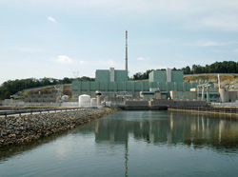
Peach Bottom 2
GE-4 BWR
Mark I Containment
1,265 MWe
Located in the State of Pennsylvania
Commenced operation in July 1974

Slide 5
Background
The Reactor Protective System (RPS) consists of two independent trains
Normally supplied through separate motor-generator sets powered from separate 4kV sources
One month planned outage of one offsite power source
Both 4kV sources would be powered from the same offsite power feed
Vulnerable to RPS actuation in case of grid disturbance
Off-normal lineup established to increase diversity and redundancy
Opposite RPS train supplied through alternate power supply with battery backup

Slide 6
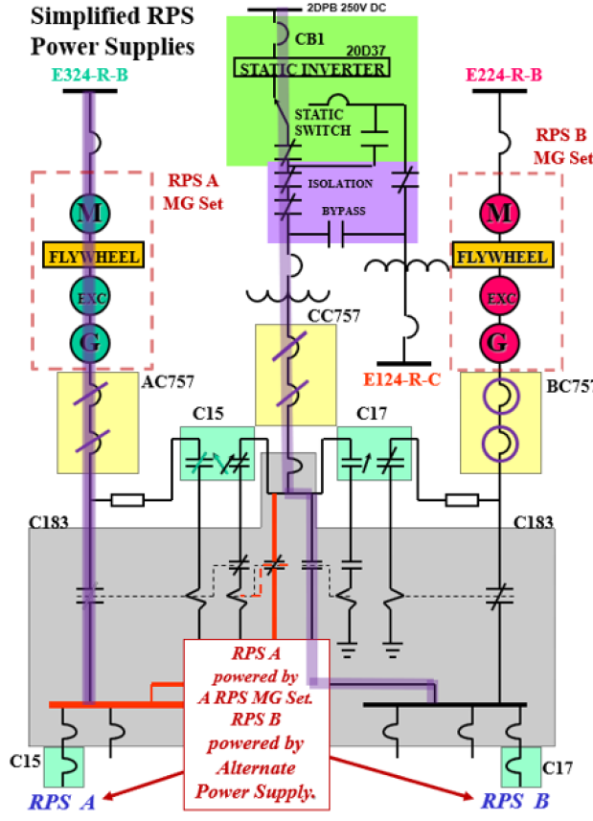
Initial RPS Lineup
“B” RPS supplied through alternate feed through inverter from DC bus
“A” RPS supplied through motor-generator set

Slide 7
Sequence of Events
May 15, 2022: Normal offsite power to the 4kV bus is restored
RPS alignment is not changed
May 16, 2022, 1537: Grid perturbation causes a loss of “A” RPS and multiple alarms
“Half-scram” condition, but unit remains at power with “B” RPS still powered from alternate power source
May 16, 2022, 1547: Control room supervisor directs restoration of “A” RPS
May 16, 2022, 1552: Loss of “B” RPS during “A” restoration causes reactor scram and main steam isolation valves to close, resulting in loss of condenser heat sink

Slide 8
What Happened
In the abnormal lineup, the procedure for restoring a “A” RPS if it was lost would cause a loss of “B” RPS
Recognized ahead of time – Equipment Operators were provided a “partial” procedure with steps lined out to ensure that “B” RPS would not be lost
Equipment Operator asked at shift turnover if the “partial” procedure still applied now that offsite power had been restored to the 4kV bus
When directed to restore “A” RPS, Equipment Operator again asked which procedure to use, and was given the original control room procedure

Slide 9
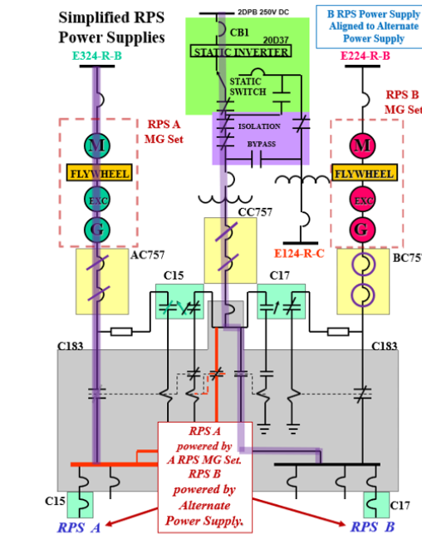
RPS Lineup before Scram
“B” RPS lost when operator opened breakers to alternate power supply
“A” RPS lost with grid perturbation
Notes:
Following the steps of the clean procedure from the control room, the equipment operator again asked the control room whether it was appropriate to “perform step 4.5 to verify breakers to the alternate power source are open” (CC757 in the diagram above). The reactor operator in the control room, who did not have the procedure because the control room procedure was with the equipment operator, directed the step to be performed. The breakers were closed, but at this site, “verify” gives permission to take action to establish the condition if it is not met. When the equipment operator opened the breakers, this disconnected “B” RPS from its alternate source, inserting a full scram and MSIV closure (Click for animation).

Slide 10
What Happened
Procedure Availability and Procedure Compliance
Equipment Operators had “partial” procedure and trained on it, but control room operators were not all aware of it
Reactor Operator did not have any procedure while the evolution was in progress
Knowledge gaps:
Control Room Supervisor and Reactor Operator did not know about the “partial” procedure
Equipment Operator did not understand that the breakers were supplying power to “B” RPS
Notes:
If the procedure had been put out as a temporary change, there would have been higher controls on its use – for instance, control room copies would have been changed out. As a partial procedure, it was not subject to those controls.
Operators did not understand the purpose of the partial procedure and how it related to RPS operations – EO spoke to this when asking if restoration of offsite power to the 4kV bus meant the partial procedure no longer applied
Just in time training had not used the partial procedure, but instead focused on restoring the lineup. The training did not result in an understanding of how the RPS electrical lineup (both normally and in the circumstances) actually worked

Slide 11
Cause
Root Cause: Operators in high stress situation failed to use available human performance tools
Management Involvement: False sense of urgency led to lack of peer checks and floor supervision of breaker manipulations
Questioning Attitude: Control room operators did not question why Equipment Operator had a separate procedure or answer earlier questions about its applicability
Contributing Causes:
Shift management failed to ensure a deliberate focus once the plant was in a stable condition
Leadership failed to ensure a balance of experience and proficiency for the shift crew

Slide 12
Safety Impact
Loss of all RPS led to reactor scram with complications
Main steam isolation valves shut resulting in loss of condenser heat sink
High Pressure Coolant Injection and Reactor Core Isolation Cooling actuated
Pressure control via safety relief valves, manually cycled 33 times
Conditional core damage probability about 6 x 10⁻⁶

Slide 13
PRA Configuration Control Operating Experience Smart Samples
(PCC OpESS)

Slide 14
Key Messages
Regulatory requirements for PCC are in risk-informed programs (RIP)
Risk Informed Decision Making could be impacted if the PRA does not reflect the plant
Industry recognizes need to focus on PCC (and need for NRC oversight)
OpESS provides additional PCC-specific inspection guidance
Cross-regional panel ensures consistent oversight and enforcement across all regional offices
Current proposed PCC oversight does not create any new policies or new enforcement precedents
Staff conducted several public meetings to gather feedback and insights from industry

Slide 15
OpESS Background
OpESS is an inspector tool to aid inspection preparation
Information and trends identified from OpESS inform future agency action
OpESS recommendation was developed from results of the voluntary Tabletops initiative, (joint effort NRC & Industry)
OpESS was issued January 2024 (ML23255A006)

Slide 16
Inspections/OpESS Application
Focused on PRA Configuration Control and not Acceptability, (does the PRA model accurately reflect the as-built, as-operated plant)
Goal is to verify processes are in place to ensure the PRA is maintained
Balanced, performance-based approach
OpESS applicability is graded based upon licensee's use of multiple Risk-informed Programs (RIPs)
Sufficient run-time since implementation of RIPs, (time for plant changes)
Sampling based on impactful plant changes, (in-progress & completed)
SRA oversight on sample selection

Slide 17
Inspection/OpESS Implementation and Path Forward
Cross Regional Panel Charter (ML24081A131) issued on June 4, 2024, to ensure consistency in identification, disposition, and enforcement of issues.
START COLLECTING DATA!
CETI Inspections: Region II – June (TP) and July (SUR) 2024
Reviewing other Team Inspection opportunities: later 2024 & 2025
Just-in-time / KM training as needed
Expand OpESS utilization
Conduct annual performance-based review and adjust as needed
Review data/trends (annually)
Determine future PCC framework (2027)

Slide 18
Initial Preliminary Impressions
Comprehensive Engineering Team Inspection complements PRA CC OpESS guidance
Senior Reactor Analyst and HQ support resulted in positive interactions with licensee
Licensee guidance and processes to ensure PRA CC were clear and effective.
Inspection provided additional examples to support future oversight framework in this area.

Slide 19
Questions

