Slide 1
SMR Update US and Canada
Michael Riddle TerraPower Sr. Manager Engineering Processes
Michel Arcand TVA - Clinch River Project Sr. Manager Engineering Support
Notes:
Locations Of Nonpower Production And Utilization Facilities | NRC.gov
List Of Power Reactor Units | NRC.gov
Pre-Application Activities | NRC.gov
Hearing Opportunities | NRC.gov
Locations Of New Nuclear Power Reactor Applications | NRC.gov

Slide 2
Technologies
Generation III+
Water Cooled
SMRs
Generation IV
Non-water cooled
Micro-Reactors
SMRs
Micro-Reactors
Legacy technology with passive safety systems
Advanced technology with reduced or no safety systems
Notes:
Mike R

Slide 3
SMR vs Micro Reactor
SMR
Not explicitly defined by regulation
Typically less than 300 MWe per unit
Can be as high as 700 MWe per unit
Can be factory-assembled and transported to location for instillation
Micro Reactor
Not explicitly defined by regulation
Typically less than 10 MWe per unit / pack
Can be as high as 50 MWe per unit / pack
Typically factory-assembled and transported to location for instillation
Notes:
Mike R

Slide 4
TRISO Fuel
Notes:
Mike R
TRISO fuel fabrication facility being built in Oark Ridge
Most Gen 4 are HALEU (High Assay Low Enriched Uranium)

Slide 5
Main Types of Reactors
Acronym | Type | Coolant | Moderator | Neutron Spectrum
PWR | Pressurized light water reactor | Light water | Light water | Thermal
BWR | Boiling water reactor | Light water | Light water | Thermal
HGTR | High-temperature gas-cooled reactor | High-temperature gas (helium) | Graphite | Thermal
MSR | Molten salt reactor | Salts | None / graphite | Fast / thermal
LMR | Liquid metal reactor | Liquid metal | None / graphite | Fast / thermal
HPR | Heat-pipe reactor | Heat-pipe |  | Thermal
Notes:
Mike A
These are the main types of reactors out there, but the individual classifications are many and unique. This is mainly dependent on coolant, neutron spectrum, and moderator type.
SFR – Liquid Metal type
Molten Salt Reactor -

Slide 6
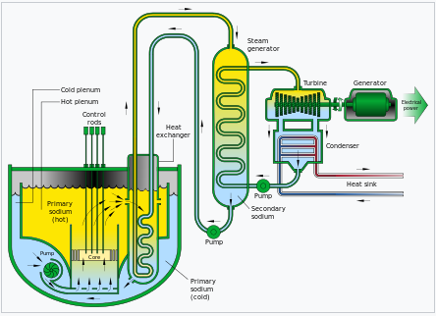
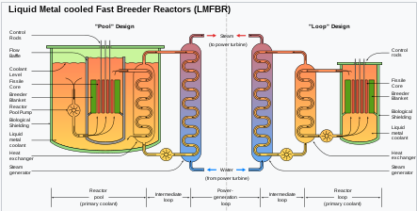
Liquid Metal and Molten Salt Reactors
Uses a type of liquid metal or salt as coolant.
May be either a thermal reactor that uses graphite as a moderator or a fast reactor where no moderator is needed.
Two main types: Pool or Loop.
Fuel could be solid type or dissolved.
Advantages:
Reduced waste due to increased chance of fission and reduced chance of capture (for fast neutron types).
Very high boiling point of liquids.
Operate at close to atmospheric pressure.
Can be refueled while operating.
Challenges: Chemical reactivity of liquids.
Several have been built and some are in operation in Russia.
Notes:
Mike A
The most prevalent new gen 4 types of reactors are MSR and LMR. Their process is similar.

Slide 7
SMR Overview
Name | Power | Type | Producer | Status
AP300 | 300 | PWR | Westinghouse | Concept D.
SMR-300 | 300 | PWR | Holtec | Concept D.
CANDU SMR | 300 | PWR | Candu Energy | Concept D.
VOYGR | 50 - 924 | PWR | NuScale Power | Licensed
Last Energy | 20 - 200 | PWR | Last Energy | Concept D.
BWRX-300 | 300 | BWR | GE-Verona | Concept D.
Notes:
Mike A
These are the active SMRs in the ~300 Mwe and up range that were found as of 6/24.

Slide 8
SMR Overview - Continued
Name | Power | Type | Producer | Status
Xe-100 | 80 – 320 | HTGR | X-energy | Concept D.
IMSR | 392 | MSR | Terrestrial Energy | Concept D.
Natrium | 345 | MSR | TerraPower | Licensing
KP-FHR | 140 | MSR | Kairos Power | Licensing - Test
ARC-100 | 100 | LMR | ARC | Concept D.
Notes:
Mike A
These are the active SMRs in the ~300 Mwe and up range that were found as of 6/24.

Slide 9
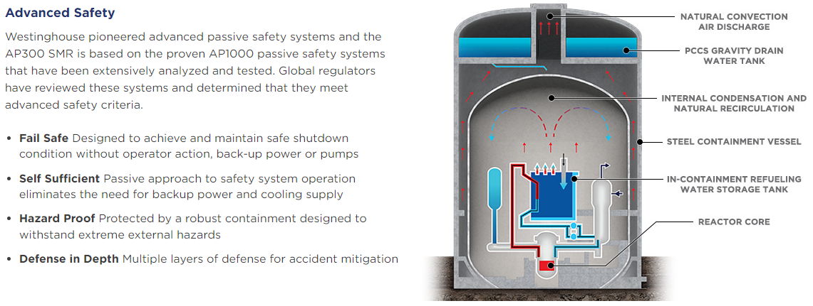
PWR - Westinghouse - AP300 SMR
Notes:
Mike R.
Type: PWR
Gen Type: Gen 3+
Power Output: 300MWe
Safety Strategy: Passive safety systems
Refueling: 12 to 18 months refuel cycle
Key features: Based on AP1000 PWR technology

Slide 10
PWR - Westinghouse - AP300 SMR
Notes:
Mike R

Slide 11
PWR - Holtec – SMR-300
Notes:
Mike R
Type: PWR
Gen Type: Gen 3+
Power Output: 300MWe
Safety Strategy: Passive safety systems
Refueling: 12-18 month refuel cycle
Key features: Based on legacy PWR technology, natural circulation

Slide 12
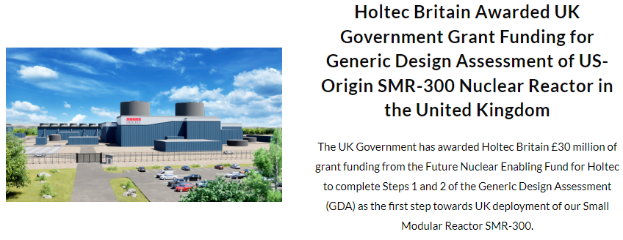
PWR - Holtec – SMR-300
Notes:
Mike R

Slide 13
PWR - Candu Energy – CANDU-SMR
Notes:
Mike A
Type: Heavy Moderated PWR
Gen Type: Gen 3+
Power Output: 300 MWe
Safety Strategy: Unsure / active???
Refueling: Continual Online Refueling
Key features: Based on legacy CANDU technology

Slide 14
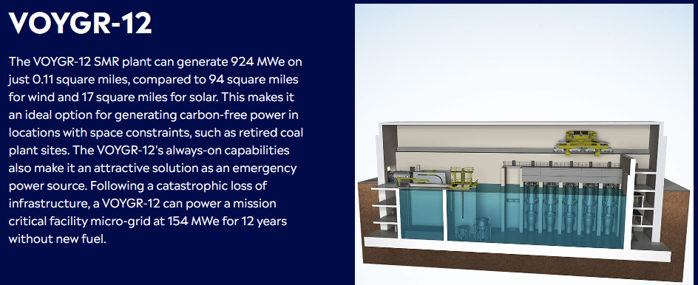
PWR - NuScale – VOYGR SMR Plants
Notes:
Mike A
Type: PWR
Gen Type: Gen 3+
Power Output: 50-924 MWe
Safety Strategy: Passive safety systems
Refueling: Up to 21 month refuel cycles depending on enrichment (up to 5%)
Key features: Based on legacy PWR technology, natural circulation, stackable (each NuScale Power Module (NPM) can produce 250MWt. Up to 12 NPMs can be placed in a plant producing up to 924 Mwe.)

Slide 15
PWR - NuScale – VOYGR SMR Plants
Notes:
Mike A

Slide 16
PWR - Last Energy
Notes:
Mike A
Type: PWR
Gen Type: Gen 3+
Power Output: Stackable 20 - 200 MWe
Safety Strategy: Active closed cycle air cooling safety system
Refueling: ???
Key features: Based on PWR technology, stackable, factory built modules

Slide 17
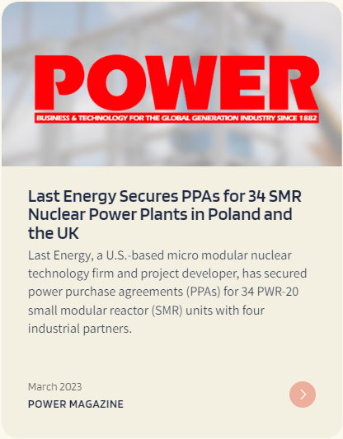
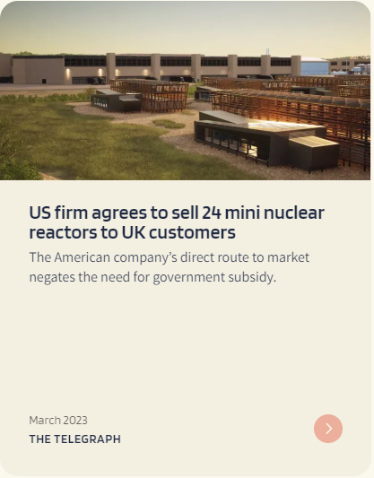
PWR - Last Energy
Notes:
Mike A

Slide 18
BWR - GE Verona - BWRX-300
Notes:
Mike A
Type: BWR
Gen Type: Gen 3+
Power Output: 300MWe
Safety Strategy: Passive
Refueling: 12-24 month refuel cycle
Key features: Based on legacy BWR technology, natural circulation

Slide 19
BWR - GE Verona - BWRX-300
Notes:
Mike A

Slide 20
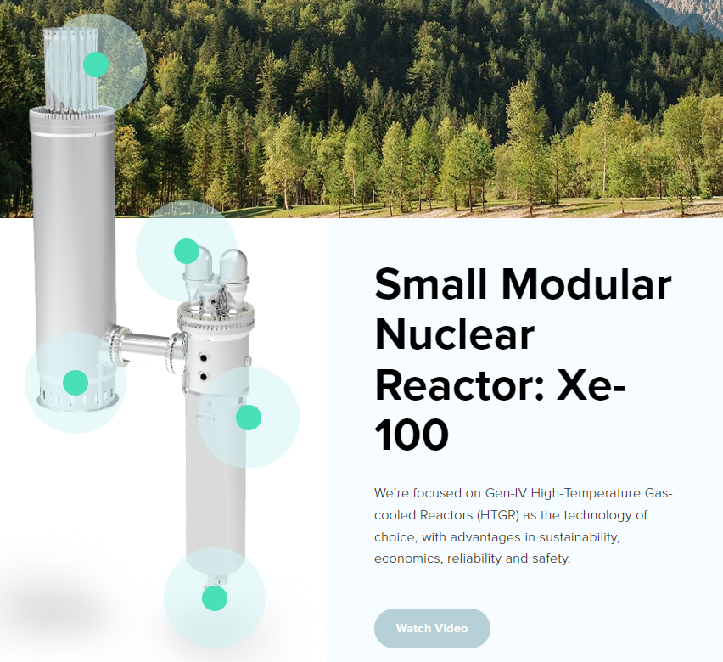
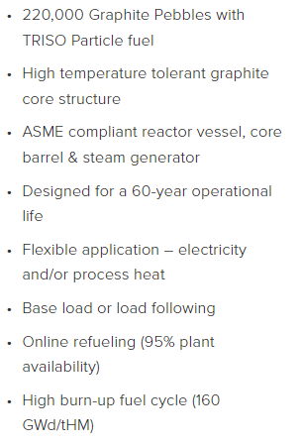
HGTR - X-Energy – Xe-100
Notes:
Mike R
Type: High-temperature gas-cooled reactor (HGTR) – thermal graphite moderated – HALEU TRISO fuel – Helium coolant
Gen Type: Gen 4
Power Output: Stackable 80 - 320 Mwe 4-pack
Safety Strategy: Meltdown-proof safety due to TRISO fuel. Passive cooling.
Refueling: Online
Key features:

Slide 21
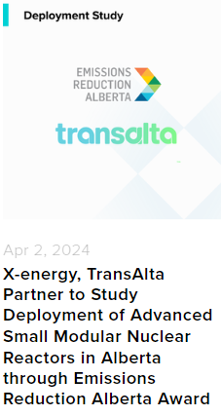
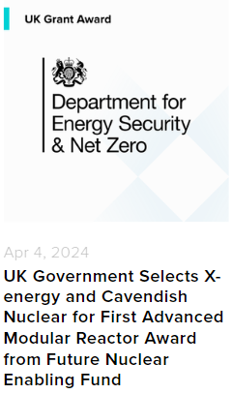
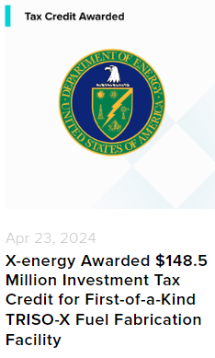
HGTR - X-Energy – Xe-100
Notes:
Mike R
Submitted engagement plan with the NRC. Completed Pase 2 of CNSC pre-licensing.

Slide 22
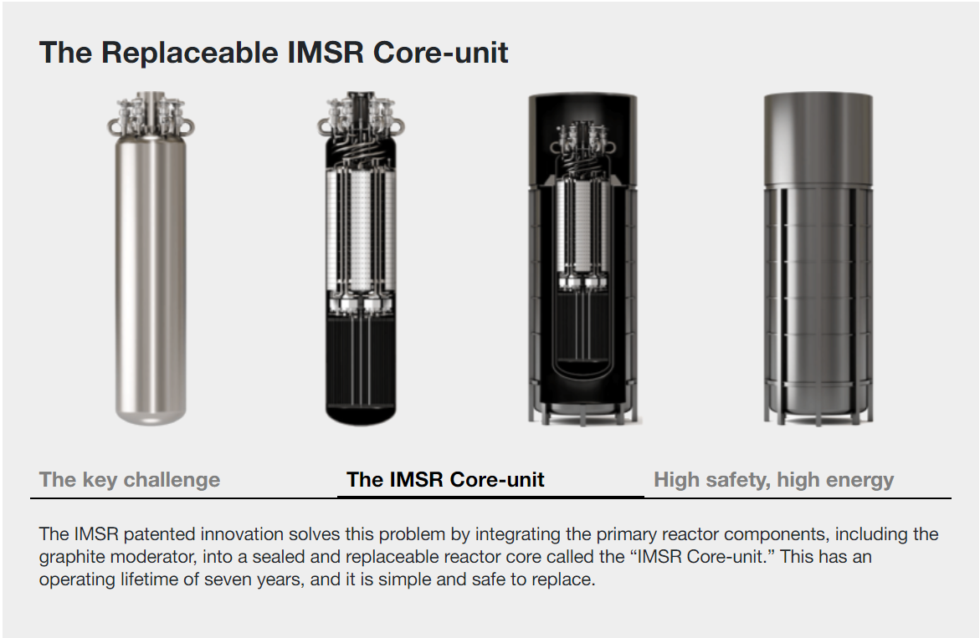
MSR - Terrestrial Energy - IMSR
Notes:
Mike R
Type: Molten Salt Reactor (MSR) – Thermal – graphite moderated
Gen Type: Gen 4
Power Output: 392 Mwe.
Safety Strategy: Minimal safety systems due to high boiling point of sodium coolant.
Refueling: 7 year operating period – replaceable reactor core
Key features: Operates at near atmospheric pressure

Slide 23
MSR - Terrestrial Energy - IMSR
Notes:
Mike R
Some pre-application activities with the NRC. Completed Phase 2 of pre-application with Canadian NSC.

Slide 24
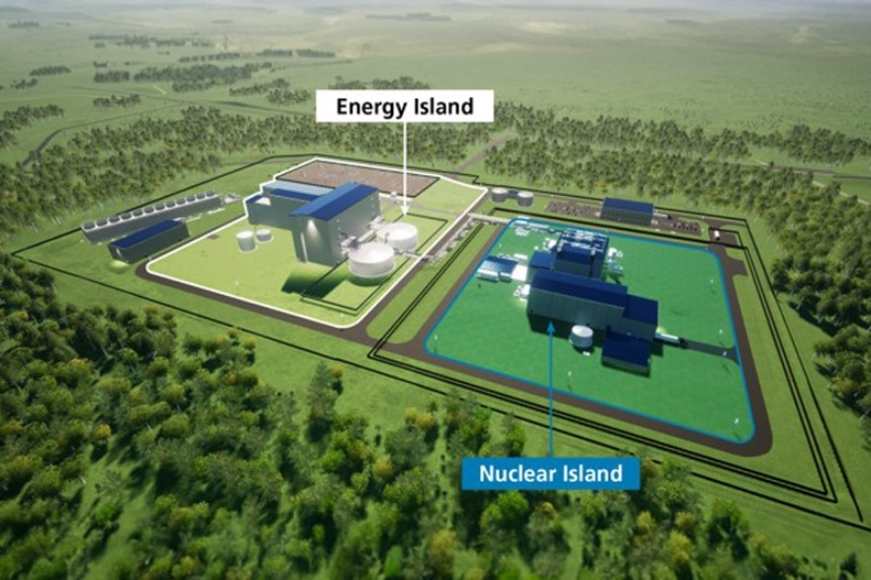
LMR - TerraPower – Natrium
Notes:
MIke R
Type: Liquid Metal Reactor (LMR) – Fast non moderated – sodium metal – HALEU fuel
Gen Type: Gen 4
Power Output: 345 – 500 (peak) Mwe.
Safety Strategy: Minimal safety systems due to high boiling point of sodium coolant.
Refueling: 24 month cycle
Key features: Sodium coolant, Operates at near atmospheric pressure, the storage tank / loop system allows for heat storage and peaking capability

Slide 25
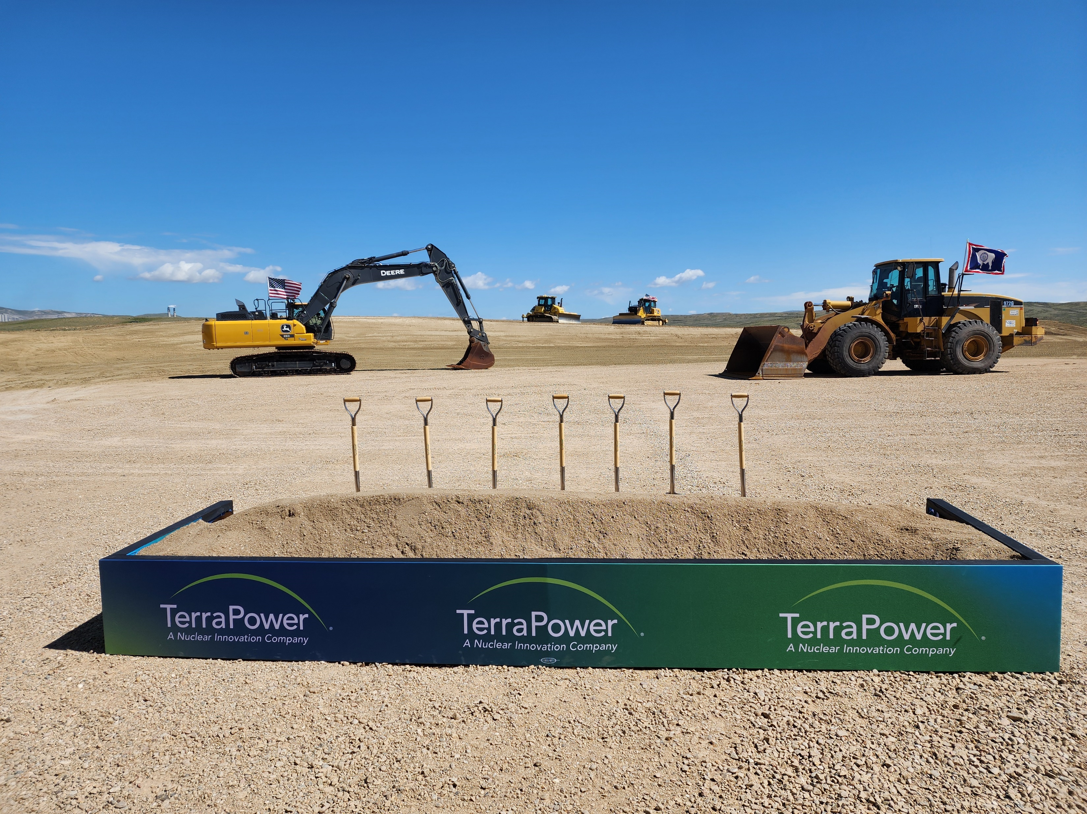
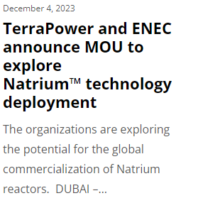
LMR - TerraPower – Natrium
Notes:
Mike R
CPA submitted and site preparation has commenced.

Slide 26
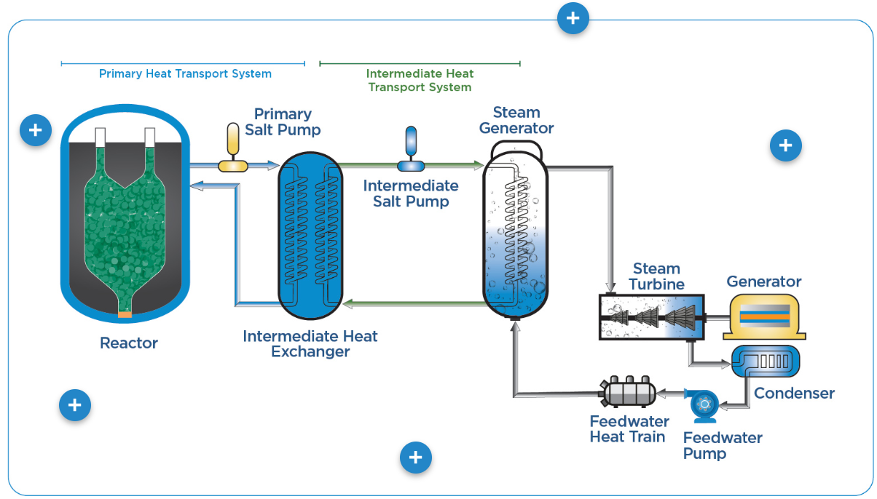
MSR - Kairos Power – KP-FHR
Notes:
Mike R
Type: Molten Salt Reactor (MSR) – fluoride salt coolant – HALEU TRISO fuel
Gen Type: Gen 4
Power Output: 140 Mwe
Safety Strategy: Meltdown-proof safety due to TRISO fuel. Passive cooling.
Refueling: Online refueling
Key features: TRISO fuel

Slide 27
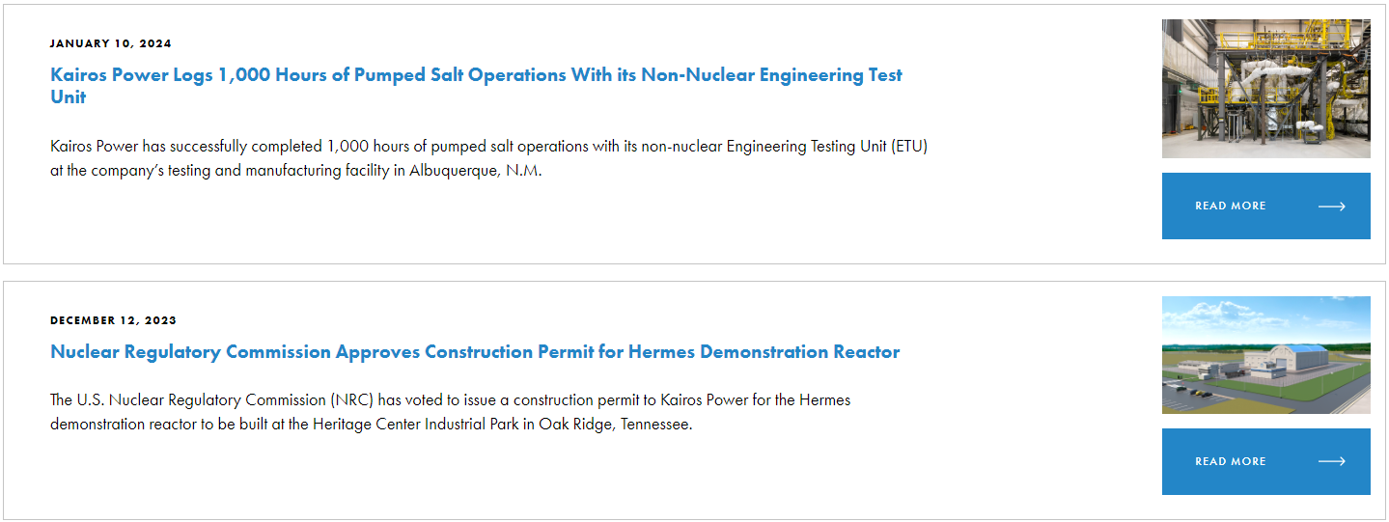
MSR - Kairos Power – KP-FHR
Notes:
CPA approved for 35 MWt demonstration reactor at Oak Ridge.

Slide 28
LMR – ARC - ARC-100
Notes:
Mike R
Type: Liquid Metal Reactor (LMR) – Sodium Metal – HALEU fuel
Gen Type: Gen 4
Power Output: 100 MWe
Safety Strategy: Passive safety systems
Refueling: 20 year fuel cycle
Key features: Metallic uranium alloy fuel – Sodium Metal Coolant

Slide 29
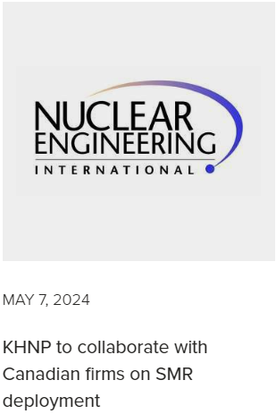
LMR – ARC - ARC-100
Notes:
Mike R
Primarily engaged with Canadian regulator. Environmental impact and site licensing reviews submitted. Has submitted a regulator engagement plan with the US NRC.

Slide 30
Micro Reactor Overview
Name | Power | Type | Producer | Status
MMR | 5-15 | HTGR | Ultra Safe Nuclear Corp. | Concept D.
Kaleidos | 1.2 | HTGR | Radiant | Concept D.
Aurora | 15 - 50 | LMR | OKLO | Concept D.
eVinci | 5 | HPR | Westinghouse | Concept D.
Notes:
Mike A
These are the active SMRs in the <300 Mwe range that were found as of 6/24.
Did not include Pre-Conceptual D. reactors including the following:
NANO Nuclear – Zeus or Odin

Slide 31
HGTR - Ultra Safe Nuclear Corp. - MMR
Notes:
Mike A
Type: High-temperature gas-cooled reactor (HGTR)
Gen Type: Gen 4
Power Output: 3.5-15MWe for up to 300MWyr – “nuclear battery”
Safety Strategy: Meltdown-proof safety due to TRISO fuel.
Refueling: Replacement after 300MWyr
Key features: Factory modules are shipped in at commissioning and out at end of live and buried for decommissioning. TRISO fuel

Slide 32
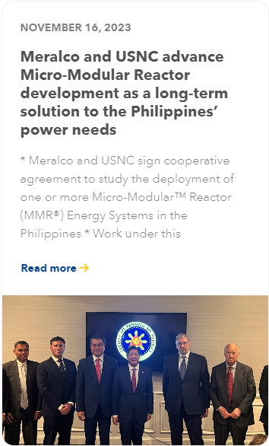
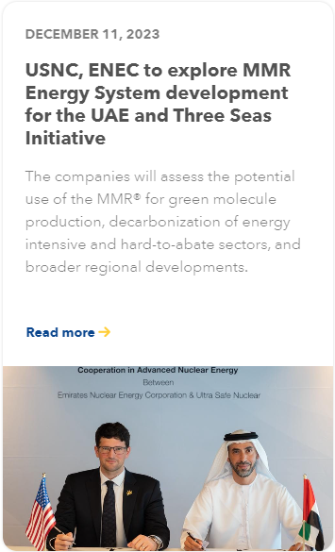
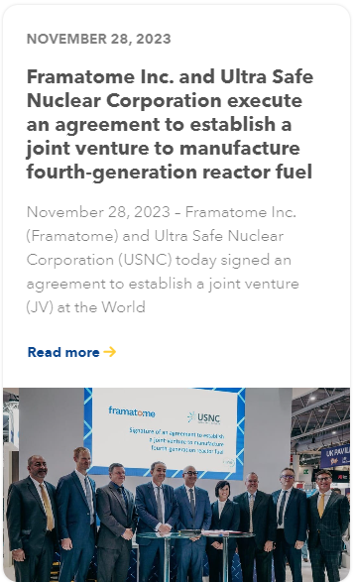
HGTR - Ultra Safe Nuclear Corp. - MMR
Notes:
Mike A
NRC pre-application activities

Slide 33
HGTR - Radiant – Kaleidos
Notes:
Mike A
Type: High Temperature Gas Reactor (HGTR)
Gen Type: Gen 4
Power Output: 1.2 MWe
Safety Strategy: Passive through natural convection and radiation heat transfer. No UHS required. TRISO fuel
Refueling: ~5 year replacement frequency and re-fueld up to 4 times.
Key features: TRISO Fuel, Sea/Land container based with no additional shielding required, autonomous operation monitored by Radiant,

Slide 34
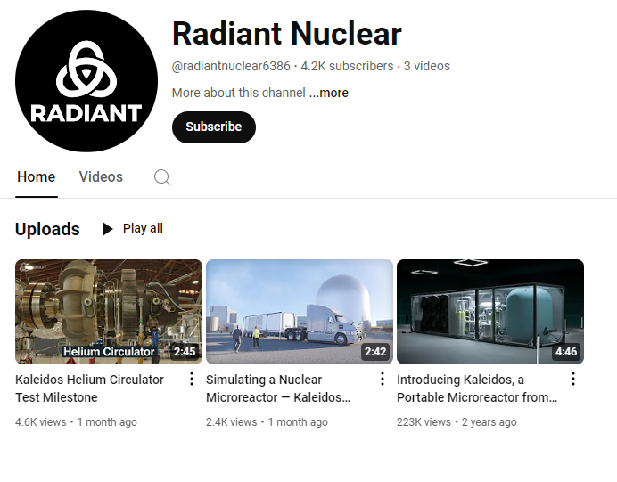
HGTR - Radiant – Kaleidos
Notes:
Mike R
NRC pre-application activities

Slide 35
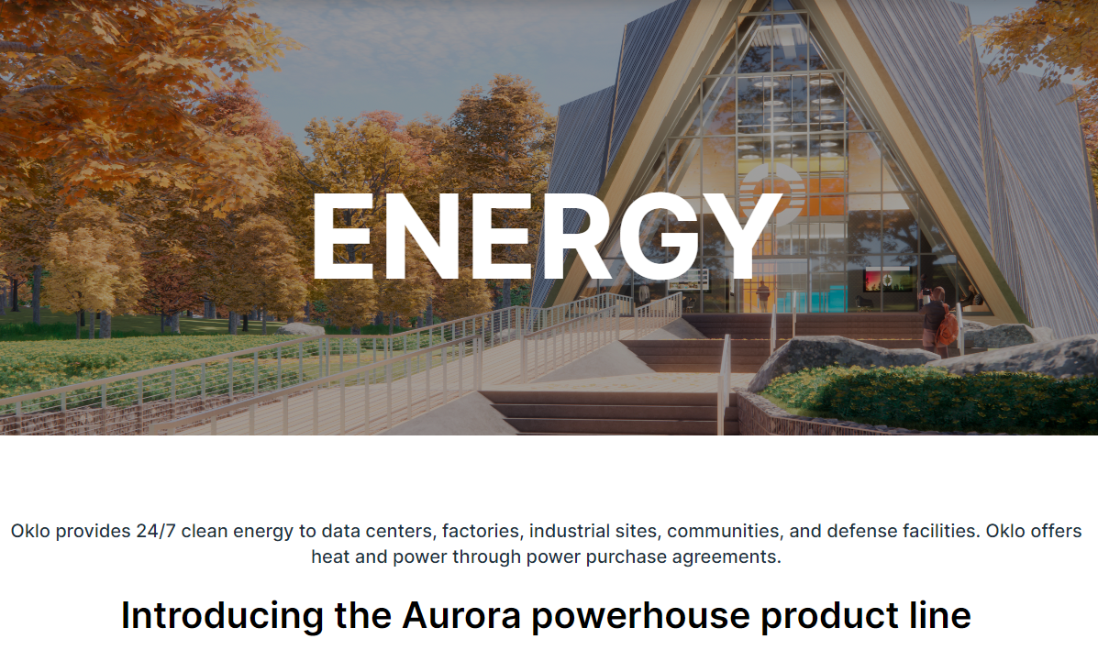
LMR – OKLO - Aurora
Notes:
Mike R
Type: Liquid Metal Reactor (LMR) - Breeder
Gen Type: Gen 4
Power Output: 15 – 50 MWe
Safety Strategy: Meltdown-proof. Self-stabilizing, self-controlling, and cooled by natural forces.
Refueling: Breeder Reactor ~ 10 year before refueling
Key features: Breeder Reactor, based on previous experimental technology

Slide 36
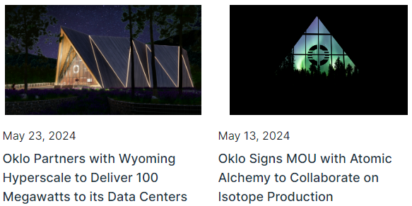
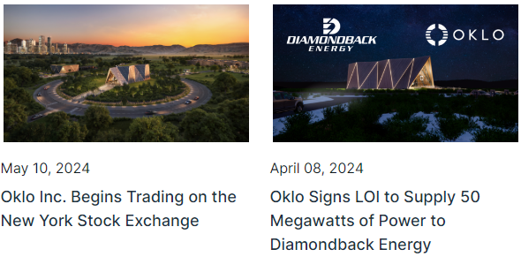
LMR – OKLO - Aurora
Notes:
Mike R
Applied for a combined license for test reactor with NRC at Idaho National Laboratory 3/11/20 but was not issued. Pre-application status with NRC.

Slide 37
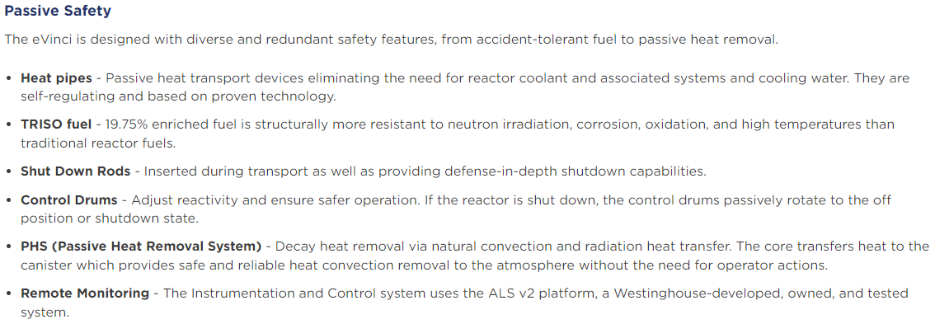
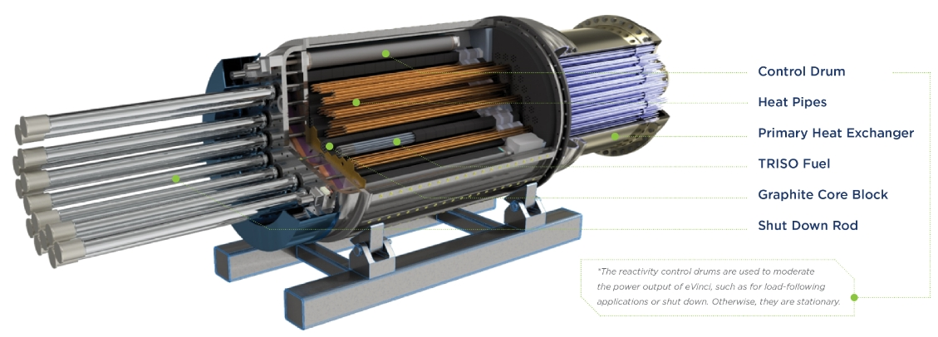
HPR - Westinghouse – eVinci
Notes:
Mike R
Type: Heat Pipe Reactor (HPR)
Gen Type: Gen 4
Power Output: 5 MWe
Safety Strategy: Passive through natural convection and radiation heat transfer. No UHS required.
Refueling: ~8 year replacement frequency
Key features: TRISO Fuel, Sea/Land container based

Slide 38
HPR - Westinghouse – eVinci
Notes:
Mike R
NRC pre-application activities

